Slide 1
Consumer Choice
LESSON 3
MICROECONOMICS
2023/2024

Slide 2
OUTLINE OF THE LECTURE AND STUDY GOALS
Students should be able to:
Understand the terms rational, preferences, utility, budget.
Discuss the difference between cardinal and ordinal approach to utility.
Explain the difference between total and marginal utility.
Describe the conditions for consumer equilibrium.
Analyse the impact of price change and income change on consumer choice.
Theory of Rational Consumer
Budget Line
Consumer Preferences
Concept of Utility
Cardinal Approach to Utility
Ordinal Approach to Utility
Consumer Equilibrium

Slide 3
Rational Choice Theory
"It is not from the benevolence of the butcher, the brewer, or the baker, that we expect our dinner, but from their regard to their own interest. We address ourselves, not to their humanity, but to their self-love, and never talk to them of our own necessities but of their advantages.“
People are rational creatures, with their own interests aka "homo economicus“
The theory originated in the 18th century and can be traced back to political economist and philosopher Adam Smith.
Key economic assumption in many economic models.
You are regarded as rational in economics if you systematically undertake actions to achieve your desired goals (doesn‘t matter how bad or good they are from ethical sense).
Every individual makes decisions addressed to maximize his personal well-being based on a reasonable assessment of all the facts.
Consumer makes the decision to such option that provides the greatest benefits (satisfaction) with the smallest effort (cost).
If you choose an option which cost is higher than the benefit you receive from it, then you are being irrational.

Slide 4
Consumer Theory
The rational consumer consumes (buys, selects) a combination of goods and services at a given level of income that bring the greatest possible satisfaction or benefit (utility).
Certain precisely specified combinations of commodities is called CONSUMER BASKET.
A rational consumer choice always needs to reflect 2 questions:
1) Which combination is the best for me?
(answered by your PREFERENCES, UTILITY)
2) Can I afford this combination?
(answered by your BUDGET and PRICES)

Slide 5
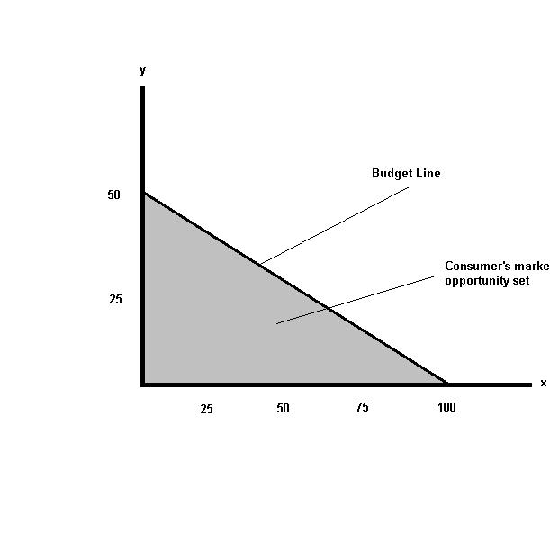
Consumer Theory
A limited amount of financial resources that we have determined to combine - BUDGET CONSTRAINT OF CONSUMERS
Px. x + Py. y = I
A set of consumption baskets that consumer obtains by the budget constraint
MARKET OPPORTUNITY SET
Border of market opportunity set forms the BUDGET LINE (BL)
MRSE =$\frac{P_{x}}{P_{y}}$
The slope of budget line (MRE) explains how it is possible to exchange one commodity for the other one in the market. Thus, it is given by the ratio of prices.

Slide 6
Task 1:
A) Mark‘s daily disposable income for bottled water and sandwiches is 160 CZK. Price of sandwich is 45 CZk and price of bottled water is 20 CZK. Draw Mark‘s budget line.
B) What will happen to the budget line when the price of bottled water increases to 25 CZK.
C) What will happen to the budget line when Mark‘s income raises to 200 CZK per day.

Slide 7
Changes in Budget Line

Slide 8
Consumer Preferences
Represent individual likes and dislikes of consumer.
Preferences themselves are independent on your income and on price of goods!
You might prefer steak rib over hamburger even if you end up choosing hamburger because of your low budget.
How to describe the consumer's preferences?
… UTILITY ...

Slide 9
Utility
Represents the satisfaction consumers receive from goods and services they purchase, consume or use.
If you receive more utility from goods A (grape juice) than from goods B (pear juice), it means you also prefer goods A over goods B.
But how can we express individual‘s utility?
cardinal approach – utility can be measured and described using numbers
ordinal approach – not possible to measure and describe utility by using numbers

Slide 10
Cardinal Approach
Cardinalism (origin of the word cardinal = crusial) considers utility as a measurable unit
Cardinal units - utilities (Willian Stanley Jevons, 1871, neoclassical school)
Other representatives - Carl Menger, Herrmann Heinrich Gossen
Benefit is measured by the total utility and marginal utility.

Slide 11
Cardinal Approach
Total Utility (TU)
– total satisfaction enjoyed from consuming any given quantity
Problems of TU:
Can anyone else but the person concerned estimate the total satisfaction from consuming 20 Big Macs in a week?
Is it possible to compare the this satisfaction with a satisfaction of different person consuming the same ammount?
Marginal Utility (MU)
– a change in total utility generated by consuming one more unit of goods (Jevons, 1862)
$$\text{MUx}\text{ =}\frac{△TU}{△x}$$
Marginal Utility (MU)
– a change in total utility generated by consuming one more unit of goods (Jevons, 1862)
"MUx =" (△𝑇𝑈)/(△𝑥)
Law of diminishing marginal utility (first Gossen´s law): consumers marginal utility of any item declines as more is consumed over any given period.
Thus MU is always decreasing.

Slide 12
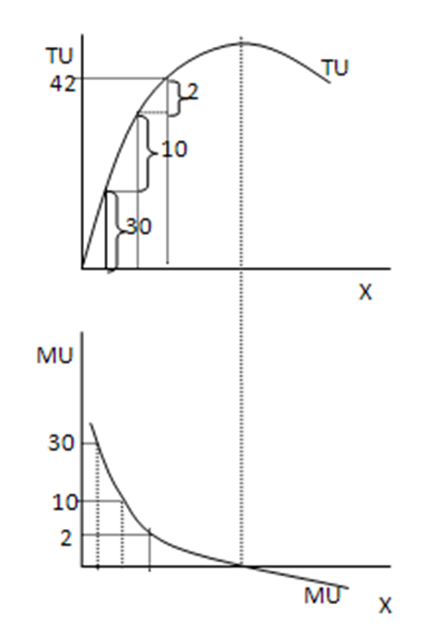
Cardinal Approach
The biggest satisfaction is brought by 1st unit of consumed goods, this means MARGINAL UTILITY is the highest for 1st unit of goods.
(When thirsty or hungry the first piece is always the most beneficial.
Buying the first laptop, car, etc. is the most useful.)
After the first unit, the TOTAL UTILITY increases more slowly and MARGINAL UTILITY decreases with every unit of consumed goods.
SATURATION POINT: TU (max) = MU equals 0
After saturation point the TOTAL UTILITY is declining and MARGINAL UTILITY is negative.
The rational consumer aims to consumer such a quantity that maximalizes their total utility.

Slide 13
Task 2:
Using the Table derive the MU schedule and plot the TU and MU functions.
Q | 0 | 1 | 2 | 3 | 4 | 5 | 6 | 7 | 8 | 9
TU | 0 | 7 | 13 | 18 | 22 | 25 | 27 | 28 | 28 | 27
Q | 0 | 1 | 2 | 3 | 4 | 5 | 6 | 7 | 8 | 9
TU | 0 | 7 | 13 | 18 | 22 | 25 | 27 | 28 | 28 | 27
MU | - | 7 | 6 | 5 | 4 | 3 | 2 | 1 | 0 | -1

Slide 14
Cardinal Approach
Until this point we only considered the total utility of consumption without considering the aspect of price. But consider how many pieces of goods would a rational consumer buy if he knew the price.
Q | 0 | 1 | 2 | 3 | 4 | 5 | 6 | 7 | 8 | 9
TU | 0 | 7 | 13 | 18 | 22 | 25 | 27 | 28 | 28 | 27
MU | - | 7 | 6 | 5 | 4 | 3 | 2 | 1 | 0 | -1
P (CZK) | - | 4 | 4 | 4 | 4 | 4 | 4 | 4 | 4 | 4
Consumer is motivated to buy
another piece because MU > P.
Consumer is not motivated to buy
another piece because MU < P.

Slide 15
Cardinal Approach – Consumer Equilibrium
Until this point we only considered the total utility of consumption without considering the aspect of price. But consider how many pieces of goods would a rational consumer buy if he knew the price.
Q | 0 | 1 | 2 | 3 | 4 | 5 | 6 | 7 | 8 | 9
TU | 0 | 7 | 13 | 18 | 22 | 25 | 27 | 28 | 28 | 27
MU | - | 7 | 6 | 5 | 4 | 3 | 2 | 1 | 0 | -1
P (CZK) | - | 4 | 4 | 4 | 4 | 4 | 4 | 4 | 4 | 4
Thus when considering both the utility and price of goods, the optimal quantity to consume is such for which:
MU = P.
However consumers need to decide between allocating resources between many goods, not only one. In that case equimarginal principle applies: A consumer equilibrium is attained when a consumer purchases goods until the marginal utility per dollar is the same for all goods consumed:
$$\frac{{MU}_{A}}{P_{A}}= \frac{{MU}_{B}}{P_{B}}= \frac{{MU}_{C}}{P_{C}} and so on…$$

Slide 16
Task 3:
A) How many oranges should Peter consume to maximalize his utility from orange consumption if the equation of total utility is: $TU=8+100x−8x^{2}$ ( x = quantity of oranges)
B) What is the level of Peter‘s total utility when he‘s maximizing his total utility?
C) What will be Peter‘s total utility from consuming 2 oranges?
D) What will be Peter‘s marginal utility from consuming 2 oranges?
E) Draw the graph of TU and MU.
F) How many oranges should Peter actually buy if the price of one orange is 20 CZK.

Slide 17
Task 4:
A) In the table below are the marginal utilities for apples and pear, decide how many bags of apples and pears shall consumer buy? You know the price of apples is 2 EUR and price of pears is 4 EUR.
Q | 1 | 2 | 3 | 4 | 5 | 6 | 7 | 8
MU(apples) | 8 | 7 | 6 | 5 | 4 | 3 | 2 | 1
MU(pears) | 13 | 10 | 7 | 4 | 1 | 0 | -3 | -6

Slide 18
Ordinal Approach
Representatives - Vilfredo Pareto, Francis Ysidro Egdeworth and John Richard Hicks
In contrast to the cardinalism this approach argues that the utility CAN NOT be measured, just arranged on the ordinal scale.
Combinations of goods are arranged so that the combination with lowest utility is located prior that with the second lowest utility etc., etc.
The base of this approach is indifference analysis, or the theory of consumer behavior (author: Vilfredo Pareto).
The principle of consumer substitution - the consumer chooses, between goods that are substitutes, a combination that brings him the same satisfaction
Graphically – INDIFFERENCE CURVE (IC), whose author is F.Y. Edgeworth (1881)

Slide 19
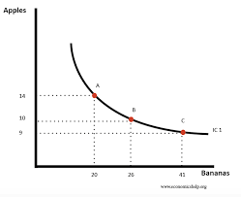
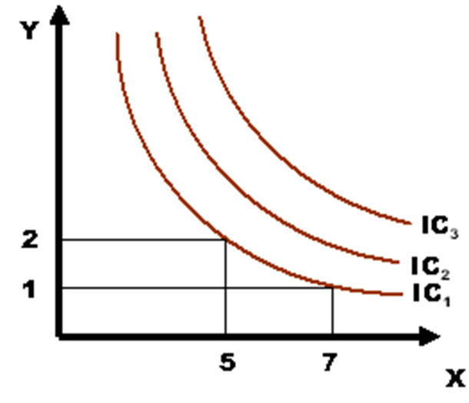
Ordinal Approach – Indifference Curve (IC)
IC shows all baskets that bring the same level of total utility - consumer is indifferent to the combination of X and Y he will consume as long as it‘s located on the same IC.
Slope of IC shows the degree of substitutability of two goods = THE MARGINAL RATE OF SUBSTITUTION (IN CONSUMPTION)
It‘s a ratio, in which one goods is replaced by a second one.
A set of indifference curves forms the INDIFFERENCE MAP
Higher positioned curves show higher total utility of consumers – thus higher IC curves are more preferrable.
MRS = $\frac{{MU}_{x}}{{MU}_{y}}$

Slide 20
Ordinal Approach – Indifference Curve (IC)
Characteristics of IC:
The curves are CONVEX to the beginning - the marginal rate of substitution increases as the consumer progresses along IC upwards (increasingly replaces the goods x by goods y)
The curves have a DECREASING SHAPE - a reduction in the consumption of one good is offset by increasing consumption of second one
The curves NEVER CROSS each other - if so, the consumer is irrational (not confess in his preferences and all combinations would be equally satisfactory).

Slide 21
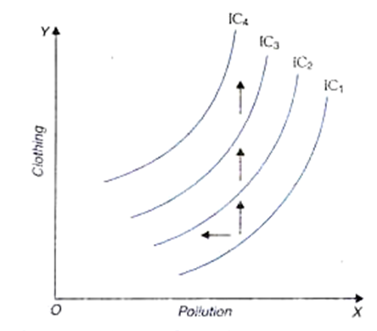
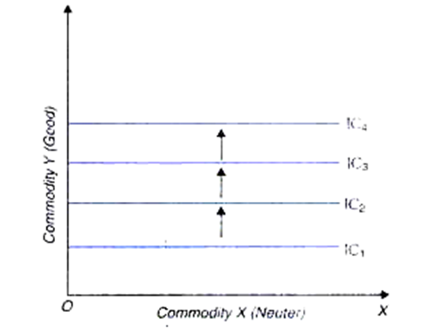
Ordinal Approach – Special Shapes of Indifference Curves
But some of these characteristics are only valid for goods X and Y that are both preferred (desired) by the consumer
The slope is different for goods which are not desired or neuter
a) undesirable goods X b) neuter goods X

Slide 22
Ordinal Approach – Special Shapes of Indifference Curves
The IC for perfect substitutes and perfect complements has different slope as well
a) perfect substitutes b) perfect complements

Slide 23
Task 5:
Draw indifference maps for following situations:
Anne loves roses but hates tulips.
Mary likes watermelon but doesn‘t care about coconut.
Luke doesn‘t mind if he drinks Pepsi or Coke.
Baker Tiffanny needs 1 eggs for every 100g of flour.
Johnny likes to play with cars and stuffed toys.

Slide 24
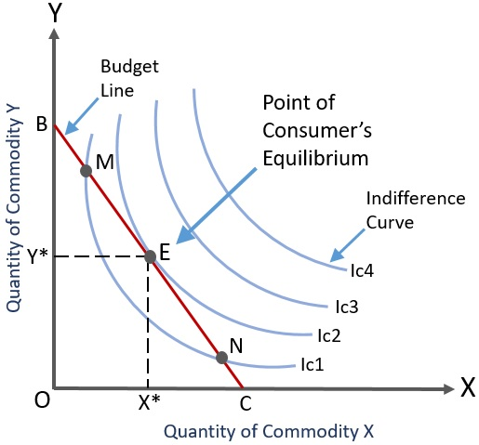
Ordinal Approach - Consumer Equilibrium
To find out consumer equilibrium, the aspect of price and income needs to be considered as well.
Thus, we need to combine indifference analysis with budget line which shows the combinations of goods X and Y that might be purchased with the same level of consumer‘s income.

Slide 25
Consumer Equilibrium
From cardinal approach we figured out that a consumer equilibrium is attained when:
$$\frac{{MU}_{X}}{P_{X}}= \frac{{MU}_{Y}}{P_{Y}}$$
The same condition is valid in the ordinal approach because ONLY in the point E:
slope of ${IC}_{2}$ = slope of BL
MRS = MRE
$\frac{{MU}_{x}}{{MU}_{y}}$ = $\frac{P_{x}}{P_{y}}$

Slide 26
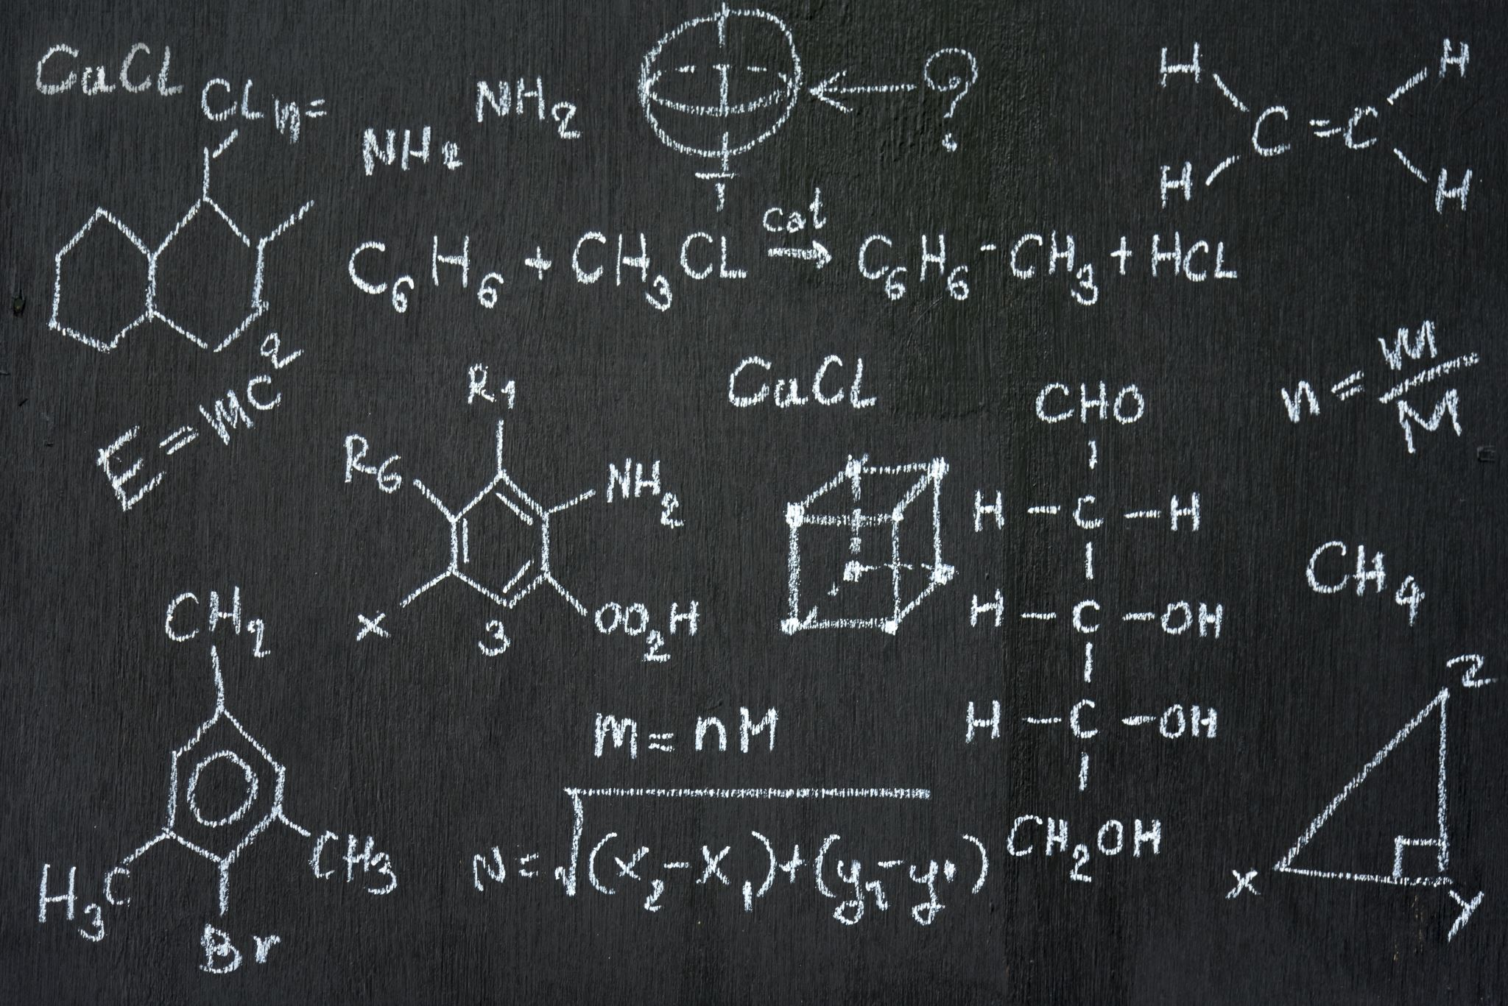
Task 6:
Find out how many commodity X and commodity Y a rational consumer would buy when you know the following variables:
MUx = 120 – 40x
MUy = 350 – 60y
Px = 30 CZK
Py = 50 CZK
I = 450 CZK

