Slide 1
Theory of Consumer Behavior (Derivation of Demand and Demand Elasticities)
LESSON 4
MICROECONOMICS
2023/2024

Slide 2
OUTLINE OF THE LECTURE AND STUDY GOALS
Students should be able to:
Understand how individual demand (and market demand) is derived from consumer equilibrium.
Distinguish the shapes of PCC based on the preferences.
Calculate and interpret the values of price elasticity of demand.
Understand how price elasticity impacts the total revenues.
Calculate and interpret the values of income elasticity of demand.
Calculate and interpret the values of cross elasticity of demand.
Review of Consumer Equilibrium
Derivation of Demand based on Consumer Equilibrium
Price Consumption Curve and its Shapes
Price Elasticity
Income Elasticity
Cross Elasticity

Slide 3
Review Task
Which combination of goods X and Y (represented by points A, B, C and D) is optimal for the consumer and why?

Slide 4
Review Task
Which combination of goods X and Y (represented by points A, B, C and D) is optimal for the consumer and why?
Rational consumers choose such a combination of goods that gives them the greatest utility (satisfaction) at a given budget constraint.
Thus, point B is the optimal choice (budget line meets the highest possible indifference curve which is U2).
$$\frac{{MRS}_{X}}{{MRS}_{Y}}=\frac{P_{X}}{P_{Y}}$$

Slide 5
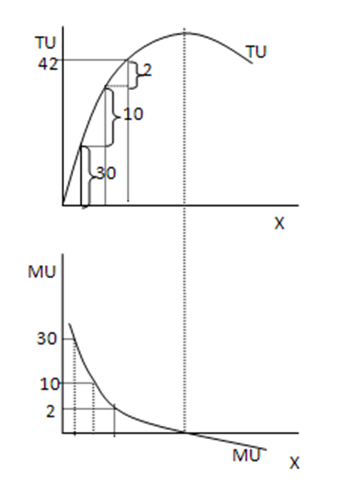
REVIEW: GOSSEN‘S LAWS
1st Gossen´s law:
LAW OF DIMINISHING MARGINAL UTILITY
2nd Gossen‘s law:
LAW OF BALANCED MARGINAL UTILITY
The consumer maximizes his total utility, only if marginal utilities (arising from the consumption of these goods) are equal.
= EQUIMARGINAL PRINCIPLE
$${MU}_{X}={MU}_{Y}$$
Within the budget constraint, then:
$$\frac{{MRS}_{X}}{P_{X}}=\frac{{MRS}_{Y}}{P_{Y}}$$

Slide 6
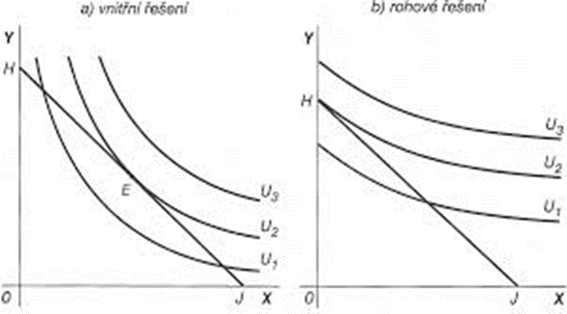
Different Solutions Based on Different Preferences
INNER SOLUTION BORDER SOLUTION

Slide 7
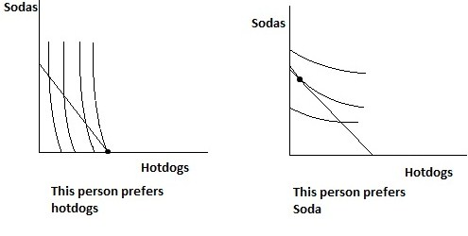
Different Solutions Based on Different Preferences

Slide 8
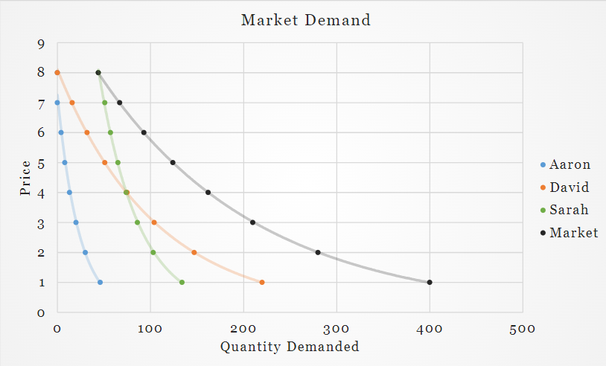
Derivation of Demand
Market demand (D) a relationship between quantities of a goods that consumers are able and willing to purchase at potential prices per unit.
Market demand (D) is obtained from horizontal summation of the individual demands (d) of all the consumers in a given market.
Thus, the question is how is the individual demand formed based on the consumer equilibrium?

Slide 9
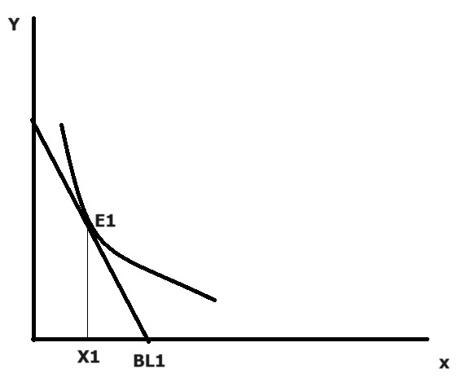
Derivation of Individual Demand
Individual Demand (d) represents the quantity of goods (X) that the consumer wants consume at various prices of that good X (WHILE OTHER FACTORS REMAIN THE SAME!).
Individual Demand curve can be derived from a good indifference analysis.
1) Let‘s consider a consumer optimum (we learned how to find that in previous lesson).
At the optimum E1 – the consumer is willing to buy X1 ammount of goods X, given the price $P_{x}$.

Slide 10
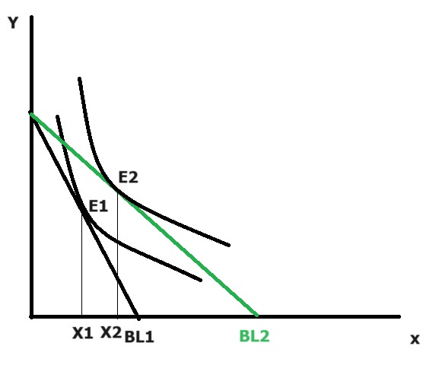
Derivation of Individual Demand
1) Let‘s consider a consumer optimum.
At the optimum E1 – the consumer is willing to buy X1 amount of goods X, given the price $P_{x}$.
2) ASSUMPTION: changes of price Px, while there‘re no changes of price Py.
3) Change in SLOPE of BL – forming of new optimum.

Slide 11
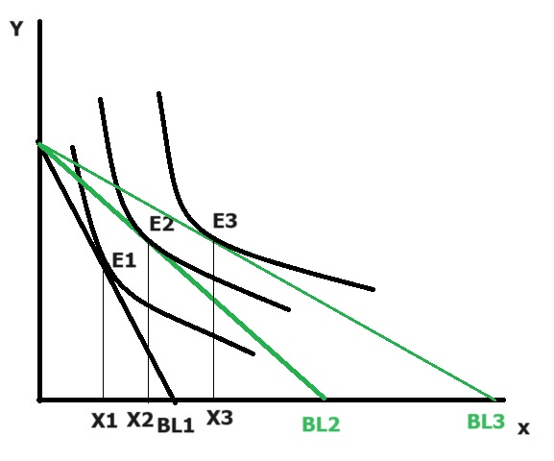
Derivation of Individual Demand
1) Let‘s consider a consumer optimum.
At the optimum E1 – the consumer is willing to buy X1 amount of goods X, given the price $P_{x}$.
2) ASSUMPTION: changes of price Px, while there‘re no changes of price Py.
3) Changes in SLOPE of BLs – forming of new optima.
If price of goods X decreases, the amount of goods X in every new optimum point is increasing (BL is getting flatter).
If price of goods X increases, the amount of goods X in every new optimum point is decreasing (BL is getting steeper).

Slide 12
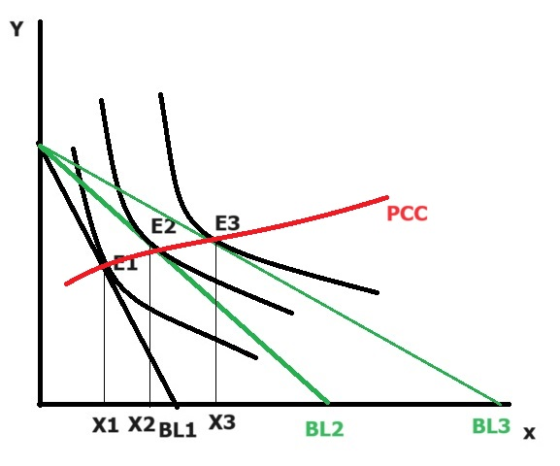
Derivation of Individual Demand
1) Let‘s consider a consumer optimum.
At the optimum E1 – the consumer is willing to buy X1 ammount of goods X, given the price $P_{x}$.
2) ASSUMPTION: changes of price Px, while there‘re no changes of price Py.
3) Changes in SLOPE of BLs – forming of new optima.
4) Connecting all the new points of optimum at all different prices of goods X – we derive the Price Consumption Curve (PCC).

Slide 13
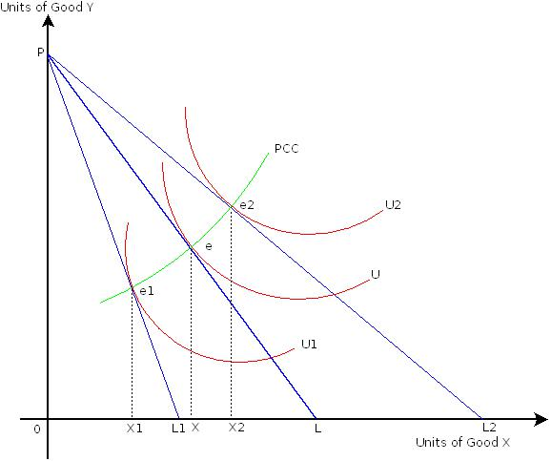
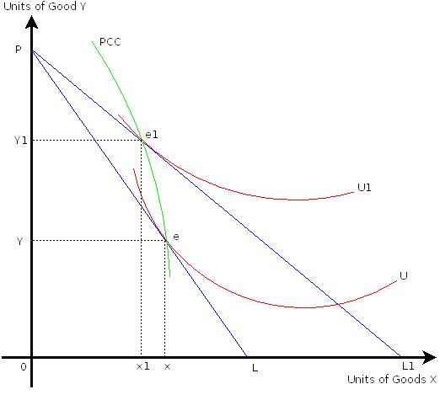
Price Consumption Curve (PCC)
A)
PCC captures all the baskets in which the consumer maximizes his utility when there is a change in the price of one of the goods.
PCC shape - the influence of price changes to the demand:
A) positive slope – X and Y are both preferred
a decline in price of X -> increasing demand for X and Y
B) negative slope –X is preferred, but not Y
a decline in prices of Y -> increasing demand for Y but decreasing demand for Y
C) reversed shape – X is not preferred, but Y is
a decline in price of Y -> decreasing demand for X and increasing demand for Y
X is GIFFEN GOOD
C)

Slide 14
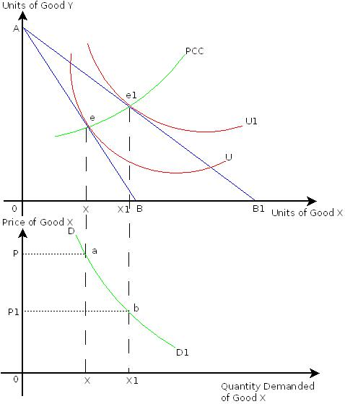
Deriving the Individual Demand from PCC
A)
Different combinations of price and quantity of goods X (representing the points on PCC) are simply transfered to a different figure = figure of demand.
C)

Slide 15
Task 1:
P | 6 | 5 | 4 | 3 | 2 | 1 | 0
Q | 0 | 20 000 | 40 000 | 60 000 | 80 000 | 100 000 | 120 000
You know the demand schedule for the products of a firm above.
a) What will happen to the total revenues when the firm increases the price of the products from 1 dollar to 3 dollars?
b) What will happen to the total revenues when the firm increases the price of the product from 3 dollars to 5 dollars?

Slide 16
Task 1:
P | 6 | 5 | 4 | 3 | 2 | 1 | 0
Q | 0 | 20 000 | 40 000 | 60 000 | 80 000 | 100 000 | 120 000
You know the demand schedule for the products of a firm above.
a) What will happen to the total revenues when the firm increases the price of the products from 1 dollar to 3 dollars?
ΔTR = 180 000 - 100 000 = + 80 000 USD
b) What will happen to the total revenues when the firm increases the price of the product even more from 3 dollars to 5 dollars?
ΔTR = 100 000 – 180 000 = - 80 000 USD
IMPLICATION:
Increasing the price of a product does not always guarantee an automatic increase in the firm‘s revenues. Firms need to analyse first if the demand can „bear“ the increase in the price. This can be easily answered by the concept of price elasticities…

Slide 17
Price Elasticity of Demand
It‘s a number representing percentual change in the quantity demanded resulting from the percentage change in the price of the commodity.
Due to the negative slope of demand the value of price elasticity is always negative but when interpreting the value we consider the absolute value!
Point Elasticity: Arc Elasticity:
$$E_{P}=\frac{\frac{∆Q}{Q2+Q1}}{\frac{∆P}{P2+P1}}$$
$$E_{P}=\frac{\%∆Q}{\%∆P}$$

Slide 18
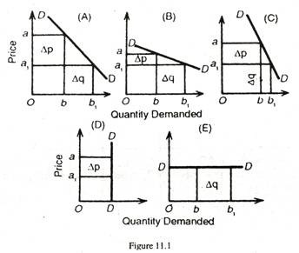
Interpretation of Price Elasticity of Demand
TYPES OF ELASTICITY
UNITARY ELASTIC DEMAND
ELASTIC DEMAND
INELASTIC DEMAND
PERFECTLY INELASTIC DEMAND
PERFECTLY ELASTIC DEMAND

Slide 19
Interpretation of Price Elasticity of Demand
Type of Elasticity | Absolute numerical value | Description
Unitary elastic demand | Ep = 1 | 1% change in the price results in exactly 1% change in the quantity demanded
Elastic demand | Ep > 1 | 1% change in the price results in greater than 1% change in the quantity demanded
Inelastic demand | 0 < Ep < 1 | 1% change in the price results in lesser than 1% (but higher than 0%) change in the quantity demanded
Perfectly elastic demand | Ep = ∞ | Little change in the price results in huge (infinite) change in the quantity demanded (little increase of price leads to no consumption of the good, etc.).
Perfectly inelastic demand | Ep = 0 | Change in the price results in no change in the quantity demanded at all.

Slide 20
PCC and Price Elasticity
A) Unitary Elasticity
B) Elastic Demand
C) Inelastic Demand
A) B) C)

Slide 21
Task 1:
P | 6 | 5 | 4 | 3 | 2 | 1 | 0
Q | 0 | 20 000 | 40 000 | 60 000 | 80 000 | 100 000 | 120 000
You know the demand schedule for the products of a firm below.
What will happen to the total revenues when the firm increases the price of the products from 1 dollar to 3 dollars?
TR = 180 000 - 100 000 = + 80 000 USD
b) What will happen to the total revenues when the firm increases the price of the product from 3 dollars to 5 dollars?
TR = 100 000 – 180 000 = - 80 000 USD
c) Calculate the arc price elasticity of this demand for the change in price from 1 dollar to 3 dollars and for the change in price from 3 dollars to 5 dollars.

Slide 22
Task 1:
P | 6 | 5 | 4 | 3 | 2 | 1 | 0
Q | 0 | 20 000 | 40 000 | 60 000 | 80 000 | 100 000 | 120 000
You know the demand schedule for the products of a firm below.
What will happen to the total revenues when the firm increases the price of the products from 1 dollar to 3 dollars?
TR = 180 000 - 100 000 = + 80 000 USD
b) What will happen to the total revenues when the firm increases the price of the product from 3 dollars to 5 dollars?
TR = 100 000 – 180 000 = - 80 000 USD
c) Calculate the arc price elasticity of this demand for the change in price from 1 dollar to 3 dollars and for the change in price from 3 dollars to 5 dollars.
$$e_{p}=\frac{\frac{60 000 −100 000}{60 000+100 000}}{\frac{3 −1}{3+1}}=−0,125$$
$$e_{p}=\frac{\frac{20 000−60 000}{20 000+60 000}}{\frac{5 −3}{5+3}}=−2$$

Slide 23
Price Elasticities and Their Impact on Total Revenues
From the previous example can be concluded that whether the total revenues increase or decrease when the price is changing is depending on the price elasticity of the demand.
Type of Price Elasticity | Increase in Price | Decrease in Price
Elastic Demand | Total revenues decrease (Demanded quantity decreases more than price increases) | Total revenues increase (Demanded quantity increases more than price decreases)
Unitary Elastic Demand | No change in revenues | No change in revenues
Inelastic Demand | Total revenues increase (Demanded quantity decreases less than price increases) | Total revenues decrease (Demanded quantity increases less than price decreases)

Slide 24
Income Elasticity of Demand
It‘s a number representing percentual change in the quantity demanded resulting from the percentage change in the consumer‘s income.
Type of Goods | Income Elasticity Value | Examples
Inferior products | Negative | „Fake“ clothes, instant food
Normal products: | Positive
Necessities | Income elasticity is between 0 and 1 | Housing, water, basic food (bread, flour, eggs…), medicine, etc.
Luxurious products | Income elasticitiy is higher than 1 | Holidays, luxurious clothes, accessories, hobbies, etc.
$$e_{i}= \frac{\frac{∆Q}{Q2+Q1}}{\frac{∆I}{I2+I1}}$$

Slide 25
Cross Elasticity of Demand
It‘s a number representing percentual change in the quantity demanded of goods X resulting from the percentage change in the price of the other goods Y.
$$e_{C}= \frac{\frac{∆Q_{X}}{Q_{X2}+Q_{X1}}}{\frac{∆P_{Y}}{P_{Y2}+P_{Y1}}}$$
Type of Goods | Cross Elasticity Value | Examples
Complements | Negative | Left eye and right eye contact lenses, paper and printer cartridge
Substitutes | Positive | Cola and Pepsi; pork and chicken meat; bus and train transportation; apple and pears
Unrelated Goods | 0

