Slide 1

CONSUMER OPTIMUM AND FORMING OF DEMAND
LESSON IV
Dr. Ingrid Majerova
Advanced Microeconomics/EVS/NAAMI

Slide 2
CONSUMR OPTIMUM AND FORMING OF DEMAND
Outline of the lecture
Consumer Optimum
Graphical and Mathematical Expression of Consumer Optimum
Idifference Curves by Different Preferences and Different Incomes
Forming of Demand
Elasticity of Demand

Slide 3
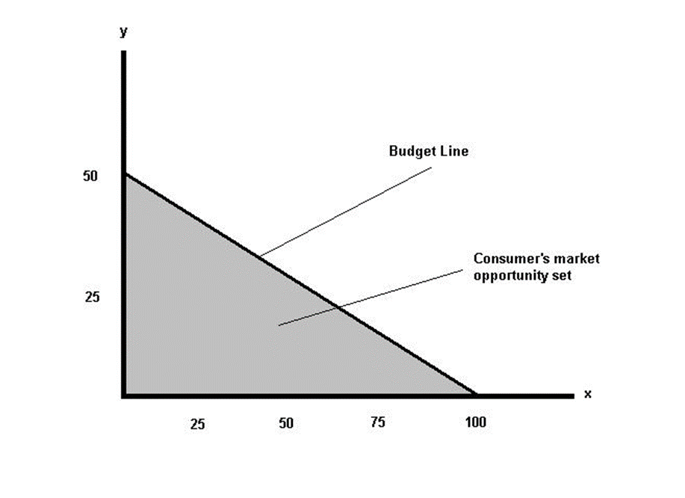

PREVIOUS LESSON …
BUDGETARY LINE
People are rational creatures, with their own interests
person „homo economicus“
Consumers make the decision to such option that gives them the greatest utility (satisfaction) minimizing the effort at a given BUDGET CONSTRAINT

Slide 4
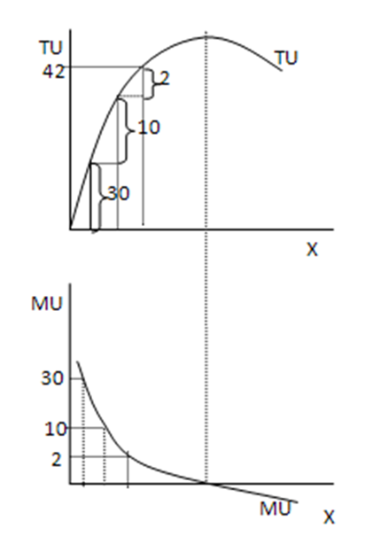
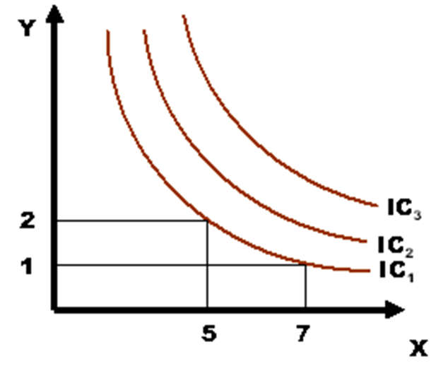
LAST LESSON …
CARDINAL APPROACH
ORDINAL APPROACH

Slide 5

CONSUMER OPTIMUM
INDIFFERENCE CURVE
Consumer optimum = optimal consumer choice = optimal combination of consumption
How consumers can found, within its set of market opportunities, just the consumer basket, which is most useful for him?
a combination of budget constraint in the form of budgetary line and preferences in the form of the highest indifference curve
graphical representation + mathematical expression

Slide 6
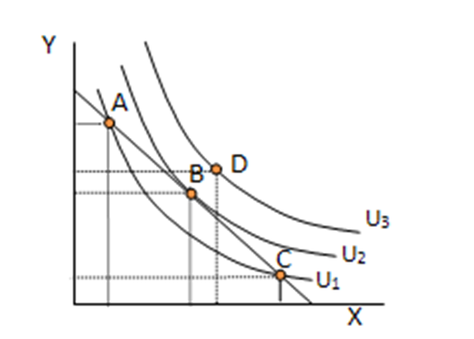
CONSUMER OPTIMUM
GRAPHICAL REPRESENTATION
combination of budget constraint in the form of budgetary line and preferences in the form of the highest POSSIBLE indifference curve

Slide 7

CONSUMER OPTIMUM
INDIFFERENCE CURVE
One BL and indifference map
(IC(U)1 – IC(U)3) - four budgetary baskets (A-D)
D - the budget basket lying on the highest indifference curve and is out of budgetary limit (UNAVAILABLE)
What about BASKETS A, B and C?
  A and C - both baskets are on the same IC and bring the same utility
IS NOT POSSILBE IN TERMS OF RATIONAL CHOISE choice because:
B - is on a higher consumer IC and therefore give priority to this basket
OPTIMUM IS SUCH CONSUMER BASKET, WHICH LIES ON THE INDIFFERENCE CURVE WHICH HAS ONLY ONE COMMON POINT WITH BUDGETARY LINE (BL is tangent of IC)

Slide 8
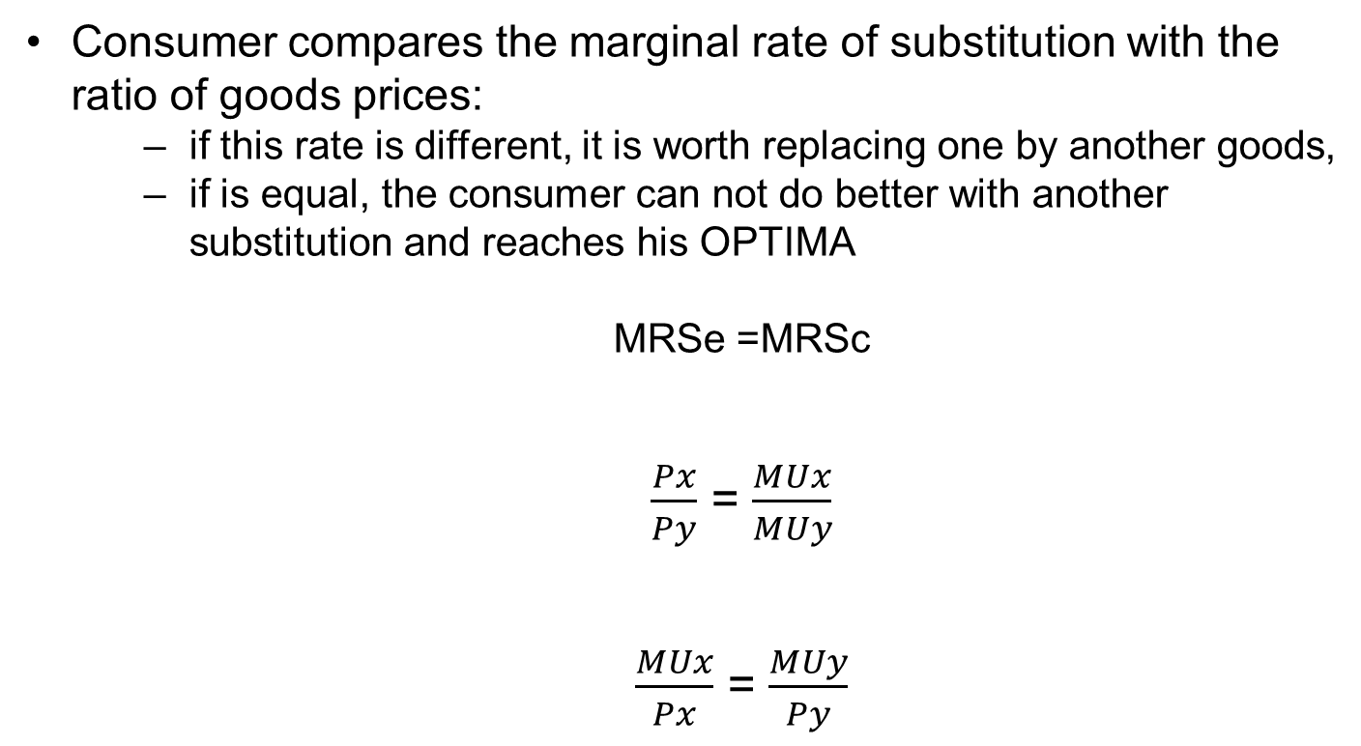
CONSUMER OPTIMUM
MATHEMATICAL EXPRESSION
Consumer compares the marginal rate of substitution with the ratio of goods prices:
  if this rate is different, it is worth replacing one by another goods,
  if is equal, the consumer can not do better with another substitution and reaches his OPTIMA
  MRSe =MRSc
  $\frac{Px}{Py}$ = $\frac{MUx}{MUy}$
  $\frac{MUx}{Px}$ = $\frac{MUy}{Py}$

Slide 9

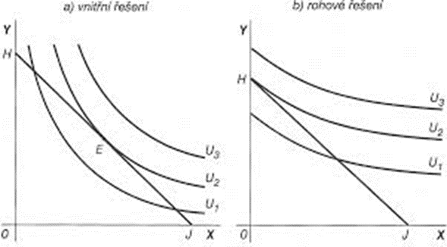
CONSUMER OPTIMUM
GOSSEN LAW
equation
GOSSEN´S SECOND LAW
law of balanced marginal utility
If the consumer satisfies its needs through scarce resources, then this consumer maximizes his total utility, only if marginal utilities (arising from the consumption of these goods) are equal.
INNER SOLUTION BORDER SOLUTION

Slide 10
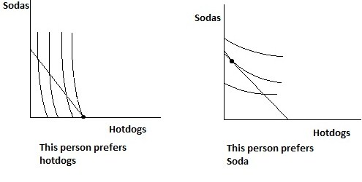
CONSUMER OPTIMUM
DIFFERENT PREFERENCES

Slide 11
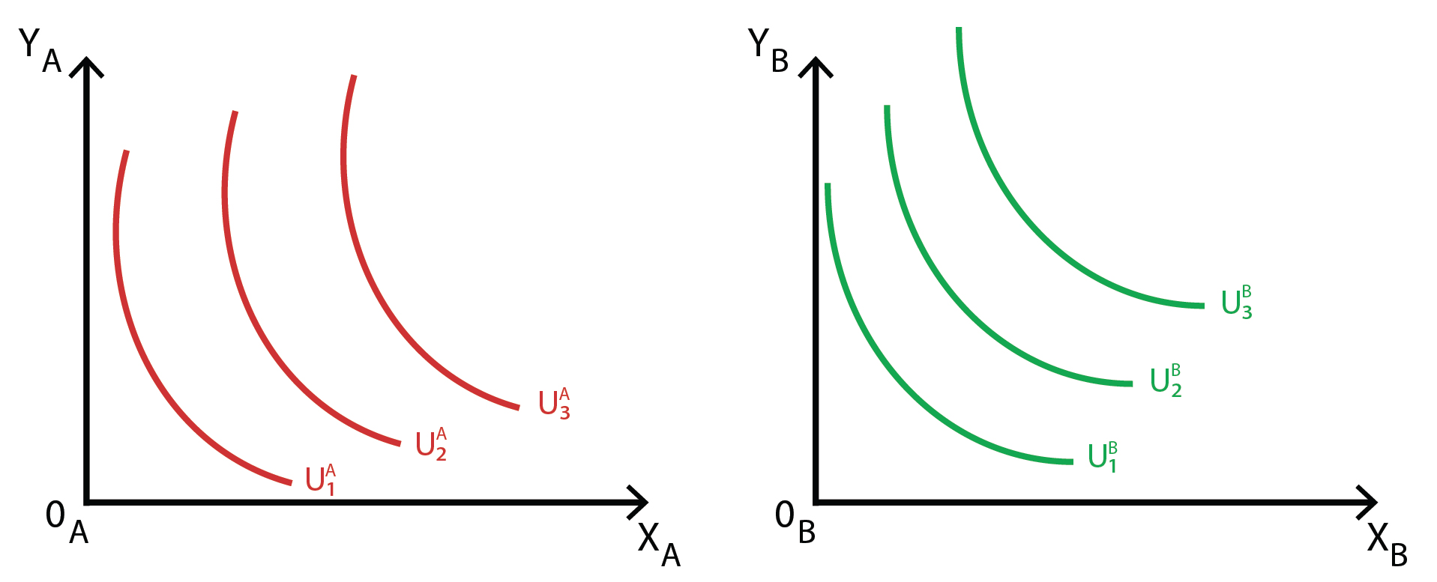

CONSUMER OPTIMUM
DIFFERENT INCOMES
low income high income

Slide 12
CONSUMER OPTIMUM
DEMAND FORMING
We speak about INDIVIDUAL DEMAND
  quantity of goods that the consumer wants consume
  at the price of that good
Individual demand - the relationship between price and demanded quantity of goods
ASSUMPTION - no change of y-good price and income, but only a change in price of good x
change in slope of BL
  If the price of x falls - BL becomes flatter

Slide 13
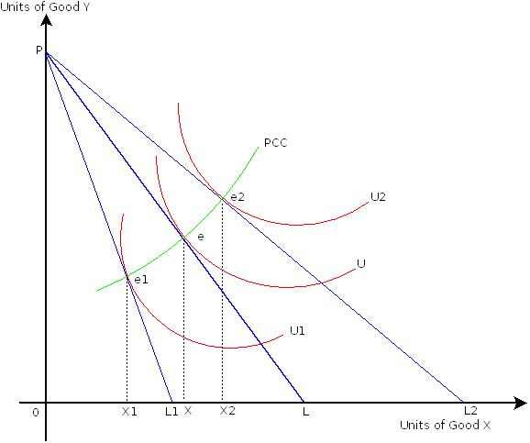
CONSUMER OPTIMUM
PRICE CONSUMPTION CURVE
If changing the price of x than BL is flatter, new equilibrium baskets are defining
We connect these points of OPTIMA and get the PRICE CONSUMPTION CURVE PCC

Slide 14
CONSUMER OPTIMUM
DEMAND FORMING
PCC captures all the baskets in which the consumer maximizes his utility when there is a change in the price of one of the goods contained in the consumer basket
PCC shape - the influence of price changes to the demand:
  positive slope - a decline in price of x increasing demand for x and y
  negative slope - a decline in prices of x increasing demand for x and decreasing demand for y
  reverse curved shape - a decline in price of x decreasing demand for x and increasing demand for y GIFFEN GOOD

Slide 15
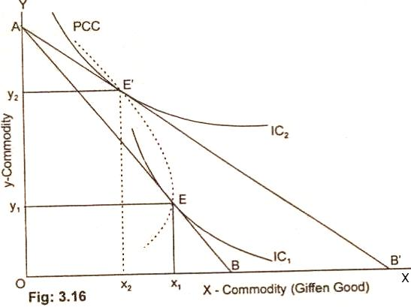
CONSUMER OPTIMUM
GIFFEN GOOD
The decrease in the price of Giffen good X
Its quantity purchased has fallen from OX1 to OX2 and the quantity demanded of Y commodity goes up from OY1 to OY2.

Slide 16
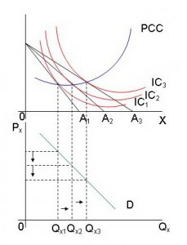
CONSUMER OPTIMUM
FORMING OF DEMAND FROM PCC
using PPC we form consumer demand
different optima (combination of price and quantity) are transfered to the next figure
ATTENTION ! DIFFERENT AXIS

Slide 17
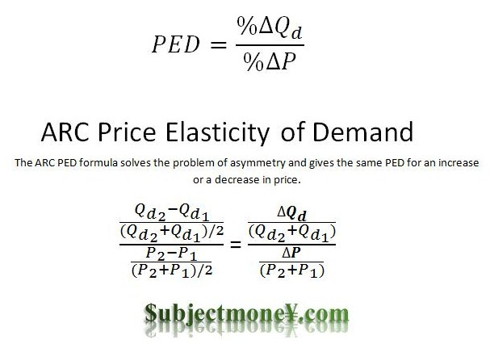
CONSUMER OPTIMUM
PRICE ELASTICITY OF DEMAND
ABSOLUTE EXPRESSION
ARC ELASTICITY POINT ELASTICITY

Slide 18
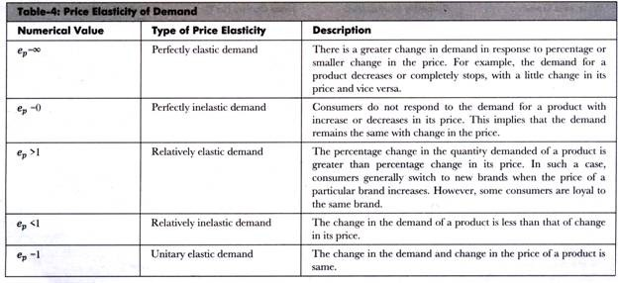
CONSUMER OPTIMUM
ELASTICITY OF DEMAND
TYPES OF ELASTICITY

Slide 19
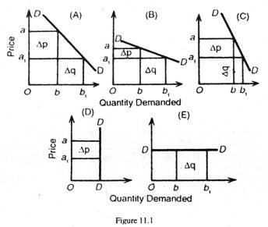
CONSUMER OPTIMUM
ELASTICITY OF DEMAND
TYPES OF ELASTICITY
UNITARY ELASTIC DEMAND
RELATIVE ELASTIC DEMAND
RELATIVE INELASTIC DEMAND
PERFECT INELASTIC DEMAND
PERFECT ELASTIC DEMAND

Slide 20
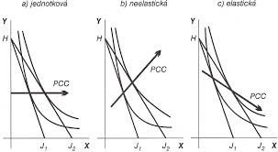
CONSUMER OPTIMUM
PCC and ELASTICITY OF DEMAND
UNITARY ELASTIC DEMAND
ELASTIC DEMAND
INELASTIC DEMAND
B) C)

Slide 21
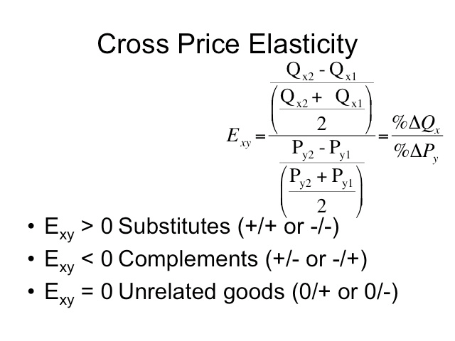
CONSUMER OPTIMUM
CROSS PRICE ELASTICITY OF DEMAND
measures the responsiveness in the quantity demand of one good when a change in price takes place in another good
ARC ELASTICITY POINT ELASTICITY

Slide 22

CONSUMER OPTIMUM
CROSS PRICE ELASTICITY OF DEMAND
FORMULA

Slide 23
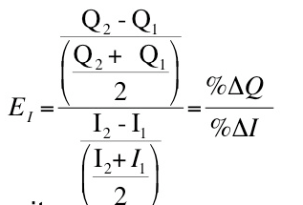
CONSUMER OPTIMUM
INCOME ELASTICITY OF DEMAND
shows how responsive the demand for a product is to a change in income
ARC ELASTICITY POINT ELASTICITY

Slide 24

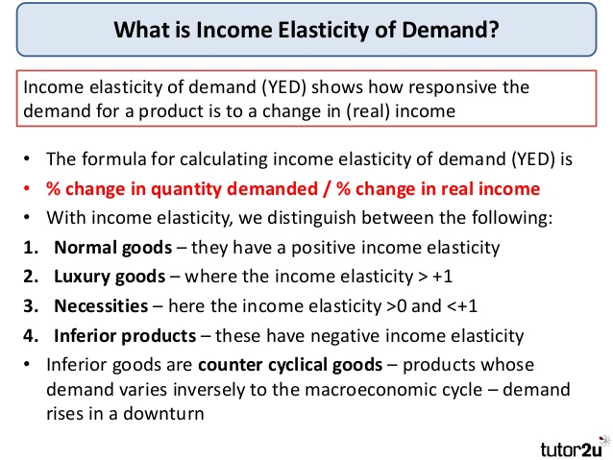
CONSUMER OPTIMUM
INCOME ELASTICITY OF DEMAND
FORMULA

Slide 25
CONSUMER OPTIMUM
THANK YOU FOR YOUR ATTENTION …

