Slide 1

REVENUES, COSTS AND PROFIT
LESSON VII
Dr. Ingrid Majerova
MICROECONOMICS/EVS/NAMIB

Slide 2
REVENUES, COSTS AND PROFIT
Outline of the lecture
Firm Profit
Firm Revenues
Firm Costs
Costs and Returns to Scale
Short and Long Run Costs

Slide 3

REVENUES, COSTS AND PROFIT
FIRM PROFIT
The aim of the company is to maximize profit ... .. what's the profit?
PROFIT OF THE FIRM IS IS A DIFFERENCE BETWEEN TOTAL FIRM REVENUES AND TOTAL FIRM COSTS
the concept of economic theory EARNINGS understand otherwise than as we know from practice (accounting)
we distinguish:
  ACCOUNTING profit
  ECONOMIC profit

Slide 4
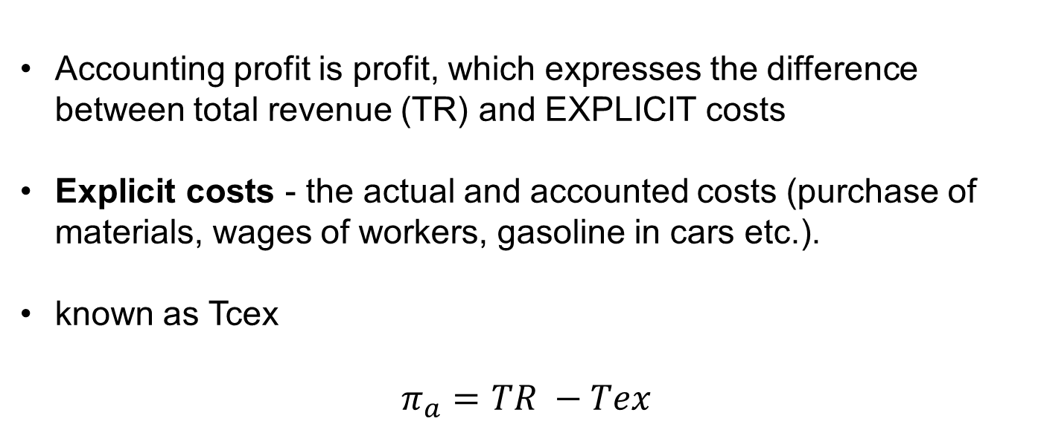
REVENUES, COSTS AND PROFIT
ACCOUNTING PROFIT
Accounting profit is profit, which expresses the difference between total revenue (TR) and EXPLICIT costs
Explicit costs - the actual and accounted costs (purchase of materials, wages of workers, gasoline in cars etc.).
known as Tcex
$$π_{a}=TR −Tex$$

Slide 5
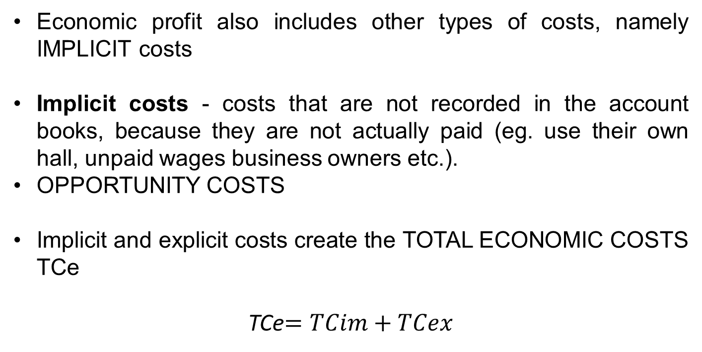
REVENUES, COSTS AND PROFIT
ECONOMIC PROFIT
Economic profit also includes other types of costs, namely IMPLICIT costs
Implicit costs - costs that are not recorded in the account books, because they are not actually paid (eg. use their own hall, unpaid wages business owners etc.).
OPPORTUNITY COSTS
Implicit and explicit costs create the TOTAL ECONOMIC COSTS TCe
TCe$=TCim+TCex$

Slide 6
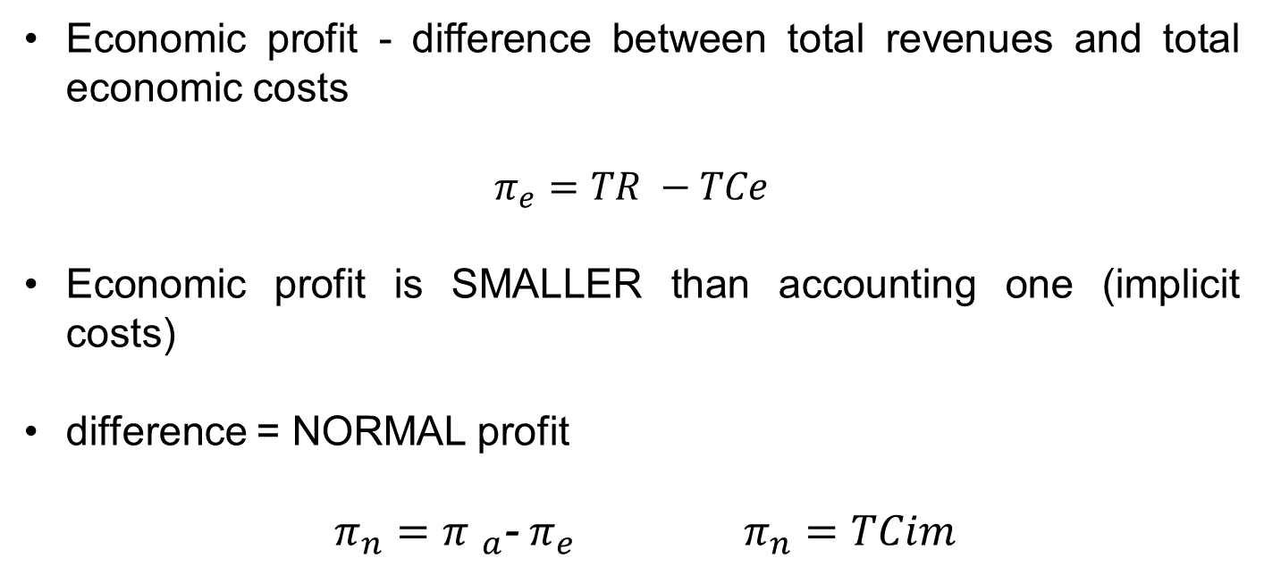
REVENUES, COSTS AND PROFIT
ECONOMIC PROFIT AND NORMAL PROFIT
Economic profit - difference between total revenues and total economic costs
$$π_{e}=TR −TCe$$
Economic profit is SMALLER than accounting one (implicit costs)
difference = NORMAL profit
$π_{n}={π }_{a}$-$π_{e} π_{n}=TCim$

Slide 7
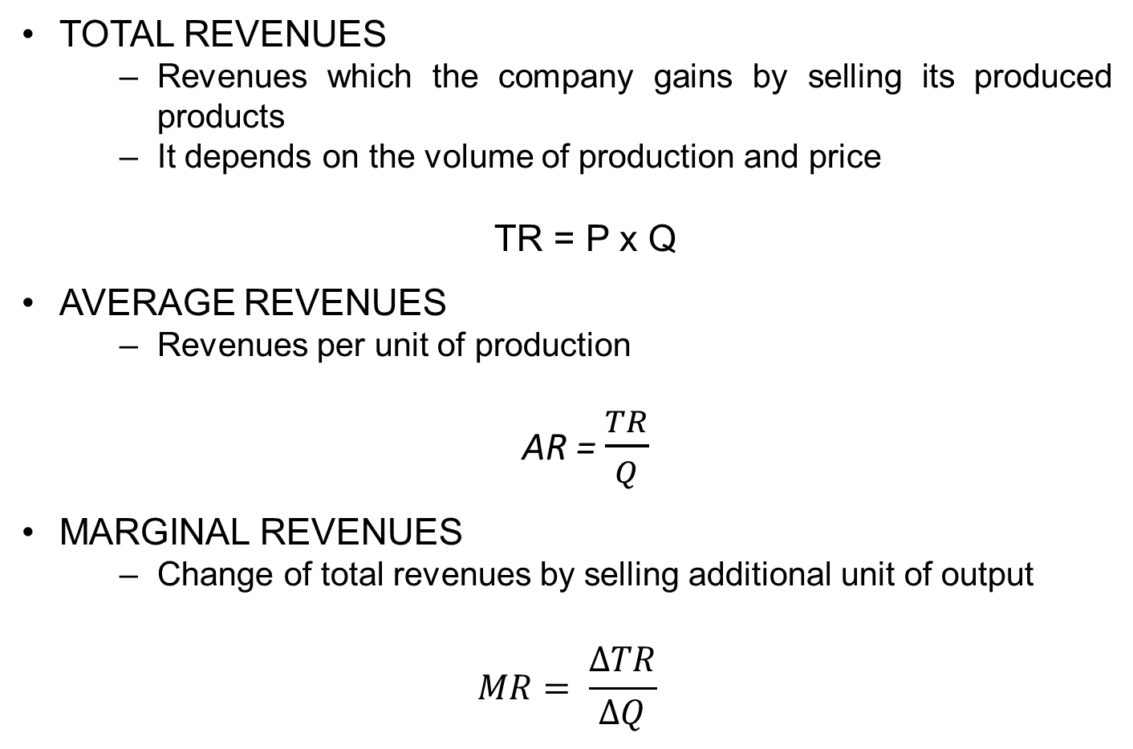
REVENUES, COSTS AND PROFIT
FIRM REVENUES
TOTAL REVENUES
  Revenues which the company gains by selling its produced products
  It depends on the volume of production and price
TR = P x Q
AVERAGE REVENUES
  Revenues per unit of production
AR = $\frac{TR}{Q}$
MARGINAL REVENUES
  Change of total revenues by selling additional unit of output
$$MR= \frac{ΔTR}{ΔQ}$$

Slide 8
REVENUES, COSTS AND PROFIT
FIRM COSTS
to quantify the cost we need to know
  amount and combination of inputs
  the minimum amount of costs
TOTAL COSTS are formed from:
  FIXED costs - does not vary with the amount of production
  VARIABLE costs - the amount depends on the volume of production
TC = FC x VC

Slide 9
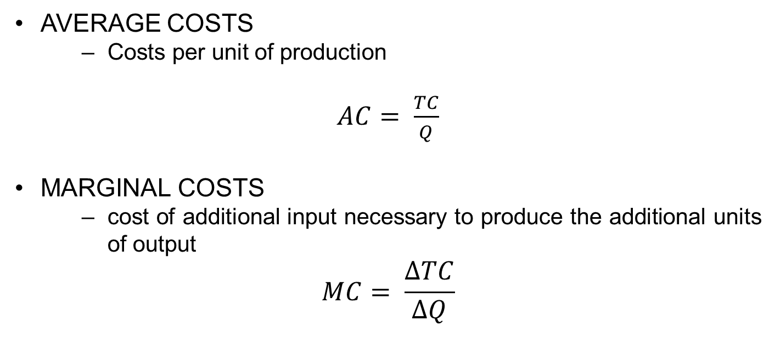
REVENUES, COSTS AND PROFIT
FIRM COSTS
AVERAGE COSTS
  Costs per unit of production
$AC= \frac{TC}{Q}$
MARGINAL COSTS
  cost of additional input necessary to produce the additional units of output
$$MC= \frac{ΔTC}{ΔQ}$$

Slide 10
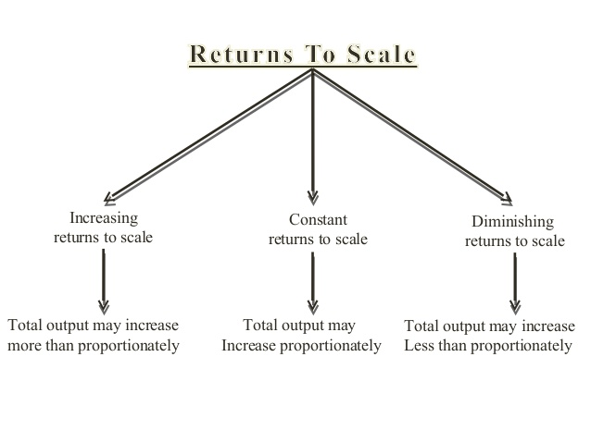
REVENUES, COSTS AND PROFIT
COSTS CURVES AND RETURNS TO SCALE

Slide 11
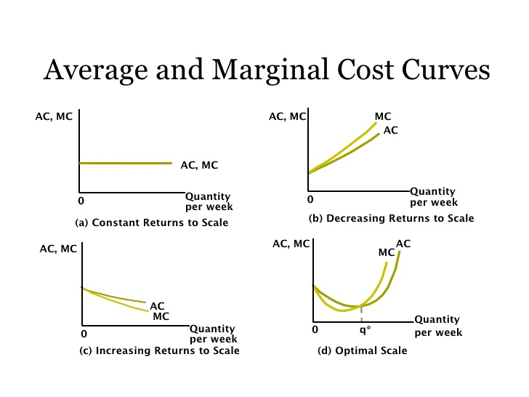
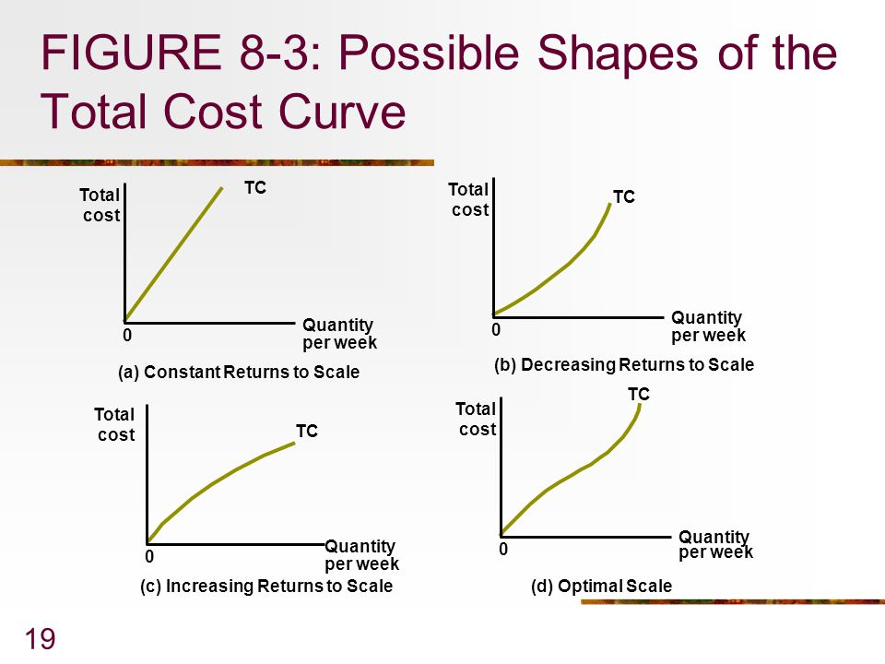
REVENUES, COSTS AND PROFIT
COSTS CURVES AND CONSTANT
RETURNS TO SCALE
Total Costs
Average and Marginal Costs

Slide 12
REVENUES, COSTS AND PROFIT
COSTS CURVES AND DECREASING RETURNS TO SCALE
Total Costs
Average and Marginal Costs

Slide 13

REVENUES, COSTS AND PROFIT
COSTS CURVES AND INCREASING RETURNS TO SCALE
Total Costs
Average and Marginal Costs

Slide 14
REVENUES, COSTS AND PROFIT
COSTS CURVES AND OPTIMAL RETURNS TO SCALE
=
OPTIMAL PRODUCTION
Total Costs
Average and Marginal Costs

Slide 15
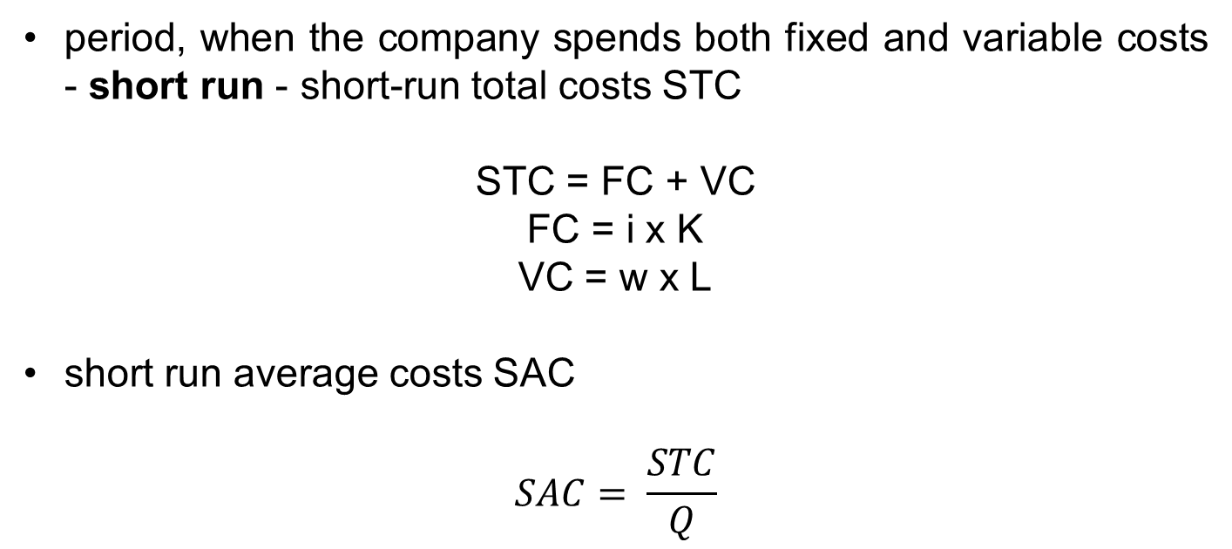
REVENUES, COSTS AND PROFIT
FIRM COSTS IN SHORT RUN
period, when the company spends both fixed and variable costs - short run - short-run total costs STC
STC = FC + VC
FC = i x K
VC = w x L
short run average costs SAC
$$SAC= \frac{STC}{Q}$$

Slide 16
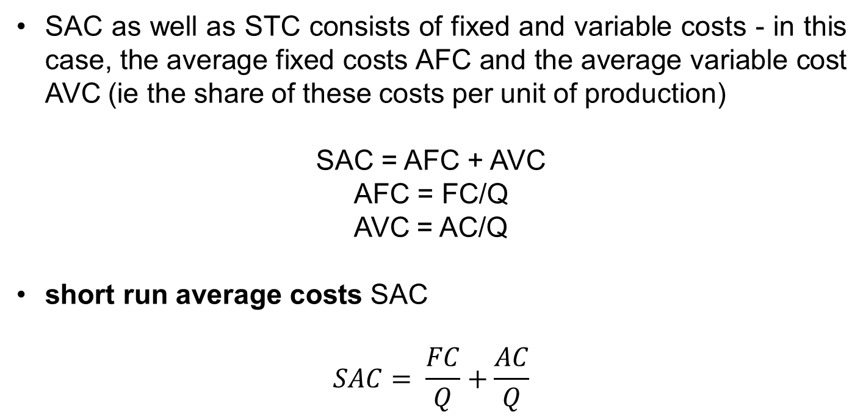
REVENUES, COSTS AND PROFIT
FIRM COSTS IN SHORT RUN
SAC as well as STC consists of fixed and variable costs - in this case, the average fixed costs AFC and the average variable cost AVC (ie the share of these costs per unit of production)
SAC = AFC + AVC
AFC = FC/Q
AVC = AC/Q
short run average costs SAC
$$SAC= \frac{FC}{Q}+\frac{AC}{Q}$$

Slide 17
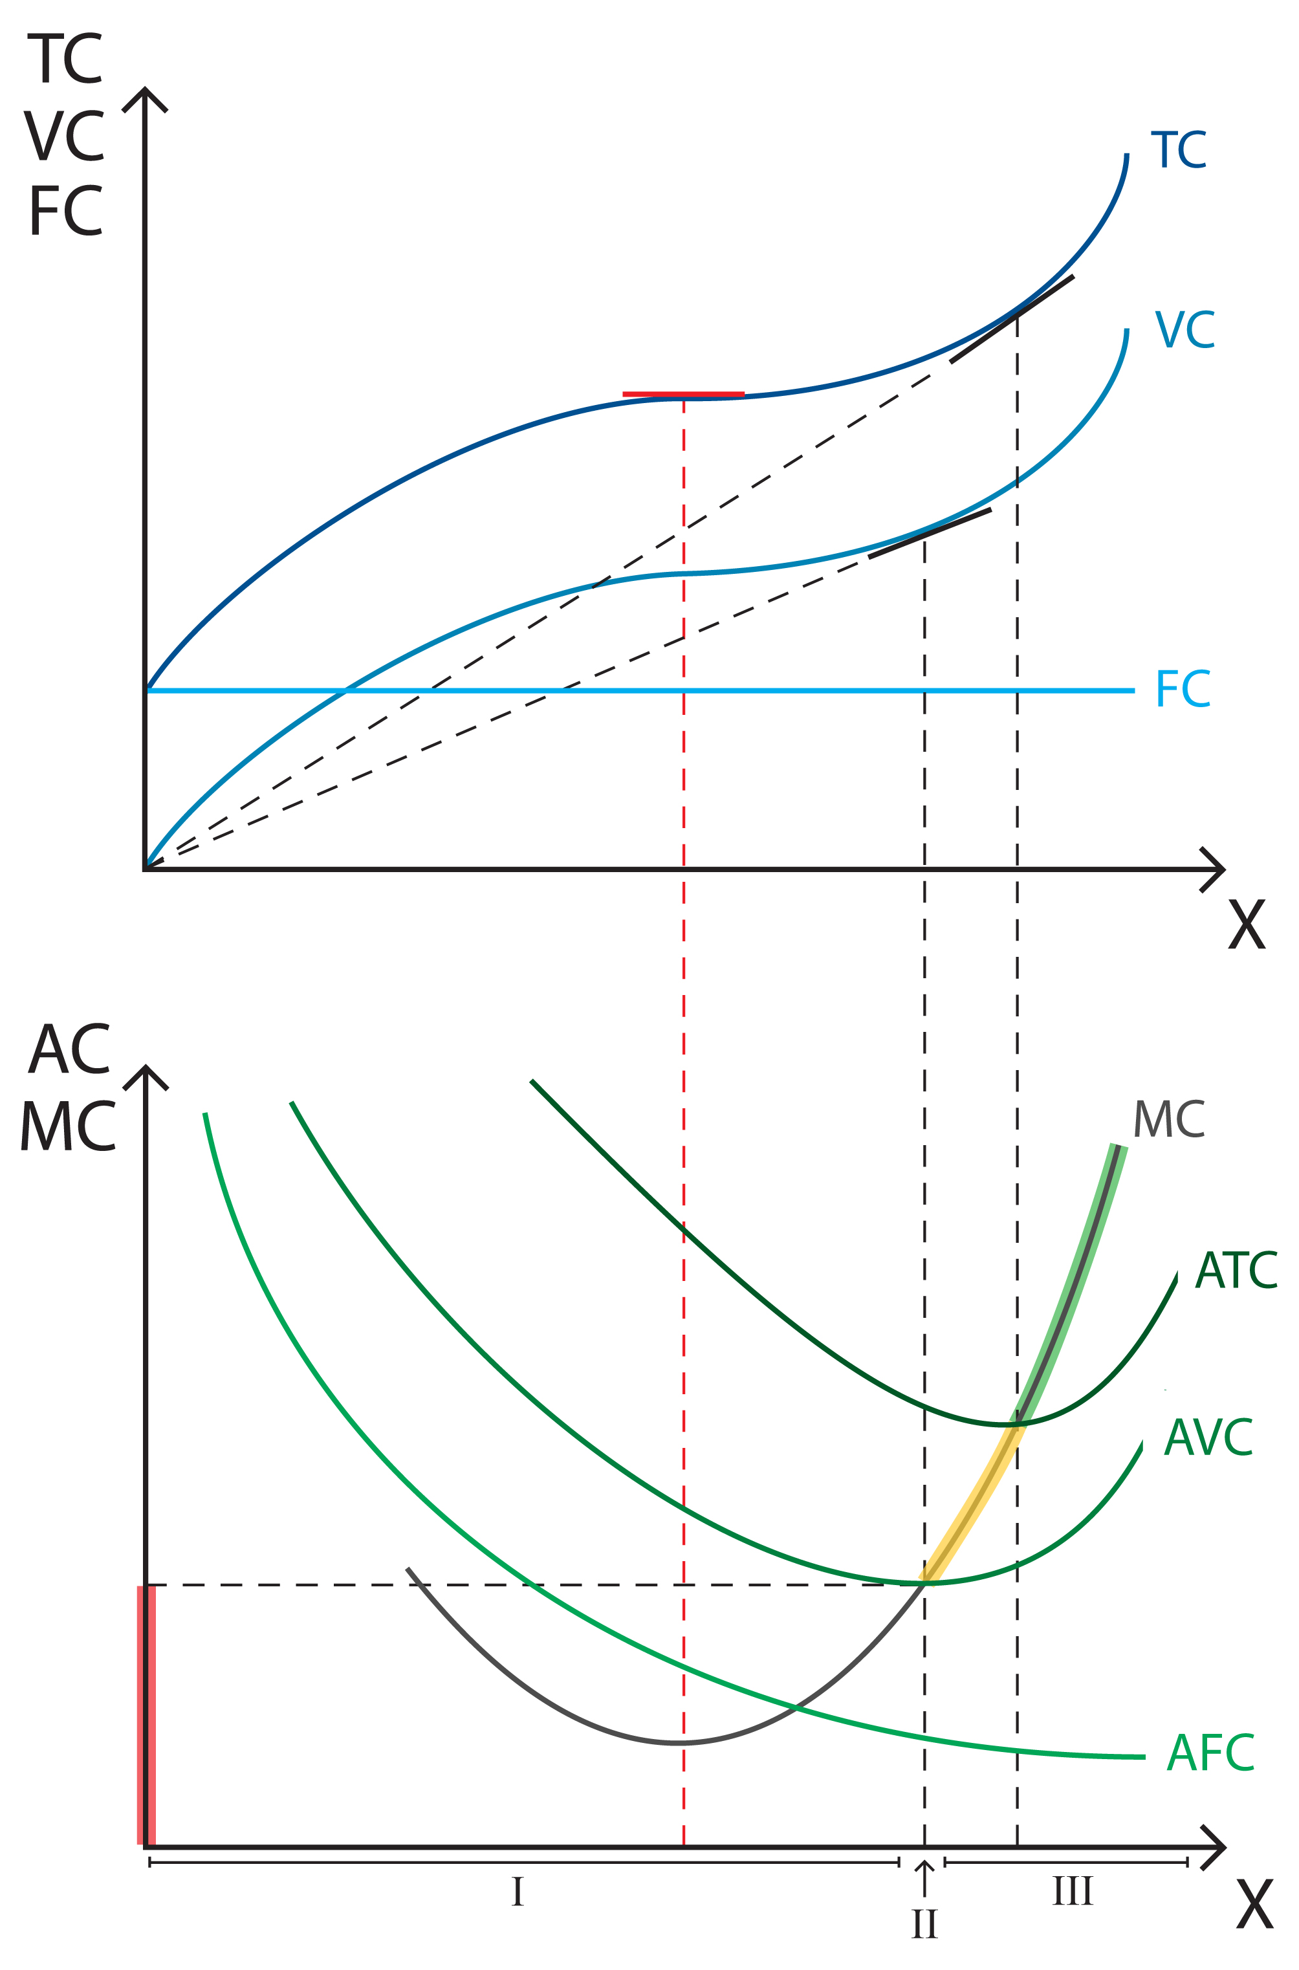
REVENUES, COSTS AND PROFIT
RELATIONSHIP OF FIRM COSTS IN SHORT RUN
I – SMC minimum - increasing returns to variable input are hereby amended in decreasing
II – AVC minimum
III – SAC minimum - at that point the firm by hiring additional units of labor increases the capacity utilization of fixed capital - exceeding this point reduces labor productivity

Slide 18
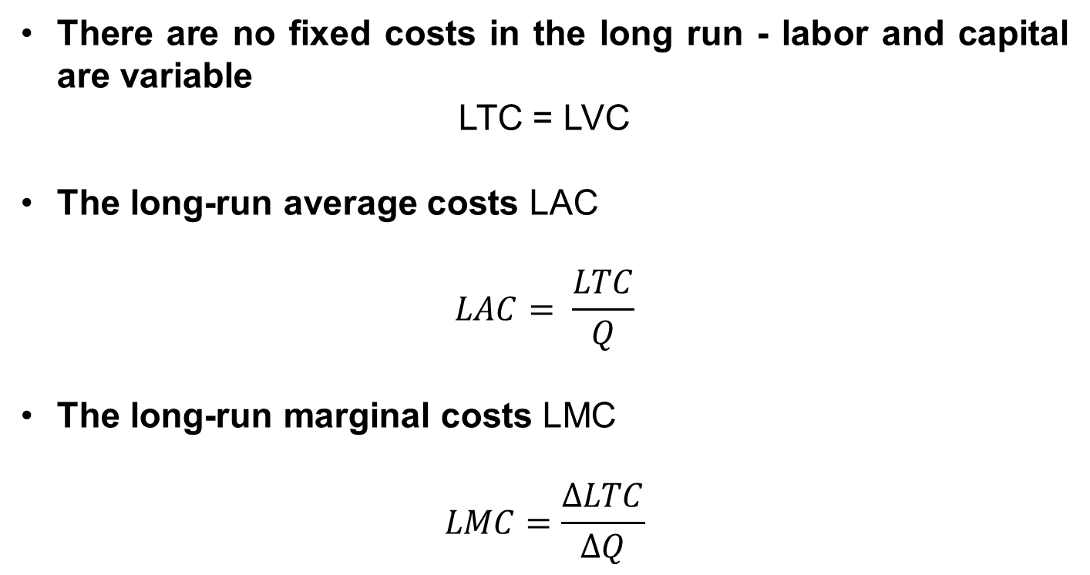
REVENUES, COSTS AND PROFIT
FIRM COSTS IN LONG RUN
There are no fixed costs in the long run - labor and capital are variable
LTC = LVC
The long-run average costs LAC
$$LAC= \frac{LTC}{Q}$$
The long-run marginal costs LMC
$$LMC=\frac{ΔLTC}{ΔQ}$$

Slide 19
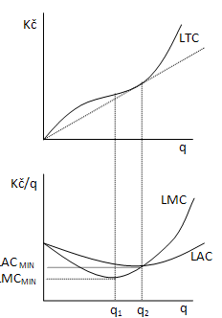
REVENUES, COSTS AND PROFIT
FIRM COSTS IN LONG RUN
q1 - minimum of LMC - increasing returns to scale are changing in decreasing returns to scale
q2 - minimum of LAC

Slide 20

REVENUES, COSTS AND PROFIT
RELATIONSHIP OF SHORT-RUN AND LONG-RUN COSTS
The shape of long-run curves is based on the shapes of short-run curves
The firm does not produce at minimum cost in the short-run - because of the existence of fixed costs
production with higher total costs

Slide 21
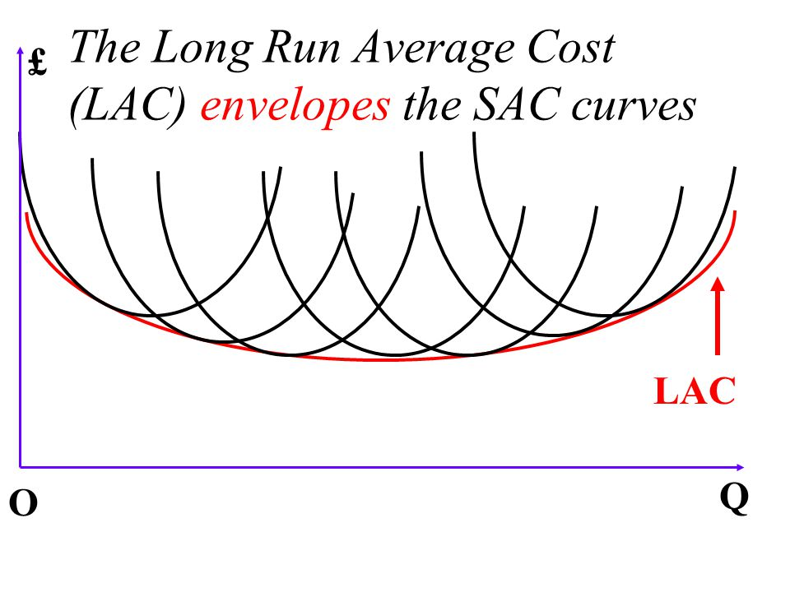
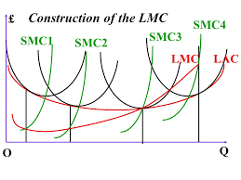
REVENUES, COSTS AND PROFIT
RELATIONSHIP OF SHORT-RUN AND LONG-RUN COSTS
Construction of LAC – ENVELOPE CURVE
Construction of LMC – LMC is not formed by minimum of SMC

Slide 22
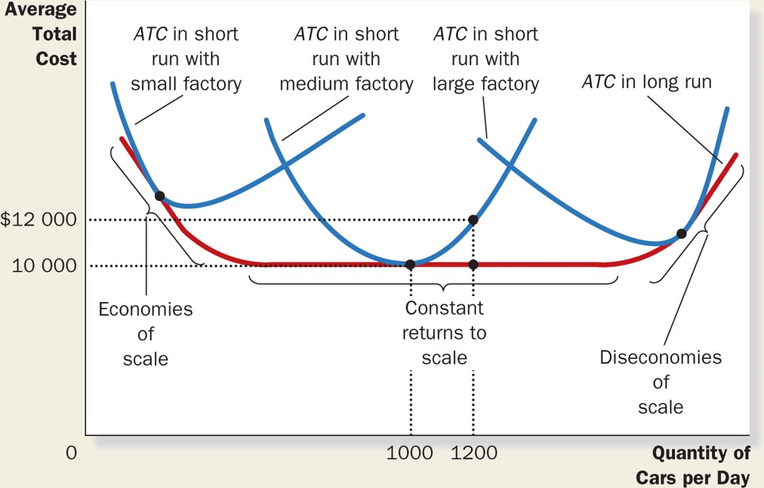
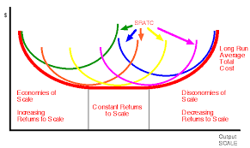
REVENUES, COSTS AND PROFIT
LONG AVERAGE COSTS
SAC and Firm Size
LAC and Returns to Scale

Slide 23
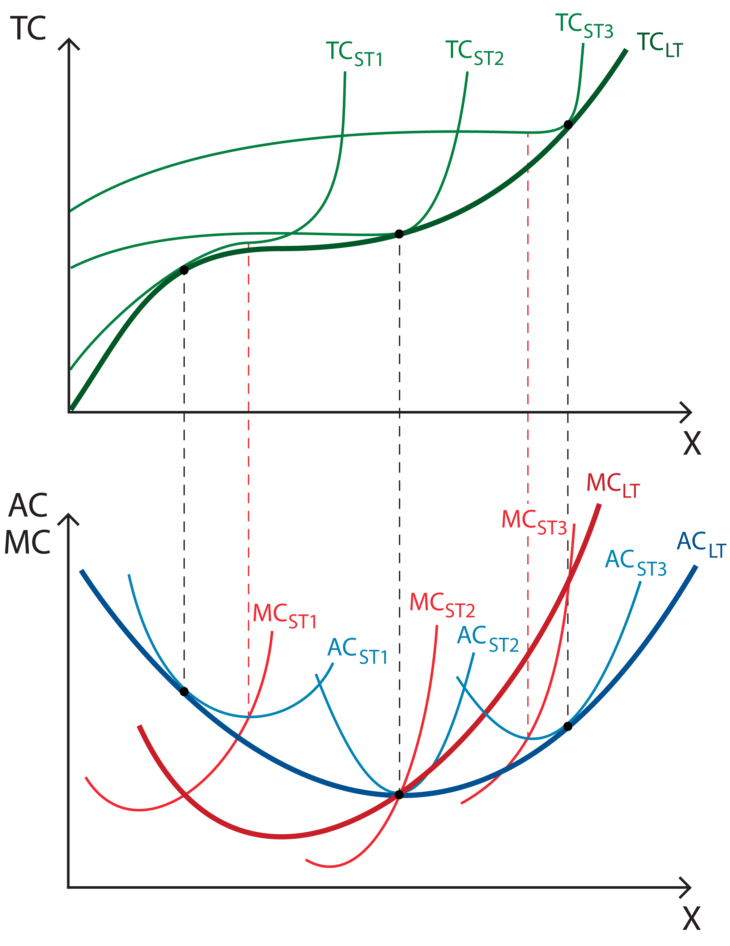

REVENUES, COSTS AND PROFIT
FIRM COSTS IN LONG RUN
LTC curve is formed by minimum of STC curves
The point is the point of optimal production, where LTC/STC, LMC/SMC and LAC/SAC are equal

Slide 24
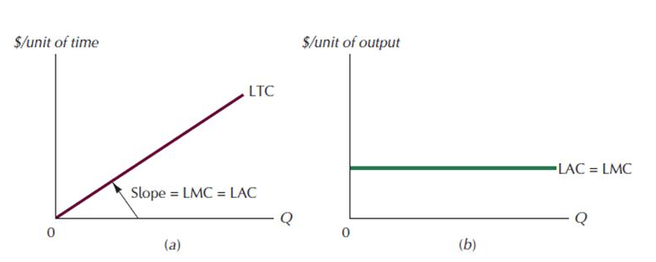
REVENUES, COSTS AND PROFIT
LONG COSTS WITH CONSTANT RETURNS TO SCALE
Long-run Total Costs
Long-run Average and Marginal Costs

Slide 25
REVENUES, COSTS AND PROFIT
THANK YOU FOR YOUR ATTENTION…

