Slide 1

MARKET OF PRODUCTION FACTORS
LAND and LABOUR
LESSON X
Dr. Ingrid Majerova
MICROECONOMICS/EVS/NAMIB

Slide 2
MARKET OF PRODUCTION FACTOR
Outline of the lecture
Revenues and Costs on the Market of Production Factors
Land Market and Land Rent
Labour Market
Monopsony
Bilateral Monopoly

Slide 3

MARKET OF PRODUCTION FACTOR
REVENUES VARIABLES ON THE MARKET OF PRODUCTION FACTORS
Marginal revenue product of factor (MRPPF)
  how much the revenue changes, if the marginal product of firm changes with involvement of additional PF
Average revenue product of factor (ARPPF)
  how many units of goods on average is per unit of PF(eg. how much, on average, one worker produces)
MRP and ARP normally first rise and then fall
  First, additional unit of PF produces more than the previous unit - the division of labor, specialization, etc. are reflected
  later the additional unit of PF produces less than the previous unit - the law of diminishing marginal returns

Slide 4
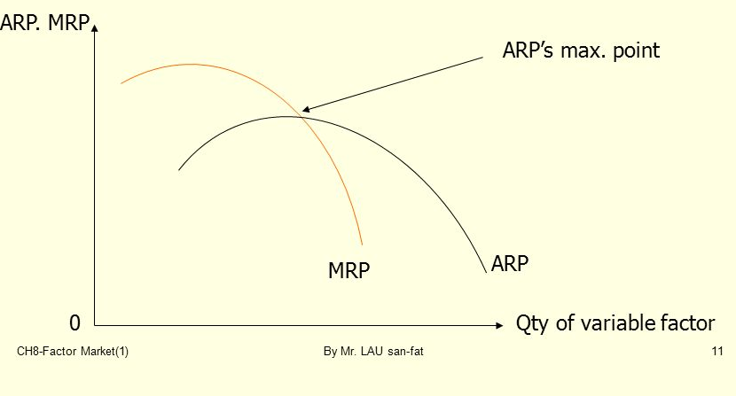
MARKET OF PRODUCTION FACTOR
MARGINAL AND AVERAGE VARIABLES ON THE MARKET OF PRODUCTION FACTORS
MRP and ARP curves follow the MP and AP curves
shape of the curve depends on the type of competition - they are flatter in perfect one and steeper in imperfect competition

Slide 5
MARKET OF PRODUCTION FACTOR
COSTS VARIABLES ON THE MARKET OF PRODUCTION FACTORS
Marginal Factor Costs (MFC) - change in total cost due to the additional involvement of factor
Average Factor Costs (AFC) – costs on the unit of involved factor (how much the firm pays for one unit of factor)
A = land, L = Labour (number of units of work), K = capital (number of units of capital)
AFCK = TC / K = i.K / K = i
AFCL = TC / L = w.L / L = w
Price of factor: r = land rent, w = wage rate, i = interest rate

Slide 6
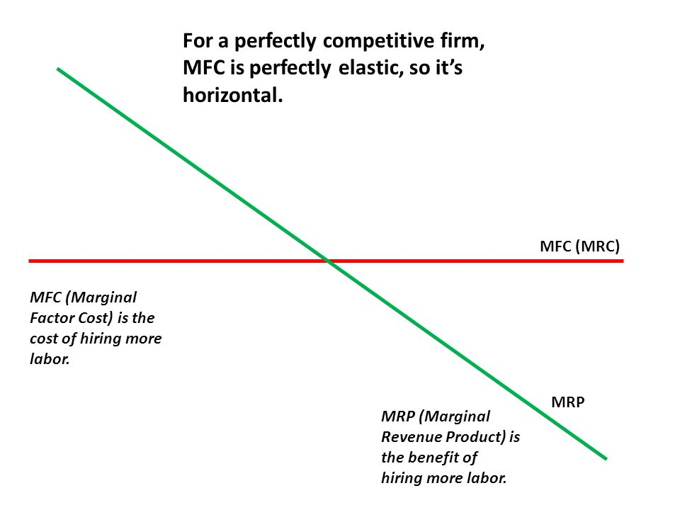
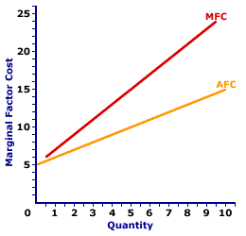
MARKET OF PRODUCTION FACTOR
COSTS VARIABLES ON THE MARKET OF PRODUCTION FACTORS
Imperfect Competition
Perfect Competiton

Slide 7
MARKET OF PRODUCTION FACTOR
LAND MARKET
Land rent (r) - the price for renting land. Land use brings land rent if the total supply of land is fixed (perfectly inelastic) and there is no other possibility of its using
r - is pure economic rent - income paid for services of factor with fixed supply (it can also be labor - eg. extraordinary singers, sportsmen ...)
The amount of rent is determined by the rate of land rent and the amount of leased land.
Land rent can arise by:
  Cultivation of particular crop
  Mining of raw materials
  Rental of building land

Slide 8
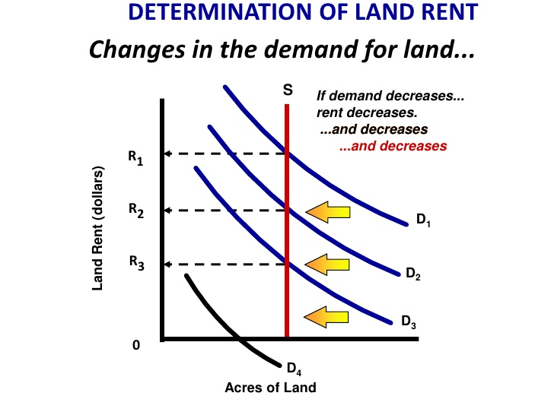
MARKET OF PRODUCTION FACTOR
LAND MARKET AND LAND RENT
Land rent – periodical payment by a landuser to a landowner

Slide 9
MARKET OF PRODUCTION FACTOR
LABOUR MARKET
Perfect competitive labour market:
  a large number of firms requesting labour
  the price of labor (wage rate) is objective towards the firm and is given by the market
  MFCL = AFCL = w
Imperfect competitive labour market:
  wage rigidities
  regulation of wages

Slide 10
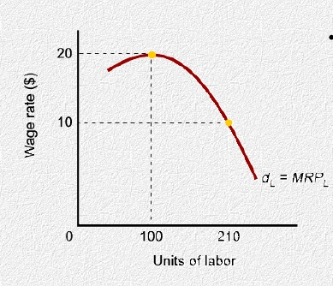
MARKET OF PRODUCTION FACTOR
LABOUR DEMAND
When a firm uses only one factor, that MRP curve is demand curve of firm

Slide 11
MARKET OF PRODUCTION FACTOR
LABOUR SUPPLY
Working in a firm and at home take up part of the day, the rest is free time.
To determine the market supply is advisable to assume only two possibilities for the use of time:
  Work - which is leased for wage
  Leisure
The consumer´s aim is to maximize benefits = how to maximize utility by dividing time between work in the firm and leisure.

Slide 12
MARKET OF PRODUCTION FACTOR
INDIVIDUAL LABOUR SUPPLY
People want to increase the number of hours until the marginal utility arising from goods obtained through the last hour of work, equal to the marginal utility of the last hour of free time
The maximum utility is achieved when the marginal utility of additional units of time in both alternatives use of time is consistent

Slide 13
MARKET OF PRODUCTION FACTOR
LABOUR SUPPLY
Changing wage rates have on a choice between work and leisure dual effect:
  Substitution effect - with higher wage, every hour of work brings a greater variety of goods and services, which leads to a tendency to work more at the expense of free time (resulting in increase of the offered amount of work).
  Income effect - the higher wage increases real income (assuming that the prices of goods and services remain the same) and thus leads to a tendency to have more free time (leading to a reduction of the offered amount of work).

Slide 14
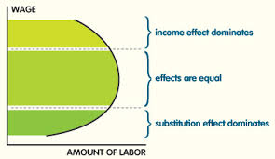
MARKET OF PRODUCTION FACTOR
LABOUR SUPPLY
BECKWARD BENDIDNG LABOUR SUPPLY CURVE

Slide 15
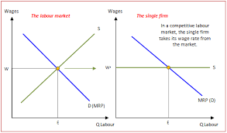
MARKET OF PRODUCTION FACTOR
EQUILIBRIUM ON LABOUR MARKET
Equilibrium on the labor market occurs at the intersection point of the curve of labour market supply and market demand for labor
Labour supply - employees
Demand for labour - employers (firms)

Slide 16
MARKET OF PRODUCTION FACTOR
MONOPSONY
Monopoly power on the site of demand for labour
Single buyer of a particular input (single employer of some specific skilled worker or sole employer of work in a certain area)
Monopsony may affect the wages of their employees
A monopsonist employer maximizes profits by choosing the employment level L, that equates the marginal revenue product (MRP) to the marginal cost MC, at point A.

Slide 17
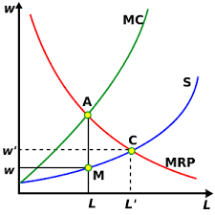

MARKET OF PRODUCTION FACTOR
MONOPSONY
Monopsony will hire a smaller quantity of labour at a lower wage rate
The wage is determined on the supply curve, at point M, and is equal to w.
DEADWEIGHT LOSS
Competitive market – wages and labour amount at C

Slide 18
MARKET OF PRODUCTION FACTOR
BILATERAL MONOPOLY
Arises when there is a monopoly power on both the labor supply (labour unions), and on the side of labor demand (monopsony)
The interests of both sides are opposed (monopsony - a minimum wage, trade unions - the highest wages)
The height of the real wage rate depends on the ratio of monopoly power of unions and monopsony
Wages are the result of collective agreements between both sides

Slide 19
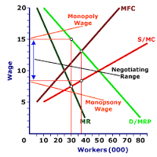
MARKET OF PRODUCTION FACTOR
BILATERAL MONOPOLY
Monopoly wage –wage required by unions
Difference between required and offered wages is the range for negotiation

Slide 20
MARKET OF PRODUCTION FACTOR
MINIMUM WAGE AND THE ROLE OF LABOUR UNIONS
= Price regulation on the labor market, or wage regulation
Objectives:
  guaranteeing a minimum income workers by the state → instrument of social policy
  increase the motivation to find a job
  increase employment

Slide 21
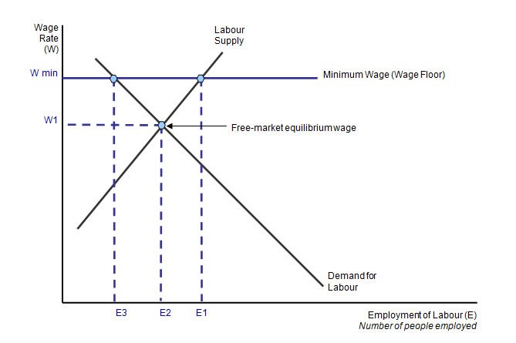
MARKET OF PRODUCTION FACTOR
MINIMUM WAGES
Minimum wage causes that the labor market does not clear, there is excess of S above D
causing the emergence of involuntary unemployment

Slide 22
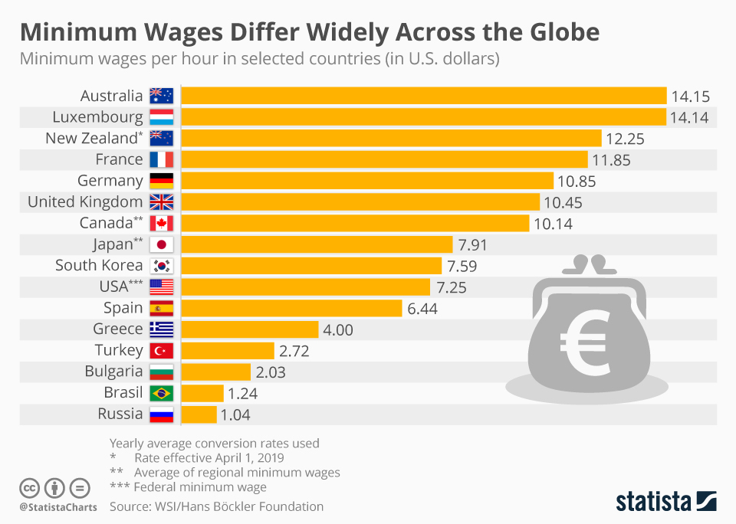
MARKET OF PRODUCTION FACTOR
MINIMUM WAGES

Slide 23
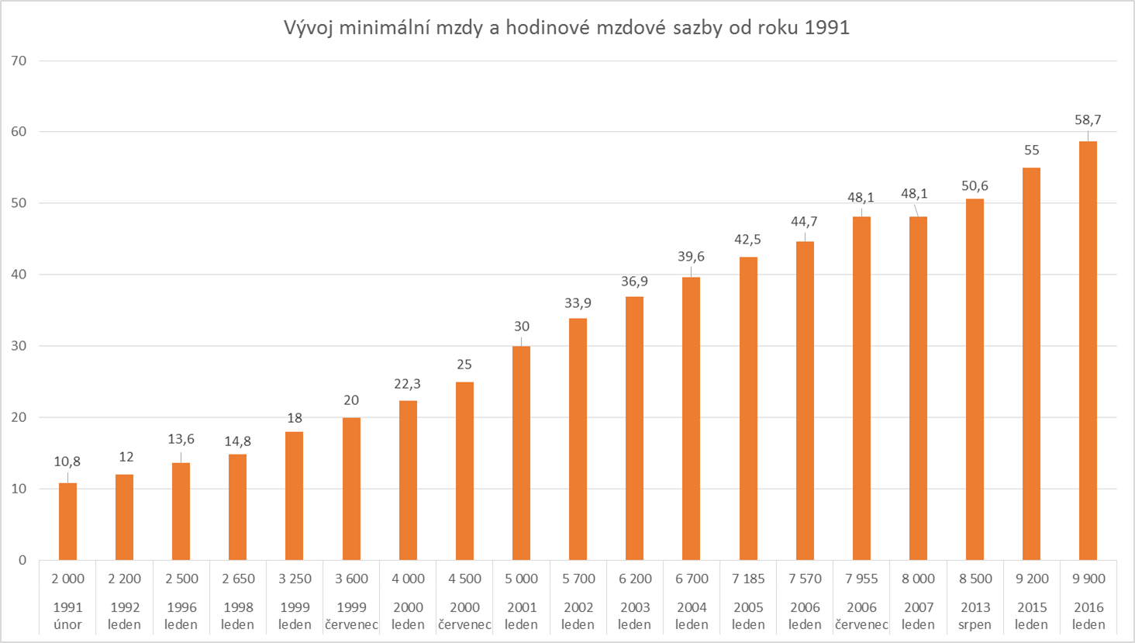
MARKET OF PRODUCTION FACTOR
DEVELOPMENT OF MINIMUM WAGES IN THE CZECH REPUBLIC

Slide 24
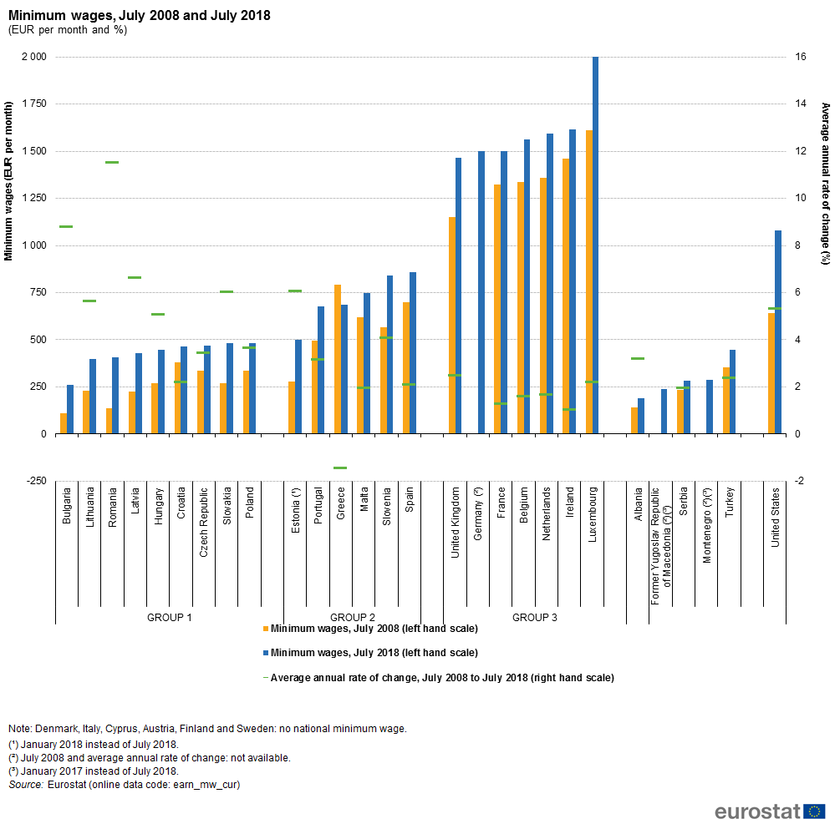
MARKET OF PRODUCTION FACTOR
DEVELOPMENT OF MINIMUM WAGES IN THE EU

Slide 25
REVENUES, COSTS AND PROFIT
THANK YOU FOR YOUR ATTENTION…

