Slide 1

Informatics
Informatics in business practice - I
Petr Suchánek
Informatics

Slide 2

Outline of the lecture
Informatics as a field of science
Hardware
Software
Data
Information
Knowledge

Slide 3
Informatics
Informatics is the study of the behavior and structure of any system that generates, stores, processes and then presents information.*
It is basically the science of information.*
The field takes into consideration the interaction between the information systems and the user, as well as the construction of the interfaces between the two, such as the user interface.*
Informatics is a branch of information engineering. It involves the practice of information processing and the engineering of information systems, and as an academic field it is an applied form of information science.**
*https://www.techopedia.com/definition/30332/informatics
**https://en.wikipedia.org/wiki/Informatics

Slide 4
Informatics
Informatics is the study of the structure, behaviour, and interactions of natural and engineered computational systems.*
Artificial intelligence;
Data Science;
Behavior informatics;
Biomimetrics;
Cognitive science;
Computer science;
Communication studies;
Information and communications technology;
Information processing;
Information science;
Information systems;
Information theory;
Information technology;
Knowledge Management;
Robotics;
Urban informatics.
*https://www.ed.ac.uk/files/atoms/files/what20is20informatics.pdf

Slide 5
Hardware
Computer hardware refers to the physical parts of a computer and related devices.*
Internal hardware devices include:**
motherboard;
central processing unit (CPU);
random access memory (RAM);
hard drive;
optical drive;
heat sink;
power supply;
transistors;
chips;
graphics processing unit (GPU);
network interface card (NIC).
*https://techterms.com/definition/hardware
**https://searchnetworking.techtarget.com/definition/hardware

Slide 6
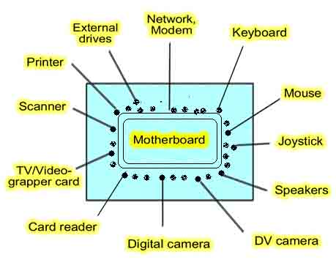
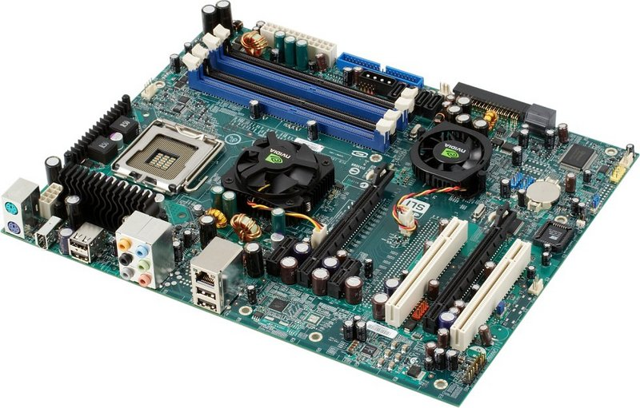
Hardware
*https://www.nehruplacemarket.com/motherboard-guide.php
**https://medium.com/computing-technology-with-it-fundamentals/system-hardware-component-motherboard-8e3d44e29f74

Slide 7
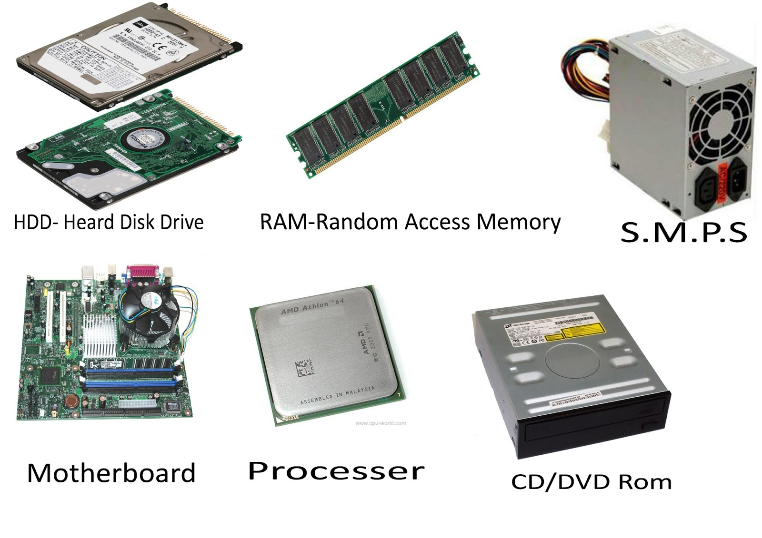
Hardware
*https://hometechbd24.blogspot.com/2016/10/how-to-build-your-own-pc-easy-guide.html
**

Slide 8
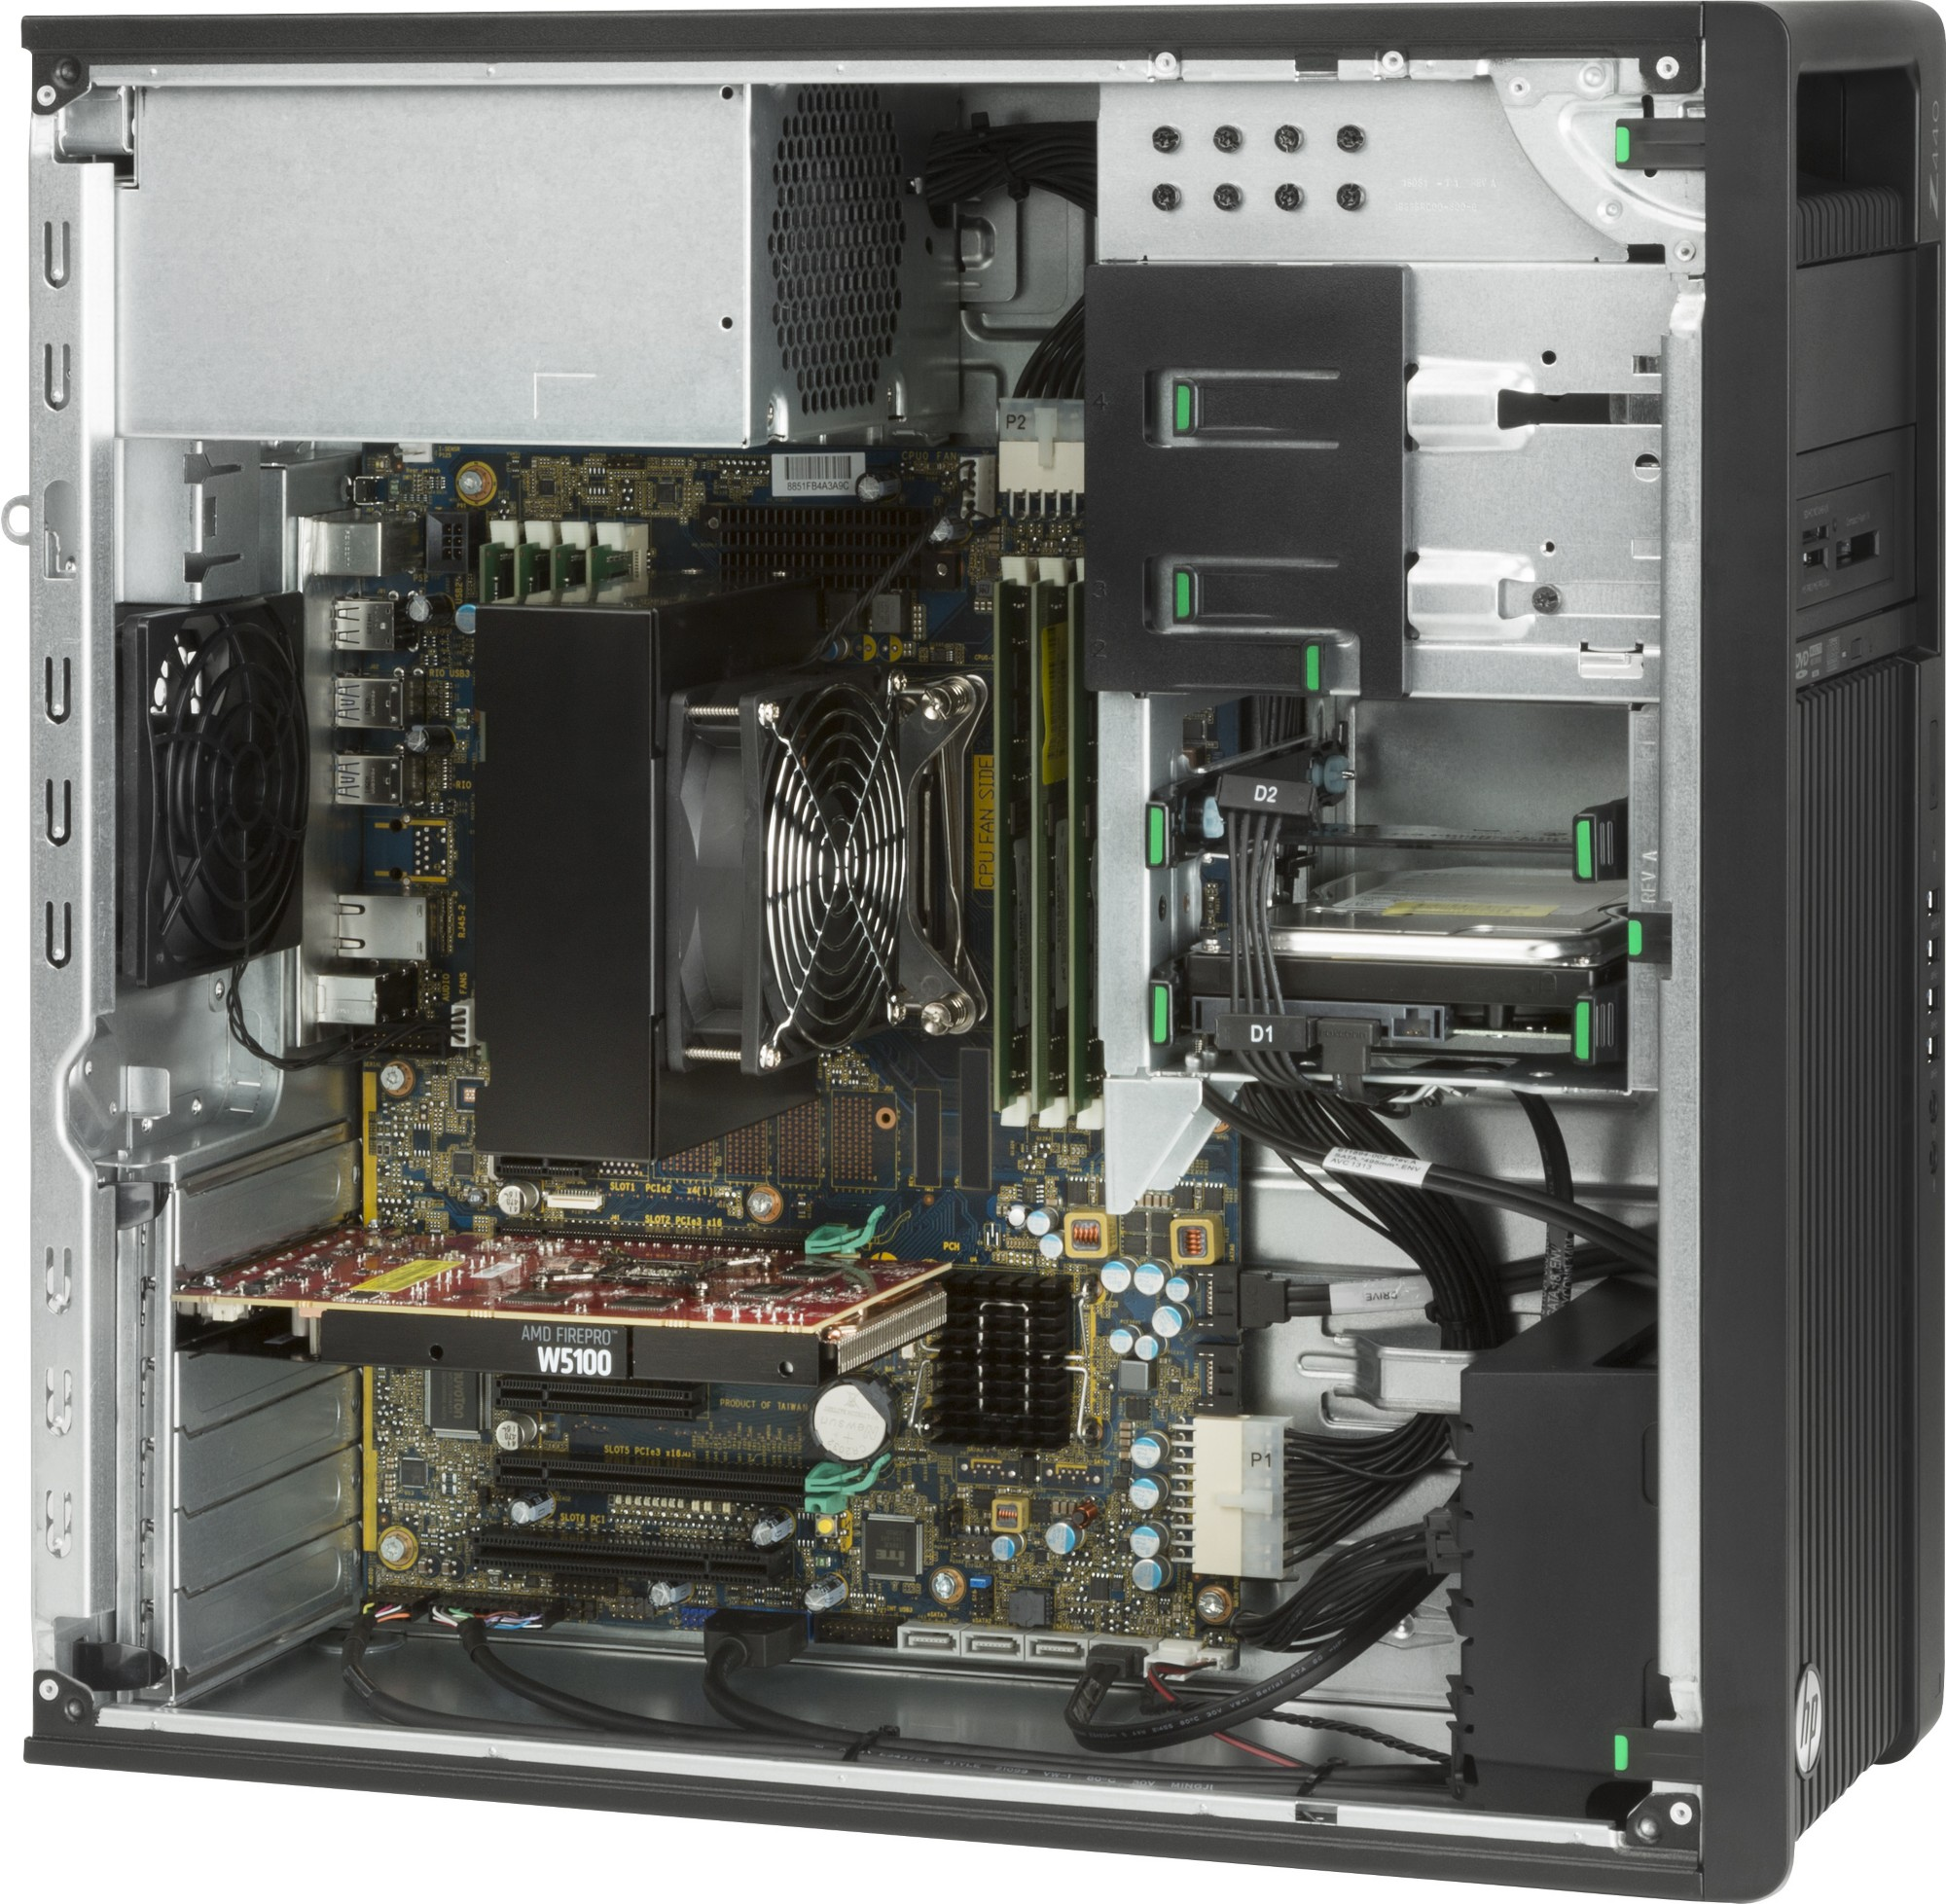
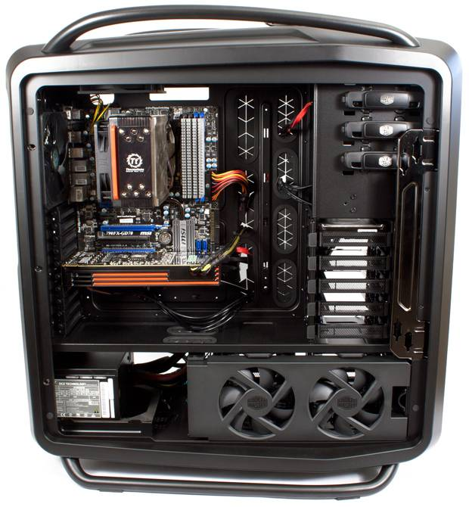
Hardware
*http://it-supplier.co.uk/hp-z440-memory-cooling-solution-j2r52aa
**https://techreport.com/review/22306/cooler-masters-cosmos-ii-enclosure/

Slide 9
Hardware
External (peripheral) hardware devices include:*
monitor;
mouse;
keyboard;
microphone;
camera;
touch pad;
stylus;
joystick;
scanner;
USB flash drive or memory;
printer;
headphones;
earphones/earbuds;
etc.
*https://searchnetworking.techtarget.com/definition/hardware

Slide 10
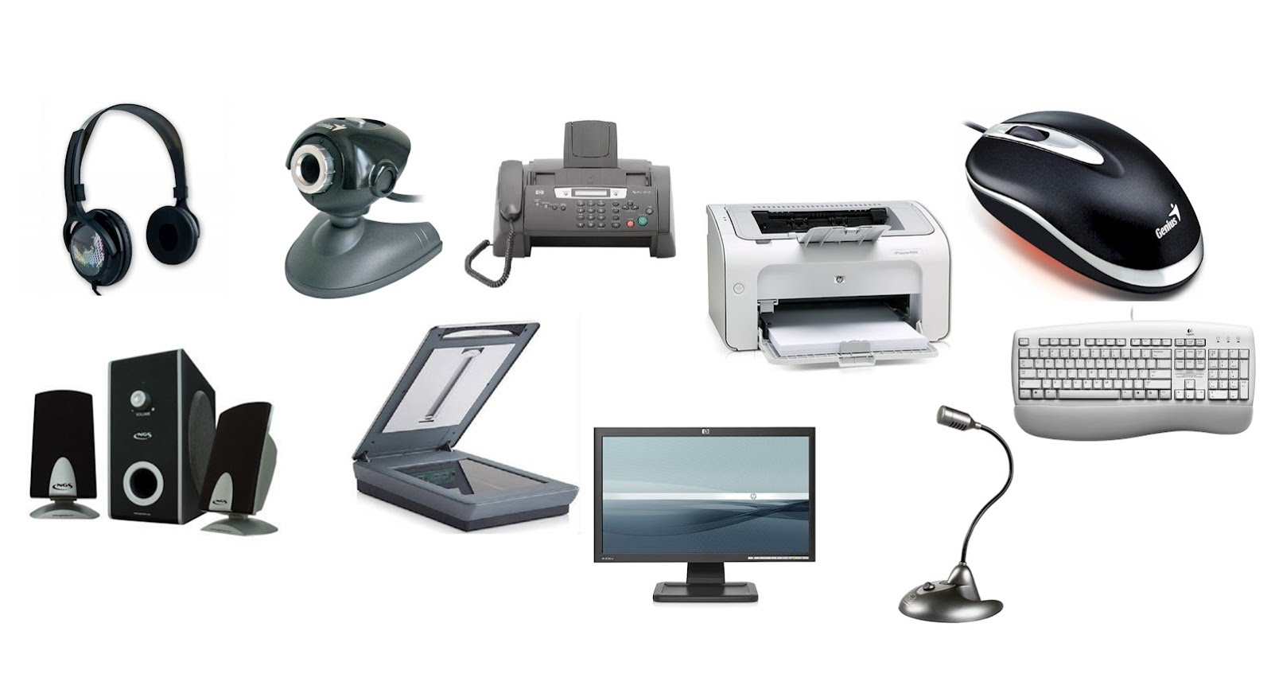
Hardware

Slide 11
Software
Software, in its most general sense, is a set of instructions or programs instructing a computer to do specific tasks.*
Software is a generic term used to describe computer programs.*
Scripts, applications, programs and a set of instructions are all terms often used to describe software.*
Computer software, or simply software, is a collection of data or computer instructions that tell the computer how to work.**
*https://www.techopedia.com/definition/4356/software
**https://en.wikipedia.org/wiki/Software

Slide 12
Software
1) System software*
  operating systems;
  device drivers;
  desktop environments;
  etc.)
2) Application software*
  office suites;
  word processors;
  spreadsheets;
  etc.
3) Computer programming tools*
  assemblers;
  compilers;
  linkers;
  etc.
The first two of these are classified for running software on computers (i.e., actually using the computers), while the last one is about developing the software in the first place. *
*https://en.wikipedia.org/wiki/Category:Software

Slide 13
System software
System software is a type of computer program that is designed to run a computer’s hardware and application programs.*
The BIOS (basic input/output system)*
  gets the computer system started after you turn it on and manages the data flow between the operating system and attached devices such as the hard disk, video adapter, keyboard, mouse and printer.
The boot program*
  loads the operating system into the computer's main memory or random access memory (RAM).
*https://whatis.techtarget.com/definition/system-software

Slide 14
System software
An assembler*
  takes basic computer instructions and converts them into a pattern of bits that the computer's processor can use to perform its basic operations.
A device driver*
  controls a particular type of device that is attached to your computer, such as a keyboard or a mouse. The driver program converts the more general input/output instructions of the operating system to messages that the device type can understand.
Additionally, system software can also include system utilities, such as the disk defragmenter and System Restore, and development tools, such as compilers and debuggers.*
*https://whatis.techtarget.com/definition/system-software

Slide 15
Operating system
An operating system (OS), in its most general sense, is software that allows a user to run other applications on a computing device.*
While it is possible for a software application to interface directly with hardware, the vast majority of applications are written for an OS, which allows them to take advantage of common libraries and not worry about specific hardware details.*
An operating system or OS is a software program that enables the computer hardware to communicate and operate with the computer software.**
*https://www.techopedia.com/definition/3515/operating-system-os
**https://www.computerhope.com/jargon/o/os.htm

Slide 16
Operating system
The operating system manages a computer's hardware resources, including:*
  Input devices such as a keyboard and mouse.
  Output devices such as display monitors, printers and scanners.
  Network devices such as modems, routers and network connections.
  Storage devices such as internal and external drives.
The most known and popular operating systems:**
  Windows;
  iOS;
  Android;
  Linux.
*https://www.techopedia.com/definition/3515/operating-system-os
**https://www.computerhope.com/issues/ch001777.htm

Slide 17
Application software
An application is any program, or group of programs, that is designed for the end user.*
Application Software Types:**
  Word processing software - MS Word, WordPad and Notepad. etc.
  Databse software - Oracle, MS Access, MySQL, etc.
  Spreadsheet software - Apple Numbers, Microsoft Excel, LO Calc, etc.
  Multimedia software - Real Player, Media Player, etc.
  Presentation Software - Microsoft Power Point, Keynotes, LO Impress, etc.
  Enterprise Software - Customer relationship management system, Enterprise resource planning, etc.
*https://www.webopedia.com/TERM/A/application.html
**https://www.educba.com/what-is-application-software-its-types/

Slide 18
Application software
Application Software Types:**
  Information Worker Software - Documentation tools, resource management tools, etc.
  Educational Software - Dictionaries: Encarta, BritannicaMathematical: MATLABOthers: Google Earth, NASA World Wind, etc.
  Simulation Software – Flight simulators, scientific simulators, etc.
  Content Access Software - Accessing content through media players, web browsers, etc.
  Application Suites - LibreOffice, Microsoft Office, etc.
  Software for Engineering and Product Development - IDE or Integrated Development Environments, etc.
**https://www.educba.com/what-is-application-software-its-types/

Slide 19
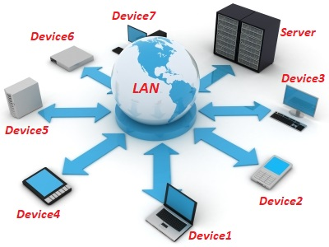
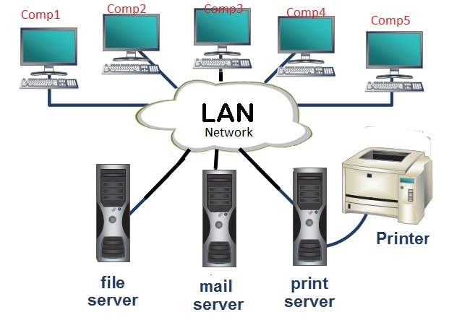
Local area network
A local-area network (LAN) is a computer network that spans a relatively small area.*
Most often, a LAN is confined to a single room, building or group of buildings, however, one LAN can be connected to other LANs over any distance via telephone lines and radio waves.*
*https://www.webopedia.com/TERM/L/local_area_network_LAN.html
**https://www.am7s.com/local-area-network-work/

Slide 20
Server
A server is a type of computer or device on a network that manages network resources.*
  Web server - computers that deliver (or serve up) Web pages;
  Proxy server - server that sits between a client application, such as a Web browser, and a real server. Proxy servers have two main purposes: to improve performance and to filter requests;
  Dedicated server - is a single computer in a network reserved for serving the needs of the network. For example, some networks require that one computer be set aside to manage communications between all the other computers;
*https://www.webopedia.com/TERM/S/server.html

Slide 21

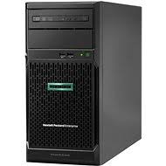
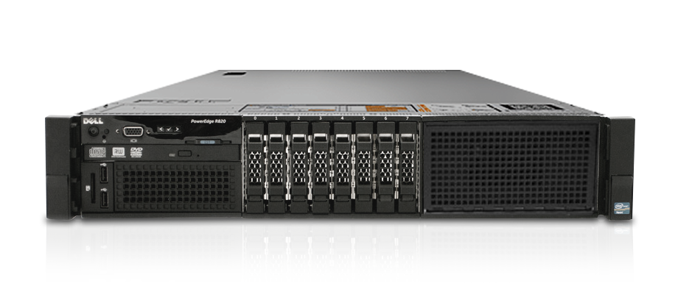
Server
  Application server - is a program that handles all application operations between users and an organization's back-end business applications or databases. This type of server is typically used for complex transaction-based applications;
  Cloud server - Cloud servers are services made available to customers on demand via the Internet. Rather than being provided by a single server or virtual server, cloud server hosting services are provided by multiple connected servers that comprise a cloud.
*https://www.webopedia.com/TERM/S/server.html

Slide 22
Data
Data is a set of values of subjects with respect to qualitative or quantitative variables.*
Data is measured, collected and reported, and analyzed, whereupon it can be visualized using graphs, images or other analysis tools.*
Data, in the context of computing, refers to distinct pieces of digital information.**
Data is usually formatted in a specific way and can exist in a variety of forms, such as numbers, text, etc.**
*https://en.wikipedia.org/wiki/Data
**https://www.techopedia.com/definition/807/data

Slide 23
Information
Information is stimuli that has meaning in some context for its receiver.*
When information is entered into and stored in a computer, it is generally referred to as data.*
After processing (such as formatting and printing), output data can again be perceived as information.*
Information is associated with data and knowledge, as information is data in context and with meaning attached.**
*https://searchsqlserver.techtarget.com/definition/information
**https://en.wikipedia.org/wiki/Information

Slide 24
Knowledge
Facts, information, and skills acquired through experience or education;
Knowledge is a familiarity, awareness, or understanding of someone or something, such as facts, information, descriptions, or skills, which is acquired through experience or education by perceiving, discovering, or learning.**
The theoretical or practical understanding of a subject.*
It can be implicit (as with practical skill or expertise) or explicit (as with the theoretical understanding of a subject);**
It can be more or less formal or systematic.**
*https://www.lexico.com/en/definition/knowledge
**https://en.wikipedia.org/wiki/Knowledge

Slide 25
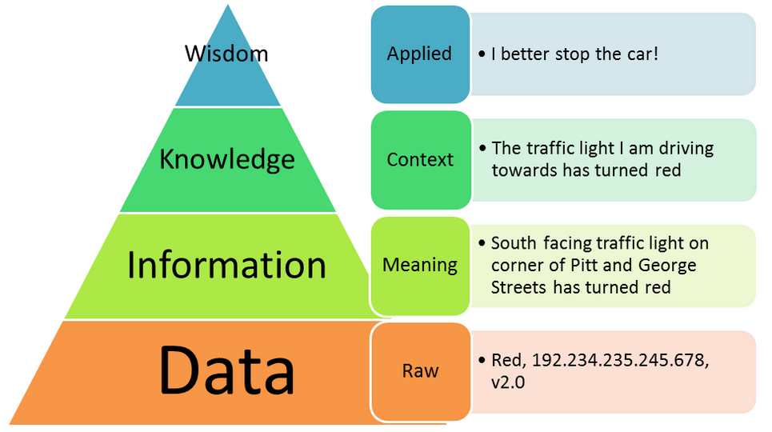
Data, information, knowledge, wisdom*
*https://blog.iota.org/honest-data-f4e25bdac5ad

Slide 26
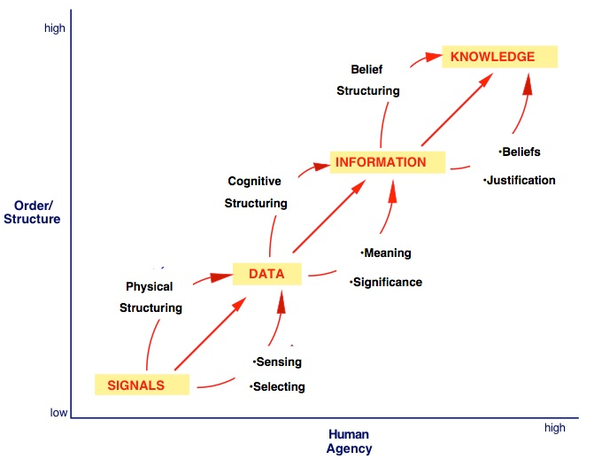
Data – information – knowledge continuum*
*http://choo.ischool.utoronto.ca/kluwer/DataInfoKnow.html

Slide 27
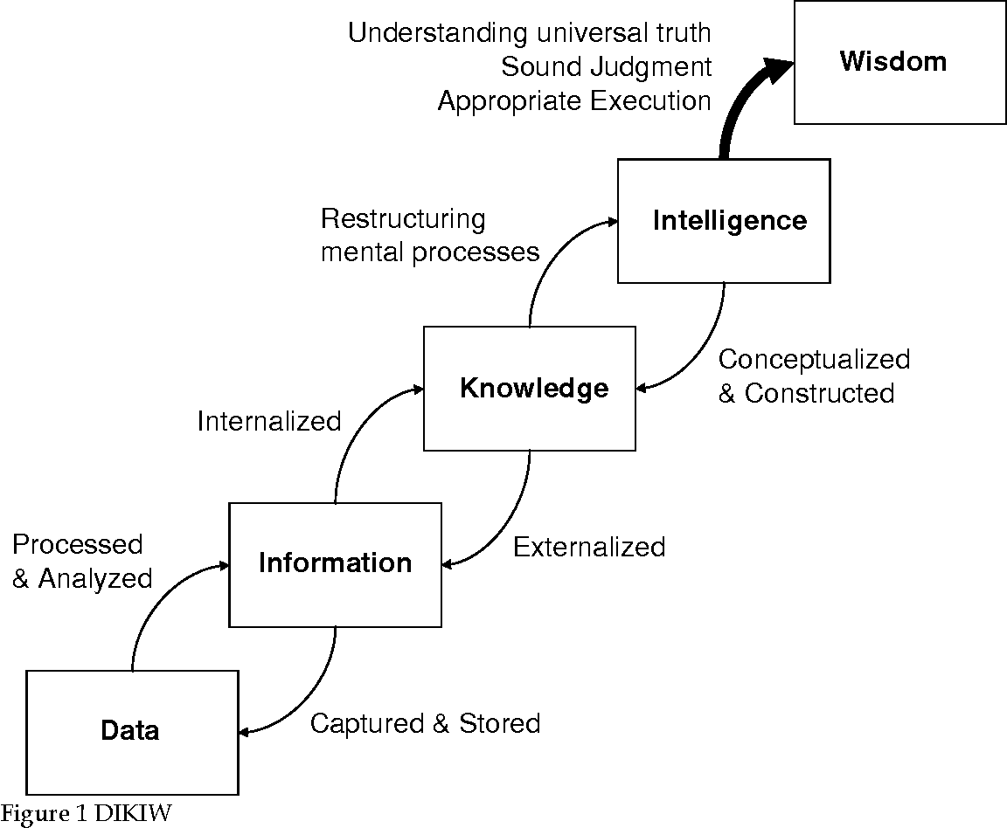
Data – information – knowledge - intelligence*
*https://www.semanticscholar.org/paper/DIKIW%3A-Data%2C-Information%2C-Knowledge%2C-Intelligence%2C-Liew/695f73fef84353bcec7cb66c0683f582522e18e2

Slide 28
The end
Thank you for your attention!
Any questions?

