Slide 1

Informatics
Informatics in business practice - II
Petr Suchánek
Informatics

Slide 2

Outline of the lecture
Information and communication technology
Internet
Internet services
System & subsystem
Information system
Informatics as a management support

Slide 3
Information and communication technology
Information and communications technology (ICT) is an extensional term for information technology (IT) that stresses the role of unified communications and the integration of telecommunications (telephone lines and wireless signals) and computers, as well as necessary enterprise software, middleware, storage, and audiovisual systems, that enable users to access, store, transmit, and manipulate information.*
ICT encompasses both the internet-enabled sphere as well as the mobile one powered by wireless networks.**
It also includes antiquated technologies, such as landline telephones, radio and television broadcast – in today's also with the use of artificial intelligence and robotics.**
*https://en.wikipedia.org/wiki/Information_and_communications_technology
**https://whatis.techtarget.com/definition/ICT-information-and-communications-technology-or-technologies

Slide 4
Information and communication technology
The term ICT is now used to refer to the combination of computer technology with telecommunication as well.*
ICT can be defined as the set of technological tools and resources used to communicate and:*
  create;
  disseminate;
  store;
  manage;
information
*https://www.kullabs.com/classes/subjects/units/lessons/notes/note-detail/1184

Slide 5
ICT - components
ICT
People
Procedures
Software
Hardware
Data
Those who operate and design softwares
Facts and figures
Set of instructions and rules
Computer programs
Computer programs
* https://www.slideshare.net/zfhh01/information-and-communication-technology-65904760

Slide 6
Internet
The Internet was born in late 1960’s.*
The internet has its root in the ARPANET system of the Advanced Research Project Agency of U.S. Department of Defense which linked together mainframe computers to form a communication networks.*
ARPANET is known as the forefather of internet.*
*https://www.slideshare.net/priyasoni91/the-internet-10511600
**https://en.wikipedia.org/wiki/Internet

Slide 7
Internet
The Internet is a globally connected network system that uses TCP/IP to transmit data via various types of media.*
The Internet is a network of global exchanges – including private, public, business, academic and government networks – connected by guided, wireless and fiber-optic technologies.*
The Internet carries a vast range of information resources and services, such as the inter-linked hypertext documents and applications of the World Wide Web (WWW), electronic mail, telephony, and file sharing.**
*https://www.techopedia.com/definition/2419/internet
**https://en.wikipedia.org/wiki/Internet

Slide 8
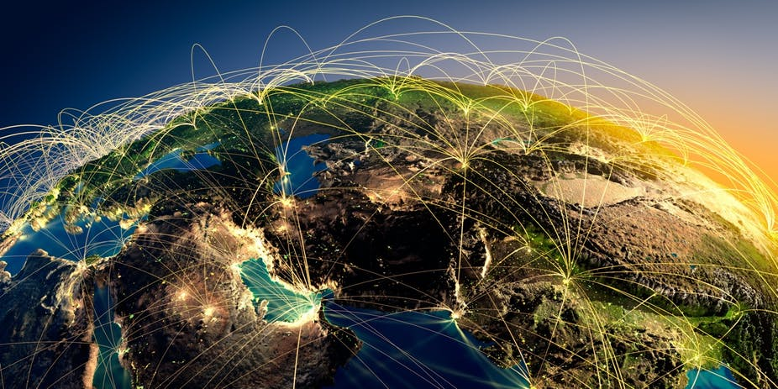
Internet services
WWW;
E-mail;
FTP;
VoIP;
Instant Messaging;
Telnet;
etc.
*http://theconversation.com/how-the-internet-was-born-from-the-arpanet-to-the-internet-68072

Slide 9
Internet - World Wide Web
The World Wide Web (WWW) is a network of online content that is formatted in HTML and accessed via HTTP.*
The term refers to all the interlinked HTML pages that can be accessed over the Internet.
HTML - Hypertext Markup Language (HTML) is the standard markup language for documents designed to be displayed in a web browser.**
It can be assisted by technologies such as Cascading Style Sheets (CSS) and scripting languages such as JavaScript, PHP, etc.**
*https://www.techopedia.com/definition/5217/world-wide-web-www
**https://en.wikipedia.org/wiki/HTML

Slide 10
Internet – Instant m
Electronic mail (email) is a digital mechanism for exchanging messages through Internet or intranet communication platforms.*
E-mail is one of the most widely used features of the Internet, along with the web.**
It allows user to send and receive messages to and from anyone with an email address, anywhere in the world.**
*https://www.techopedia.com/definition/24803/electronic-mail-e-mail
**https://techterms.com/definition/email

Slide 11
Internet – FTP
The File Transfer Protocol (FTP) is a standard network protocol used for the transfer of computer files between a client and server on a computer network.*
A protocol is a system of rules that networked computers use to communicate with one another.**
FTP is a client-server protocol that may be used to transfer files between computers on the internet.**
The client asks for the files and the server provides them.**
*https://en.wikipedia.org/wiki/File_Transfer_Protocol
**https://www.cloudwards.net/what-is-ftp/

Slide 12
Internet – VoIP
Voice over Internet Protocol (VoIP), also called IP telephony, is a method and group of technologies for the delivery of voice communications and multimedia sessions over Internet Protocol (IP) networks, such as the Internet.*
The terms Internet telephony, broadband telephony, and broadband phone service specifically refer to the provisioning of communications services (voice, fax, SMS, voice-messaging) over the public Internet, rather than via the public switched telephone network (PSTN), also known as plain old telephone service (POTS).*
*https://en.wikipedia.org/wiki/Voice_over_IP

Slide 13
Internet – Instant messaging
An instant message (IM) is a real-time, text-based communication similar to chat.*
IM uses a shared software client between or among two or more people using personal computers, iPhones or other devices.*
The communication is done over a network, often the Internet, and may include advanced modes with live voice or video.*
File transfers are also sometimes allowed but are limited in size.*
*https://www.techopedia.com/definition/402/instant-message-im

Slide 14
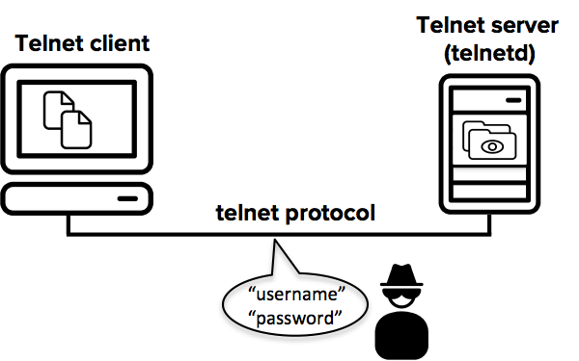
Internet – Telnet
Telnet is an application protocol used on the Internet or local area network to provide a bidirectional interactive text-oriented communication facility using a virtual terminal connection.*
Telnet is a member of TCP/IP family of internet protocols and allows communications with any computer linked over the internet even if it does not support TCP/IP specifications.**
*https://en.wikipedia.org/wiki/Telnet
**http://www.businessdictionary.com/definition/telnet.html

Slide 15
System
A system is a collection of elements or components that are organized for a common purpose.*
A System is a group of interacting or interrelated entities that form a unified whole.**
A system is delineated by its spatial and temporal boundaries, surrounded and influenced by its environment, described by its structure and purpose and expressed in its functioning.**
Systems are the subjects of study of systems theory.**
*https://searchwindowsserver.techtarget.com/definition/system
**https://en.wikipedia.org/wiki/System

Slide 16
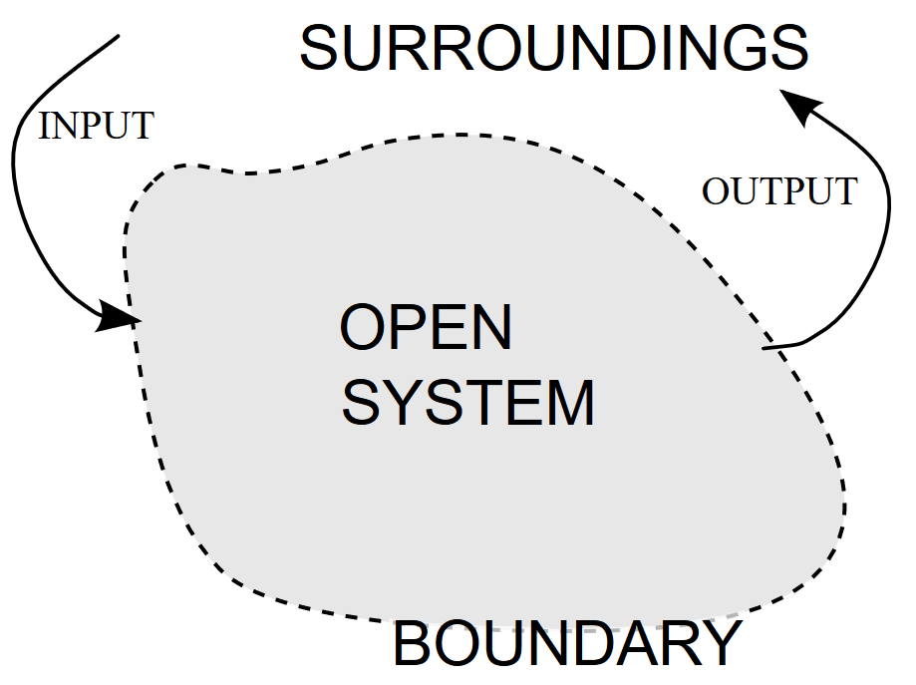
System
*https://upload.wikimedia.org/wikipedia/commons/7/77/OpenSystemRepresentation.svg

Slide 17
Subsystem
A subsystem is a set of elements, which is a system itself, and a component of a larger system.*
The main elements they have in common are the components that handle input, scheduling, spooling and output; they also have the ability to interact with local and remote operators.*
A subsystem description is a system object that contains information defining the characteristics of an operating environment controlled by the system.*
*https://en.wikipedia.org/wiki/System

Slide 18
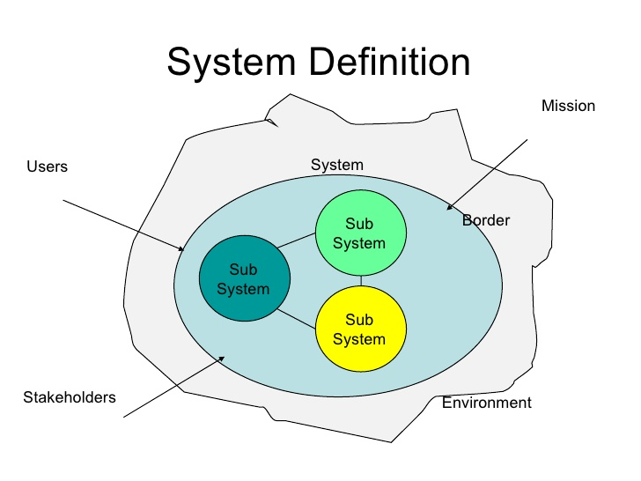
System & Subsystems
*https://www.slideshare.net/elfuchs/csse

Slide 19
Information system
Information systems (IS) are formal, sociotechnical, organizational systems designed to
  collect;
  process;
  store;
  distribute;
  present.
A computer information system is a system composed of people and computers that processes or interprets information.*
information.*
*https://en.wikipedia.org/wiki/Information_system

Slide 20
Information system - components
Hardware*
  The term hardware refers to machinery. This category includes the computer itself, which is often referred to as the central processing unit (CPU), and all of its support equipment. Among the support, equipment are input and output devices, storage devices and communications devices.*
Software*
  The term software refers to computer programs and the manuals (if any) that support them. Computer programs are machine-readable instructions that direct the circuitry within the hardware parts of the system to function in ways that produce useful information from data. Programs are generally stored on some input/output medium, often a disk or tape.
*https://en.wikipedia.org/wiki/Information_system

Slide 21
Information system - components
Data*
  Data are facts that are used by programs to produce useful information. Like programs, data are generally stored in machine-readable form on disk or tape until the computer needs them.*
Procedures*
  Procedures are the policies that govern the operation of a computer system. "Procedures are to people what software is to hardware" is a common analogy that is used to illustrate the role of procedures in a system.
*https://en.wikipedia.org/wiki/Information_system

Slide 22
Information system - components
People*
  Every system needs people if it is to be useful. Often the most overlooked element of the system are the people, probably the component that most influence the success or failure of information systems. This includes "not only the users, but those who operate and service the computers, those who maintain the data, and those who support the network of computers."*
Feedback*
  It is another component of the IS, that defines that an IS may be provided with a feedback (Although this component isn't necessary to function).
Networks*
  Networks are a connecting system that allows diverse computers to distribute resources.
*https://en.wikipedia.org/wiki/Information_system

Slide 23
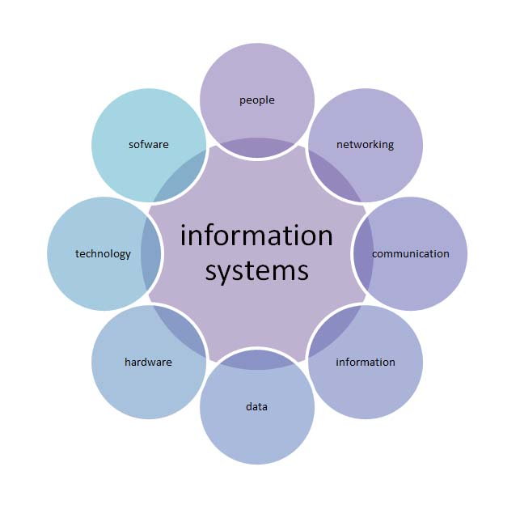
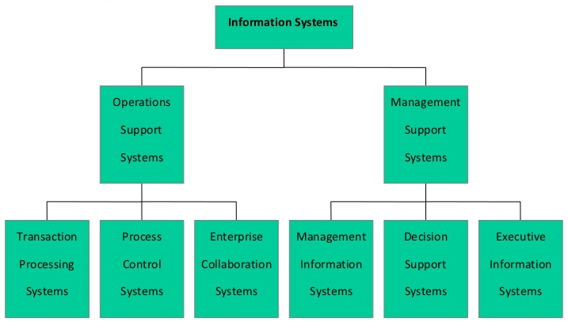
Subsystem
*https://edugeneral.org/blog/business/types-of-information-systems/
**https://www.slideshare.net/MaluResmi/management-information-system-8349815

Slide 24
Information system - types
Transaction processing system;
Decision support system;
Executive information system;
Management information system;
Workflow system;
Enterprise resource planning;
Expert systems.
s://en.wikipedia.org/wiki/System

Slide 25
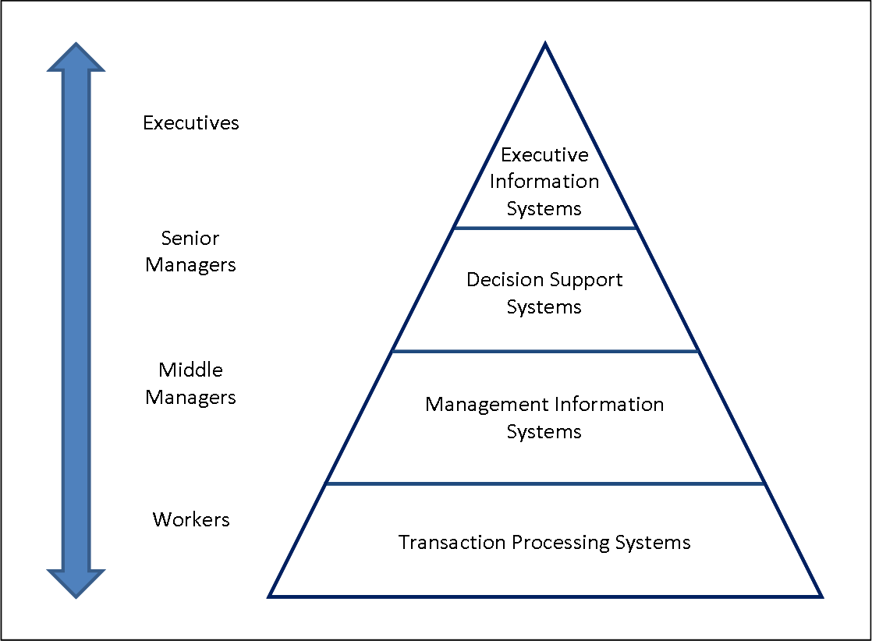
Information system - types
*https://edugeneral.org/blog/business/types-of-information-systems/

Slide 26
Management information system
Management Information System, commonly referred to as MIS is a phrase consisting of three words:*
  management;
  information;
  systems.
Management information systems (MIS) are applying computer-base for managing information in an organization for management roles such as interpersonal roles, informational roles and decisional roles.**
*https://www.cleverism.com/management-information-systems-mis/
**https://www.accountinginformationsystems.org/management-information-systems/

Slide 27
Management information system
Operational level system*
  In this level, there is transaction processing systems (TPS). They involve processing routine operation in organizations for decision support systems, management support system, knowledge work systems and office system. TPS are computerized systems that make performing tasks easier.
Knowledge level system*
  These systems are used by knowledge workers such as scientists, engineers and clerks (they hold university degree.). Following these samples knowledge work systems (KWS) and office systems. KWS tasks are creating properly new information and knowledge by process. Then, knowledge worker can use it. Office systems perform document and communication. KWS and office systems process data from TPS.
*https://www.accountinginformationsystems.org/management-information-systems/

Slide 28
Management information system
Management level system*
  This level consists of management support systems (MSS) (many text book use MIS meaning MSS.) and decision support systems (DSS). These systems provide information for management functions like planning, controlling and decision making. MSS process data from TPS, then managers can use it. DSS help managers for making decision. They include models to evaluate situation and give possible choices. They process data from TPS and MSS.
Knowledge level system*
  Executives need internal and external data for planning strategy. So, executive information systems are created for them. ESS response executives’ queries. They process data from MSS and DSS.
*https://www.accountinginformationsystems.org/management-information-systems/

Slide 29
Management information system - advantages
Users can quickly and timely access information since information is systematically stored by using computer systems and computer networks.
MIS support executives making decision, setting and adjusting strategies and operational plans. They summarize and analyze information. So, executives can easily apply it.
Good MIS will show how an operation accords to an organization goal. It’s adopted to monitor an operation.
MIS reduce organizations’ cost because of time, labor and expenses reducing in long run.
*https://www.accountinginformationsystems.org/management-information-systems/

Slide 30
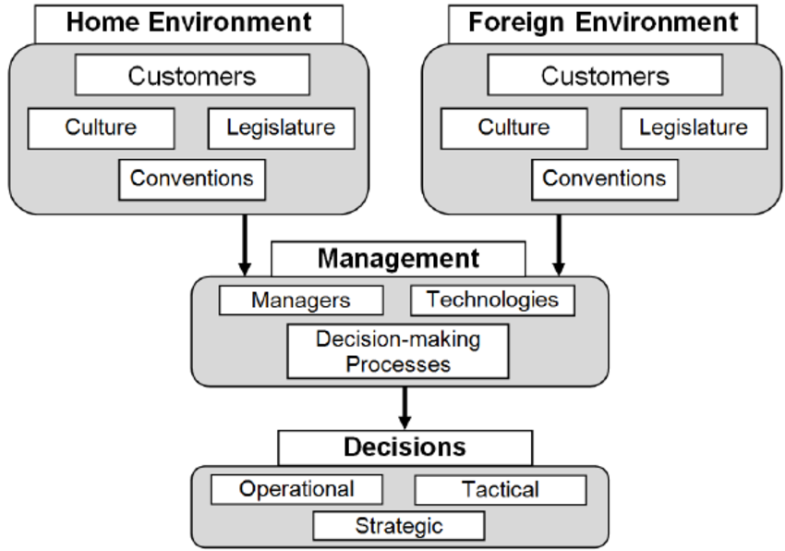
Management information system - example
*https://www.researchgate.net/figure/E-commerce-Management-System-and-its-Source-Information-Areas_fig1_48375884

Slide 31
The end
Thank you for your attention!
Any questions?

