Slide 1

Informatics
Text editors - 2
Petr Suchánek
Informatics

Slide 2

Outline of the lecture
Sections
Editing and proofing tools
Preparing printouts
Tables
Graphic objects
References
Mailings

Slide 3
Text editors - sections
Sections let you set specific page layout and formatting options (such as line numbering, columns, or headers and footers) for different parts of a document.*
By using sections, for example, you can format the introduction of a report as a single column, and then format the body of the report as two columns.*
Word treats a document as a single section until you insert a section break.*
Each section break controls the layout and formatting of the section previous to the break. For example, if you delete a section break, the text before the break acquires all the formatting of the section that follows the break.*
*https://support.office.com/en-us/article/insert-delete-or-change-a-section-break-0eeae2d6-b906-42d3-a1bd-7e77ca8ea1f3

Slide 4
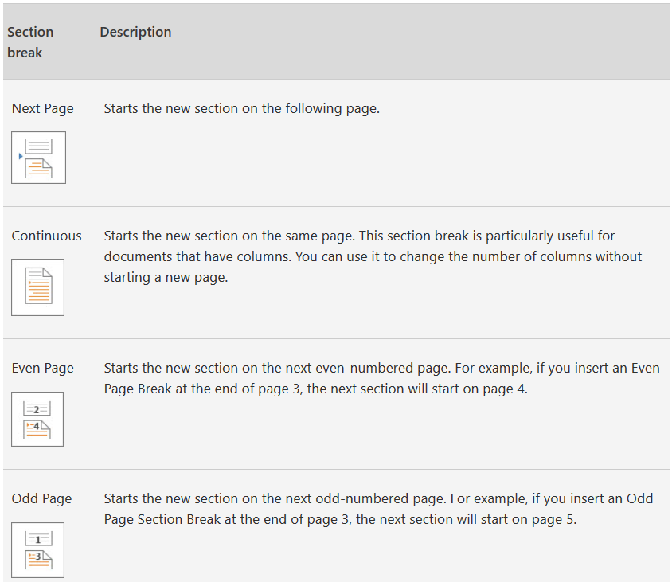
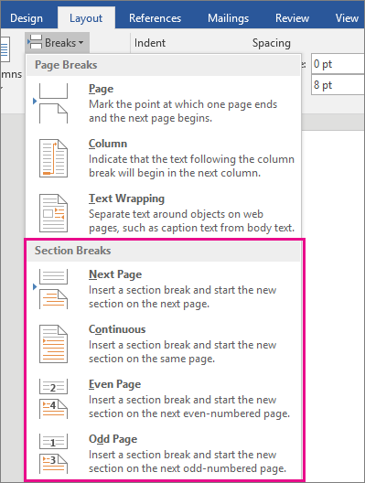
Text editors - sections
Click where you want a new section to begin.*
Click Layout / Breaks, and then click the type of section break you want.*
*https://support.office.com/en-us/article/insert-delete-or-change-a-section-break-0eeae2d6-b906-42d3-a1bd-7e77ca8ea1f3

Slide 5

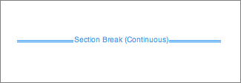
Text editors - sections
If you added section breaks to your document, the easiest way to see where they begin and end is to show formatting marks.*
Click the Home tab, and then click Show all nonprinting characters.*
Click the section break to select it and then press DELETE.*
*https://support.office.com/en-us/article/insert-delete-or-change-a-section-break-0eeae2d6-b906-42d3-a1bd-7e77ca8ea1f3

Slide 6
Text editors – proofing tools
Open a new document or email message.*
On the Review tab, in the Language group, click Language.*
Click Set Proofing Language.*
In the Language dialog box, select the Detect language automatically check box.*
Review the languages shown above the double line in the Mark selected text as list. Office can detect only those languages listed above the double line. If the languages that you use are not shown above the double line, you must enable the editing language (turn on the language-specific options) so that Office can automatically detect them.*
*https://support.office.com/en-us/article/turn-on-automatic-language-detection-194d309c-3e10-4bd5-a694-ba9bbdf4a28e

Slide 7
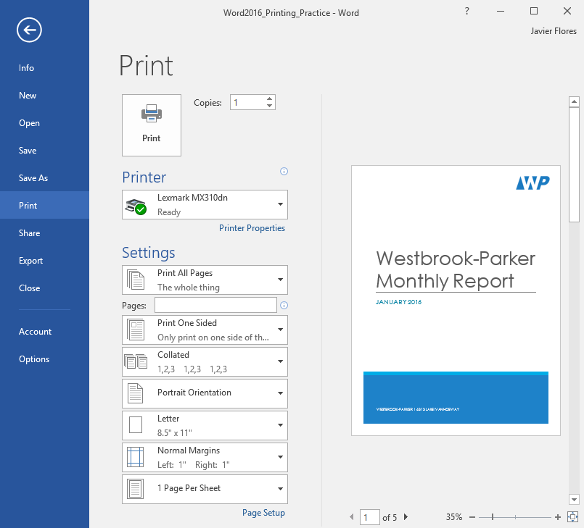
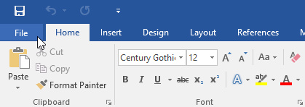
Text editors – preparing printouts
Select the File tab.*
Select Print.*
Navigate to the Print pane, then select the desired printer.*
* https://edu.gcfglobal.org/en/word2016/printing-documents/1/

Slide 8
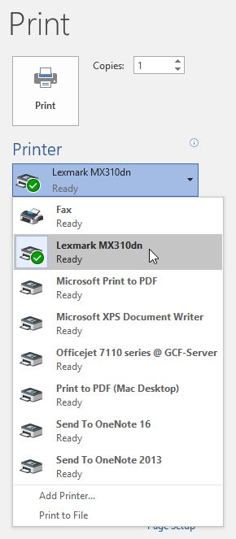
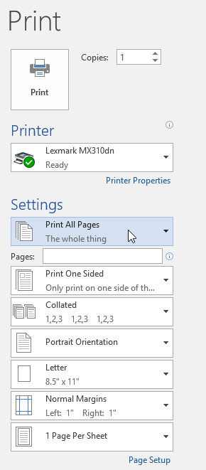
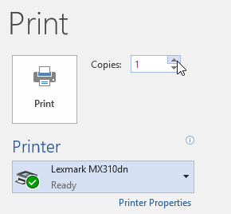
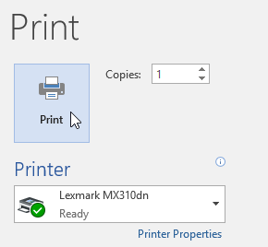
Text editors – preparing printouts
* https://edu.gcfglobal.org/en/word2016/printing-documents/1/

Slide 9
Text editors – tables
A table is a grid of cells arranged in rows and columns.*
Tables can be used to organize any type of content, whether you're working with text or numerical data.*
In Word, you can quickly insert a blank table or convert existing text to a table.*
You can also customize your table using different styles and layouts.*
*https://edu.gcfglobal.org/en/word2016/tables/1/

Slide 10
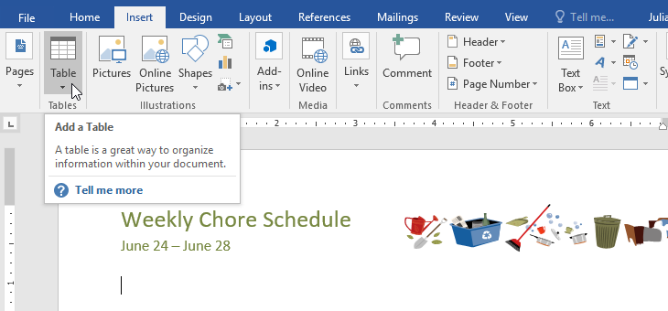
Text editors – tables
Place the insertion point where you want the table to appear.*
Navigate to the Insert tab, then click the Table command.*
*https://edu.gcfglobal.org/en/word2016/tables/1/

Slide 11
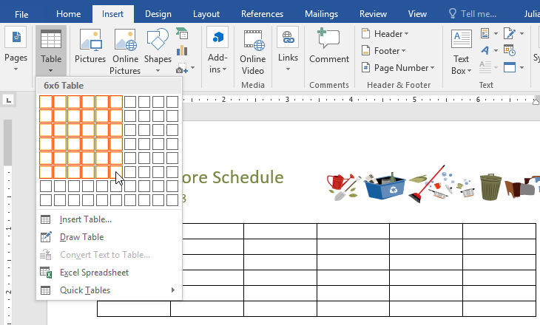
Text editors – tables
Hover over the grid to select the number of columns and rows you want.*
*https://edu.gcfglobal.org/en/word2016/tables/1/

Slide 12
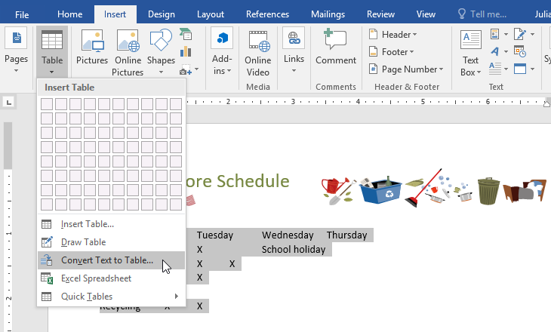
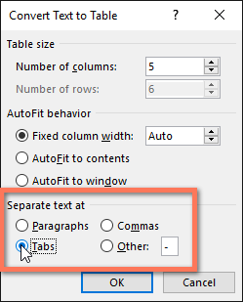
Text editors – tables
To convert existing text to a table Select the text you want to convert to a table.*
Go to the Insert tab, then click the Table command.*
Select Convert Text to Table from the drop-down menu.*
*https://edu.gcfglobal.org/en/word2016/tables/1/

Slide 13
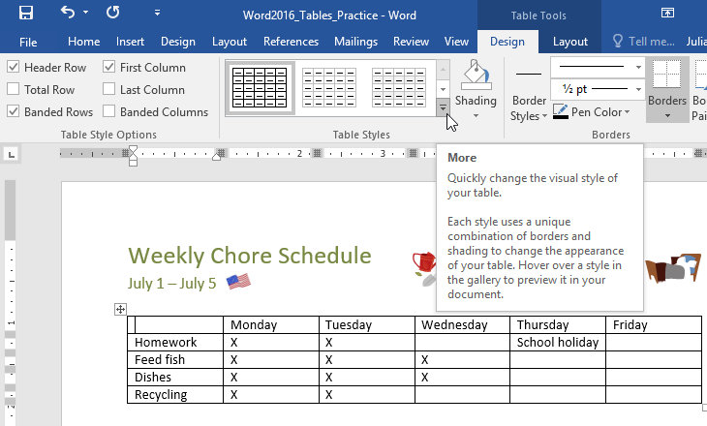
Text editors – tables
Table styles let you change the look and feel of your table instantly. They control several design elements, including color, borders, and fonts.*
Click anywhere in your table to select it, then click the Design tab on the far right of the Ribbon.*
Locate the Table Styles group, then click the More drop-down arrow to see the full list of styles.*
*https://edu.gcfglobal.org/en/word2016/tables/1/

Slide 14
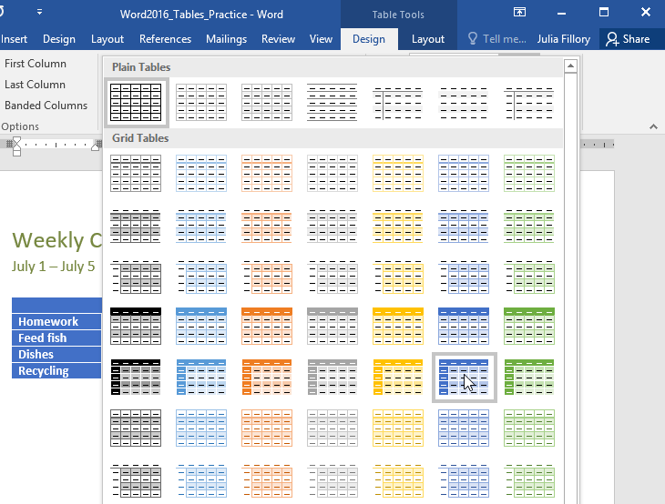
Text editors – tables
Select the table style you want.*
The table style will appear.*
*https://edu.gcfglobal.org/en/word2016/tables/1/

Slide 15
Text editors – tables - position
Right-click on the table and select Table Properties from the context menu.*
The Table Properties dialog box is for precise control over the data and its display.*
Control the size, alignment, and indentation of the table.*
By default, Word aligns a table on the left. If you want to center a table on the page, select the Table tab. Click on Alignment / Center.*
The Indent from left figure controls the distance of the table from the left margin.*
*https://www.makeuseof.com/tag/8-formatting-tips-perfect-tables-microsoft-word/

Slide 16
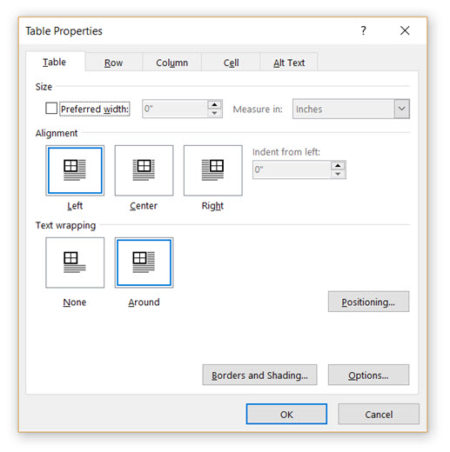
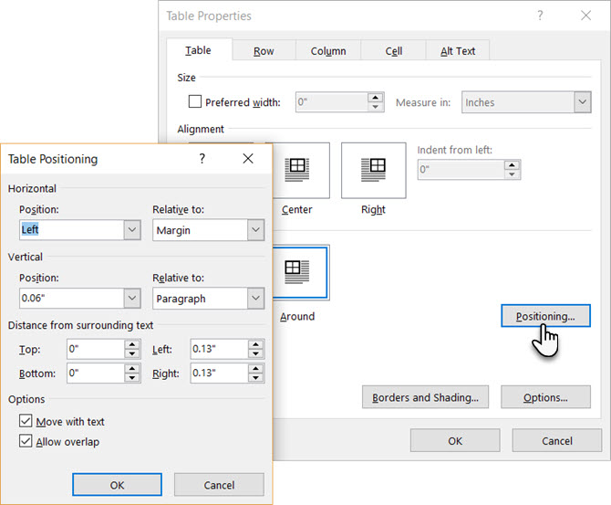
Text editors – tables - position
*https://www.makeuseof.com/tag/8-formatting-tips-perfect-tables-microsoft-word/

Slide 17
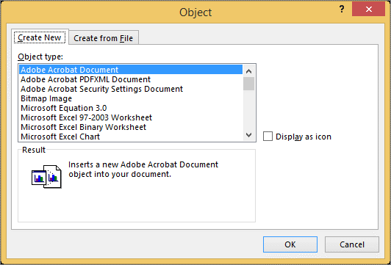
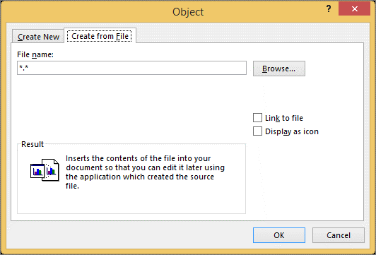
Text editors – graphic objects
To create a new file that is inserted into your Word document or email message, in the Object dialog box, click the Create New tab, and then select an option from the Object type list.*
*https://support.office.com/en-us/article/insert-an-object-in-word-or-outlook-8fc1ea53-0e01-4603-a4cf-98c49b6ea3f5

Slide 18
Text editors – graphic objects
Place the insertion point where you want the image to appear.*
Select the Insert tab on the Ribbon, then click the Pictures command.*
The Insert Picture dialog box will appear.*
Navigate to the folder where your image is located, then select the image and click Insert.*
The image will appear in the document.*
*https://edu.gcfglobal.org/en/word2016/pictures-and-text-wrapping/1/

Slide 19
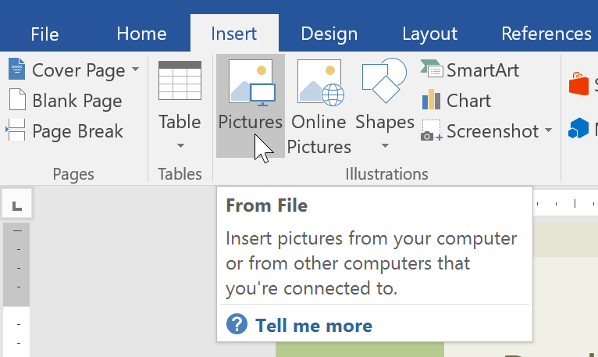
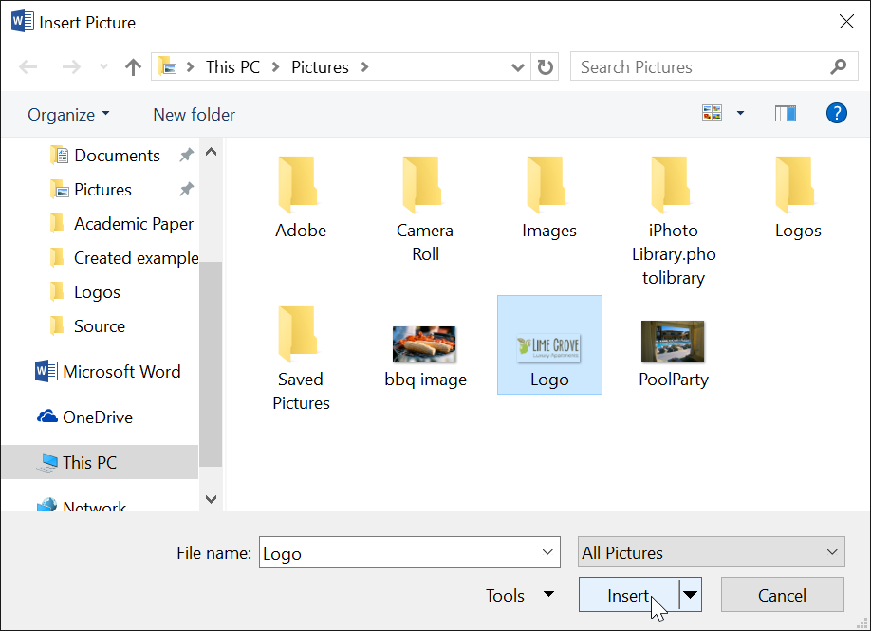
Text editors – graphic objects
*https://edu.gcfglobal.org/en/word2016/pictures-and-text-wrapping/1/

Slide 20
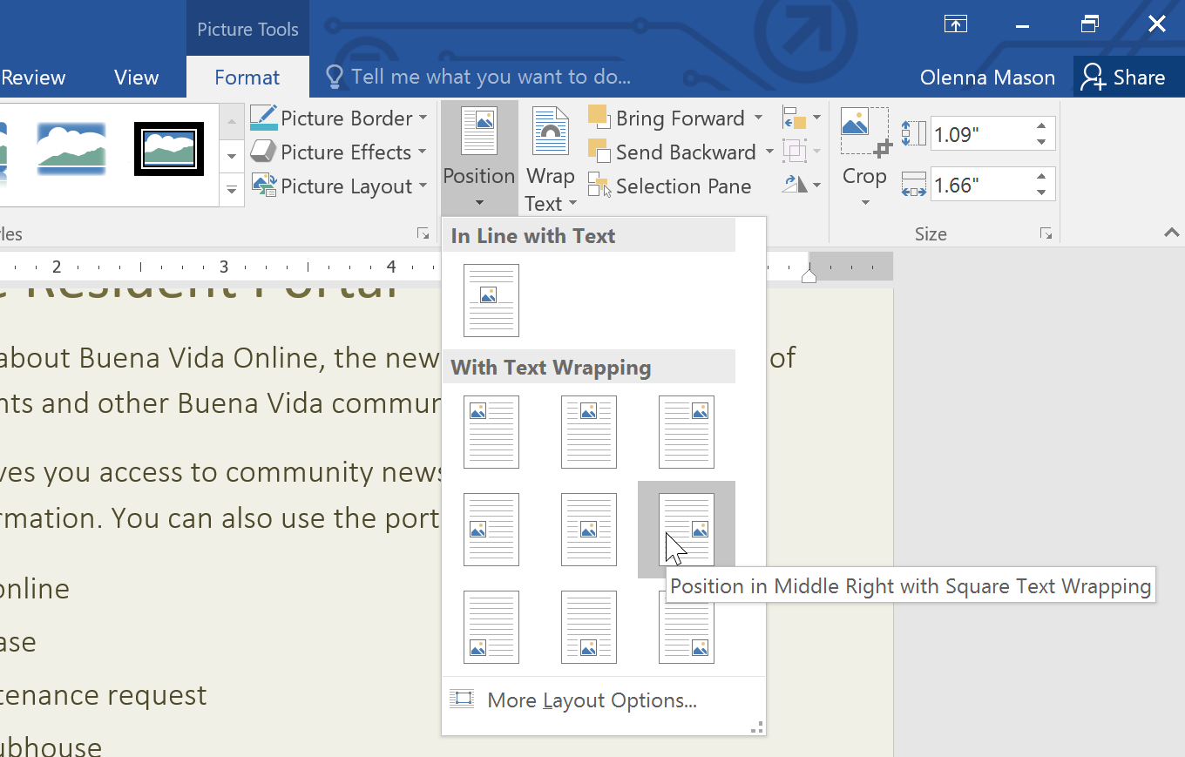
Text editors – graphic objects
Predefined text wrapping allows you to quickly move the image to a specific location on the page.*
The text will automatically wrap around the object so it's still easy to read.*
*https://edu.gcfglobal.org/en/word2016/pictures-and-text-wrapping/1/

Slide 21
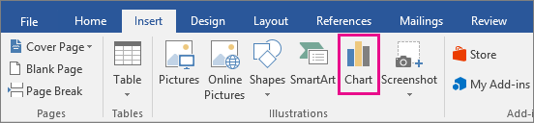
Text editors – graphic objects
To create a simple chart from scratch in Word, click Insert / Chart, and pick the chart you want.*
Click Insert / Chart.*
Click the chart type and then double-click the chart you want.*
In the spreadsheet that appears, replace the default data with your own information.*
*https://support.office.com/en-us/article/add-a-chart-to-your-document-in-word-ff48e3eb-5e04-4368-a39e-20df7c798932

Slide 22
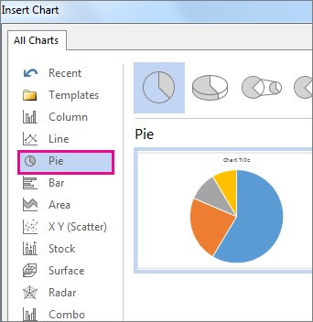
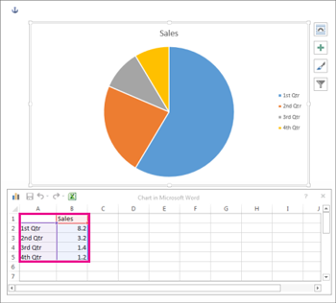
Text editors – graphic objects
*https://support.office.com/en-us/article/add-a-chart-to-your-document-in-word-ff48e3eb-5e04-4368-a39e-20df7c798932

Slide 23
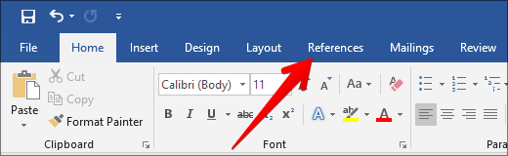
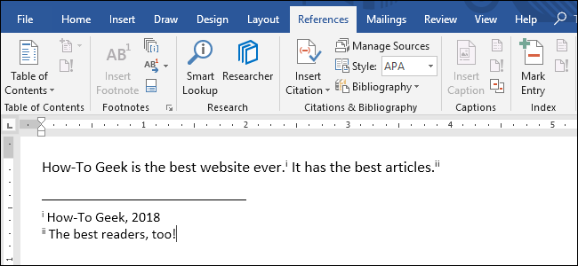
Text editors – references
Table of Contents.
Footnotes.
Citations & Bibliography.
Captions.
Index.
*https://www.howtogeek.com/359187/how-to-use-footnotes-and-endnotes-in-microsoft-word/

Slide 24
Text editors – mailings
Mail Merge is a useful tool that allows you to produce:*
  multiple letters;
  labels;
  envelopes;
  name tags;
  more using information stored in a list;
  database;
  spreadsheet.
When performing a Mail Merge, you will need a Word document (you can start with an existing one or create a new one) and a recipient list, which is typically an Excel workbook.*
*https://edu.gcfglobal.org/en/word2016/mail-merge/1/

Slide 25
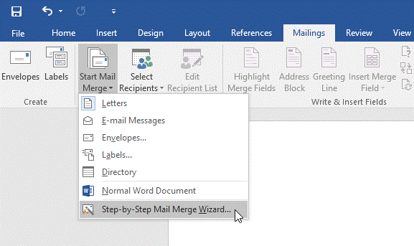
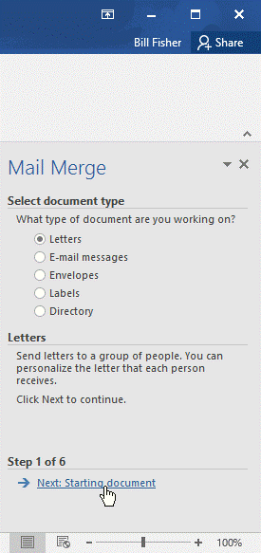
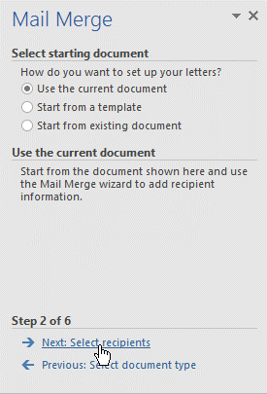
Text editors – mailings
*https://edu.gcfglobal.org/en/word2016/mail-merge/1/

Slide 26
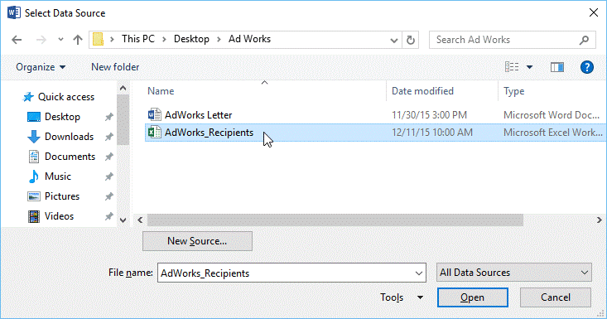
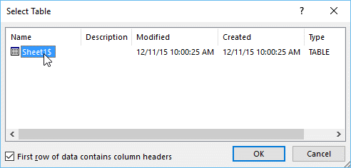
Text editors – mailings
*https://edu.gcfglobal.org/en/word2016/mail-merge/1/

Slide 27
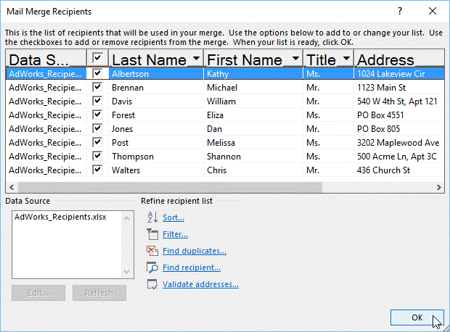
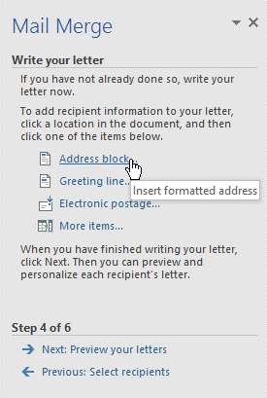
Text editors – mailings
*https://edu.gcfglobal.org/en/word2016/mail-merge/1/

Slide 28
The end
Thank you for your attention!
Any questions?

