Slide 1

Informatics
Creation of presentation
Petr Suchánek
Informatics

Slide 2

Outline of the lecture
Business presentation
Main principles of presentation
Slides
Objects
Animations
Timing
Effects

Slide 3
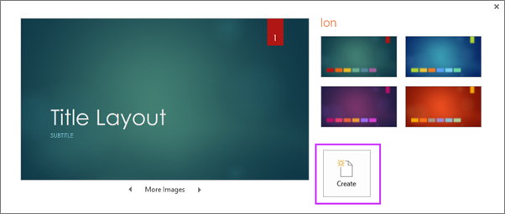
Basic tasks
When you open PowerPoint, you’ll see some built-in themes and templates. A theme is a slide design that contains matching colors, fonts, and special effects like shadows, reflections, and more.*
On the File tab of the Ribbon, select New, and then choose a theme.*
PowerPoint shows you a preview of the theme, with four color variations to choose from on the right side.*
Click Create, or pick a color variation and then click Create.*
*https://support.office.com/en-us/article/basic-tasks-for-creating-a-powerpoint-presentation-efbbc1cd-c5f1-4264-b48e-c8a7b0334e36

Slide 4
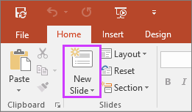
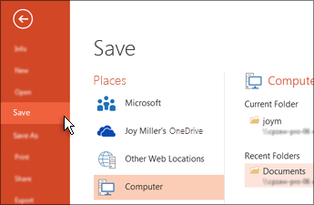
Basic tasks
On the Home tab, click the bottom half of New Slide, and pick a slide layout.*
On the File tab, choose Save.*
Pick or browse to a folder.*
In the File name box, type a name for your presentation, and then choose Save.*
*https://support.office.com/en-us/article/basic-tasks-for-creating-a-powerpoint-presentation-efbbc1cd-c5f1-4264-b48e-c8a7b0334e36

Slide 5
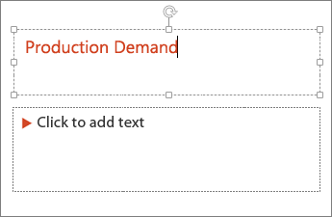
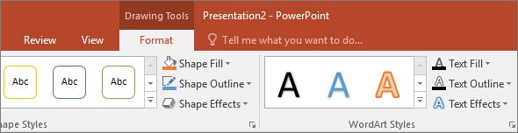
Add and format text
Select a text placeholder, and begin typing.*
Select the text.*
Under Drawing Tools, choose Format.*
*https://support.office.com/en-us/article/basic-tasks-for-creating-a-powerpoint-presentation-efbbc1cd-c5f1-4264-b48e-c8a7b0334e36

Slide 6
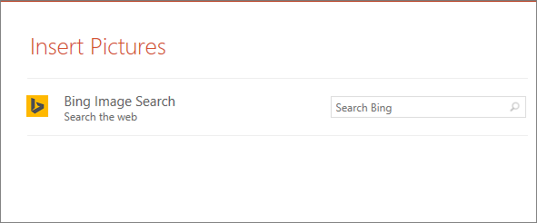
Add picture
To insert a picture that is saved on your local drive or an internal server, choose Pictures, browse for the picture, and then choose Insert.*
To insert a picture from the web, choose Online Pictures, and use the search box to find a picture.*
Choose a picture, and then click Insert.*
*https://support.office.com/en-us/article/basic-tasks-for-creating-a-powerpoint-presentation-efbbc1cd-c5f1-4264-b48e-c8a7b0334e36

Slide 7
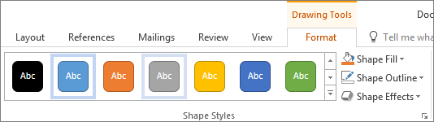
Add shapes
On the Insert tab, select Shapes, and then select a shape from the menu that appears.*
In the slide area, click and drag to draw the shape.*
Select the Format or Shape Format tab on the ribbon.*
Open the Shape Styles gallery to quickly add a color and style (including shading) to the selected shape.*
*https://support.office.com/en-us/article/basic-tasks-for-creating-a-powerpoint-presentation-efbbc1cd-c5f1-4264-b48e-c8a7b0334e36

Slide 8
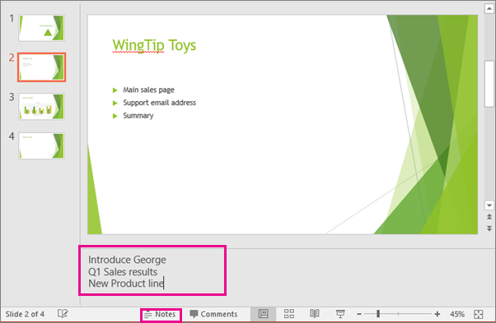
Add speaker notes
To open the notes pane, at the bottom of the window, click Notes notes button in PowerPoint.*
Click inside the Notes pane below the slide, and begin typing your notes.*
*https://support.office.com/en-us/article/basic-tasks-for-creating-a-powerpoint-presentation-efbbc1cd-c5f1-4264-b48e-c8a7b0334e36

Slide 9
Animating Text and Objects
In PowerPoint, you can animate text and objects such as clip art, shapes, and pictures.
Animation - or movement - on the slide can be used to draw the audience's attention to specific content or to make the slide easier to read.*
There are several animation effects you can choose from, and they are organized into four types.*
*https://edu.gcfglobal.org/en/powerpoint2016/animating-text-and-objects/1/

Slide 10
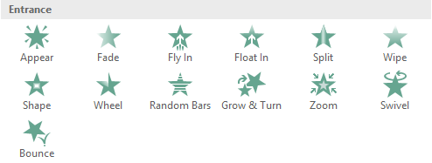
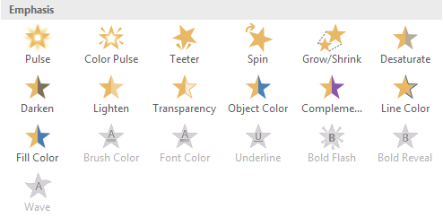
Animating Text and Objects
Entrance: These control how the object enters the slide. For example, with the Bounce animation the object will "fall" onto the slide and then bounce several times.*
Emphasis: These animations occur while the object is on the slide, often triggered by a mouse click. For example, you can set an object to spin when you click the mouse.*
*https://edu.gcfglobal.org/en/powerpoint2016/animating-text-and-objects/1/

Slide 11
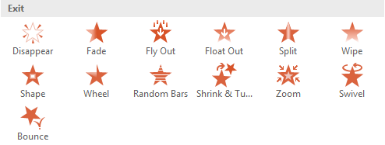

Animating Text and Objects
Exit: These control how the object exits the slide. For example, with the Fade animation the object will simply fade away.*
Motion Paths: These are similar to Emphasis effects, except the object moves within the slide along a predetermined path, like a circle.*
*https://edu.gcfglobal.org/en/powerpoint2016/animating-text-and-objects/1/

Slide 12
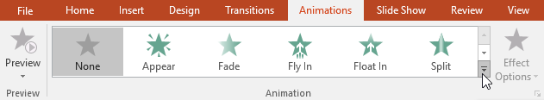
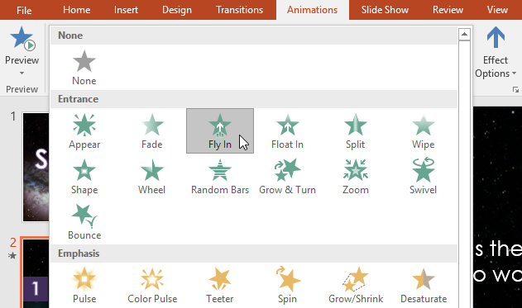
Animating Text and Objects
Select the object you want to animate.*
On the Animations tab, click the More drop-down arrow in the Animation group.*
A drop-down menu of animation effects will appear. Select the desired effect.*
*https://edu.gcfglobal.org/en/powerpoint2016/animating-text-and-objects/1/

Slide 13
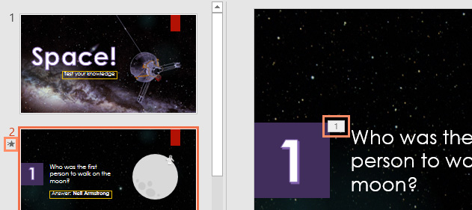
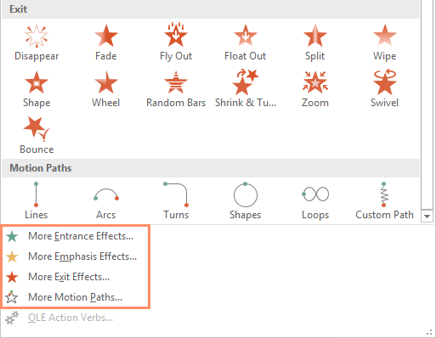
Animating Text and Objects
The effect will apply to the object.*
The object will have a small number next to it to show that it has an animation.*
In the Slide pane, a star symbol also will appear next to the slide.*
At the bottom of the menu, you can access even more effects.*
*https://edu.gcfglobal.org/en/powerpoint2016/animating-text-and-objects/1/

Slide 14
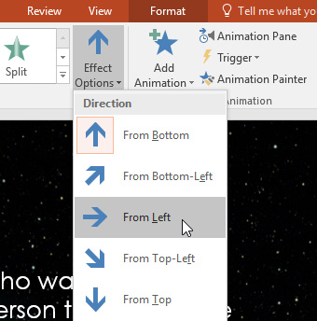
Animating Text and Objects
Some effects will have options you can change.*
For example, with the Fly In effect you can control which direction the object comes from.*
These options can be accessed from the Effect Options command in the Animation group.*
*https://edu.gcfglobal.org/en/powerpoint2016/animating-text-and-objects/1/

Slide 15
Animating Text and Objects
If you select a new animation from the menu in the Animation group, it will replace the object's current animation.
However, you'll sometimes want to place more than one animation on an object, like an Entrance and an Exit effect.
To do this, you'll need to use the Add Animation command, which will allow you to keep your current animations while adding new ones.*
*https://edu.gcfglobal.org/en/powerpoint2016/animating-text-and-objects/1/

Slide 16
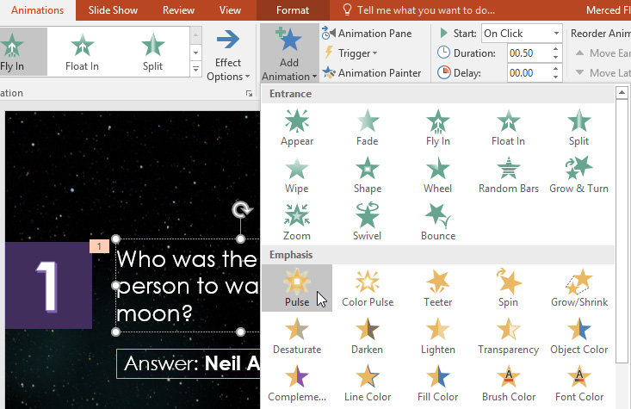
Animating Text and Objects
Select an object.*
Click the Animations tab.*
In the Advanced Animation group, click the Add Animation command to view the available animations.*
Select the desired animation effect.*
*https://edu.gcfglobal.org/en/powerpoint2016/animating-text-and-objects/1/

Slide 17
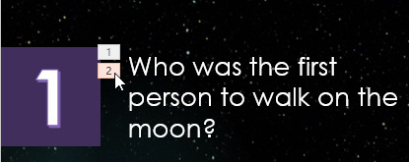

Animating Text and Objects
To reorder the animations Select the number of the effect you want to change.*
From the Animations tab, click the Move Earlier or Move Later commands to change the ordering.*
*https://edu.gcfglobal.org/en/powerpoint2016/animating-text-and-objects/1/

Slide 18
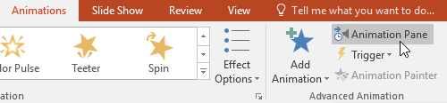
Animating Text and Objects
The Animation Pane allows you to view and manage all of the effects that are on the current slide.*
You can modify and reorder effects directly from the Animation Pane, which is especially useful when you have several effects.*
From the Animations tab, click the Animation Pane command.*
*https://edu.gcfglobal.org/en/powerpoint2016/animating-text-and-objects/1/

Slide 19
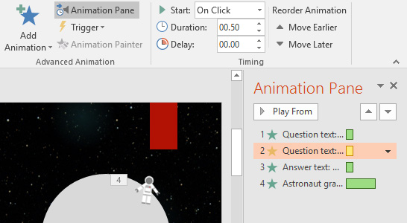
Animating Text and Objects
The Animation Pane will open on the right side of the window.
It will show all of the effects for the current slide in the order in which they will appear.*
*https://edu.gcfglobal.org/en/powerpoint2016/animating-text-and-objects/1/

Slide 20
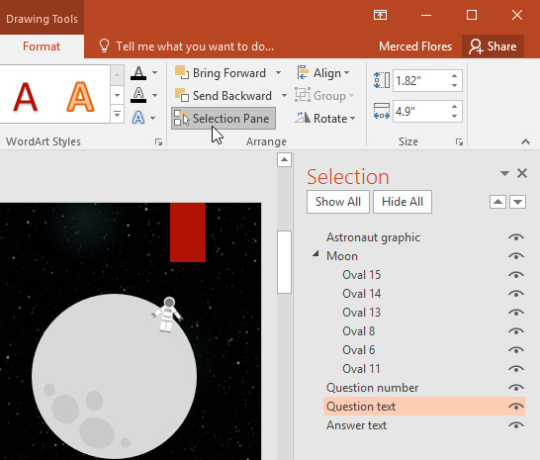
Animating Text and Objects
If you have several animated objects, it may help to rename the objects before reordering them in the Animation Pane.*
You can rename them in the Selection Pane.*
To open the Selection Pane, click an object, then from the Format tab click Selection Pane.*
Double-click the name of an object to rename it.*
*https://edu.gcfglobal.org/en/powerpoint2016/animating-text-and-objects/1/

Slide 21
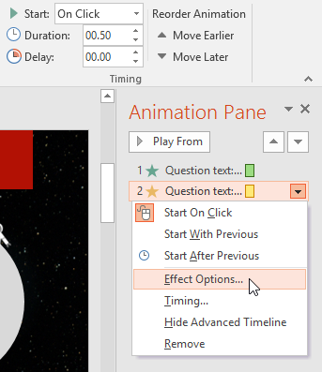
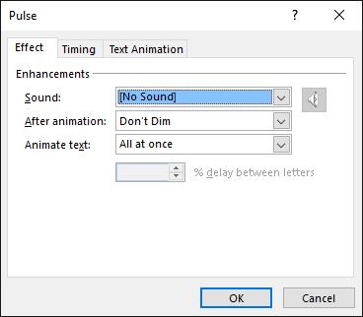
Animating Text and Objects
From the Animation Pane, select an effect. A drop-down arrow will appear next to the effect.*
Click the drop-down arrow, then select Effect Options.*
The Effect Options dialog box will appear. Click the drop-down menus and select the desired enhancement. You can add a sound to the animation, add an effect after the animation is over, or animate text in a different sequence.*
*https://edu.gcfglobal.org/en/powerpoint2016/animating-text-and-objects/1/

Slide 22
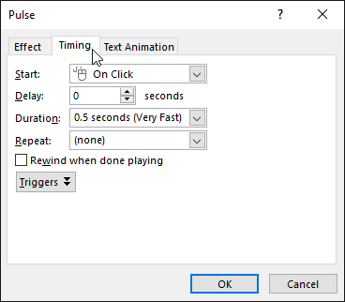
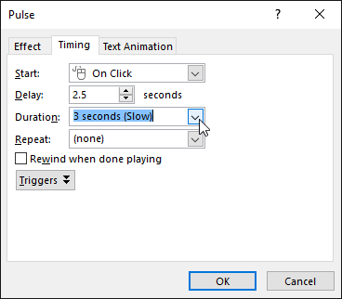
Animating Text and Objects
From the Effect Options dialog box, select the Timing tab.*
From here, you can add a delay before the effect starts, change the duration of the effect, and control whether the effect repeats.*
*https://edu.gcfglobal.org/en/powerpoint2016/animating-text-and-objects/1/

Slide 23
Simple rules for better presentation*
Don't read your presentation straight from the slides*
If your audience can both read and hear, it’s a waste of time for you to simply read your slides aloud.
Your audience will zone out and stop listening to what you’re saying, which means they won’t hear any extra information you include.
Instead of typing out your entire presentation, include only main ideas, keywords, and talking points in your slide show text. Engage your audience by sharing the details out loud.
*https://edu.gcfglobal.org/en/powerpoint-tips/simple-rules-for-better-powerpoint-presentations/1/

Slide 24
Simple rules for better presentation*
Follow the 5/5/5 rule
To keep your audience from feeling overwhelmed, you should keep the text on each slide short and to the point.
Some experts suggest using the 5/5/5 rule:
  no more than five words per line of text;
  five lines of text per slide;
  five text-heavy slides in a row.
*https://edu.gcfglobal.org/en/powerpoint-tips/simple-rules-for-better-powerpoint-presentations/1/

Slide 25
Simple rules for better presentation*
Don't forget your audience
Who will be watching your presentation?
The same goofy effects and funny clip art that would entertain a classroom full of middle-school students might make you look unprofessional in front of business colleagues and clients.
Humor can lighten up a presentation, but if you use it inappropriately your audience might think you don’t know what you’re doing.
Know your audience, and tailor your presentation to their tastes and expectations.
*https://edu.gcfglobal.org/en/powerpoint-tips/simple-rules-for-better-powerpoint-presentations/1/

Slide 26
Simple rules for better presentation*
Choose readable colors and fonts
Your text should be easy to read and pleasant to look at.
Large, simple fonts and theme colors are always your best bet.
The best fonts and colors can vary depending on your presentation setting.
Presenting in a large room?
Make your text larger than usual so people in the back can read it. Presenting with the lights on?
Dark text on a light background is your best bet for visibility.
*https://edu.gcfglobal.org/en/powerpoint-tips/simple-rules-for-better-powerpoint-presentations/1/

Slide 27
Simple rules for better presentation*
Don't overload your presentation with animations
As anyone who’s sat through a presentation while every letter of every paragraph zoomed across the screen can tell you, being inundated with complicated animations and exciting slide transitions can become irritating.
Before including effects like this in your presentation, ask yourself: Would this moment in the presentation be equally strong without an added effect?
Does it unnecessarily delay information? If the answer to either question is yes - or even maybe - leave out the effect.
*https://edu.gcfglobal.org/en/powerpoint-tips/simple-rules-for-better-powerpoint-presentations/1/

Slide 28
Simple rules for better presentation*
Use animations sparingly to enhance your presentation
Don’t take the last tip to mean you should avoid animations and other effects entirely.
When used sparingly, subtle effects and animations can add to your presentation.
For example, having bullet points appear as you address them rather than before can help keep your audience’s attention.
*https://edu.gcfglobal.org/en/powerpoint-tips/simple-rules-for-better-powerpoint-presentations/1/

Slide 29
Simple rules for better presentation*
https://edu.gcfglobal.org/en/powerpoint-tips/simple-rules-for-better-powerpoint-presentations/1/
https://learn.filtered.com/blog/the-principles-of-slide-design
https://www.windowscentral.com/how-create-animations-powerpoint-2016
https://support.office.com/en-us/article/animation-basics-for-your-presentation-4fbc7d35-3548-431a-a871-709945f9352c
https://www.teachucomp.com/slide-transition-animation-in-powerpoint-tutorial/

Slide 30
The end
Thank you for your attention!
Any questions?

