Slide 1

Informatics
Database management system - II
Petr Suchánek
Informatics

Slide 2

Outline of the lecture
Relationship
Database types

Slide 3
Relationship
In relational database terms, a relationship is a situation where multiple tables can contain related data that is linked by a common field.*
A relationship consists of a parent table and a child table.*
The child table references the parent table by having a field that matches a field in the parent table.*
The child's field is referred to as a foreign key.*
The parent's field is the primary key.*
In a relationship, any data entered into the child's foreign key field must match a value from the parent's primary key field.*
*https://www.quackit.com/microsoft_access/microsoft_access_2016/tutorial/create_a_relationship_in_microsoft_access.cfm

Slide 4
Relationship
By ensuring that the foreign key's data matches data in the primary key, we know that all records in the child table will have an associated record in the parent table.*
So we can create a one-to-many relationship between the Albums and Artists table.*
Our relationship will determine that an artist can have many albums, but an album can only belong to one artist.*
*https://www.quackit.com/microsoft_access/microsoft_access_2016/tutorial/create_a_relationship_in_microsoft_access.cfm

Slide 5
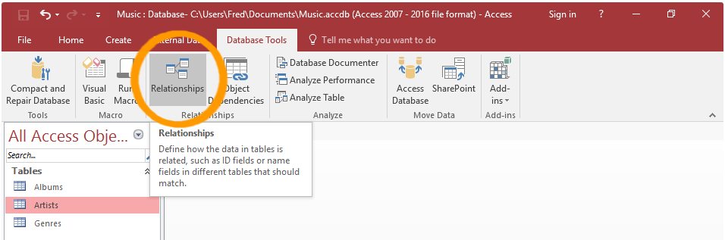
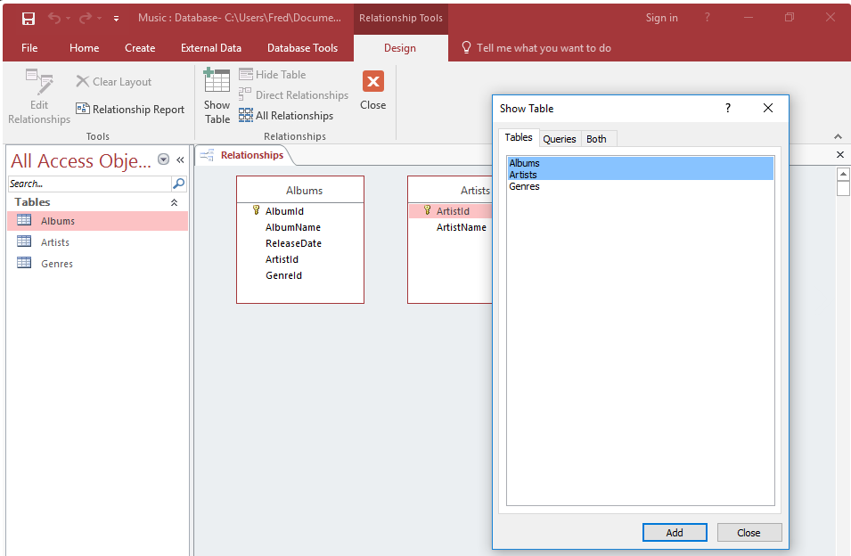
Relationship
Click Relationships from the Database Tools tab on the Ribbon.*
The Show Tables dialog box should appear.*
Select both the Artists and Albums tables from the list and click Add.*
Click Close to close the dialog box.*
*https://www.quackit.com/microsoft_access/microsoft_access_2016/tutorial/create_a_relationship_in_microsoft_access.cfm

Slide 6
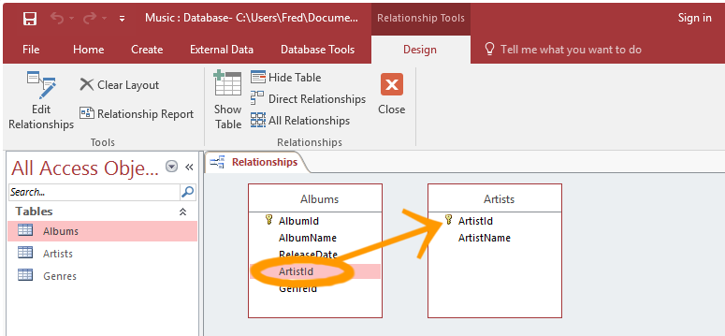
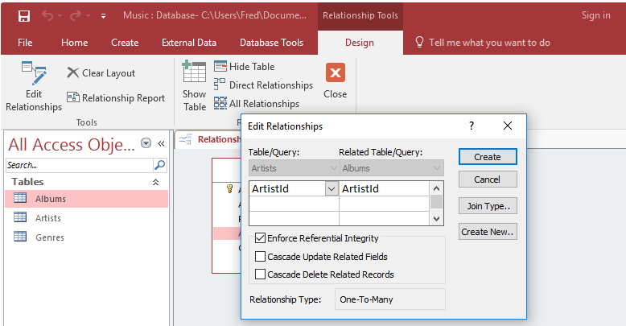
Relationship
Click and drag the Albums.ArtistId field over the Artists.ArtistId field and release.*
The Edit Relationships dialog box appears.*
Check Enforce Referential Integrity and click Create.*
*https://www.quackit.com/microsoft_access/microsoft_access_2016/tutorial/create_a_relationship_in_microsoft_access.cfm

Slide 7
Relationship
https://www.dummies.com/software/microsoft-office/access/how-to-set-table-relationships-in-access-2016/
https://database.guide/how-to-create-a-relationship-in-access/
http://en.tekstenuitleg.net/articles/software/create-a-one-to-many-relationship-in-access
https://support.microsoft.com/en-us/help/304466/how-to-define-relationships-between-tables-in-an-access-database

Slide 8
Query
Queries are very useful tools when it comes to databases and they are often called by the user through a form.*
They can be used to search for and grab data from one or more of your tables, perform certain actions on the database and even carryout a variety of calculations depending on your needs.*
Luckily for us, Microsoft Access allows for many types of queries, some of the main ones being select, action, parameter and aggregate queries.*
They can be thought of as just another part of your database – essentially an object like a table or a macro.*
Either use the Query Wizard that Microsoft Access provides for you, or Create your own queries from scratch.*
*http://www.databasedev.co.uk/microsoft-access-query-types.html

Slide 9
Select query
The select query is the simplest type of query and because of that, it is also the most commonly used one in Microsoft Access databases.*
It can be used to select and display data from either one table or a series of them depending on what is needed.*
In the end, it is the user-determined criteria that tells the database what the selection is to be based on.*
After the select query is called, it creates a "virtual" table where the data can be changed, but at no more than one record at a time.*
*http://www.databasedev.co.uk/microsoft-access-query-types.html

Slide 10
Action query
When the action query is called, the database undergoes a specific action depending on what was specified in the query itself.*
This can include such things as creating new tables, deleting rows from existing ones and updating records or creating entirely new ones.*
Action queries are very popular in data management because they allow for many records to be changed at one time instead of only single records like in a select query.*
*http://www.databasedev.co.uk/microsoft-access-query-types.html

Slide 11
Action query
Append Query
  takes the set results of a query and "appends" (or adds) them to an existing table.
Delete Query
  deletes all records in an underlying table from the set results of a query.
Make Table Query
  as the name suggests, it creates a table based on the set results of a query.
Update Query
  allows for one or more field in your table to be updated.
*http://www.databasedev.co.uk/microsoft-access-query-types.html

Slide 12
Action – delete query*
Create a SELECT query to determine the records that will be deleted. Apply any required query criteria;
In the query design view, click on the drop-down arrow to the right of the Query Type button and choose Delete Query;
If needed, modify the query further so that the correct fields will be deleted with the desired new data;
Click on the Run (!) button to run the action query;
When informed of the number of records to be deleted in the Microsoft Access dialog box, click Yes;
Close the query, saving if required.
*http://www.databasedev.co.uk/delete_query.html

Slide 13
Action – make table query*
Using our scenario, we will create a make-table query for all customers from the specified area that have ordered products in the past 12 months.*
We will need to perform the following steps to create the query:
  Create a new query, use the Customers and Orders tables;
  From the Query Type button on the toolbar, select Make Table;
  Select the mailing information fields, in our case CustomerTitle, CustomerName, Address, City, Postcode from the Customers table, and OrderDate from the Orders table;
  Specify the chosen City criteria in the City field and add the criteria required in the OrderDate field to only show records from the last 12 months - using the DateAdd function: >=DateAdd("yyyy",-1,Now());
*http://www.databasedev.co.uk/make-table-query.html

Slide 14
Action – make table query*
  To check that the results are returned that we expect, click on the datasheet button Datasheet view button on the toolbar. Once you have verified this, switch back to query design view;
  In query design, deselect the Show: property for the OrderDate field, as we do not need this to be visible in our new table;
  Click on the Run button on the toolbar. Microsoft Access now displays a message to indicate how many records will be copied to the new table;
  Click Yes to complete the query, and create the new table.
*http://www.databasedev.co.uk/make-table-query.html

Slide 15
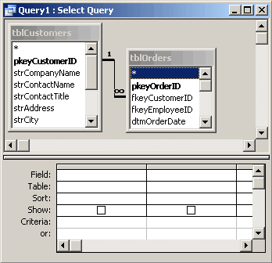
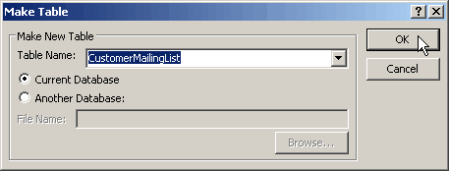
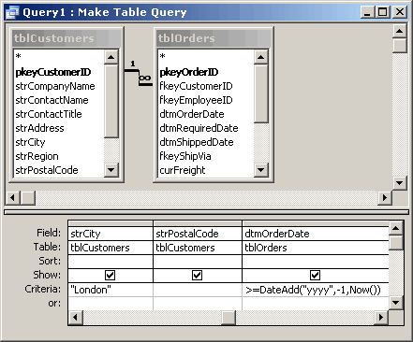
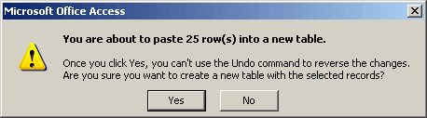
Action – make table query*
*http://www.databasedev.co.uk/make-table-query.html

Slide 16
Action – update query*
Create a SELECT query to determine the records that will be updated. Apply any required query criteria, and view the data that will be updated by pressing the Datasheet button;
In the query design view, click on the drop-down arrow to the right of the Query Type button and choose Update Query;
After you are satisfied that the information to be updated is correct Run the query using the Run Icon.
*http://www.databasedev.co.uk/update_query.html

Slide 17
Parameter query
In Microsoft Access, a parameter query works with other types of queries to get whatever results you are after.*
This is because, when using this type of query, you are able to pass a parameter to a different query, such as an action or a select query.*
It can either be a value or a condition and will essentially tell the other query specifically what you want it to do.*
It is often chosen because it allows for a dialog box where the end user can enter whatever parameter value they wish each time the query is run.*
The parameter query is just a modified select query.*
*http://www.databasedev.co.uk/microsoft-access-query-types.html

Slide 18
Aggregate query
A special type of query is known as an aggregate query.*
It can work on other queries (such as selection, action or parameter) just like the parameter query does, but instead of passing a parameter to another query it totals up the items by selected groups.*
It essentially creates a summation of any selected attribute in your table.*
This can be further generated into statistical amounts such as averages and standard deviation, just to name a couple.*
*http://www.databasedev.co.uk/microsoft-access-query-types.html

Slide 19
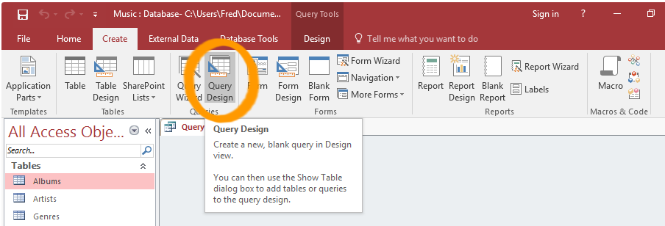
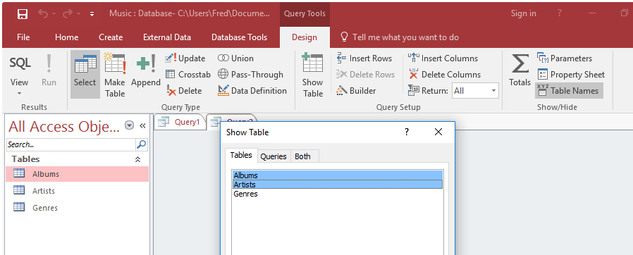
Query
Click Query Design from the Create tab on the Ribbon.*
The Show Table dialog box will appear.*
Select both the Artists and Albums tables and click Add.*
Click Close to close the dialog box.*
*https://www.quackit.com/microsoft_access/microsoft_access_2016/tutorial/create_a_query_in_microsoft_access.cfm

Slide 20
Query
Now we get to design our query. We'll keep it simple, and create a query that returns all albums from Iron Maiden.*
Select the options as per the screenshot.*
Run the query by clicking the ! Run button on the Ribbon.*
If you can't read the screenshot, the query options are:
Fields:
  Albums.AlbumName
  Albums.Genre
  Albums.ReleaseDate
  Artists.ArtistName
*https://www.quackit.com/microsoft_access/microsoft_access_2016/tutorial/create_a_query_in_microsoft_access.cfm

Slide 21
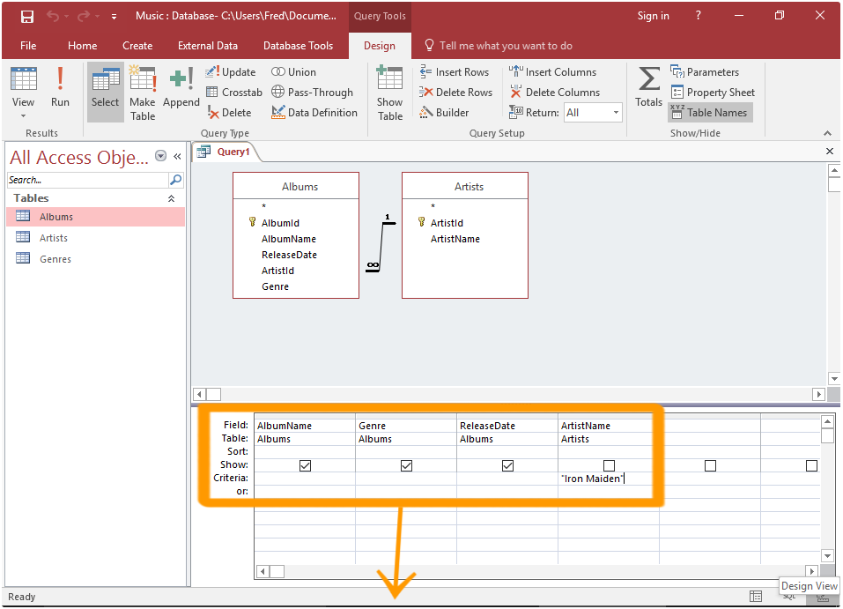
Query
*https://www.quackit.com/microsoft_access/microsoft_access_2016/tutorial/create_a_query_in_microsoft_access.cfm

Slide 22
Query wizard
On the Create tab, in the Queries group, click Query Wizard.*
In the New Query dialog box, click Simple Query Wizard, and then click OK.*
Next, you add fields. You can add up to 255 fields from as many as 32 tables or queries.*
For each field, perform these two steps:*
  Under Tables/Queries, click the table or query that contains the field.
  Under Available Fields, double-click the field to add it to the Selected Fields list. If you want to add all fields to your query, click the button with the double right arrows (>>).
  When you have added all the fields that you want, click Next.
*https://support.office.com/en-us/article/create-a-simple-select-query-de8b1c8d-14e9-4b25-8e22-70888d54de59

Slide 23
Query wizard
If you did not add any number fields (fields that contain numeric data), skip ahead to step 9. If you added any number fields, the wizard asks whether you want the query to return details or summary data.*
Do one of the following:
  If you want to see individual records, click Detail, and then click Next. Skip ahead to step 9.
  If you want to see summarized numeric data, such as averages, click Summary, and then click Summary Options.
*https://www.quackit.com/microsoft_access/microsoft_access_2016/tutorial/create_a_query_in_microsoft_access.cfm

Slide 24
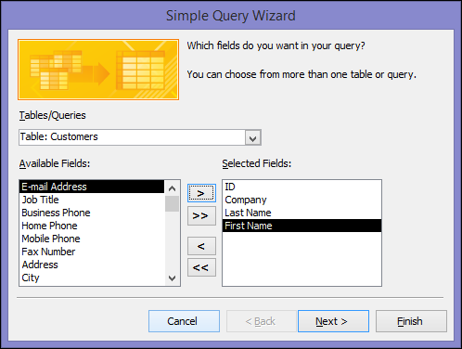
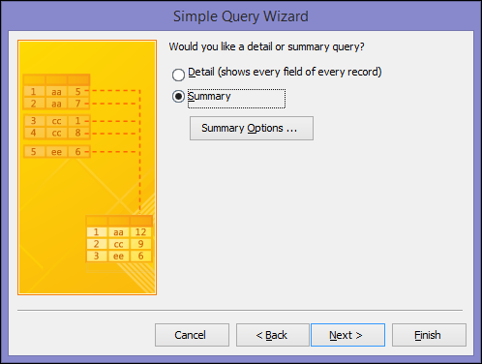
Query wizard
*https://support.office.com/en-us/article/create-a-simple-select-query-de8b1c8d-14e9-4b25-8e22-70888d54de59

Slide 25
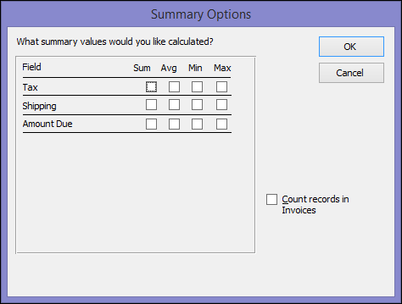
Query wizard
In the Summary Options dialog box, specify which fields you want to summarize, and how you want to summarize the data. Only number fields are listed.*
For each number field, choose one of the following functions:*
  Sum The query returns the sum of all the values of the field.
  Avg The query returns the average of the values of the field.
  Min The query returns the smallest value of the field.
  Max The query returns the largest value of the field.
*https://www.quackit.com/microsoft_access/microsoft_access_2016/tutorial/create_a_query_in_microsoft_access.cfm

Slide 26
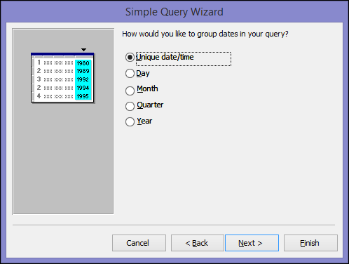
Query wizard
If you want the query results to include a count of the records in a data source, select the appropriate Count records in data source name check box.*
Click OK to close the Summary Options dialog box.*
If you did not add a date/time field to the query, skip ahead to step 9. If you added a date-time field to the query, the Query Wizard asks you how you would like to group the date values.*
*https://www.quackit.com/microsoft_access/microsoft_access_2016/tutorial/create_a_query_in_microsoft_access.cfm

Slide 27
Query wizard
*https://www.quackit.com/microsoft_access/microsoft_access_2016/tutorial/create_a_query_in_microsoft_access.cfm

Slide 28
The end
Thank you for your attention!
Any questions?

