Slide 1
Quantitative Methods
Lecture 4
Determinants and
Systems of linear equations
BAKVM

Slide 2
Determinants
Systems of linear equations
Linear mappings

Slide 3

The determinant of a square matrix
Let $n∈ℕ$ be a natural number and let $A∈ℝ^{n×n}$ be a square matrix.
The determinant of the matrix $A$ is denoted by
$$\det{A} \text{or} \left|\begin{matrix}A\end{matrix}\right|$$
We define the determinant inductively for $n=1, 2, 3, 4, 5,…$

Slide 4

The determinant of a square matrix
The determinant of a $1×1$ matrix is
$$\det\left(\begin{matrix}a_{11}\end{matrix}\right)=\left|\begin{matrix}a_{11}\end{matrix}\right|=a_{11}$$
i.e. the determinant is equal to the single entry $a_{11}$ of the matrix.

Slide 5




The determinant of a square matrix
The determinant of a $2×2$ matrix is calculated by the formula
$$\det\left(\begin{matrix}a_{11} & a_{12} \\ a_{21} & a_{22}\end{matrix}\right)=\left|\begin{matrix}a_{11} & a_{12} \\ a_{21} & a_{22}\end{matrix}\right|=a_{11}a_{22}−a_{21}a_{12}$$
Notice the scheme of the formula:
$$\left|\begin{matrix}a_{11} & a_{12} \\ a_{21} & a_{22}\end{matrix}\right|$$
$$+$$
$$−$$

Slide 6
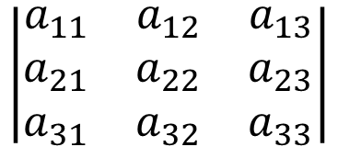
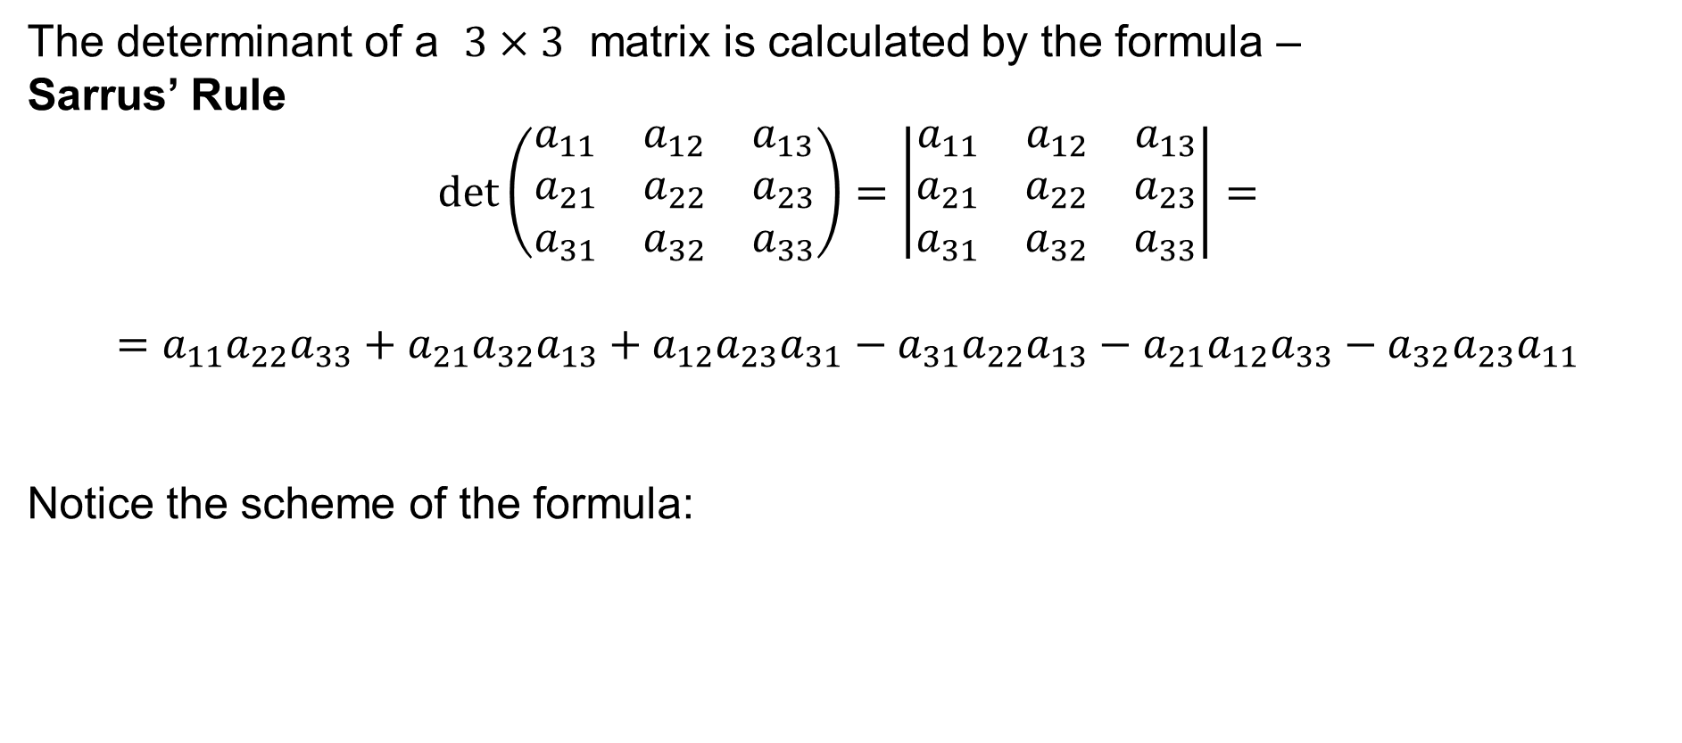
The determinant of a square matrix
The determinant of a $3×3$ matrix is calculated by the formula –
Sarrus’ Rule
$$\det\left(\begin{matrix}a_{11} & a_{12} & a_{13} \\ a_{21} & a_{22} & a_{23} \\ a_{31} & a_{32} & a_{33}\end{matrix}\right)=\left|\begin{matrix}a_{11} & a_{12} & a_{13} \\ a_{21} & a_{22} & a_{23} \\ a_{31} & a_{32} & a_{33}\end{matrix}\right|=$$
$$=a_{11}a_{22}a_{33}+a_{21}a_{32}a_{13}+a_{12}a_{23}a_{31}−a_{31}a_{22}a_{13}−a_{21}a_{12}a_{33}−a_{32}a_{23}a_{11}$$
Notice the scheme of the formula:
$$\left|\begin{matrix}a_{11} & a_{12} & a_{13} \\ a_{21} & a_{22} & a_{23} \\ a_{31} & a_{32} & a_{33}\end{matrix}\right|$$
$$+$$
$$−$$

Slide 7
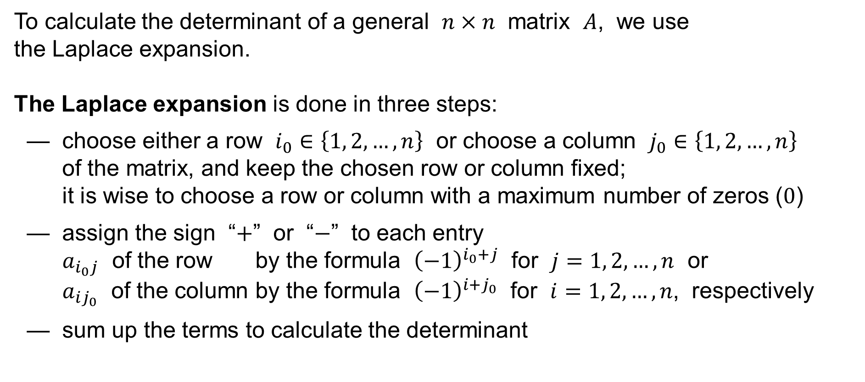
Laplace expansion of the determinant
To calculate the determinant of a general $n×n$ matrix $A$, we use
the Laplace expansion.
The Laplace expansion is done in three steps:
— choose either a row $i_{0}∈\left\{1, 2,…,n\right\}$ or choose a column $j_{0}∈\left\{1, 2,…,n\right\}$
of the matrix, and keep the chosen row or column fixed;
it is wise to choose a row or column with a maximum number of zeros ($0$)
— assign the sign “$+$” or “$−$” to each entry
$a_{i_{0}j}$ of the row by the formula ${\left(−1\right)}^{i_{0}+j}$ for $j=1, 2,…,n$ or
$a_{ij_{0}}$ of the column by the formula ${\left(−1\right)}^{i+j_{0}}$ for $i=1, 2,…,n$, respectively
— sum up the terms to calculate the determinant

Slide 8
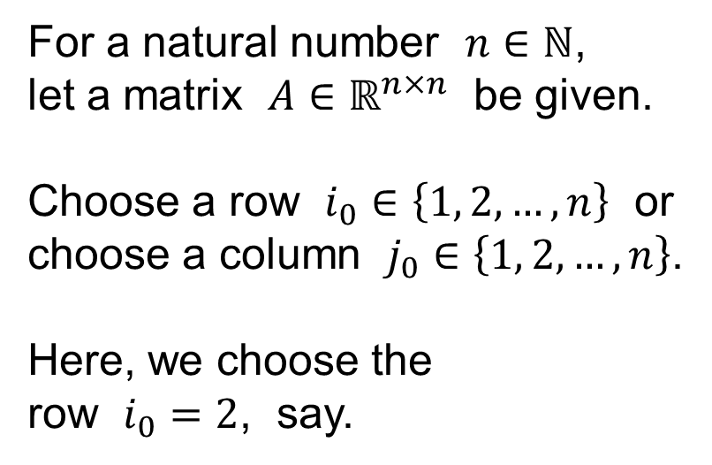
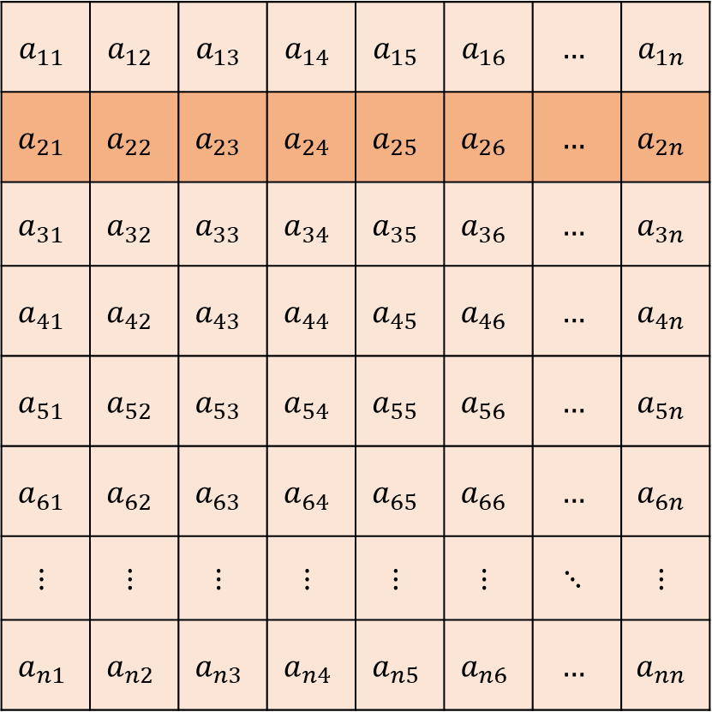
Laplace expansion of the determinant
For a natural number $n∈ℕ$,
let a matrix $A∈ℝ^{n×n}$ be given.
Choose a row $i_{0}∈\left\{1, 2,…,n\right\}$ or
choose a column $j_{0}∈\left\{1, 2,…,n\right\}$.
Here, we choose the
row $i_{0}=2$, say.
$$a_{11}$$ | $$a_{12}$$ | $$a_{13}$$ | $$a_{14}$$ | $$a_{15}$$ | $$a_{16}$$ | $$…$$ | $$a_{1n}$$
$$a_{21}$$ | $$a_{22}$$ | $$a_{23}$$ | $$a_{24}$$ | $$a_{25}$$ | $$a_{26}$$ | $$…$$ | $$a_{2n}$$
$$a_{31}$$ | $$a_{32}$$ | $$a_{33}$$ | $$a_{34}$$ | $$a_{35}$$ | $$a_{36}$$ | $$…$$ | $$a_{3n}$$
$$a_{41}$$ | $$a_{42}$$ | $$a_{43}$$ | $$a_{44}$$ | $$a_{45}$$ | $$a_{46}$$ | $$…$$ | $$a_{4n}$$
$$a_{51}$$ | $$a_{52}$$ | $$a_{53}$$ | $$a_{54}$$ | $$a_{55}$$ | $$a_{56}$$ | $$…$$ | $$a_{5n}$$
$$a_{61}$$ | $$a_{62}$$ | $$a_{63}$$ | $$a_{64}$$ | $$a_{65}$$ | $$a_{66}$$ | $$…$$ | $$a_{6n}$$
$$⋮$$ | $$⋮$$ | $$⋮$$ | $$⋮$$ | $$⋮$$ | $$⋮$$ | $$⋱$$ | $$⋮$$
$$a_{n1}$$ | $$a_{n2}$$ | $$a_{n3}$$ | $$a_{n4}$$ | $$a_{n5}$$ | $$a_{n6}$$ | $$…$$ | $$a_{nn}$$

Slide 9
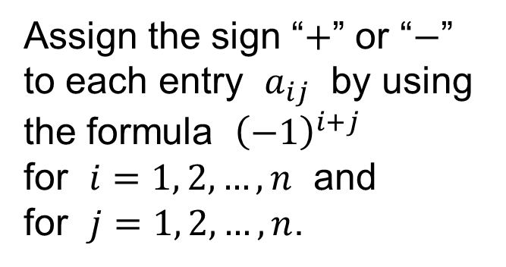
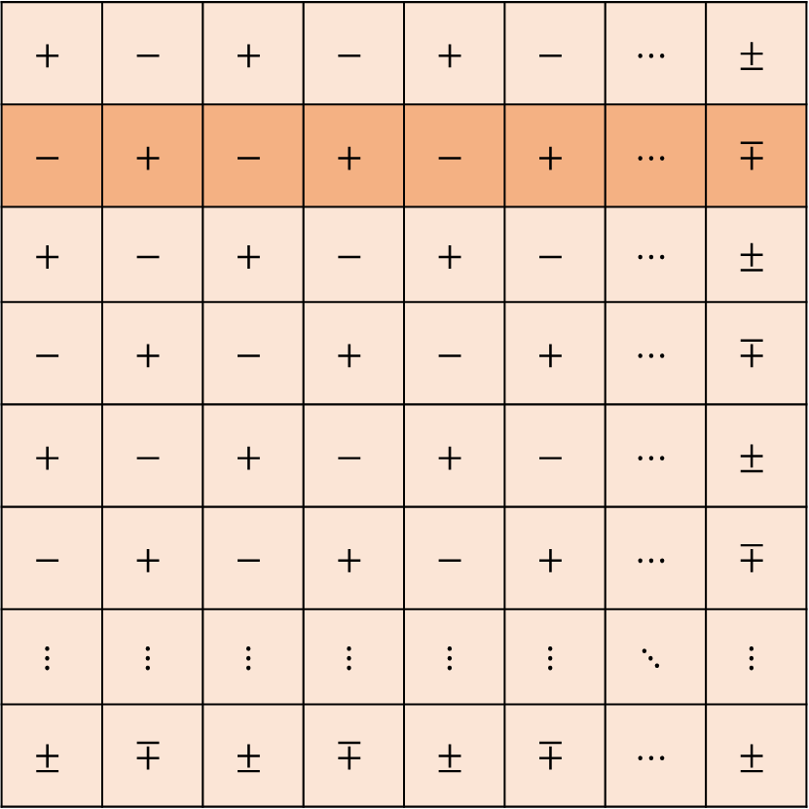
Laplace expansion of the determinant
Assign the sign “$+$” or “$−$”
to each entry $a_{ij}$ by using
the formula ${\left(−1\right)}^{i+j}$
for $i=1, 2,…,n$ and
for $j=1, 2,…,n$.
$$+$$ | $$−$$ | $$+$$ | $$−$$ | $$+$$ | $$−$$ | $$⋯$$ | $$±$$
$$−$$ | $$+$$ | $$−$$ | $$+$$ | $$−$$ | $$+$$ | $$⋯$$ | $$∓$$
$$+$$ | $$−$$ | $$+$$ | $$−$$ | $$+$$ | $$−$$ | $$⋯$$ | $$±$$
$$−$$ | $$+$$ | $$−$$ | $$+$$ | $$−$$ | $$+$$ | $$⋯$$ | $$∓$$
$$+$$ | $$−$$ | $$+$$ | $$−$$ | $$+$$ | $$−$$ | $$⋯$$ | $$±$$
$$−$$ | $$+$$ | $$−$$ | $$+$$ | $$−$$ | $$+$$ | $$⋯$$ | $$∓$$
$$⋮$$ | $$⋮$$ | $$⋮$$ | $$⋮$$ | $$⋮$$ | $$⋮$$ | $$⋱$$ | $$⋮$$
$$±$$ | $$∓$$ | $$±$$ | $$∓$$ | $$±$$ | $$∓$$ | $$⋯$$ | $$±$$

Slide 10
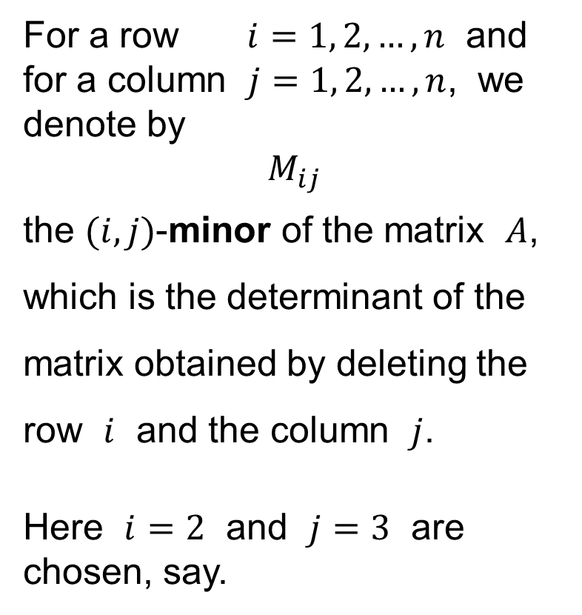
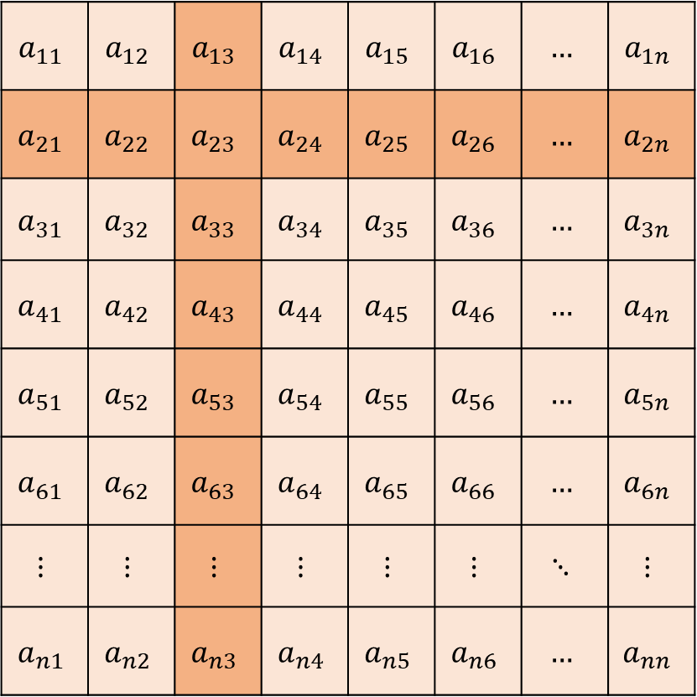
Laplace expansion of the determinant
For a row $i=1, 2,…,n$ and
for a column $j=1, 2,…,n$, we
denote by
$$M_{ij}$$
the $(i,j)$-minor of the matrix $A$,
which is the determinant of the
matrix obtained by deleting the
row $i$ and the column $j$.
Here $i=2$ and $j=3$ are
chosen, say.
$$a_{11}$$ | $$a_{12}$$ | $$a_{13}$$ | $$a_{14}$$ | $$a_{15}$$ | $$a_{16}$$ | $$…$$ | $$a_{1n}$$
$$a_{21}$$ | $$a_{22}$$ | $$a_{23}$$ | $$a_{24}$$ | $$a_{25}$$ | $$a_{26}$$ | $$…$$ | $$a_{2n}$$
$$a_{31}$$ | $$a_{32}$$ | $$a_{33}$$ | $$a_{34}$$ | $$a_{35}$$ | $$a_{36}$$ | $$…$$ | $$a_{3n}$$
$$a_{41}$$ | $$a_{42}$$ | $$a_{43}$$ | $$a_{44}$$ | $$a_{45}$$ | $$a_{46}$$ | $$…$$ | $$a_{4n}$$
$$a_{51}$$ | $$a_{52}$$ | $$a_{53}$$ | $$a_{54}$$ | $$a_{55}$$ | $$a_{56}$$ | $$…$$ | $$a_{5n}$$
$$a_{61}$$ | $$a_{62}$$ | $$a_{63}$$ | $$a_{64}$$ | $$a_{65}$$ | $$a_{66}$$ | $$…$$ | $$a_{6n}$$
$$⋮$$ | $$⋮$$ | $$⋮$$ | $$⋮$$ | $$⋮$$ | $$⋮$$ | $$⋱$$ | $$⋮$$
$$a_{n1}$$ | $$a_{n2}$$ | $$a_{n3}$$ | $$a_{n4}$$ | $$a_{n5}$$ | $$a_{n6}$$ | $$…$$ | $$a_{nn}$$

Slide 11
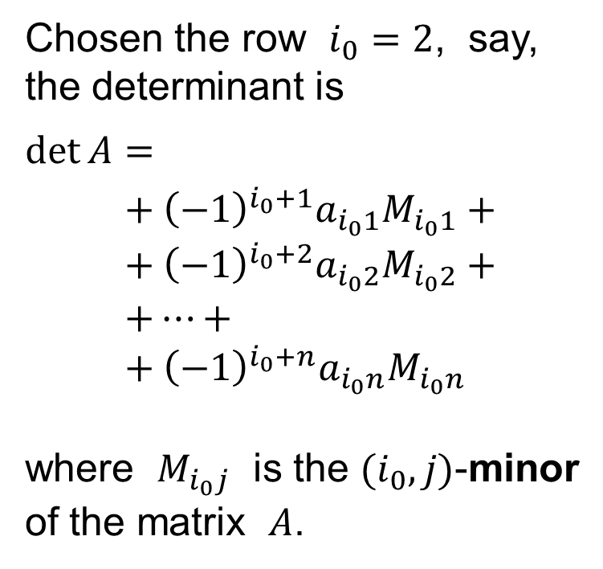
Laplace expansion of the determinant
Chosen the row $i_{0}=2$, say,
the determinant is
$\det{A}=$
$$+ {\left(−1\right)}^{i_{0}+1}a_{i_{0}1}M_{i_{0}1}+ \\ + {\left(−1\right)}^{i_{0}+2}a_{i_{0}2}M_{i_{0}2}+ \\ +⋯+ \\ + {\left(−1\right)}^{i_{0}+n}a_{i_{0}n}M_{i_{0}n}$$
where $M_{i_{0}j}$ is the $(i_{0},j)$-minor
of the matrix $A$.
$$a_{11}$$ | $$a_{12}$$ | $$a_{13}$$ | $$a_{14}$$ | $$a_{15}$$ | $$a_{16}$$ | $$…$$ | $$a_{1n}$$
$$a_{21}$$ | $$a_{22}$$ | $$a_{23}$$ | $$a_{24}$$ | $$a_{25}$$ | $$a_{26}$$ | $$…$$ | $$a_{2n}$$
$$a_{31}$$ | $$a_{32}$$ | $$a_{33}$$ | $$a_{34}$$ | $$a_{35}$$ | $$a_{36}$$ | $$…$$ | $$a_{3n}$$
$$a_{41}$$ | $$a_{42}$$ | $$a_{43}$$ | $$a_{44}$$ | $$a_{45}$$ | $$a_{46}$$ | $$…$$ | $$a_{4n}$$
$$a_{51}$$ | $$a_{52}$$ | $$a_{53}$$ | $$a_{54}$$ | $$a_{55}$$ | $$a_{56}$$ | $$…$$ | $$a_{5n}$$
$$a_{61}$$ | $$a_{62}$$ | $$a_{63}$$ | $$a_{64}$$ | $$a_{65}$$ | $$a_{66}$$ | $$…$$ | $$a_{6n}$$
$$⋮$$ | $$⋮$$ | $$⋮$$ | $$⋮$$ | $$⋮$$ | $$⋮$$ | $$⋱$$ | $$⋮$$
$$a_{n1}$$ | $$a_{n2}$$ | $$a_{n3}$$ | $$a_{n4}$$ | $$a_{n5}$$ | $$a_{n6}$$ | $$…$$ | $$a_{nn}$$

Slide 12
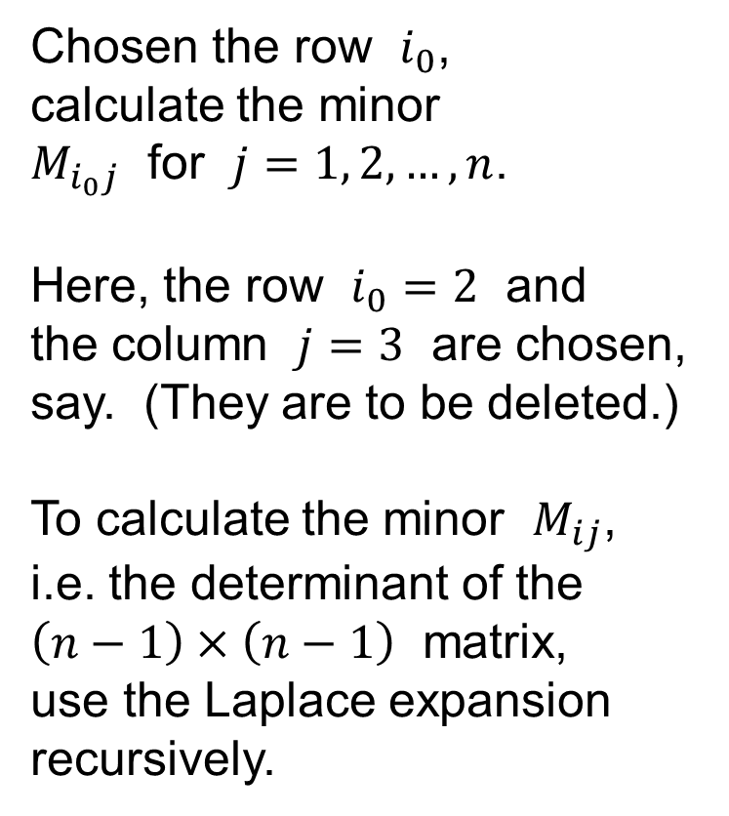
Laplace expansion of the determinant
Chosen the row $i_{0}$,
calculate the minor
$M_{i_{0}j}$ for $j=1, 2,…,n$.
Here, the row $i_{0}=2$ and
the column $j=3$ are chosen,
say. (They are to be deleted.)
To calculate the minor $M_{ij}$,
i.e. the determinant of the
$\left(n−1\right)×\left(n−1\right)$ matrix,
use the Laplace expansion
recursively.
$$a_{11}$$ | $$a_{12}$$ | $$a_{13}$$ | $$a_{14}$$ | $$a_{15}$$ | $$a_{16}$$ | $$…$$ | $$a_{1n}$$
$$a_{21}$$ | $$a_{22}$$ | $$a_{23}$$ | $$a_{24}$$ | $$a_{25}$$ | $$a_{26}$$ | $$…$$ | $$a_{2n}$$
$$a_{31}$$ | $$a_{32}$$ | $$a_{33}$$ | $$a_{34}$$ | $$a_{35}$$ | $$a_{36}$$ | $$…$$ | $$a_{3n}$$
$$a_{41}$$ | $$a_{42}$$ | $$a_{43}$$ | $$a_{44}$$ | $$a_{45}$$ | $$a_{46}$$ | $$…$$ | $$a_{4n}$$
$$a_{51}$$ | $$a_{52}$$ | $$a_{53}$$ | $$a_{54}$$ | $$a_{55}$$ | $$a_{56}$$ | $$…$$ | $$a_{5n}$$
$$a_{61}$$ | $$a_{62}$$ | $$a_{63}$$ | $$a_{64}$$ | $$a_{65}$$ | $$a_{66}$$ | $$…$$ | $$a_{6n}$$
$$⋮$$ | $$⋮$$ | $$⋮$$ | $$⋮$$ | $$⋮$$ | $$⋮$$ | $$⋱$$ | $$⋮$$
$$a_{n1}$$ | $$a_{n2}$$ | $$a_{n3}$$ | $$a_{n4}$$ | $$a_{n5}$$ | $$a_{n6}$$ | $$…$$ | $$a_{nn}$$

Slide 13
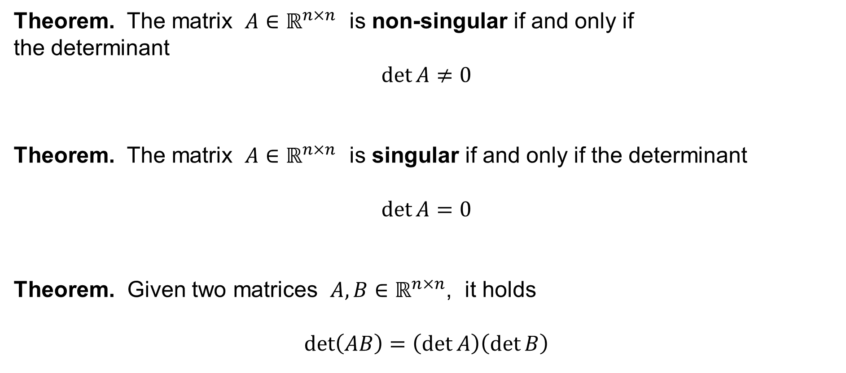
Three theorems on the determinant
Theorem. The matrix $A∈ℝ^{n×n}$ is non-singular if and only if
the determinant
$$\det{A}≠0$$
Theorem. The matrix $A∈ℝ^{n×n}$ is singular if and only if the determinant
$$\det{A}=0$$
Theorem. Given two matrices $A,B∈ℝ^{n×n}$, it holds
$$\det\left(AB\right)=\left(\det{A}\right)\left(\det{B}\right)$$

Slide 14
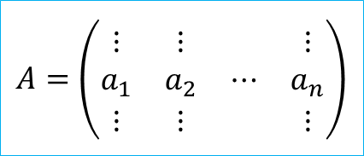

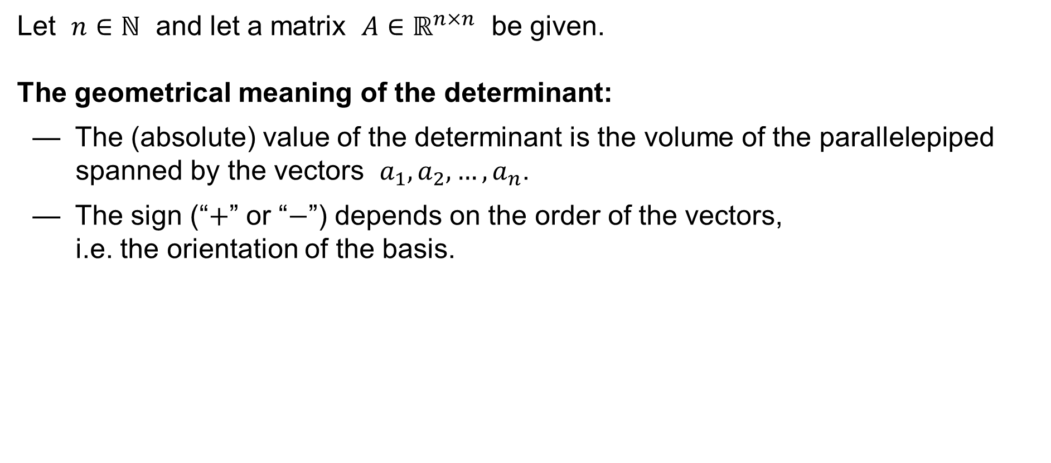



The geometrical meaning of the determinant
Let $n∈ℕ$ and let a matrix $A∈ℝ^{n×n}$ be given.
The geometrical meaning of the determinant:
— The (absolute) value of the determinant is the volume of the parallelepiped spanned by the vectors $a_{1},a_{2},…,a_{n}$.
— The sign (“$+$” or “$−$”) depends on the order of the vectors,
i.e. the orientation of the basis.
$$A=\left(\begin{matrix}⋮ & ⋮ & & ⋮ \\ a_{1} & a_{2} & ⋯ & a_{n} \\ ⋮ & ⋮ & & ⋮\end{matrix}\right)$$
$$a_{3}$$
$$a_{2}$$
$$0$$
$$a_{1}$$

Slide 15
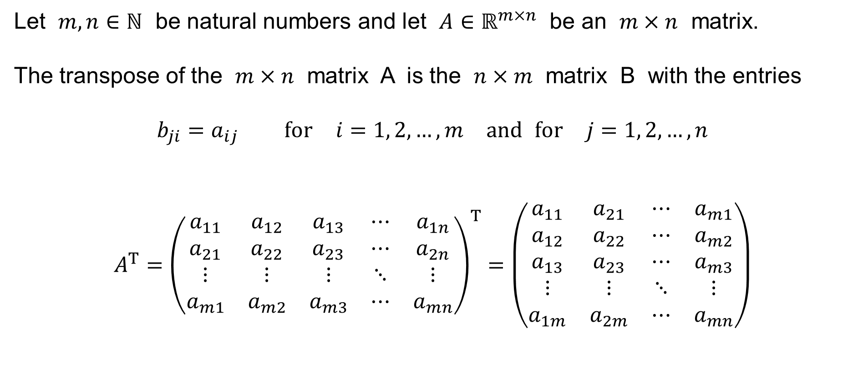
The transposed matrix
Let $m,n∈ℕ$ be natural numbers and let $A∈ℝ^{m×n}$ be an $m×n$ matrix.
The transpose of the $m×n$ matrix A is the $n×m$ matrix B with the entries
$$b_{ji}=a_{ij} \text{for} i=1, 2,…,m \text{and} \text{for} j=1, 2,…,n$$
$$A^{T}={\left(\begin{matrix}a_{11} & a_{12} & a_{13} & ⋯ & a_{1n} \\ a_{21} & a_{22} & a_{23} & ⋯ & a_{2n} \\ ⋮ & ⋮ & ⋮ & ⋱ & ⋮ \\ a_{m1} & a_{m2} & a_{m3} & ⋯ & a_{mn}\end{matrix}\right)}^{T}=\left(\begin{matrix}a_{11} & a_{21} & ⋯ & a_{m1} \\ a_{12} & a_{22} & ⋯ & a_{m2} \\ a_{13} & a_{23} & ⋯ & a_{m3} \\ ⋮ & ⋮ & ⋱ & ⋮ \\ a_{1m} & a_{2m} & ⋯ & a_{mn}\end{matrix}\right)$$

Slide 16
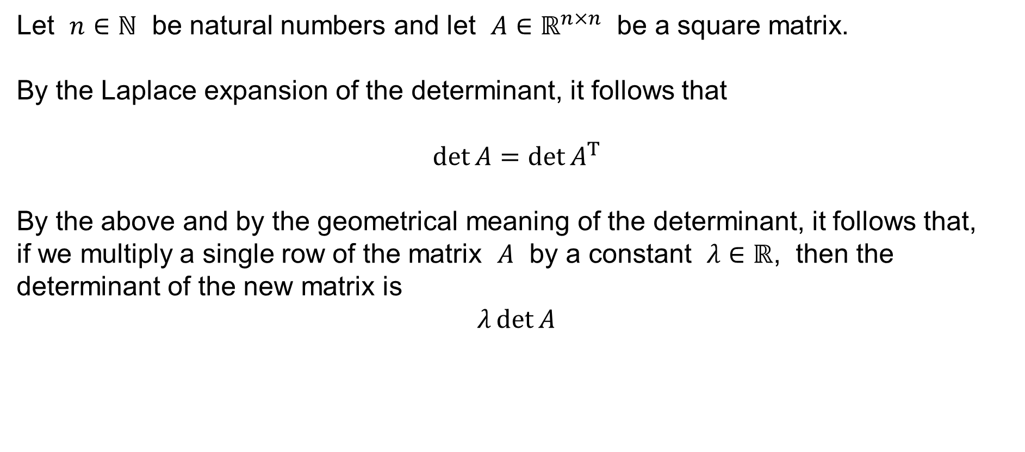
Some properties of the determinant
Let $n∈ℕ$ be natural numbers and let $A∈ℝ^{n×n}$ be a square matrix.
By the Laplace expansion of the determinant, it follows that
$$\det{A}=\det{A^{T}}$$
By the above and by the geometrical meaning of the determinant, it follows that,
if we multiply a single row of the matrix $A$ by a constant $λ∈ℝ$, then the determinant of the new matrix is
$$λ\det{A}$$

Slide 17
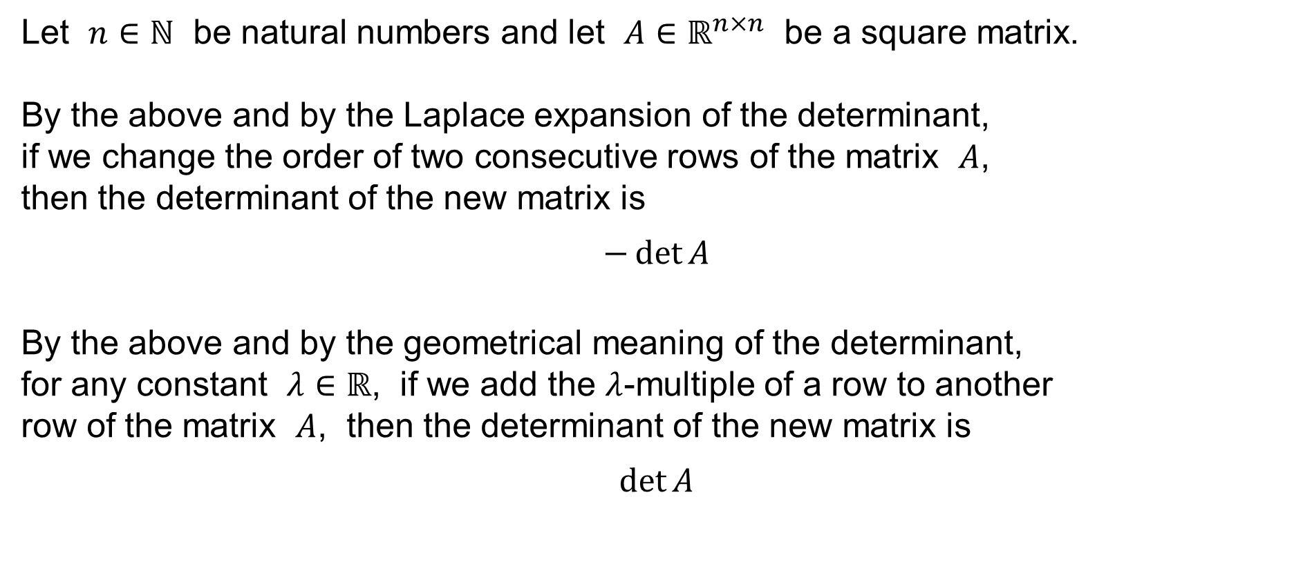
Some properties of the determinant
Let $n∈ℕ$ be natural numbers and let $A∈ℝ^{n×n}$ be a square matrix.
By the above and by the Laplace expansion of the determinant,
if we change the order of two consecutive rows of the matrix $A$,
then the determinant of the new matrix is
$$−\det{A}$$
By the above and by the geometrical meaning of the determinant,
for any constant $λ∈ℝ$, if we add the $λ$-multiple of a row to another
row of the matrix $A$, then the determinant of the new matrix is
$$\det{A}$$

Slide 18
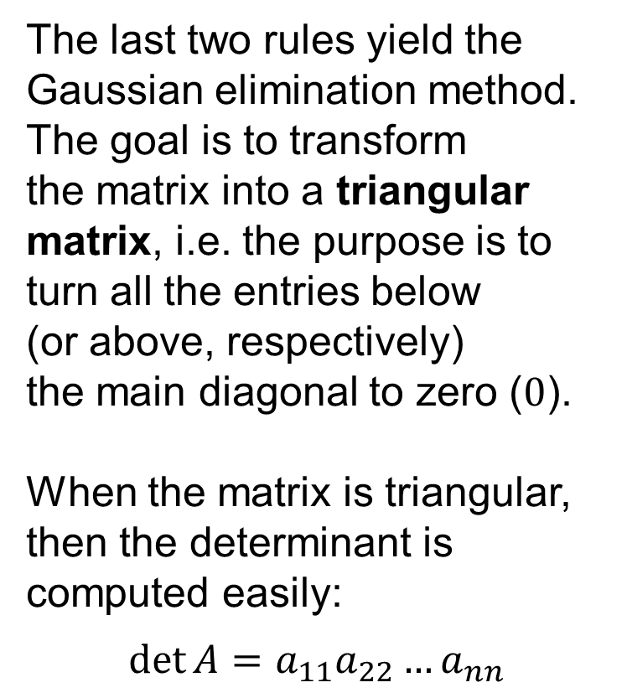
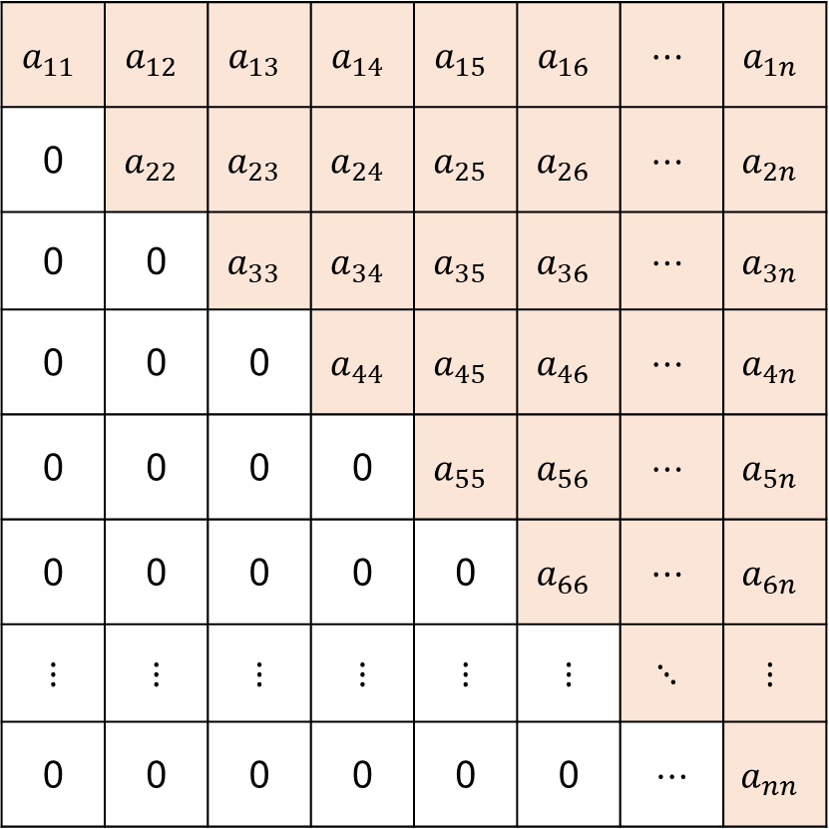
To compute the determinant practically…
The last two rules yield the
Gaussian elimination method.
The goal is to transform
the matrix into a triangular
matrix, i.e. the purpose is to
turn all the entries below
(or above, respectively)
the main diagonal to zero ($0$).
When the matrix is triangular,
then the determinant is
computed easily:
$$\det{A}=a_{11}a_{22}…a_{nn}$$
$$a_{11}$$ | $$a_{12}$$ | $$a_{13}$$ | $$a_{14}$$ | $$a_{15}$$ | $$a_{16}$$ | $$⋯$$ | $$a_{1n}$$
0 | $$a_{22}$$ | $$a_{23}$$ | $$a_{24}$$ | $$a_{25}$$ | $$a_{26}$$ | $$⋯$$ | $$a_{2n}$$
0 | 0 | $$a_{33}$$ | $$a_{34}$$ | $$a_{35}$$ | $$a_{36}$$ | $$⋯$$ | $$a_{3n}$$
0 | 0 | 0 | $$a_{44}$$ | $$a_{45}$$ | $$a_{46}$$ | $$⋯$$ | $$a_{4n}$$
0 | 0 | 0 | 0 | $$a_{55}$$ | $$a_{56}$$ | $$⋯$$ | $$a_{5n}$$
0 | 0 | 0 | 0 | 0 | $$a_{66}$$ | $$⋯$$ | $$a_{6n}$$
⋮ | ⋮ | ⋮ | ⋮ | ⋮ | ⋮ | $$⋱$$ | $$⋮$$
0 | 0 | 0 | 0 | 0 | 0 | ⋯ | $$a_{nn}$$

Slide 19
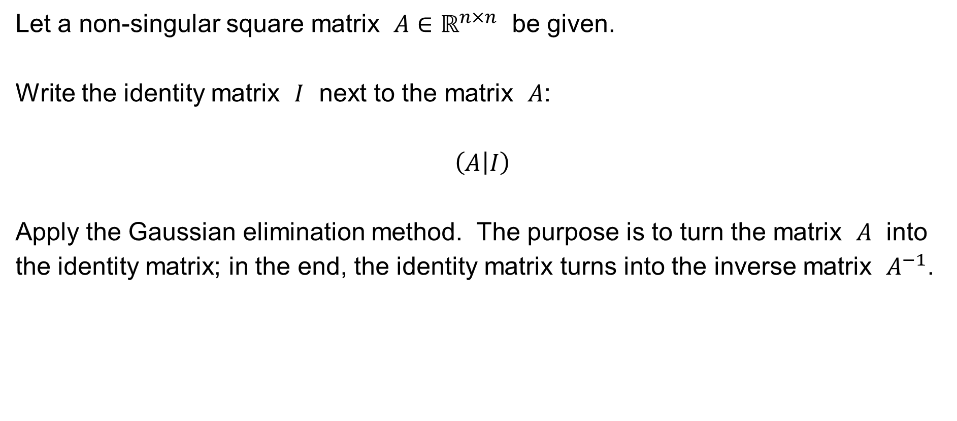
To compute the inverse matrix practically…
Let a non-singular square matrix $A∈ℝ^{n×n}$ be given.
Write the identity matrix $I$ next to the matrix $A$:
$$\left(A | I\right)$$
Apply the Gaussian elimination method. The purpose is to turn the matrix $A$ into the identity matrix; in the end, the identity matrix turns into the inverse matrix $A^{−1}$.

Slide 20
Systems of linear equations
System of linear equations
Gaussian elimination
Cramer’s rule

Slide 21
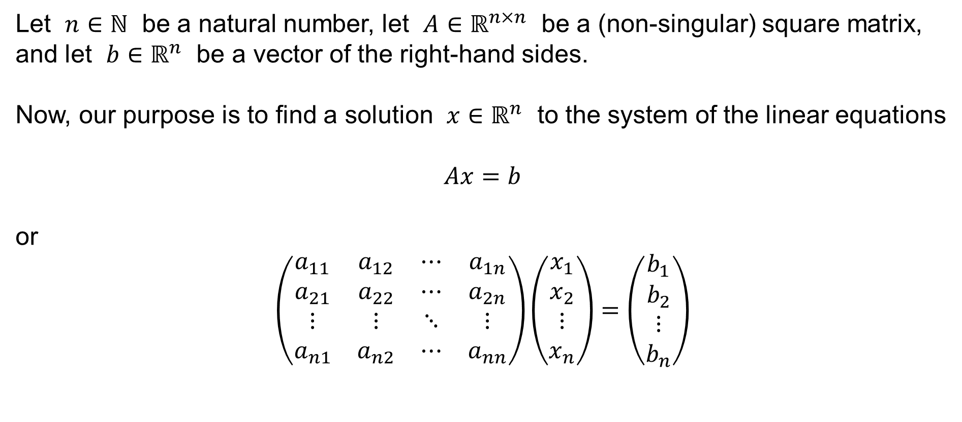
A system of linear equations
Let $n∈ℕ$ be a natural number, let $A∈ℝ^{n×n}$ be a (non-singular) square matrix, and let $b∈ℝ^{n}$ be a vector of the right-hand sides.
Now, our purpose is to find a solution $x∈ℝ^{n}$ to the system of the linear equations
$$Ax=b$$
or
$$\left(\begin{matrix}a_{11} & a_{12} & ⋯ & a_{1n} \\ a_{21} & a_{22} & ⋯ & a_{2n} \\ ⋮ & ⋮ & ⋱ & ⋮ \\ a_{n1} & a_{n2} & ⋯ & a_{nn}\end{matrix}\right)\left(\begin{matrix}x_{1} \\ x_{2} \\ ⋮ \\ x_{n}\end{matrix}\right)=\left(\begin{matrix}b_{1} \\ b_{2} \\ ⋮ \\ b_{n}\end{matrix}\right)$$

Slide 22

A system of linear equations
Notice that the system of the linear equations
$$Ax=b$$
can also be written as
$$a_{11}x_{1}+a_{12}x_{2}+⋯+a_{1n}x_{n}=b_{1} \\ a_{21}x_{1}+a_{22}x_{2}+⋯+a_{2n}x_{n}=b_{2} \\ ⋮ \\ a_{n1}x_{1}+a_{n2}x_{2}+⋯+a_{nn}x_{n}=b_{n}$$

Slide 23
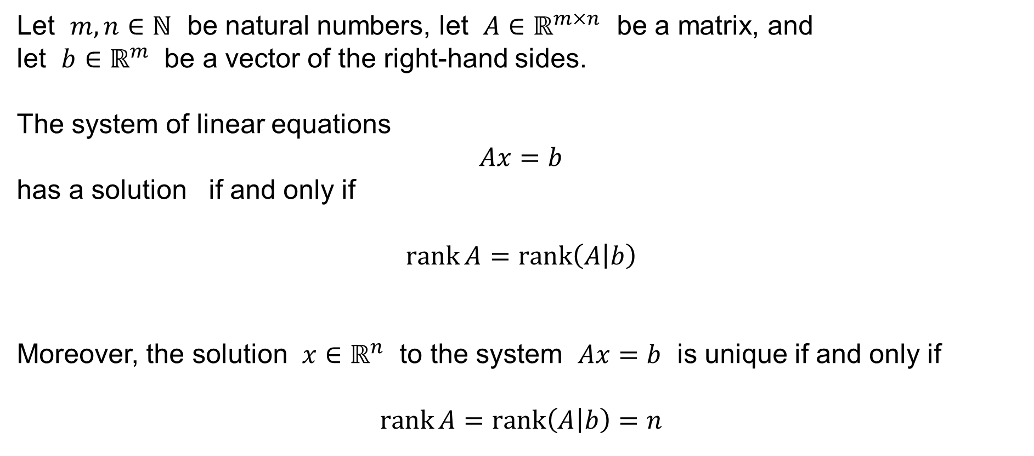
Frobenius’ Theorem
Let $m,n∈ℕ$ be natural numbers, let $A∈ℝ^{m×n}$ be a matrix, and
let $b∈ℝ^{m}$ be a vector of the right-hand sides.
The system of linear equations
$$Ax=b$$
has a solution if and only if
$$\operatorname{rank}{A}=\operatorname{rank}\left(A | b\right)$$
Moreover, the solution $x∈ℝ^{n}$ to the system $Ax=b$ is unique if and only if
$$\operatorname{rank}{A}=\operatorname{rank}\left(A | b\right)=n$$

Slide 24
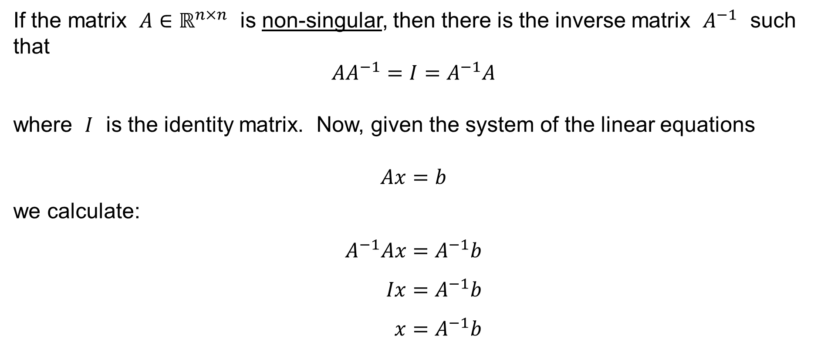
A system of linear equations
If the matrix $A∈ℝ^{n×n}$ is non-singular, then there is the inverse matrix $A^{−1}$ such that
$$AA^{−1}=I=A^{−1}A$$
where $I$ is the identity matrix. Now, given the system of the linear equations
$$Ax=b$$
we calculate:
$$A^{−1}Ax=A^{−1}b \\ Ix=A^{−1}b \\ x=A^{−1}b$$

Slide 25

A system of linear equations
We have thus shown that the solution $x∈ℝ^{n}$ to the system of the linear equations
$$Ax=b$$
is
$$x=A^{−1}b$$
Thus, in theory, it is enough to compute the inverse matrix $A^{−1}$.

Slide 26
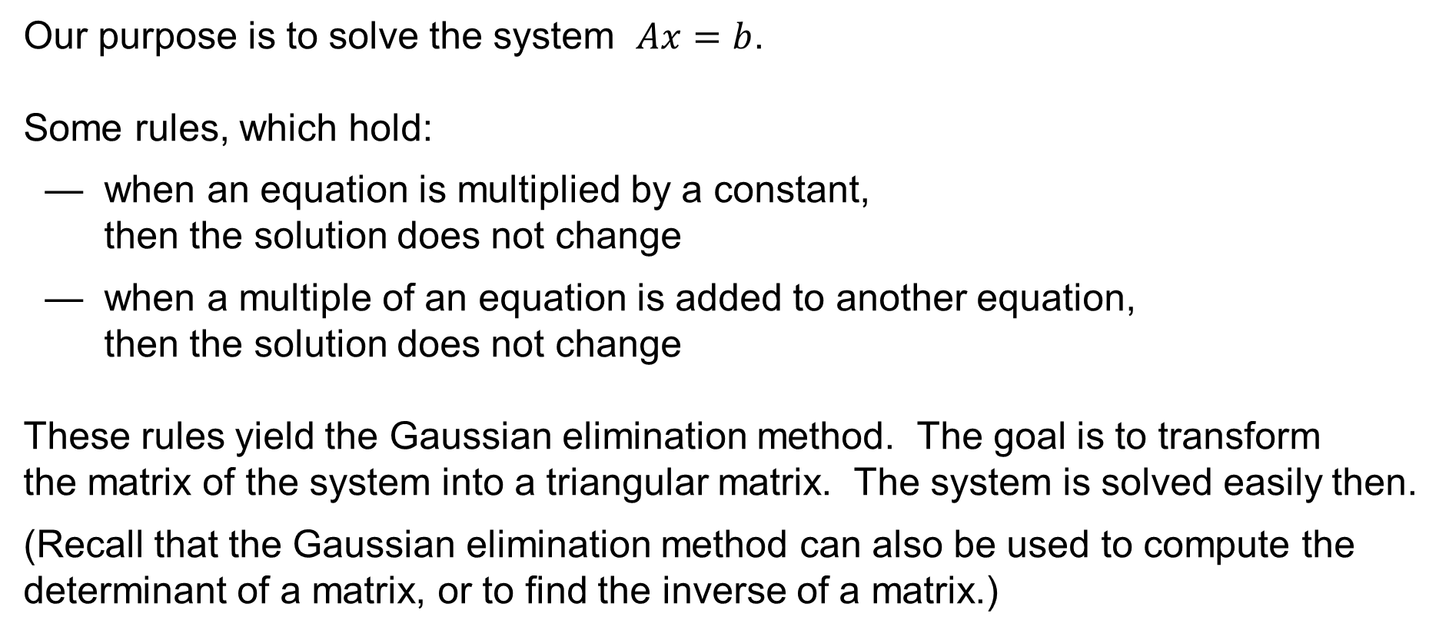
To solve a system of linear equations practically…
Our purpose is to solve the system $Ax=b$.
Some rules, which hold:
— when an equation is multiplied by a constant,
then the solution does not change
— when a multiple of an equation is added to another equation,
then the solution does not change
These rules yield the Gaussian elimination method. The goal is to transform
the matrix of the system into a triangular matrix. The system is solved easily then.
(Recall that the Gaussian elimination method can also be used to compute the determinant of a matrix, or to find the inverse of a matrix.)

Slide 27
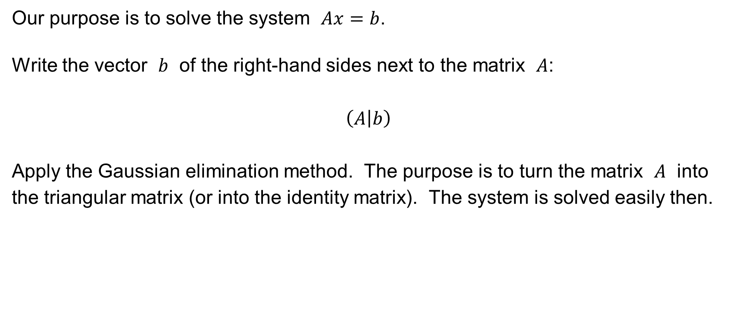
To solve a system of linear equations practically…
Our purpose is to solve the system $Ax=b$.
Write the vector $b$ of the right-hand sides next to the matrix $A$:
$$\left(A | b\right)$$
Apply the Gaussian elimination method. The purpose is to turn the matrix $A$ into the triangular matrix (or into the identity matrix). The system is solved easily then.

Slide 28
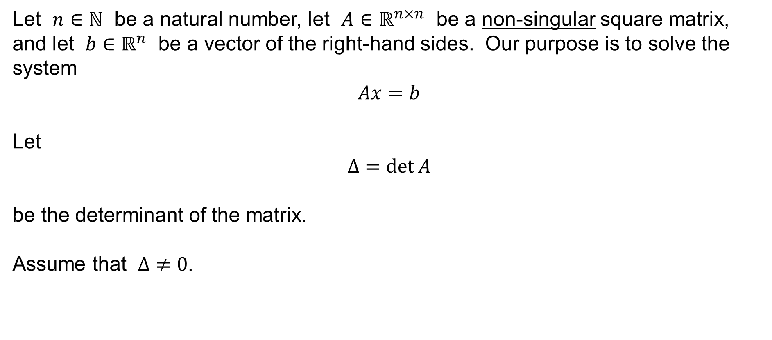
Cramer’s Rule
Let $n∈ℕ$ be a natural number, let $A∈ℝ^{n×n}$ be a non-singular square matrix, and let $b∈ℝ^{n}$ be a vector of the right-hand sides. Our purpose is to solve the system
$$Ax=b$$
Let
$$Δ=\det{A}$$
be the determinant of the matrix.
Assume that $Δ≠0$.

Slide 29
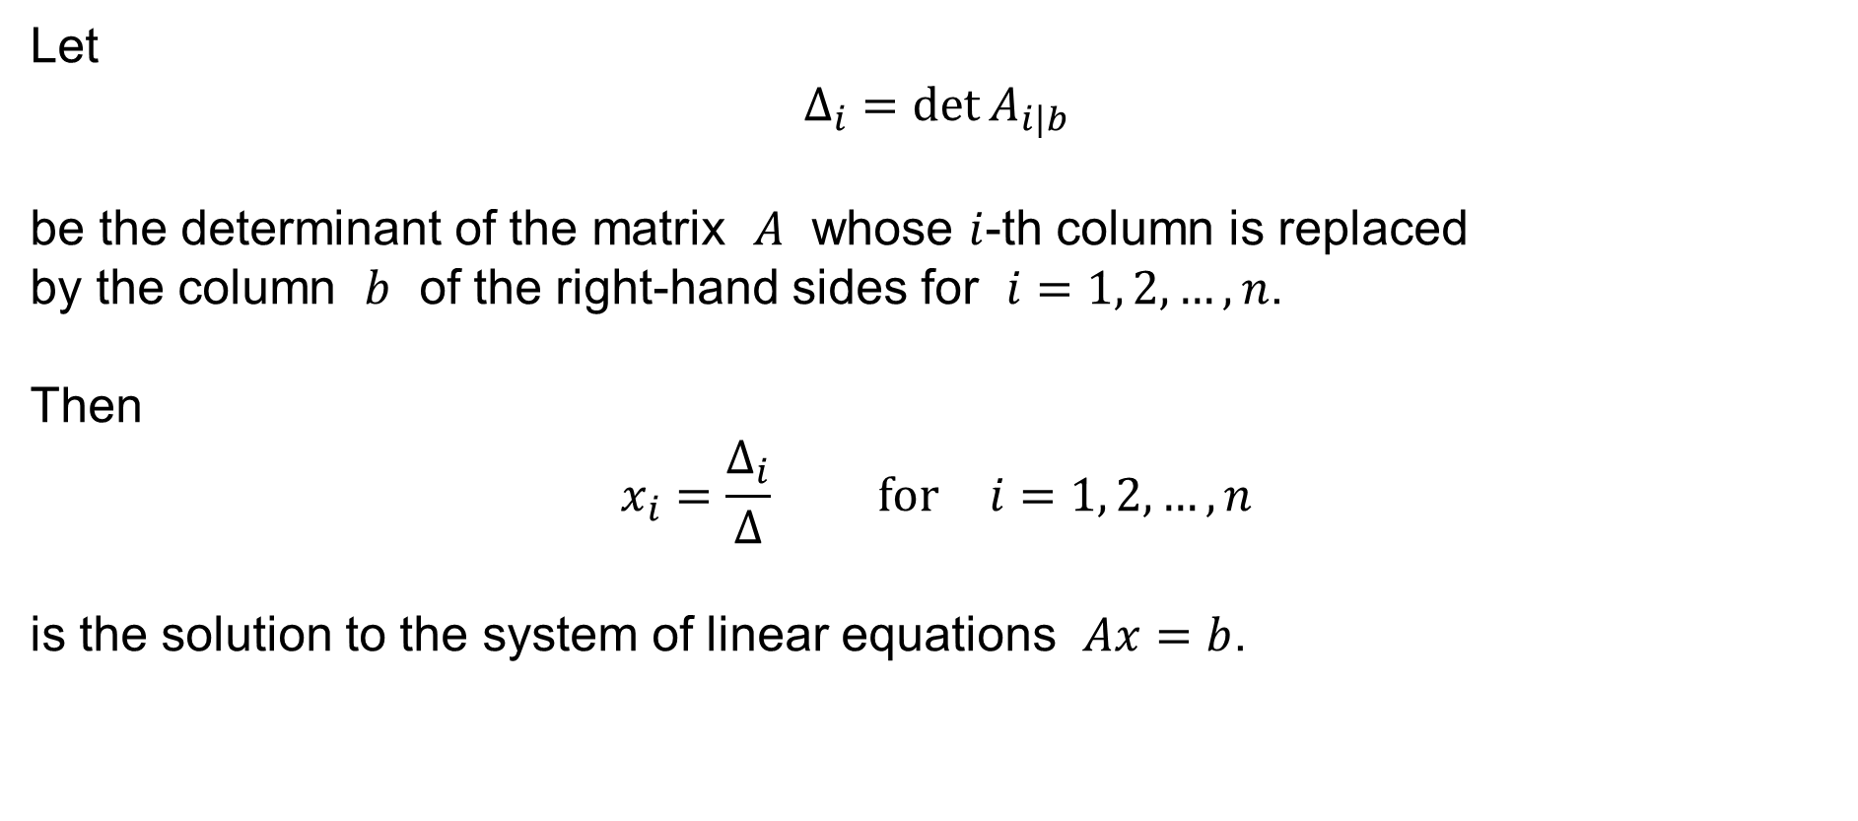
Cramer’s Rule
Let
$$Δ_{i}=\det{A_{i|b}}$$
be the determinant of the matrix $A$ whose $i$-th column is replaced
by the column $b$ of the right-hand sides for $i=1, 2,…, n$.
Then
$$x_{i}=\frac{Δ_{i}}{Δ} \text{for} i=1, 2,…,n$$
is the solution to the system of linear equations $Ax=b$.

