Slide 1
Quantitative Methods
Lecture 6
Differential calculus
BAKVM

Slide 2
The derivative of a function
Derivatives of elementary functions

Slide 3
The derivative of a function
Motivation: instantaneous velocity and the line tangent to the graph
of a function
Rules to calculate the derivative
Chain rule

Slide 4
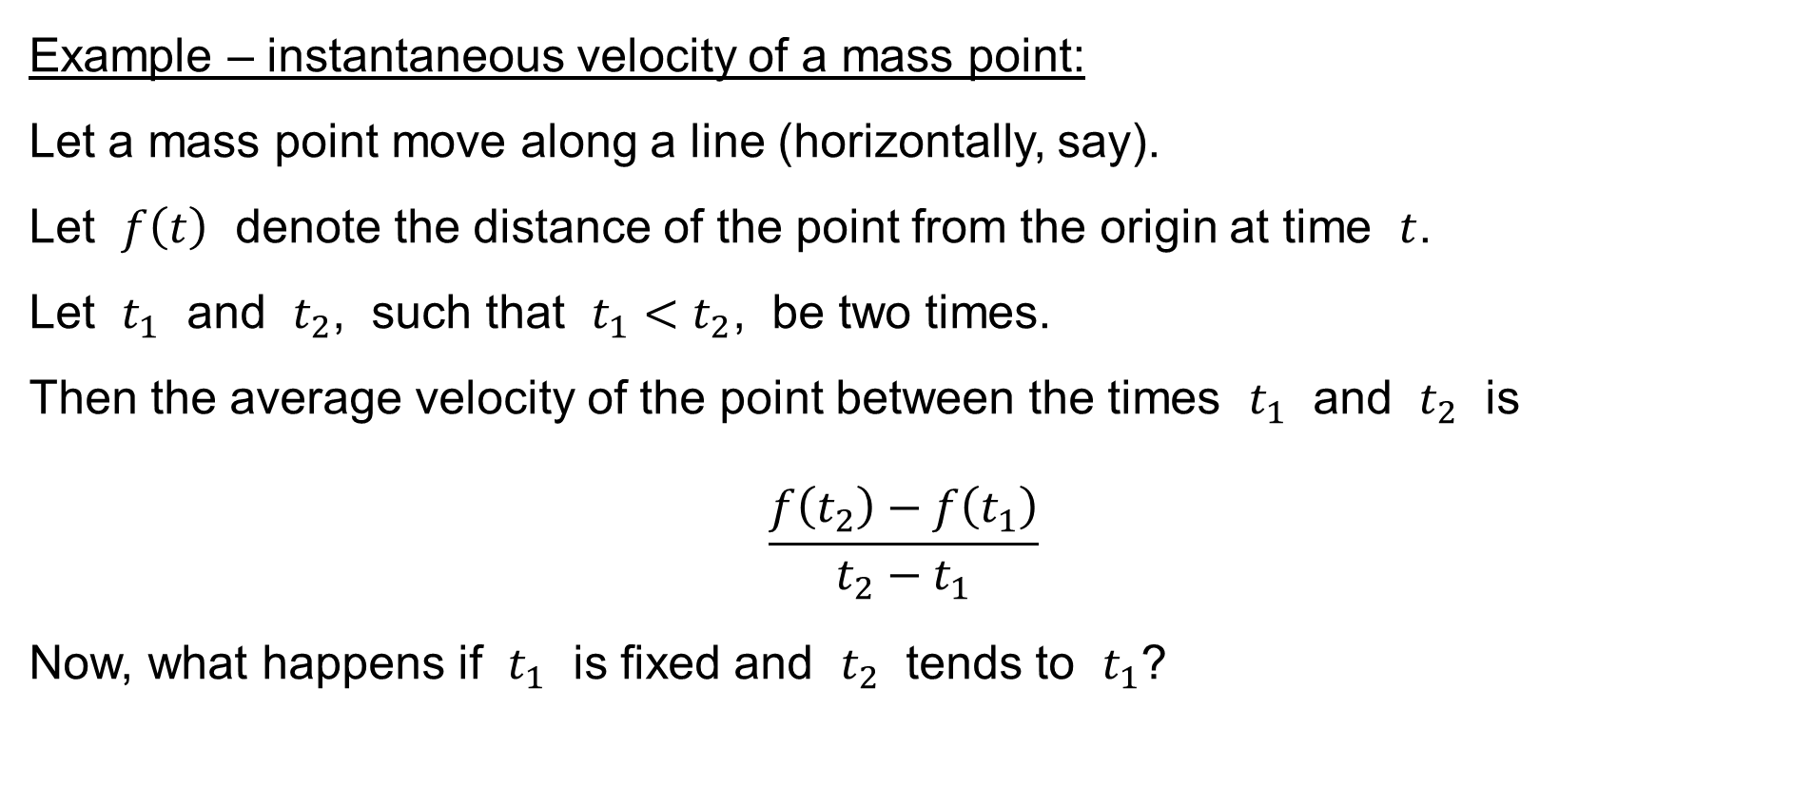
The derivative of a function
Example – instantaneous velocity of a mass point:
Let a mass point move along a line (horizontally, say).
Let $f\left(t\right)$ denote the distance of the point from the origin at time $t$.
Let $t_{1}$ and $t_{2}$, such that $t_{1}<t_{2}$, be two times.
Then the average velocity of the point between the times $t_{1}$ and $t_{2}$ is
$$\frac{f\left(t_{2}\right)−f\left(t_{1}\right)}{t_{2}−t_{1}}$$
Now, what happens if $t_{1}$ is fixed and $t_{2}$ tends to $t_{1}$?

Slide 5
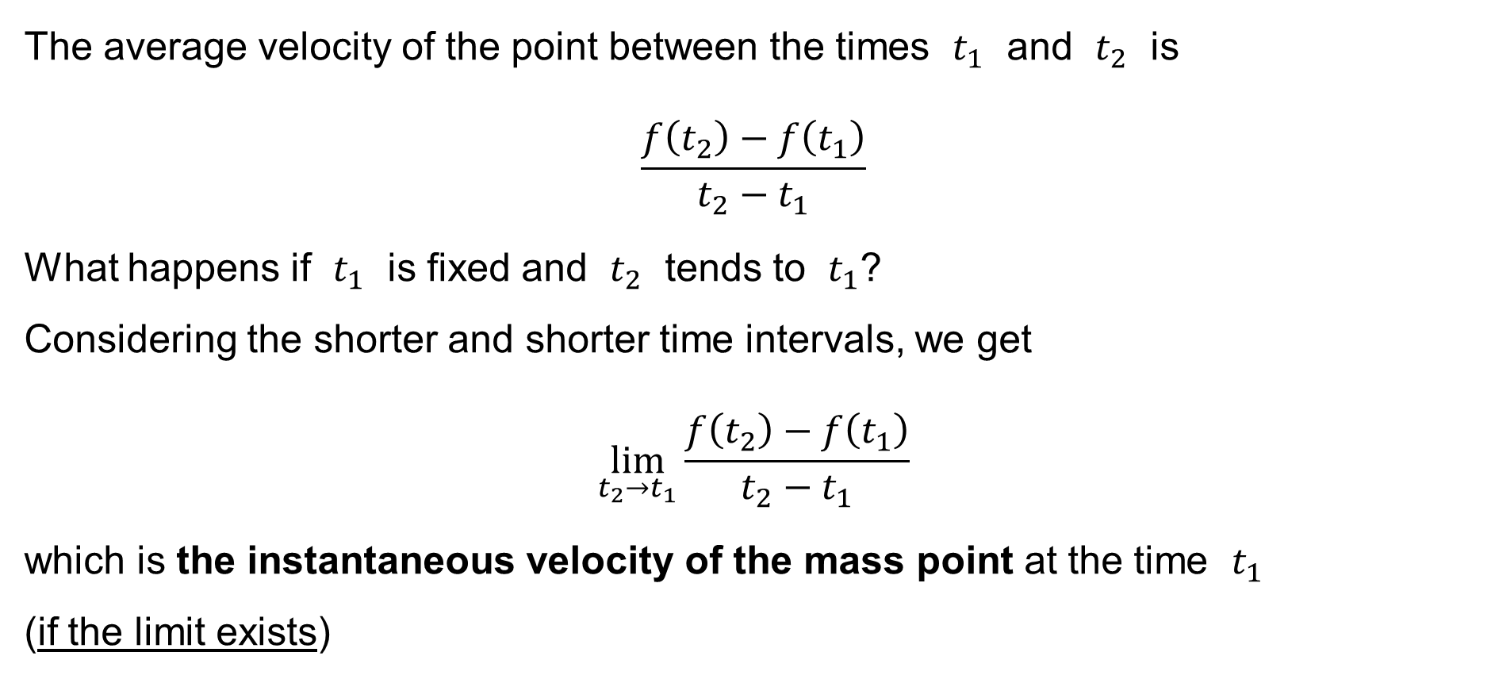
The derivative of a function
The average velocity of the point between the times $t_{1}$ and $t_{2}$ is
$$\frac{f\left(t_{2}\right)−f\left(t_{1}\right)}{t_{2}−t_{1}}$$
What happens if $t_{1}$ is fixed and $t_{2}$ tends to $t_{1}$?
Considering the shorter and shorter time intervals, we get
$$\lim_{t_{2}→t_{1}}{\frac{f\left(t_{2}\right)−f\left(t_{1}\right)}{t_{2}−t_{1}}}$$
which is the instantaneous velocity of the mass point at the time $t_{1}$
(if the limit exists)

Slide 6
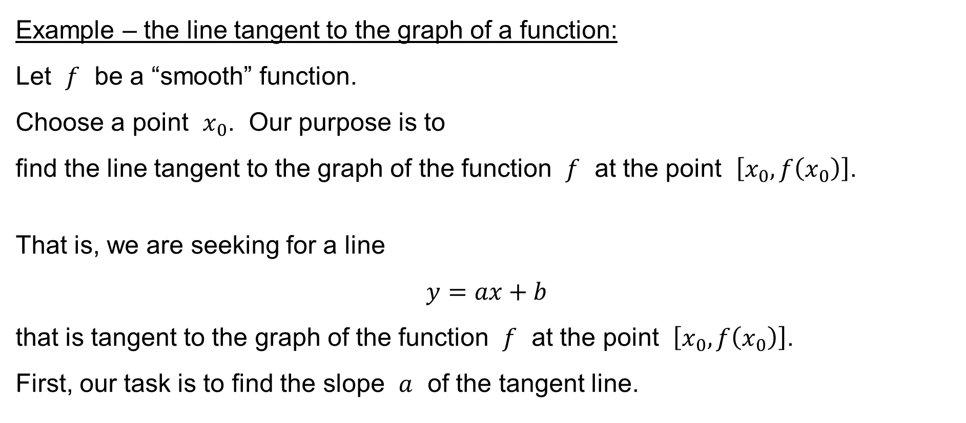
The derivative of a function
Example – the line tangent to the graph of a function:
Let $f$ be a “smooth” function.
Choose a point $x_{0}$. Our purpose is to
find the line tangent to the graph of the function $f$ at the point $\left[x_{0},f\left(x_{0}\right)\right]$.
That is, we are seeking for a line
$$y=ax+b$$
that is tangent to the graph of the function $f$ at the point $\left[x_{0},f\left(x_{0}\right)\right]$.
First, our task is to find the slope $a$ of the tangent line.

Slide 7
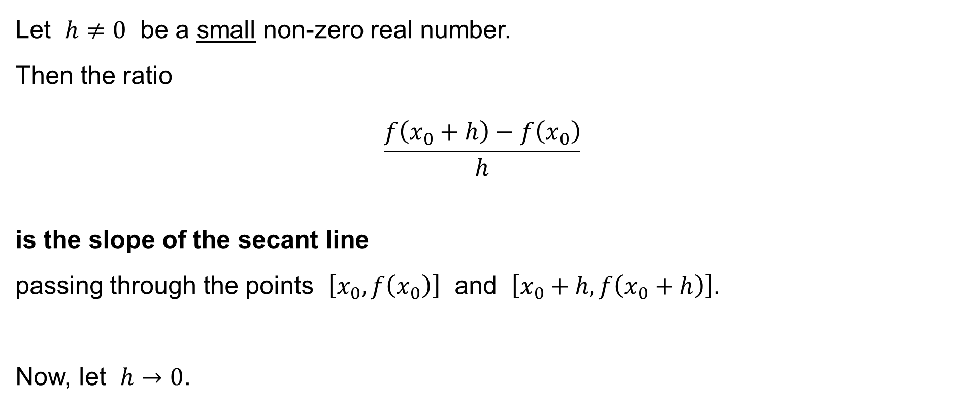
The derivative of a function
Let $h≠0$ be a small non-zero real number.
Then the ratio
$$\frac{f\left(x_{0}+h\right)−f\left(x_{0}\right)}{h}$$
is the slope of the secant line
passing through the points $\left[x_{0},f\left(x_{0}\right)\right]$ and $\left[x_{0}+h,f\left(x_{0}+h\right)\right]$.
Now, let $h→0$.

Slide 8

The derivative of a function
Then
$$a=\lim_{h→0}{\frac{f\left(x_{0}+h\right)−f\left(x_{0}\right)}{h}}$$
is the slope of the tangent line at the point $\left[x_{0},f\left(x_{0}\right)\right]$
(if the limit exists).
It then also holds:
$$a=\lim_{x→x_{0}}{\frac{f\left(x\right)−f\left(x_{0}\right)}{x−x_{0}}}$$

Slide 9
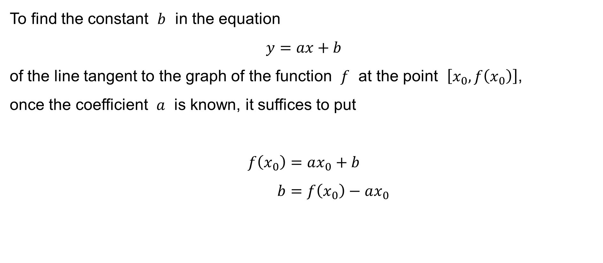
The derivative of a function
To find the constant $b$ in the equation
$$y=ax+b$$
of the line tangent to the graph of the function $f$ at the point $\left[x_{0},f\left(x_{0}\right)\right]$,
once the coefficient $a$ is known, it suffices to put
$$f\left(x_{0}\right)=ax_{0}+b \\ b=f\left(x_{0}\right)−ax_{0}$$

Slide 10
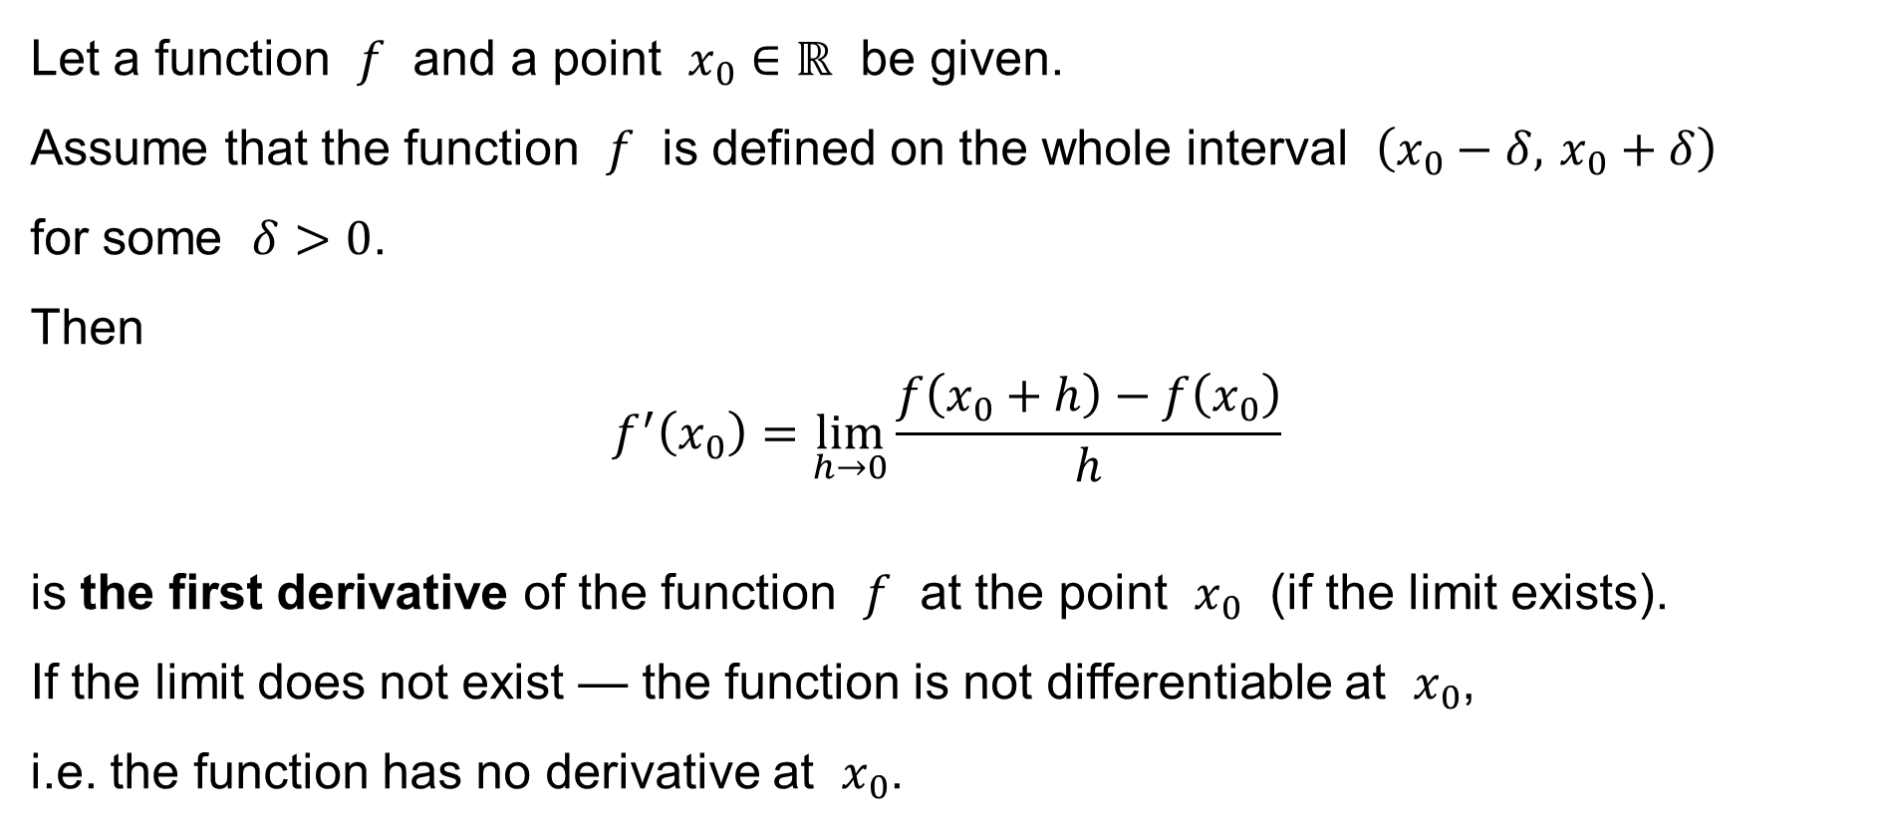
The derivative of a function
Let a function $f$ and a point $x_{0}∈ℝ$ be given.
Assume that the function $f$ is defined on the whole interval $\left(x_{0}−δ, x_{0}+δ\right)$
for some $δ>0$.
Then
$$f^{′}\left(x_{0}\right)=\lim_{h→0}{\frac{f\left(x_{0}+h\right)−f\left(x_{0}\right)}{h}}$$
is the first derivative of the function $f$ at the point $x_{0}$ (if the limit exists).
If the limit does not exist — the function is not differentiable at $x_{0}$,
i.e. the function has no derivative at $x_{0}$.

Slide 11
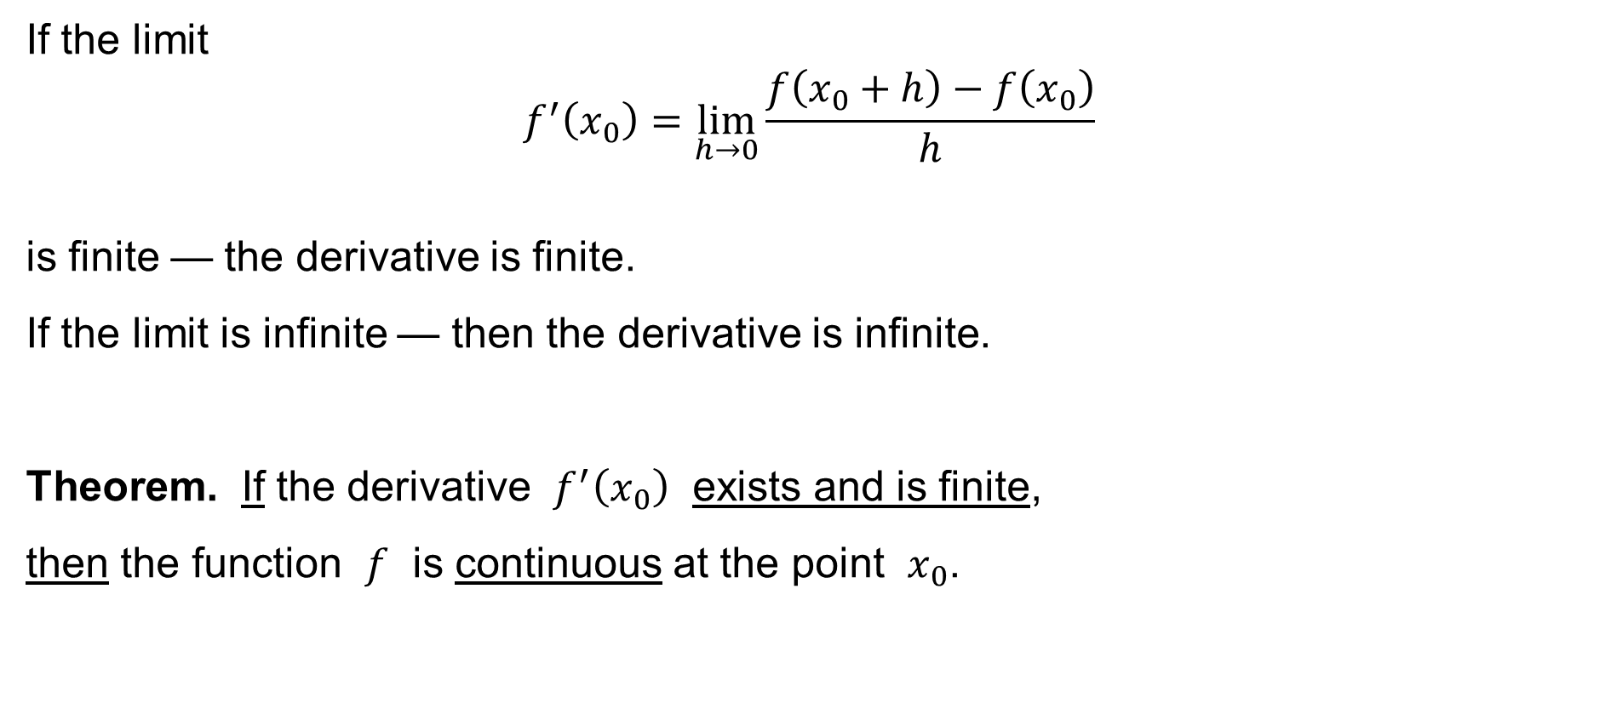
The derivative of a function
If the limit
$$f^{′}\left(x_{0}\right)=\lim_{h→0}{\frac{f\left(x_{0}+h\right)−f\left(x_{0}\right)}{h}}$$
is finite — the derivative is finite.
If the limit is infinite — then the derivative is infinite.
Theorem. If the derivative $f^{′}\left(x_{0}\right)$ exists and is finite,
then the function $f$ is continuous at the point $x_{0}$.

Slide 12

Rules to calculate the derivative I
Let $f$ be a function such that its derivatives at a point $x∈ℝ$ exists and is finite.
That is, $f^{′}\left(x\right)$ exists and is finite.
Moreover, let $c∈ℝ$ be any constant.
It then holds:
$${\left(c×f\right)}^{′}\left(x\right)=c×f^{′}\left(x\right)$$

Slide 13
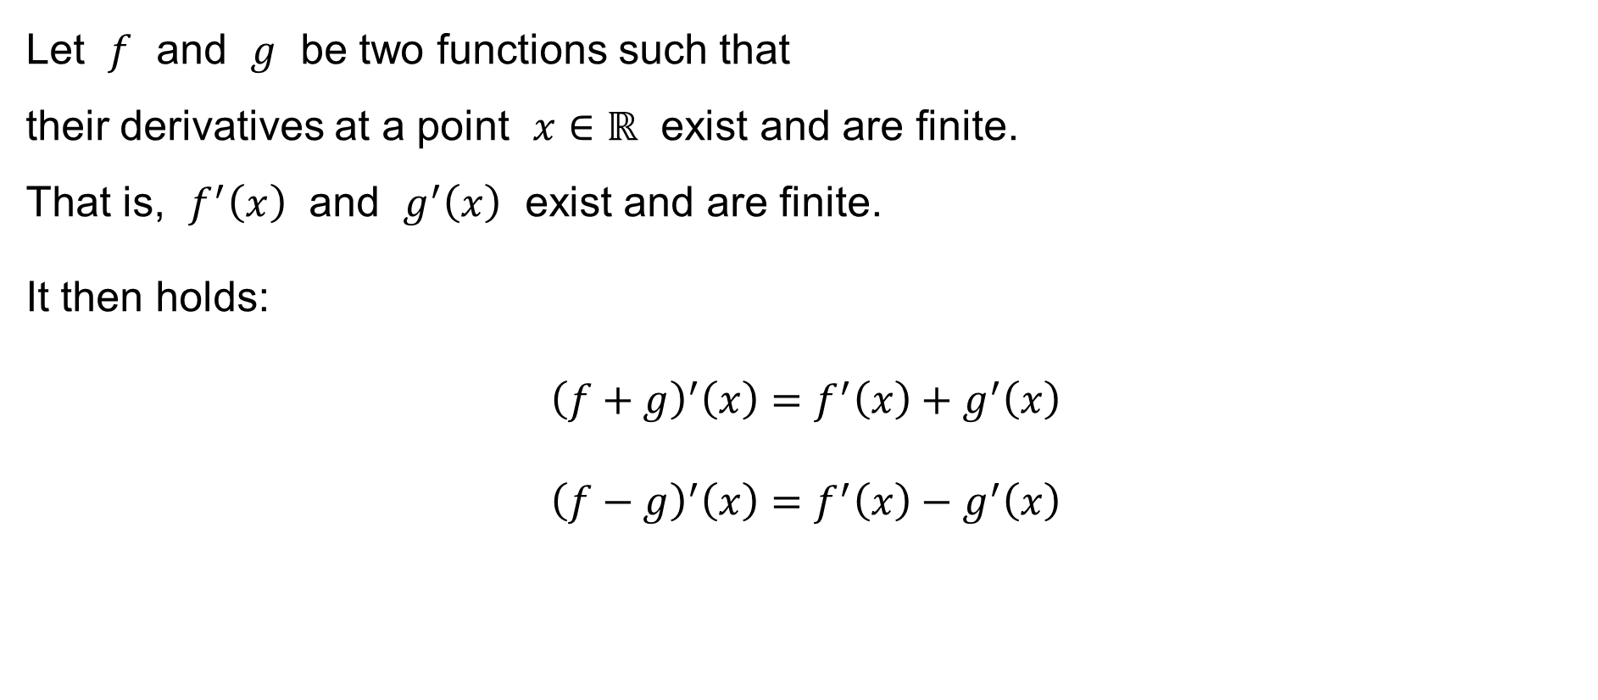
Rules to calculate the derivative II
Let $f$ and $g$ be two functions such that
their derivatives at a point $x∈ℝ$ exist and are finite.
That is, $f^{′}\left(x\right)$ and $g^{′}\left(x\right)$ exist and are finite.
It then holds:
$${\left(f+g\right)}^{′}\left(x\right)=f^{′}\left(x\right)+g^{′}\left(x\right) \\ {\left(f−g\right)}^{′}\left(x\right)=f^{′}\left(x\right)−g^{′}\left(x\right)$$

Slide 14
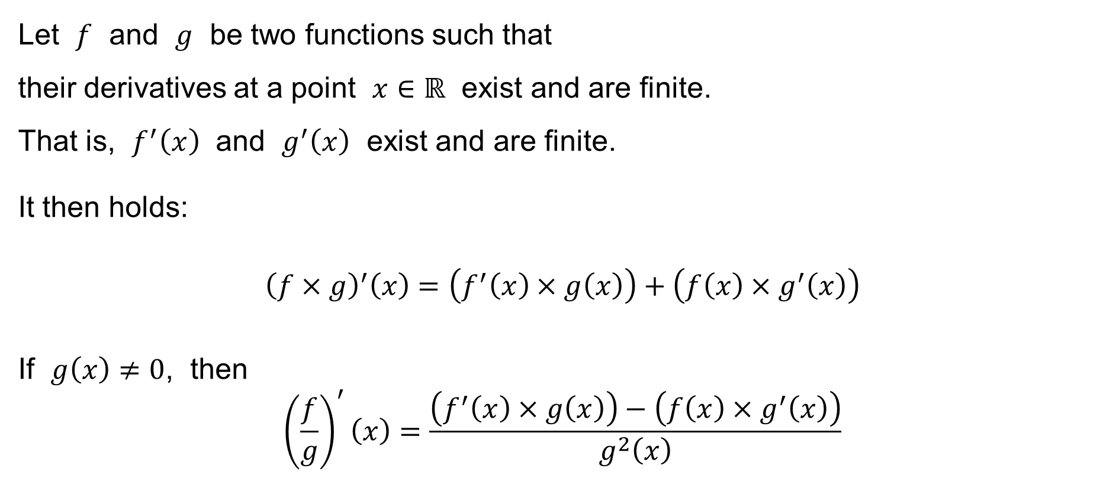
Rules to calculate the derivative III
Let $f$ and $g$ be two functions such that
their derivatives at a point $x∈ℝ$ exist and are finite.
That is, $f^{′}\left(x\right)$ and $g^{′}\left(x\right)$ exist and are finite.
It then holds:
$${\left(f×g\right)}^{′}\left(x\right)=\left(f^{′}\left(x\right)×g\left(x\right)\right)+\left(f\left(x\right)×g^{′}\left(x\right)\right)$$
If $g\left(x\right)≠0$, then
$${\left(\frac{f}{g}\right)}^{′}\left(x\right)=\frac{\left(f^{′}\left(x\right)×g\left(x\right)\right)−\left(f\left(x\right)×g^{′}\left(x\right)\right)}{g^{2}\left(x\right)}$$

Slide 15
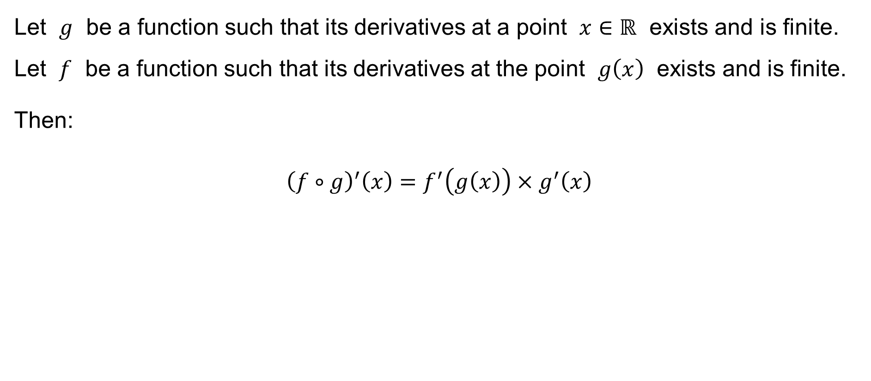
Chain rule
Let $g$ be a function such that its derivatives at a point $x∈ℝ$ exists and is finite.
Let $f$ be a function such that its derivatives at the point $g\left(x\right)$ exists and is finite.
Then:
$${\left(f∘g\right)}^{′}\left(x\right)=f^{′}\left(g\left(x\right)\right)×g^{′}\left(x\right)$$

Slide 16

Examples: Derivatives of elementary functions I
Let $f\left(x\right)=\text{const}\text{.}$
Then $f^{′}\left(x\right)=0$
$$f^{′}\left(x\right)=\lim_{h→0}{\frac{f\left(x+h\right)−f\left(x\right)}{h}}=\lim_{h→0}{\frac{\text{const}\text{.}−\text{const}\text{.}}{h}}=\lim_{h→0}{\frac{0}{h}}=\lim_{h→0}{0}=0$$

Slide 17

Examples: Derivatives of elementary functions II
Let $f\left(x\right)=x^{n} \text{for} n=1, 2, 3, 4, 5,…$
Then $f^{′}\left(x\right)=n×x^{n−1}$
$$f^{′}\left(x\right)=\lim_{h→0}{\frac{f\left(x+h\right)−f\left(x\right)}{h}}=\lim_{h→0}{\frac{{\left(x+h\right)}^{n}−x^{n}}{h}}= \\ =\lim_{h→0}{\frac{x^{n}+\left({n \atop 1}\right)x^{n−1}h+\left({n \atop k}\right)x^{n−2}h^{2}+⋯+h^{n}−x^{n}}{h}}=nx^{n−1}$$

Slide 18

Examples: Derivatives of elementary functions III
Let $f\left(x\right)=\sqrt[n]{x}=x^{\frac{1}{n}} \text{for} n=1, 2, 3, 4, 5,…$
Then $f^{′}\left(x\right)=\frac{1}{n×\sqrt[n]{x^{n−1}}}=\frac{1}{n}×x^{\frac{1}{n}−1}$
— calculate the derivative of the function inverse ($\sqrt[n]{x}$) to the function $f\left(x\right)=x^{n}$

Slide 19

Examples: Derivatives of elementary functions IV
Let $f\left(x\right)=x^{\frac{p}{q}}=\sqrt[q]{x^{p}} \text{for} p,q=1, 2, 3, 4, 5,…$
Then $f^{′}\left(x\right)=\frac{p}{q}×\sqrt[q]{x^{p−q}}=\frac{p}{q}×x^{\frac{p−q}{q}}$
— calculate the derivative of the composite function ($\sqrt[q]{x^{p}}$) – chain rule

Slide 20

Examples: Derivatives of elementary functions IV
Let $f\left(x\right)=x^{λ} \text{for} λ∈ℝ$
Then $f^{′}\left(x\right)=λ×x^{λ−1}$
— consider the limit of $x^{λ_{n}}$ for $λ_{n}=\frac{p_{n}}{q_{n}}→λ$

Slide 21

Examples: Derivatives of elementary functions V
Let $f\left(x\right)=e^{x}$
Then $f^{′}\left(x\right)=e^{x}$

Slide 22

Examples: Derivatives of elementary functions VI
Let $f\left(x\right)=\sin{x}$
Then $f^{′}\left(x\right)=\cos{x}$
Let $f\left(x\right)=\cos{x}$
Then $f^{′}\left(x\right)=−\sin{x}$

Slide 23

Examples: Derivatives of elementary functions VII
Let $f\left(x\right)=\tan{x}$
Then $f^{′}\left(x\right)=\frac{1}{\cos^{2}{x}}=\frac{1}{{\left(\cos{x}\right)}^{2}}$
$${\left(\tan{x}\right)}^{′}={\left(\frac{\sin{x}}{\cos{x}}\right)}^{′}=\frac{\cos{x}×\cos{x}−\sin{x}×\left(−\sin{x}\right)}{\cos^{2}{x}}=\frac{\cos^{2}{x}+\sin^{2}{x}}{\cos^{2}{x}}=\frac{1}{\cos^{2}{x}}$$

Slide 24

Examples: Derivatives of elementary functions VIII
Let $f\left(x\right)=a^{x} \text{for} a>0$
Then $f^{′}\left(x\right)=a^{x}×\ln{a}$
$$f\left(x\right)=a^{x}=e^{\ln\left(a^{x}\right)}=e^{x\ln{a}} \\ f^{′}\left(x\right)=e^{x\ln{a}}×\left(1×\ln{a}\right)=a^{x}×\ln{a}$$

Slide 25
The rules of differentiation
Let f(x) and g(x) be functions with the derivative
in the interval Then:

Slide 26
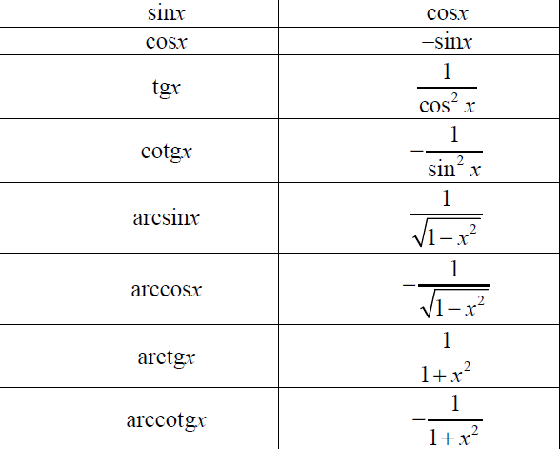
Derivatives of elementary functions

Slide 27
Examples

