Slide 1
Quantitative Methods
Lecture 7
L’Hospital’s rule
BAKVM

Slide 2
L’Hospital’s rule
Higher-order derivatives

Slide 3
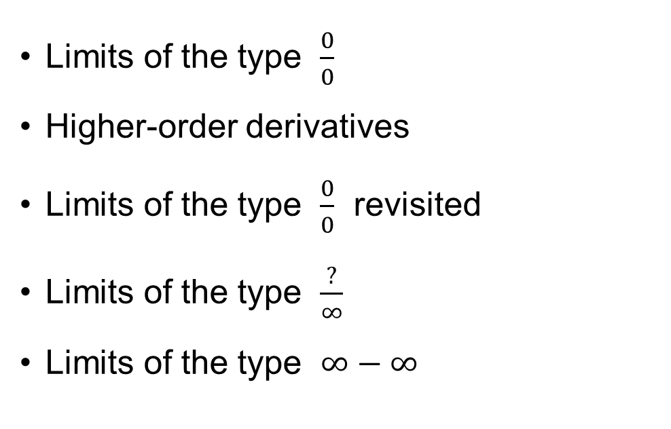
L’Hospital’s rule
Limits of the type $\frac{0}{0}$
Higher-order derivatives
Limits of the type $\frac{0}{0}$ revisited
Limits of the type $\frac{?}{∞}$
Limits of the type $∞−∞$

Slide 4
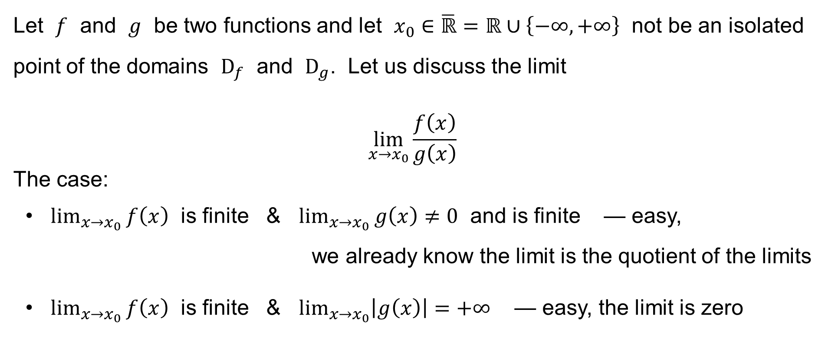
L’Hospital’s Rule
Let $f$ and $g$ be two functions and let $x_{0}∈\overline{ℝ}=ℝ∪\left\{−∞,+∞\right\}$ not be an isolated point of the domains $D_{f}$ and $D_{g}$. Let us discuss the limit
$$\lim_{x→x_{0}}{\frac{f\left(x\right)}{g\left(x\right)}}$$
The case:
• $\lim_{x→x_{0}}{f\left(x\right)}$ is finite & $\lim_{x→x_{0}}{g\left(x\right)}≠0$ and is finite — easy,
we already know the limit is the quotient of the limits
• $\lim_{x→x_{0}}{f\left(x\right)}$ is finite & $\lim_{x→x_{0}}\left|g\left(x\right)\right|=+∞$ — easy, the limit is zero

Slide 5
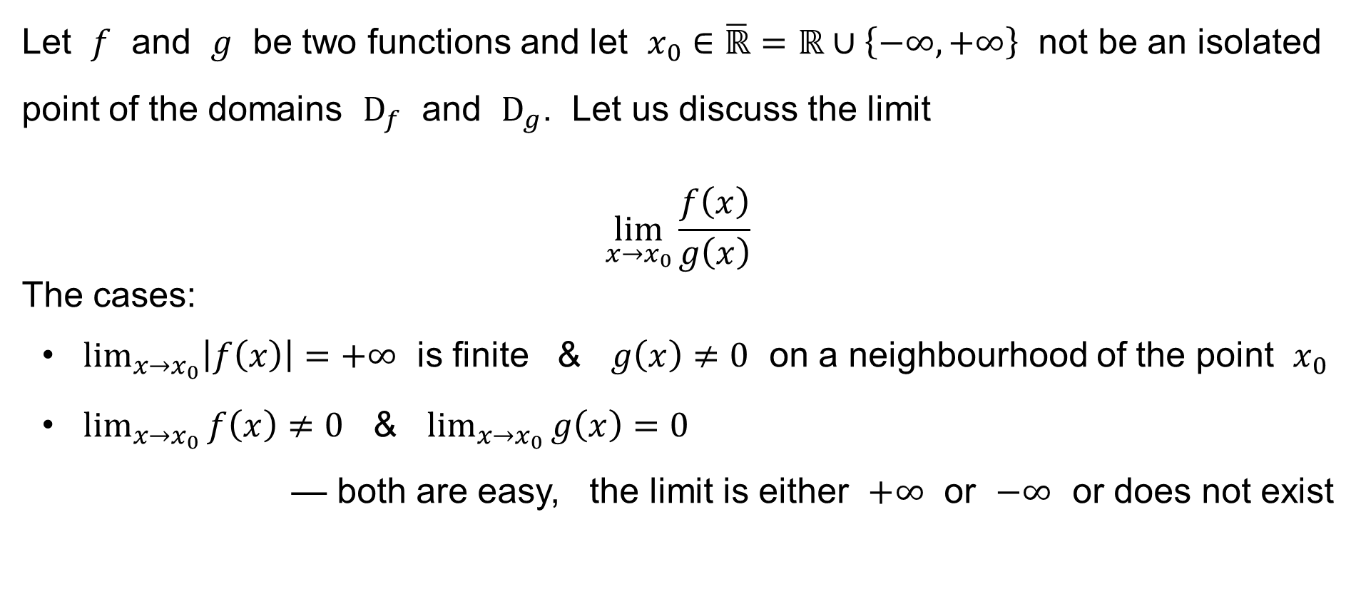
L’Hospital’s Rule
Let $f$ and $g$ be two functions and let $x_{0}∈\overline{ℝ}=ℝ∪\left\{−∞,+∞\right\}$ not be an isolated point of the domains $D_{f}$ and $D_{g}$. Let us discuss the limit
$$\lim_{x→x_{0}}{\frac{f\left(x\right)}{g\left(x\right)}}$$
The cases:
• $\lim_{x→x_{0}}\left|f\left(x\right)\right|=+∞$ is finite & $g\left(x\right)≠0$ on a neighbourhood of the point $x_{0}$
• $\lim_{x→x_{0}}{f\left(x\right)}≠0$ & $\lim_{x→x_{0}}{g\left(x\right)}=0$
— both are easy, the limit is either $+∞$ or $−∞$ or does not exist

Slide 6
L’Hospital’s Rule
Let $f$ and $g$ be two functions and let $x_{0}∈\overline{ℝ}=ℝ∪\left\{−∞,+∞\right\}$ not be an isolated point of the domains $D_{f}$ and $D_{g}$. Let us discuss the limit
$$\lim_{x→x_{0}}{\frac{f\left(x\right)}{g\left(x\right)}}$$
The cases:
• $\lim_{x→x_{0}}\left|f\left(x\right)\right|=+∞$ is finite & $g\left(x\right)≠0$ on a neighbourhood of the point $x_{0}$
• $\lim_{x→x_{0}}{f\left(x\right)}≠0$ & $\lim_{x→x_{0}}{g\left(x\right)}=0$
— both are easy, the limit is either $+∞$ or $−∞$ or does not exist

Slide 7
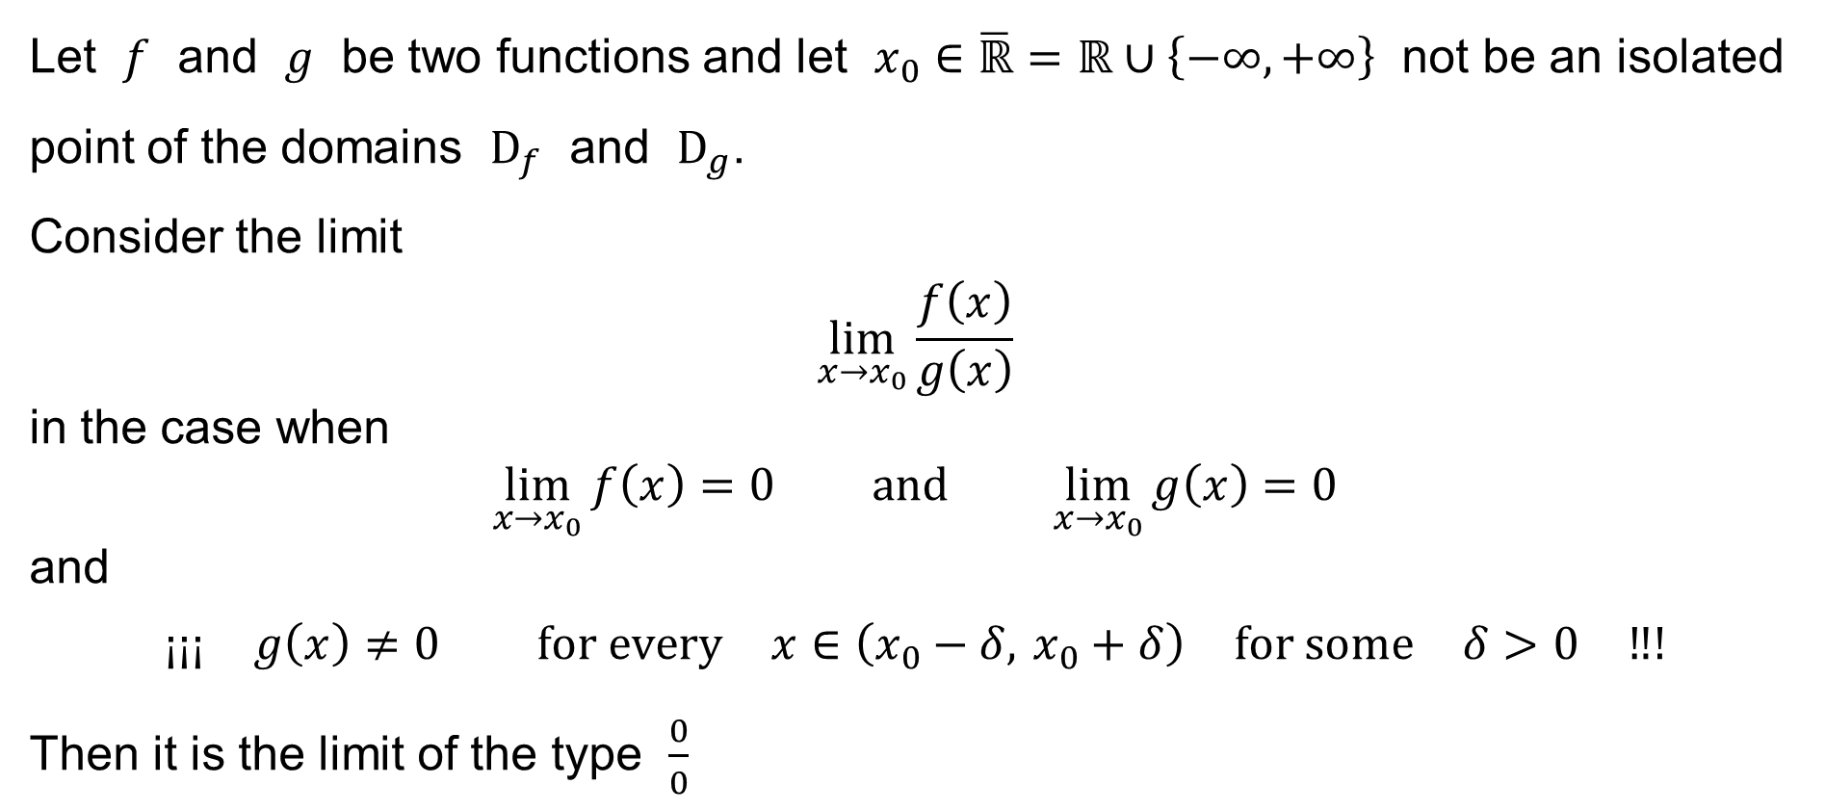
L’Hospital’s Rule
Let $f$ and $g$ be two functions and let $x_{0}∈\overline{ℝ}=ℝ∪\left\{−∞,+∞\right\}$ not be an isolated point of the domains $D_{f}$ and $D_{g}$.
Consider the limit
$$\lim_{x→x_{0}}{\frac{f\left(x\right)}{g\left(x\right)}}$$
in the case when
$$\lim_{x→x_{0}}{f\left(x\right)}=0 \text{and} \lim_{x→x_{0}}{g\left(x\right)}=0$$
and
$$\text{¡¡¡} g\left(x\right)≠0 \text{for} \text{every} x∈\left(x_{0}−δ, x_{0}+δ\right) \text{for} \text{some} δ>0 \text{‼!}$$
Then it is the limit of the type $\frac{0}{0}$

Slide 8

Notice
A special case of the limit
$$\lim_{x→x_{0}}{\frac{f\left(x\right)}{g\left(x\right)}}$$
is for
$$f\left(x\right)=F\left(x\right)−F\left(x_{0}\right) \text{and} g\left(x\right)=x−x_{0}$$
If the function $F$ is continuous at the point $x_{0}$, then $\lim_{x→x_{0}}{f\left(x\right)}=0$ and
$$\lim_{x→x_{0}}{\frac{f\left(x\right)}{g\left(x\right)}}=F^{′}\left(x_{0}\right)=f^{′}\left(x_{0}\right)$$
if the limit exists.

Slide 9
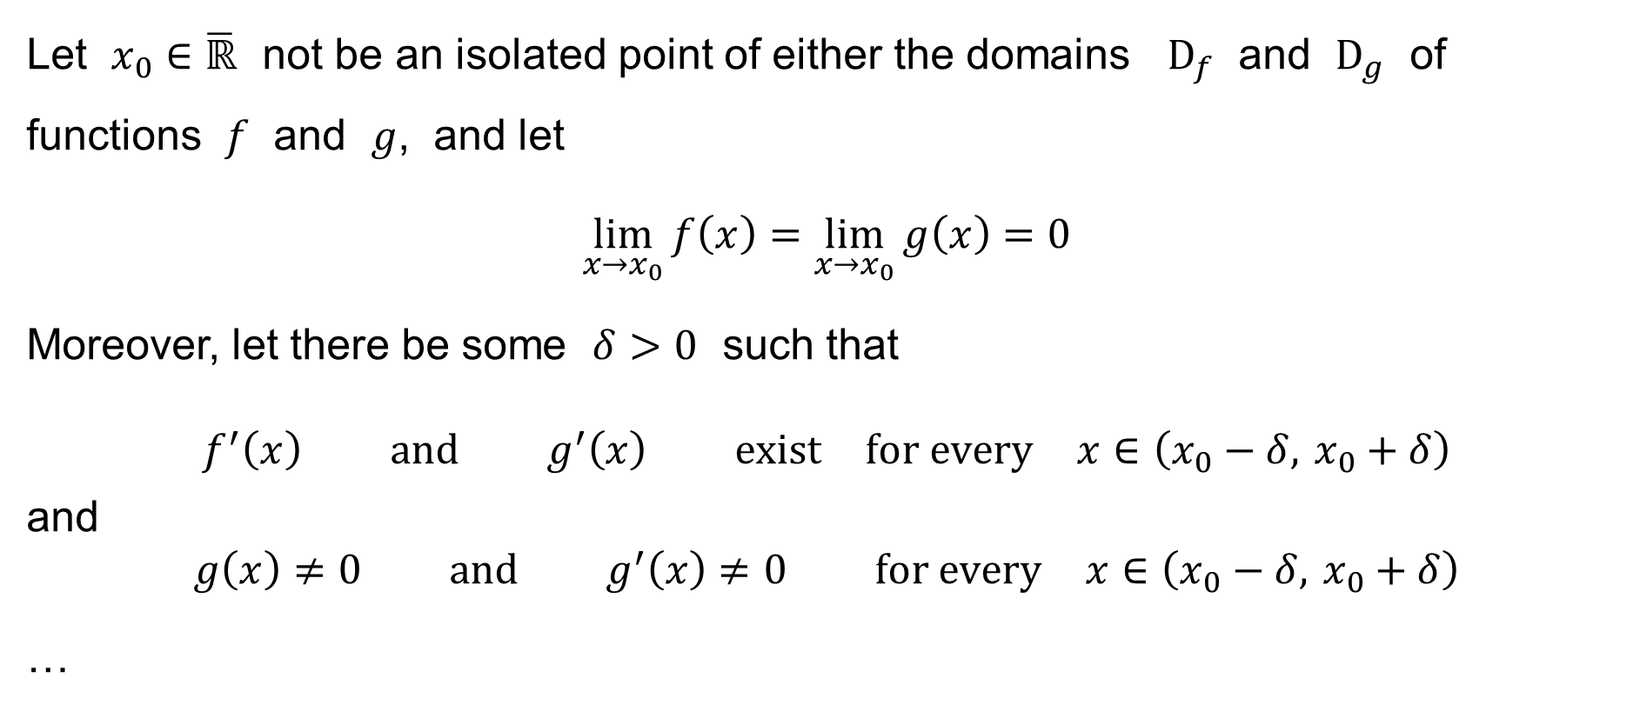
Theorem (L’Hospital’s Rule)
Let $x_{0}∈\overline{ℝ}$ not be an isolated point of either the domains $D_{f}$ and $D_{g}$ of functions $f$ and $g$, and let
$$\lim_{x→x_{0}}{f\left(x\right)}=\lim_{x→x_{0}}{g\left(x\right)}=0$$
Moreover, let there be some $δ>0$ such that
$$f^{′}\left(x\right) \text{and} g^{′}\left(x\right) \text{exist} \text{for} \text{every} x∈\left(x_{0}−δ, x_{0}+δ\right)$$
and
$$g\left(x\right)≠0 \text{and} g^{′}\left(x\right)≠0 \text{for} \text{every} x∈\left(x_{0}−δ, x_{0}+δ\right)$$
…

Slide 10

Theorem (L’Hospital’s Rule)
… Then: If the limit
$$\lim_{x→x_{0}}{\frac{f^{′}\left(x\right)}{g^{′}\left(x\right)}}$$
exists (finite or infinite), then the limit
$$\lim_{x→x_{0}}{\frac{f\left(x\right)}{g\left(x\right)}}$$
also exists and it holds
$$\lim_{x→x_{0}}{\frac{f\left(x\right)}{g\left(x\right)}}=\lim_{x→x_{0}}{\frac{f^{′}\left(x\right)}{g^{′}\left(x\right)}}$$

Slide 11
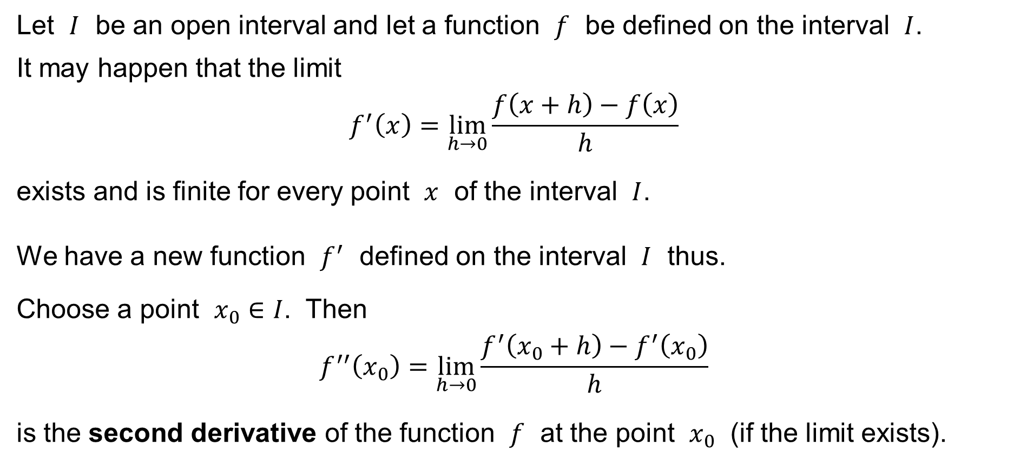
Higher-order derivatives
Let $I$ be an open interval and let a function $f$ be defined on the interval $I$.
It may happen that the limit
$$f^{′}\left(x\right)=\lim_{h→0}{\frac{f\left(x+h\right)−f\left(x\right)}{h}}$$
exists and is finite for every point $x$ of the interval $I$.
We have a new function $f^{′}$ defined on the interval $I$ thus.
Choose a point $x_{0}∈I$. Then
$$f^{′′}\left(x_{0}\right)=\lim_{h→0}{\frac{f^{′}\left(x_{0}+h\right)−f^{′}\left(x_{0}\right)}{h}}$$
is the second derivative of the function $f$ at the point $x_{0}$ (if the limit exists).

Slide 12


Higher-order derivatives
Notation:
$f^{′}$ … the (first) derivative
$f^{′′}$ … the second derivative
$f^{′′′}$ … the third derivative
$f^{\left(4\right)}$ … the fourth derivative
⋮
$f^{\left(n\right)}$ … the $n$-th derivative
We also put:
$f^{\left(0\right)}=f$ … the zeroth derivative
of the function $f$, i.e. the original function $f$

Slide 13
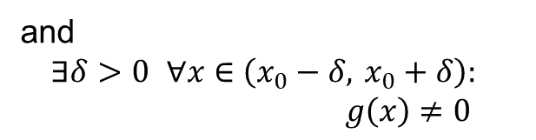

It also holds — Theorem
Let
$$\lim_{x→x_{0}}{f\left(x\right)}=\lim_{x→x_{0}}{g\left(x\right)}=0$$
and
$$f^{′}\left(x_{0}\right)=f^{′′}\left(x_{0}\right)=⋯=f^{\left(n−1\right)}\left(x_{0}\right)=0$$
$$g^{′}\left(x_{0}\right)=g^{′′}\left(x_{0}\right)=⋯=g^{\left(n−1\right)}\left(x_{0}\right)=0$$
and
$$f^{\left(n\right)} \text{exists} \text{and} \text{is} \text{finite}$$
$$g^{\left(n\right)} \text{exists} \text{and} \text{is} \text{finite}$$
Then
$$\lim_{x→x_{0}}{\frac{f\left(x\right)}{g\left(x\right)}}=\frac{f^{\left(n\right)}\left(x_{0}\right)}{g^{\left(n\right)}\left(x_{0}\right)}$$
the derivatives exist
and are zero
and
$$∃δ>0 ∀x∈\left(x_{0}−δ, x_{0}+δ\right): \\ g\left(x\right)≠0$$

Slide 14
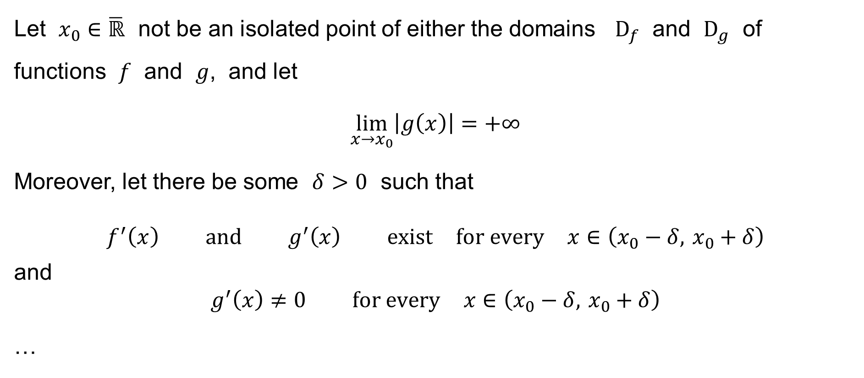
Theorem
Let $x_{0}∈\overline{ℝ}$ not be an isolated point of either the domains $D_{f}$ and $D_{g}$ of functions $f$ and $g$, and let
$$\lim_{x→x_{0}}\left|g\left(x\right)\right|=+∞$$
Moreover, let there be some $δ>0$ such that
$$f^{′}\left(x\right) \text{and} g^{′}\left(x\right) \text{exist} \text{for} \text{every} x∈\left(x_{0}−δ, x_{0}+δ\right)$$
and
$$g^{′}\left(x\right)≠0 \text{for} \text{every} x∈\left(x_{0}−δ, x_{0}+δ\right)$$
…

Slide 15
Theorem
… Then: If the limit
$$\lim_{x→x_{0}}{\frac{f^{′}\left(x\right)}{g^{′}\left(x\right)}}$$
exists (finite or infinite), then the limit
$$\lim_{x→x_{0}}{\frac{f\left(x\right)}{g\left(x\right)}}$$
also exists and it holds
$$\lim_{x→x_{0}}{\frac{f\left(x\right)}{g\left(x\right)}}=\lim_{x→x_{0}}{\frac{f^{′}\left(x\right)}{g^{′}\left(x\right)}}$$

Slide 16

Limit of the type ∞−∞
Let
$$\lim{f\left(x\right)}=\lim{g\left(x\right)}=±∞$$
Then
$$\lim{f\left(x\right)−g\left(x\right)}=\lim{\frac{\frac{1}{g\left(x\right)}−\frac{1}{f\left(x\right)}}{\frac{1}{f\left(x\right)g\left(x\right)}}}$$
i.e. the limit of the type $∞−∞$ is transformed into the type $\frac{0}{0}$

Slide 17

Example
Find the limit
$$\lim_{x→0}{\frac{\sin{x}}{x}}$$
Recall that ${\left(\sin{x}\right)}^{′}=\cos{x}$ and that ${\left(x\right)}^{′}={\left(x^{1}\right)}^{′}=1x^{0}=1$.
Hence:
$$\lim_{x→0}{\frac{\sin{x}}{x}}=\lim_{x→0}{\frac{\cos{x}}{1}}=\frac{1}{1}=1$$

Slide 18

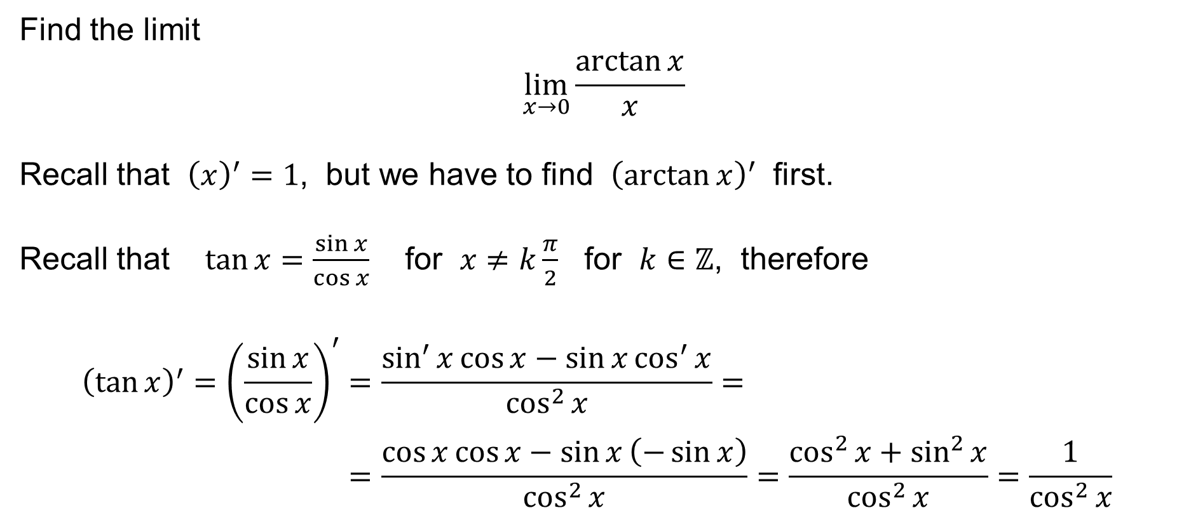
Example
Find the limit
$$\lim_{x→0}{\frac{\arctan{x}}{x}}$$
Recall that ${\left(x\right)}^{′}=1$, but we have to find ${\left(\arctan{x}\right)}^{′}$ first.
Recall that $\tan{x}=\frac{\sin{x}}{\cos{x}}$ for $x≠k\frac{π}{2}$ for $k∈ℤ$, therefore
$${\left(\tan{x}\right)}^{′}={\left(\frac{\sin{x}}{\cos{x}}\right)}^{′}=\frac{\sin^{′}{x}\cos{x}−\sin{x}\cos^{′}{x}}{\cos^{2}{x}}= \\ =\frac{\cos{x}\cos{x}−\sin{x}\left(−\sin{x}\right)}{\cos^{2}{x}}=\frac{\cos^{2}{x}+\sin^{2}{x}}{\cos^{2}{x}}=\frac{1}{\cos^{2}{x}}$$
$${\left(\frac{f}{g}\right)}^{′}=\frac{f^{′}g−fg^{′}}{g^{2}}$$

Slide 19

Example (continued)
Next, it holds for every $x∈\left(−\frac{π}{2}, \frac{π}{2}\right)$ that
$$\arctan{\tan{x}}=x | {\left( \right)}^{′} \\ {\left(\arctan{\tan{x}}\right)}^{′}=1 \\ \arctan^{′}{\tan{x}}×\frac{1}{\cos^{2}{x}}=1 \\ \arctan^{′}{\tan{x}}=\cos^{2}{x} | x=\arctan{y} \\ \arctan^{′}{y}=\cos^{2}{\arctan{y}}$$

Slide 20








Example (continued)
Now, we know that $\arctan^{′}{y}=\cos^{2}{\arctan{y}}$ for all $y∈\left(−∞,+∞\right)$, but
what is $\cos^{2}{\arctan{y}}$ ?
$$\cos{α}=\frac{b}{c}=\frac{b}{\sqrt{a^{2}+b^{2}}} \\ \cos^{2}{α}=\frac{b^{2}}{a^{2}+b^{2}} \\ \cos^{2}{\arctan{\frac{a}{b}}}=\frac{b^{2}}{a^{2}+b^{2}}$$
$$a^{2}+b^{2}=c^{2} \\ c=\sqrt{a^{2}+b^{2}}$$
$$\tan{α}=\frac{a}{b} \\ α=\arctan{\frac{a}{b}}$$
$$c$$
$$a$$
$$α$$
$$b$$
Assuming WLOG that $b=±1$, we have obtained the result: $\arctan^{′}{a}=\cos^{2}{\arctan{a}}=\frac{1}{1+a^{2}}$

Slide 21

Example (finished)
Finally:
$$\lim_{x→0}{\frac{\arctan{x}}{x}}=\lim_{x→0}{\frac{\frac{1}{1+x^{2}}}{1}}=\frac{\frac{1}{1+0}}{1}=\frac{1}{1}=1$$

Slide 22

Example
Find the limit
$$\lim_{x→0}\left(\frac{1}{\sin{x}}−\frac{1}{\arcsin{x}}\right)$$
We calculate:
$$\lim_{x→0}\left(\frac{1}{\sin{x}}−\frac{1}{\arcsin{x}}\right)=\lim_{x→0}{\frac{\arcsin{x}−\sin{x}}{\sin{x}×\arcsin{x}}}$$
Recall that ${\left(\sin{x}\right)}^{′}=\cos{x}$, but we have to find ${\left(\arcsin{x}\right)}^{′}$ first.

Slide 23

Example (continued)
Next, it holds for every $x∈\left(−\frac{π}{2}, \frac{π}{2}\right)$ that
$$\arcsin{\sin{x}}=x | {\left( \right)}^{′} \\ {\left(\arcsin{\sin{x}}\right)}^{′}=1 \\ \arcsin^{′}{\sin{x}}×\cos{x}=1 \\ \arcsin^{′}{\sin{x}}=\frac{1}{\cos{x}} | x=\arcsin{y} \\ \arcsin^{′}{y}=\frac{1}{\cos{\arcsin{y}}}$$

Slide 24




Example (continued)
Now, we know that $\arcsin^{′}{y}=\frac{1}{\cos{\arcsin{y}}}$ for all $y∈\left(−1,+1\right)$, but
what is $\frac{1}{\cos{\arcsin{y}}}$ ?
$$\cos{α}=\frac{b}{c}=\frac{\sqrt{c^{2}−a^{2}}}{c} \\ \cos{\arcsin{\frac{a}{c}}}=\frac{\sqrt{c^{2}−a^{2}}}{c}$$
$$a^{2}+b^{2}=c^{2} \\ b=\sqrt{c^{2}−a^{2}}$$
$$\sin{α}=\frac{a}{c} \\ α=\arcsin{\frac{a}{c}}$$
$$c$$
$$a$$
$$α$$
$$b$$
Assuming WLOG that $c=1$, we have obtained the result: $\arcsin^{′}{a}=\frac{1}{\cos{\arcsin{a}}}=\frac{1}{\sqrt{1−a^{2}}}$

Slide 25


Example (continued)
Finally:
$$\lim_{x→0}\left(\frac{1}{\sin{x}}−\frac{1}{\arcsin{x}}\right)=\lim_{x→0}{\frac{\arcsin{x}−\sin{x}}{\sin{x}×\arcsin{x}}}= \\ =\lim_{x→0}{\frac{\frac{1}{\sqrt{1−x^{2}}}−\cos{x}}{\cos{x}×\arcsin{x}+\sin{x}×\frac{1}{\sqrt{1−x^{2}}}}}=⋯$$
$${\left(fg\right)}^{′}=f^{′}g+fg^{′}$$

Slide 26

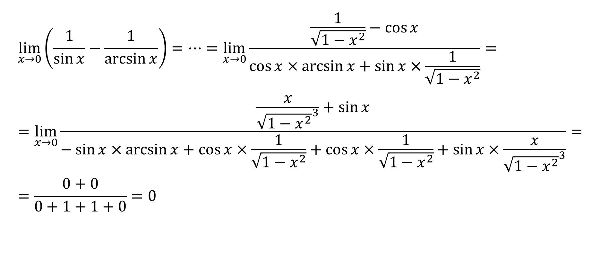

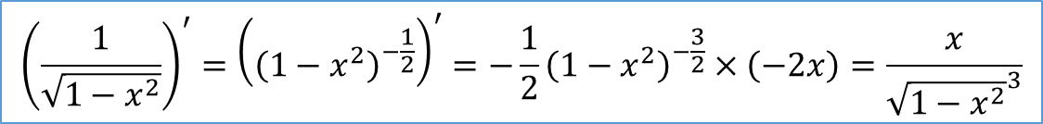
Example (finished)
$$\lim_{x→0}\left(\frac{1}{\sin{x}}−\frac{1}{\arcsin{x}}\right)=⋯=\lim_{x→0}{\frac{\frac{1}{\sqrt{1−x^{2}}}−\cos{x}}{\cos{x}×\arcsin{x}+\sin{x}×\frac{1}{\sqrt{1−x^{2}}}}}= \\ =\lim_{x→0}{\frac{\frac{x}{{\sqrt{1−x^{2}}}^{3}}+\sin{x}}{−\sin{x}×\arcsin{x}+\cos{x}×\frac{1}{\sqrt{1−x^{2}}}+\cos{x}×\frac{1}{\sqrt{1−x^{2}}}+\sin{x}×\frac{x}{{\sqrt{1−x^{2}}}^{3}}}}= \\ =\frac{0+0}{0+1+1+0}=0$$
$${\left(fg\right)}^{′}=f^{′}g+fg^{′}$$
$${\left(f\left(g\left(x\right)\right)\right)}^{′}=f^{′}\left(g\left(x\right)\right)×g^{′}\left(x\right)$$
$${\left(\frac{1}{\sqrt{1−x^{2}}}\right)}^{′}={\left({\left(1−x^{2}\right)}^{−\frac{1}{2}}\right)}^{′}=−\frac{1}{2}{\left(1−x^{2}\right)}^{−\frac{3}{2}}×\left(−2x\right)=\frac{x}{{\sqrt{1−x^{2}}}^{3}}$$

