Slide 1
Management information systems
BCP and SCM
Petr Suchánek
Management information systems
DAMIA

Slide 2
Outline of the lecture
Business continuity planning
Supply chain management

Slide 3
Business continuity planning*
Business Continuity Planning (BCP) or Business Continuity and Resiliency Planning (BCRP) creates a guideline for continuing business operations under adverse conditions such as a natural calamity, an interruption in regular business processes, loss or damage to critical infrastructure, or a crime done against the business.
It is defined as a plan that "identifies an organization's exposure to internal and external threats and synthesizes hard and soft assets to provide effective prevention and recovery for the organization, while maintaining competitive advantage and value system integrity."
Understandably, risk management and disaster management are major components in business continuity planning.
* https://www.tutorialspoint.com/management_information_system/mis_tutorial.pdf

Slide 4
Business continuity planning
Reducing the possibility of any interruption in regular business processes using proper risk management.
Minimizing the impact of interruption, if any.
Teaching the staff their roles and responsibilities in such a situation to safeguard their own security and other interests.
Handling any potential failure in supply chain system, to maintain the natural flow of business.
Protecting the business from failure and negative publicity.
Protecting customers and maintaining customer relationships.
Protecting the prevalent and prospective market and competitive advantage of the business.
Protecting profits, revenue and goodwill.
Setting a recovery plan following a disruption to normal operating conditions.
Fulfilling legislative and regulatory requirements.
Objectives of BCP*
* https://www.tutorialspoint.com/management_information_system/mis_tutorial.pdf

Slide 5
Business continuity planning
The business continuity planning process involves recovery, continuation, and preservation of the entire business operation, not just its technology component. It should include contingency plans to protect all resources of the organization, e.g., human resource, financial resource and IT infrastructure, against any mishap.
It has the following phases:
Project management & initiation;
Business Impact Analysis (BIA);
Recovery strategies;
Plan design & development;
Testing, maintenance, awareness, training.
Phases of BCP*
* https://www.tutorialspoint.com/management_information_system/mis_tutorial.pdf

Slide 6
Business continuity planning
This phase has the following sub-phases:
Establish need (risk analysis);
Get management support;
Establish team (functional, technical, BCC - Business Continuity Coordinator);
Create work plan (scope, goals, methods, timeline);
Initial report to management;
Obtain management approval to proceed.
Project management and initiation*
* https://www.tutorialspoint.com/management_information_system/mis_tutorial.pdf

Slide 7
Business continuity planning
Business impact analysis*
This phase is used to obtain formal agreement with senior management for each time-critical business resource. This phase has the following sub-phases:
Deciding maximum tolerable downtime, also known as MAO (Maximum Allowable Outage);
Quantifying loss due to business outage (financial, extra cost of recovery, embarrassment), without estimating the probability of kinds of incidents, it only quantifies the consequences;
Choosing information gathering methods (surveys, interviews, software tools);
Selecting interviewees;
Customizing questionnaire;
Analyzing information;
* https://www.tutorialspoint.com/management_information_system/mis_tutorial.pdf

Slide 8
Business continuity planning
Business impact analysis*
This phase is used to obtain formal agreement with senior management for each time-critical business resource. This phase has the following sub-phases:
Identifying time-critical business functions;
Assigning MTDs;
Ranking critical business functions by MTDs;
Reporting recovery options;
Obtaining management approval.
* https://www.tutorialspoint.com/management_information_system/mis_tutorial.pdf

Slide 9
Business continuity planning
Recovery phase*
This phase involves creating recovery strategies are based on MTDs, predefined and management-approved. These strategies should address recovery of:
Business operations;
Facilities & supplies;
Users (workers and end-users);
Network;
Data center (technical);
Data (off-site backups of data and applications).
* https://www.tutorialspoint.com/management_information_system/mis_tutorial.pdf

Slide 10
Business continuity planning
BCP development phase*
This phase involves creating detailed recovery plan that includes:
Business & service recovery plans;
Maintenance plan;
Awareness & training plan;
Testing plan.
The Sample Plan is divided into the following phases:
Initial disaster response;
Resume critical business ops;
Resume non-critical business ops;
Restoration (return to primary site);
Interacting with external groups (customers, media, emergency responders).
* https://www.tutorialspoint.com/management_information_system/mis_tutorial.pdf

Slide 11
Business continuity planning
Final phase*
The final phase is a continuously evolving process containing testing, maintenance, and training.
The testing process generally follows procedures like structured walk-through, creating checklist, simulation, parallel and full interruptions.
Maintenance involves:
Fixing problems found in testing
Implementing change management
Auditing and addressing audit findings
Annual review of plan
Training is an ongoing process and it should be made a part of the corporate standards and the corporate culture.
* https://www.tutorialspoint.com/management_information_system/mis_tutorial.pdf

Slide 12
Supply chain management
Supply chain management (SCM) is the active management of supply chain activities to maximize customer value and achieve a sustainable competitive advantage. It represents a conscious effort by the supply chain firms to develop and run supply chains in the most effective & efficient ways possible. Supply chain activities cover everything from product development, sourcing, production, and logistics, as well as the information systems needed to coordinate these activities.*
Management of material and information flow in a supply chain to provide the highest degree of customer satisfaction at the lowest possible cost. Supply chain management requires the commitment of supply chain partners to work closely to coordinate order generation, order taking, and order fulfillment. They thereby create an extended enterprise spreading far beyond the producer's location.**
*https://scm.ncsu.edu/scm-articles/article/what-is-supply-chain-management
**http://www.businessdictionary.com/definition/supply-chain-management-SCM.html

Slide 13
Supply chain management
Objectives of CSM*
To decrease inventory cost by more accurately predicting demand and scheduling production to match it.
To reduce overall production cost by streamlining production and by improving information flow.
To improve customer satisfaction.
* https://www.tutorialspoint.com/management_information_system/mis_tutorial.pdf

Slide 14
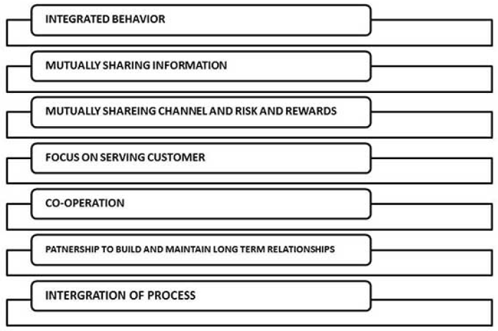
Supply chain management
Features of CSM*
* https://www.tutorialspoint.com/management_information_system/mis_tutorial.pdf

Slide 15
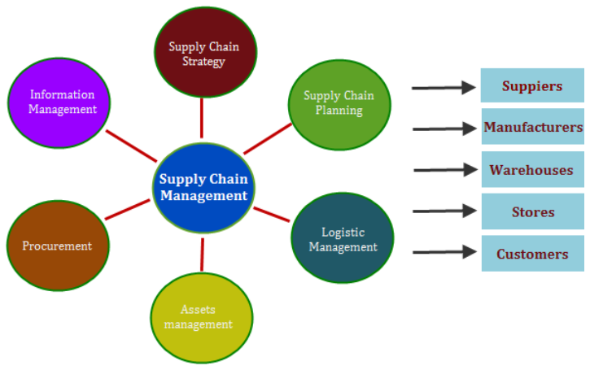
Supply chain management
Features of Supply Chain Management Software*
Supply Chain Management (SCM) is an integral process in a variety of industrial sectors. The growth of Information technology (IT) has led to the development of various software programs that can support the SCM process. One such product is supply chain management software.
* https://www.futurismtechnologies.com/blog/5-features-of-supply-chain-management-software/

Slide 16
Supply chain management
Key features of Supply Chain Management*
Supply chain management software is designed to perform the following functions:
Processing Customer Requirements - SCMS can help enhance the speed of customer requirement processing. This includes checking for raw material availability, product manufacturing, and passing the product to the logistics team. The software can track the entire process, and ensure that the product is delivered on time.
Inventory Management - In warehouses, managers can use SCMS to effectively manage the quantity of stocked goods. The software can also help support inventory concerns such as asset management, replenishment lead time, and future inventory and price forecasting.
Purchase Order Processing - With SCMS, the purchase order processes are usually automated. It reduces time and effort needed to generate and manage purchase orders. Pre-defined parameters can be set up to replenish inventories, generate serial numbers for product shipments, and track inventory costs.
* https://www.futurismtechnologies.com/blog/5-features-of-supply-chain-management-software/

Slide 17
Supply chain management
Key features of Supply Chain Management*
Supply chain management software is designed to perform the following functions:
Supplier Relationship Management - The strategic planning and managing of all supplier interactions can be accomplished with SCMS. The software can be used to assess the suppliers assets and capabilities and compare them with the organization business strategy.
Warehouse Management - SCMS can effectively support a warehouse management system in the movement and storage of products. SCMS can quickly process transactions such a picking, placing, receiving, and shipping.
As one can see, the SCM software can be an immensely supportive tool in supply chain management processes.
* https://www.futurismtechnologies.com/blog/5-features-of-supply-chain-management-software/

Slide 18
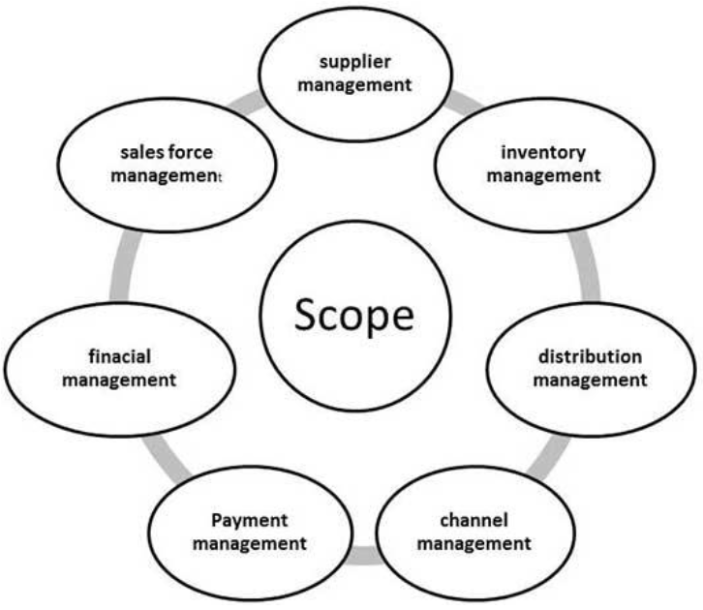
Supply chain management
Scope of SCM*
* https://www.tutorialspoint.com/management_information_system/mis_tutorial.pdf

Slide 19
Supply chain management
SCM processes*
Customer Relationship Management
Customer Service Management
Demand Management
Customer Order Fulfillment
Manufacturing Flow Management
Procurement Management
Product Development and Commercialization
Returns Management
* https://www.tutorialspoint.com/management_information_system/mis_tutorial.pdf

Slide 20
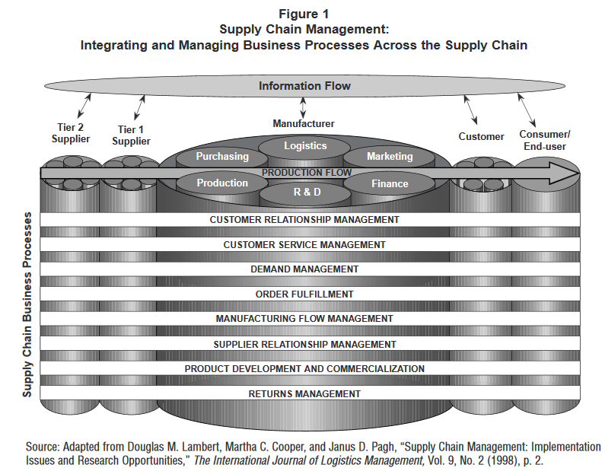
Supply chain management
SCM processes*
* http://ecsocman.hse.ru/data/474/089/1217/article4.pdf

Slide 21
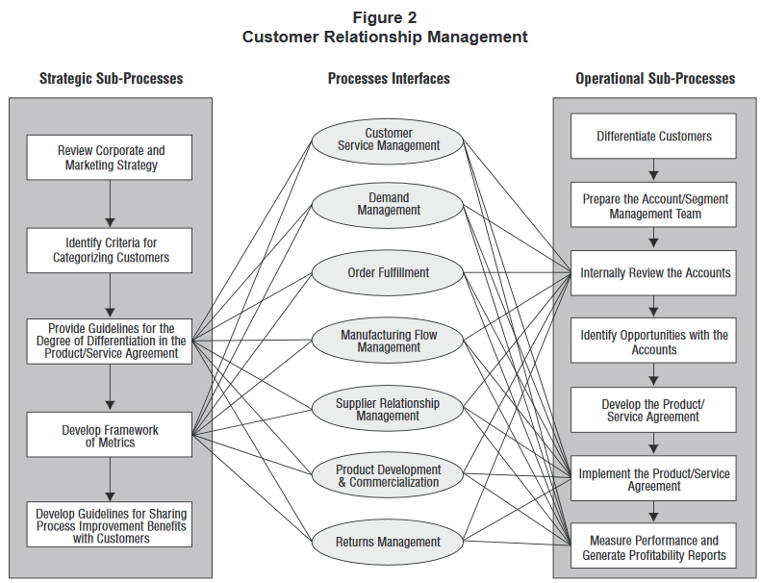
Supply chain management
SCM processes*
* http://ecsocman.hse.ru/data/474/089/1217/article4.pdf

Slide 22
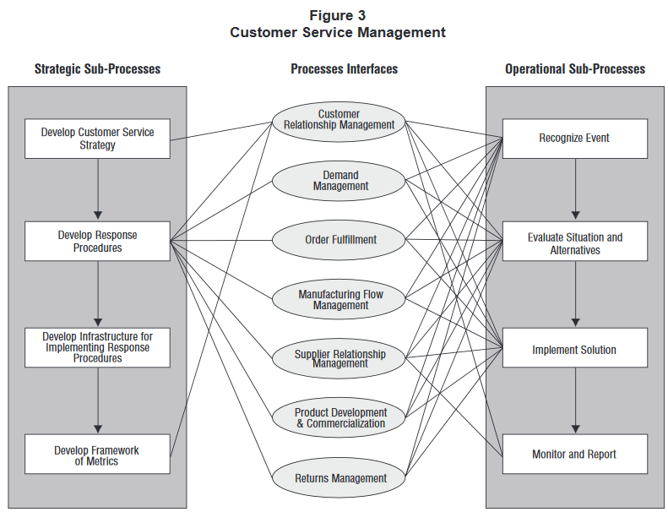
Supply chain management
SCM processes*
* http://ecsocman.hse.ru/data/474/089/1217/article4.pdf

Slide 23
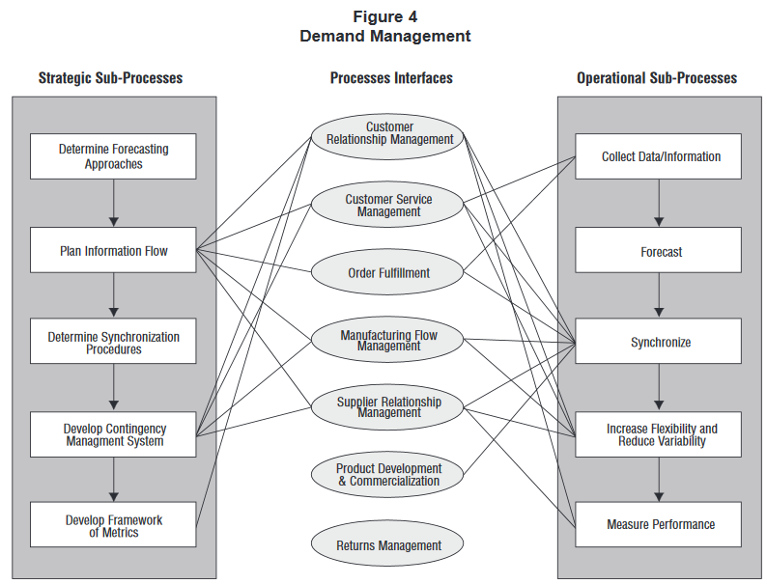
Supply chain management
SCM processes*
* http://ecsocman.hse.ru/data/474/089/1217/article4.pdf

Slide 24
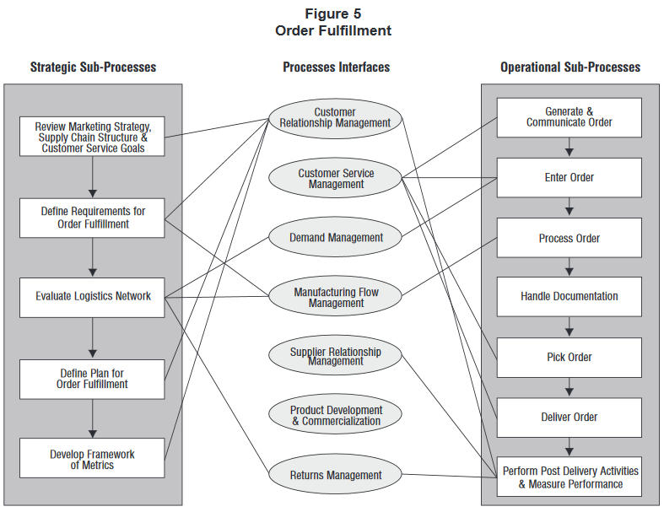
Supply chain management
SCM processes*
* http://ecsocman.hse.ru/data/474/089/1217/article4.pdf

Slide 25
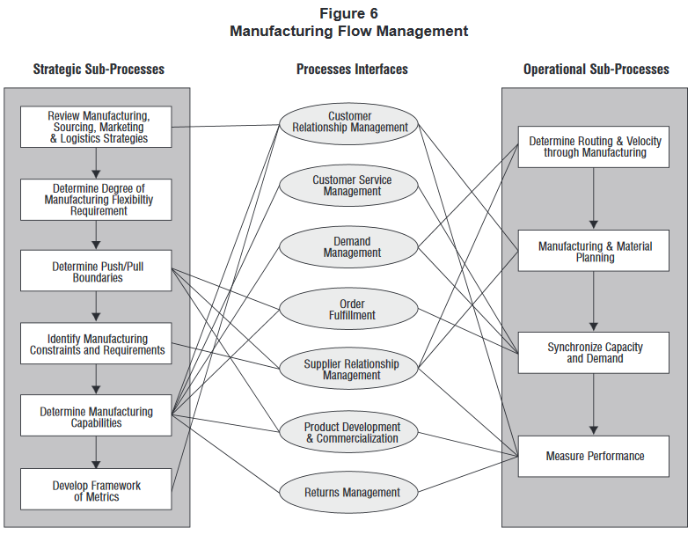
Supply chain management
SCM processes*
* http://ecsocman.hse.ru/data/474/089/1217/article4.pdf

Slide 26
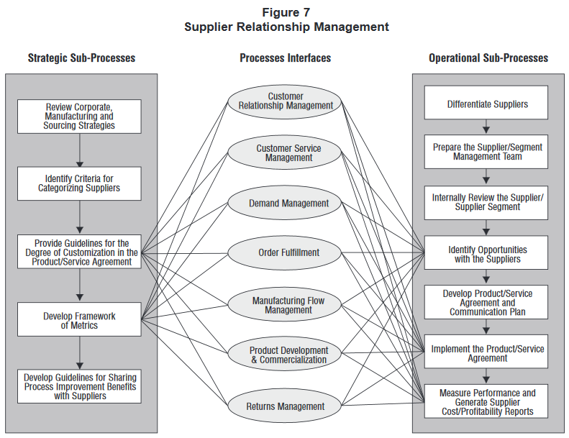
Supply chain management
SCM processes*
* http://ecsocman.hse.ru/data/474/089/1217/article4.pdf

Slide 27
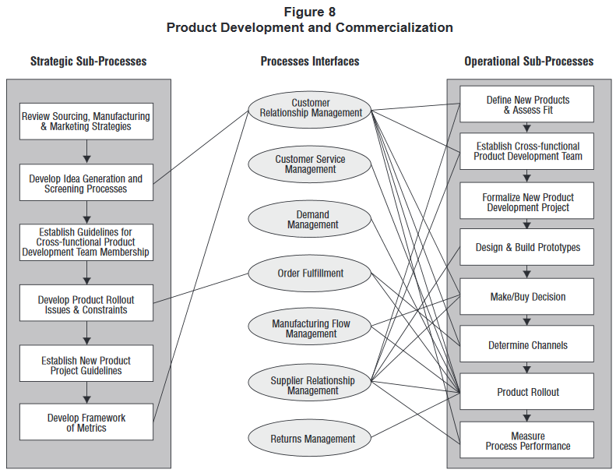
Supply chain management
SCM processes*
* http://ecsocman.hse.ru/data/474/089/1217/article4.pdf

Slide 28
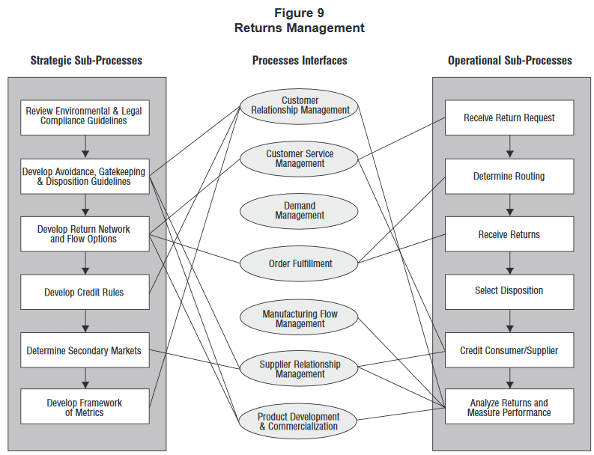
Supply chain management
SCM processes*
* http://ecsocman.hse.ru/data/474/089/1217/article4.pdf

Slide 29
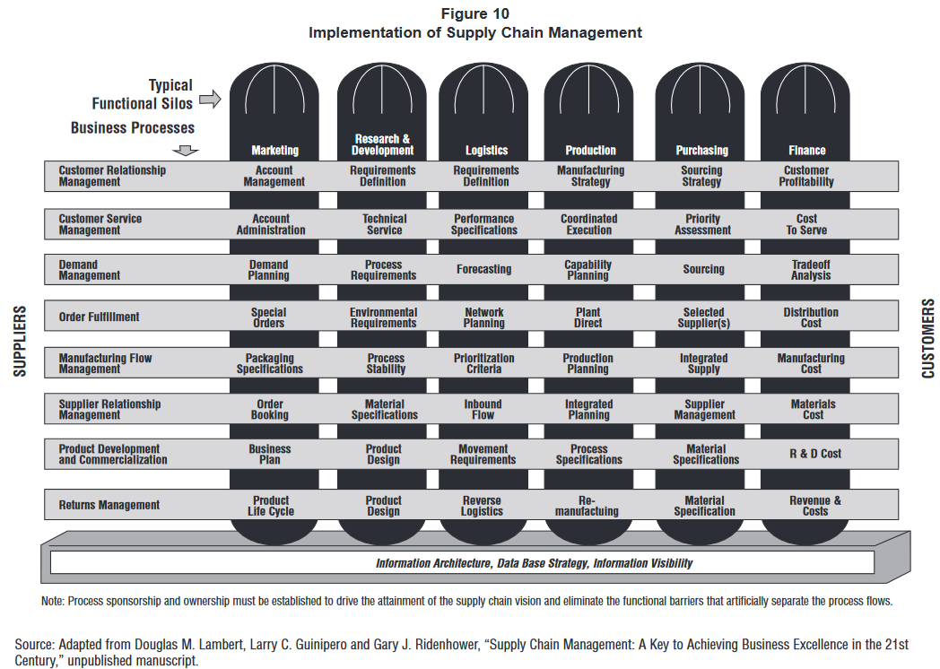
Supply chain management
SCM processes*
* http://ecsocman.hse.ru/data/474/089/1217/article4.pdf

Slide 30
Compulsory and recommended references
LAUDON, K.C. and J.P LAUDON, 2015. Management Information Systems: Managing the Digital Firm (14th Edition). New York: Pearson Publishing. ISBN 978-0133898163.
https://www.ready.gov/business/implementation/continuity
http://searchdisasterrecovery.techtarget.com/definition/business-continuity-action-plan
https://scm.ncsu.edu/scm-articles/article/what-is-supply-chain-management
http://www.sciencedirect.com/science/article/pii/S0305048304001343
http://www.supplychainquarterly.com/topics/Procurement/scq201101bestpractices/
https://www.researchgate.net/publication/272491031_Impact_of_supply_chain_management_practices_on_sustainability

