Slide 1

Enterprise Theory
.
Ing. Tomáš Pražák, Ph.D.

Slide 2
Business life cycle and its stages
Apple short
Apple long

Slide 3
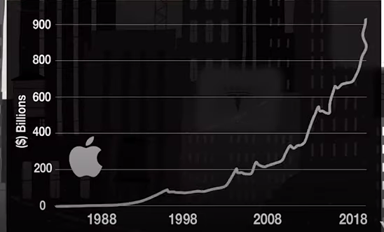
Business life cycle and its stages
  establishment
  grow
  stabilization
  crisis (recovery)
  Extinction (liquidation of the enterprise)

Slide 4
  Property and capital structure of the company
  company property necessary for the implementation of business activity:
  production facilities, materiál, transport, buildings
  sources of property financing

Slide 5
Identifikace majetkové a kapitálové struktury
jeden ze základních faktorů umožňujících plynule hodnotit finanční zdraví firmy
nedílná součást průběžného vedení podnikových aktivit a cyklicky prováděných analýz výkonnosti firmy

Slide 6
    Business property – assets
    fixed assets:
  perform their function for at least one year
  fixed intangible assets:
    Software
    patents
    intangible outputs of research and development
    license

Slide 7
  long-term tangible assets:
  movable property:
      machinery
      production facilities
      transports
      inventory
    immovable property:
      buildings
      production halls
      Grounds
  long-term financial assets:
    shares and securities

Slide 8
short-term (current) assets :
  stock :
    Material and raw material
    Semi-finished products
    Work in progress
    Finished products
    Auxiliary and operating substances
    Packaging

Slide 9
  receivables:
    outstanding financial amounts according to invoices
  short-term financial assets :
    cash
    money in a current account at the bank
    checks

Slide 10
    Sources of asset coverage - capital – liabilities
    Shares and equity :
  Shareholders funds:
  Capital
  Profit
  Funds

Slide 11
foreign capital:
  short-term foreign capital:
    Short-term bank loans
    Trade obligations
    liabilities to employees
  long-term foreign capital:
    long-term bank loan
    corporate bonds
  reserves

Slide 12
Thank you for Attentions ☺

