Slide 1

Enterprise theory
-
The economic result and the Break event point
.
Tomáš Pražák
Lecturer

Slide 2
Costs
E = f ( Q ) = v x Q +F
NE= V + F
where
F … total fixed costs [CZK]
v … unit variable costs [CZK/piece, CZK/kg, CZK/l, …]
V … total variable costs
Q … volume of production [pcs, kg, l, …]

Slide 3
Sales
S = (p x Q)
where
p ... selling price per piece [CZK/piece]
Q … volume of production [pcs, kg, l, …]

Slide 4
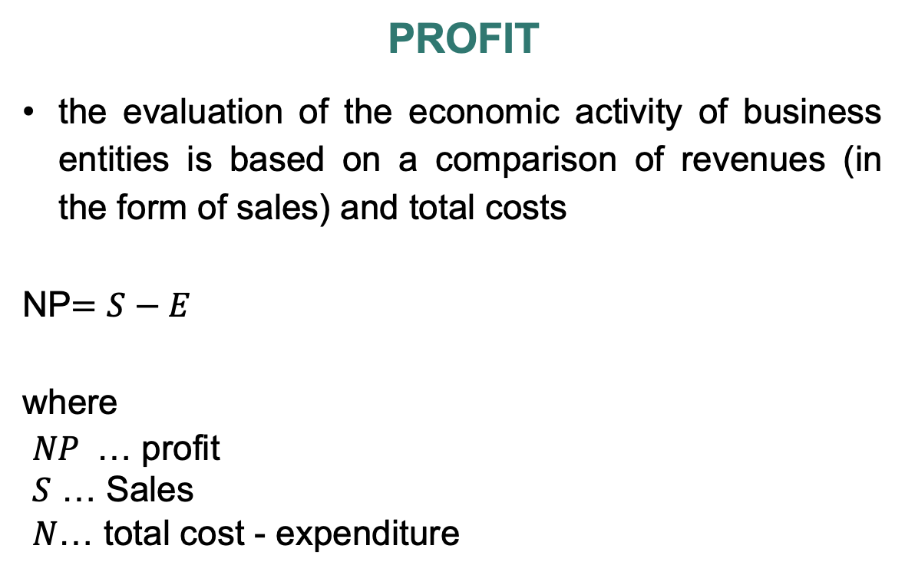
Profit
the evaluation of the economic activity of business entities is based on a comparison of revenues (in the form of sales) and total costs
NP$=S−E$
where
$NP$ … profit
$S$ … Sales
$N$… total cost - expenditure

Slide 5
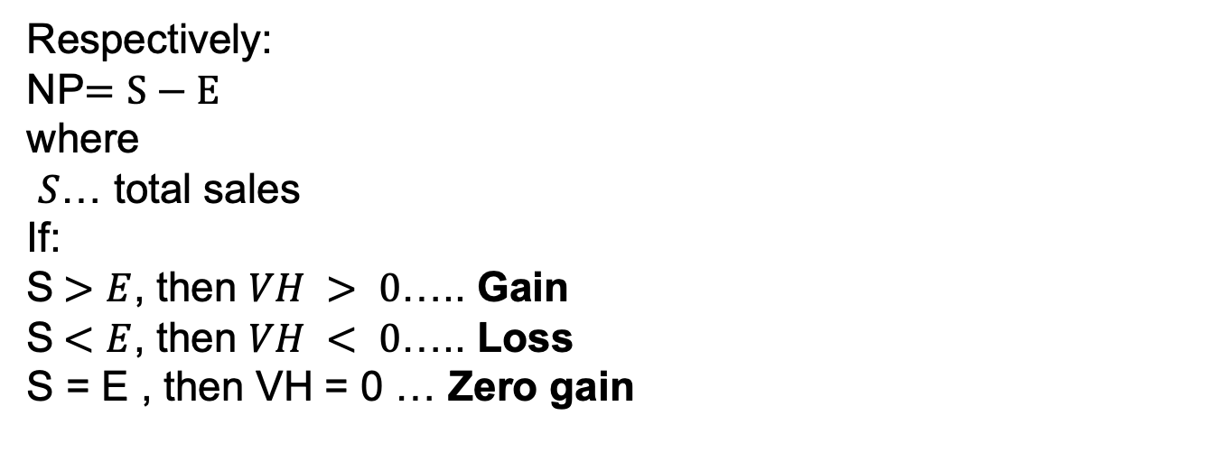
Respectively:
NP$=S−E$
where
$S$… total sales
If:
S$>E$, then $VH > 0$….. Gain
S$<E$, then $VH < 0$….. Loss
S = E , then VH = 0 … Zero gain

Slide 6
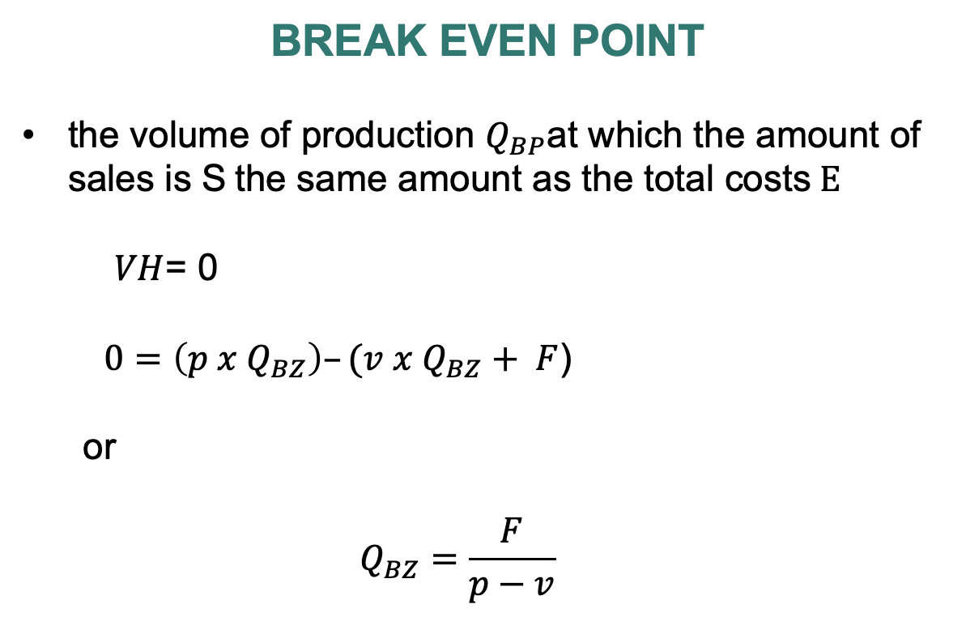
Break Even point
the volume of production $Q_{BP}$at which the amount of sales is S the same amount as the total costs$E$
  $VH$= 0
  $0=\left(p x Q_{BZ}\right)–(v x Q_{BZ}+ F$)
  or
  $$Q_{BZ}=\frac{F}{p−v}$$

Slide 7
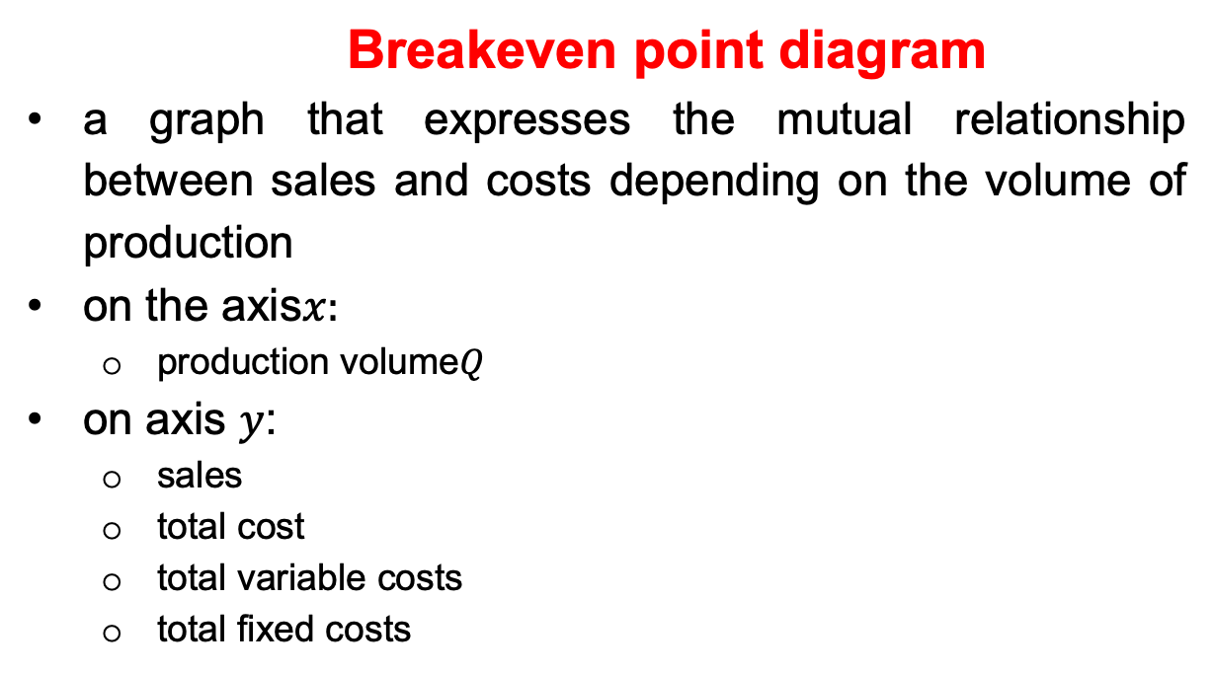
  Breakeven point diagram
a graph that expresses the mutual relationship between sales and costs depending on the volume of production
on the axis$x:$
  production volume$Q$
on axis $y$:
  sales
  total cost
  total variable costs
  total fixed costs

Slide 9
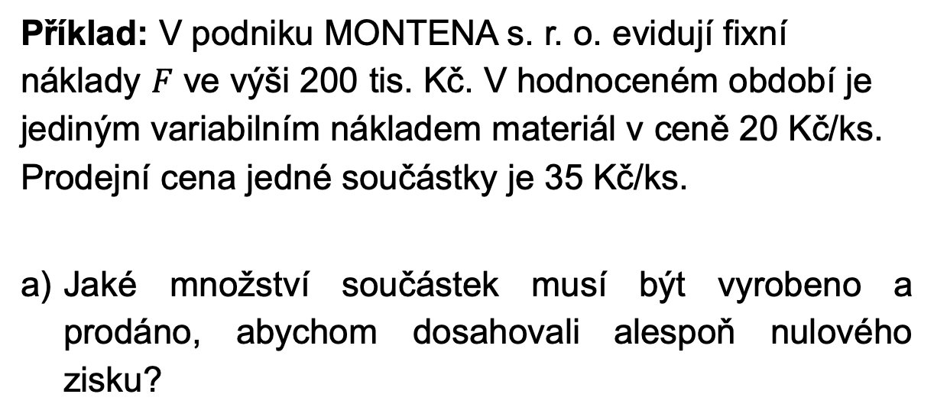
Example: In the company MONTENA s.r.o. they record fixed costs $F$in the amount of 200 thousand. CZK. In the evaluated period, the only variable cost is material at a price of CZK 20/piece. The selling price of one component is 35 CZK/pc.
What quantity of parts must be produced and sold to break even?

Slide 10
the found relationship can be used to calculate the so-called "limit" quantities:
  limit value of fixed costs
  limit value of unit variable costs
  limit price

Slide 11

limit price calculation:
  $NP$= 0
  $0=\left( p_{lim}∙Q\right)–(v∙Q+ F$)
or
$$p_{lim}∙Q−v∙Q=F$$
$$p_{lim}=\frac{F+v∙Q}{Q}=\frac{F}{Q}+v$$

Slide 12
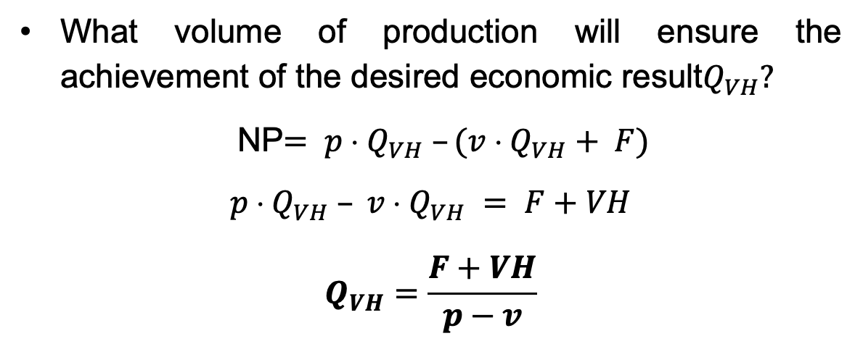
What volume of production will ensure the achievement of the desired economic result$Q_{VH}?$
NP$= p  Q_{VH} –(v  Q_{VH}+ F)$
$$p  Q_{VH} – v  Q_{VH} = F+VH$$
$$Q_{VH}=\frac{F+VH}{p−v}$$

Slide 13
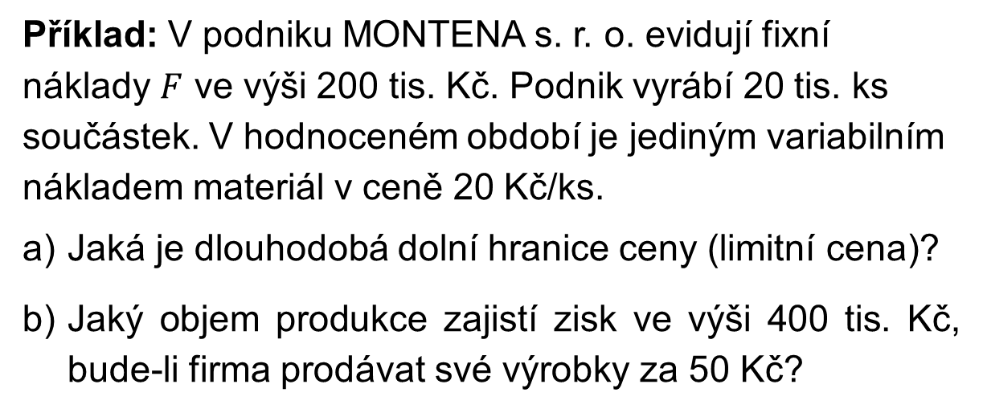
Example: In the company MONTENA s.r.o. they record fixed costs $F$in the amount of 200 thousand. CZK. The company produces 20 thousand pcs of components. In the evaluated period, the only variable cost is material at a price of CZK 20/pc.
What is the long-term lower price limit (limit price)?
What volume of production will ensure a profit of 400 thousand CZK, if the company will sell its products for CZK 50?

Slide 14
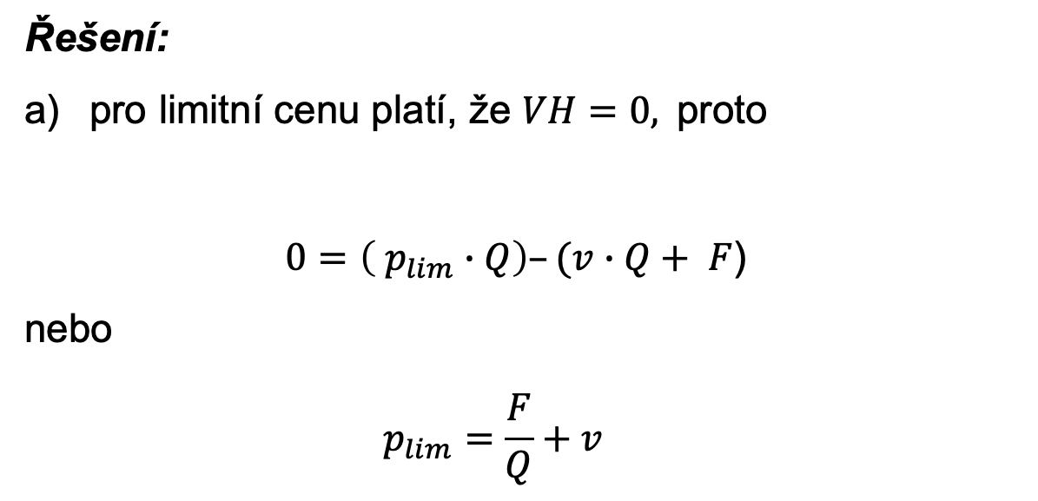
Solution:
for the limit price it is true that $VH=0,$therefore
$0=\left( p_{lim}∙Q\right)–(v∙Q+ F$)
or
$$p_{lim}=\frac{F}{Q}+v$$

Slide 15
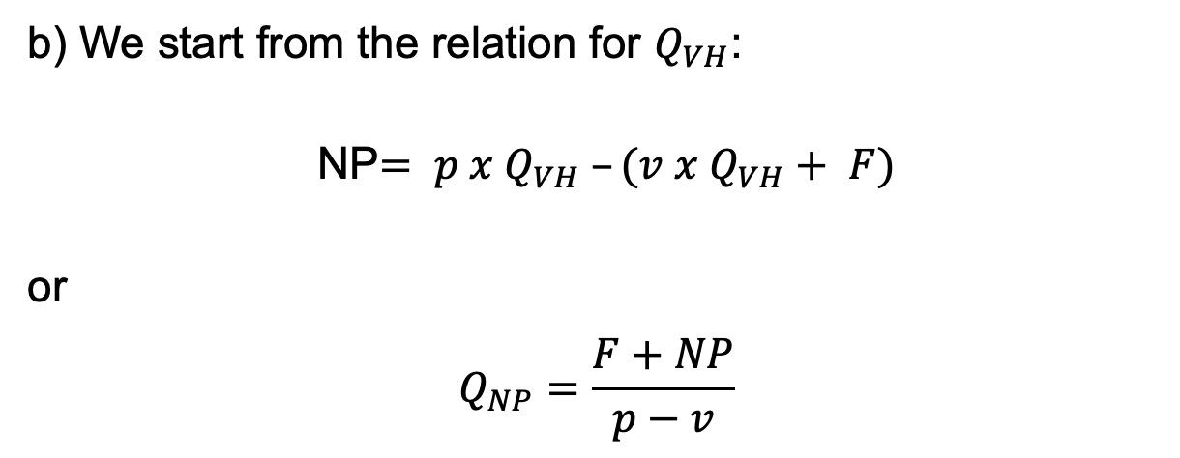
b) We start from the relation for $Q_{VH}$:
NP$= p x Q_{VH} –(v x Q_{VH}+ F)$
or
$$Q_{NP}=\frac{F+NP}{p−v}$$

