Slide 1

The Enterprise theory
-
Purchasing and inventory management
.

Slide 2
  purchase
one of the basic corporate functions
it is implemented by all types of businesses
ensures trouble-free operation of production and non-production processes in the company
organizationally secured by the purchasing department

Slide 3
Stages of the buying process
purchase initiation
specification of requirements (necessity, nature, scope)
market analysis of possible suppliers
selection of a suitable supplier
wording of the order
implementation of logistics activities associated with the entry of the delivery into the company
delivery payment
supplier performance evaluation

Slide 4
  Stocks
  current assets of the business
  the result of a purchase or business activity
  they always bind themselves with funds
  To have or not to have? Can you do business without inventory?

Slide 5
  Types of supplies
I. Classification of stocks by species
production stocks:
  raw materials, basic material, operating substances, spare parts, packaging
  tangible assets whose consumption period is less than 1 year
work in progress inventory
stocks of finished goods
goods

Slide 6
II. Breakdown of stocks according to functional components
current stock – to ensure expected consumption in the period between two deliveries
insurance stock – to cover possible deviations in supplies or consumption
technological stock – if the material needs to be modified before it is released for consumption, its amount results from the production technology

Slide 7
seasonal ( occasional ) supply – compensates for expected fluctuations in supply or consumption
speculative stock - to achieve an extraordinary profit by a suitable purchase
emergency stock - ensures the survival of the business in the event of unforeseen events

Slide 8
III. Breakdown of stocks according to capacity calculations
minimum stock – stock status at the moment before a new delivery
maximum stock – the highest stock level reached at the time of a new delivery
immediate stock :
  actual physical inventory - the actual stock level in the warehouse
  disposition stock – actual stock reduced by already applied requirements for delivery (goods ready for dispatch)
  balance stock – disposition stock increased by the size of stock deliveries ordered but not yet received (material on the way)

Slide 9
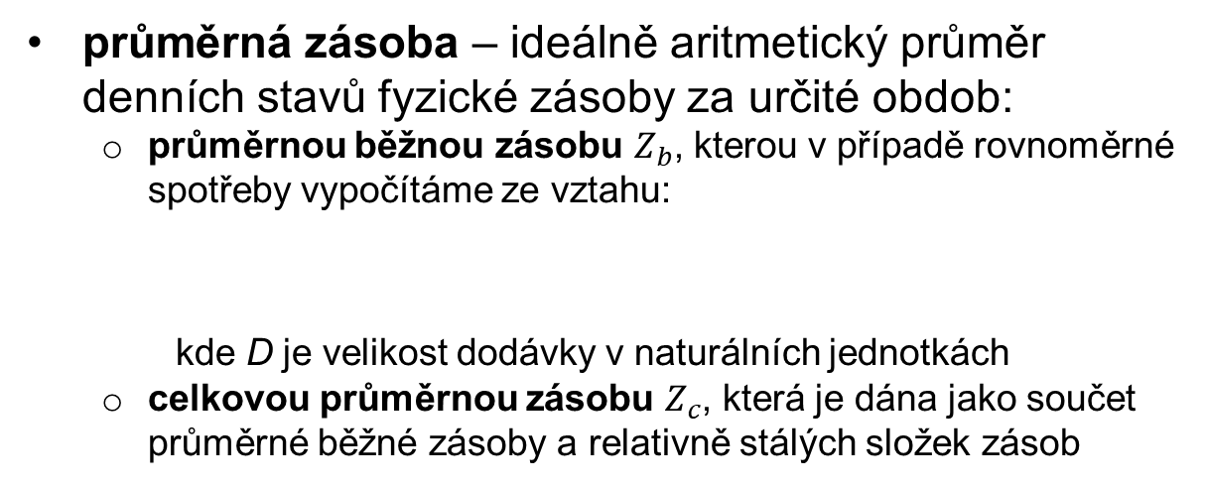
average stock – ideally the arithmetic average of daily physical stock levels for a certain period:
  the average current stock $Z_{b}$, which in the case of uniform consumption is calculated from the relationship:
where D is the delivery size in natural units
  total average inventory $Z_{c}$, which is given as the sum of average current inventory and relatively constant inventory components

Slide 10
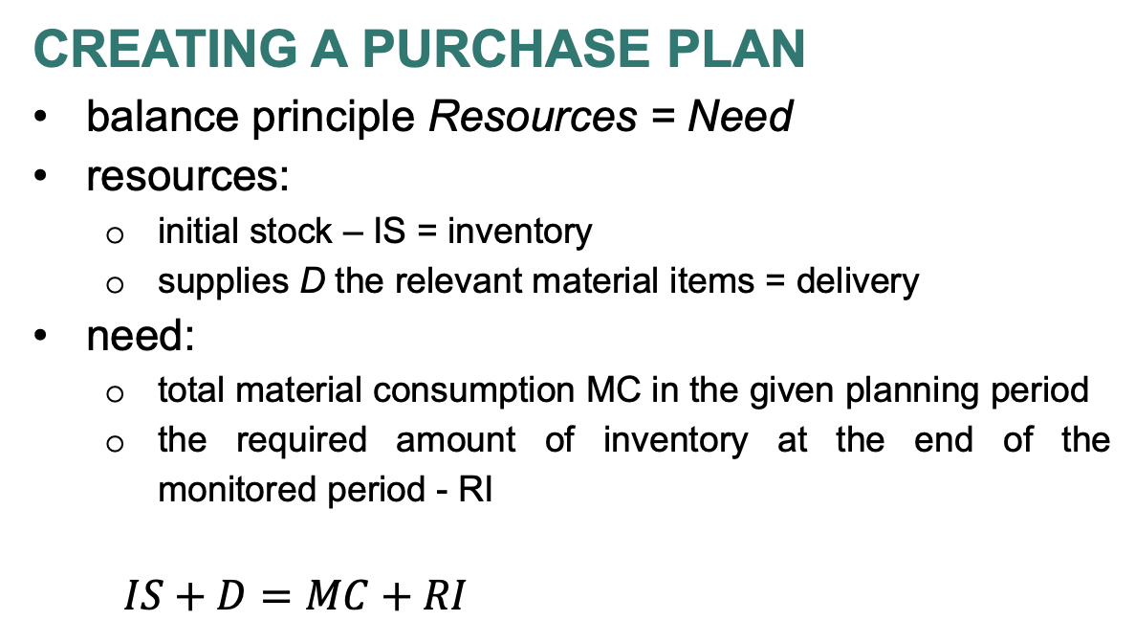
  Creating a purchase plan
balance principle Resources = Need
resources:
  initial stock – IS = inventory
  supplies D the relevant material items = delivery
need:
  total material consumption MC in the given planning period
  the required amount of inventory at the end of the monitored period - RI
  $IS+D=MC+RI$

Slide 11
  The hotel is planning shopping activities for the next month of November. On average, 600 liters of juice are consumed in the hotel per day. Juices are stored in 0.5 l bottles. At the end of November, the hotel plans to have a stock of 2,500 bottles. At the beginning of November, this stock will be 2,600 bottles. How many bottles of juice must the hotel order for November?

Slide 12
  Resources = Needs
  No. inventory + purchase (delivery) = consumption + ending inventory
  2600 + x = 36000 + 2500
  Purchase = 35,900 pcs

