Slide 1
Financing the Business

Slide 2

The Bankers’ Anagram
Character
Ability
Management
Purpose
Amount
Repayment
Insurance

Slide 3
Sources and Uses of Funds
Long-term source
Equity
Medium & long-term loans
Leasing
Hire Purchase
Long-term use
Fixed or permanent assets - land & buildings, plant & equipment, vehicles etc.
Short-term source
Factoring
Overdraft & short-term loans
Short-term use
Working capital - debtors, stocks

Slide 4
Bank credit
Advantages
Flexible, once agreed available on demand
Cheap
Good solution to short-term need
Disadvantages
Repayable on demand
Usually secured
Can be refused because of lack of security
Higher rate of interest than loans

Slide 5
Loans
Advantages
Term of loan is fixed – not repayable on demand
Interest & capital repayments fixed & known in advance
Rate of interest usually lower than overdraft
Disadvantages
Usually secured
Can be refused because of lack of security
Requires good cash flow to pay interest & repay capital

Slide 6
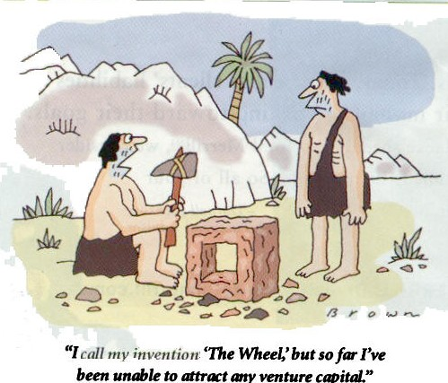
Are you sure it’s the fault of Financiers?

Slide 7
Part I -Start up- budget
Give sources, amounts, and terms of proposed loans. Also explain in detail how much will be contributed by each investor and what percent ownership each will have. Paid once
Fixed, variable expenses -mothly

Slide 8
Startup expenses are one-time expenses that occur before you open your doors for business and start selling your product or service. Expenses are money you pay for services, like legal expenses, or design services, or rent — intangible things that you don't get to keep.

Slide 9
Examples of Start-up costs I
Legal: Money you spent on legal fees for establishing the business's legal structure, as well as fees for registrations, local licenses, trademark research, etc., belong in your startup expenses.
Logo design, Initial website design . What you spend before startup belongs here.
Insurance:Include any insurance costs you incur before the launch date of your business. This includes insurance on your store/office itself, as well as inventory, vehicles, etc.
Personal costs: If you have employees on the clock before you open your doors, their pay belongs in your startup expenses. Payroll becomes an item in your profit-and-loss table later, but pre-startup, it's a startup expense.
Rent/Security deposit: Most businesses secure a location and have to start paying for it before their startup date.
Computer and office equipment:
Training: If you took courses or attended workshops to get prepared for startup, (or you sent employees for training) the costs for that training should be listed in your expenses.
Pre-opening marketing: Any advertising and marketing expenses should be included here — things like radio or print ads, brochures, or "Grand Opening" signs and announcements.
Office supplies: Chances are you needed to stock up on items you'll need to support your office. Your paper, pens, personalized stationary, even your paper clips should be listed as startup expenses.
Consultants: Many businesses hire consultants to assist when starting a business. Whether they consulted on site location, helped you learn more about your competition, or advised you on your IT needs, the costs associated with their services are startup expenses.
Other: Are most likely were other expenses associated with your startup that you should make sure to include. Did you pay for electricity to your storefront or office, or for phone service before you launched? Maybe you had software developed or had other unique needs.

Slide 10
Examples of monthly costs in start up II
To keep the business afloat during the normal lean months, just after the start, before sales grow enough to support the normal cash flow
one that says you should have six months' worth of expenses stored up before you start
Rent:
Utilities:
Payroll/personal costs:
Inventory:
Marketing:
All other:

Slide 11
Financial plan

Slide 12
Financial Plan
Balance Sheet
  Assests
  Liabilities
  Equity
Income Statement
  Revenues – Cost of Goods Sold = Net Income
Cash Flow Statement
  Operating Activities
  Investing Activities
  Financing Activities

Slide 13
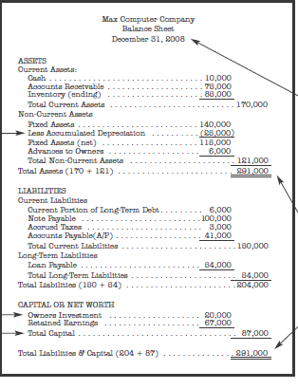
Balance sheet

Slide 14
Balance sheet structure
Assets
Liabilities and Capital
What the company owns
1.Current Assets
Can be converted into cash in one year
A)Accounts Receivable
Sales made but not collected
B)Inventory
Inventory on hand, waiting to be sold
2. Non-Current Assets
Takes one year or more to turn into cash
A)Fixed Assets
This includes property, plant, and equipment
B) Depreciation
Subtract Accumulated Depreciation
1. Current Liabilities -How much the company owes
Liabilities due within one year
A) Current Portion of Short-Term Debt
One year’s worth of loan payments
2. Long-Term Liabilities
Due for more than one year
A) Loan Payable
Due after one year’s worth of payments
3. CAPITAL OR NET WORTH
The business’ equity
A) Owners Investment
Amount of money owners have invested
B) Retained Earnings
Income earned and kept in the business

Slide 15
INCOME STATEMENT (Profit and Loss )

Slide 16
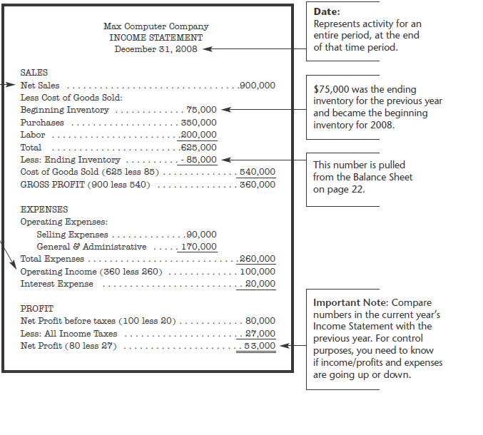

Slide 17
SALES
EXPENSES
Net Sales
Revenue or income. Gross sales is before returns and allowances. Net sales is after returns and allowances.
Less Cost of Goods Sold
Cost to make products including materials and labor.
Beginning Inventory
Comes from the Ending Inventory of the previous year.
Purchases
Used to make product.
Labor
Used to make product only. Other labor-related expenses are included in the Operating Expenses section.
Less: Ending Inventory
This number becomes the beginning inventory for the next year’s Income Statement.
Total Cost of Goods Sold
Compute the Cost of Goods Sold.
Gross Profit
Sales less cost of goods sold. This is your profit margin.
Selling Expenses
Salaries and expenses related to sales only.
General and Administrative
All other expenses used to run the company.
Operating Income (or Loss)
Shows how the business performed.
Interest Expense
Subtract interest expense.
Net Profit before taxes Less: Income Taxes
Tax rates depend on your business’ legal status.
PROFIT
Profit left after all expenses (including taxes) have been paid.

