Slide 1

CSR REPORTING
CSR PERFORMANCE, GLOBAL REPORTING INITIATIVE
Ing. Pavel Adámek, Ph.D.
CORPORATE SOCIAL RESPONSIBILITY/PEM-NACSR

Slide 2
CSR REPORTING
Outline of the lecture
Global trends in CSR reporting
KPMG 2020 Survey of Corporate Responsibility Reporting
The GRI Sustainability Reporting Guidelines

Slide 3
CSR REPORTING
INTRODUCTION
Sustainability and CSR policies, plans, programs, and projects have been initiated in corporations around the world. Given the broad nature of sustainability, the breadth and depth of these initiatives varies widely.
The internationally recognized system GRI to maintain the unification reports. Although the titles of these reports differ, they typically include words such as “sustainability”, “responsibility”, „accountability” or “citizenship”, and they focus on addressing the economic, environmental, and social dimensions of corporate performance through a review of both qualitative and quantitative information.
CSR reports are typically focused mainly on the environmental and social elements of organizational performance, with the mandatory annual report containing the financial/economic performance.

Slide 4
CSR REPORTING
INTRODUCTION
„More than three quarters of the world’s largest 250 companies now include at least some “non-financial” information in their annual financial reports. And where the largest firms lead, others inevitably follow. We can also see that some countries appear to be enthusiastically adopting the concept of integrated financial and “non-financial” reporting, in many cases nudged along by regulation or stock exchange guidelines“. (KPMG)
We operate and use the principles of the major initiatives (principles) or standards which are used by the large companies in the Czech Republic, namely Global Reporting Initiative (GRI) and Top Responsible Company Award organized and awarded by Business for Society.
GRI has pioneered the creation of the world's most widely used concept that provides organizations with guidance on how to generate reports focused on sustainable development, which are publicly published and accessible to all interested parties in order to provide a detailed overview of the activities of the organization.

Slide 5
CSR REPORTING
INTRODUCTION
For many years companies have been issuing Corporate Responsibility (CR) reports – not that they were called CR reports in the early days, any more than the activities that we now count as CSR we thought of as such.
The first reports data appeared were normally included as a section in the annual report.
Only latterly have companies begun to issue „free-standing“ environmental, sustainability, or other types of report now grouped under the term „corporate responsibility“.

Slide 6
CSR REPORTING
Major providers of sustainability reporting guidance
Sustainability reports are released by companies and organizations of all types, sizes and sectors, from every corner of the world.
Major providers of sustainability reporting guidance include:
  GRI (GRI's Sustainability Reporting Standards)
  The Organisation for Economic Co-operation and Development (OECD Guidelines for Multinational Enterprises)
  The United Nations Global Compact
  The International Organization for Standardization (ISO 26000, International Standard for social responsibility)

Slide 7
CSR REPORTING
Major providers of sustainability reporting guidance
Tim Mohin, Chief Executive of the Global Reporting Index (GRI), explained:
“In the past decade there has been a tremendous upswing in interest coming from the financial sector. With over 90% of the largest companies now filing sustainability reports (85% of the S&P 500), the data is plentiful. But that is not new. What is new is the interest in using the information for investment decisions.“
A recent study from Oxford University found that more than 80% of mainstream investors now consider ‘ESG’ – environmental, social and governance – information when making investment decisions. And the numbers are compelling - globally, there are now $22.89 trillion of assets being professionally managed under responsible investment strategies, an increase of 25 percent since 2014. This number is so large it needs context – it exceeds the GDP of the entire US economy.”

Slide 8
CSR REPORTING
1. Global trends in CSR reporting
CN100 companies continue to catch up with the G250
The N100 refers to a worldwide sample of 4,900 companies comprising the top 100 companies by revenue in each of the 49 countries researched in this study. These N100 statistics provide a broadbased snapshot of CR reporting among both large and mid-cap firms around the world.
The G250 refers to the world’s 250 largest companies by revenue based on the Fortune 500 ranking. Large global companies are typically leaders in CR reporting and their behavior often predicts trends that are subsequently adopted more widely.
More details about - ttps://home.kpmg/xx/en/home/insights/2020/11/the-time-has-come-survey-of-sustainability-reporting.html

Slide 9
CSR REPORTING
1. Global trends in CSR reporting
The survey findings reveal that 80 percent of N100 companies worldwide now report on sustainability.
This underlying global sustainability reporting rate (N100) has risen by 5 percentage points since the last KPMG survey in 2017, from 75 to 80 percent.
It shows that N100 companies continue to catch up with the G250. It is likely that the N100 reporting rate will continue to climb steadily in coming years.
Since 2011, 90 percent or more of the G250 have reported rate on sustainability. This statistic fluctuates marginally year-to-year as the group of companies comprising the G250 changes.
Sustainability reporting has seen a particularly strong increase in three countries: Kazakhstan (+ 34 percentage points); Slovakia (+21 percentage points) and Germany (+19 percentage points).
More details about - ttps://home.kpmg/xx/en/home/insights/2020/11/the-time-has-come-survey-of-sustainability-reporting.html

Slide 10
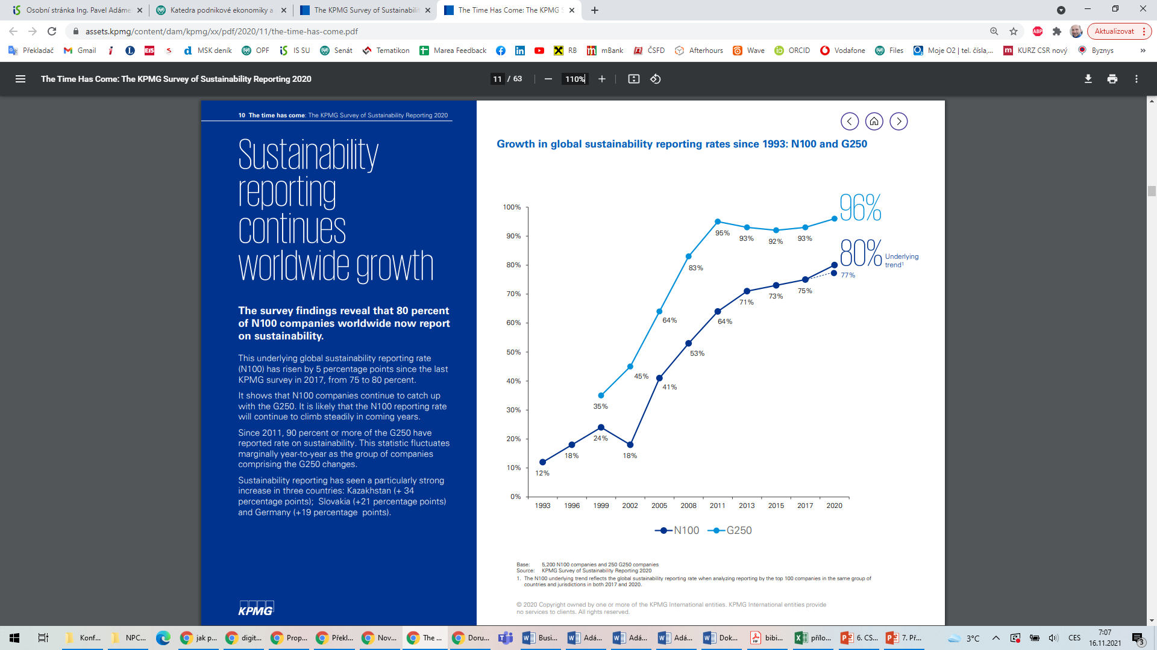
CSR REPORTING
1. Global trends in CSR reporting
Source: ttps://home.kpmg/xx/en/home/insights/2020/11/the-time-has-come-survey-of-sustainability-reporting.html

Slide 11
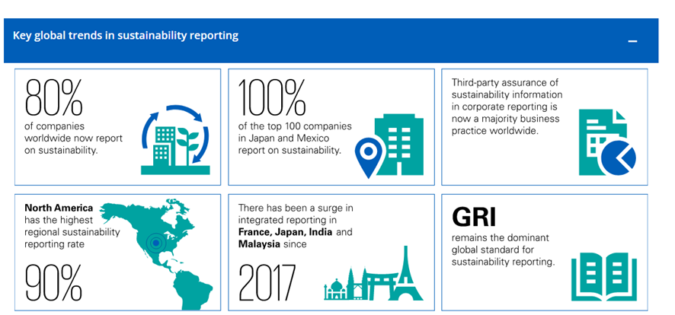
CSR REPORTING
1. Global trends in CSR reporting

Slide 12
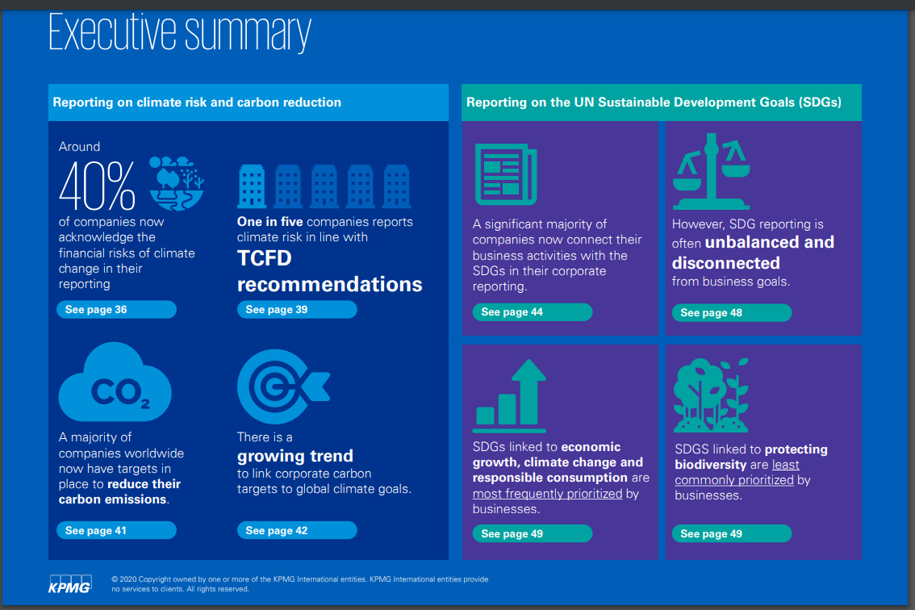
CSR REPORTING
1. Global trends in CSR reporting

Slide 13
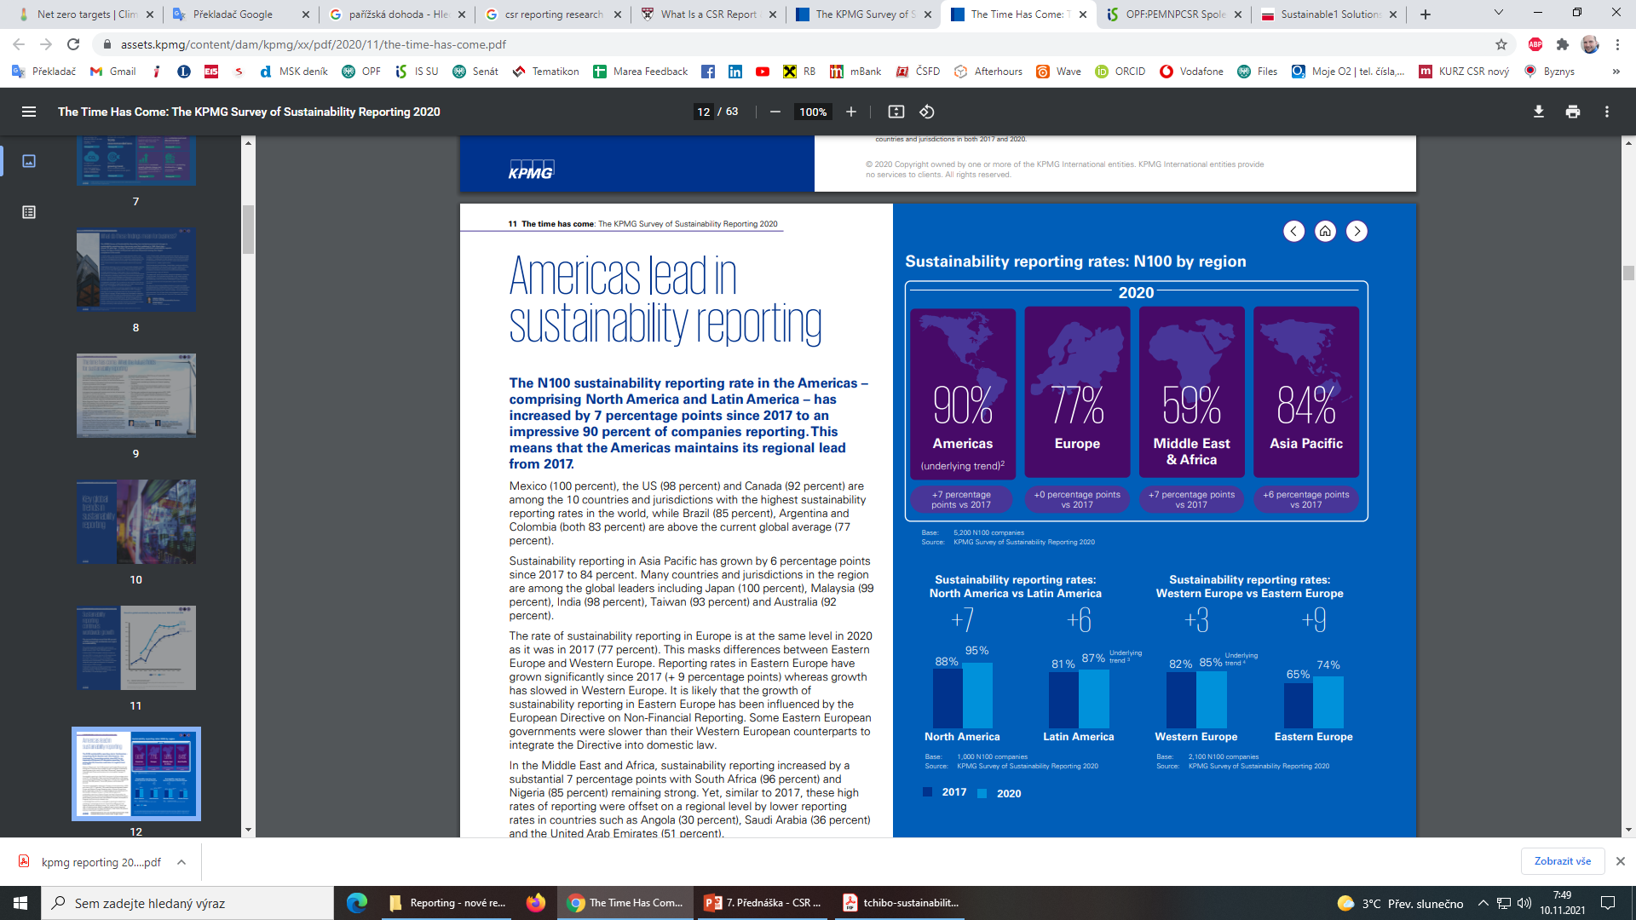
CSR REPORTING
1. Global trends in CSR reporting

Slide 14
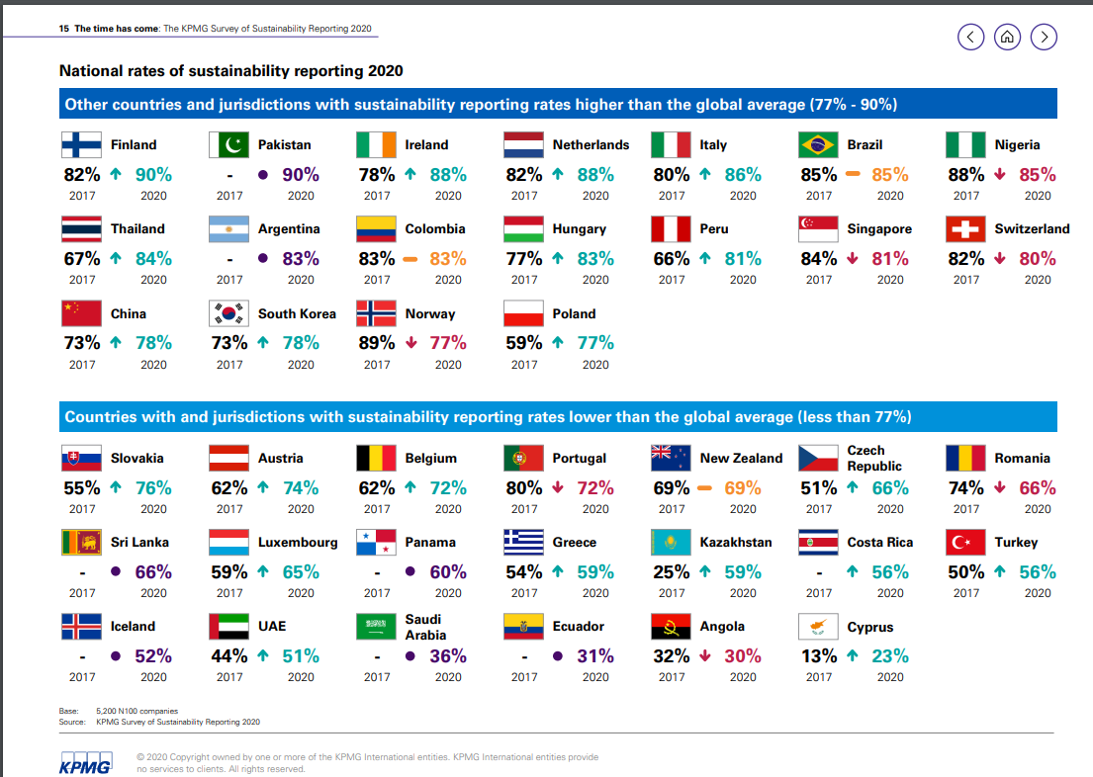
CSR REPORTING
1. Global trends in CSR reporting

Slide 15
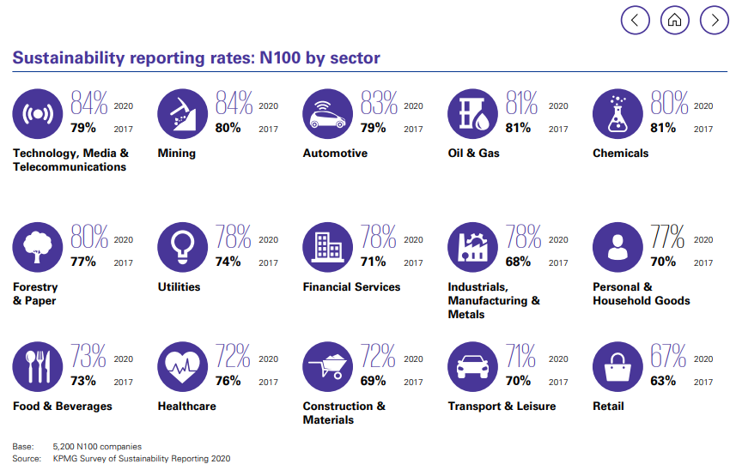
CSR REPORTING
1. Global trends in CSR reporting

Slide 16
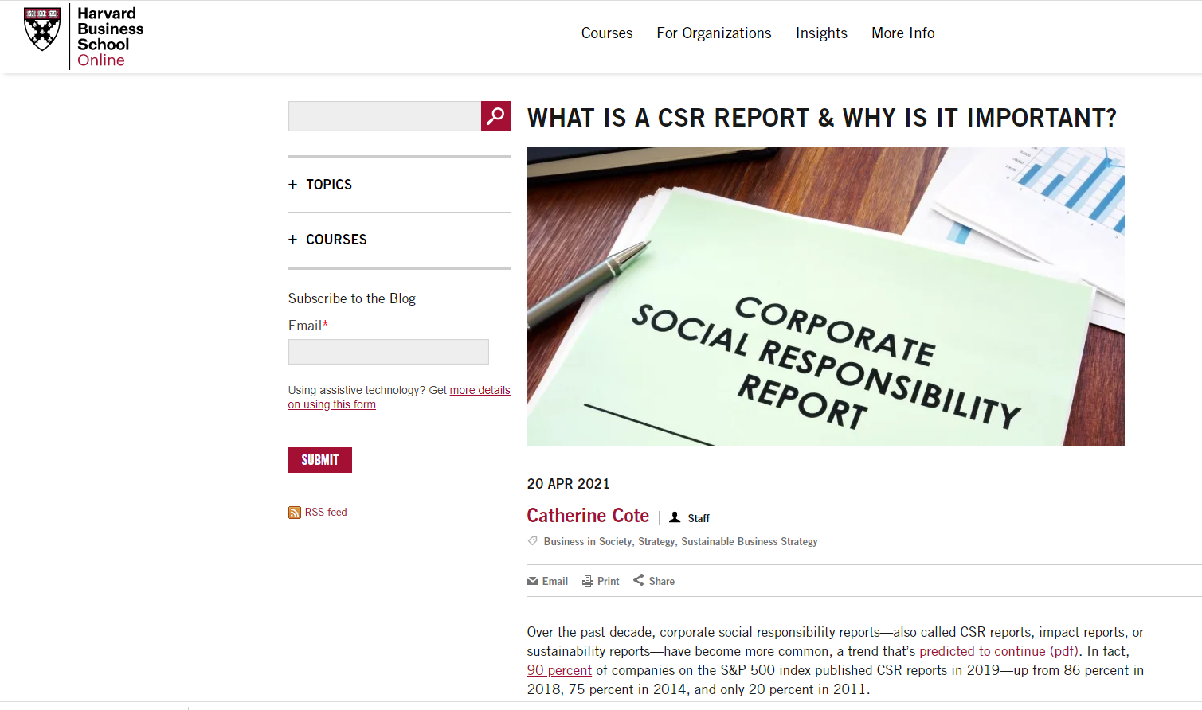
CSR REPORTING
HBS – Business Insight
https://online.hbs.edu/blog/post/what-is-a-csr-report?tempview=logoconvert

Slide 17
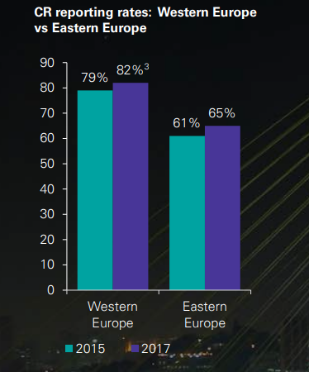
CSR REPORTING
1. Global trends in CSR reporting
Many businesses in Eastern Europe are still focused on the financial bottom line rather than the triple bottom line - it’s fair to say that a culture of sustainability is yet to properly take hold across the region.
The EU Directive on Non-Financial Reporting was transposed. Despite this, Eastern Europe are still just beginning to understand the topic and build their capacity to respond.
However, It´s expected to see steady growth in CR reporting in Eastern Europe over the next few years and improving quality as regulatory requirements, market pressure and increasing awareness take effect.

Slide 18
CSR REPORTING
Reporting awards
Corporate Registr – CRRA CR Reporting Awards 2020 https://www.corporateregister.com/crra/
Organised by CorporateRegister.com, the CR Reporting Awards are the world’s only independent global annual awards for corporate responsibility reporting.
The awards were developed in August 2007 to identify and acknowledge the best in corporate non-financial reporting.
All registered users of CorporateRegister.com were entitled to vote.
Founded in 1998, CorporateRegister.com is the global CR resources website and hosts the world’s most comprehensive directory of corporate non-financial reporting, profiling over 102,000 reports from 17,000 organisations across 150 countries. Around 10,500 CR (Corporate Responsibility) reports are published annually and are added to the current 102,000 reports profiled free and online.

Slide 19
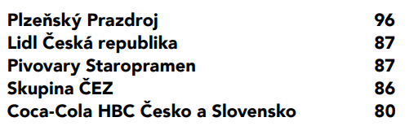
CSR REPORTING
Reporting awards
Winner - H&M Hennes & Mauritz AB Sustainability Performance Report 2019
TOP RESPONSIBLE COMPANY IN THE CZECH REPUBLIC – CSR REPORTING 2019 in percentage overall evaluation:

Slide 20
CSR REPORTING
European Sustainability Reporting Standards
In 2023 the Commission adopted today the European Sustainability Reporting Standards (ESRS) for use by all companies subject to the Corporate Sustainability Reporting Directive (CSRD). This marks another step forward in the transition to a sustainable EU economy.
The Directive on corporate sustainability reporting (CSRD) empowers the Commission to adopt delegated and implementing acts to specify how competent authorities and market participants shall comply with the obligations laid down in the directive. https://finance.ec.europa.eu/regulation-and-supervision/financial-services-legislation/implementing-and-delegated-acts/corporate-sustainability-reporting-directive_en
EU rules require large companies and listed companies to publish regular reports on the social and environmental risks they face, and on how their activities impact people and the environment. https://finance.ec.europa.eu/capital-markets-union-and-financial-markets/company-reporting-and-auditing/company-reporting/corporate-sustainability-reporting_en

Slide 21
CSR REPORTING
European Sustainability Reporting Standards
EU rules require large companies and listed companies to publish regular reports on the social and environmental risks they face, and on how their activities impact people and the environment. https://finance.ec.europa.eu/capital-markets-union-and-financial-markets/company-reporting-and-auditing/company-reporting/corporate-sustainability-reporting_en
Rules introduced by the Non-Financial Reporting Directive
The rules introduced by the Non-Financial Reporting Directive (NFRD) remain in force until companies have to apply the new rules of the CSRD. Under the NFRD, large companies have to publish information related to
  environmental matters
  social matters and treatment of employees
  respect for human rights
  anti-corruption and bribery
  diversity on company boards (in terms of age, gender, educational and professional background)
These reporting rules apply to large public-interest companies with more than 500 employees. This covers approximately 11 700 large companies and groups across the EU, including
  listed companies
  banks
  insurance companies
  other companies designated by national authorities as public-interest entities

Slide 22
CSR REPORTING
Benefits of reporting
Internal benefits:
  Increased understanding of risks and opportunities
  Emphasizing the link between financial and non-financial performance
  Influencing long term management strategy and policy, and business plans
  Streamlining processes, reducing costs and improving efficiency
  Benchmarking and assessing sustainability performance with respect to laws, norms, codes, performance standards, and voluntary initiatives
  Avoiding being implicated in publicized environmental, social and governance failures
  Comparing performance internally, and between organizations and sectors

Slide 23
CSR REPORTING
Benefits of reporting
External benefits:
  Mitigating – or reversing – negative environmental, social and governance impacts
  Improving reputation and brand loyalty
  Enabling external stakeholders to understand the organization’s true value, and tangible and intangible assets
  Demonstrating how the organization influences, and is influenced by, expectations about sustainable development

Slide 24
CSR REPORTING
2. The GRI Sustainability Reporting Guidelines
Global Reporting Initiative (GRI) is a large international non-profit organization and a network of thousands of experts from dozens of countries around the world.
GRI was founded in 1997 by the Coalition for Environmentally responsible Economics (CERES), in collaboration with the United Nations Environmental Programme (UNEP) and its headquarters is located in Amsterdam.
Initiative GRI defines CSR report as publicly published a report, which the company makes available to all stakeholders in order to provide a detailed overview of corporate activities in broader economic, environmental and social dimensions.

Slide 25
CSR REPORTING
2. The GRI Sustainability Reporting Guidelines
The first draft Guidelines 2000 was issued in 2000, his second release entitled Sustainable Reporting Guidelines established in 2002.
Four years later, followed by the third edition, called G3 Guidelines, which in 2013 was replaced by the G4 version of the Sustainability Reporting Guidelines.
Directive is freely available on the organization's website.

Slide 26
CSR REPORTING
2. The GRI Sustainability Reporting Guidelines
The GRI Sustainability Reporting Guidelines (the Guidelines) offer Reporting Principles and Standard Disclosures, and an Implementation Manual for the preparation of sustainability reports by organizations, regardless of their size, sector or location.
The Guidelines also offer an international reference for all those interested in the disclosure of governance approach and of the environmental, social and economic performance and impacts of organizations.
The Guidelines are developed through a global multistakeholder process involving representatives from business, labor, civil society, and financial markets, as well as auditors and experts in various fields; and in close dialogue with regulators and governmental agencies in several countries.

Slide 27
CSR REPORTING
2. The GRI Sustainability Reporting Guidelines
GRI’s Standards help businesses, governments and other organizations understand and communicate the impact of business on critical sustainability issues. Some of the distinctive elements of the GRI Standards include:
  Multi-stakeholder input: Our approach is based on multi-stakeholder engagement, representing the best combination of technical expertise and diversity of experience to address the needs of all report makers and users. This approach enables us to produce universally-applicable reporting guidance.
  A record of use and endorsement: Of the world’s largest 250 corporations, 92% report on their sustainability performance and 74% of these use GRI’s Standards to do so.
  Governmental references and activities.

Slide 28
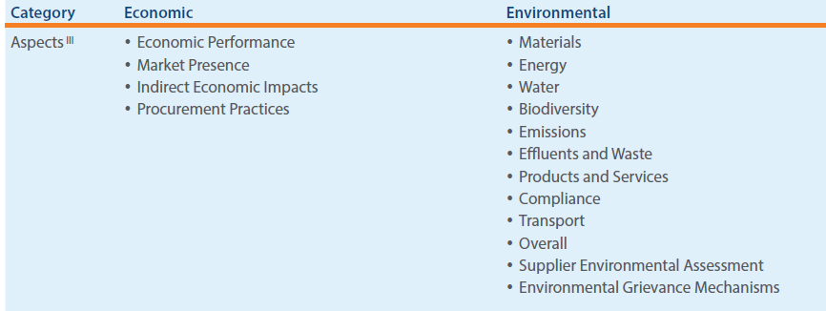
CSR REPORTING
2. The GRI Sustainability Reporting Guidelines
An examples of categories and aspets in the guidelines
Source: GRI, G4, www.globalreporting.org

Slide 29
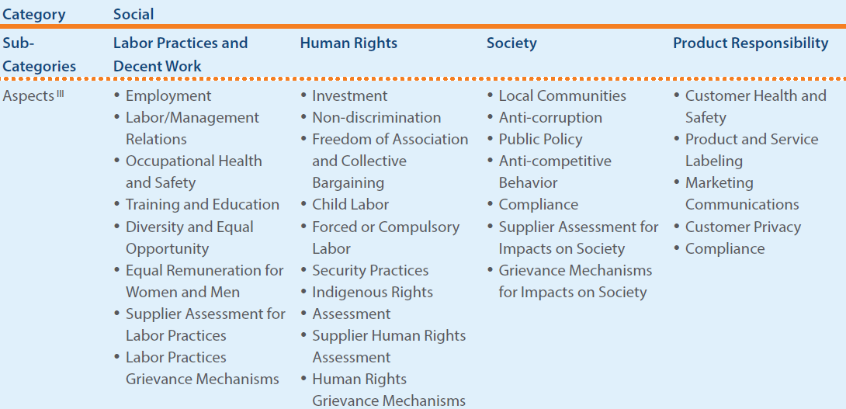
CSR REPORTING
2. The GRI Sustainability Reporting Guidelines
An examples of categories and aspets in the guidelines
Source: GRI, G4, www.globalreporting.org

Slide 30
CSR REPORTING
2. The GRI Sustainability Reporting Guidelines
Economic performance – the economic dimension of sustainability concerns the organization’s impacts on the economic conditions of its stakeholders, and on economic systems at local, national, and global levels.
  Direct economic value generated (examples from G4-EC1): Operating costs, Employee wages and benefits, Payments to providers of capital, Payments to government, Community investments.
  Indirect economic impacts (examples from G4-EC8):
    Changing the productivity of organizations, sectors
    Economic development in areas of high poverty
    Economic impact of improving or deteriorating social or environmental conditions
    Jobs supported in the supply chain or distribution chain
    Stimulating, enabling, or limiting foreign direct investment
    Economic impact of the use of products and services

Slide 31
CSR REPORTING
2. The GRI Sustainability Reporting Guidelines
Environmental performance – the environmental dimension of sustainability concerns the organization’s impact on living and non-living natural systems, including land, air, water and ecosystems.
The environmental category covers impacts related to inputs (such as energy and water) and outputs (such as emissions, effluents and waste). In addition, it covers biodiversity, transport, and product and service-related impacts, as well as environmental compliance and expenditures (more study in G4- EN part of GRI).
  Materials (examples G4-EN1):
    Report the total weight or volume of materials that are used to produce and package the organization’s primary products and services during the reporting period, by:
    Non-renewable materials used
    Renewable materials used
  Percentage of materials used that are recycled input materials
  Energy consuption within the organization (elektricity, heating, cooling, steam consuption

Slide 32
CSR REPORTING
2. The GRI Sustainability Reporting Guidelines
Environmental performance
  Total weight of waste by type and disposal method (examples G4-EN23):
    Reuse
    Recycling
    Composting
    Recovery, including energy recovery
    Incineration (mass burn)
    Dep well injection
    Landfill
    On-site storage

Slide 33
CSR REPORTING
2. The GRI Sustainability Reporting Guidelines
Social performance – the social dimension of sustainability concerns the impacts the organization has on the social systems within which it operates. The social category includes the sub-categories:
Labor Practices and Decent Work
Human Rights
Society (local communities, anti-corruption,
Product Responsibility (customer health and safety, labeling, marketing communications,
More study in G4-LA part of GRI). Examples (G4-LA2):
  Employment
    Benefits provided to full-time employees (life insurence, health care, disability and invalidity coverage, parental leave, retirement provision, stock ownership).
  Training and education
  Diversity and equal opprortunity
  Equal remuneration for women and men

Slide 34
CSR REPORTING
Process for defining reporting content - summary
Step – Identification
  consider the GRI Aspects list and other topics of interest apply the Principles of Sustainability Context and Stakeholder Inclusiveness: Identify the Aspects – and other relevant topics – based on the relevant economic, environmental and social impacts related to all of the organization’s activities, products, services, and relationships.
  Identify where the impacts occur.
  Make a list of the aspects and other topics considered relevant.
Step – Prioritization
  Apply the principles of materality and stakeholder inclusiveness (signifikance fo the economic, environmental and social impacts)
  Define and document thresholds (criteria)
  For each materiál aspect identified, decide the level of coverage
  Lis the materiál spects to be included in the report

Slide 35
CSR REPORTING
Process for defining reporting content - summary
Step – Validation
  Apply the Principles of Completeness and Stakeholder Inclusiveness
  Approve the list of identified material Aspects with the relevant internal senior decision-maker
  Determine which information is available and explain those for which it still needs to establish management approaches and measurements systems
Step – Review
  Apply the Principles of Sustainability Context and Stakeholder Engagement: Review the Aspects that were material in the previous reporting period
  Use the result of the review to inform Step 1 Identification for the next reporting cycle
For the description and detailed guidance of the steps summarized here, see Guidance for G4-18, Implementation Manual pp. 31-40.

Slide 36
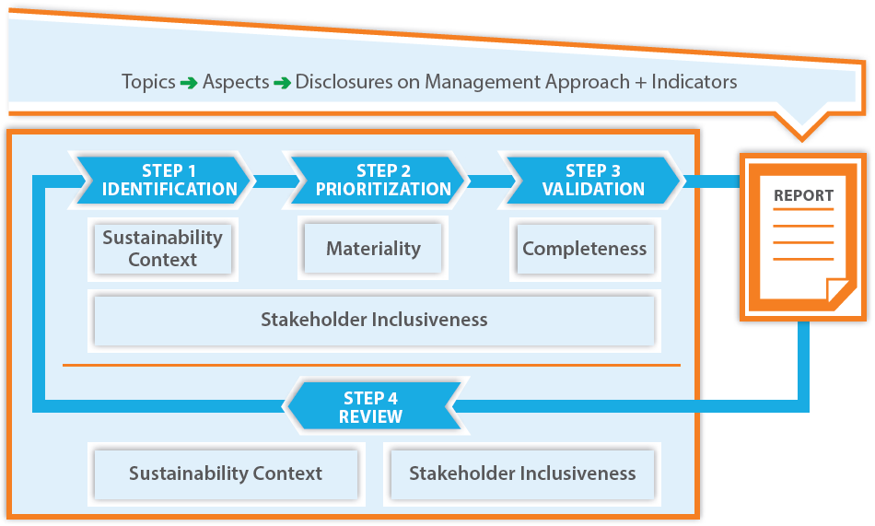
CSR REPORTING
Process for defining reporting content - summary
Defining material aspects and boundaries – process overview
Source: GRI, G4, www.globalreporting.org

Slide 37
CSR REPORTING
summary of the lecture
Sustainability reporting is a process that assists organizations in setting goals, measuring performance and managing change towards a sustainable global economy – one that combines long term profitability with social responsibility and environmental care.
Sustainability reporting – mainly through but not limited to a sustainability report – is the key platform for communicating the organization’s economic, environmental, social and governance performance, reflecting positive and negative impacts.
The aspects that the organization deems to be material, in response to its stakeholders’ expectations and interests, drive sustainability reporting.

Slide 38
CSR REPORTING
summary of the lecture
Integrated reporting is an emerging and evolving trend in corporate reporting, which in general aims primarily to offer an organization’s providers of financial capital with an integrated representation of the key factors that are material to its present and future value creation.
The accounting plays an important part in this process of improving the credibility of CR performance.
Recommended study:
  The KPMG Survey of Corporate responsibility reporting 2020
  GRI Sustainability Reporting Standards (G4)
  Blowfield and Murray, Corporate Responsibility, 2014 (chapter 8)

