Slide 1

Basic elements of management
Ing. Žaneta Rylková, Ph.D.
Managerial Economics

Slide 2

Outline of the lecture
Management - meanings
Basic elements - functions
Branches of management
Styles and techniques of management
Control

Slide 3

Management
A firm´s body
Directing a firm

Slide 4
Management
A firm´s body
  As a body, management refers to a group of top executives of a firm who perform the act of management.
  They operate through several functions as described in the next frame. These top managers define the firm´s goals, especially the maximization of profit and long-term financial stability, include them in long-term and operative plans, defend the firm´s integrity and solve critical situations.

Slide 5
Management
Directing a firm
  As a process, management consists in performing the necessary functions;
  Particularly planning, organizing, decision-making, leading, motivating, coordinating and controlling a group of people for the purpose of making them accomplish a goal.
  In this role, management often utilizes natural, technological, financial and human resources.
  Analogically, management is sometimes subdivided into several categories corresponding to the use of resources.

Slide 6
Management
Management is the art of getting things done through people.
Managers are people who do things right.
Before an executive can think of tackling the future, he must be able to dispose of the challenges of today in less time and with greater impact and performance.

Slide 7
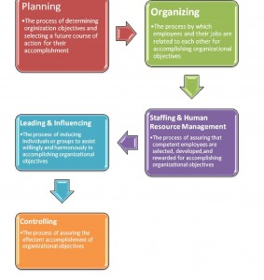
Basic elements - functions
Resource: The Extension management process (Adapted from Buford, J. et at. 1995) Management in Extension. 3rd edition. Columbus OH: Ohio State University Extension)

Slide 8
Functions of management
Planning - Defines the firm´s goals, decides what is to be done to achieve them in certain future period and generates plans for precise and timely fulfilment.
Organizing – aims at utilizing needed resources in an efficient way, assigns employees to specific jobs and establishes relations between individuals and groups inside the firm.

Slide 9
Functions of management
Decision-making – involves the careful evaluation of existing alternatives and the selection of one which appears to be the most appropriate for running the business. It is also needed in directing people to proper actions, in motivating them and coordinating their performances. The decisions are strategic, tactical or operational.
Controlling – compares plans with actual achievements and helps formulate ways to improvements and modifications based on feedback.

Slide 10
Functions of management
Staffing – this simply means finding and building the appropriate staff. Until and unless the right people aren´t employed the correct completion of tasks will remain a distant dream. Also known as human resource function, it involves recruitment, placement, selection and training.
Directing – involves guiding the team towards the right direction by leading, motivating and encouraging them. Working in a positive environment of motivation and encouragement brings out the best in people. Hence a good manager makes sure to encourage or criticise his/her subordinates at suitable times to maintain an atmosphere of willingness to work.

Slide 11
Branches of management
As a process of concentrating and streamling a firm´s efforts towards specified goals, management is applied in various areas of the firm´s activity, in forms and by methods adequate to the specifics of the given area.
The empirical experience of firms gained over long years of business activity has led to discerning several basic branches of management, even though each of them may have multitude of subcategories.
Therefore, the following cathegories are to be considered as mere a roughcast of the current concepts, not as complete or definite summary.

Slide 12
Branches of management
Strategy
Production/operation
Marketing
Human resources
Finance
Information systems
Organisation
Managerial economics

Slide 13
Branches of management
Strategy
  Implies large-scale plans for achieving major long-term goals, for which the firm must allocate the necessary material, financial and human resources. The effects resulting from such an undertaking have to be substantial.
  The choice of strategy is based on strategic segmentation, a process in which the firm´s strategic areas are identified.
  External and internal conditions characterizing the firm´s position are usually analyzed by means of a SWOT analysis (an acronym for strenght, weaknesses, opportunities and threats).
  The strategic approach is applicable to all other areas under examination.

Slide 14
Branches of management
Production/operation
  Management is needed for production and operations in many directions, from large investments to day-to-day operations, and may concern research and development, changes in technology, adjustments in production programmes or business logistics, it can be achieved through project or quality management, etc.
Marketing
  Is the sphere where goods, mediocre or bad management influences the economic results of the whole firm to a considerable extent. The area covers all commercial activities, sales, advertising, promotion, services, customer and public relations and brand management.

Slide 15
Branches of management
Human resources
  The area of human resources is the main domain of personnel management, which si the part of management concerned with people at work and their relations within a firm as regards, for example, the delimitation of competences, knowledge management, employee training, application of motivation stimuli, performance appraisals and social issues.
  It is always to be borne in mind that the main responsibility for this kind of management rests with line managers, while the role of HR departments is mainly supportive and advisory.

Slide 16
Branches of management
Finance
  Financial management is often referred to as the science of managing the firm´s financial assets for the appropriate funding of business activities.
  In organizational terms, the process is primarily associated with financial planning and the quantification of resources, and with financial control, focusing on profit, stability and trouble-free cashflow.
  An important part of financial management is debt management. The proportion between internal and external financing also has to be determined.
  Sometimes, financial management refers to managerial accounting, which uses various financial indicators, especially ratios derived from financial records and statements, for evaluating the firm´s performance and outlook.

Slide 17
Branches of management
Information systems
  Information management is the gathering and managing of information, which relates to an important part of a firm´s activity, from one or more sources and passing it on to one or more recipients.
  There is a close conjunction between information management and knowledge management, greatly facilitated by the all-pervasive ICT (information communication technologies) that gives new formats to presentations in the form of reports and memoranda, discussion forums, corporate libraries, training programmes, etc.
  Experts believe that the desired effect can be best achieved by increasing corporate IQ and by inducing all employees to share information on the largest possible scale.
  Information sharing should also be included in all performance ratings.

Slide 18
Branches of management
Organisation
  The management of organizational structure has to respond to new trends towards flat styles of organization, the accent on teamwork, the transfer of the decision-making processes to lower management levels and the concentration on autonomous operations (so-called core activities).
  One of the relevant studies aptly states „Management is becoming less based on the traditional concept of command-and-control, and more about facilitation and the support of collaborative activity, utilizing principles such as those of human interaction management.“
  Organizational restructuring is, of course, even more distinct in firms which have reshaped their whole setup to work fully online.

Slide 19
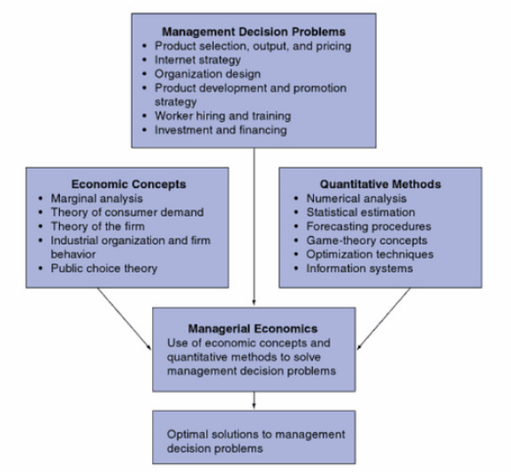
Tool for improving management decision making
MANAGERIAL ECONOMICS
Helps managers recognize how economic forces affect organizations and describes the economic consequences of managerial behaviour.
Source: Hirschey, 2009, p. 4

Slide 20
Conclusions
We have already seen how important management and managerial functions are to an organization.
In management to there are levels depending on seniority and experience levels as well as ability.
We have already taken a look at the levels of management and some important functions and elements of management.

