Slide 1

Break-even point and analysis of profit of an enterprise
Ing. Žaneta Rylková, Ph.D.
Managerial Economics

Slide 2

Outline of the lecture
Break-even point
Rentability of costs
Rentability of revenues

Slide 3
Economic result – function of volume production
Difference between revenues (sales) and total costs marks economic result:
ER = R – C,
ER = S – C,
Assuming: R = p ·Q, and C = v · Q + F
The rule:
ER = p · Q – (v · Q + F) (1)

Slide 4
Economic result – function of volume production
In equation:
ER economic result
R revenues
C costs (total)
p price per unit
Q production volume
C_{V} variable costs
v variable costs per unit

Slide 5
Break-even point graph

Slide 6
Analysis of the profit of the enterprise
Information of the value of profit cannot be always sufficient for the evaluation of the enterprise economy, therefore the profit is rated with the selected items.
These ratio indicators are defined as profitability indicators and serve as a gauge of business effectivity and at the same time the enterprise manager abilities.

Slide 7
Analysis of the profit of the enterprise
Using the profitability of economic activity is evaluated by current enterprise profit, in its range and in the relation to economic sources, which the enterprise used for achieving of this profit. It may be considered as result expression of certain and devision of financial result of the enterprise.

Slide 8
Analysis of the profit of the enterprise
According to mentioned basic calculation of the profitability indicator there may be used different:
  Forms of capital (total capital, equity capital, long-term invested capital)
  Category of profit: profit before taxation, profit after taxation (net profit) and before the deduction of interests, operational profit, profit after taxation.

Slide 9
Analysis of the profit of the enterprise
Suitable combination of input variables it is possible to calculate basic profitability indicators such as:
  Return on assets (ROA)
  Return on equity (ROE)
  Return on sales (ROS)
  Return on costs (ROC)

Slide 10
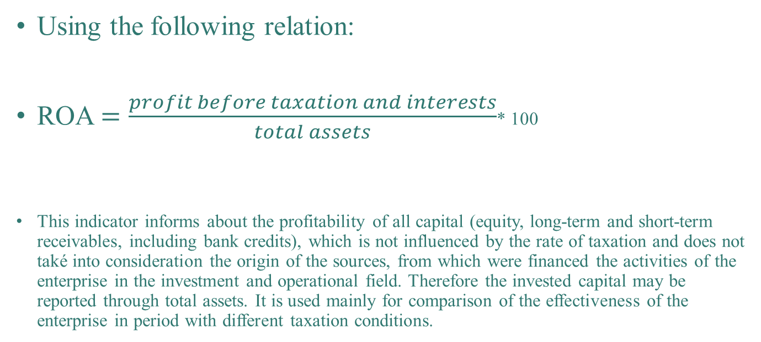
Return on assets
Using the following relation:
ROA $=\frac{profit before taxation and interests}{total assets}$* 100
This indicator informs about the profitability of all capital (equity, long-term and short-term receivables, including bank credits), which is not influenced by the rate of taxation and does not také into consideration the origin of the sources, from which were financed the activities of the enterprise in the investment and operational field. Therefore the invested capital may be reported through total assets. It is used mainly for comparison of the effectiveness of the enterprise in period with different taxation conditions.

Slide 11
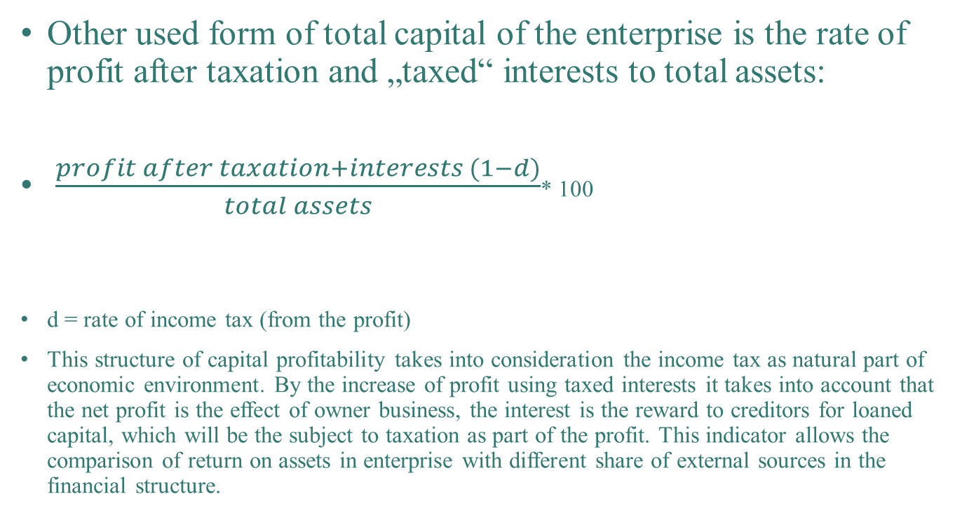
Return on assets
Other used form of total capital of the enterprise is the rate of profit after taxation and „taxed“ interests to total assets:
$\frac{profit after taxation+interests (1−d)}{total assets}$* 100
d = rate of income tax (from the profit)
This structure of capital profitability takes into consideration the income tax as natural part of economic environment. By the increase of profit using taxed interests it takes into account that the net profit is the effect of owner business, the interest is the reward to creditors for loaned capital, which will be the subject to taxation as part of the profit. This indicator allows the comparison of return on assets in enterprise with different share of external sources in the financial structure.

Slide 12
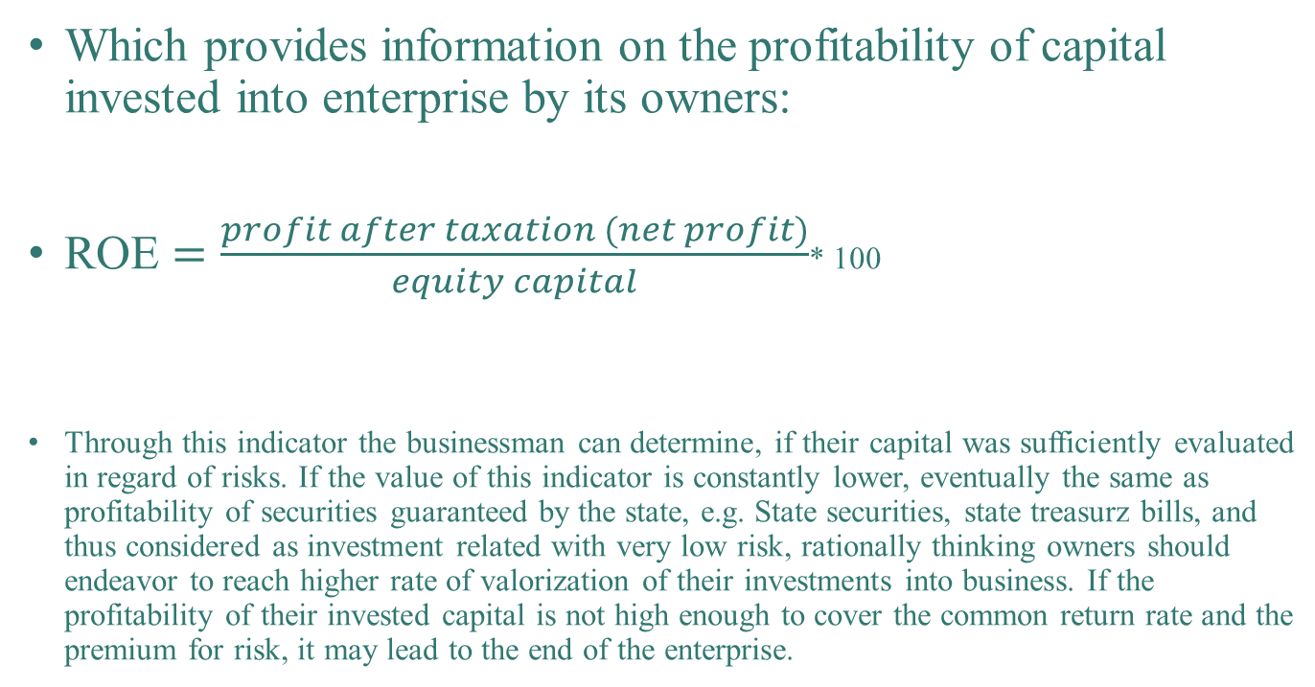
Return on equity
Which provides information on the profitability of capital invested into enterprise by its owners:
ROE $=\frac{profit after taxation (net profit)}{equity capital}$* 100
Through this indicator the businessman can determine, if their capital was sufficiently evaluated in regard of risks. If the value of this indicator is constantly lower, eventually the same as profitability of securities guaranteed by the state, e.g. State securities, state treasurz bills, and thus considered as investment related with very low risk, rationally thinking owners should endeavor to reach higher rate of valorization of their investments into business. If the profitability of their invested capital is not high enough to cover the common return rate and the premium for risk, it may lead to the end of the enterprise.

Slide 13
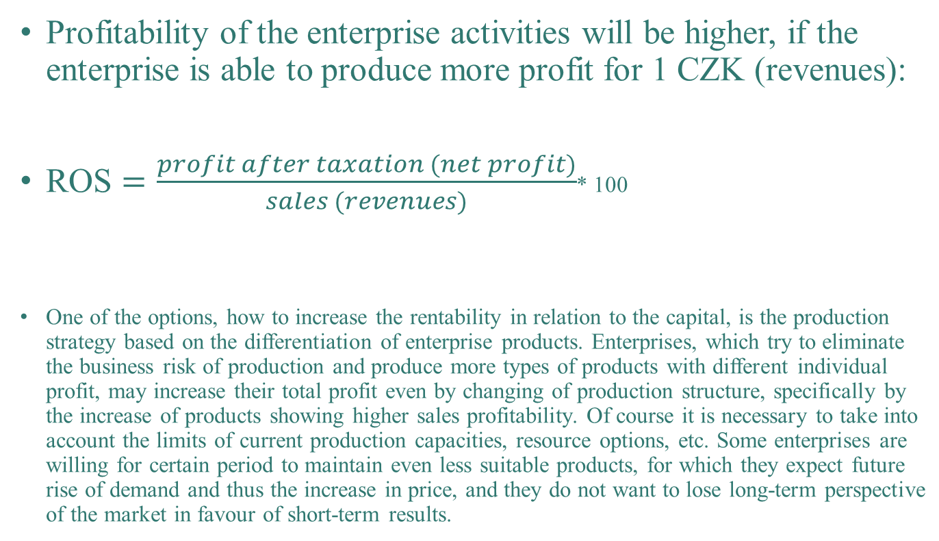
Return on sales
Profitability of the enterprise activities will be higher, if the enterprise is able to produce more profit for 1 CZK (revenues):
ROS $=\frac{profit after taxation (net profit)}{sales (revenues)}$* 100
One of the options, how to increase the rentability in relation to the capital, is the production strategy based on the differentiation of enterprise products. Enterprises, which try to eliminate the business risk of production and produce more types of products with different individual profit, may increase their total profit even by changing of production structure, specifically by the increase of products showing higher sales profitability. Of course it is necessary to take into account the limits of current production capacities, resource options, etc. Some enterprises are willing for certain period to maintain even less suitable products, for which they expect future rise of demand and thus the increase in price, and they do not want to lose long-term perspective of the market in favour of short-term results.

Slide 14
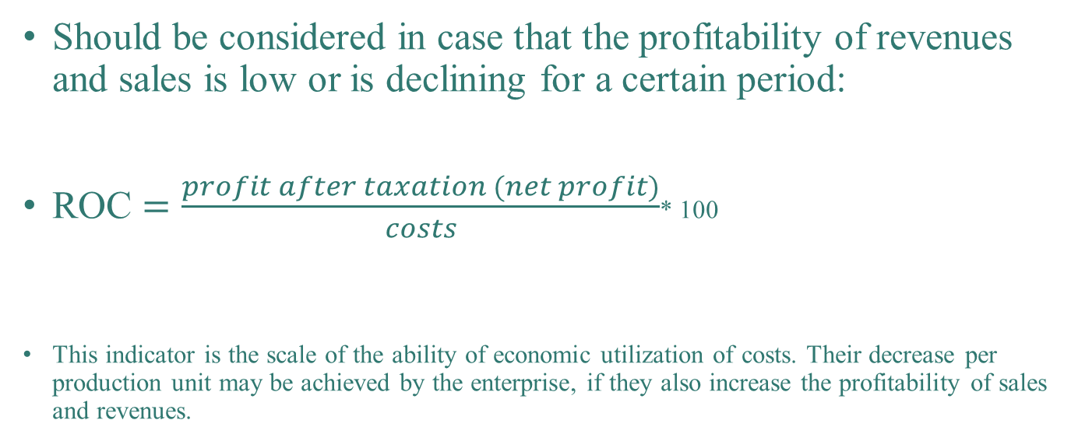
Return on costs
Should be considered in case that the profitability of revenues and sales is low or is declining for a certain period:
ROC $=\frac{profit after taxation (net profit)}{costs}$* 100
This indicator is the scale of the ability of economic utilization of costs. Their decrease per production unit may be achieved by the enterprise, if they also increase the profitability of sales and revenues.

Slide 15
Profitability
Beside the above mentioned indicators of profitability often quantified in % (i.e. rate of profitability), are used also complementary indicators, e.g. profit in CZK per employee.

