Slide 1

Functional Strategy
Ing. Šárka Zapletalová, Ph.D.
Department of Business Economics and Management
STRATEGIC MANAGEMENT

Slide 2

Outline of the lecture
Functional strategy
Marketing strategy
Financial strategy
Research and development strategy
Operations strategy
Purchasing strategy
Logistics strategy
HRM strategy
IT strategy
The Sourcing decisions
Strategic choice

Slide 3
Introduction
Functional strategy is the approach a functional area takes to achieve corporate and business unit objectives and strategies by maximizing resource productivity.
It is concerned with developing and nurturing a distinctive competence to provide a company or business unit with a competitive advantage.
Multidivisional corporation has several business units, each with its own business strategy, each business unit has its own set of departments, each with its own functional strategy.

Slide 4
Functional Strategy
Functional strategy is the approach a functional area takes to achieve corporate and business unit objectives and strategies by maximizing resource productivity.
It is concerned with developing and nurturing a distinctive competence to provide a company or business unit with a competitive advantage.
Functional strategy could be for example:
marketing strategy,
financial strategy,
research and development strategy,
operations strategy,
purchasing strategy,
logistic strategy,
HRM stratedy,
IT strategy.

Slide 5
Functional Strategy
Just as a multidivisional corporation has several business units, each with its own business strategy, each business unit has its own set of departments, each with its own functional strategy.
  For example, a business unit following a competitive strategy of differentiation through high quality needs a manufacturing functional strategy that emphasizes expensive quality.
  Assurance processes over cheaper, high-volume production; a human resource functional strategy that emphasizes the hiring and training of a highly skilled, but costly, workforce; and a marketing functional strategy that emphasizes distribution channel “pull,” using advertising to increase consumer demand, over “push,” using promotional allowances to retailers.

Slide 6
Marketing Strategy
Marketing strategy deals with pricing, selling, and distributing a product.
Using a market development strategy, a company or business unit can
  capture a larger share of an existing market for current products through market saturation and market penetration or
  develop new uses and/or markets for current products.
  Consumer product giants such as P&G, Colgate-Palmolive, and Unilever are experts at using advertising and promotion to implement a market saturation/penetration strategy to gain the dominant market share in a product category. As seeming masters of the product life cycle, these companies are able to extend product life almost indefinitely through “new and improved” variations of product and packaging that appeal to most market niches.

Slide 7
Marketing Strategy
Using the product development strategy, a company or unit can
  develop new products for existing markets or
  develop new products for new markets.
Using a successful brand name to market other products is called brand extension, and it is a good way to appeal to a company’s current customers.
  Smith & Wesson, famous for its handguns, has taken this approach by using licensing to put its name on men’s cologne and other products like the Smith & Wesson 357 Magnum Wood Pellet Smoker (for smoking meats).
There are numerous other marketing strategies. For advertising and promotion, for example, a company or business unit can choose between “push” and “pull” marketing strategies.

Slide 8
Marketing Strategy
Other marketing strategies deal with distribution and pricing.
  Should a company use distributors and dealers to sell its products, or should it sell directly to mass merchandisers or use the direct marketing model by selling straight to the consumers via the Internet?
When pricing a new product, a company or business unit can follow one of two strategies. For new-product pioneers, skim pricing offers the opportunity to “skim the cream” from the top of the demand curve with a high price while the product is novel and competitors are few.
Penetration pricing, in contrast, attempts to hasten market development and offers the pioneer the opportunity to use the experience curve to gain market share with a low price and then dominate the industry.

Slide 9
Financial Strategy
Financial strategy examines the financial implications of corporate and business-level strategic options and identifies the best financial course of action.
It can also provide competitive advantage through a lower cost of funds and a flexible ability to raise capital to support a business strategy.
Financial strategy usually attempts to maximize the financial value of a firm.
The trade-off between achieving the desired debt-to-equity ratio and relying on internal long-term financing via cash flow is a key issue in financial strategy.

Slide 10
Financial Strategy
Research reveals that a firm’s financial strategy is influenced by its corporate diversification strategy. Equity financing, for example, is preferred for related diversification, whereas debt financing is preferred for unrelated diversification.
In a leveraged buyout, a company is acquired in a transaction financed largely by debt, usually obtained from a third party, such as an insurance company or an investment banker.
The management of dividends and stock price is an important part of a corporation’s financial strategy.

Slide 11
Financial Strategy
A number of firms have been supporting the price of their stock by using reverse stock splits.
  Contrasted with a typical forward 2-for-1 stock split in which an investor receives an additional share for every share owned (with each share being worth only half as much), in a reverse 1-for-2 stock split, an investor’s shares are split in half for the same total amount of money (with each share now being worth twice as much).
  Thus, 100 shares of stock worth $10 each are exchanged for 50 shares worth $20 each.
A rather novel financial strategy is the selling of a company’s patents.

Slide 12
Research and Development Strategy
Research and development strategy deals with product and process innovation and improvement.
It also deals with the appropriate mix of different types of research and development (basic, product, or process) and with the question of how new technology should be accessed - through internal development, external acquisition, or strategic alliances.
A new approach to R&D is open innovation, in which a firm uses alliances and connections with corporate, government, academic labs, and even consumers to develop new products and processes.
  For example, Intel opened four small-scale research facilities adjacent to universities to promote the cross-pollination of ideas.
Investing corporate venture capital is one way to gain access to promising innovations at a lower cost than by developing them internally.

Slide 13
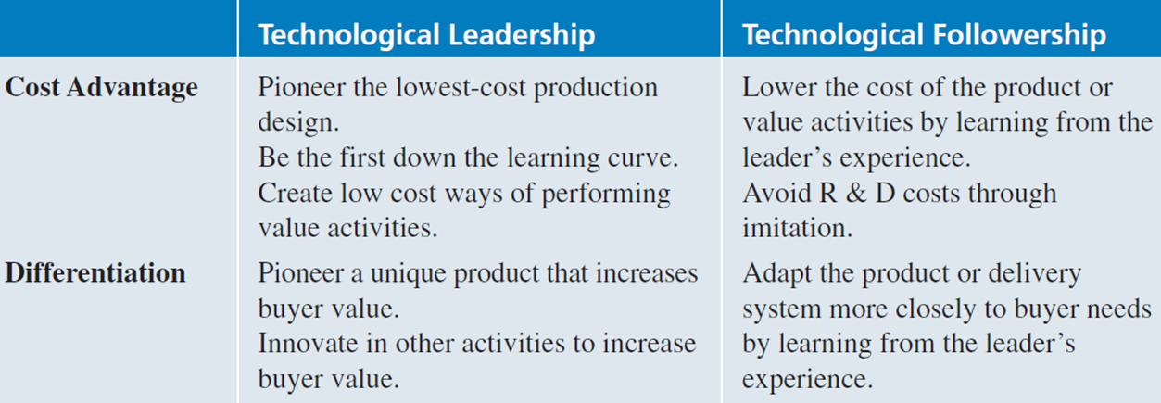
Research and Development Strategy
  One of the R&D choices is to be either a technological leader, pioneering an innovation, or a technological follower, imitating the products of competitors.
    One example of an effective use of the leader R&D functional strategy to achieve a differentiation competitive advantage is Nike, Inc. Nike spends more than most in the industry on R&D to differentiate the performance of its athletic shoes from that of its competitors. As a result, its products have become the favorite of serious athletes.

Slide 14
Operations Strategy
Operations strategy determines how and where a product or service is to be manufactured, the level of vertical integration in the production process, the deployment of physical resources, and relationships with suppliers.
It should also deal with the optimum level of technology the firm should use in its operations processes.
Advanced Manufacturing Technology (AMT) is revolutionizing operations worldwide and should continue to have a major impact as corporations strive to integrate diverse business activities by using computer assisted design and manufacturing (CAD/CAM) principles.

Slide 15
Operations Strategy
A firm’s manufacturing strategy is often affected by a product’s life cycle.
As the sales of a product increase, there will be an increase in production volume ranging from lot sizes as low as one in a job shop (one-of-a-kind production using skilled labor) through connected line batch flow (components are standardized; each machine functions such as a job shop but is positioned in the same order as the parts are processed) to lot sizes as high as 100,000 or more per year for flexible manufacturing systems (parts are grouped into manufacturing families to produce a wide variety of mass-produced items) and dedicated transfer lines (highly automated assembly lines making one mass-produced product using little human labor).

Slide 16
Operations Strategy
A mass-production systemis an excellent method to produce a large number of low-cost, standard goods and services.
Under the continuous improvement system developed by Japanese firms, empowered cross-functional teams strive constantly to improve production processes.
Because continuous improvement enables firms to use the same low-cost competitive strategy as do mass-production firms but at a significantly higher level of quality, it is rapidly replacing mass production as an operations strategy.

Slide 17
Operations Strategy
The automobile industry is currently experimenting with the strategy of modular manufacturing in which preassembled subassemblies are delivered as they are needed (i.e., Justin- Time) to a company’s assembly-line workers, who quickly piece the modules together into a finished product.
The concept of a product’s life cycle eventually leading to one-size-fits-all mass production is being increasingly challenged by the new concept of mass customization.
Appropriate for an ever-changing environment, mass customization requires that people, processes, units, and technology reconfigure themselves to give customers exactly what they want, when they want it.

Slide 18
Purchasing Strategy
Purchasing strategy deals with obtaining the raw materials, parts, and supplies needed to perform the operations function.
Purchasing strategy is important because materials and components purchased from suppliers comprise 50% of total manufacturing costs of manufacturing companies in the United Kingdom, United States, Australia, Belgium, and Finland.
The basic purchasing choices are multiple, sole, and parallel sourcing.
  Under multiple sourcing, the purchasing company orders a particular part from several vendors.
  W. Edward Deming, a well-known management consultant, strongly recommended sole sourcing as the only manageable way to obtain high supplier quality. Sole sourcing relies on only one supplier for a particular part. Sole sourcing reduces transaction costs and builds quality by having the purchaser and supplier work together as partners rather than as adversaries.
  In parallel sourcing, two suppliers are the sole suppliers of two different parts, but they are also backup suppliers for each other’s parts.

Slide 19
Logistics Strategy
Logistics strategy deals with the flow of products into and out of the manufacturing process.
Three trends related to this strategy are evident: centralization, outsourcing, and the use of the Internet.
To gain logistical synergies across business units, corporations began centralizing logistics in the headquarters group.
Many companies have found that outsourcing logistics reduces costs and improves delivery time.

Slide 20
HRM Strategy
HRM strategy, among other things, addresses the issue of whether a company or business unit should hire a large number of low-skilled employees who receive low pay, perform repetitive jobs, and are most likely quit after a short time or hire skilled employees who receive relatively high pay and are cross-trained to participate in selfmanaging work teams.
A complete 360-degree appraisal, in which input is gathered
from multiple sources, is now being used by more than 10% of U.S. corporations and has become one of the most popular and effective tools in developing employees and new managers.
Companies are finding that having a diverse workforce can be a competitive advantage.

Slide 21
IT Strategy
Corporations are increasingly using information technology strategy to provide business units with competitive advantage.
Multinational corporations are finding that having a sophisticated intranet allows employees to practice follow-the-sun management, in which project team members living in one country.
Many companies, such as Lockheed Martin, General Electric, and Whirlpool, use information technology to form closer relationships with both their customers and suppliers through sophisticated extranets.

Slide 22
The Sourcing Decision: Location of Function
For a functional strategy to have the best chance of success, it should be built on a distinctive competency residing within that functional area.
If a corporation does not have a distinctive competency in a particular functional area, that functional area could be a candidate for outsourcing.
Outsourcing is purchasing from someone else a product or service that had been previously provided internally. Thus, it is the reverse of vertical integration. Outsourcing is becoming an increasingly important part of strategic decision making and an important way to increase efficiency and often quality.

Slide 23
The Sourcing Decision: Location of Function
An outsourcing decision depends on the fraction of total value added that the activity under consideration represents and on the amount of potential competitive advantage in that activity for the company or business unit.
A firm should consider outsourcing any activity or function that has low potential for competitive advantage.
If that activity constitutes only a small part of the total value of the firm’s products or services, it should be purchased on the open market (assuming that quality providers of the activity are plentiful).
If, however, the activity contributes highly to the company’s products or services, the firm should purchase it through long-term contracts with trusted suppliers or distributors.

Slide 24
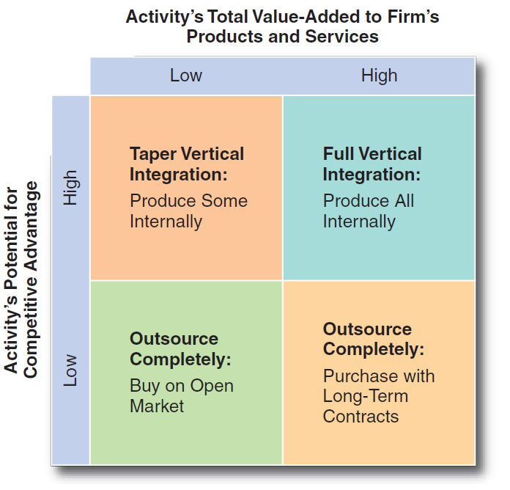
The Sourcing Decision: Location of Function
Outsourcing Matrix
Full vertical integration should be considered only when that activity or function adds significant value to the company’s products or services in addition to providing competitive advantage.
SOURCE: J. D. Hunger and T. L. Wheelen, “Proposed Outsourcing Matrix.”

Slide 25
The Sourcing Decision: Location of Function
Offshoring is the outsourcing of an activity or a function to a wholly owned company or an independent provider in another country.
Offshoring is a global phenomenon that has been supported by advances in information and communication technologies, the development of stable, secure, and high-speed data transmission systems, and logistical advances like containerized shipping.

Slide 26
Strategic Choice: Selecting the Best Strategy
After the pros and cons of the potential strategic alternatives have been identified and evaluated, one must be selected for implementation. By now, it is likely that many feasible alternatives will have emerged.
  How is the best strategy determined?
The most important criterion is the capability of the proposed strategy to deal with the specific strategic factors developed earlier, in the SWOT analysis.
If the alternative doesn’t take advantage of environmental opportunities and corporate strengths/competencies, and lead away from environmental threats and corporate weaknesses, it will probably fail.

Slide 27
Strategic Choice: Selecting the Best Strategy
Constructin Corporate Scenarios
Corporate scenarios are pro forma (estimated future) balance sheets and income statements that forecast the effect each alternative strategy and its various programs will likely have on division and corporate return on investment.
  In a survey of Fortune 500 firms, 84% reported using computer simulation models in strategic planning. Most of these were simply spreadsheet-based simulation models dealing with what-if questions.
The recommended scenarios are simply extensions of the industry scenarios.

Slide 28
Strategic Choice: Selecting the Best Strategy
Constructin Corporate Scenarios
To construct a corporate scenario, follow these steps:
  Use industry scenarios to develop a set of assumptions about the task environment (in the specific country under consideration).
    List optimistic, pessimistic, and most likely assumptions for key economic factors such as the GDP, CPI (Consumer Price Index), and prime interest rate and for other key external strategic factors such as governmental regulation and industry trends.
  Develop common-size financial statements for the company’s or business unit’s previous years, to serve as the basis for the trend analysis projections of pro forma financial statements.
  Construct detailed pro forma financial statements for each strategic alternative.
The result of this detailed scenario construction should be anticipated net profits, cash flow, and net working capital for each of three versions of the two alternatives for five years into the future.

