Slide 1


3. Part II-Tourist attractions in the Czech Republic -7 regions
.
Předmět:
The Tourist Attractions in the Czech Republic and in the World
Ing. Patrik Kajzar, Ph.D.

Slide 2
The main tourist attractions in Olomouc
Olomouc Region is located in the north-western and central part of its historical region of Moravia (Morava) and in a small part of the historical region of Czech Silesia (České Slezsko). It is named for its capital Olomouc.
The northern part of the region is of a mountainous nature.
The Jeseníky mountains are located here, including Praděd which is the highest point of the region (1,492 m above sea level). The southern part of the Region consists of the Hanakian lowland.
The lowest point of the region is situated on the water level of the Morava River near to Kojetín in the Přerov District (190 m above sea level).
The Morava river flows through the region and the majority of the region's territory belongs to Morava’s drainage basin. A small northern part of the region belongs to the drainage basin of Odra River which flows to the Baltic Sea.

Slide 3
The main tourist attractions in Olomouc
The Olomouc Region offers a great variety of natural points of interest. Protected landscape area of the Jeseníky mountains offers a number of scenic places such as with the largest Moravian peatbog Rejvíz and a 45m high High Waterfall. Another scenic place is Dlouhé Stráně water reservoir situated on the top of a hill.
The heart of the Hana region is very rich in monuments. The historic sights of Olomouc would surely be sufficient, but the region itself has also lots of attractions. The fairytale-like Bouzov Castle is located just about 35 km from Olomouc.
Other well known castles include Sovinec Castle or Helfštýn Castle, renowned for its annual gathering of blacksmiths called “Hefaiston”.
Near Olomouc there is the Chateau Náměšť na Hané with a display of traveling coaches of Olomouc bishops and archbishops. Historic carriages and coaches can also be admired in a museum located near the Chateau Čechy pod Kosířem. Mladeč caves and Javoříčko caves are worth a visit as well.

Slide 4
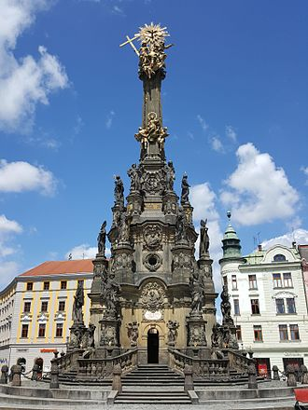
The main tourist attractions in Olomouc
Holy Trinity Column - This memorial column, erected in the early years of the 18th century, is the most outstanding example of a type of monument specific to central Europe. In the characteristic regional style known as ‘Olomouc Baroque’ and rising to a height of 35 m, it is decorated with many fine religious sculptures, the work of the distinguished Moravian artist Ondřej Zahner. The Holy Trinity Column was inscribed in the UNESCO list in 2000.
For winter sports many downhill courses and pistes are prepared in the Jeseníky mountains in areas of Červenohorské sedlo, Kouty nad Desnou, Petříkov, Ostružná, Ramzová and many others.
Holy Trinity Column, Olomouc

Slide 5
The main tourist attractions in Pardubice
Pardubice region is located mainly in the eastern part of its historical region of Bohemia, with a small part in northwestern Moravia.
It is named after its capital Pardubice. As an administrative unit, Pardubice Region has in the course of history existed three times. It was established for the first time in 1850, and extended from Český Brod to the Bohemian-Moravian border.
The southern and southeastern parts of the region are home to the hilly areas of Žďárské vrchy and Železné Hory (Iron Mountains). The central and western parts of the region are formed by the Polabí lowlands. In the northeast, the region reaches the Orlické hory and Hrubý Jeseník Mountains.
The European Watershed runs through the region, where it separates the basins of the North Sea and the Black Sea. The tripoint of the Danube (Black Sea), Elbe (North Sea) and Oder (Baltic Sea) watersheds is located at the peak of Králický Sněžník.

Slide 6
The main tourist attractions in Pardubice
The rivers in the drainage basin of the Danube are the Morava, Moravská Sázava, Svitava and Třebůvka.
Litomyšl was established around the trade route that connected Bohemia and Moravia at the end of the 10th and beginning of the 11th centuries. The dominant feature of the city is the Italianate Renaissance castle with its more than eight thousand examples of sgrafitto, which has been on the UNESCO World Cultural and Heritage List since 1999. Litomyšl is the birthplace of the composer Bedřich Smetana, whose name is commemorated by an annual opera festival. On the 500 metre long square can be found the Gothic town hall and a number of Renaissance and Baroque houses.
Landscape for horse breeding in Kladruby – UNESCO. The cultural landscape includes not only the stud farm, but the surrounding pastures, including artificially built water canals and tree-lined alleys lined. The landscape is an excellent combination of the work of nature and man in preserved pre-industrial form and represents a significant phenomenon of human civilization, which for centuries has been a specialised breeding of ceremonial, representative horses.

Slide 7
The main tourist attractions in Pilsen
The Pilsen Region lies in the southwest of the Czech Republic. It borders Karlovy Vary in the northwest, the Ústí Region in the north, the Central Bohemian Region in the northwest and the South Bohemian Region in the east. The longest border is with Germany (Bavaria) in the southwest.
The region is ideally positioned between the capital of Prague and western European countries.
The Pilsen Region is the third largest region in the Czech Republic and is the ninth most populous, accounting for 5.4% of the country’s total population. After the South Bohemian Region it is the second most sparsely populated region in the Czech Republic.
The City of Pilsen has been the natural centre of the region ever since its foundation. Pilsen was established by King Wenceslaus II in 1295 at the confluence of four rivers – the Radbuza, Mže, Úhlava and Úslava. From the very outset it has been an outstanding trade centre situated at an important crossroads to Nuremberg and Regensburg.

Slide 8
The main tourist attractions in Pilsen
Municipal centres apart from Pilsen include Klatovy, Domažlice, Tachov and Rokycany. Considering the low population density towns like Sušice, Stříbro, Plasy, Kralovice, Horšovský Týn, Přeštice and Nepomuk are also of regional importance.
The Pilsen Region is characterised by its variety of natural conditions. This diversity is caused by the terrain. The border mountain range in the southwest (Bohemian Forest/Šumava and Upper Palatinate Forest) and the Pilsen Valley in the northeast of the region are dominant features of the landscape.
The Pilsen Hills and part of the Brdy Hills are other areas that form the region. In terms of waterways, the largest part of the region falls under the Berounka catchment area – the historical districts of Pilsen, Kralovice, Tachov, Domažlice, Rokycany and part of Klatovy.
The best of the region and The most interesting attractions in the whole Pilsen region:
Rotunda of St. Peter and Paul in Starý Plzenec – the old est integral architectural landmark in Bohemia.

Slide 9
The main tourist attractions in Pilsen
St. Bartholomew´s Cathedral in Pilsen – the tallest church spire in Bohemia (102,26 m )
Republic Town Square of Pilsen – one of the largest medieval town squares in the Czech Republic
Synagogue in Pilsen – the second largest in Europe and the third largest in the world, synagogues in Jerusalem and Budapest being the largest
Pilsen – Brewery Museum in Pilsen – the old est museum of its kind in the world, preserved in the original medieval brewery house.
West-Bohemian Museum in Pilsen – the largest collection of Gothic harquebus guns in Europe
Zoological and botanical garden in Pilsen – the only facility in the Czech Republic combining both zoological and botanical gardens; these two gardens have been operating since 1981 in Lochotín city part, neighbouring the largest amphitheatre in the central Europe.

Slide 10
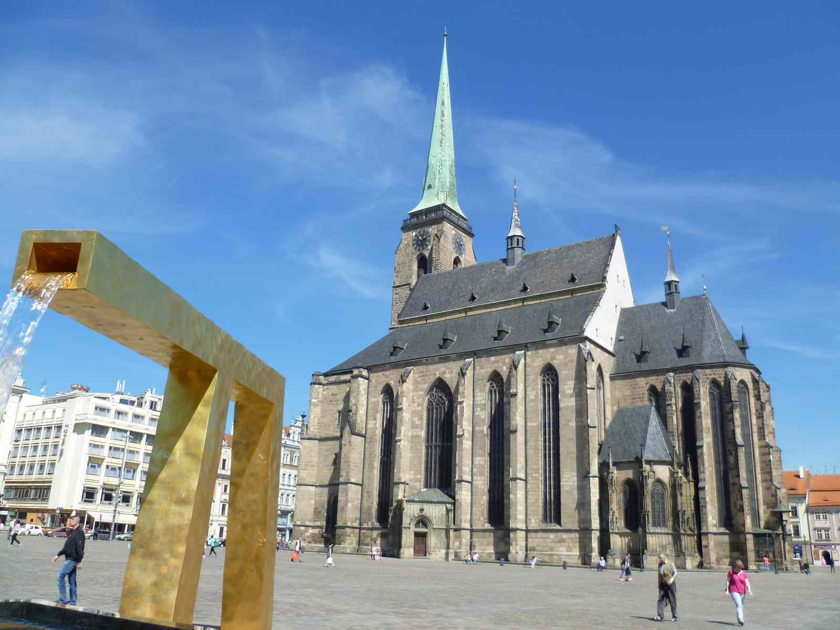
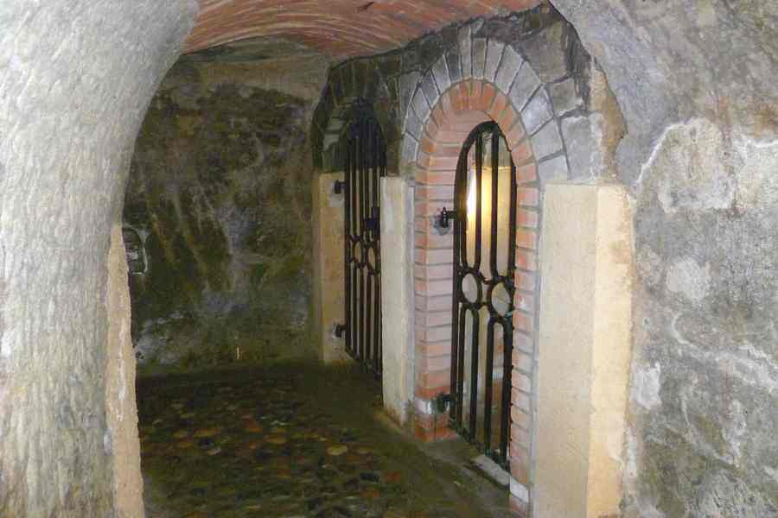
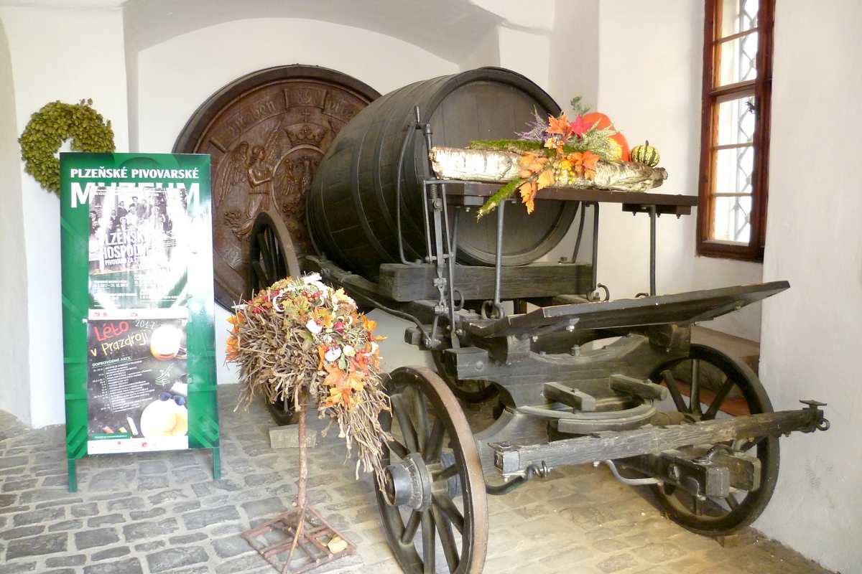
The main tourist attractions in Pilsen
Ceramic pylon in Pilsen - the highest (10 m) ceramic object, rotated at potter's wheel, in the world. It is made from 4,5 tons of clay by Westbohemian artist Ivan Hostaša. The pylon is written down in the Guiness Book of Records
At the site of the Zbiroh medieval castle, there is a 163m deep well of oblong shape, hewn in solid rock. It ranks among the deepest wells in Europe.
St.Bartholomew´s Cathedral
Pilsen Historical Underground
Brewery museum

Slide 11
The main tourist attractions in Central Bohemia
The Central Bohemian Region is located in the central part of its historical region of Bohemia. Its administrative center is placed in the Czech capital Prague (Czech: Praha), which lies in the center of the region.
The city is not, however, a part of it and creates a region of its own.
The Central Bohemian Region is situated in the center of Bohemia. In terms of area it is the largest region in the Czech Republic. It occupies 11,014 km² which is almost 14% of the total area of the country.
It surrounds the country’s capital Prague and it borders with Liberec Region (in the north), Hradec Králové Region (north-east), Pardubice Region (east), Vysočina Region (south-east), South Bohemian Region (south), Plzeň Region (west) and Ústí nad Labem Region (north-west).

Slide 12
The main tourist attractions in Central Bohemia
The Central Bohemian Region is the largest region of the Czech Republic, occupying 14% of its total area.
The region has relatively various natural conditions. The highest point of the region is located on Tok hill (846 m) in Brdy Highlands in the south-eastern part of the region. The lowest point of the region is situated on the water surface of the Elbe River (Czech: Labe) near Dolní Beřkovice.
The region is divided into two landscape types. The north-eastern part is formed by Polabí lowlands with a high share of land being used for agricultural purposes and deciduous forests. The south-western part of the region is hilly with coniferous and mixed forests.
Important rivers in the region are Elbe, Vltava, Berounka, Jizera and Sázava. On Vltava river, a series of nine dams (Czech: Vltavská kaskáda) were constructed throughout the 20th century.

Slide 13
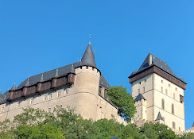
The main tourist attractions in Central Bohemia
There are a number of landscape parks located in the region. Křivoklátsko is the largest and most important landscape park in the region, being at the same time a UNESCO Biosphere Reservation. Another remarkable area is the Bohemian Karst, the largest karst area in the Czech republic where the Koněprusy Caves (Czech: Koněpruské jeskyně) are located. Finally, Kokořínsko Landscape park is for a large part situated in the Central Bohemian Region.
Karlštejn Castle is a large Gothic castle founded 1348 CE by Charles IV, Holy Roman Emperor-elect and King of Bohemia. The castle served as a place for safekeeping the Imperial Regalia as well as the Bohemian/Czech crown jewels, holy relics, and other royal treasures. Located about 30 kilometres (19 mi) southwest of Prague above the village of the same name, it is one of the most famous and most frequently visited castles in the Czech Republic.
Karlštejn Castle

Slide 14
The main tourist attractions in Central Bohemia
Kokořín Castle is a castle located some 10 km (6 mi) northeast of Mělník, Czech Republic. It was built in the first half of the 14th century by order of Hynek Berka z Dubé. It was heavily damaged during the Hussite Wars and stood in ruins until the reconstruction campaign of 1911–1918. It was nationalized in 1948 and has been designated a national cultural landmark since 2001. The nature preserve of Kokořínsko takes its name from this castle.
Konopiště is a four-winged, three-storey château located in the Czech Republic, about 50 km (30 mi) southeast of Prague, outside the city of Benešov.
Lány is a village in the Czech Republic, 35 km (22 mi) west of Prague, in Central Bohemian Region, outside the main road towards Karlovy Vary. Its major landmark is a castle, serving as a summer residence of Czechoslovak and later Czech Presidents. There is also a sports car museum and Museum of T. G. Masaryk, the first President of Czechoslovakia. Both President Masaryk and his wife are buried in the local cemetery.

Slide 15
The main tourist attractions in Ústí nad Labem
Ústí nad Labem Region or Ústecký Region is located in the north-western part of the historical land of Bohemia and the whole country, and named after the capital, Ústí nad Labem. It covers the majority of the former North Bohemia province and is part of the broader area of North Bohemia.
The region borders the regions of Liberec (east), Central Bohemia (south), Plzeň (southwest), Karlovy Vary (west) and the German region of Saxony to the north.
The Ústí region comprises a range of very different types of landscape. Between the high escarpment of the Ore Mountains range and the Bohemian Central Uplands with many volcanic hills, there are vast areas devastated by surface coal mining (the North Bohemian Basin), partly being recultivated into an artificial landscape with ponds, plains and groves.
The Elbe river runs through the Central Uplands in a winding gorge of the Porta Bohemica. The southern part of the region, Polabí, is flat and fertile, while in the northeast are the sandstone formations of Bohemian Switzerland, including the monumental Pravčická brána, a natural sandstone arch.

Slide 16
The main tourist attractions in Ústí nad Labem
Duchcov is the name of a grand house in the town of Duchcov, located about 8 km from Litvínov, in northern Bohemia, Czech Republic. The château houses a museum with a collection of historic furniture. Also on display is the painting and portrait gallery of the Waldsteins. One room is dedicated to Giacomo Casanova, who was employed here as a librarian from 1785 to 1798, and his memoirs Histoire de ma vie were written here in the years before his death in 1798.
The Pravčická brána is a narrow rock formation located in Bohemian Switzerland in the Czech Republic, approx. 3 km northwest of Hřensko. With a span of 26.5 metres, an inside height of 16 metres, 8 metre maximum width and 3 metre arch, it is the largest natural sandstone arch in Europe.
Říp Mountain also known as Říp Hill, is a 459 m solitary hill rising up from the central Bohemian flatland where, according to legend, the first Czechs settled. Říp is located 20 km south-east of Litoměřice, Czech Republic. The mountain and the rotunda are among the Czech national cultural monuments.

Slide 17
The main tourist attractions in Vysočina
The Vysočina Region is located partly in the south-eastern part of the historical region of Bohemia and partly in the south-west of the historical region of Moravia. Its capital is Jihlava.
The region is the location of two mountain ranges, Žďárské vrchy and Jihlavské vrchy, both part of the Bohemian-Moravian Highlands. The Vysočina Region is home to three UNESCO World Heritage Sites, the most in any region in the Czech Republic.
With three UNESCO World Heritage Sites, the region is home to more of these than any other region of the Czech Republic. These are the historical centre of Telč, the Pilgrimage Church of Saint John of Nepomuk in Žďár nad Sázavou and the Jewish Quarter and St Procopius' Basilica in Třebíč.
The region is one of just three in the country (the others being Prague and the Central Bohemian Region) which does not have a border with a foreign country.

Slide 18
The main tourist attractions in Vysočina
Žďár nad Sázavou was originally a market town, established on an ancient regional route, and at its inception it was closely linked with the establishment of the Cistercian monastery in 1252. The town was elevated to city status at the beginning of the seventeenth century. Today the city plays host to several cultural and social events, and for tourists it offers a whole range of active recreation options thanks to its advantageous position. The Pilgrimage Church of St John of Nepomuk at Zelená Hora was inscribed in the UNESCO List in 1994.
Pilgrimage church of St. John of Nepomuk at Zelená hora - The pilgrimage church, dedicated to St. John of Nepomuk, was built in the early 1820s. It is the finest work of the architect Jan Blažej Santini and is the most original example of the so-called baroque gothic style. It was built on a five-pointed star plan and is surrounded by a cemetery and cloisters.

Slide 19
The main tourist attractions in Vysočina
Třebíč dates from 1101 when a Benedictine monastery was established here. Thanks to its position on the banks of the River Jihlava and the munificence of its founders the city became an important centre for religious life and education. Today it is an important economic, administrative, political and cultural centre in south-west Moravia. The city offers a wide range of active recreation opportunities in the picturesque environment of the foothills of the Czech-Moravian Vysočina (Highland) region.
Jewish Quarter and St. Prokop's Basilica - The ensemble of the Jewish Quarter and the Basilica is a unique example of the close co-existence of Christian and Jewish culture from the Middle Ages until the 20th century. The Basilica of St. Procopius. Originally built as part of the Benedictine monastery in the early 13th century, it was influenced by Western European ideas in its construction.

Slide 20
The main tourist attractions in Vysočina
Telč is situated at the south-west tip of Moravia, half-way between Prague and Vienna. According to legend the foundation of the city is associated with the victory of the Moravian Prince Otto II over the Bohemian King Břetislav in 1099.
Historic centre - The city was built on the original foundations following a devastating fire at the end of the 14th century. A number of the renaissance and baroque townhouses remain to this day strengthened by a protective system of ponds. The gothic castle was rebuilt in the renaissance style at the end of the 16th century.
One of the most prominent protected zones is „CHKO Žďárské vrchy“, whose rock formations, forest remains and rare species of moorland plants combine to make it one of the jewels in the region’s crown.
The highest peaks of the region - Javořice (837 m) and Devět skal (836 m).

Slide 21
The main tourist attractions in Zlín
Zlín Region is located in the central-eastern part of the historical region of Moravia. It is named after its capital Zlín. Together with the Olomouc Region it forms a cohesion area of Central Moravia.
It is located in the eastern part of the Czech Republic, where the borders with Slovakia (Trenčín and Žilina Regions) are formed by its eastern edge. It borders with South Moravian Region in the southwest, Olomouc Region in the northwest and Moravian-Silesian Region in the north. Culturally, the region is composed of parts of three traditional Moravian regions: Hanakia, the Moravian Slovakia and the Moravian Wallachia.
Most of the streams in the area flow to Morava River. The most important ones are the Bečva River in the northern part and the Olšava River in the southern part. Morava River is the biggest river of the Region flowing through both the vales from west to the south.

Slide 22
The main tourist attractions in Zlín
Zlín Region is attractive for tourists featuring a number of nature, cultural and historic monuments such mountains, garden architecture, spas, wine valleys, remains of the Great Moravia empire, series of religious monuments and historically valuable buildings as well as a unique example of modern Baťa’s functional architecture.
Luhačovice is a spa town in the Zlín Region, Moravia, Czech Republic.
Down-hill and cross country skiing is possible in Pustevny, Portáš, Velké Karlovice, the Chřiby highlands and Hostýn-Vsetín Highlands.
Along the Morava River there is the Moravian cycle route, which is connected to the Austrian and Slovak cycle routes.
Mountain climbers can practice in The Pulčín rocks, Lačnov rocks or Čertovy rocks.
An original experience is the voyage on the Baťa canal (in Czech: Baťův kanál).
The gothic castle Buchlov, the baroque castle in Buchlovice and Velehrad pilgrimage place.
The monument of Great Moravia in Staré Město.
The Valašské museum in nature and open-air museum in Rožnov pod Radhoštěm.

Slide 23
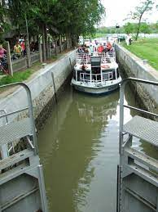
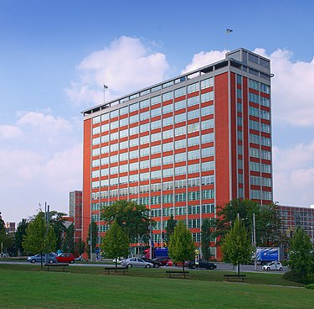

The main tourist attractions in Zlín
The zoological garden with a castle in Lešná.
The Museum of footwear in Zlín.
The Valašské museum
Baťa canal
Baťa's Skyscraper

Slide 24
Thank you for your attention

