Slide 1

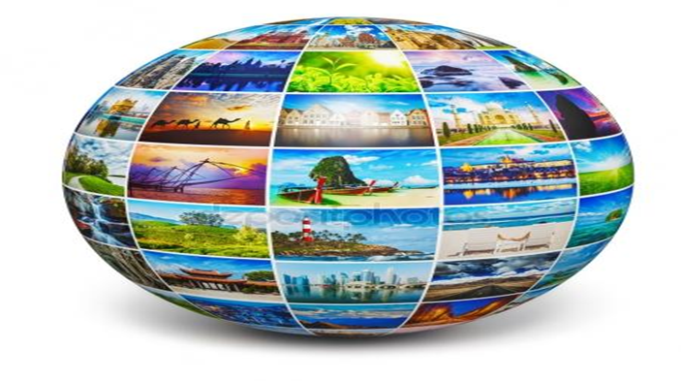

8. Tourist attractions in the Northern European countries
.
Předmět:
The Tourist Attractions in the Czech Republic and in the World

Slide 2
Geography of Denmark
For the most part Denmark consists of flat lands with very little elevation, except for the hilly central area on the Jutland Peninsula.
Its average height above sea level is only 31 meters and the highest natural point is Mollehoj, at 170.86 meters.
Denmark's lowest point is Lammefjord, at 7 meters below sea level. The coastline is indented by many fjords, with LimFjord (in the north) the largest.
In addition to the Jutland Peninsula, the country includes over 440 named islands; Zealand is the largest, followed by Funen, Lolland, Falster and Bornholm, an island located in the Baltic Sea to the east of Zealand.
The country is drained by a dozen or so rivers, and the most significant include the Guden, Odense, Skjern, Stora, Susa and Vida - a river that flows along its southern border with Germany.
The longest river in Denmark is the Guden at 160 km, in length.

Slide 3
The main tourist attractions in Denmark
When visiting Copenhagen, many visitors make a beeline for this iconic recreation space. Dating from 1843, Tivoli is the inspiration behind the world-famous Disney theme parks, and here, you'll find a huge range of attractions including a roller coaster, roundabouts, puppet theaters, restaurants, cafés, gardens, food pavilions, and even a Moorish-styled concert hall.
Christiansborg Palace, Copenhagen - On the tiny island of Slotsholmen in the center of Copenhagen, you'll find the Danish seat of government. Boasting more than 800 years of history, Christiansborg is the power base of the kingdom of Denmark and now home to the Parliament, the Prime Minister's Office, and the Supreme Court.
National Museum of Denmark, Copenhagen - A ten-minute stroll from Tivoli Gardens leads to the National Museum (Nationalmuseet), which delves into Danish history and culture. The museum displays an impressive collection of Danish artefacts, including a 2,000-year-old sun chariot, Danish porcelain and silver, and Romanesque and Gothic church trimmings.

Slide 4
The main tourist attractions in Denmark
The National Gallery of Denmark (Statens Museum for Kunst), Copenhagen -The National Gallery of Denmark houses the country's largest collection of Danish art. The original exhibits were once housed at Christiansborg, but moved to the current location in the late 19th century.
Nyhavn, Copenhagen - The star of countless images and postcards of the city, Nyhavn (New Harbor) is a great place to stroll or grab a slice of Copenhagen café culture. Located to the rear of Amalienborg Palace, this was once a disreputable stretch of dockland but has been given a new lease of life with its multi-colored houses, restaurants, and tall ships (some of which are museums) dotting the quayside.
The Round Tower, Copenhagen - Well worth scaling for the excellent panoramic views, the Round Tower (Rundetårn) is 36 meters high and was built as an observatory in 1642. Here, you'll find a small collection connected with the famous Danish astronomer Tycho Brahe. A short walk through the surrounding old town takes you to Gråbrødretorv, one of the city's most picturesque squares.

Slide 5
The main tourist attractions in Denmark
Oresund Bridge -Decades in the planning and often controversial, the Oresund Bridge has quickly become a Scandinavian icon. The bridge is around ten kilometers from Copenhagen, and you can either drive across or take the train.
Lyngby Open-Air Museum (Frilandsmuseet), Copenhagen - just over 15 kilometers outside Copenhagen, you'll find Lyngby Open-Air Museum, part of the Danish National Museum, and a must-see for many visitors to Denmark. Occupying 35 hectares, there are authentic farmhouses, agricultural buildings, dwellings, and mills from across the country in this "living museum.„
Kronborg Slot, Helsingør - Kronborg Castle is not only the setting of Shakespeare's Hamlet, but also a UNESCO World Heritage Site. Consequently it scores top billing on Helsingor's list of must-see sights. Even those with just a passing interest in the bard will surely want to visit.
Kujataa Greenland: Norse and Inuit Farming at the Edge of the Ice Cap

Slide 6
The main tourist attractions in Denmark
Egeskov Castle, Kvarnstrup Fairy-tale Egeskov Castle lies in a beautiful setting less than 30 minutes' drive from Odense and is the best preserved moat-castle in Europe. The superb Renaissance structure as seen today was completed in 1554 and originally built for defence purposes. A Vintage Car Museum opened in 1967, and other attractions include a treetop walk and Segway tours. The Banqueting Hall is simply magnificent.
Hans Christian Andersen Museum, Odense-You can't visit Denmark without being aware of Hans Christian Andersen. His fairy tales and stories are woven into the fabric of Danish society. The museum dates from 1908 and is dedicated to the writer's life and work with displays of artefacts, mementos, and Andersen's own sketches and artwork.
Off the Beaten Path in Denmark: The Farøe Islands - The Kingdom of Denmark also encompasses two autonomous countries: the far-flung Farøe Islands and Greenland. A boat trip to the Vestmanna bird cliffs is a highlight. The Faroe Islands also boast a lively music scene with many festivals in the summer.

Slide 7
Geography of Norway
Before the last ice age ended about 10,000 years ago, Norway was covered by a thick ice sheet. When that ice finally retreated (or melted) its movement across the land formed islands, lakes, rivers and mountains. It also etched-out deep valleys that then filled with sea water forming Norway's fjords.
Norway is one of Europe's most mountainous countries, and dominated north to south by the many ranges of the Scandinavian Mountains.
It's a rugged land of elevated plateaus, deep forested valleys and a few remaining ice age glaciers, including Folgefonna, Hardangerjokulen and Jostedalsbreen - the largest glacier on the continental Europe landmass.
There are reportedly over 150,000 (counted) lakes, most quite small, with the largest being Lake Mjosa.
Significant rivers include the Glama, the country's longest, and the Dramselva, Lagen (two of them) and the Tana in the far north.

Slide 8
The main tourist attractions in Norway
Scenic Rail Routes -There's no better way to see Norway's stunning countryside than by train. Perhaps surprisingly for such a mountainous country, Norway's rail lines stretch more than 2,000 miles, encountering along the way some 775 tunnels and over 3,000 bridges. The best scenic routes begin in Oslo, including the Bergen Railway, which runs over the Hardangervidda mountain plateau. Other routes of note are the Dovre Railway from Oslo to Trondheim with its sideline the Rauma Railway between Dombås and Åndalsnes, and the famous Flåm Railway, the world's steepest.
Hurtigruten - A way of life since its establishment in 1893, the incredible Hurtigruten ferry system continues to be a vital connection between the country's far-flung corners. One of the fleet's 11 ships departs Bergen daily, sailing to Kirkenes and back in just 12 days at an average speed of 15 knots, stopping at numerous interesting ports along the way from which you can branch out and explore this great country.

Slide 9
The main tourist attractions in Norway
Geirangerfjord -Part of the spectacular Fjord Norway network - and regularly topping the UNESCO World Heritage Sites list - the Geirangerfjord region north of Ålesund offers some of the finest scenery anywhere in Norway. The eastward continuation of the Sunnylvsfjord, the Geirangerfjord boasts some of the country's most spectacular views. One of the best is from the summit of Dalsnibba: at 4,905ft, the views of the surrounding mountains and the Geirangerfjord far below are simply breathtaking.
Arctic Circle - A sizable section of northern Norway is located within the Arctic Circle, a fact that provides the country with two of its most popular tourist attractions. The first, the Midnight Sun, is an impressive sight and experience. During the summer months, surrounding the summer solstice, these latitudes see endless days when the sun doesn't set. However, it's the spectacular Aurora Borealis, or Northern Lights, that really steal the show in winter.

Slide 10
The main tourist attractions in Norway
National Day -Held each May 17th, Norway's Constitution Day - usually referred to as National Day - marks the country's independence from Denmark in 1814. It's a tremendously colorful day, and as important to Norway as the 4th of July is to the US. By far the biggest celebration takes place in Oslo where huge crowds line Karl Johans gate, the city's main thoroughfare, to watch the parade's 100+ schools and marching bands. Oslo's Royal Palace Square is another popular spot, particularly for a glimpse of the Royal Family.
Lillehammer - Located above Lake Mjøsa at the south end of the Gudbrandsdal valley, Lillehammer is one of Norway's best-known year-round tourist destinations. In summer, it's all about attractions such as Malhaugen Park, an open-air museum consisting of more than 100 historic buildings, including 18th Century farmhouses, workshops and a stave church. Another notable landmark is Peer Gynt's Cottage. Dating from the early 1700s, it's said to have been the home of the prototype of Ibsen's famed hero. But it's when the snow flies that Lillehammer really shines. Host to the 1994 Winter Olympics, the city's list of winter activities is endless.

Slide 11
The main tourist attractions in Norway
Atlantic Ocean Road -The Atlantic Ocean Road - one of 18 National Tourist Routes in Norway - is not only a vital connection for the maze of tiny islands it serves, it's also a lure for anglers, diving enthusiasts and visitors wanting to get as close as possible to the sea. Although just over five miles long, it's gained a reputation as one of the most spectacular stretches of coastal highway in the world, weaving through an archipelago in Eide and Averøy in More og Rømsdal. In addition to the excellent views - always spectacular, whatever the weather - you'll get a chance to visit lovely little fishing villages, quaint wooden churches, and the famous Trolls' Church Cave.
Jotunheimen - The largest Alpine region on the Norwegian high plateau, the Jotunheimen covers an area of 1,351 square miles and includes Scandinavia's highest mountains.
Spitzbergen - The Norwegian archipelago of Svalbard, centered on the island of Spitzbergen, lies just 810 miles from the North Pole. Although covering an area of 24,200 square miles, its population of only 3,700 hardy souls lives in five settlements, including Ny Ålesund (population 70), the world's most northerly settlement.

Slide 12
Geography of Sweden
Sweden's border with Norway is covered by the Scandinavian Mountains, or in Swedish, the Kolen (or Kjolen) Mountains. These are relatively low-level mountains, as Sweden's highest point, Kebnekaise, stands at just 2,111 meters.
Sweden's coastal areas include several small islands and reefs, especially in the east and southwest. Directly south of Stockholm (a city of islands) are Gotland and Oland, Sweden's largest islands. White sandy beaches are common along the southern coastline.
Significant lakes include Siljan, Storsjom, Varern and Vattern, and with few exceptions, the balance of Sweden's lakes are on the small side.
Sweden's largest rivers include the Angerman, Eman, Indal, Lagan, Ljusnan, Lule, Osterdal, Skellefte, Storuman, Torne and Ume.

Slide 13
The main tourist attractions in Sweden
Drottningholm-Fairytale Drottningholm Palace on the island of Lovö is a UNESCO World Heritage Site and lies about 11 kilometers west of Stockholm city center (45 minutes by boat). Be sure to take in the Chinese Pavilion which dates from the late 1700s. The 18th-century Palace Theatre (Drottningholms Slottsteater) is still used for performances during the summer months. In the Theatre Museum, you can see period stage costumes and stage scenery.
The Vasa Museum in Stockholm is Sweden's most popular museum and now attracts around a million visitors annually. More than 20 million people have visited since the museum opened in 1990, and it's not hard to see why. In 1628 the pride of the Swedish Imperial fleet, the Vasa battle ship, sank on its maiden voyage.
Stockholm Archipelago, Stromma Boat Tours - Stockholm is often referred to as the Venice of the North. Water is everywhere, and around 30,000 islands lie in Stockholm's wondrous archipelago (skärgården). Distinctive red and yellow timber summerhouses occupy some islands while others remain totally unspoiled.

Slide 14
The main tourist attractions in Sweden
Djurgården -Djurgården park with its many wonderful amenities is a guaranteed draw for visitors and locals alike, particularly during the glorious Scandinavian summer months. Abba the Museum can be found here along with the Gröna Lund amusement park and the open-air museum and zoo, Skansen. You can catch a ferry from Gamla Stan or Slussen or take a tram or bus from Norrmalmstorg. Alternatively, the park is a pleasant 15-minute walk from the city center. Stop by the Djurgården Visitors' Center for more information.
Famous as being Sweden's first ever town and founded in AD 980, the last century of the Viking era, the idyllic village of Sigtuna nestles alongside Lake Mälaren in the lush green landscape of Uppland, north of Stockholm.
Visby, Gotland - Visby's reputation as 'the pearl of the Baltic' and UNESCO World Heritage Site status are both well deserved. A self-guided or guided tour of the magnificent walls, which date back some 700 years, is a must. Built into the structure are some 44 defensive towers, and the walls still bear the scars of attack in the form of two breaches.

Slide 15
The main tourist attractions in Sweden
The Göta Canal-Often described as Sweden's greatest feat of engineering, the canal dates from the early 19th century and is 190 kilometers in length. In addition, by connecting with lakes Vänern and Vättern and the Trollhätte Canal, it forms part of a water link all the way from Stockholm, in the northeast, to Gothenburg, in the southwest. Featuring 47 bridges and 58 locks the canal stretches from Sjötorp at Lake Vänern to Söderköping on the Baltic Sea.
Kiruna, Lapland - Sharing the same latitude as central Greenland, Kiruna is Sweden's northernmost town. It's also the chief town of the largest commune in the country, which borders both Norway and Finland. The world's first ever Ice Hotel at Jukkasjärvi is about 17 kilometers outside the city; Sweden's highest mountain, Kebnekaise, is 90 kilometers west; and 95 kilometers northwest is Abisko National Park where the Lapland Railroad runs west to Narvik on the Norwegian coast.
Abisko National Park, Lapland - n summer, this is the Land of the Midnight Sun with 24-hour daylight lasting several weeks. The park is some 77 square kilometers in size and famous for its pristine natural beauty and Nordic wildlife.

Slide 16
The main tourist attractions in Sweden
Liseberg Theme Park, Gothenburg -Liseberg is one of the most popular destinations in Sweden and each year, the park lures more than three million visitors. It has a huge range of attractions, from children's carousels and a fairy-tale castle to adrenalin-pumping rides for speed demons, bumper cars, and four roller coasters. The park stages concerts in summer too and it's a real favorite with both Swedish families and visitors from abroad.
Oresund Bridge, Malmo - From Malmo city center, a 15-minute drive takes visitors to the magnificent Oresund Bridge. Famous throughout the world since opening in 1999 and several decades in the planning, the structure has gained further notoriety through the hit Danish/Swedish TV drama 'The Bridge.' This incredible engineering feat now links Sweden to Denmark, and in turn, the continent of Europe.
Lund Cathedra- This is Sweden's most visited cathedral and one of the most visited sites in the southern province of Skåne. The present building dates from the 12th century. Over the altar is a magnificent 14th-century carved reredos, the work of a north German master.

Slide 17
Geography of Finland
Finland is a mostly flat land, with more than 70% of it covered by thick forest. In the southern areas, water seems a more common sight than land as countless clear water lakes are everywhere.
To the north of the Arctic Circle, the terrain rises into the hills and low mountains of Lapland. The country's highest point, Haltiatunturi, at 1,328 meters, stands on the edge of its border with Norway.
The largest Lakes include Nasijarv, Oulujarvi, Paijanne, Pielinen and Finland's largest, Lake Saimaa. With a few exceptions, the balance of Finland's lakes are on the small side.
Finland's most significant rivers include the Kemi, Luiro, Muonio, Oulu, Teno and Torne.
Numerous canals flow lake to lake in the south. The largest, the Saimaa Canal, connects Lake Saimaa with the Gulf of Finland.

Slide 18
The main tourist attractions in Finland
The Åland Islands or Åland is an autonomous archipelago between Sweden and Finland. A predominantly Swedish-speaking province of Finland, Åland is comprised of a few large islands and nearly 10,000 smaller ones. About 27,500 people live in Åland today, with about 11,000 in the main town of Mariehamn. The main industry of the islands has always been shipping and trade, so the Maritime Museum, the Museum Ship Pommern, and the Maritime Quarter in Mariehamn are worth seeing to understand the islands' fascinating maritime history. Also worth a visit is the Jan Karlsgården open air museum in Kastelholm where visitors can see what a typical island farm looked like around 1890.
Hämeenlinna, is attractively situated on a long, narrow lake, the Vanajavesi. The Hattelmala hills are a boundary to the south of Hämeenlinna. The town was founded by the Swedish governor, Per Brahe, in 1639 on a site to the north of the 13th-century Tavastehus Castle, which he enlarged and strengthened. The red brick castle is one of the noted landmarks along with Aulanko Park.

Slide 19
The main tourist attractions in Finland
In the center of Hämeenlinna is the Market Square (Kauppatori). On its east side stands the Lutheran church, with a statue of Paavo Cajander in the gardens in front of it. On the south side of the square is the Town Hall. North of the square visitors will find the Sibelius Museum, and a little bit further on, the Sibelius Park. Be sure to also visit the Hämeenlinna Historical Museum near the park.
Helsinki, is the capital of Finland and chief town of the province of Uusimaa (Nyland). The city offers a variety of cultural opportunities such as the National Museum of Finland; the Helsinki City Museum; the Finnish Art Gallery, featuring classical to modern art exhibits; and three major theaters.
Jyväskylä was founded by Tsar Nicholas I in 1837. The small city is located on the north side of the Jyväsjärvi lake, which is linked by a narrow strait, the Aijälänsalmi, with Lake Päijänne, Finland's second largest lake and its deepest, to the south.

Slide 20
The main tourist attractions in Finland
In the centrally-located Church Gardens (Kirkkopuisto) is the neo-Gothic Town Church. Nearby is a monument to the Finnish writer, Minna Canth (1844-97). On the way from there to the harbor and the lake are three buildings by the famed Finnish architect Alvar Aalto: the Municipal Theater, the Police Headquarters, and the Local Government Offices. To the north, in Rajakatu, are the Orthodox church and a neo-Classical church. The impressive Jyväskylä International Arts Festival is held in June and is the longest-running annual cultural event in Finland.
For most people, seeing the Northern Lights is a once-in-a-lifetime treat. Finland is perhaps the top country in the world for seeing these blazing curtains of light drape across the sky. Although, at times, the lights can be seen even in the southern most regions of the nation, the best place to see them is in Lapland.

Slide 21
The main tourist attractions in Finland
Lake Saimaa - The dominant lake of the region is massive Lake Saimaa, the "lake of a thousand islands." Lake Saimaa itself has an area of some 1,300 square kilometers - excluding its numerous islands. The whole lake system is drained by the river Vuoksi, which leaves Lake Saimaa to the north of the town of Imatra and flows into Lake Ladoga in Russia.
Savonlinna is the main city of Finland's lake region. Savonlinna is indeed the Olavinlinna Castle. The castle, which has been beautifully restored, contains a number of handsome rooms used for receptions and conferences, among them the King's or Knights' Hall, the Congress Hall, and the Great Hall. Three massive round towers have survived, and in one of them, the Church Tower, is a small chapel, still used for worship and weddings. In the Great Bastion is a summer café. East of Savonlinna lies Kerimäki and the largest wooden church in the world.

Slide 22
The main tourist attractions in Finland
Lemmenjoki National Park -Anyone seeking an Arctic wilderness experience will love Lemmenjoki National Park. The 70-year-old tract over boreal forest is the largest park in Finland and one of the most extensive chunks of wildlands in all of Europe, covering more than 1,000 square miles. The namesake of the park, the Lemmenjoki River, is a sight to behold as it flows down from the fells into a stunning valley of towering pines. Visitors can either rent a boat or take a tour.
Sweet little Oulu lies near the north end of the Gulf of Bothnia, at the mouth of the Oulu river. At the north end of the busy Kirkkokatu in Oulu stands the Cathedral, originally built in 1770-72. To the left of the entrance, a monument commemorates those who fell in the Civil War of 1918. From the north end of Kirkkokatu, a small bridge leads into the beautiful island of Ainola Park. At the west end of the island is the Municipal Library and the Provincial Museum. Farther north is the Botanic Garden, and on the island of Hupisaari, a summer theater. Another popular tourist attraction is the Tietomaa Science Center to the east of the Oulu Botanic Garden.

Slide 23
Geography of Iceland
Iceland is largely an arctic desert punctuated by mountains, glaciers, geysers, hot springs, volcanoes and waterfalls.
Most of the vegetation and agricultural areas are in the lowlands close to the coastline.
Iceland's most distinctive features are the glaciers that cover over (11,922 sq. km) or 11. 5% of the total area of the country.
By far the largest of the glaciers is the Vatnajokull in southeast Iceland, with an area of (8,400 sq. km). The Vatnajokull glacier is equal in size to all the glaciers on the European mainland put together, and reaches a thickness of (1 km).
The highest point in Iceland is Hvannadalshnukur, a peak on the edge of the Öræfajökull Volcano, which rises (2,110 m).

Slide 24
The main tourist attractions in Iceland
Whale Watching, Reykjavik -No matter when you plan to travel, whale watching happens year round, although summer is the most popular time to see these gentle giants. During the warmer months, trips run day and night, including whale watching in the midnight sun. Tour operators say there's an 80-95% chance of seeing these magnificent creatures, depending on the time of year.
Blue Lagoon, Grindavík - Just 40 minutes' drive from Reykjavík this most iconic of geothermal spas should be at the top of any visitor's must-see list. Here, you'll find natural bathing in pale blue water in the shadow of a power station. An entire Blue Lagoon industry has grown around this attraction since it first became a hit with locals in 1976. The water from the underground hot springs reaches 37-39 degrees Celsius and is said to be highly beneficial for both health and skin.
Spectacular Geysers - An easy 50-minute drive from Reykjavik, Strokkur Geysir (after which all geysers are named) is the most popular fountain geyser in the country and famed throughout the world.

Slide 25
The main tourist attractions in Iceland
The Northern Lights, Aurora Borealis -The northern Lights, or Aurora Borealis, are among the most popular visitor attractions in Iceland. Auroras are linked to solar wind, a flow of ions radiating from the sun. These particles become ensnared in the earth's magnetic field and collide with atmospheric molecules, causing bursts of energy, which appear as large circles around the poles.
Landmannalaugar - In the south of Iceland, 180 kilometers from Reykjavik, is Landmannalaugar National Park, one of Iceland's most popular tourist destinations. The main features of this mystical landscape are the multihued rhyolite mountains, Hekla volcano, and extensive lava fields.
Maelifell Volcano & Myrdalsjökull Glacier Park - South of Landmannalaugar lies Myrdalsjökull Glacier Park, which for safety reasons can only be visited during summer. Large amounts of rain soak the area, particularly in winter when roads can be severely damaged. Maelifell volcano is the undisputed jewel-in-the-crown of this wild, rugged glacial landscape.

Slide 26
The main tourist attractions in Iceland
Askja Caldera -n the northern region of Vatnajökull National Park, Askja caldera and geothermal pool in the Dyngjufjöll Mountains is not one for the faint-hearted.
Dettifoss Waterfall - Dettifoss, in the north of Vatnajökull National Park, truly is a breathtaking example of the raw power of nature. Plunging 45 meters and with a width of 100 meters, it's said to be the most powerful waterfall in Europe.
Magnificent Gullfoss Waterfall lies around one and a half hour's drive west of Reykjavik. The river Hvítá plummets into a canyon, which forms three step terraces, creating a powerful torrent. Gullfoss encompasses two cascades, the upper one drops 11 meters, while the lower one cascades about 21 meters.
Surtsey – is volcanic island approximately 32 km from the south coast of Iceland, is a new island formed by volcanic eruptions that took place from 1963 to 1967. It is all the more outstanding for having been protected since its birth, providing the world with a pristine natural laboratory.

Slide 27
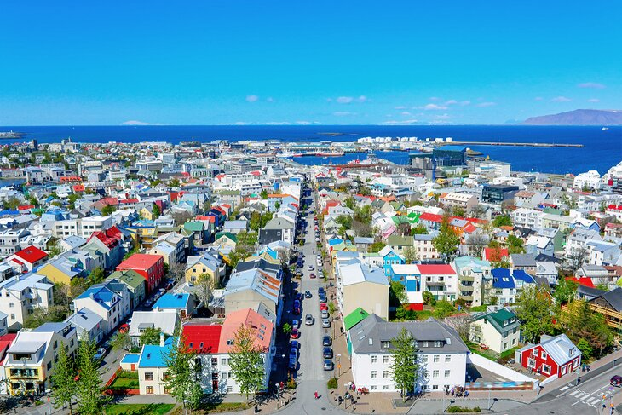
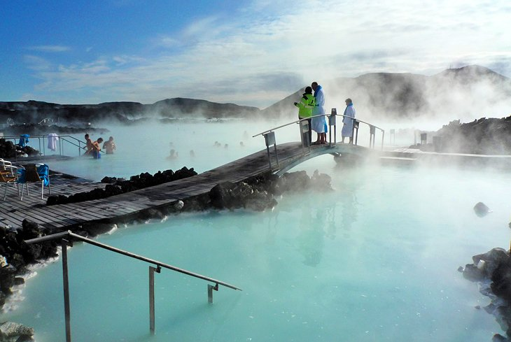
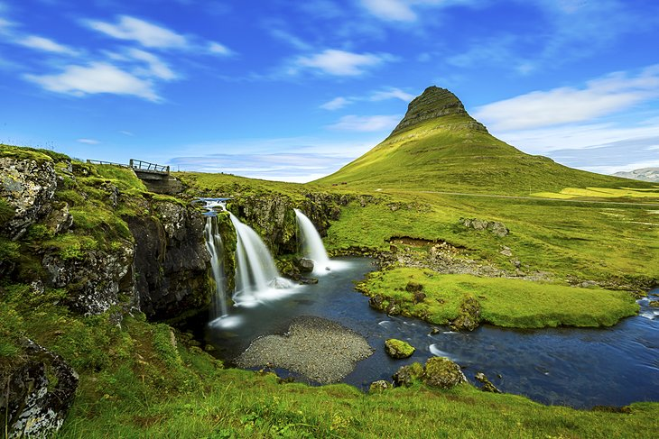
The main tourist attractions in Iceland
Thingvellir is the National Park where the Althing, an open-air assembly representing the whole of Iceland, was established in 930 and continued to meet until 1798. Over two weeks a year, the assembly set laws - seen as a covenant between free men - and settled disputes. The Althing has deep historical and symbolic associations for the people of Iceland.
Reykjavik
Blue Lagoon, Grindavík
Kirkjufell Mountain, Grundarfjördur

Slide 28
Thank you for your attention

