Slide 1
Název prezentace
Název projektu | Rozvoj vzdělávání na Slezské univerzitě v Opavě
Registrační číslo projektu | CZ.02.2.69/0.0./0.0/16_015/0002400
Prezentace předmětu:
Intercultural Communication
Lecturer:
Ing. Patrik Kajzar, Ph.D.

Slide 2
6. Effective communication
Předmět:
Intercultural Communication
Tato přednáška byla vytvořena pro projekt „Rozvoj vzdělávání na Slezské univerzitě v Opavě“ Opavě

Slide 3
Effective communication
The aim of the lecture is to emphasize of importance on the issue of effective communications.
.

Slide 4
INTERCULTURAL COMMUNICATION AND ITS SPECIfics
Introduction to effective communication
Essentials of effective communication
Communication techniques
Barriers to communication
.
Overview

Slide 5
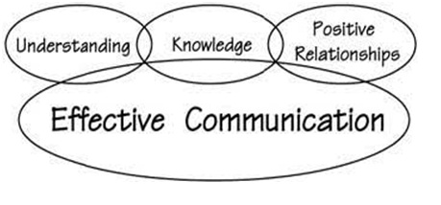
Introduction to effective communication
No matter what field you are in, your ability to rise up higher and faster in your career largely depends on how effectively you interact with other people.
The message that is sent is the same message that is received.
Fig. 1: Communication and essentials of effective Communication
Source: http://www.biyanicolleges.org/communication-and-essentials-of-effective-communication/

Slide 6
Effective communication
Effective communication may be defined as:
Using language that is appropriate to others' levels of understanding.
Making sure others receive the information or knowledge intended.
Developing relationships with others.
Talking with others in a way that facilitates openness, honesty and cooperation.
Providing feedback.

Slide 7
Essentials of effective communication
Effective communication is one of the most important keys for our success.
Essentials skills for effective communication are
1. Listening
2. Non-verbal communication
3. Confidence
4. Body language
5. Eye contact
6. Always have an opened mind
7. Give and receive feedback

Slide 8
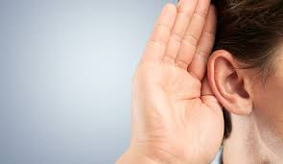
Essentials of effective communication
Fig. 2: Listening
Listening
The most important aspect
Effective communication requires active listening
Active listening is hearing and understanding what person is saying to you
Fully understand the message.
Source:https://www.callcentrehelper.com/ten-tips-to-improve-listening-skills-on-the-telephone-1534.htm

Slide 9
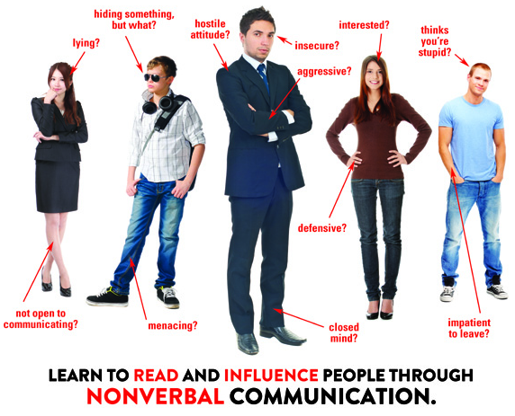
Essentials of effective communication
Fig.3: Non-verbal communication
Non-verbal communication
The words we choose
The tone of your voice
Hands gestures, eye contact
Signals person who is going to speak openly with you are relaxed legs, opened arms, friendly tone
Signal of non-verbal communication will give you an insight into how that person is feeling.
Source:https://seelio.com/w/128u/nonverbal-communication-touch-behaviors

Slide 10
Essentials of effective communication
Confidence
The most important phenomenon
Looking out for the non-verbal clues
Sound confident and other people will believe you
Making eye contact, use friendly tone (NEVER AGGRESIVE)
Fig. 4: Confidence Level
Source: https://www.skipprichard.com/confidence-more-compelling-than-competence/

Slide 11
Essentials of effective communication
Eye contact
Part of non-verbal communication
Person convey 60%-70% of what he wanted to say, and the other portion is conveyed by eye contact.
Body language
Your body should help convey your word
Means your hands gestures
Follow the general etiquette

Slide 12
Communication techniques
The difference between a person who knows effective communication techniques and a person who doesn’t is night and day.
85% of job success comes from having well-developed soft skills and people skills.
Maintain good body language
First effective technique.
Communicated positive, constructive, friendly
to other people.
Develop good eye contact, neutral and positive
emotions with yours arms, hands and face.
Don´t be afraid to use humor.

Slide 13
Communication techniques
Seek first to understand
Seek first to unnderstand, than to understood, you open doors into the hearts and minds of others
People will know that you are really care about what they have to say
When you understand their needs, you can respond in a way that builds trust with them.

Slide 14
Communication techniques
Ask open-ended question
These questions cannot be answered simply yes or no
For example „what needs to change to make this situation better?“, “what do you mean by that, specifically?”
These kind of questions could help you solve problems, and work more effectively.

Slide 15
Communication techniques
Be open and honest
This technique is just common sence
„Honestly is the best policy.“
Trust is extremly important for effective teamwork, and it´s hard to build
People will like and trust you more, when you are honest with them

Slide 16
Communication techniques
Frame your views
You should have a strong grasp on the other views
Don´t change your own view!
Framing your views
Smile
Is your best tool and your best weapon tolled into one.

Slide 17
Barriers to communication
„The greatest compliment that was ever paid to me was when someone asked me what I thought, and attended to my answer.“ – Henry David Thoreau (American essayist, poet, philosopher, abolitionist, naturalist, tax resister, development critic, surveyor, and historian)
Barriers to effective communication include:
Judging th other person
Not paying attention to the person you are talking to
Using technical language
Giving solutions or unwanted advice
Avoiding the concerns of others

Slide 18
Barriers to communication
There are many reasons why communication may failed.
Kinds of barriesr to effective communcation.
I. ENVIROMENTAL AND PSYCHICAL BARRIERS
- Time: quicker and speedy channels of communication, communicate with somebody by the emails or sending letters by post.
- Space: when telefonic communication isn´t very effective.
For example one of them is from India and the orher is from United States. They can send the details by the email.

Slide 19
Barriers to communication
Place:
The place shoul be clear and not crowded.
Where there is a noice, there a person cannot effectively communicate.
Medium:
Communication takes place in various forms; it is oral, written, audio, video, formal, informal,
the medium used for the purpose of communicating should be accurate, precise and understandable.

Slide 20
Barriers to communication
II. SEMANTIC BARRIERS
Language differences and the difficulty in understanding unfamiliar accents.
Language and vocabulary that is used in communication should be understandable to the persons.
Two or more persons when they are communicating with each other should use a common language, so that everyone can understand it well.

Slide 21
Barriers to communication
III. CULTURAL BARRIERS
Cultural differences
Different nationalities, religions, castes, creeds, races, ethnicities etc.
In the form of communication, it is vital to form an understanding and acceptance of another person’s culture.
IV. PSYCHOLOGICAL BARRIERS
ill health, poor eyesight or hearing difficulties, pain.

Slide 22
Barriers to communication
V. PERCEPCION OF REALITY
Different levels of percepcion and viewpoint
Communicating about a particular topic, condition, problem, issue, situation, dilemma, stress or a concept.
While communicating, it is important to be open, flexible and transparent.

Slide 23
Don´t forget
Create a positive outcomes in the workplace in every conversation because communication is key for creating wins for all paries.
To communicate effectively, you have to know what you want to take ownership for your own needs. Be clear.
Keep your request direct, simple and to the point.
Provide a compelling request.
Listen to what the other person needs and listen carefully to their feedback.
Dynamic communication is one of the most important skills to develop.

Slide 24
Summary
Effective communication is one of the most important keys for our success.
Essentials skills for effective communication are: listening, non-verbal communication, confidence, body language, eye contact, always have an opened mind, give and receive feedback.
Assertive behaviour is one of the important human abilities.
The most well-known techniques are: Broken Record Technique and Technique of Open Door.
Communication barriers are obstacles in the way of effective communication.
We can barriers to communication divided in to: tangible and intangible differences.

Slide 25
Thank you for your attention

