Slide 1


Název prezentace
Název projektu | Rozvoj vzdělávání na Slezské univerzitě v Opavě
Registrační číslo projektu | CZ.02.2.69/0.0./0.0/16_015/0002400
Prezentace předmětu:
Intercultural Communication
Lecturer:
Ing. Patrik Kajzar, Ph.D.

Slide 2

5. Verbal and non-verbal communication
Předmět:
Intercultural Communication
Tato přednáška byla vytvořena pro projekt „Rozvoj vzdělávání na Slezské univerzitě v Opavě“ Opavě

Slide 3

Verbal and non-verbal communication
The aim of the lecture is to briefly tackles the verbal and non-verbal communication and its importance for business communication.
.

Slide 4
Verbal and non-verbal communication
Introduction to Verbal communication
Types of verbal communication
Introduction to Non-Verbal communication
Types of Non-verbal communication
.
Overview

Slide 5
Introduction to Verbal Communication
Almost every job requires workers to use verbal communication skills. That’s why verbal skills are highly ranked on the candidate evaluation checklists used by many job interviewers.
Effective verbal communication skills include more than just talking. Verbal communication encompasses both how you deliver messages and how you receive them. Communication is a soft skill, and it’s one that is important to every employer.
The three different types of communication are verbal, nonverbal and visual.
The two major forms of verbal communication are written (or typed) and oral.
Consists of words, sentences and phrases.
Acts as the primary tool for expression between two or more people .
Is sharign of information between individuals by using speech.
Success depends on the speaking ablitity and on the listening skills.

Slide 6
Types of verbal communication
Four types of verbal communication
1. Intrapersonal communication:
This type of conversations are extremly private, silent conversations we have with ourself.
2. Interpersonal communication:
Between two individuals, one-on-one conversation.
3.Small group comunication:
More than two people involved (board meetings, team meetigns)
4.Public communication:
One individual addresses a large gathering of people (public speeches)

Slide 7
Verbal communication skills
People who communicte with a friendly tone and smile always have the adge. Be friendly to the others.
Think before you speak.
Be clear.
Don´t talk too much, be consise.
Speak with confidence.
Focuse on your body language.

Slide 8
Listening skills
Listening is the key to all effective communication.
Messages are easily misunderstood without the ability to listen effectively.
Many top empoyers provide listening skills training for their empoyees because it´s very importatnt.
Listening is not the same as hearing.
It requires focus and concentrated effort.

Slide 9
Active listening
Active listening is helpful skill for any worker to develop.
It helps you truly understand what people are saying in conversations and meetings.
Why is this important?
Because it means focusing fully on the speech but also actively showing verbal and non-verbal sing of listening.
Sings of active listening
Non-verbal sings – smile, eye-contact, posture, mirroring, distraction.
Verbal sings – remembering, reflection, clarification, summarisation.

Slide 10
Active listening techniques
Building Trust: “Tell me what I can do to help.”
Demonstrating Concern: “I am eager to help you; I know you are going through some tough challenges.”
Paraphrasing: “So, you think that we need to build up our social media marketing efforts.”
Brief Verbal Affirmation: “Thank you. I appreciate your time in speaking to me.”
Asking Open-Ended Questions:“It’s clear that the current situation is intolerable for you. What changes would you like to see?”

Slide 11
Active listening techniques
Asking Specific Questions: “What is your average rate of staff turnover?”
Waiting to Disclose Your Opinion: “Tell me more about your proposal to reorganize the department.” “Can you please provide some history for me regarding your relationship with your former business partner?”
Disclosing Similar Situations: “I was also very conflicted about returning to work after the birth of my son.”

Slide 12
Active listening
Active listening presumes:
Focus on yourself (Are you ready to listen?)
Listen to yourself (Where is your mind today?)
Make sure that you are JUST LISTENING!
Barriers to active listening:
Talker not speaking loudly
Room temperature (hot or cold)
Clock watching
Loud noises

Slide 13
Oral communication
Oral communication
Verbaly transmiting information and ideas from one individual on group to another
Types
Informal – face-to-face conversation, telephone conversation, discussion that take place at business meeting
Formal – pressentations at business meetings, classroom lectures, speech given at a graduation ceremony
Modern types of oral communication
Video phones and video conferences, podcast, voice over the internet protocol (skype).

Slide 14
Oral communication skills
Pronouncing the words clearly is an important thing to be remembered.
Words have to be pronounced by changing their tones.
Avoiding fillers (,,um, ah, hmm, etc. ,,) could be irritating for listeners.
Interrupting the speaker is considered a sing of poor communication in a face-to-face conversation.
Careful listening and speaking clearly si important and it helps respond in a proper manner.
Always make an eye contact with the listeners.
Asking questions and answering the question with correct details.

Slide 15
Oral communication skills
It is not advisable to carry on the communication process without understanding a particular point.
In a communication process, body language of a person is considered as important as the spoken words.
Oral communication skills are important for
Managerial role
Work place success
Secure a new job
Advance your career

Slide 16
Reading skills
Readers use strategies to understand what they read
Reading strategy 1. – purposeful reading
If you are looking for answers to questions
General understanding of a topic or issue
You can create this purpose: - REFER TO (assessment tasks, lecture slides, tutorial questions,, textbook questions)
- CREATE (questions based on lacture slides or on the skim of the text..)
- CONSIDER (what you already know)
Purposeful reading can halp you read faster and more selectively.

Slide 17
Reading skills
Reading strategy 2. – scanning
Reading quickly to search for specific information
Scanning allow you to „read“ up to 1,500 words a minute
Reading strategy 3. – skimming
As with scanning, skimming does not involve reading every word. Instead, you may skim by reading:
• titles
• subheadings
• words in that are in bold, in italics or underlined
• diagrams
• chapter objectives
• chapter summaries

Slide 18
Reading skills
Reading strategy 4.- information words
This may require ability to conduct “surface reading”.
It is worth remembering that no more than 50% of the words in an average textbook are “information” words.
If you concentrate on information words, you can read faster and with better comprehension.
Look for the message, and the information words will emerge naturally.

Slide 19
Effective writing skills
Good writing skills are bedrock of good commnication and could help you to connect with people
You are able to write cleary, concisely and correctly
Bad writing creates a terrible impression
Common methods at communication in workplace
Email
Remember, there is a crucial element missing in this form of communication – tone of voice and facial expressions – and this cannot be fixed by using smiley faced emoticons!
To warm up the conversation, start on a personal note
Avoid using words with strong emotional connotations;
Keep it short and use simple sentences
Read your email twice to correct errors or rephrase parts of it

Slide 20
Effective writing skills
Report Writing
It analyses a problem, discusses it, and makes recommendations for action.
Follow a formal structure and break it down into headers and sub-headers.
Start with an introduction, follow that with the main body of the report, and end with a conclusion.
Also, prepare a page-long or even shorter summary or extract of your report.
Never use too much jargon.

Slide 21
Effective writing skills
Technical Writing
Craft and write documents such as product and service manuals
Technical writer must do that while guiding a reader through a product or service that the latter is already having a problem with or attempting to become proficient in.
Technical writing skills include the ability to be crisp and crystal clear.

Slide 22
Introduction to Non-Verbal Communication
People speaks by using their vocal chords, but they converse using their entire bodies.
A great amount of human behavior is emphasized through non-verbal signals.
Over 70% of all communication is non-verbal
4 categories of non-verbal communication
Aesthetic – involves cretive expression (dance, music, theater, etc,...)
Physical – involves bodily movements used during social interactions (smile, frown,wink,...)
Signs – include any signals that are used or displayed to communicate a message or that have a special meaning
Symbols – any material objects (jewelry, cars, clothing, etc,...)

Slide 23
Personal Appearance, gestures, and postures
Personal appearance
Is your own image that you give out to other people.
Is undeniably significant to what people think of you.
It important to look clean and tidy .
First impression could be about attitude as well as dress.
Gestures
Common gestures are waving, pointing, using fingers, handshake,
Other gestures are arbitrary and realted to culture
Gestural language – for those who cannot speak oraly (hand gestures)

Slide 24
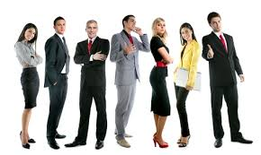
Personal Appearance, gestures, and postures
Postures
How you move your body
Posture can reflect people´s emotions, attitudes and intentions
How people stant could say a lot about what they are thinking and feeling
Fig.1: Postures
Source: https://theartofcharm.com/art-of-dating/the-art-of-body-posture-how-to-project-confidence-with-one-simple-change/

Slide 25
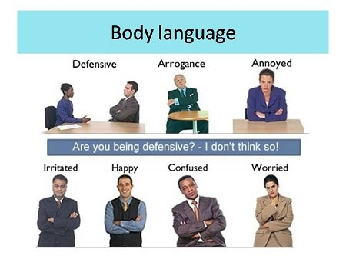
Body and time language
Body language
People in the workplace can convey a great deal of information without even speaking.
Fig.2: Body language
Source:https://www.researchgate.net/post/What_is_the_percentage_ratio_of_using_your_body_language_in_expressing_your_academic_idea

Slide 26
Body and time language
Types of body language
1. Parts of the body
2.Intent
PARTS OF THE BODY
The head – side to side, shaking of hair, back to front
Facial expressions – Eyebrows, eyes, nose, lips, tongue, jaw
Body posture – Body proximity (how far or close to the orher person), shoulder movements, arm placement, leg and feet placement,
Hand and finger gestures – move your hands and fingers, handlings the objects (pen, paper, etc,..)

Slide 27
Body and time language
Time language
Easy to use that anyone in the world is the common language.
is the common language of the world. Time Language is the world's languages.
Time Language is a language that can be used by anyone.

Slide 28
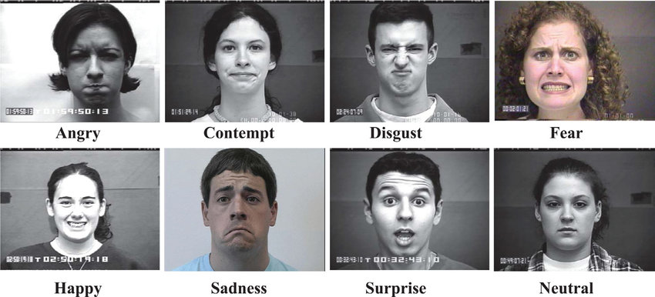
Facial expression
All facial organs on human face indicates facially expressive message.
These are hair, forehead, eyebrows, eyes, mouth, chin, nose, lips, ears, teethe, tongue etc.
Facial expressions comes naturally hence it is beyond the control of speaker.
Fig.3: Facial expression
Source:https://www.researchgate.net/figure/Samples-of-eight-facial-expressions-of-the-extended-Cohn-Kanade-database_fig4_319567060

Slide 29

Eye contacts
• Eye contact has very much in face-to-face communication.
• Absence of eye contact shows lack of interest & understanding.
• We look faster than listen or talk.
• Eyes are human windows except them there is no life.
• The speaker must look in to the eyes of the audience from right to left & left to right this will built up the confidence & eliminate the nervousness.
• It build the rapport between the speaker & the listener
Fig.4: Eye contact
Source:https://www.aksent.org.in/blog/6-ways-to-improve-eye-contact-skills/

Slide 30
Summary
Communication and communication skills are one of the most important human abilities.
The three different types of communication are verbal, nonverbal and visual.
Verbal communication skills we can divided in to: Listening skills, Oral communication skills, Reading skills and Writting skills.
Non-verbal communication or body language is based on the use of so-called non-verbal means.
The ability to read and interpret a person's attitude can lead to gaining a lot of information about the other person.
Signals of non – verbal communication: Aesthetic Physical, Signs, Symbols.

Slide 31
Thank you for your attention

