Slide 1
Market Structures:
Imperfect Competition
LESSON 7
MICROECONOMICS
2023/2024

Slide 2
OUTLINE OF THE LECTURE
AND
STUDY GOALS
Students should be able to:
Explain the characteristics of TR, MR, AR and individual demand of an imperfectly competitive firm.
Differentiate between monopoly, oligopoly and monopolistic competition.
Explain why is monopoly inefficient and the ways how to regulate it.
Name the types and examples of oligopoly.
Understand how imperfectly competitive firms decide on their output and the price of production.
Characteristics of Imperfect Competition
Monopoly
Oligopoly
Monopolistic Competition

Slide 3
MARKET STRUCTURES
PERFECT COPETITION
- an economic model based on the following assumptions:
- homogenous product
- many buyers and sellers without any market power to influence the price
- no entry or exit barriers
- perfect and free informations
IMPERFECT COMPETITION
- monopoly
- oligopoly
- monopolistic competition
Goal of every firm (whether perfectly or imperfectly competitive) is to maximise profit.

Slide 4
Imperfect Competition
Basic definition:
A market where one seller (the firm) may affect the market price.
Monopoly
Oligopoly
Monopolistic Competition
Single firm selling a commodity with no close substitutes.
Few sellers of a commodity. Action of one seller affects the other ones.
Many firms selling closely related but not identical products.
The firm is the industry = absolute market power.
Certain but limited degree of control over the price.
There is no general model of oligopoly but many different models (Cournout, Edgeworth, Chamberlin…) based on the specific assumptions.

Slide 5
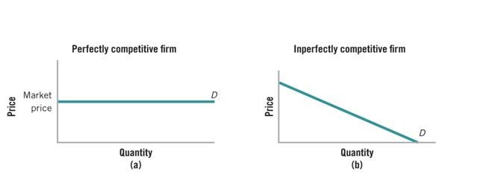
General Assumptions about Imperfectly Competitive Firms
Differentiation of product means the company can set its price → firms can affect the market price (the rate of price influencing depends on the specific form of competition – monopoly, oligopoly, monopolistic competition)
Decision of imperfectly competitive firm is more inclusive → firm does not decide only on the level of output but also the price for which to sell the input.
If the firm wants to sell more of the commodity it needs to lower its price → negatively sloped individual demand curve.

Slide 6
Revenues
Q | P | TR | MR | AR
1 | 250
2 | 220
3 | 190
4 | 160
5 | 120
6 | 90
Complete the table with revenues of the firm when you know for which price the firm will be selling various quantities.
Based on the data derive and describe the graphs of TR, MR and AR for an imperfectly competitive firm.

Slide 7
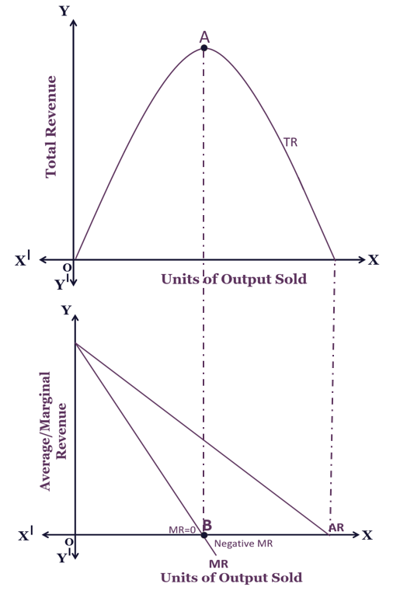
Revenues
Total revenues may rise or fall (depending on the elasticity of demand for firm´s production).
Demand is elastic - percentage growth in the quantity of sold production is greater than the percentage decrease in prices, so although price decreases, the total revenues grow (till point A).
Demand is inelastic - percentage growth in the quantity of sold production is less than the percentage decrease in prices, if the firm reduces the price, its total revenues are decreasing (from point A on).
Two fundamental differences from the perfect competition:
AR and MR curves have a negative slope, which is the result of a negative slope individual demand curves.
The curve MR is not identical with the curve of the AR, but decreases faster.

Slide 8

Monopoly
Only one firm in the market, representing the whole industry and offering a unique product.
There are local or national monopolies but to find a monopoly on a global scale could be difficult.
Barriers to Entry - constraints that prevent additional sellers to enter the market:
Government franchises and licenses (postal services, local transportation and communication services…)
Patents and copyrights
Ownership of an entire supply of a source
Cost advantages of large-scale operations (natural monopoly – one large firm supplies the whole market with lower costs than two smaller firms would)

Slide 9

Monopsony
Monopsony is the opposite of monopoly and represents a market in which is only one buyer.
Monopsony power is the ability of the buyer to influence the price in his favor.
It allows you to purchase goods at a lower price than in conditions of perfect competition.
Example: military production (main buyer is state), job market (nuclear plant as the only job provider to nuclear engineers in the country…)

Slide 10
Monopoly
A) You have information about the price and total costs of the performances based on how many you hold per year. Determine how many performances you will hold per year to maximize your profit.
Price | Output (performances per year) | Total Cost | ATC | MC | TR | MR | Profit
1 000 000 | 1 | 500 000
900 000 | 2 | 1 000 000
800 000 | 3 | 1 600 000
700 000 | 4 | 2 250 000
600 000 | 5 | 3 150 000
500 000 | 6 | 4 150 000
400 000 | 7 | 5 550 000
300 000 | 8 | 7 550 000

Slide 11
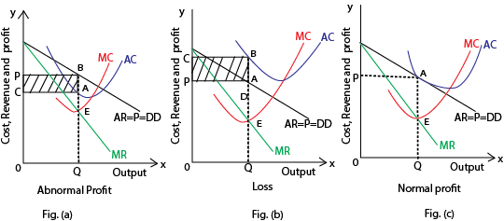
Equilibrium - Monopoly
As monopoly is the only firm in the market this means individual demand equals to market demand (d = D).
Monopoly will produce such a quantity (Qs) for which MR = MC (golden rule of profit maximisation).
For that level of output monopoly will set the price (P) as high as possible aka as high as the demand (D) is willing to accept.

Slide 12


The Monopoly Power
In terms of monopoly the supply curve does not exist, because there is not one relationship between price and quantity.
Monopoly power is the ability to set the price higher than the marginal costs.
The degree of monopoly power can be expressed by Lerner index (L).
$$L= \frac{P −MC}{P}$$
To express the monopoly power is used:
The degree of concentration - % share of the strongest firm in the industry on the production of industry
Profit - questionable criterion

Slide 13
Monopoly
$$L= \frac{P −MC}{P}$$
A) Calculate the mopoly power using Lerner index:
B) Draw the equilibrium for this monopoly.
Price | Output (performances per year) | Total Cost | ATC | MC | TR | MR | Profit
1 000 000 | 1 | 500 000 | 500 000 | - | 1 000 000 | - | 500 000
900 000 | 2 | 1 000 000 | 500 000 | 500 000 | 1 800 000 | 800 000 | 800 000
800 000 | 3 | 1 600 000 | 533 333 | 600 000 | 2 400 000 | 600 000 | 800 000
700 000 | 4 | 2 250 000 | 562 500 | 650 000 | 2 800 000 | 400 000 | 550 000
600 000 | 5 | 3 150 000 | 630 000 | 900 000 | 3 000 000 | 200 000 | -150 000
500 000 | 6 | 4 150 000 | 691 666 | 1 000 000 | 3 000 000 | 0 | -1 150 000
400 000 | 7 | 5 550 000 | 792 857 | 1 400 000 | 2 800 000 | -200 000 | -2 750 000
300 000 | 8 | 7 550 000 | 943 750 | 2 000 000 | 2 400 000 | -400 000 | -5 150 000

Slide 14

Inefficiency and Regulation of Monopoly
Inefficient production – monopoly produces less output for a higher price than a perfect competition would and the price is above the marginal cost.
Monopoly is not led by a market mechanism for optimum utilization of social resources.
Regulation:
Price Control – setting a maximum price (at the level where SMC = D).
Lump-Sum Tax – reducing the profit without affecting the output and price
Unit Tax – reducing the profit but monopolist might be able to shift part of the tax burden upon the consumer (reducing the output and increasing the price)
Antitrust laws - those prohibiting certain behavior in the marketplace and reduce the monopoly power of different ways.
The ability to convert a monopoly to state ownership

Slide 15
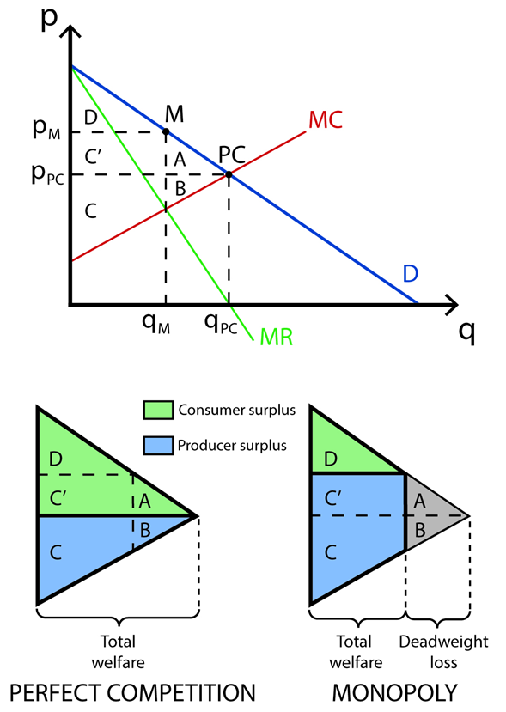
Surpulus Of Producer and Consumer
Qm – output produced by monopoly
Qpc – output perfect competition would produce
Pm – price set by monopoly
Ppc – price of production under perfect competition
In monopoly the consumer surplus is lower and producer surplus is bigger than in perfect competition.
Moreover, there‘s loss due to the production that was not produced and sold by monopoly (grey area = deadweight loss).

Slide 16

Oligopoly
Few sellers dominate the sales of a product and where entry of new firms is difficult or impossible.
Product: homogenous (aluminum, steel) or differentiated (chewing gums)
The concentration ratio measures the market share of the largest firms in an industry and is used to detect an oligopoly. There is no precise upper limit to the number of firms in an oligopoly, but the number must be low enough that the actions of one firm significantly influence the others.
Duopoly – form of oligopoly with only 2 firms in industry

Slide 17
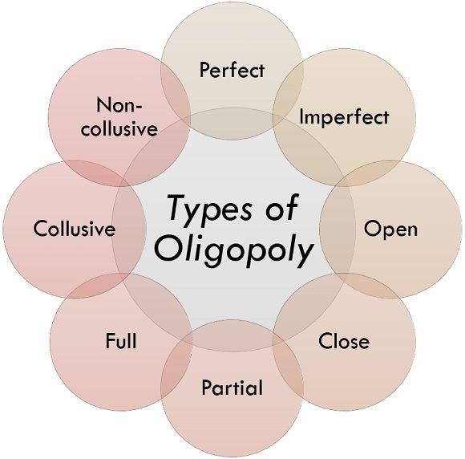
Types of Oligopolies
Collusive oligopoly – it arises in a situation where several firms selling the same or similar products find that their prices are similar, and that the mutual price war would weaken them.
More advantageous for them is to increase their profits by increasing prices on the market or by market division.
Companies enter into a secret agreement and set monopoly prices for individual companies or production quotas - each company oligopoly then behaves like a monopoly.
Cartel – illegal agreement about advantageous cooperation (OPEC).

Slide 18
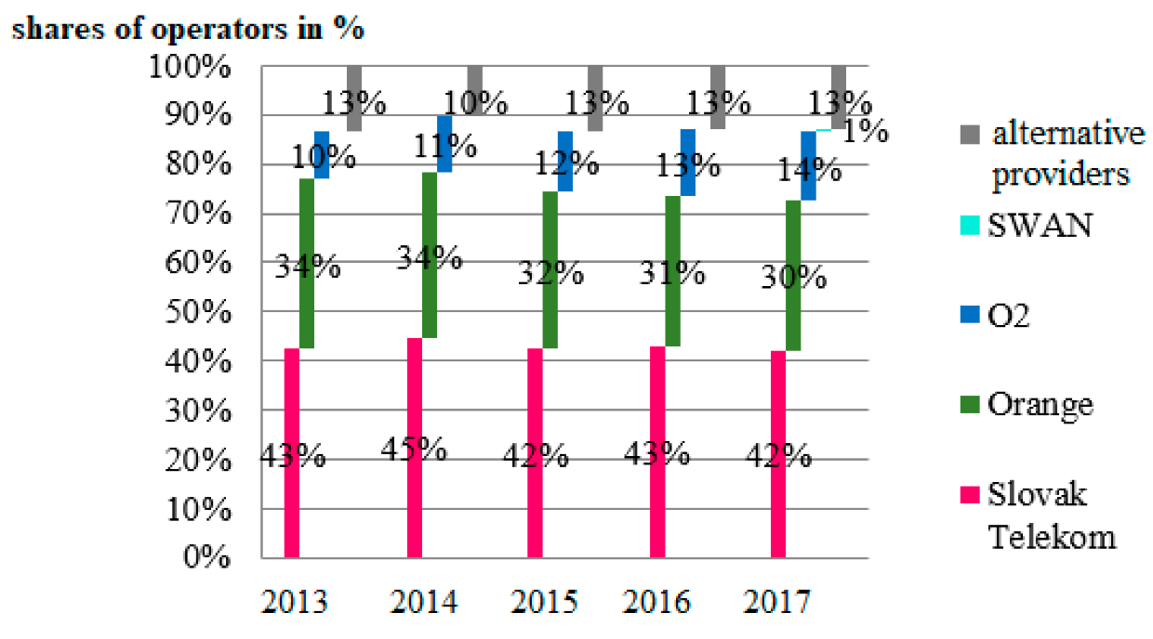
Examples of Oligopolies
Industry | No of sellers | 4 largest | 8 largest
Aluminum | 15 | 64 % | 88 %
Lead | 5 | 99 % | 100 %
Steel | 211 | 42 % | 64 %
Automobiles | 28 | 92 % | 97 %
Cereals | 22 | 86 % | 98 %
Chewing gum | 9 | 95 % | 99 %
Tires | 108 | 66 % | 86 %
Cigars | 54 | 60 % | 82 %
Pet food | 222 | 52 % | 71 %
Market shares based on total revenues in SK:
US Department of Commerce, 1982; Shipments by 4 largest and 8 largest firms

Slide 19
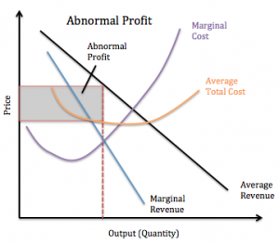
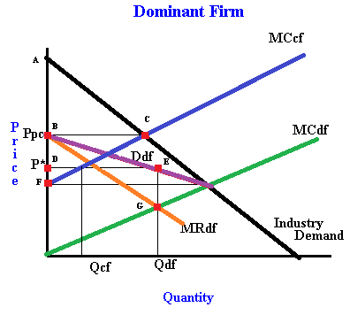
Collusive Oligopoly Oligopoly with Dominant Firm
The profit is like profit of monopoly.
For the dominant firm is better to leave a part of market for weaker competitor
Smaller firm respect the prices of dominant firm in industry.

Slide 20

Monopolistic Competition
Many sellers compete to sell a differentiated product in a market where entry of new sellers is possible.
1) Each firm has a small share of the market demand for a similar but not identical product.
2) The product of each firm selling in the market is not a perfect substitute for that sold by competing firms.
3) Firms in the market don‘t consider the reaction of their rivals when choosing their prices and sales targets.
4) Relative freedom to enter by new firms.
5) No opportunity or motive for firms to cooperate in ways that would decrease the competition (such as cartels).

Slide 21
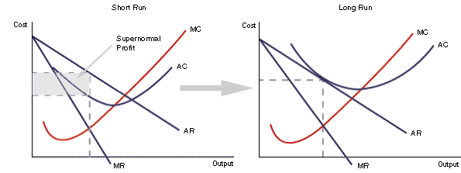
Short-Run and Long-Run Equilibrium –Monopolistic Competition
Firm has a monopoly over its own production and demand curve for production is highly elastic, because other companies offer close substitutes.
In the short run - the firm can realize monopoly profits - the slope of the demand curve.
In the long run, however, this monopoly profit is compressed to zero due to movement between industries. Monopoly profits attract competition and demand for the firm's production drops. New companies are coming into the industry until the monopoly profit is zero.

