Slide 1
Costs, Revenues and Profit
LESSON 5
MICROECONOMICS
2023/2024

Slide 2
OUTLINE OF THE LECTURE AND STUDY GOALS
Students should be able to:
Distinguish accounting, economic and normal profit.
Distinguish between explicit and implicit costs.
Distinguish the types of costs in short-run and long-run.
Distinguish the development of different types of revenues for perfectly and imperfectly competitive firms.
Profit – accounting, economic and normal
Costs – explicit and implicit
Costs – total, fixed and variable
Costs – total, average and marginal
Revenues – perfect competition
Revenues – imperfect competition

Slide 3
Profit
Main goal of firm = maximalization of profit
Profit = Total Revenues – Total Costs
Accounting profit | Economic profit | Normal profit
Accounting profit is profit, which expresses the difference between total revenue (TR) and total EXPLICIT costs | Economic profit also considers existence of other types of costs, namely IMPLICIT costs | Difference between economic and accounting profit = IMPLICIT costs
$$π_{a}=TR −TCex$$ | $$π_{e}=TR −(TCex+TCim)$$ | $π_{n}$= $π_{a}− π_{e}$

Slide 4
Costs – explicit and implicit
Explicit costs - the actual and accounted costs
Implicit costs - costs that are not recorded in the account books, because they are not actually paid
They are the opportunity costs of not using the factors of production in a different, best alternative, way
Problem to solve:
Fred currently works for a corporate law firm. He is considering opening his own legal practice, where he expects to earn $200,000 per year once he establishes himself. To open his own practice, Fred would have to quit his current job, where he is earning an annual salary of $125,000. To run his own firm, he would need an office and a law clerk. He has found the perfect office, which rents for $50,000 per year. He could hire a law clerk for $35,000 per year.
If these figures are accurate, what would be Fred‘s explicit and implicit costs and would Fred’s legal practice be profitable?

Slide 5
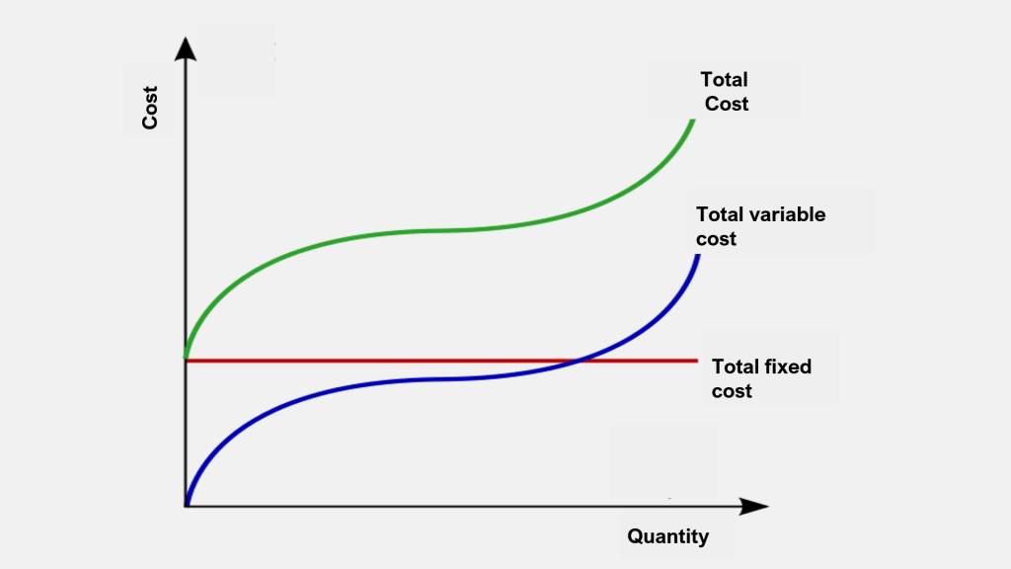
Costs – total, fixed and variable (short-run)
In the short-run at least one factor of productions is fixed in quantity even if level of production changes.
The fixed amount of the production factor (capital) therefore represents obligation for the firm to pay certain level of fixed costs (FC) in the short-period.
Some factors of productions in short-run are variable in quantity, they increase and decrease and thus their costs are variable costs as well.
Total costs in short-run are the sum of total fixed and total variable costs:
TC = FC + VC
FC = i*K (but K is constant)
VC = w*L (L is variable)

Slide 6
Practice – Calculating Total Costs
Number of workers | Total output (pairs of shoes per week) | Fixed costs (dollars) | Variable costs (dollars) | Total Costs (dollars)
0 | 0 | 1 000 | 0
1 | 7 | 1 000 | 300
2 | 18 | 1 000 | 600
3 | 33 | 1 000 | 900
4 | 46 | 1 000 | 1 200
5 | 55 | 1 000 | 1 500
6 | 60 | 1 000 | 1 800
7 | 63 | 1 000 | 2 100
8 | 63 | 1 000 | 2 400
9 | 54 | 1 000 | 2 700
10 | 40 | 1 000 | 3 000

Slide 7
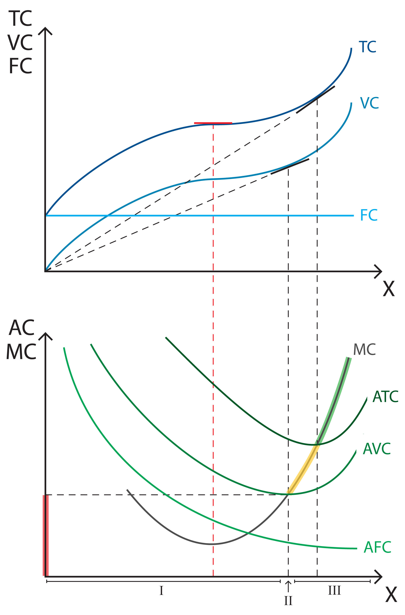
Costs – total, average and marginal costs (short-run)
TOTAL COSTS
TC = FC + VC
AVERAGE COSTS (average total costs, average fixed costs and average variable costs)
Costs per unit of production
$$ATC= \frac{TC}{Q} OR ATC=AFC+AVC$$
$AFC= \frac{FC}{Q}$
$AVC= \frac{VC}{Q}$
MARGINAL COSTS
cost of additional input necessary to produce the additional units of output
$$MC= \frac{ΔTC}{ΔQ}$$

Slide 8
Practice – Calculating Average and Marginal Costs
Total output (pairs of shoes per week) | Fixed costs (dollars) | Variable costs (dollars) | Total Costs (dollars)
0 | 1 000 | 0 | 1 000
7 | 1 000 | 300 | 1 300
18 | 1 000 | 600 | 1 600
33 | 1 000 | 900 | 1 900
46 | 1 000 | 1 200 | 2 200
55 | 1 000 | 1 500 | 2 500
60 | 1 000 | 1 800 | 2 800
63 | 1 000 | 2 100 | 3 100
AFC | AVC | ATC | MC

Slide 9
Practice – Calculating Average and Marginal Costs
Total output (pairs of shoes per week) | Fixed costs (dollars) | Variable costs (dollars) | Total Costs (dollars)
0 | 1 000 | 0 | 1 000
7 | 1 000 | 300 | 1 300
18 | 1 000 | 600 | 1 600
33 | 1 000 | 900 | 1 900
46 | 1 000 | 1 200 | 2 200
55 | 1 000 | 1 500 | 2 500
60 | 1 000 | 1 800 | 2 800
63 | 1 000 | 2 100 | 3 100
AFC | AVC | ATC | MC
- | - | - | -
142,86 | 42,86 | 185,72 | 42,86
55,56 | 33,33 | 88,89 | 27,27
30,30 | 27,27 | 57,57 | 20,00
21,74 | 26,09 | 47,83 | 23,08
18,18 | 27,27 | 45,45 | 33,33
16,67 | 30,00 | 46,67 | 60
15.87 | 33,33 | 49,20 | 100

Slide 10
Costs – total, average and marginal costs (short-run)
I – SMC minimum - increasing returns to variable input are hereby amended in decreasing
II – AVC minimum
III – SAC minimum - at that point the firm by hiring additional units of labor increases the capacity utilization of fixed capital - exceeding this point reduces labor productivity

Slide 11
Costs and Returns to Scale
Decreasing Returns to Scale
Constant Returns to Scale
Increasing Returns to Scale

Slide 12
Costs – total, average and marginal costs (long-run)
There are no fixed costs in the long-run - labor and capital are variable.
LTC = LVC
The long-run average costs LAC
$$LAC= \frac{LTC}{Q}$$
The long-run marginal costs LMC
$$LMC=\frac{ΔLTC}{ΔQ}$$

Slide 13
Relationship between Short-run and Long-run Costs
The shape of long-run curves is based on the shapes of short-run curves.
Construction of LTC curve - is formed by minimum of STC curves.
Construction of LAC – is formed by enveloping minimums of SAC curves (envelope curve)
Construction of LMC – is formed by connecting levels of respective SMC curves that correspond to minimum of SAC (NOT mimnimums of SMC!)

Slide 14
Relationship between Short-run and Long-run Costs
The shape of long-run curves is based on the shapes of short-run curves.
Construction of LTC curve - is formed by minimum of STC curves.
Construction of LAC – is formed by enveloping minimums of SAC curves (envelope curve)
Construction of LMC – is formed by connecting levels of respective SMC curves that correspond to minimum of SAC (NOT mimnimums of SMC!)
the point of optimal production, where LTC/STC, LMC/SMC and LAC/SAC are equal

Slide 15
Revenues
TOTAL REVENUES
Revenues which the company gains by selling its produced products
It depends on the volume of production and price
TR = P x Q
AVERAGE REVENUES
Revenues per unit of production
AR = $\frac{TR}{Q}$ also: AR = P
MARGINAL REVENUES
Change of total revenues by selling additional unit of output
$$MR= \frac{ΔTR}{ΔQ}$$

Slide 16
Revenues - perfect competition
Price is formed in perfectly competitive market and firm cannot influence it. Individual demand of firm (d) is perfectly elastic.
Every piece of firm production is sold for $25 ---------> d = P = AR = MR (= 25)

Slide 17
Revenues - imperfect competition
Individual demand of firm (d) is typically downward sloping and equals to AR because if firm wants to increase quantity sold, it needs to decrease the price (AR). ------→ d = P = AR ≠ MR

