Slide 1

COST-VOLUME-PROFIT AND BREAK-EVEN ANALYSIS
Ing. Markéta Skupieňová, Ph.D.
MANAGERIAL ACCOUNTING/NANMU

Slide 2
COST-VOLUME-PROFIT AND BREAK-EVEN ANALYSIS
COST-VOLUME-PROFIT (CVP) ANALYSIS
CVP analysis, together with cost behavior information, helps managers perform many useful analyses.
More specifically, it looks at the effects on profits of changes in such factors as variable costs, fixed costs, selling prices, volume, and mix of products sold.
By studying the relationships among costs, sales and net income, management is better able to cope with many planning decisions.

Slide 3
COST-VOLUME-PROFIT AND BREAK-EVEN ANALYSIS
BREAK-EVEN ANALYSIS
Break-even analysis, a branch of CVP analysis, determines the break-even sales, which is the level of sales at which total costs equal total revenue.

Slide 4
COST-VOLUME-PROFIT AND BREAK-EVEN ANALYSIS
QUESTIONS ANSWERED BY CVP ANALYSIS
CVP analysis tries to answer the following questions:
What sales volume is required to break even?
What sales volume is necessary in order to earn a desired profit?
What profit can be expected on a given sales volume?
How would changes in selling price, variable costs, fixed costs,m and output affect profits?
How would a change in the mix of products sold affect the break-even and target income volume and profit potential?

Slide 5
COST-VOLUME-PROFIT AND BREAK-EVEN ANALYSIS
CONTRIBUTION MARGIN (CM)
The contribution margin is the excess of sales (S) over the variable costs (VC) of the product.
It is the amount of money available to cover fixed costs (FC) and to generate profits.
CM = sales (S) – variable costs (VC)

Slide 6
COST-VOLUME-PROFIT AND BREAK-EVEN ANALYSIS
UNIT CONTRIBUTION MARGIN (CM)
The unit contribution margin is the excess of the unit selling price (p) over the unit variable cost (v)
Unit CM = unit selling price (p) – unit variable cost (v)

Slide 7
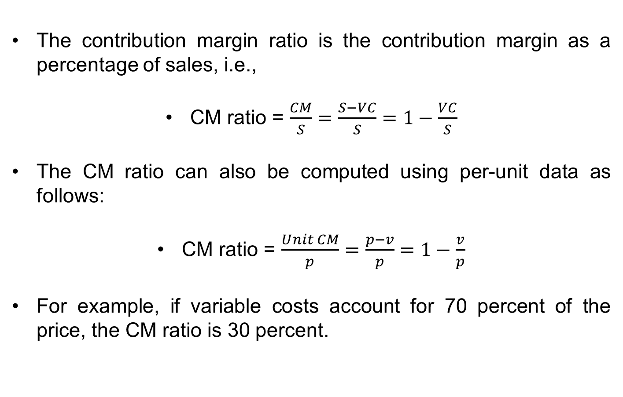
COST-VOLUME-PROFIT AND BREAK-EVEN ANALYSIS
CONTRIBUTION MARGIN RATIO (CM ratio)
The contribution margin ratio is the contribution margin as a percentage of sales, i.e.,
CM ratio = $\frac{CM}{S}=\frac{S−VC}{S}=1−\frac{VC}{S}$
The CM ratio can also be computed using per-unit data as follows:
CM ratio = $\frac{Unit CM}{p}=\frac{p−v}{p}=1−\frac{v}{p}$
For example, if variable costs account for 70 percent of the price, the CM ratio is 30 percent.

Slide 8
COST-VOLUME-PROFIT AND BREAK-EVEN ANALYSIS
BREAK-EVEN ANALYSIS
The break-even point, the point of no profit and no loss, provides managers with insights into profit planning.
It can be computed in three different ways:
  The equation approach
  The contribution approach
  The graphical approach

Slide 9
COST-VOLUME-PROFIT AND BREAK-EVEN ANALYSIS
BREAK-EVEN POINT – THE EQUATION APPROACH
The equation approach is based on the cost-volume equation, which shows the relationships among sales, variable and fixed costs, and profit.
S = VC + FC + profit
At the break-even volume:
S = VC + FC + 0
or
Profit = S – VC – FC
0 = P*Q – v*Q – FC

Slide 10
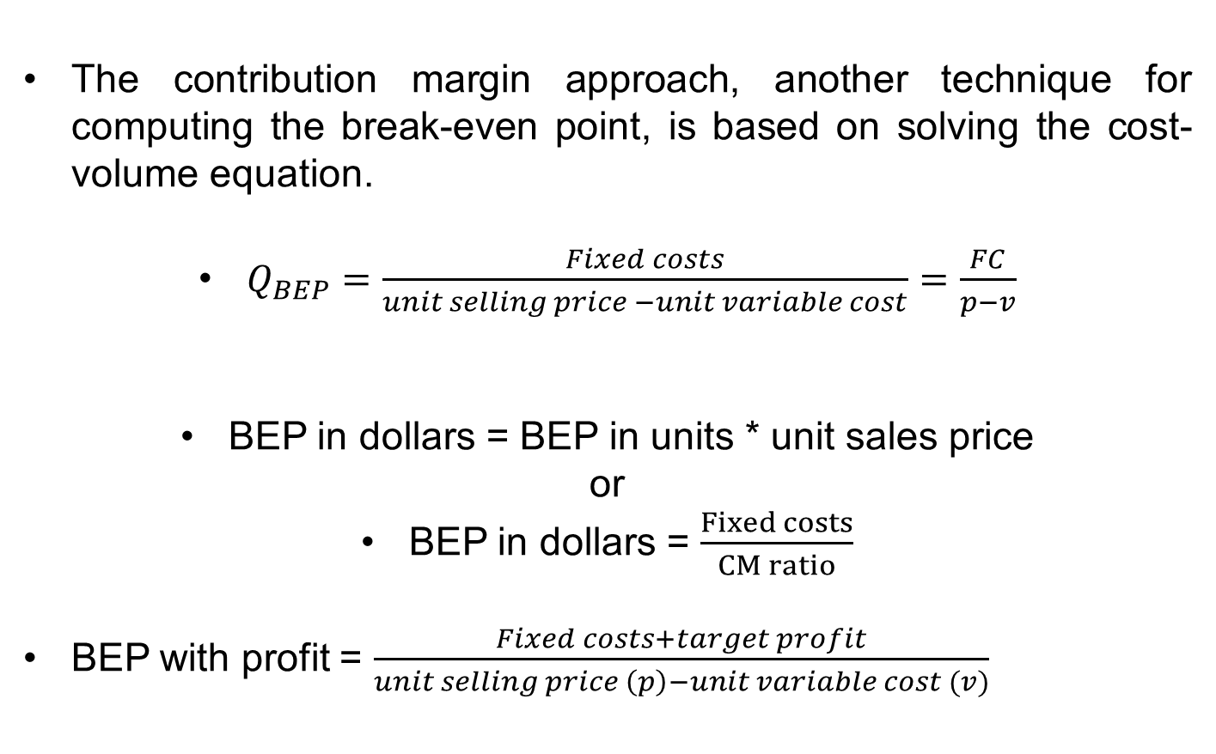
COST-VOLUME-PROFIT AND BREAK-EVEN ANALYSIS
BREAK-EVEN POINT – THE CONTRIBUTION MARGIN APPROACH
The contribution margin approach, another technique for computing the break-even point, is based on solving the cost-volume equation.
$Q_{BEP}=\frac{Fixed costs}{unit selling price −unit variable cost}=\frac{FC}{p−v}$
BEP in dollars = BEP in units * unit sales price
or
BEP in dollars = $\frac{Fixed costs}{CM ratio}$
BEP with profit = $\frac{Fixed costs+target profit}{unit selling price \left(p\right)−unit variable cost (v)}$

Slide 11
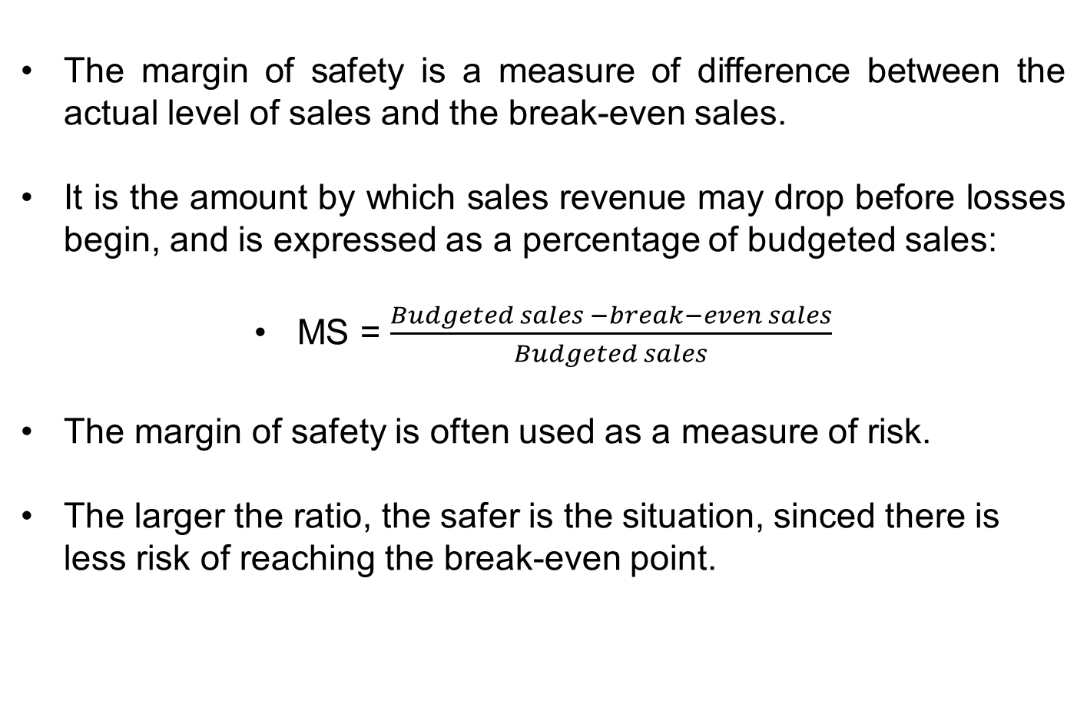
COST-VOLUME-PROFIT AND BREAK-EVEN ANALYSIS
MARGIN OF SAFETY (MS)
The margin of safety is a measure of difference between the actual level of sales and the break-even sales.
It is the amount by which sales revenue may drop before losses begin, and is expressed as a percentage of budgeted sales:
MS = $\frac{Budgeted sales −break−even sales}{Budgeted sales}$
The margin of safety is often used as a measure of risk.
The larger the ratio, the safer is the situation, sinced there is less risk of reaching the break-even point.

Slide 12
Thank you for your attention.

