Slide 1

PRODUCT COSTING METHODS (JOB-ORDER COSTING, PROCESS COSTING AND COST ALLOCATION)
Ing. Markéta Skupieňová, Ph.D.
MANAGERIAL ACCOUNTING/NANMU

Slide 2
PRODUCT COSTING METHODS (JOB-ORDER COSTING, PROCESS COSTING AND COST ALLOCATION)
COST ACCUMULATION SYSTEMS
A cost accumulation system is a product costing system.
This process accumulates manufacturing costs such as materials, labor, and factory overhead and assigns them to cost objectives, such as finished goods and work in process.
Product costing is necessary not only for inventory valuation and income determination but also for establishing the unit sales price.

Slide 3
PRODUCT COSTING METHODS (JOB-ORDER COSTING, PROCESS COSTING AND COST ALLOCATION)
COST ACCUMULATION SYSTEMS
We will discuss the essentials of the cost accumulation system that is used to measure the manufacturing costs of products.
This is essentially a two-step process:
1. The measurement of costs that are applicable to manufacturing operations during a given accounting period, and
2. The assignment of these costs to products.

Slide 4
PRODUCT COSTING METHODS (JOB-ORDER COSTING, PROCESS COSTING AND COST ALLOCATION)
COST ACCUMULATION SYSTEMS
There are two basic approaches to cost accounting and accumulation:
1. Job-order costing
2. Process costing

Slide 5
PRODUCT COSTING METHODS (JOB-ORDER COSTING, PROCESS COSTING AND COST ALLOCATION)
JOB-ORDER COSTING AND PROCESS COSTING COMPARED
The distinction between job-order costing and process costing centers largely around how product costing is accomplished.
With job-order costing, the focus is to apply costs to specific jobs, which may consist of either a single physical unit or a few like units.

Slide 6
PRODUCT COSTING METHODS (JOB-ORDER COSTING, PROCESS COSTING AND COST ALLOCATION)
JOB-ORDER COSTING AND PROCESS COSTING COMPARED
Under process costing, accounting data are accumulated by the production department (or cost center) and averaged over all of the production that occurred in the department.
There is mass production of like units which are manufactured on a continuous basis through a series of uniform production steps known as processes.

Slide 7
PRODUCT COSTING METHODS (JOB-ORDER COSTING, PROCESS COSTING AND COST ALLOCATION)
JOB-ORDER COSTING AND PROCESS COSTING COMPARED
This table summarizes the basic differences between these two methods.
 | Job-Order Costing | Process Costing
Cost unit | Job, order, or contract | Physical unit
Costs are accumulated | By jobs | By departments
Subsidiary record | Job cost sheet | Cost-of-production report
Used by | Custom manufacturers | Processing industries
Permits computation of | A unit cost for inventory costing purposes A profit or loss on each job | A unit cost to be used to compute the costs of goods completed and work in process

Slide 8
PRODUCT COSTING METHODS (JOB-ORDER COSTING, PROCESS COSTING AND COST ALLOCATION)
JOB-ORDER COSTING
Job-order costing is the cost accumulation system under which costs are accumulated by jobs, contracts, or orders.
This costing method is appropriate when the products are manufactured in identifiable lots or batches or when the products are manufactured to customer specifications.
Job-order costing is widely used by custom manufacturers such as printing, aircraft and construction companies.

Slide 9
PRODUCT COSTING METHODS (JOB-ORDER COSTING, PROCESS COSTING AND COST ALLOCATION)
JOB-ORDER COSTING
It may also be used by service business such as auto repair shops and professional services.
Job-order costing keeps track of costs as follows:
  Direct material and direct labor are traced to a particular job.
  Costs that are not directly traceable – factory overhead – are applied to individual jobs using a predetermined overhead (application) rate.

Slide 10
PRODUCT COSTING METHODS (JOB-ORDER COSTING, PROCESS COSTING AND COST ALLOCATION)
JOB COST SHEET
A job cost sheet is used to record various production costs for work-in-process inventory.
A separate cost sheet is kept for each identifiable job, accumulating the direct materials, direct labor, and factory overhead assigned to that job as it moves through production.
The form varies according to the needs of the company.
This is the key document in the system.

Slide 11
PRODUCT COSTING METHODS (JOB-ORDER COSTING, PROCESS COSTING AND COST ALLOCATION)
JOB COST SHEET
It summarizes all of the manufacturing costs-direct materials, direct labor, and applied factory overhead – of producing a given job or batch of products.
One sheet is maintained for each job, and the file of job cost sheets for unfinished jobs is the subsidiary record for the Work-in-Process Inventory account.
When the jobs are completed and transferred, the job cost sheets are transferred to a completed jobs file and the number of units and their unit costs are recorded on inventory cards supporting the Finished Goods Inventory account.

Slide 12
PRODUCT COSTING METHODS (JOB-ORDER COSTING, PROCESS COSTING AND COST ALLOCATION)
FACTORY OVERHEAD APPLICATION
Many items of factory overhead cost are incurred for the entire factory and for the entire accounting period and cannot be identified specifically with particular jobs.
Furthermore, the amount of actual factory overhead costs incurred is not usually available until the end of the accounting period.
However, it is often critical to make cost data available for pricing purposes as each job is completed.
Therefore, in order job costs to be available on a timely basis, it is customary to apply factory overhead by using a predetermined factory overhead rate.

Slide 13
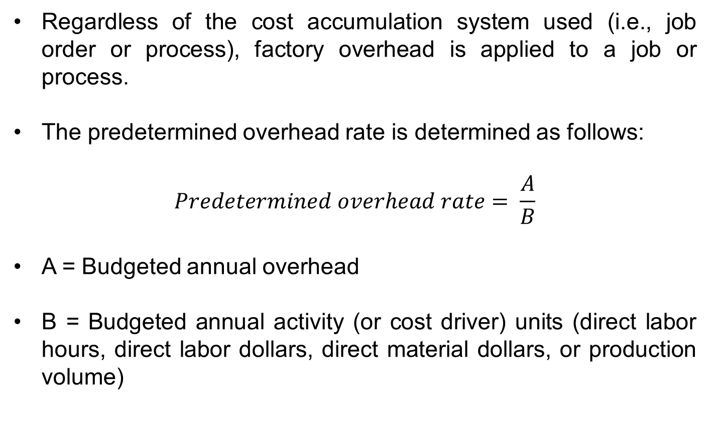
PRODUCT COSTING METHODS (JOB-ORDER COSTING, PROCESS COSTING AND COST ALLOCATION)
PREDETERMINED FACTORY OVERHEAD RATE
Regardless of the cost accumulation system used (i.e., job order or process), factory overhead is applied to a job or process.
The predetermined overhead rate is determined as follows:
$$Predetermined overhead rate= \frac{A}{B}$$
A = Budgeted annual overhead
B = Budgeted annual activity (or cost driver) units (direct labor hours, direct labor dollars, direct material dollars, or production volume)

Slide 14
PRODUCT COSTING METHODS (JOB-ORDER COSTING, PROCESS COSTING AND COST ALLOCATION)
PREDETERMINED FACTORY OVERHEAD RATE
Budgeted activity units used in the denominator of the formula, more often called the denominator activity level, are measured in direct labor hours, machine hours, direct labor costs, production units, or any other representative surrogate of production activity.

Slide 15
PRODUCT COSTING METHODS (JOB-ORDER COSTING, PROCESS COSTING AND COST ALLOCATION)
DISPOSITION OF UNDER- AND OVERAPPLIED OVERHEAD
Inevitably, actual overhead cost incurred during a period and factory overhead costs applied will differ.
Conventionally, at the end of the year, the difference between actual overhead and applied overhead is closed to Cost of Goods Sold if it is immaterial.
On the other hand, if a material difference exists, Work in Process, Finished Goods, and Cost of Goods Sold are adjusted on a proportionate basis based on units or dollars at year-end for the deviation between actual and applied overhead.

Slide 16
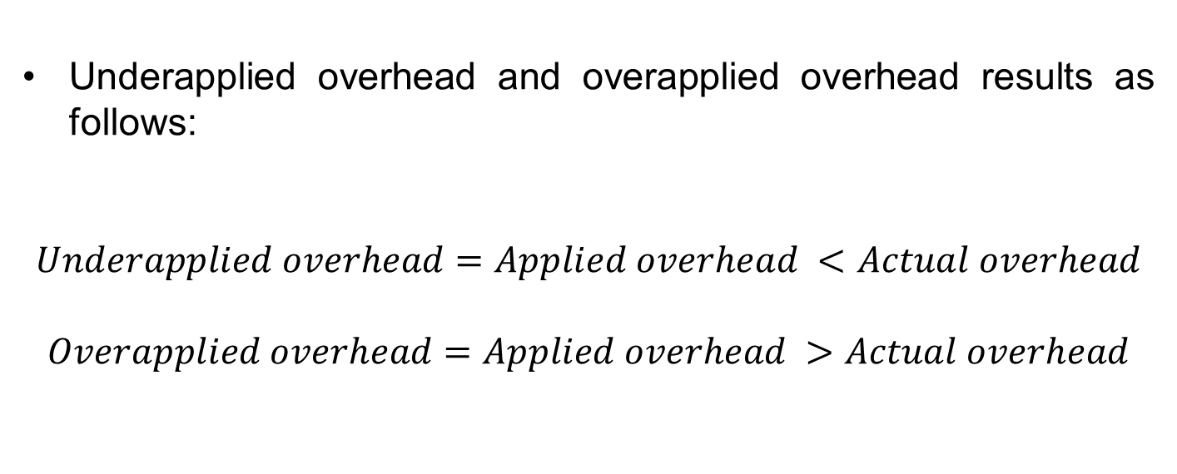
PRODUCT COSTING METHODS (JOB-ORDER COSTING, PROCESS COSTING AND COST ALLOCATION)
DISPOSITION OF UNDER- AND OVERAPPLIED OVERHEAD
Underapplied overhead and overapplied overhead results as follows:
$$Underapplied overhead=Applied overhead <Actual overhead$$
$$Overapplied overhead=Applied overhead >Actual overhead$$

Slide 17
PRODUCT COSTING METHODS (JOB-ORDER COSTING, PROCESS COSTING AND COST ALLOCATION)
PROCESS COSTING
Process costing is a cost accumulation system that aggregates manufacturing costs by departments of by production processes.
Total manufacturing costs are accumulated by two major categories, direct materials and conversion costs (the sum of direct labor and factory overhead applied).
Unit cost is determined by dividing the total costs charged to a cost center by the output of that cost center. In that sense, the unit costs are averages.

Slide 18
PRODUCT COSTING METHODS (JOB-ORDER COSTING, PROCESS COSTING AND COST ALLOCATION)
PROCESS COSTING
Process costing is appropriate for companies that produce a continuous mass of like units through a series of operations or processes.
Process costing is used in such industries as petroleum, chemicals, oil refining, textiles, and food processing.

Slide 19
Thank you for your attention.

