Slide 1
Overview of e-commerce in Czechia
Radim Dolák

Slide 2
Outline of the lecture
Introduction to e-commerce
E-commerce statistics in the Czech Republic
TOP samples of Czech e-shops
Overview of e-commerce in Czechia

Slide 3
Introduction to e-commerce
The history of ecommerce begins with the first ever online sale: on the August 11, 1994 a man sold a CD by the band Sting to his friend through his website NetMarket, an American retail platform. This is the first example of a consumer purchasing a product from a business through the World Wide Web—or “ecommerce” as we commonly know it today.
According to (Velmurugan & Narayanasamy, 2008) e-commerce is defined as an attempt to increase transactional efficiency and effectiveness in all aspects of the design, production, marketing and sales of products or services for existing and developing marketplaces through the utilization of current and emerging electronic technologies.
Overview of e-commerce in Czechia

Slide 4
Introduction to e-commerce
Major Ecommerce Business Classifications
B2B: Business to Business Ecommerce
B2C: Business to Consumer Ecommerce
C2C: Consumer to Consumer Ecommerce
C2B: Consumer to Business Ecommerce
Government / Public Administration Ecommerce
Overview of e-commerce in Czechia

Slide 5
Introduction to e-commerce
Overview of e-commerce in Czechia

Slide 6
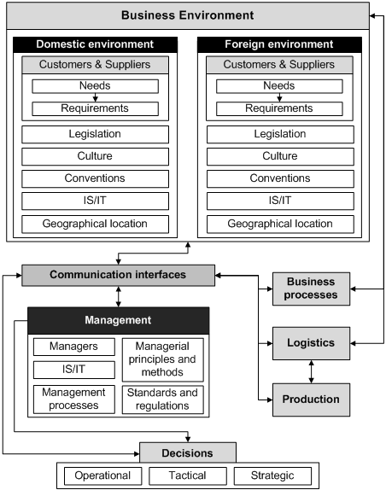
Introduction to e-commerce
Overview of e-commerce in Czechia

Slide 7
E-commerce statistics in the Czech Republic
The Czech eCommerce market is among the fastest growing within Europe.
According to the Czech Association for Electronic Commerce, the market was worth more than $8 billion in 2022.
Approximately 54 percent of the total Czech population shops online. eCommerce now holds a 16 percent share of total retail in the market.
This means that user penetration in this market is 54% in 2020 and is predicted to reach 65.1% by 2025.
All top ecommerce sites are based in the Czech domain.
Overview of e-commerce in Czechia

Slide 8
E-commerce news in Czechia - Allegro
Allegro, a prominent e-commerce platform in Poland, serves as a relevant case study for understanding regional dynamics in e-commerce.
Allegro has been compared to other international platforms like Amazon, showcasing how local platforms can thrive by catering to specific market needs.
The acquisition of the Mall Group, a Czech e-commerce holding, by Allegro underscores the growing influence of regional players in the broader European market
Overview of e-commerce in Czechia

Slide 9
E-commerce news in Czechia - Temu
Temu is another emerging player in the e-commerce sector, has gained attention for its unique business model and competitive pricing strategies.
While specific references to Temu in the Czech context are limited, its operational strategies reflect broader trends in e-commerce where platforms focus on affordability and consumer engagement to capture market share.
The competitive landscape in the Czech Republic is thus shaped by both local and international players, each vying for consumer loyalty through innovative practices and tailored offerings
Overview of e-commerce in Czechia

Slide 10
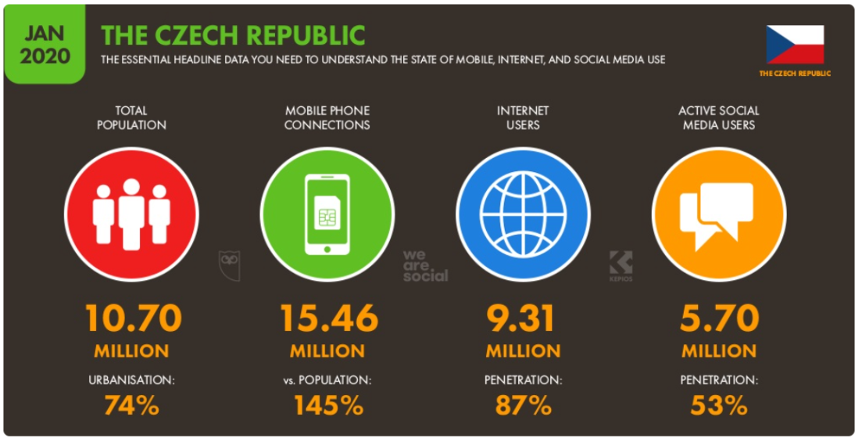
E-commerce statistics in the Czech Republic
Overview of e-commerce in Czechia

Slide 11
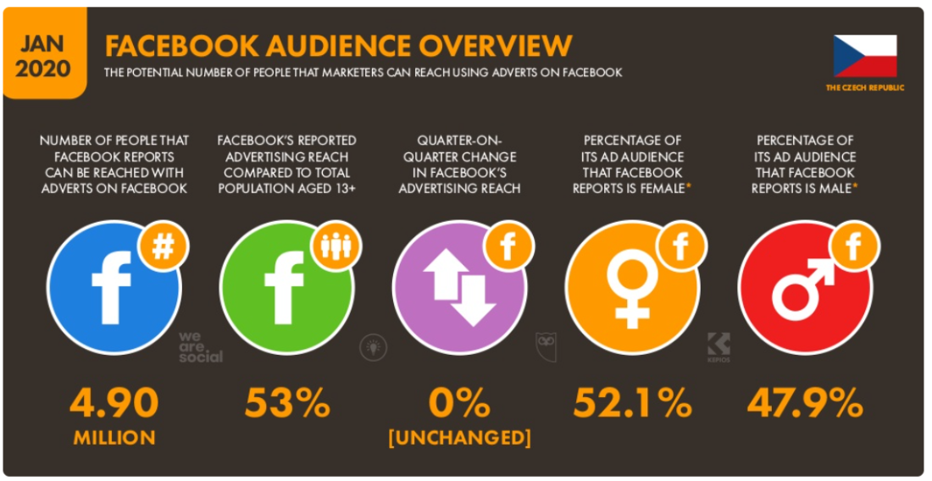
E-commerce statistics in the Czech Republic
Overview of e-commerce in Czechia

Slide 12
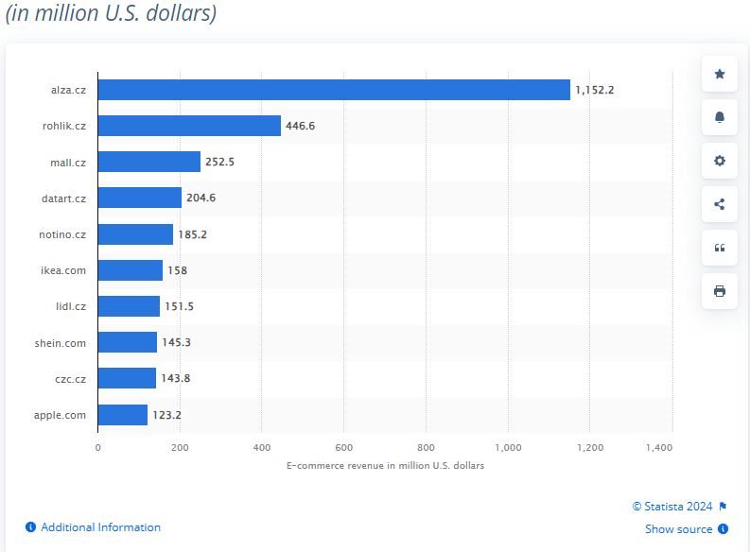
Top online stores in 2023, by e-commerce net sales
Overview of e-commerce in Czechia

Slide 13
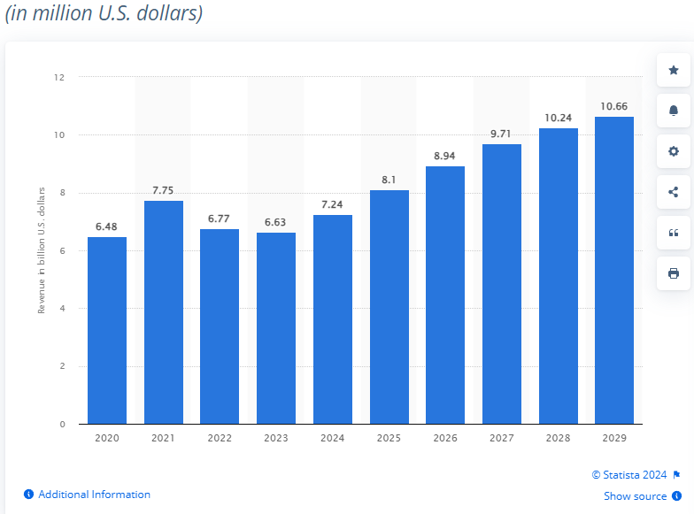
Revenue of the e-commerce market in from 2020 to 2029
Overview of e-commerce in Czechia

Slide 14
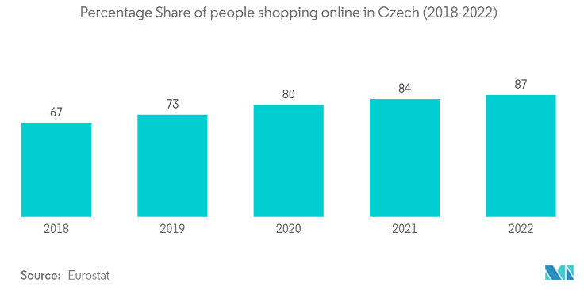
E-commerce statistics in the Czech Republic
Overview of e-commerce in Czechia

Slide 15
E-commerce statistics in the Czech Republic
Overview of e-commerce in Czechia

Slide 16
E-commerce statistics in the Czech Republic
NUMBER OF E-SHOPS
Overview of e-commerce in Czechia

Slide 17
E-commerce statistics in the Czech Republic
TURNOVER GROWTH
Overview of e-commerce in Czechia

Slide 18
E-commerce statistics in the Czech Republic
Overview of e-commerce in Czechia

Slide 19
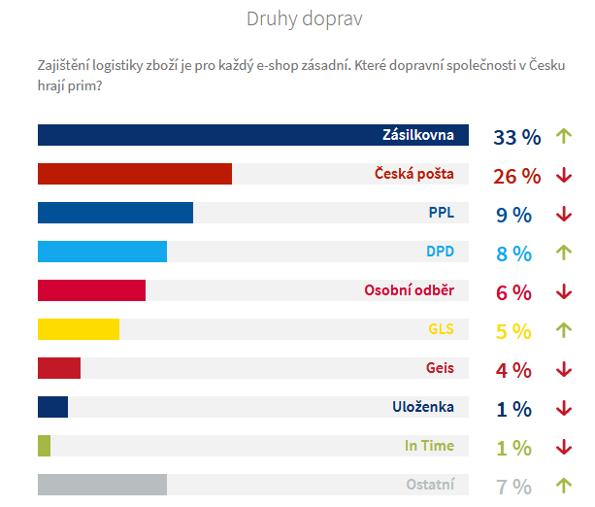
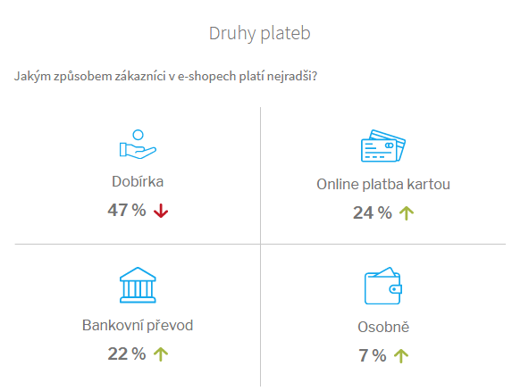
E-commerce statistics in the Czech Republic
Source: https://www.ceska-ecommerce.cz/
Overview of e-commerce in Czechia

Slide 20
E-commerce statistics in the Czech Republic
Overview of e-commerce in Czechia

Slide 21
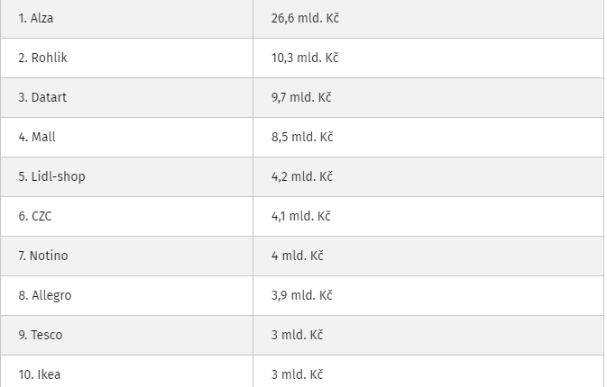
The largest e-shops in the Czech Republic by sales
Overview of e-commerce in Czechia

Slide 22
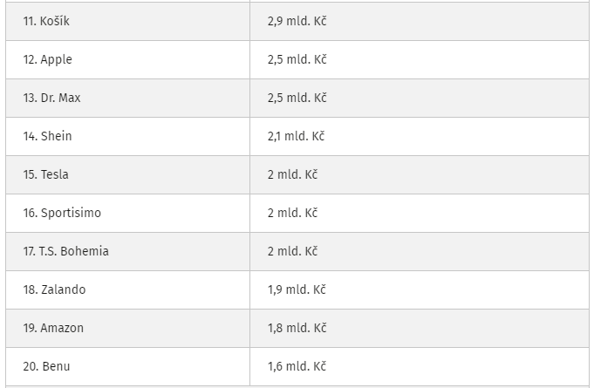
The largest e-shops in the Czech Republic by sales
Overview of e-commerce in Czechia

Slide 23
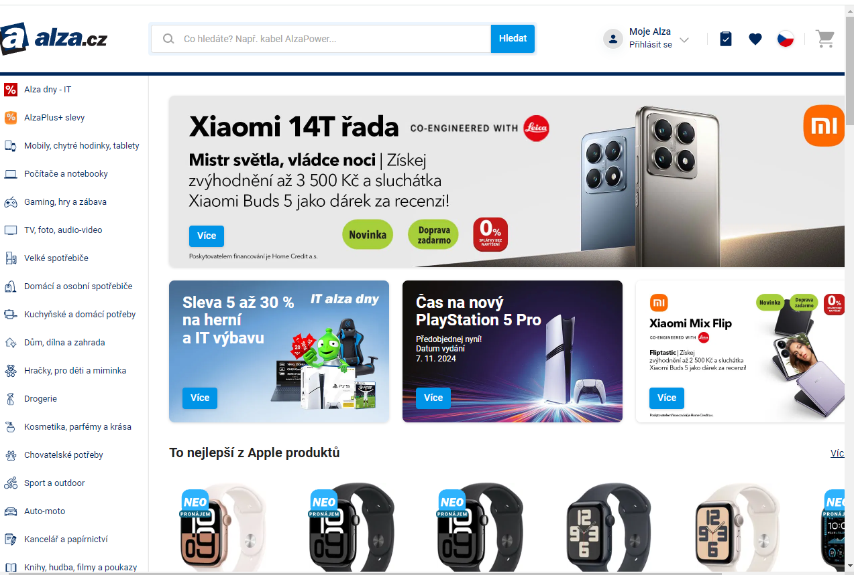
TOP samples of Czech e-shops
Overview of e-commerce in Czechia

Slide 24
TOP samples of Czech e-shops
Overview of e-commerce in Czechia

Slide 25
TOP samples of Czech e-shops
Overview of e-commerce in Czechia

Slide 26
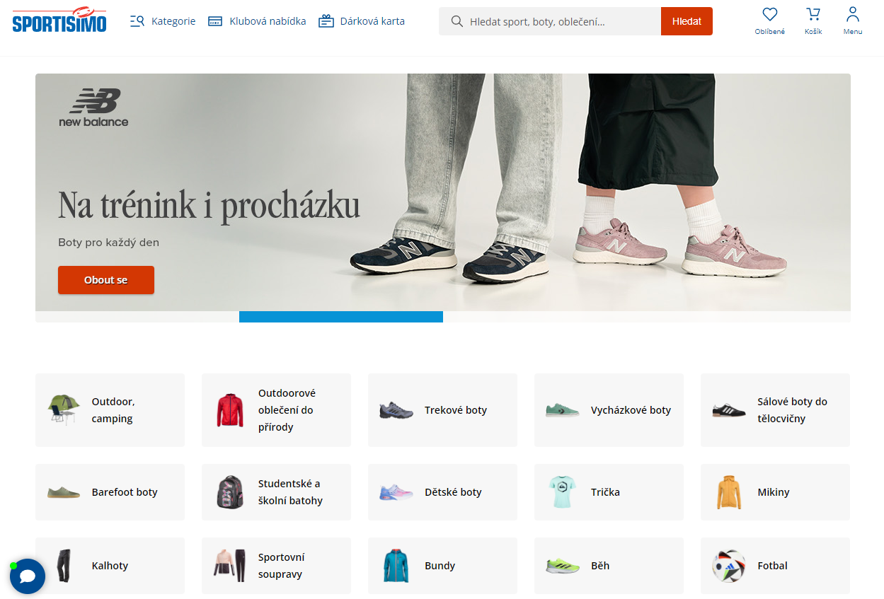
TOP samples of Czech e-shops
Overview of e-commerce in Czechia

Slide 27
TOP samples of Czech e-shops
Overview of e-commerce in Czechia

Slide 28
THANK YOU FOR YOUR ATTENTION

