Slide 1

E-business
Information society and global information infrastructure - I
Petr Suchánek
E-business

Slide 2

Outline of the lecture
Information society
Global information society - infrastructure
Information and global information infrastructure entities
Data
Information
Knowledge

Slide 3
Information society
An information society is a society where the creation, distribution, use, integration and manipulation of information is a significant economic, political, and cultural activity.*
Its main drivers are digital information and communication technologies, which have resulted in an information explosion and are profoundly changing all aspects of social organization, including the economy, education, health, etc.*
The markers of this rapid change may be technological, economic, occupational, spatial, cultural, or some combination of all of these.*
*https://en.wikipedia.org/wiki/Information_society

Slide 4
Information society
The growth of technologically mediated information has been quantified in different ways, including society's technological capacity to store information, to communicate information, and to compute information.*
The machine tools of the Information Society are computers and telecommunications, rather than lathes or ploughs.**
Progress in information technologies and communication is changing the way we live: how we work and do business, how we educate our children, study and do research, train ourselves, and how we are entertained.
The information society is not only affecting the way people interact but it is also requiring the traditional organisational structures to be more flexible, more participatory and more decentralised.**
*https://en.wikipedia.org/wiki/Information_society
**https://whatis.techtarget.com/definition/Information-Society

Slide 5
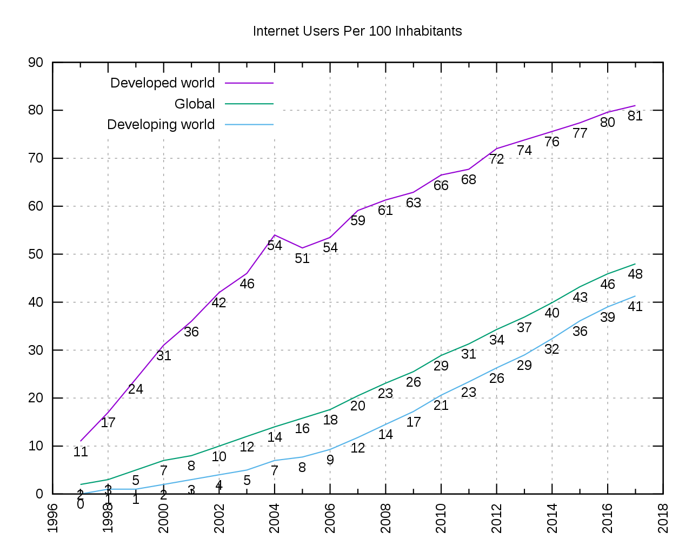
Information society
*https://en.wikipedia.org/wiki/Information_society

Slide 6
Information society
A successful development of Information Society is possible only at the condition that all its components are developed uniformly and simultaneously.*
According to the European Commission’s (EC) programme eEurope2020 and the Digital Agenda for Europe the general objectives for the development of society are:*
  developing an economy which based on knowledge and innovation;
  delivering sustainable economic and social benefits from a digital single market which is based on fast and ultra-fast Internet and interoperable applications.
*https://www.sciencedirect.com/science/article/pii/S2212567115008102

Slide 7
Information society*
Opening up access to content;
Making online and cross border transactions straightforward;
Building digital confidence;
Reinforcing the single market for telecommunications services;
Enhancing interoperability through coordination;
Trust and security;
Guarantee universal broadband coverage with increasing speeds;
Open and neutral Internet;
Enhancing digital literacy, skills and inclusion;
Sustainable healthcare and ICT - based support for dignified and independent living;
e-Government services.
*https://www.sciencedirect.com/science/article/pii/S2212567115008102

Slide 8
Global information infrastructure
The Global Information Infrastructure (GII) can be defined as a seamless web of interactive communications being deployed at world-wide level to provide the infrastructure for new services and activities based on the strategic use of all types of information.*
The Internet is considered the de facto global information infrastructure right now. However, for the GII to evolve as envisioned, either the Internet or its successor must deal with challenging issues such as security, privacy, hardware and software compatibility, translation, rights to information, identity management, digital rights management (DRM), competition, and governance.**
*https://www.oecd-ilibrary.org/
**https://searchcio.techtarget.com/definition/global-information-infrastructure

Slide 9
Global information infrastructure - national
In recent years the subject of National Information Infrastructure (NII) has been receiving greater attention in both scholarly and trade publications.*
The issue is expected to have significant implications for the use of electronic communication in education, business, industry, and government.*
The NII is expected to provide for “ the integration of software, hardware and skills that will make it easy and affordable to connect people with each other, with computers, and with a vast array of services and information resources.*
*https://www.slideshare.net/bhagirathisahoo75/seminar-ppt-20849695

Slide 10
Information and global information infrastructure
Global information infrastructure issues:*
  Market and product competition;
  Electronic commerce and digital payments;
  Interconnection, open access, interoperability and standards;
  Universal service.
Global information society issues:*
  Content and growth;
  Cultural and linguistic diversity;
  Controversial content;
  Security, privacy and intellectual property.
*https://www.oecd-ilibrary.org/

Slide 11
Information society
https://www.igi-global.com/dictionary/library-science-and-technology-in-a-changing-world/14504
https://www.encyclopedia.com/social-sciences/encyclopedias-almanacs-transcripts-and-maps/information-society
http://www.artefaktum.hu/it/Webster.htm
https://www.oecd-ilibrary.org/docserver/237382063227.pdf?expires=1570278500&id=id&accname=guest&checksum=10AE79AF78357730F3DAD447BCC7CC6A
https://www.oecd-ilibrary.org/docserver/237382063227.pdf?expires=1570302690&id=id&accname=guest&checksum=138CAACBD517975B0FFD42D567EFBA4A

Slide 12
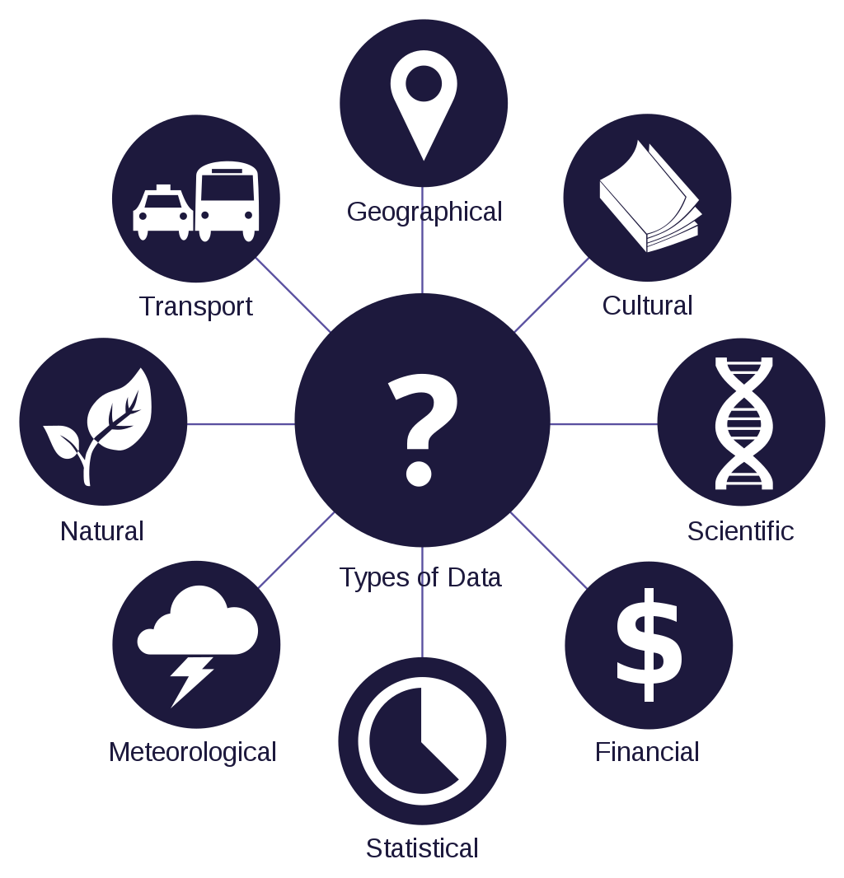
Data
Data is a set of values of subjects with respect to qualitative or quantitative variables.*
Data is:**
  measured;
  collected;
  reported;
  analyzed;
  visualized.
*https://en.wikipedia.org/wiki/Data
**https://en.wikipedia.org/wiki/Data#/media/File:Data_types_-_en.svg

Slide 13
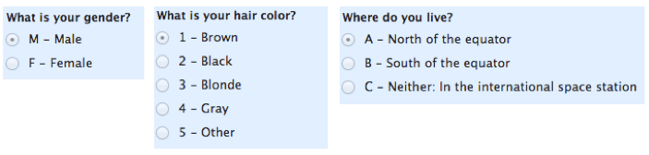
Data – nominal
In statistics, nominal data (also known as nominal scale) is a type of data that is used to label variables without providing any quantitative value.*
It is the simplest form of a scale of measure.*
Unlike ordinal data, nominal data cannot be ordered and cannot be measured.*
* https://corporatefinanceinstitute.com/resources/knowledge/other/nominal-data/
**https://www.mymarketresearchmethods.com/types-of-data-nominal-ordinal-interval-ratio/

Slide 14
Data – nominal*
Nominal data can be analyzed using the grouping method.
The variables can be grouped together into categories, and for each category, the frequency or percentage can be calculated.
The data can also be presented visually such as by using a pie chart.
Although nominal data cannot be treated using mathematical operators, they still can be analyzed using advanced statistical methods.
For example, one way to analyze the data is through hypothesis testing.
* https://corporatefinanceinstitute.com/resources/knowledge/other/nominal-data/

Slide 15
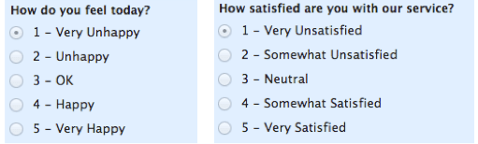
Data – ordinal
Ordinal data is a categorical, statistical data type where the variables have natural, ordered categories and the distances between the categories is not known.*
Ordinal scales are typically measures of non-numeric concepts like satisfaction, happiness, discomfort, etc.**
“Ordinal” is easy to remember because is sounds like “order” and that’s the key to remember with “ordinal scales”–it is the order that matters, but that’s all you really get from these.**
*https://en.wikipedia.org/wiki/Ordinal_data
**https://www.mymarketresearchmethods.com/types-of-data-nominal-ordinal-interval-ratio/

Slide 16
Data – ordinal
Ordinal Scale Characteristics:*
  Along with identifying and describing the magnitude, the ordinal scale shows the relative rank of variables;
  The properties of the interval are not known;
  Measurement of non-numeric attributes such as frequency, satisfaction, happiness etc.;
  In addition to the information provided by nominal scale, ordinal scale identifies the rank of variables;
  Using this scale, survey makers can analyze the degree of agreement among respondents with respect to the identified order of the variables.
*https://www.questionpro.com/blog/ordinal-scale/

Slide 17
Data – interval
Interval scales are numeric scales in which we know both the order and the exact differences between the values.*
The classic example of an interval scale is Celsius temperature because the difference between each value is the same.*
For example, the difference between 60 and 50 degrees is a measurable 10 degrees, as is the difference between 80 and 70 degrees.*
Interval scales are nice because the realm of statistical analysis on these data sets opens up.*
For example, central tendency can be measured by mode, median, or mean; standard deviation can also be calculated.*
*https://www.mymarketresearchmethods.com/types-of-data-nominal-ordinal-interval-ratio/

Slide 18
Data – interval*
Measurement: Interval data is measured using an interval scale, which not only shows the order and direction but also shows the exact difference in the value. For example, the markings on a thermometer or a ruler are equidistant, in simpler words they measure the same distance between the two markings.
Interval Difference: The distances between each value on interval data is equal. For example, the difference between 10 cm and 20 cms is the same as 20 cms and 30 cms.
Calculation: In interval data, one can add or subtract values but cannot divide or multiply. Almost all statistical analysis are applicable when calculating interval data, mean, mode, median etc.
Point Zero: Absolute zero point is arbitrary, which means a variable can be measured even if it has a negative value like temperature can be -10 below zero but height cannot be below zero.
*https://www.questionpro.com/blog/interval-data/

Slide 19
Data – ratio
Ratio Data is defined as a quantitative data, having the same properties as interval data, with an equal and definitive ratio between each data and absolute “zero” being a treated as a point of origin.*
In other words, there can be no negative numerical value in ratio data.*
Ratio data has all properties of interval data such as – data should have numeric values, a distance between the two points are equal etc.*
*https://www.questionpro.com/blog/ratio-data/

Slide 20
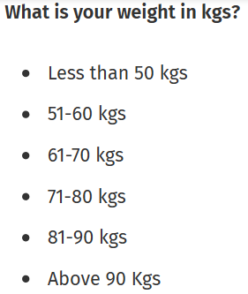
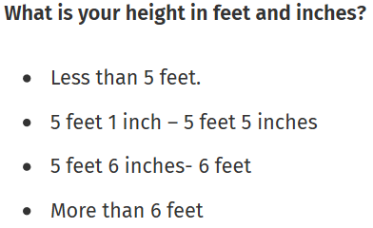
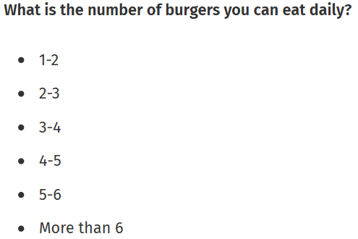
Data – ratio
*https://www.questionpro.com/blog/ratio-data/

Slide 21
Information
Information is stimuli that has meaning in some context for its receiver.*
When information is entered into and stored in a computer, it is generally referred to as data.*
After processing (such as calculations, formatting, printing etc.), output data can again be perceived as information.*
Information can be thought of as the resolution of uncertainty; it is that which answers the question of "what an entity is" and thus defines both its essence and nature of its characteristics.**
* https://searchsqlserver.techtarget.com/definition/information
**https://en.wikipedia.org/wiki/Information

Slide 22
Information
Information is data that has been converted into a more useful or intelligible form.*
It is the set of data that has been organized for direct utilization of mankind, as information helps human beings in their decision making process.*
Examples are:*
  Time Table;
  Merit List;
  Report card;
  Headed tables;
  printed documents;
  etc.
*http://ecomputernotes.com/fundamental/information-technology/what-do-you-mean-by-data-and-information

Slide 23
Knowledge
Knowledge is what we know.*
Think of this as the map of the World we build inside our brains.*
Like a physical map, it helps us know where things are – but it contains more than that.*
It also contains our beliefs and expectations. “If I do this, I will probably get that.”*
Crucially, the brain links all these things together into a giant network of ideas, memories, predictions, beliefs, etc.*
*http://www.infogineering.net/data-information-knowledge.htm

Slide 24
Data – Information – Knowledge - Wisdom
According to Russell Ackoff, a systems theorist and professor of organizational change, the content of the human mind can be classified into five categories:*
  Data: symbols;
  Information: data that are processed to be useful; provides answers to "who", "what", "where", and "when" questions;
  Knowledge: application of data and information; answers "how" questions;
  Understanding: appreciation of "why“;
  Wisdom: evaluated understanding.
*http://www.systems-thinking.org/dikw/dikw.htm

Slide 25
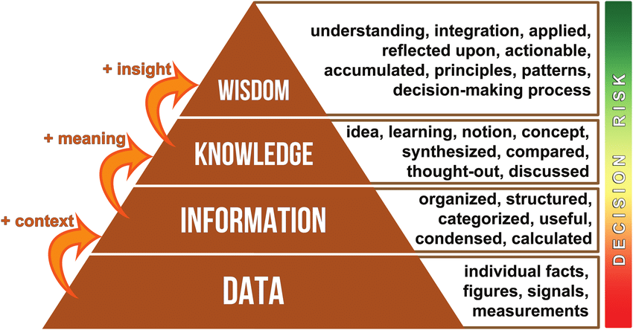
Data – Information – Knowledge - Wisdom
* https://www.researchgate.net/figure/The-data-information-knowledge-wisdom-DIKW-hierarchy-as-a-pyramid-to-manage-knowledge_fig6_332400827

Slide 26
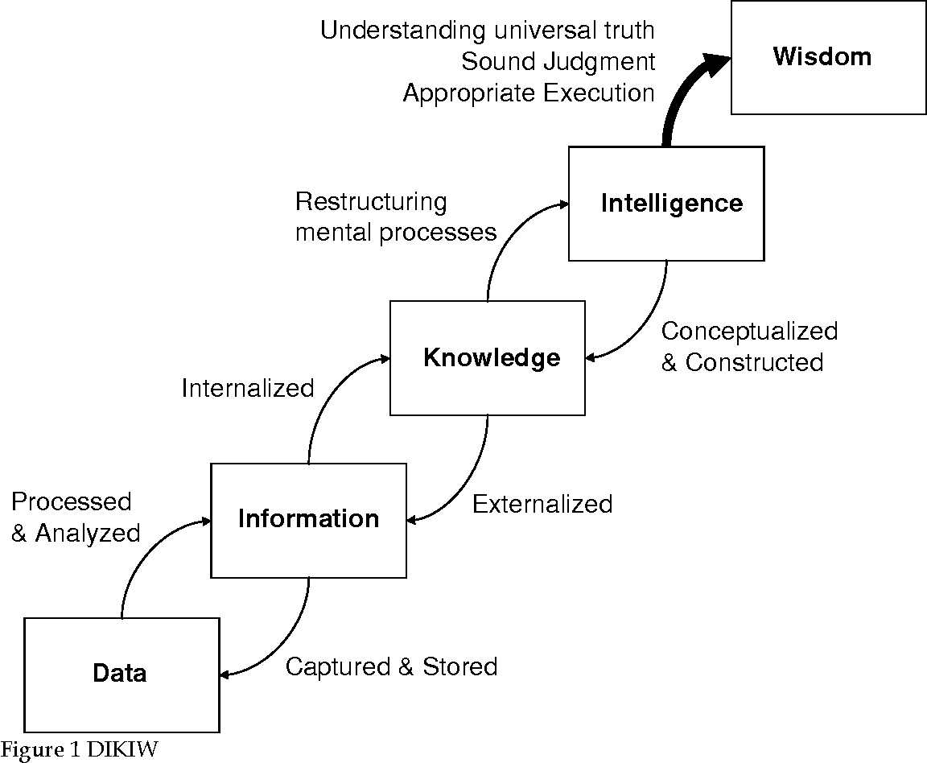
Data – Information – Knowledge - Wisdom
*https://www.semanticscholar.org/paper/DIKIW%3A-Data%2C-Information%2C-Knowledge%2C-Intelligence%2C-Liew/695f73fef84353bcec7cb66c0683f582522e18e2/figure/0

Slide 27
The end
Thank you for your attention!
Any questions?

