Slide 1
E-business
Information society and global information infrastructure - II
Petr Suchánek
E-business

Slide 2
Outline of the lecture
Information and communication technology (ICT)
Information system
Internet
Intranet
Internet services

Slide 3
Information and communication technology
Information technology (IT) is the use of any computers, storage, networking and other physical devices, infrastructure and processes to create, process, store, secure and exchange all forms of electronic data.*
IT includes several layers of physical equipment (hardware), virtualization and management or automation tools, operating systems and applications (software) used to perform essential functions.*
User devices, peripherals and software, such as laptops, smartphones or even recording equipment, can be included in the IT domain.*
IT can also refer to the architectures, methodologies and regulations governing the use and storage of data.*
*https://searchdatacenter.techtarget.com/definition/IT

Slide 4
Information and communication technology
Business applications include databases like SQL Server, transactional systems such as real-time order entry, email servers like Exchange, Web servers like Apache, customer relationship management and enterprise resource planning systems.*
These applications execute programmed instructions to manipulate, consolidate, disperse or otherwise affect data for a business purpose.*
Computer servers run business applications.*
Servers interact with client users and other servers across one or more business networks.*
*https://searchdatacenter.techtarget.com/definition/IT

Slide 5
Information and communication technology
Storage is any kind of technology that holds information as data. Information can take any form including file data, multimedia, telephony data and Web data, data from sensors or future formats.*
Storage includes volatile random access memory (RAM) as well as non-volatile tape, hard disk and solid-state flash drives.*
IT architectures have evolved to include virtualization and cloud computing, where physical resources are abstracted and pooled in different configurations to meet application requirements.*
*https://searchdatacenter.techtarget.com/definition/IT

Slide 6
Information and communication technology
Information and communications technology (ICT) is an extensional term for information technology (IT) that stresses the role of unified communications and the integration of telecommunications (telephone lines and wireless signals) and computers, as well as necessary enterprise software, middleware, storage, and audiovisual systems, that enable users to:*
access;
store;
transmit;
manipulate.
information
*https://en.wikipedia.org/wiki/Information_and_communications_technology

Slide 7
Information and communication technology
Computer hardware is a collective term used to describe any of the physical components of an analog or digital computer.*
The term hardware distinguishes the tangible aspects of a computing device from software, which consists of written instructions that tell physical components what to do.*
Computer hardware can be categorized as having either internal or external components.*
Internal components include items such as the motherboard, central processing unit (CPU), random access memory (RAM), hard drive, optical drive, heat sink, power supply, transistors, chips, graphics processing unit (GPU), and network interface card (NIC).*
*https://searchnetworking.techtarget.com/definition/hardware

Slide 8
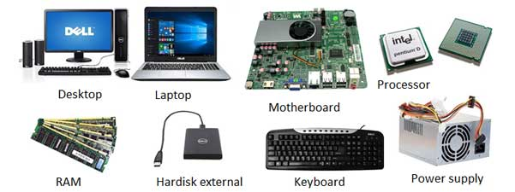
Information and communication technology
External components, also called peripheral components, are those items that are often connected to the computer in order to control either its input or output.*
Common input components include a mouse, keyboard, microphone, camera, touch pad, stylus, joystick, scanner, USB flash drive or memory card, monitors, printers, speakers, headphones, etc.*
*https://searchnetworking.techtarget.com/definition/hardware
**https://rintutorial.blogspot.com/2018/04/computer-hardware-what-is-computer-rintutorial.html

Slide 9
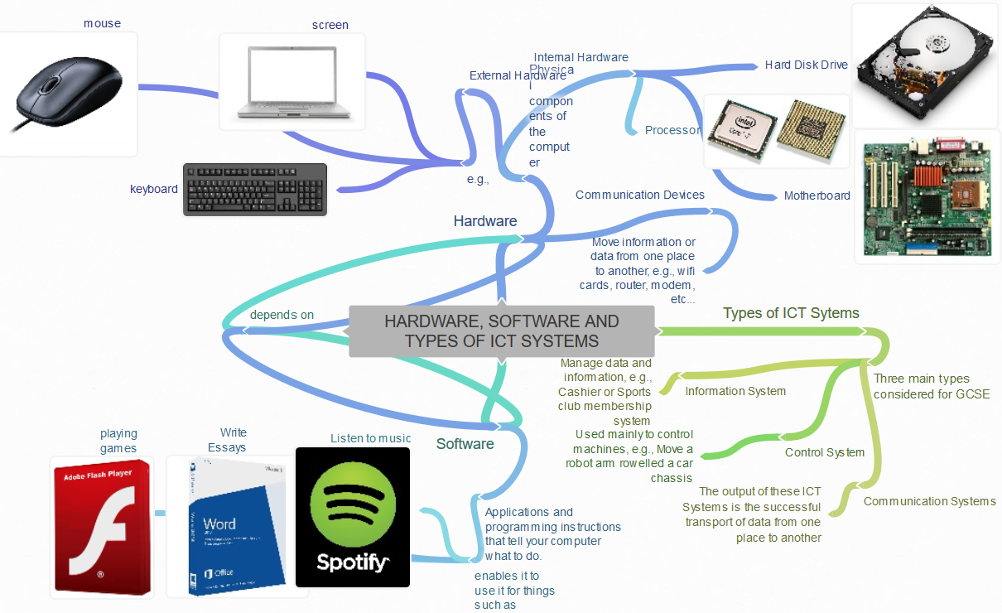
Information and communication technology
*https://coggle.it/diagram/WCpHKzwwb1cGc-Mz/t/hardware%2C-software-and-types-of-ict-systems

Slide 10
Information system
Information systems (IS) is the study of complementary networks of hardware and software that people and organizations use to collect, filter, process, create, and distribute data.*
Information systems are combinations of hardware, software, and telecommunications networks that people build and use to collect, create, and distribute useful data, typically in organizational settings.*
Information systems are interrelated components working together to collect, process, store, and disseminate information to support decision making, coordination, control, analysis, and viualization in an organization.*
*https://bus206.pressbooks.com/chapter/chapter-1/

Slide 11
Information system
IS is a set of interrelated components that collect, manipulate, and disseminate data and information and provide feedback to meet an objective (Businesses can use information systems to increase revenues and reduce costs.*
IS is an organized combination of people, hardware, software, communication networks, data and procedures that stores, retrieves, transforms, and disseminate information in an organization.*
Information systems (IS) are formal, sociotechnical, organizational systems designed to collect, process, store, and distribute information. In a sociotechnical perspective, information systems are composed by four components: task, people, structure (or roles), and technology.**
*https://www.slideshare.net/kerrytat/lesson-5-information-systems-presentation
**https://en.wikipedia.org/wiki/Information_system

Slide 12
Information system - components
Hardware: Computer-based information systems use computer hardware, such as processors, monitors, keyboard and printers.*
Software: These are the programs used to organize, process and analyze data.*
Databases: Information systems work with data, organized into tables and files.*
Network: Different elements need to be connected to each other, especially if many different people in an organization use the same information system.*
Procedures: These describe how specific data are processed and analyzed in order to get the answers for which the information system is designed.*
Feedback: it is another component of the IS, that defines that an IS may be provided with a feedback (Although this component isn't necessary to function).**
*https://study.com/academy/lesson/what-are-information-systems-definition-types-quiz.html
**https://en.wikipedia.org/wiki/Information_system

Slide 13
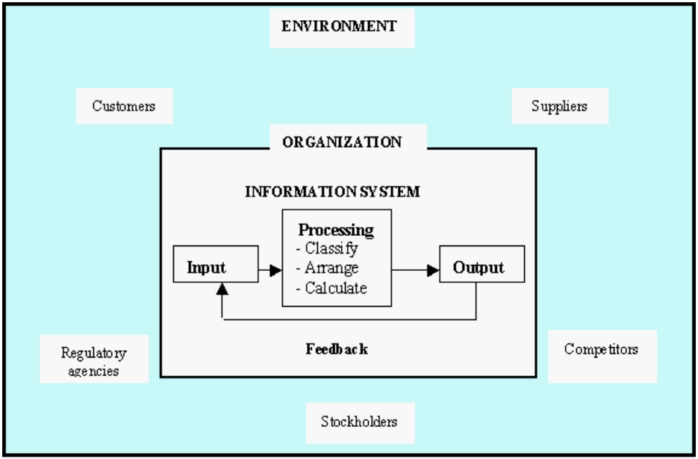
Information system - types
* http://www.uh.edu/~mrana/try.htm

Slide 14
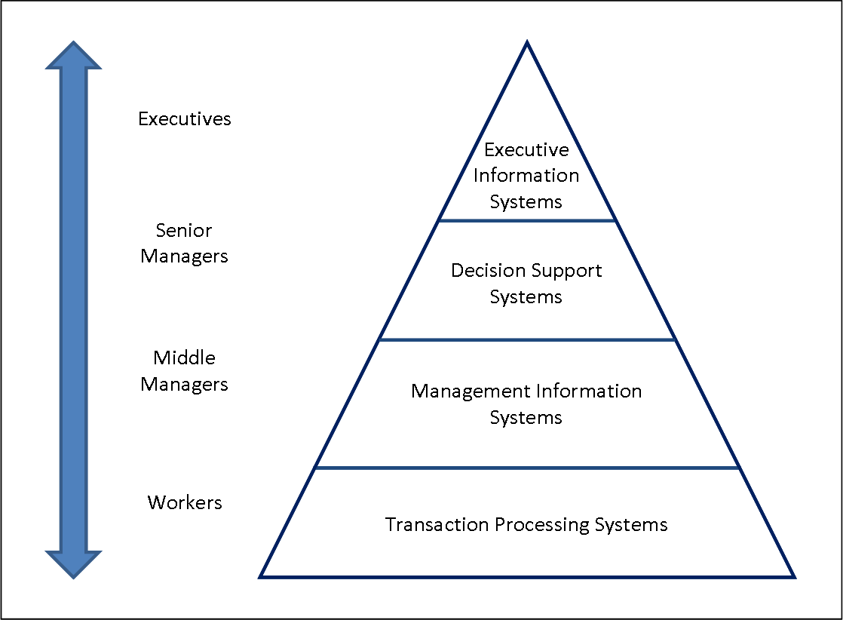
Information system - types
*https://en.wikipedia.org/wiki/Information_system

Slide 15
Information system - types
Executive Information System (EIS)*
Senior management use an EIS to make decisions that affect the entire organization. Executives need high-level data with the ability to drill down as necessary.
Marketing Information System (MkIS)*
Marketing teams use MkIS to report on the effectiveness of past and current campaigns and use the lessons learned to plan future campaigns.
Business Intelligence System (BIS)*
Operations use a BIS to make business decisions based on the collection, integration, and analysis of the collected data and information. This system is similar to EIS, but both lower level managers and executives use it.
*https://www.smartsheet.com/management-information-systems

Slide 16
Information system - types
Customer Relationship Management System (CRM)*
A CRM system stores key information about customers, including previous sales, contact information, and sales opportunities. Marketing, customer service, sales, and business development teams often use CRM.
Sales Force Automation System (SFA)*
A specialized component of a CRM system that automates many tasks that a sales team performs. It can include contact management, lead tracking and generation, and order management.
Knowledge Management System (KMS)*
Customer service can use a KM system to answer questions and troubleshoot problems.
*https://www.smartsheet.com/management-information-systems

Slide 17
Information system - types
Transaction Processing System (TPS)*
An MIS that completes a sale and manages related details. On a basic level, a TPS could be a point of sale (POS) system, or a system that allows a traveller to search for a hotel and include room options, such as price range, the type and number of beds, or a swimming pool, and then select and book it. Employees can use the data created to report on usage trends and track sales over time.*
Financial Accounting System (FAS)*
This MIS is specific to departments dealing with finances and accounting, such as accounts payable (AP) and accounts receivable (AR).
*https://www.smartsheet.com/management-information-systems

Slide 18
Information system – MIS reports
Scheduled*
Created on a regular basis, these reports use rules the requestor has provided to pull and organize the data. Scheduled reports allow businesses to analyze data over time (e.g. an airline can see the percentage of lost luggage by month), location (e.g. a retail chain can compare sales figures from different stores), or other parameters.
Ad-hoc*
These are one-off reports that a user creates to answer a question. If the reports are useful, you can turn ad-hoc reports into scheduled reports.
Real-time*
This type of MIS report allows someone to monitor changes as they occur. For example, a call center manager may see an unexpected spike in call volume, and find a way to increase productivity or send some of the calls elsewhere.
*https://www.smartsheet.com/management-information-systems

Slide 19
Information system
https://www.britannica.com/topic/information-system
https://bus206.pressbooks.com/chapter/chapter-1/
https://www.techopedia.com/definition/24142/information-system-is
https://www.guru99.com/mis-definition.html
https://www.geeksforgeeks.org/types-of-information-system/
https://www.managementstudyguide.com/types-of-information-systems.htm
https://www.marketing91.com/types-of-management-information-system/

Slide 20
Internet
The Internet is a globally connected network system that uses TCP/IP to transmit data via various types of media.*
The Internet is a network of global exchanges – including private, public, business, academic and government networks – connected by guided, wireless and fiber-optic technologies.*
The terms Internet and World Wide Web are often used interchangeably, but they are not exactly the same thing.*
The Internet refers to the global communication system, including hardware and infrastructure, while the web is one of the services communicated over the Internet.*
*https://www.techopedia.com/definition/2419/internet

Slide 21
Intranet
An intranet is a private network contained within an enterprise that is used to securely share company information and computing resources among employees.*
An intranet can also be used to facilitate working in groups and teleconferences.*
Intranets increase communication within an organization by allowing employees to easily access important information, links, applications and forms as well as databases that can provide company records.*
Security can also be increased within the intranet by establishing a database that maintains all of the usernames of people who are allowed access to the network.*
* https://whatis.techtarget.com/definition/intranet

Slide 22
Intranet
Streamlining everyday activities by making repeated tasks more feasible.*
Centralizing and managing important information and company data in a single database.*
Making collaboration easier since information can be shared across the entire network.*
Providing personalized content to employees based on their role within the company.*
Improving internal communication by making employee directories, company news and organization charts readily available.*
Providing fast and easy access to information about company policies, benefits and updates.*
*https://whatis.techtarget.com/definition/intranet

Slide 23
Internet services
The Internet can be used to:
access a huge 'library' of information from the millions of websites around the world that make up the World Wide Web;
send and receive email messages;
share photographs and video clips with your friends and family;
buy goods and services (and often save money!);
carry out online banking;
use Skype to make free phone calls to other computer users;
play games with other people online;
catch up on TV and radio programmes that you've missed – or watch them again;
learn something new with an online course;
etc…
*https://www.digitalunite.com/technology-guides/using-internet/connecting-internet/what-internet

Slide 24
Internet services
In addition to browsing the Internet with a browser, the Internet has other services that can also be used:*
Chat - is a text-based communication that is live or in real-time. For example, when talking to someone in chat any typed text is received by other participants immediately. In contrast, other text-based communications such as e-mail are modes of correspondence that are not real-time;
E-mail - is information stored on a computer that is exchanged between two users over telecommunications. More plainly, e-mail is a message that may contain text, files, images, or other attachments sent through a network to a specified individual or group of individuals;
*https://www.computerhope.com/jargon/i/internet.htm

Slide 25
Internet services
Forum - Not to be confused with a form, a bulletin board (BB or Bboard), discussion forum, discussion board, and forum is an area where users share thoughts, ideas, or help by posting text messages. Forums are different from chat because it is almost never live and can be read at any time;*
FTP - Short for File Transfer Protocol, FTP is the most common way of sending and receiving files between two computers. An example of how FTP is used today is by web developers, who connect to their web server using an FTP client or FTP program (e.g., FileZilla) to send (upload) updated versions of a web page;*
Online - Today, being online refers to when a user, computer, or another device is connected to the Internet;*
*https://www.computerhope.com/jargon/i/internet.htm

Slide 26
Internet services
Instant messaging - When describing an action or feature, IM is short for instant message, which is a message directly sent from one person to another. When referring to a program, IM is short for Instant Messenger, which is a program that connects users to the Internet or a network to send text messages to other IM users. Finally, when used as a verb, IM is short for instant messaging, which is the act of sending a message in an IM program;*
Social network - Alternatively referred to as a virtual community or profile site, a social network is a website that brings people together to talk, share ideas and interests, or make new friends. This type of collaboration and sharing is known as social media. Unlike traditional media that is created by no more than ten people, social media sites contain content created by hundreds or even millions of different people;*
*https://www.computerhope.com/jargon/i/internet.htm

Slide 27
Internet services
Voice over IP - Alternatively referred to as IP telephone or Internet phone, VoIP is short for Voice over Internet Protocol, and it enables users to make calls over the Internet. To make a call, a telephone is connected to a network cable, rather than a phone line, or a call is made over a computer. VoIP allows long distance phone calls to be cheaper, although sometimes with lower audio quality;*
WWW - Short for World Wide Web, the WWW, W3, or web is a graphical interface for the Internet that was first introduced to the public on August 6, 1991, by Tim Berners-Lee. A few days later on August 23, 1991, it was available to everyone.*
*https://www.computerhope.com/jargon/i/internet.htm

Slide 28
Internet & intranet
http://www.techcuriosity.com/articles/difference_between_internet_and_intranet.php
https://www.tutorialspoint.com/computer_fundamentals/computer_internet_intranet.htm
https://techdifferences.com/difference-between-internet-and-intranet.html
https://www.stechies.com/difference-between-internet-intranet/
https://techwelkin.com/internet-vs-intranet
https://www.it4nextgen.com/difference-between-internet-and-intranet/

Slide 29
The end
Thank you for your attention!
Any questions?

