Slide 1

E-business
E-business and e-commerce
Petr Suchánek
E-business

Slide 2

Outline of the lecture
E-business
E-commerce
M-commerce

Slide 3
E-business
E-business (electronic business) is the conduct of business processes on the Internet.*
These e-business processes include:*
  buying and selling goods and services;
  servicing customers;
  processing payments;
  managing production control;
  collaborating with business partners;
  sharing information;
  running automated employee services;
  recruiting;
  and more.
*https://searchcio.techtarget.com/definition/e-business

Slide 4
E-business
Electronic business (e-business) refers to the use of the Web, Internet, intranets, extranets or some combination thereof to conduct business.*
E-business is similar to e-commerce, but it goes beyond the simple buying and selling of products and services online.*
E-business includes a much wider range of businesses processes, such as supply chain management, electronic order processing and customer relationship management.*
E-business processes, therefore, can help companies to operate more effectively and efficiently.*
*https://www.techopedia.com/definition/1493/electronic-business-e-business

Slide 5
Core Activities of a Business
Business requires coordinated teamwork of specialists in various departments to achieve efficiency and effectiveness on a large scale.*
  Finance: mid-term and long-range financial planning to ensure that there is an adequate supply of money available to;
  Accounting: a record of financial commitments and compensations for the purpose of tracking movement of value across the organization and throughout the production process;
  Marketing: getting groups of potential customers and consumers interested in products and services;
  Sales: selling products and services to customers maintain records to assist forecasting future demand and market growth;
  Operations: systems to acquire resources, produce, package and deliver products;
  Management: sets the direction and pace of business endeavors.
*https://bookdown.org/rbatzing/ebusiness/general-principles.html

Slide 6
E-business - support functions
As businesses grow in size, various support functions are required to keep the core business running. These functions include the following:*
  Management Information Systems: collect, analyze and distribute mission-critical information to key administrators;
  Human Resources: attract, hire, train and retain effective employees;
  Legal Department: ensure compliance with laws and regulations;
  Investor Relations: communications with shareholders to attract support and investments;
  Customer Relations: after sales care of customers and encouragement of brand loyalty;
  Facilities Management: maintenance of facilities and equipment to maximize the utility and value of capital investments in equipment and infrastructure.
* https://bookdown.org/rbatzing/ebusiness/general-principles.html

Slide 7
E-business components*
The core components of e-business are information, communication, and transaction. Business partners use digital networks (i.e. public or private communication networks) to conduct business processes using innovative technologies to improve efficiency. Three key areas are particularly important for e-business:
  E-procurement: the electronic sourcing of products and services by companies, focused on reducing costs and effort.
  Online stores: the electronic sale of products and services via appropriate platforms, such as online stores.
  Online marketplaces: electronic commerce via digital networks, connecting the buyers and suppliers of products and services.
*https://www.ionos.com/digitalguide/online-marketing/online-sales/what-is-e-business/

Slide 8
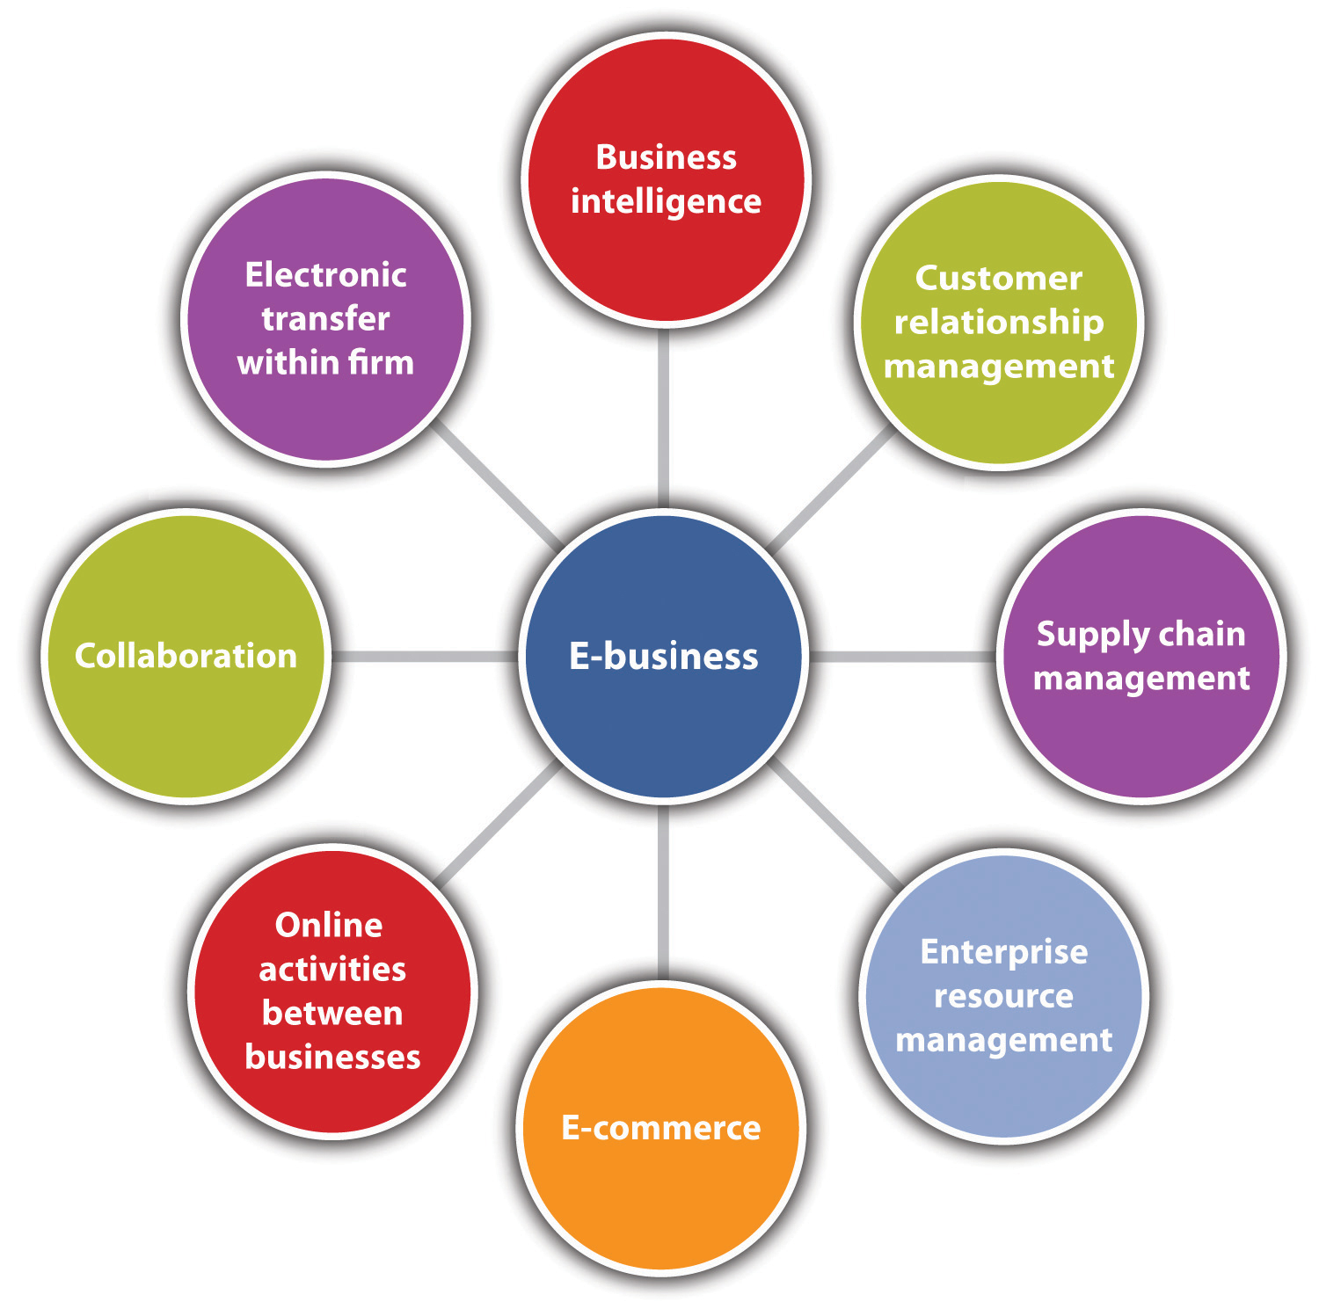
E-business components*
business intelligence (BI);
customer relationship management (CRM);
supply chain management (SCM);
enterprise resource planning (ERP);
e-commerce;
conducting electronic transactions within the firm;
collaboration;
online activities among businesses.
*https://saylordotorg.github.io/text_small-business-management-in-the-21st-century/s08-01-e-business-and-e-commerce-the-.html

Slide 9
Market participants in e-business
E-business can take place between a large number of market participants: between businesses and consumers, various private individuals, public administrations, and other organizations such as NGOs.*
Generally speaking, these various market participants can be divided into three distinct categories:*
  Business (B);
  Consumer/citizen (C);
  Administration (A).
All three categories can play the role of either buyer or service provider within the market, meaning there are nine possible combinations for e-business relationships.
*https://www.ionos.com/digitalguide/online-marketing/online-sales/what-is-e-business/

Slide 10
Function of electronic business
The most important role of electronic business is “electronic value creation” – the generation of electronic added value. The forms of electronic added value are usually distinguished in the following way:*
  Structuring value: an online offer achieves an overview of a large quantity of information;
  Selection value: an online offer provides specific database information upon request;
  Matching value: an online offer makes it possible to merge inquiries from supplier and buyers more efficiently;
  Transaction value: an online offer makes a business more efficient;
  Coordination value: an online offer allows different providers to better combine their services;
  Communication value: an online offer improves communication between different consumers.
*https://www.ionos.com/digitalguide/online-marketing/online-sales/what-is-e-business/

Slide 11
Function of electronic business
Depending on which type of value a company decides to pursue, they can choose one or more value activities – for example the*
  collection;
  structuring;
  pre-selection;
  summary;
  distribution of information.
A so-called “digital information product” can also be created, offering added values which the customer is prepared to pay for. This information product may be a website, blog comparison portal, e-book, or a software application.*
*https://www.ionos.com/digitalguide/online-marketing/online-sales/what-is-e-business/

Slide 12
Function of electronic business
The electronic value creation process involves the following steps:*
  Collecting large quantities of information to identify data relevant to the product;
  Processing the information and transforming it into a product;
  Transferring the final information product to the customer;
  Repeat this process whenever new information becomes available – information products are not static and must be kept up to date.
Besides the generation of electronic added value, the various long-term goals of the e-business must be determined, such as how best to automate commercial processes, or establishing new business models (such as cutting out middlemen).*
*https://www.ionos.com/digitalguide/online-marketing/online-sales/what-is-e-business/

Slide 13
Function of electronic business
https://searchcio.techtarget.com/definition/e-business
https://www.techopedia.com/definition/1493/electronic-business-e-business
https://www.toppr.com/guides/business-studies/emerging-modes-of-business/e-business/
http://www.prudens.com/patens/ebusiness/busmodel.html
https://smallbusiness.chron.com/e-business-systems-5270.html
https://www.slideshare.net/sudipitm/e-business-systems
https://bizfluent.com/info-7835940-role-ebusiness-business.html

Slide 14
E-commerce
Ecommerce, also known as electronic commerce or internet commerce, refers to the buying and selling of goods or services using the internet, and the transfer of money and data to execute these transactions.*
Ecommerce is often used to refer to the sale of physical products online, but it can also describe any kind of commercial transaction that is facilitated through the internet.*
Whereas e-business refers to all aspects of operating an online business, ecommerce refers specifically to the transaction of goods and services.*
*https://www.shopify.com/encyclopedia/what-is-ecommerce

Slide 15
Examples of e-commerce*
Ecommerce can take on a variety of forms involving different transactional relationships between businesses and consumers, as well as different objects being exchanged as part of these transactions.
Retail:
  The sale of a product by a business directly to a customer without any intermediary.
Wholesale:
  The sale of products in bulk, often to a retailer that then sells them directly to consumers.
Dropshipping:
  The sale of a product, which is manufactured and shipped to the consumer by a third party.
*https://www.shopify.com/encyclopedia/what-is-ecommerce

Slide 16
Examples of e-commerce*
Subscription:
  The automatic recurring purchase of a product or service on a regular basis until the subscriber chooses to cancel.
Physical products:
  Any tangible good that requires inventory to be replenished and orders to be physically shipped to customers as sales are made.
Digital products:
  Downloadable digital goods, templates, and courses, or media that must be purchased for consumption or licensed for use.
Services:
  A skill or set of skills provided in exchange for compensation. The service provider’s time can be purchased for a fee.
*https://www.shopify.com/encyclopedia/what-is-ecommerce

Slide 17
Features of e-commerce*
It is easy to set up;
There are no geographical boundaries;
Much cheaper than traditional business;
There are flexible business hours;
Marketing strategies cost less;
Online business receive subsidies from the government;
There are a few security and integrity issues;
There is no personal touch;
Buyer and seller don’t meet;
Delivery of products takes time;
There is a transaction risk;
Anyone can buy anything from anywhere at anytime;
The transaction risk is higher than traditional business.
*https://www.toppr.com/guides/business-studies/emerging-modes-of-business/e-business/

Slide 18
Types of e-commerce*
Business-to-Business (B2B)
  Transactions that take place between two organizations come under Business to business. Producers and traditional commerce wholesalers typically operate with this type of electronic commerce. Also it greatly improves the efficiency of companies.
Business-to-Consumer (B2C)
  When a consumer buys products from a seller then it is business to consumer transaction. People shopping from Flipkart, Amazon, etc. is an example of business to consumer transaction. In such a transaction the final consumer himself is directly buying from the seller.
*https://www.toppr.com/guides/business-studies/emerging-modes-of-business/e-business/

Slide 19
Types of e-commerce*
Consumer-to-Consumer (C2C)
  A consumer selling product or service to another consumer is a consumer to consumer transaction. For example, people put up ads on OLX of the products that they want to sell. C2C type of transactions generally occurs for second-hand products. The website is only the facilitator not the provider of the goods or the service.
Consumer-to-Business (C2B)
  In C2B there is a complete reversal of the traditional sense of exchanging goods. This type of e-commerce is very common in crowdsourcing based projects. A large number of individuals make their services or products available for purchase for companies seeking precisely these types of services or products.
*https://www.toppr.com/guides/business-studies/emerging-modes-of-business/e-business/

Slide 20
Types of e-commerce*
Consumer-to-Administration (C2A)
  The Consumer-to-Administration model encompasses all electronic transactions conducted between individuals and public administration. Some examples of applications include:
    Education – disseminating information, distance learning, etc.
    Social Security – through the distribution of information, making payments, etc.
    Taxes – filing tax returns, payments, etc.
    Health – appointments, information about illnesses, payment of health services, etc.
Business-to-Administration (B2A)
  This part of e-commerce encompasses all transactions conducted online by companies and public administration or the government and its varies agencies. Also, these types of services have increased considerably in recent years with investments made in e-government.
*https://www.toppr.com/guides/business-studies/emerging-modes-of-business/e-business/

Slide 21
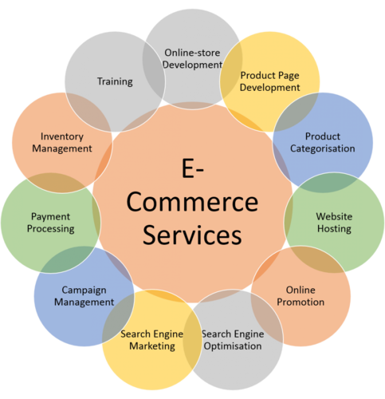
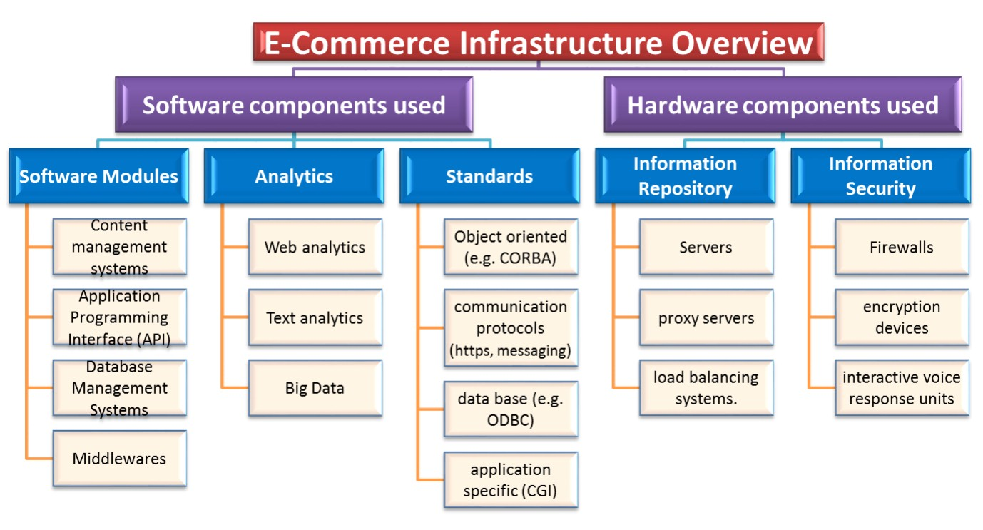
Types of e-commerce*
*https://www.indiamart.com/proddetail/ecommerce-services-13329266088.html
**https://tech-talk.org/2015/02/10/e-commerce-infrastructure-planning-and-management/

Slide 22
M-commerce
Mobile commerce, also known as m-commerce or mcommerce, is the use of wireless handheld devices like cellphones and tablets to conduct commercial transactions online, including the purchase and sale of products, online banking, and paying bills.*
M-commerce is a type of e-commerce on the rise that features online sales transactions made via mobile devices, such as smartphones and tablets.**
M-commerce includes mobile shopping, mobile banking and mobile payments.**
Mobile chatbots also provide e-commerce opportunities to businesses, allowing consumers to complete transactions with companies via voice or text conversations.**
*https://www.investopedia.com/terms/m/mobile-commerce.asp
**https://searchcio.techtarget.com/definition/e-commerce

Slide 23
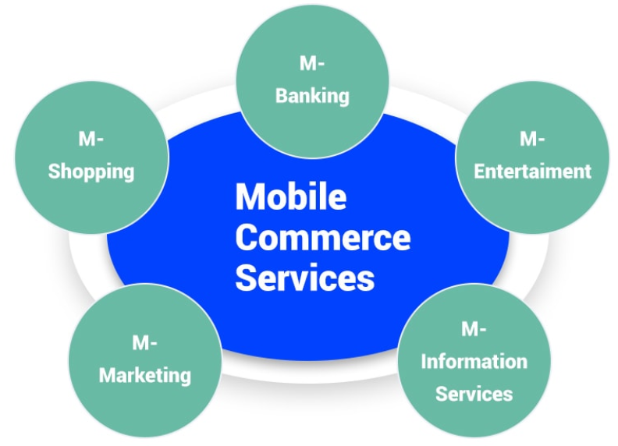
M-commerce
*https://spur-i-t.com/blog/shopify-marketing-how-to-sell-to-mobile-customers/

Slide 24
E-business & e-commerce*
E-business and e-commerce are not synonymous terms. E-commerce generates revenue. E-business does not.
E-business and/or e-commerce may not be of interest to all small businesses. However, using technology well is proving to be one of the most prominent drivers of business success.
E-business consists of several major components, one of which is e-commerce.
Every Internet business is either pure-play (an Internet presence only) or brick-and-click (having both a physical and an online presence).
*https://saylordotorg.github.io/text_small-business-management-in-the-21st-century/s08-01-e-business-and-e-commerce-the-.html

Slide 25
E-business & e-commerce*
The seven major types of e-commerce are B2B, B2C, C2C, B2G, C2B, m-commerce, and P2P.
An e-commerce business model is the method that a business uses to generate revenue online. Some models are very simple; others are more complicated. New business models are being introduced all the time.
E-commerce will continue to grab more market share, and the line between online and offline commerce will become less defined.
*https://saylordotorg.github.io/text_small-business-management-in-the-21st-century/s08-01-e-business-and-e-commerce-the-.html

Slide 26
E-commerce
https://www.shopify.com/encyclopedia/what-is-ecommerce
https://ecommerce-platforms.com/glossary/ecommerce
https://searchcio.techtarget.com/definition/e-commerce
https://www.investopedia.com/terms/e/ecommerce.asp
https://netonomy.net/2013/10/16/most-important-components-ecommerce-stores-ignored/
https://searchmobilecomputing.techtarget.com/definition/m-commerce
https://en.wikipedia.org/wiki/Mobile_commerce
https://www.ecommerceceo.com/types-of-ecommerce-business-models/

Slide 27
The end
Thank you for your attention!
Any questions?

