Slide 1

E-business
E-business and e-commerce - II
Petr Suchánek
E-business

Slide 2

Outline of the lecture
E-store (Internet shop, e-shop)
Internet marketplace
Online Marketplace
Online Marketplace – advantages & disadvantages
Online Marketplace
  business benefits
  benefits for buyers
  benefits for sellers

Slide 3
E-store
An online storefront is a web site that enables visitors to find, order and pay for products and services.*
Running a successful store involves getting qualified buyers to visit your store, helping them to understand their problem (and the pain or desire that it is causing them), giving evidence you can solve their problem (credibility), and making it easy for them to acquire the solution from you (steps they use to gain ownership of the item).*
Online storefronts typically include storefronts, shopping carts, payment processing, and order fulfillment systems.*
*http://www.emarketingdictionary.com/Internet_Marketing_dictionary_Online_Store_definition.html

Slide 4
E-store*
Store Navigation
Store Hosting
Online Catalog
Product Page Layout
E-Commerce Host
Online Mall
Shopping Cart
Payment Processing
Transaction Cost
Fraud Detection
Online Coupons
Product Fulfillment
Online Store Interfaces
Database Connectivity
Inventory Management
Fraud Management
Online Auctions
*http://www.emarketingdictionary.com/Internet_Marketing_dictionary_Online_Store_definition.html

Slide 5
Key Components of an Online Store*
Product catalog:
  The catalog component organizes your inventory and presents products consistently. Unless you have only a few products, you generally enter your product list into a database or spreadsheet that includes at least the product name, category, description, price, and photo filename.
Shopping cart:
  Users place their tentative purchases into a cart, which tracks the contents, allows shoppers to delete items or change quantities, and provides a subtotal of the amount due.
  If you have a small store with only a few items, you can use an online order form rather than a cart.
*https://www.dummies.com/business/start-a-business/small-business-marketing/key-components-of-an-online-store/

Slide 6
Key Components of an Online Store*
Check stand:
  This portion of your online store computes shipping and taxes, totals the bill, and accepts shipping and billing information (including credit card numbers) in a secure manner. The check stand or other element of the storefront should issue an onscreen Thank You to confirm order submission and e-mail an order confirmation.
Reporting and order tracking:
  Unless your store is very small, it helps to have easy-to-understand reports on sales, customers, and product popularity. The larger your store, the more store analytics you want. Order tracking allows you, and your customer, to know the status of an order in terms of fulfillment and shipping.
*https://www.dummies.com/business/start-a-business/small-business-marketing/key-components-of-an-online-store/

Slide 7
Key Components of an Online Store*
Other add-ons:
  Large, sophisticated stores might interface with inventory, point-of-sale, and accounting systems. They might also integrate with live sales interaction capability, customer relationship management (CRM) systems that track a customer’s experience with your business, or other enterprise-level solutions.
Product:
  The products that sell well online are not necessarily the same as the ones that sell well offline.
Promotion:
  You can use onsite promotion, such as internal banners, discounts, upsales, and other techniques to move products and increase sales.
*https://www.dummies.com/business/start-a-business/small-business-marketing/key-components-of-an-online-store/

Slide 8
Key Components of an Online Store*
Price:
  You don’t have to price products the same in online and offline environments unless your online audience is likely to come into the store to purchase. Your competition, overhead, cost of sales, and cost of shipping might differ between online and offline stores, just as they might between stores in different physical locations.
  If you decide to keep prices the same, you might need to adjust the price in both channels to maintain your profit margin.
Placement:
  The placement of items on a page determines how much attention they receive and, therefore, how well they sell. Think of your site as containing multiple internal distribution channels.
*https://www.dummies.com/business/start-a-business/small-business-marketing/key-components-of-an-online-store/

Slide 9
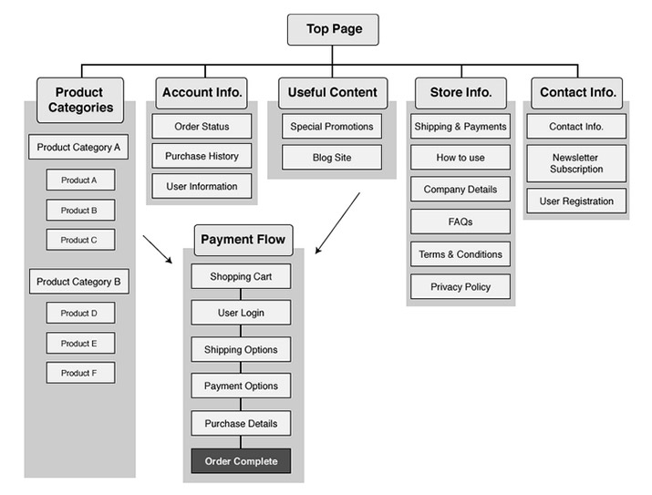
E-store website*
*https://blog.btrax.com/selling-in-japan-converting-traffic-into-sales-part-2/

Slide 10
Online Store - important e-commerce features*
Content management capabilities;
Promotion and discount code tools;
An easy-to-use checkout;
Search engine optimized code and layout;
Reporting tools;
An integrated blog or articles section;
Email marketing integration;
Multiple payment options (Credit card, PayPal, PO, Terms, etc.);
The ability to scale up with your platform.
*https://www.outerboxdesign.com/web-design-articles/ecommerce_features

Slide 11
Online Store - important e-commerce features*
https://www.searchenginejournal.com/ecommerce-guide/must-have-website-features/
https://www.bigcommerce.com/essentials/features/
https://www.webalive.com.au/ecommerce-website-features/
https://www.webfx.com/blog/web-design/e-commerce-website-features-tips-examples/
https://ecommercebooth.com/ecommerce-website-features-to-boost-loyalty-sales/
https://www.proteusthemes.com/blog/10-functionalities-that-every-e-commerce-store-needs-in-2019/

Slide 12
Online Store - development*
https://www.wearediagram.com/blog/5-things-to-consider-when-developing-an-ecommerce-website
https://blog.templatetoaster.com/ecommerce-website-development/
https://deepfried.com/6-steps-towards-creating-a-successful-ecommerce-website/
https://www.businessofapps.com/insights/ecommerce-website-development-process/
https://founderu.selz.com/7-steps-creating-ecommerce-website-store-pro/

Slide 13
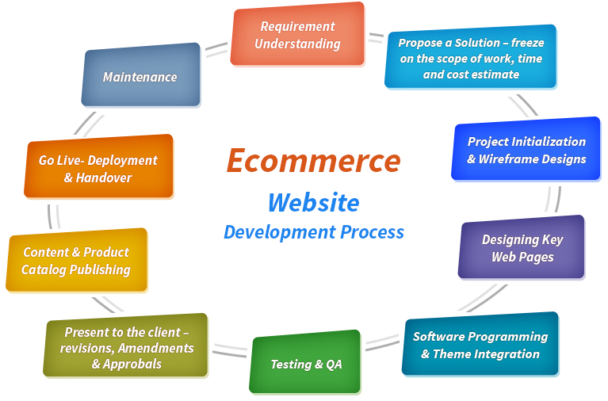
Online Store - development*
*https://www.b3net.com/orange-county-ecommerce-developer.html

Slide 14
Online marketplace
An online marketplace (or online e-commerce marketplace) is a type of e-commerce site where product or service information is provided by multiple third parties, whereas transactions are processed by the marketplace operator.*
Online marketplaces are the primary type of multichannel ecommerce and can be a way to streamline the production process.*
In an online marketplace, consumer transactions are processed by the marketplace operator and then delivered and fulfilled by the participating retailers or wholesalers (often called drop shipping).*
*https://en.wikipedia.org/wiki/Online_marketplace

Slide 15
Online marketplace - business models
Ad-based / pay for placement or features:*
  Ad-based marketplaces charge suppliers for premium placement.
  Often, the marketplace has free listings for suppliers in curated lists.
  For example, if you visit Yelp and search for restaurants, it will present you with a list of the top 10 restaurants in your area, ordered by their algorithm.
  Businesses that are willing to pay a premium can purchase ad space at the top of the results in order to get more exposure.
  In some cases, such as Craigslist Jobs, the only way to appear in the results is to pay a fee.
*https://learn.g2.com/what-is-online-marketplace

Slide 16
Online marketplace - business models
Transactional:*
  Transactional marketplaces make money when a transaction occurs. These types of marketplaces typically take a percentage of the overall transaction.
  The benefit here is that the suppliers only have to pay when they make money.
  On-demand services like Uber and Taskrabbit fall into this category.
  Some transactional marketplaces actually process the transaction, and pay sellers their earnings – minus fees and commissions.
  Other marketplaces, like CreditCards.com and Student Loan hero, earn money via affiliate links.
*https://learn.g2.com/what-is-online-marketplace

Slide 17
Online marketplace - business models
Lead generation:*
  Some marketplaces capture information from the demand side, and then sell that information - known as a lead - to suppliers.
  For example, if you wanted a patio installed, you might visit Thumbtack and answer a few questions about the project.
  Thumbtack will then give that information to local contractors who it thinks can complete that project (based on the questions answered) and charge them for that lead.
*https://learn.g2.com/what-is-online-marketplace

Slide 18
Online marketplace – vertical & horizontal
Horizontal e-commerce businesses are those that sell products from a large number of categories.*
The most famous horizontal e-commerce business is Amazon.com It sells books, furniture, food, grocery, apparel, toys, software, music, gadgets, and a whole lot more.*
Horizontal e-commerce businesses present themselves as a one-stop shop and communicate convenience as a strong benefit.*
They also tend to find supply chain or scale advantages that help them offer great prices.*
*https://www.thebalancesmb.com/horizontal-vs-vertical-ecommerce-1141751

Slide 19
Online marketplace – vertical & horizontal
Unlike horizontal plays, vertical e-commerce players are specialists.*
So an online retailer that only sells baby products is a vertical e-commerce business, so is one that only sells shoes.*
It is akin to the "category killer" that traditional retailers understand.*
Vertical e-commerce players rely on being able to showcase the product better.*
Since they focus on one, or few, product categories, they can engineer the user experience in a way that highlights the special features of the product category.*
*https://www.thebalancesmb.com/horizontal-vs-vertical-ecommerce-1141751

Slide 20
Online marketplace – advantages*
It provides an additional channel to market and sell your products;
The platform offers reduced marketing costs compared to other sales channels;
It allows new opportunities for overseas sales - there has been noted online marketplace growth in the categories of homeware, pets, fashion and sporting goods;
They are popular with customers and offer a convenient way to compare prices and products from a single source;
Being part of an established online marketplace provides a level of trust between you and the buyer.
*https://www.nibusinessinfo.co.uk/content/advantages-and-disadvantages-using-online-marketplaces

Slide 21
Online marketplace – advantages*
Impartial reviews of your products and service may give new customers the confidence to buy;
They offer opportunities to establish new trading partnerships with traders and suppliers, either within your supply chain or across supply chains;
They provide greater transparency - availability, prices and stock levels are accessible in an open environment;
It is possible to operate a round-the-clock - time constraints and problems with varying international trading hours are removed.
*https://www.nibusinessinfo.co.uk/content/advantages-and-disadvantages-using-online-marketplaces

Slide 22
Online marketplace – disadvantages*
Marketplaces can charge commission on every sale and fees can vary from site to site.
Before selling your products on a marketplace, make sure you understand the marketplace’s pricing structure.
See fees for selling on Amazon, and fees for selling on eBay.
The online stores may impose restrictive terms and conditions in terms of how you can communicate to customers.
There may be marketplace limitations as to how your business can brand its online presence.
*https://www.nibusinessinfo.co.uk/content/advantages-and-disadvantages-using-online-marketplaces

Slide 23
Online marketplace – business benefits*
A marketplace allows the business or platform operators to charge a cut on the products that the vendors sell therefore exponentially increasing the profit opportunities.
E-marketplaces provide a transparent purchasing process as factors such as the prices of the product and availability of the stock are all accessible on a single platform in an open environment.
Better opportunities for suppliers and buyers to establish new trading relationship either within or across their supply chain.
Time constraints for trading across geographies is eliminated because of the online platform which operates round the clock.
*https://www.happiestminds.com/Insights/ecommerce-marketplace/

Slide 24
Online marketplace – benefits for buyers*
The buyers get a wide variety of options on products to compare on a single website. Thus helping them find the most reasonable price for the best quality product.
Real time updated information on the price and availability makes it easier for the buyers to get the best deal.
The buyers can find trusted established vendors and build a trading partnership by dealing exclusively with them.
*https://www.happiestminds.com/Insights/ecommerce-marketplace/

Slide 25
Online marketplace – benefits for sellers*
Smaller stores or vendors who are not sure about establishing their own eCommerce website or want to reduce their marketing costs can align themselves with these larger businesses and gain visibility through their fulfillment options.
Regular exchange of quotes between the new and the old vendors is possible, thereby streamlining and maintaining- standardization.
The platform acts as an additional sales channel to market and sell their products.
Enables oversea sales by providing opportunities to trade in the international e-marketplace.
*https://www.happiestminds.com/Insights/ecommerce-marketplace/

Slide 26
Online marketplace
https://ecommercegermany.com/blog/12-leading-marketplaces-europe
https://www.practicalecommerce.com/ecommerce-marketplaces-worldwide
https://ecommercegermany.com/blog/13-leading-marketplaces-north-america
https://ecommercegermany.com/blog/12-leading-marketplaces-europe
https://tinuiti.com/blog/ecommerce/top-online-marketplaces/

Slide 27
The end
Thank you for your attention!
Any questions?

