Slide 1

E-business
E-business models
Petr Suchánek
E-business

Slide 2

Outline of the lecture
B2B
B2C
Value chain
Value of products and services in e-business
Virtual value chain
Supply chain
Supply chain management

Slide 3
B2B
Business to business also called B to B or B2B, is a form of transaction between businesses, such as one involving a manufacturer and wholesaler, or a wholesaler and a retailer.*
Business to business refers to business that is conducted between companies, rather than between a company and individual consumers.*
Business to business stands in contrast to business to consumer (B2C) and business to government (B2G) transactions.*
B2B may include outsourcing, which occurs when a business hires a contractor with knowledge and experience in that business's industry.**
*https://www.investopedia.com/terms/b/btob.asp
**https://www.techopedia.com/definition/1423/business-to-business-b2b

Slide 4
B2B – characteristics*
Elements of Business-to-Business Sales
  Business-to-business sales often involve more expensive or more technologically advanced products.
  Business-to-business clients order more products and spend more money than retail clients.
  This means that business-to-business sales have the potential to make more money than business-to-people sales.
  Business-to business sellers need fewer clients than retail sellers because of the amount of money a single business client can generate.
  This means that business-to-business sellers can focus more effort on each business client.
*https://smallbusiness.chron.com/advantages-businesstobusiness-vs-businesstopeople-10464.html

Slide 5
B2B – characteristics*
Business Buyer Logic
  Business buyers tend to be more logical and rational about their purchases because, unlike retail clients, business clients are making decisions for a large number of people.
  Retail clients are buying for their own consumer clients, business users are buying for their employees and institutions are buying for their patrons.
  The rationality of business clients means that they often make purchase decisions based on predictable criteria, such as price, durability, support and familiarity with the seller.
*https://smallbusiness.chron.com/advantages-businesstobusiness-vs-businesstopeople-10464.html

Slide 6
B2B – characteristics*
Product Specificity
  Sometimes business buyers require products made specifically for their business.
  This is more likely to happen with business users and institutional buyers.
  This type of product specificity virtually guarantees a purchase and aids in long-term relationship management.
  As part of the selling process, business-to-business sellers may need to demonstrate their company's ability to make products according to the business buyers' requirements.
*https://smallbusiness.chron.com/advantages-businesstobusiness-vs-businesstopeople-10464.html

Slide 7
B2B – characteristics*
Reciprocal Buying
  Business-to-business buyers and sellers may buy from each other, cementing long-term relationships and creating money-saving opportunities.
  This situation occurs most often when both parties are buying for business use.
*https://smallbusiness.chron.com/advantages-businesstobusiness-vs-businesstopeople-10464.html

Slide 8
B2C
Business-to-consumer (B2C) is an Internet and electronic commerce (e-commerce) model that denotes a financial transaction or online sale between a business and consumer.*
B2C involves a service or product exchange from a business to a consumer, whereby merchants sell products to consumers.*
B2B2C (business-to-business-to-consumer) extends the B2B (business-to-business) model to include e-commerce for consumers.**
The goal is to create a mutually beneficial relationship between suppliers of goods and services and online retailers.**
*https://www.techopedia.com/definition/1424/business-to-consumer-b2c
**https://whatis.techtarget.com/definition/B2B2C-business-to-business-to-consumer

Slide 9
B2C – business models
Direct sellers
  This is the most common model, in which people buy goods from online retailers.
  These may include manufacturers or small businesses, or simply online versions of department stores that sell products from different manufacturers.
Online intermediaries
  These are liaisons or go-betweens who don’t actually own products or services that put buyers and sellers together.
  Sites like Expedia, Trivago, and Etsy fall into this category.
*https://www.investopedia.com/terms/b/btoc.asp

Slide 10
B2C – business models
Advertising-based B2C
  This model uses free content to get visitors to a website.
  Those visitors, in turn, come across digital or online ads.
  Basically, large volumes of web traffic are used to sell advertising, which sells goods and services.
  Media sites like the Huffington Post, a high-traffic site that mixes in advertising with its native content is one example.
Community-based
  Sites like Facebook, which builds online communities based on shared interests, help marketers and advertisers promote their products directly to consumers.
  Websites will target ads based on users’ demographics and geographical location.
*https://www.investopedia.com/terms/b/btoc.asp

Slide 11
B2C – business models
Fee-based
  Direct-to-consumer sites like Netflix charge a fee so consumers can access their content.
  The site may also offer free, but limited, content while charging for most of it.
  The New York Times and other large newspapers often use a fee-based B2C business model.
*https://www.investopedia.com/terms/b/btoc.asp

Slide 12
Value chain
A value chain is a business model that describes the full range of activities needed to create a product or service.*
For companies that produce goods, a value chain comprises the steps that involve bringing a product from conception to distribution, and everything in between - such as procuring raw materials, manufacturing functions, and marketing activities.*
A company conducts a value-chain analysis by evaluating the detailed procedures involved in each step of its business.*
The purpose of value-chain analyses is to increase production efficiency so that a company may deliver maximum value for the least possible cost.*
*https://www.investopedia.com/terms/v/valuechain.asp

Slide 13
Components of a value chain
Inbound logistics - functions like receiving, warehousing, and managing inventory.
Operations - procedures for converting raw materials into finished product.
Outbound logistics - activities to distribute a final product to a consumer.
Marketing and sales - strategies to enhance visibility and target appropriate customers - such as advertising, promotion, and pricing.
Service - programs to maintain products and enhance consumer experience -customer service, maintenance, repair, refund, and exchange.
*https://www.investopedia.com/terms/v/valuechain.asp

Slide 14
Value chain – support activities
Procurement - how a company obtains raw materials.
Technological development - used at a firm's research and development (R&D) stage - designing and developing manufacturing techniques; and automating processes.
Human resources (HR) management - hiring and retaining employees who will fulfill business strategy; and help design, market, and sell the product.
Infrastructure - company systems; and composition of its management team - planning, accounting, finance, and quality control.
*https://www.investopedia.com/terms/v/valuechain.asp

Slide 15
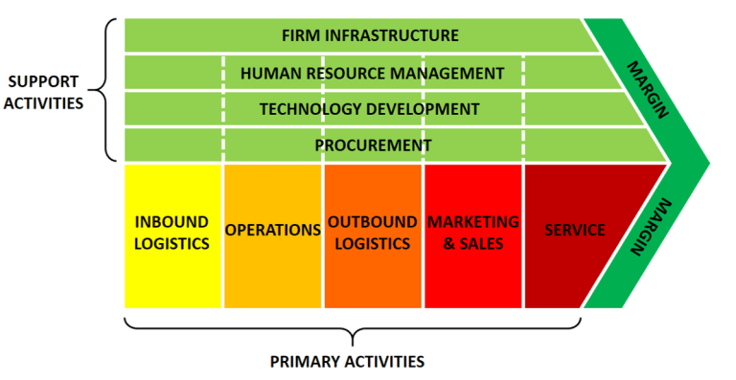
Value chain – support activities
*https://www.business-to-you.com/value-chain/

Slide 16
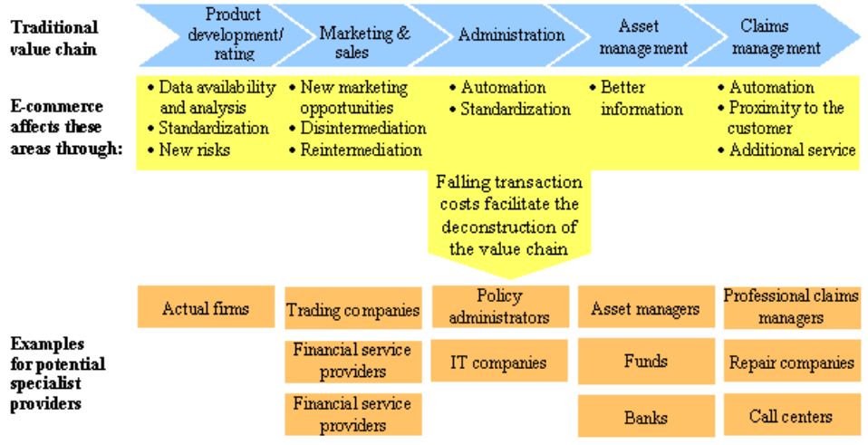
Value chain in e-commerce
*https://www.researchgate.net/figure/Insurance-value-chain-and-e-commerce-opportunities_fig8_268259388

Slide 17
Value chain in e-commerce
https://www.visiture.com/blog/22-ways-add-value-ecommerce-site/
https://tinuiti.com/blog/ecommerce/50-value-propositions-for-ecommerce-retailers/
https://www.growcode.com/blog/ecommerce-value-proposition/
https://www.campaignlive.co.uk/article/whats-value-ecommerce/1438041
https://www.builderfly.com/6-profitable-e-commerce-values-for-your-startup
https://feinternational.com/blog/value-and-sell-an-e-commerce/

Slide 18
Supply chain
A supply chain is the network of all the
  individuals;
  organizations;
  resources;
  activities;
  and technology
involved in the creation and sale of a product, from the delivery of source materials from the supplier to the manufacturer, through to its eventual delivery to the end user.*
The supply chain segment involved with getting the finished product from the manufacturer to the consumer is known as the distribution channel.*
*https://whatis.techtarget.com/definition/supply-chain

Slide 19
Supply chain management
Supply chain management (SCM) is the broad range of activities required to plan, control and execute a product's flow, from acquiring raw materials and production through distribution to the final customer, in the most streamlined and cost-effective way possible.*
SCM encompasses the integrated planning and execution of processes required to optimize the flow of materials, information and financial capital in the areas that broadly include demand planning, sourcing, production, inventory management and storage, transportation - or logistics - and return for excess or defective products.*
Both business strategy and specialized software are used in these endeavors to create a competitive advantage.*
*https://searcherp.techtarget.com/definition/supply-chain-management-SCM

Slide 20
Supply chain management – components*
Planning
  This is one of the most important stages. Before the beginning of the entire supply chain, it is essential to finalise the strategies and put them into place.
  Checking the demand for the product or service, checking the viability, costing, profit, and manpower etc., are vital.
  Without a proper plan or strategy in place, it will be well-nigh impossible for the business to achieve effective and long term benefits.
  Therefore, enough time has to be devoted to this phase.
  Only after the finalisation of the plans and consideration of all pros and cons, can one proceed further.
  Every business needs a plan or blueprint or a roadmap based on which the strategies are made.
  Planning helps to identify the demand and supply trends in the market and this, in turn, helps to create a successful supply chain management system.
*https://www.iqualifyuk.com/library/business-management-section/the-eight-components-of-supply-chain-management/

Slide 21
Supply chain management – components*
Information
  The world today is dominated by a continuous flow of information.
  In order to be successful, it is essential that a business stays abreast with all the latest information about the various aspects of its production.
  The market trends of supply and demand for a particular product can be best understood if the information is properly and timely disseminated through the many levels of the business.
  Information is crucial in a knowledge-based world economy, and ignorance about any aspect of business may actually spell doom for the prospects of the business.
*https://www.iqualifyuk.com/library/business-management-section/the-eight-components-of-supply-chain-management/

Slide 22
Supply chain management – components*
Source
  Suppliers play a very crucial role in supply chain management systems.
  Products and services sold to the end user are created with the help of different sets of raw materials.
  It is therefore necessary that suitable quality raw materials are procured at cost effective rates.
  If a supplier is unable to supply on time, and within the stipulated budget, the business is bound to suffer losses and gain a negative reputation.
  It is crucial that a company procures good quality resources so it can create good quality products and maintain its reputation in the market.
  This necessitates a strong role for suppliers in the supply chain management system.
*https://www.iqualifyuk.com/library/business-management-section/the-eight-components-of-supply-chain-management/

Slide 23
Supply chain management – components*
Inventory
  For a highly effective supply chain management system it is essential that an inventory is kept and thoroughly maintained.
  An inventory means the ready list of items, raw materials and other essentials required for the product or service.
  This list has to be regularly updated to demarcate available stock and required stock.
  Inventory management is critical to the function of supply chain management, because without proper inventory management the production, as well as sale of the product, is not possible.
  Businesses have now started to pay more attention to this component simply because of its impact on the supply chain.
*https://www.iqualifyuk.com/library/business-management-section/the-eight-components-of-supply-chain-management/

Slide 24
Supply chain management – components*
Production
  Production is one among the most important aspects of this system.
  It is only possible when all the other components of the supply chain are in tandem with each other.
  For the process of production to start it is essential that proper planning and supply of goods, as well as the inventory, are well maintained.
  The production of goods is followed by testing, packaging and the final preparation for delivery of the finished product.
*https://www.iqualifyuk.com/library/business-management-section/the-eight-components-of-supply-chain-management/

Slide 25
Supply chain management – components*
Location
  Any business, that wants to survive as well as flourish, needs a location which is profitable for the business.
  Take for example, a carbonated drink factory is set up in an area where water supply is scarce.
  Water is a basic necessity of such business.
  The lack of water could hamper the production as well as affect the goodwill of the company.
  A business cannot survive if it has to share an already scarce raw material with the community.
  Hence, a suitable location, which is well connected, and very close to the source of essential resources for production is vital to a business’ prosperity.
  The requirement and availability of manpower must also be considered while setting up a business unit.
*https://www.iqualifyuk.com/library/business-management-section/the-eight-components-of-supply-chain-management/

Slide 26
Supply chain management – components*
Transportation
  Transportation is vital in terms of carrying raw materials to the manufacturing unit and delivering the final product to the market.
  At each stage, timely transportation of goods is mandatory to sustain a smooth business process.
  Any business which pays attention to this component, and takes good care of it, will benefit from the production and transportation of its goods on time.
  It is essential that a company works towards a safe and secure transportation process.
  Be it in-house or a third-party vendor, the transportation management system must ensure zero damage and minimal loss in transit.
  A well-managed logistics system along with flawless invoicing are the two pillars of secure transportation.
*https://www.iqualifyuk.com/library/business-management-section/the-eight-components-of-supply-chain-management/

Slide 27
Supply chain management – components*
Return of goods
  Among the various components that create a strong supply chain is the facility for the return of faulty/malfunctioning goods, along with a highly responsive consumer grievance redress unit.
*https://www.iqualifyuk.com/library/business-management-section/the-eight-components-of-supply-chain-management/

Slide 28
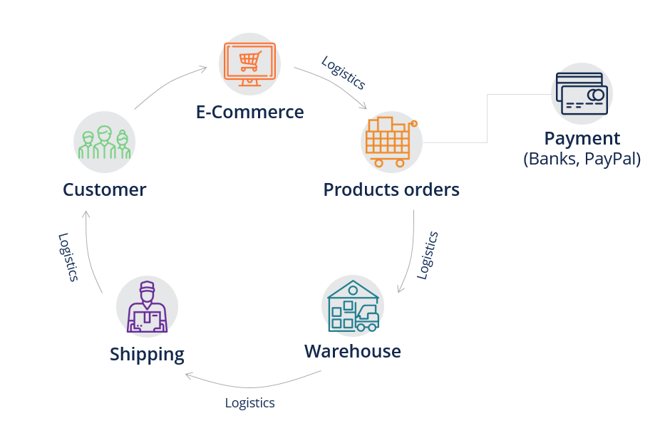
Supply chain management – components*
*https://corporatefinanceinstitute.com/resources/knowledge/strategy/supply-chain/

Slide 29
The end
Thank you for your attention!
Any questions?

