Slide 1

E-business
E-business system - I
Petr Suchánek
E-business

Slide 2

Outline of the lecture
E-business system architecture
Flows in E-Commerce System

Slide 3
E-business system
E-business systems are a set of online technologies, equipment and tools that a business uses to conduct business via the Internet.*
These systems help a company connect with customers, process orders and manage information.*
For instance, one high-profit e-business system is a web-based retail store where customers can purchase products online.*
At the very center of an e-business system is a website (domain and web hosting account), email account (which commonly comes with the web hosting account), and an Internet connection.*
These three tools form the base of an e-business system, allow the integration of all other e-business tools and allow the user to connect to the World Wide Web to publish information.*
*https://smallbusiness.chron.com/e-business-systems-5270.html

Slide 4
E-business system
An e-business system is composed of more than just an Internet account and intangible online accounts.*
You also need tangible equipment to access and utilize the system.*
Other important e-business tools include computers, Internet modems, Internet adapters, dedicated servers, and Ethernet cabling if you want to establish an online intranet (interoffice) system where employees communicate with each other securely.*
In addition to physical equipment, you may also need database, Internet security and shopping cart software to establish a professional e-business system.*
*https://smallbusiness.chron.com/e-business-systems-5270.html

Slide 5
E-business system
While a small business owner may choose to manage the e-business system on her own, she may find success by allowing contractors or dedicated employees to take care of those duties.*
For instance, one element of a successful e-business system is the proper design of the online system so that it's simple for visitors and employees to navigate.*
The small business owner may hire computer programmers and Web architects to take care of these important duties.*
*https://smallbusiness.chron.com/e-business-systems-5270.html

Slide 6
E-business system – important components
Suppliers and supply chain management
Before starting an ecommerce operation make sure:*
  you have enough and the right merchandise suppliers;
  they are financially and operational safe;
  they are able to provide real-time stock inventory;
  they are able to deliver purchased products fast.
*https://netonomy.net/2013/10/16/most-important-components-ecommerce-stores-ignored/

Slide 7
E-business system – important components
Warehouse operations*
Technology is the key – all 3PL service providers use technology (warehouse management systems) to know at all times where the products are, what’s the most efficient way to pick those products, who should be the person in charge for each package and others;
Think about the season – some seasons (such as the Holidays) are more operationally intensive then others. Be ready to employ temporary workforce to fulfill your orders;
Everything needs to be tracked and monitored – security and accountability are the key to handling large numbers of orders and workforce.
*https://netonomy.net/2013/10/16/most-important-components-ecommerce-stores-ignored/

Slide 8
E-business system – important components
Shipping and returns*
Hire a shipping provider
  It’s probably not worth it to have a shipping service of your own;
Pay attention to systems integrations when it comes to online store – warehouse – shipping flow;
Handle your returns as gracefully as possible
  It may mean the difference between an unsatisfied customer and a lifetime brand ambassador.
*https://netonomy.net/2013/10/16/most-important-components-ecommerce-stores-ignored/

Slide 9
E-business system – important components
Client Relationship Management (CRM)*
CRM is not just software
  it’s a company policy on how to treat clients;
Profiling is a must
  understand as much as possible about your customer so you can serve better;
“Customer-centric” is not a buzz-word – it’s common sense;
There is no “client service department”
  Everybody working in an ecommerce store needs to know who the client is, record interactions and treat customers accordingly.
*https://netonomy.net/2013/10/16/most-important-components-ecommerce-stores-ignored/

Slide 10
E-business system – important components
Ecommerce catalogue and product display*
Make sure you don’t over-design your store – your products are the most important items. Make them shine.
analyze and predict: predictive analytics is the practice of analyzing users behavior and predicting what would they rather buy at any given time. Read more about it here.
Search, search and let’s not forget search: most of your customers will be using a search engine to navigate to your store:
  Make sure your store is optimized. Once there, when in doubt, they will want to search for products;
  Make sure your site search works;
  When their order was shipped they will want to search for its location - show them.
*https://netonomy.net/2013/10/16/most-important-components-ecommerce-stores-ignored/

Slide 11
E-business system – important components
Marketing and loyalty programs*
Rewarding purchases
  Reward your users with points they can spend on your store. It’s really effective in keeping your customers tied to your brand, as well as making them feel great about it;
Social shopping
  Make your customer feel like a king when he can give out discounts and freebies to its peers and friends;
Reward social media
  Most online users have some kind of influence in their micro community of friends. Encourage them to take part in your story, share your products and reward them with freebies, discounts and … well …sometimes “Thank you” is enough.
*https://netonomy.net/2013/10/16/most-important-components-ecommerce-stores-ignored/

Slide 12
E-business system – e-commerce
The structural model describes an e-commerce system as a set of functionally connected components. The main basic components of e-commerce systems are:
  customers and generally business environment;
  the Internet;
  the web server;
  LAN (Local Area Network);
  CRM (Customer Relationship Management) ERP (Enterprise Resource Planning);
  payment system;
  delivery of goods;
  after-delivery (after-sales) services;
  information systems (CRM/ERP) of cooperating suppliers.

Slide 13
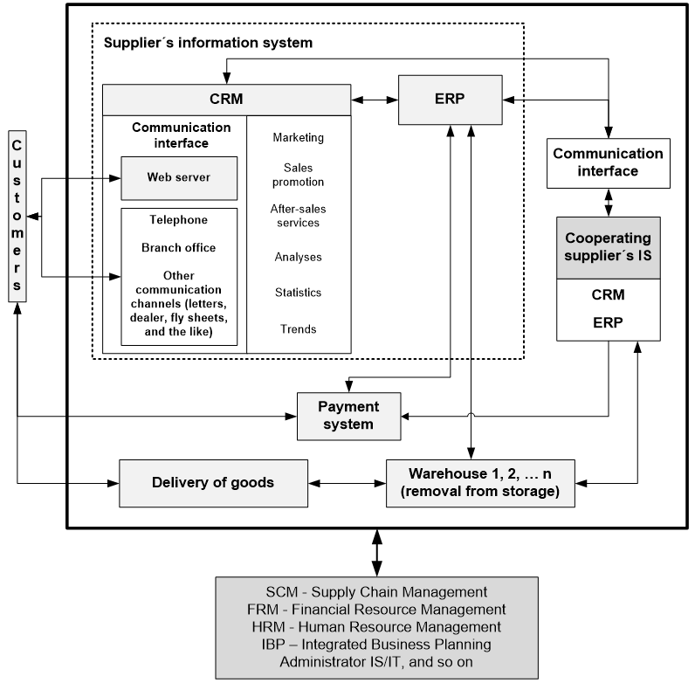
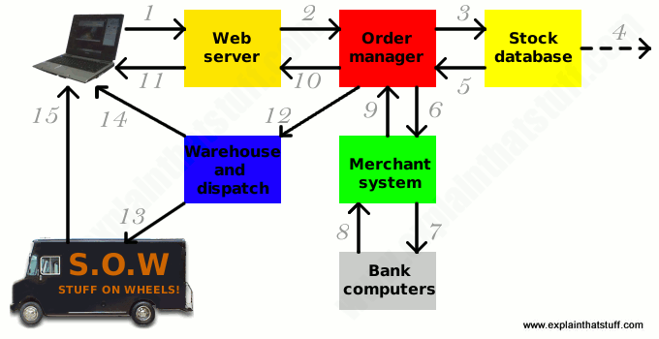
E-business system – e-commerce

Slide 14
E-business system – e-commerce*
Sitting at her computer, a customer tries to order a book online. Her Web browser communicates back-and-forth over the Internet with a Web server that manages the store's website.
The Web server sends her order to the order manager. This is a central computer that sees orders through every stage of processing from submission to dispatch.
The order manager queries a database to find out whether what the customer wants is actually in stock.
If the item is not in stock, the stock database system can order new supplies from the wholesalers or manufacturers. This might involve communicating with order systems at the manufacturer's HQ to find out estimated supply times while the customer is still sitting at her computer (in other words, in "real time").
*https://www.explainthatstuff.com/ecommerce.html

Slide 15
E-business system – e-commerce*
The stock database confirms whether the item is in stock or suggests an estimated delivery date when supplies will be received from the manufacturer.
Assuming the item is in stock, the order manager continues to process it. Next it communicates with a merchant system (run by a credit-card processing firm or linked to a bank) to take payment using the customer's credit or debit card number.
The merchant system might make extra checks with the customer's own bank computer.
The bank computer confirms whether the customer has enough funds.
*https://www.explainthatstuff.com/ecommerce.html

Slide 16
E-business system – e-commerce*
The merchant system authorizes the transaction to go ahead, though funds will not be completely transferred until several days later.
The order manager confirms that the transaction has been successfully processed and notifies the Web server.
The Web server shows the customer a Web page confirming that her order has been processed and the transaction is complete.
The order manager sends a request to the warehouse to dispatch the goods to the customer.
A truck from a dispatch firm collects the goods from the warehouse and delivers them.
*https://www.explainthatstuff.com/ecommerce.html

Slide 17
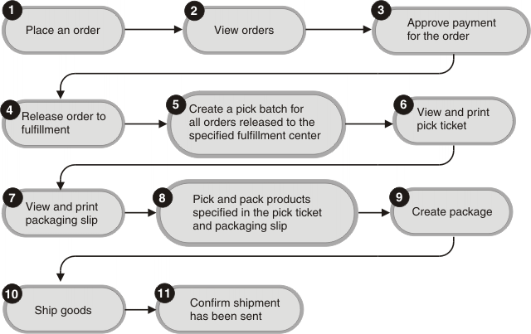
E-business system – e-commerce*
Once the goods have been dispatched, the warehouse computer e-mails the customer to confirm that her goods are on their way.
The goods are delivered to the customer.
*https://www.explainthatstuff.com/ecommerce.html
**https://www.ibm.com/support/knowledgecenter/en/SSZLC2_7.0.0/com.ibm.commerce.user.business.doc/concepts/cosoflowext.htm

Slide 18
E-commerce system – typical functions*
These are the typical functions of an e-commerce system available both on back office and front office:
  Registration;
  Basket;
  Payment;
  Product management;
  Orders management;
  VAT and shipping costs.
*https://www.engitel.com/en/products/spingo-commerce/typical-functions-of-ecommerce-system.html

Slide 19
E-commerce system – typical functions*
Registration
  In order to make a purchase, users must register with the site, providing all the information needed for shipping and billing.
  The data will be stored on a database and will be available from the back office.
Basket
  The basket is a tool that, like a shopping basket, allows users to select the products they want and then go to the checkout for payment.
  Managing the basket means:
    summarising user requests within the possibilities offered by the catalogue;
    checking the basket and possibly cancel/modify the items placed in it;
    starting the payment process for the selected products.
*https://www.engitel.com/en/products/spingo-commerce/typical-functions-of-ecommerce-system.html

Slide 20
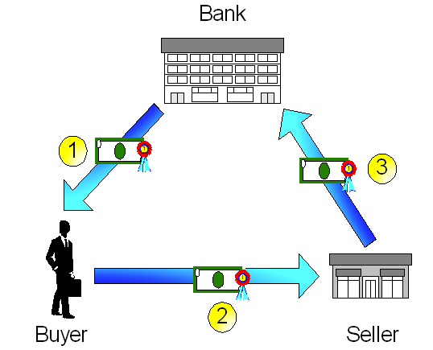
E-commerce system – typical functions*
Payment
  The payment system is a mechanism that facilitates dialogue between the parties involved in financial transactions:
    the bank;
    the store;
    buyer.
*https://www.engitel.com/en/products/spingo-commerce/typical-functions-of-ecommerce-system.html
**http://www.liberaldictionary.com/ecash/

Slide 21
E-commerce system – typical functions*
Product management
  This is the main part of the e-commerce system and provides all the features required for product placement, order fulfilment, etc.
  This makes it possible to define a product via a set of standard fields:
    product code;
    category;
    subcategory;
    product name;
    description;
    image, zoom;
    sizes available;
    price in different currency;
    'pieces' in stock.
*https://www.engitel.com/en/products/spingo-commerce/typical-functions-of-ecommerce-system.html

Slide 22
E-commerce system – typical functions*
Order management
  The order is the card that summarises all the delivery and order information to enable correct delivery. It includes:
    list of products purchased;
    user information;
    details of place of delivery;
    delivery time information;
    payment information.
  Managing the order means crossing the information on the registration database, the data in the basket, the delivery information and verification data relating to the payment credit rating.
*https://www.engitel.com/en/products/spingo-commerce/typical-functions-of-ecommerce-system.html

Slide 23
E-commerce system – typical functions*
Listing orders and customer details
  From the back office of the site you can search and sort orders by:
    customer;
    order status;
    date;
    payment.
  Orders may be printed for attachment to the shipment (packing list).
  All this information is summarised in a form identified by a number or reference code (order number).
*https://www.engitel.com/en/products/spingo-commerce/typical-functions-of-ecommerce-system.html

Slide 24
E-commerce system – typical functions*
VAT and shipping costs
  In addition to the cost of products purchased, the system manages the VAT and the shipping charges.
  The e-commerce module is able to manage VAT rates in countries within and outside the EU.
  Shipping costs both fixed and variable based on the weight and volume of the shipment.
Discounts
  Discounts and promotions are managed for a single product or product category.
*https://www.engitel.com/en/products/spingo-commerce/typical-functions-of-ecommerce-system.html

Slide 25
Flows in E-Commerce System*
Product flow
  This refers to the movement of the goods from the suppliers to the customers.
  Logistics players play a key role in moving products through this chain.
  In fact, Logistics takes the primary onus for success of an e-commerce entity.
  The products and services have to reach at the right time and the right place and in the right condition!
  Usually the retailers tie up with a reputed logistics provider for the supply of goods.
*https://www.storehippo.com/blog/flows-in-e-commerce-system

Slide 26
Flows in E-Commerce System*
Cash flow
  Naturally, when you purchase a product or a service, you pay for it. So, the cash flow is from the customers back to Suppliers.
  This happens through multiple channels.
  Some customers chose offline mode of payment i.e. Cash on Delivery.
  In this case the logistics player collects the amount from the customer’s place and transfers it to the suplliers account.
  On the other hand, some customers pay online with their debit/credit cards and suppliers receive the amount accordingly.
  There are many other ways to pay online like Internet Banking, E-Gift Voucher and Wallet.
*https://www.storehippo.com/blog/flows-in-e-commerce-system

Slide 27
Flows in E-Commerce System*
Information flow
  This information flow happens in both the directions.
  This flow of information is necessary for the proper functioning of all the activities in an E-Commerce model.
  Customers ask for information and likewise the retailer also requires information from the customer.
  Since, the process is basically online, this flow is important for a smooth transaction and seamless working of the stores.
*https://www.storehippo.com/blog/flows-in-e-commerce-system

Slide 28
Flows in E-Commerce System*
Reverse product flow
  This refers to the product return which has to be picked from the customer and returned to the retailer through the E-Commerce player.
  If a customer is not fully satisfied with the product or finds it in a damaged/defective condition, the customer can conveniently initiate the return online and ask for replacement or exchange or refund as per the policies of the e-commerce player which varies from product to product.
*https://www.storehippo.com/blog/flows-in-e-commerce-system

Slide 29
The end
Thank you for your attention!
Any questions?

