Slide 1
E-business
E-business system - II
Petr Suchánek
E-business

Slide 2
Outline of the lecture
CRM in e-business

Slide 3
CRM
Customer relationship management (CRM) is the combination of
practices,
strategies,
and technologies
that companies use to manage and analyze customer interactions and data throughout the customer lifecycle, with the goal of improving customer service relationships and assisting in customer retention and driving sales growth.*
CRM systems compile customer data across different channels, or points of contact between the customer and the company, which could include the company's website, telephone, live chat, direct mail, marketing materials and social media.*
*https://searchcustomerexperience.techtarget.com/definition/CRM-customer-relationship-management

Slide 4
CRM
CRM systems can also give customer-facing staff detailed information on customers' personal information, purchase history, buying preferences and concerns.*
Customer relationship management includes the principles, practices, and guidelines an organization follows when interacting with its customers.**
CRM is often used to refer to technology companies and systems that help manage external interactions with customers.**
Major areas of growth in CRM technology include software, cloud computing, and artificial intelligence.**
Major areas of growth in CRM technology include software, cloud computing, and artificial intelligence.
*https://searchcustomerexperience.techtarget.com/definition/CRM-customer-relationship-management
**https://www.investopedia.com/terms/c/customer_relation_management.asp

Slide 5
CRM - technology
CRM Software*
Special CRM software aggregates customer information in one place to give businesses easy access to data, such as contact data, purchase history and any previous contact with customer service representatives.
This data helps employees interact with clients, anticipate customer needs, recognize customer updates and track performance goals when it comes to sales.
CRM software's main purpose is to make interactions more efficient and productive.
Automated procedures within a CRM module include sending sales team marketing materials based on a customer's selection of a product or service.
Programs also assess a customer's needs to reduce the time it takes to fulfill a request.
*https://www.investopedia.com/terms/c/customer_relation_management.asp

Slide 6
CRM - technology
CRM Cloud Solutions*
Cloud-based systems provide real-time data to sales agents at the office and in the field as long as a computer, smartphone, laptop or tablet connects to the internet.
Such systems boast heightened accessibility to customer information and eliminate the sometimes-complicated installation process involved with other CRM products or software.
If a company goes out of business or faces an acquisition, access to customer information may become compromised.
A business might have compatibility issues when and if it migrates to a different vendor for this kind of software.
Also, cloud-based CRM programs typically cost more than in-house programs.
*https://www.investopedia.com/terms/c/customer_relation_management.asp

Slide 7
CRM - technology
CRM Human Management and Artificial Intelligence (AI)*
All of the computer software in the world to help with CRM means nothing without proper management and decision-making from humans.
Plus, the best programs organize data in a way that humans can interpret readily and use to their advantage.
For successful CRM, companies must learn to discern useful information and superfluous data and must weed out any duplicate and incomplete records that may give employees inaccurate information about customers.
AI is expected to strengthen CRM activities by speeding up sales cycles, optimizing pricing and distribution logistics, lowering costs of support calls, increasing resolution rates, and preventing loss through fraud detection.
*https://www.investopedia.com/terms/c/customer_relation_management.asp

Slide 8
CRM - components
Sales Force Automation*
This is component that is undertaken by the maximum business organizations.
It includes forecasting, recording sales processing as well as keeping a track of the potential interactions.
It helps to know the revenue generation opportunities better and that makes it very significant.
The component also includes analyzing the salesforecasts and the performances by the workforce.
To achieve an overall improvement in the development and growth of the industry, numerous components work hand in hand to form salesforce automation as a consequent unit.
Some of the major elements of the same are Lead Management, Account Management, Opportunity Management, Forecasting, Pipeline Analysis, Contact Management, Activity Management, Email Management and Reporting.
*https://crm.walkme.com/components-customer-relationship-management/

Slide 9
CRM - components
Human Resource Management*
Human Resource Management involves the effective and correct use of human resource and skills at the specific moment and situation.
This requires to be make sure that the skills and intellectual levels of the professionals match the tasks undertaken by them according to their job profiles.
It is an essential component not only for the large scale corporations but the medium industries as well.
It involves adopting an effective people strategy and studying the skills or the workforce and the growth being generated thereby designing and implementing the strategies needed accordingly with the aim of achieving development.
*https://crm.walkme.com/components-customer-relationship-management/

Slide 10
CRM - components
Lead Management*
Lead Management as the name suggests, refers to keeping the track of the sales leads as well as their distribution.
The business that are benefitted by this component of CRM the most are the sales industries, marketing firms and customer executive centres.
It involves an efficient management of the campaigns, designing customized forms, finalizing the mailing lists and several other elements.
An extensive study of the purchase patterns of the customers as well as potential sales leads helps to capture the maximum number of sales leads to improve the sales.
*https://crm.walkme.com/components-customer-relationship-management/

Slide 11
CRM - components
Customer Service*
Customer Relationship Management emphasizes on collecting customer information and data, their purchase informations and patterns as well as involves providing the collected information to the necessary and concerned departments.
Almost all the major departments including the sales department, marketing team and the management personnel are required to take steps to develop their awareness and understanding of the customer needs as well as complaints.
This undoubtedly makes the business or the company to deliver quick and perfect solutions and assistance to the customers as well as cater to their needs which increases the dependability and trust of the customers and people on the organization.
*https://crm.walkme.com/components-customer-relationship-management/

Slide 12
CRM - components
Marketing*
Marketing is one of the most significant component of Customer Relationship Management and it refers to the promotional activities that are adopted by a company in order to promote their products.
The marketing could be targeted to a particular group of people as well as to the general crowd.
Marketing involves crafting and implementing strategies in order to sell the product. CRM assists in the marketing process by enhancing and improving the effectiveness of the strategies used for marketing and promotion.
This is done by making an observation and study of the potential customers.
Some of the major elements of marketing are List Management, Campaign Management, Activity Management, Document Management, Call Management, Mass Emails and Reporting.
*https://crm.walkme.com/components-customer-relationship-management/

Slide 13
CRM - components
Workflow Automation*
A number of processes run simultaneously when it comes to the management and this requires an efficient cost cutting as well as the streamlining of all the processes.
The phenomenon of doing so is known as Workflow Automation.
It not only reduces the excess expenditure but also prevents the repetition of a particular task by different people by reducing the work and work force that is getting wasted for avoidable jobs.
Routing out the paperwork and form filling are some of the elements of the process and it aims at preventing the loss of time and excess effort.
*https://crm.walkme.com/components-customer-relationship-management/

Slide 14
CRM - components
Business Reporting*
CRM comes with a management of sales, customer care reports and marketing.
The customer care reports assist the executives of a company to gain an insight into their daily work management and operations.
This enables one to know the precise position of the company at any particular instance.
CRM provides the reports on the business and that makes it play a major role here.
It is ensured that the reports are accurate as well as precise. Another significant feature is the forecasting and the ability to export the business reports on other systems.
In order to make comparisons, one can save historical data as well.
*https://crm.walkme.com/components-customer-relationship-management/

Slide 15
CRM - components
Analytics*
Analytics is the process of studying and representing the data in order to observe the trends in the market.
Creating graphical representations of the data in the form of histograms, charts, figures and diagrams utilizing the current data as well as the one generated in the past is essential to achieve a detailed understanding and study of the trends.
Analytics is an extremely significant element of Customer Relationship Management as it allows to make in-depth study of information that is required to calculate the progress in the business.
*https://crm.walkme.com/components-customer-relationship-management/

Slide 16
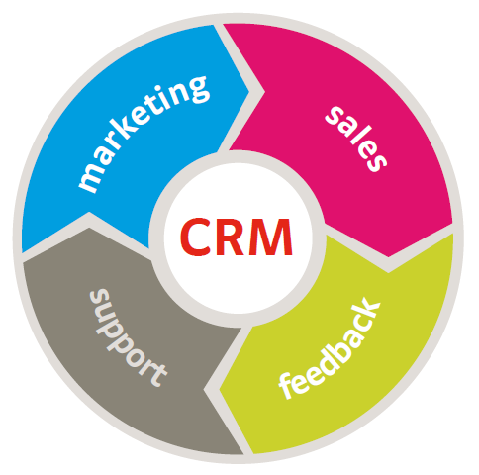
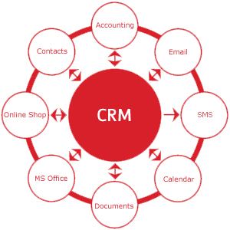
CRM - components
* https://www.nexell.net/en/services/crm-services-2.html
** http://jisc.cetis.ac.uk/crm-tools/what-is-crm.html

Slide 17
CRM - collaborative
Collaborative CRM is a method in Customer Relationship Management (CRM) where various departments (like Sales, Marketing, Service, Finance) within an organization share customer information to maximize profitability, increase customer satisfaction and loyalty.*
The purpose of collaboration is to enhance the quality of service and customer satisfaction.*
Feedback from a customer, gathered by technical support team could help marketing team to suggest more suitable products or services to the customer.
Two major parts in Collaborative CRM are Interaction Management and Channel Management.
*https://techonestop.com/what-is-collaborative-crm-strategy

Slide 18
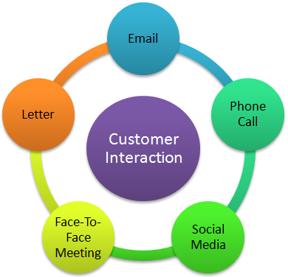
CRM - collaborative
Interaction Management
This process is responsible to manage all interactions between the organization and its customers.
Some customers may prefer paper less communication like email or phone call or social media, some may prefer face-to-face interaction or physical letter.
Whatever the communication channel is, it is important for an organization to reach customers via their preferred channels only.
Interaction management system handles all these communications across various channels.
*https://techonestop.com/what-is-collaborative-crm-strategy

Slide 19
CRM - operational
Operational CRM streamlines the business process of an organization.*
It mainly focuses on automation and improvement of customer facing and customer touching business processes.*
It includes Sales automation, Marketing automation and Service automation.*
Main purpose of Operational CRM system is to generate leads, convert them into contacts, capture all required details and provide support throughout customer lifecycle.*
*https://techonestop.com/what-is-operational-crm

Slide 20
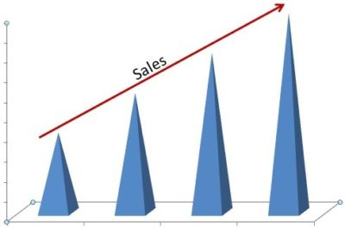
CRM - operational
Sales Force Automation*
Lead Management
Contact Management
Account Management
Tracking Customer Preferences
Performance Management
Quote-to-Order management
Sales Forecasting
*https://techonestop.com/what-is-operational-crm

Slide 21
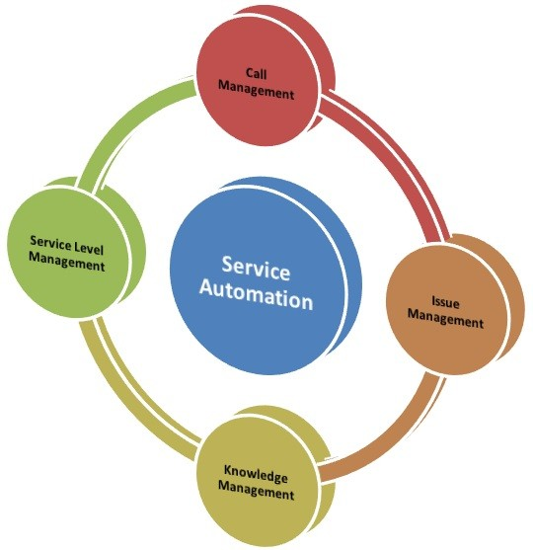
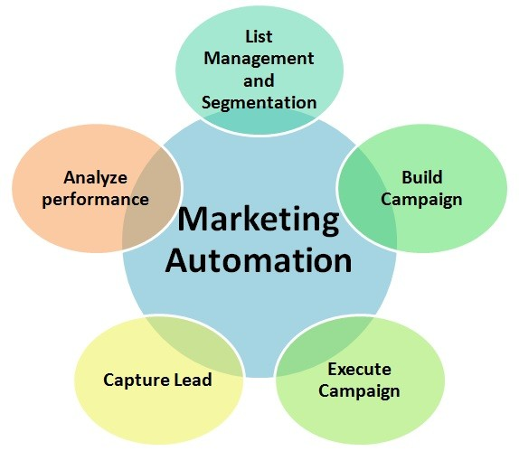
CRM - operational
Marketing Automation*
Service automation*
*https://techonestop.com/what-is-operational-crm

Slide 22
CRM - analytical
Analytical CRM helps top management, marketing, sales and support personnel to determine the better way to serve customers.*
Data analysis is the main function of this type of CRM application.*
It analyzes customer data, coming from various touch points, to get better insights about current status of an organization.*
It helps top management to take better decision, marketing executives to understand the campaign effectiveness, sales executives to increase sales and support personnel to improve quality of support and build strong customer relationship.*
*https://techonestop.com/types-of-crm-operational-analytical-collaborative

Slide 23
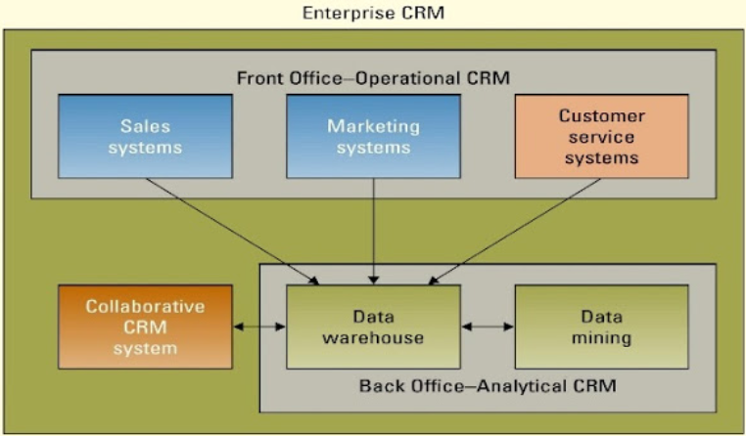
CRM - analytical
Features of Analytical CRM:*
Gather customer’s information, coming from different channels and analyze data in a structured way;
Help organization to set business methodology in Sales, Marketing and Support to improve customer relationship and loyalty;
Improve the CRM system effectiveness and analyze key performance indicators, set by business.
*https://techonestop.com/types-of-crm-operational-analytical-collaborative
**http://effaamirah97.blogspot.com/2017/02/chapter-11-building-customer-centric.html

Slide 24
The end
Thank you for your attention!
Any questions?

