Slide 1

E-business
E-business system - III
Petr Suchánek
E-business

Slide 2

Outline of the lecture
Customer oriented systems
Identifying customer target groups
Advantages and disadvantages of e-business and e-commerce for customers and sellers.

Slide 3
Customer oriented system
The Customer-oriented solutions are complete products developed for the concrete Customer.*
Every Customer-oriented system results from the individual work with the client taking into account specific details of his business processes.*
The “ordered” software allows to solve problems that could not be solved with standard solutions.*
The Customer-oriented system is made according to the principle: “The system for the user, but not the user for the system”.*
*http://www.ssl.obninsk.ru/web/002/english.nsf/index/kis-zak

Slide 4
Identifying customer target groups
Given the current state of the economy, having a well-defined target market is more important than ever.*
Targeting a specific market does not mean that you are excluding people who do not fit your criteria.*
Rather, target marketing allows you to focus your marketing dollars and brand message on a specific market that is more likely to buy from you than other markets.*
With a clearly defined target audience, it is much easier to determine where and how to market your company.*
*https://www.inc.com/guides/2010/06/defining-your-target-market.html

Slide 5
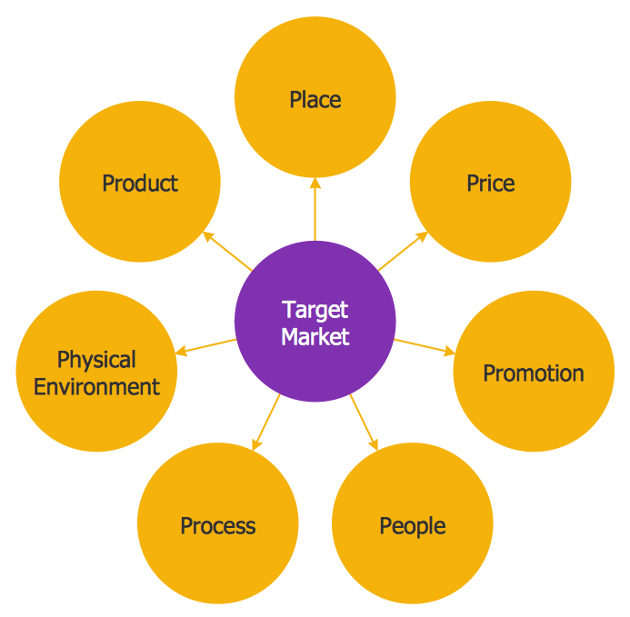
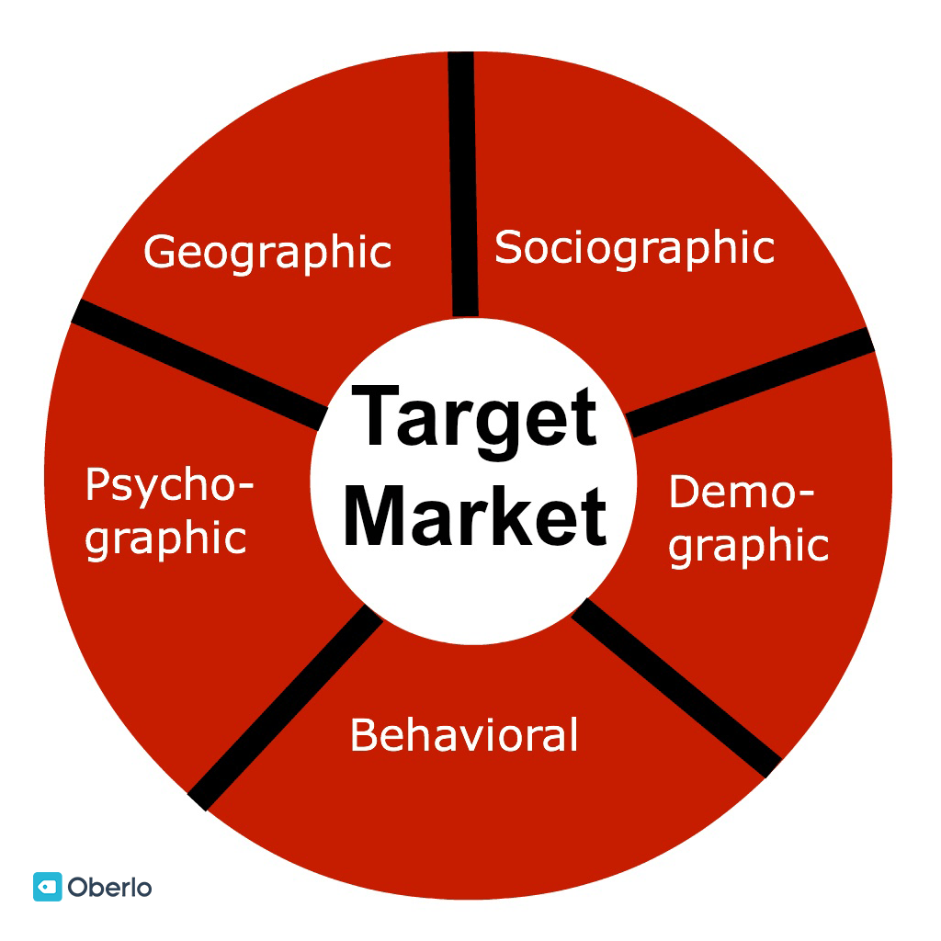
Identifying customer target groups – target market
*https://en.wikipedia.org/wiki/Market_segmentation
** https://www.oberlo.com/blog/target-audience

Slide 6
Identifying customer target groups
Look at your current customer base
  Who are your current customers, and why do they buy from you? Look for common characteristics and interests. Which ones bring in the most business? It is very likely that other people like them could also benefit from your product/service.
*https://www.inc.com/guides/2010/06/defining-your-target-market.html

Slide 7
Identifying customer target groups
Analyze your product/service*
  Write out a list of each feature of your product or service. Next to each feature, list the benefits it provides (and the benefits of those benefits). For example, a graphic designer offers high-quality design services. The benefit is a professional company image. A professional image will attract more customers because they see the company as professional and trustworthy. So ultimately, the benefit of high-quality design is gaining more customers and making more money.
  Once you have your benefits listed, make a list of people who have a need that your benefit fulfills. For example, a graphic designer could choose to target businesses interested in increasing their client base. While this is still too general, you now have a base to start from.
*https://www.inc.com/guides/2010/06/defining-your-target-market.html

Slide 8
Identifying customer target groups
Choose specific demographics to target*
  Figure out not only who has a need for your product or service, but also who is most likely to buy it. Think about the following factors:
    Age
    Location
    Gender
    Income level
    Education level
    Marital or family status
    Occupation
    Ethnic background
*https://www.inc.com/guides/2010/06/defining-your-target-market.html

Slide 9
Identifying customer target groups
Consider the psychographics of your target*
  Psychographics are the more personal characteristics of a person, including:
    Personality;
    Attitudes;
    Values;
    Interests/hobbies;
    Lifestyles;
    Behavior.
Determine how your product or service will fit into your target's lifestyle. How and when will your target use the product? What features are most appealing to your target? What media does your target turn to for information? Does your target read the newspaper, search online, or attend particular events?
*https://www.inc.com/guides/2010/06/defining-your-target-market.html

Slide 10
Identifying customer target groups
Evaluate your decision*
  Once you've decided on a target market, be sure to consider these questions:
    Are there enough people who fit my criteria?
    Will my target really benefit from my product/service? Will they see a need for it?
    Do I understand what drives my target to make decisions?
    Can they afford my product/service?
    Can I reach them with my message? Are they easily accessible?
*https://www.inc.com/guides/2010/06/defining-your-target-market.html

Slide 11
E-business advantages to customer
Wide range of products and services*
  Electronic commerce through internet enables the customers to choose a product or service of their choice from any vendor anywhere in the world.
  Due to space constraint, a vendor can stock only a minimum amount of goods in the physical store.
  A virtual store enables a business organization to stock a lot of goods without considering the inventory cost.
  Hence, a business also provides a lot of choice to consumers to choose a product of his /her choice.
*https://accountlearning.com/top-5-advantages-of-e-commerce-to-consumers/

Slide 12
E-business advantages to customer
Convenience*
  Customers can buy any product from anywhere in the world without moving away from their workplace or home through internet.
  Due to bad weather, people may restrict their shopping even if necessity arises.
  E-commerce provides convenience to buy goods or services without causing any physical constraints to the consumers.
Saves time
  Time saving is one of the prime benefits of online shopping.
  Time taken for selection, buying and paying for an online product may not take more than 15 minutes; the products are delivered to customers’ door steps within a week.
  It saves delivery time for the buyers.
*https://accountlearning.com/top-5-advntages-of-e-commerce-to-consumers/

Slide 13
E-business advantages to customer
Saves money*
  The cost incurred by the business on the middlemen generally falls on the consumer.
  Since the middlemen are eliminated, the customer is free from bearing the cost of the middlemen.
  To attract customers and to combat competitors, several business organizations offer product and services at cheaper price.
  Certain goods like e-books, music audio clips, software can be purchased and delivered through internet.
  It saves cost for the buyers.
*https://accountlearning.com/top-5-advntages-of-e-commerce-to-consumers/

Slide 14
E-business advantages to customer
Adequate information*
  Internet is used as a main vehicle to conduct transactions in e-business.
  Internet allows customers to search for product information, compare the prices and benefits and finally evaluate its value before committing purchase.
  Through internet, customers can get their queries clarified and track their delivery status when the goods are being sent to them.
  If any doubts arise while handling the products, the customers can easily contact the business through internet.
*https://accountlearning.com/top-5-advntages-of-e-commerce-to-consumers/

Slide 15
Advantages of Ecommerce*
Faster buying/selling procedure, as well as easy to find products.
Buying/selling 24/7.
More reach to customers, there is no theoretical geographic limitations.
Low operational costs and better quality of services.
No need of physical company set-ups.
Easy to start and manage a business.
Customers can easily select products from different providers without moving around physically.
*http://www.esalestrack.com/blog/2008/09/advantages-and-disadvantages-of.html

Slide 16
Disadvantages of Ecommerce*
Any one, good or bad, can easily start a business. And there are many bad sites which eat up customers’ money.
There is no guarantee of product quality.
Mechanical failures can cause unpredictable effects on the total processes.
As there is minimum chance of direct customer to company interactions, customer loyalty is always on a check.
There are many hackers who look for opportunities, and thus an ecommerce site, service, payment gateways, all are always prone to attack.
*http://www.esalestrack.com/blog/2008/09/advantages-and-disadvantages-of.html

Slide 17
Advantages and disadvantages of e-business
https://medium.com/@briannawillsss/18-major-benefits-of-e-commerce-business-for-retailers-customers-in-2015-63c5fc87f679
https://www.adeogroup.co.uk/ecommerce-benefits/
https://www.aonerank.com/digital-marketing-learning/benefits-ecommerce-customers/
https://www.tutorialspoint.com/e_commerce/e_commerce_advantages.htm
https://factory.hr/blog/benefits-of-ecommerce-for-businesses-and-consumers

Slide 18
The end
Thank you for your attention!
Any questions?

