Slide 1
E-business
Electronic payment systems
Petr Suchánek
E-business

Slide 2
Outline of the lecture
Electronic payment systems

Slide 3
Electronic payment
E-payments are considered a fast and secure alternative to traditional payment methods, such as bank transfers, checks, etc.*
Accepting electronic payments comes with lots of benefits for both merchants (of any size) and consumers.*
An electronic payment is any kind of non-cash payment that doesn't involve a paper check.**
Methods of electronic payments include credit cards, debit cards and the ACH (Automated Clearing House) network.**
The ACH system comprises direct deposit, direct debit and electronic checks (e-checks).**
*https://securionpay.com/blog/how-to-define-e-payments/
**https://money.howstuffworks.com/personal-finance/online-banking/electronic-payment1.htm

Slide 4
Electronic payment system
Electronic Payment is a financial exchange that takes place online between buyers and sellers.*
The content of this exchange is usually some form of digital financial instrument (such as encrypted credit card numbers, electronic cheques or digital cash) that is backed by a bank or an intermediary, or by a legal tender.*
An e-payment system is a way of making transactions or paying for goods and services through an electronic medium, without the use of checks or cash.**
As the world advances more with technology development, we can see the rise of electronic payment systems and payment processing devices.**
*https://webservices.ignou.ac.in/virtualcampus/adit/course/cst304/ecom2.htm
**https://securionpay.com/blog/e-payment-system/

Slide 5
Electronic payment
Customer action*
The process begins when a customer visits the merchant’s site and adds to the cart items (products or services) they want to buy.
They, then need to fill out the payment form with certain information (e.g. card number, expiration date, CVV code, address).
Depending on the payment method, the customer is either redirected to external service or bank’s website or continues the payment on the website or in an app.*
Payment authentication by the operator*
The payment gateway (with other parties involved) checks whether the payment information is valid.
If everything’s OK, the process continues and the payment gateway reports back the successful transaction.
After that, the customer receives a payment confirmation — the notification is usually displayed in real-time.
*https://securionpay.com/blog/how-to-define-e-payments/

Slide 6
Electronic payment
Payment to the seller’s account*
An online payment provider receives a payment from a customer’s bank and transfers it to the merchant’s account.
*https://securionpay.com/blog/how-to-define-e-payments/
**https://www.shutterstock.com/cs/search/electronic+payment

Slide 7
Stages of Payment Processing - authorization
Authorization*
Authorization is the initial phase of a transaction.
The cardholder initiates a sale, prompting the merchant to request authorization from the customer’s issuing bank.
If the issuing bank grants authorization, it means the cardholder’s account is in good standing, there are sufficient funds to cover the sale, and the card hasn’t been reported lost or stolen.
The merchant can proceed with the sale.
If the bank does not grant authorization, it means there is an issue with the account and the transaction should be terminated.
* https://homebusinessmag.com/money/how-to-guides-money/step-step-guide-processing-online-payments/

Slide 8
Stages of Payment Processing - authorization
To request authorization, the merchant routes an authorization request through various relay points:
Issuer - The bank that provides the consumer with a credit or debit card.
Acquirer - The financial institution that provides the merchant account.
Processor - The link between the acquirer and the merchant. The processor attends to all the payment processing tasks, but the acquirer holds the liability.
Payment Gateway - The entity responsible for connecting the merchant to the processor, similar to a POS system for in-person transactions.
Card Networks - Interbank networks that provide branded cards (MasterCard, Visa, etc.) to consumers and facilitate payments for merchants.
* https://homebusinessmag.com/money/how-to-guides-money/step-step-guide-processing-online-payments/

Slide 9
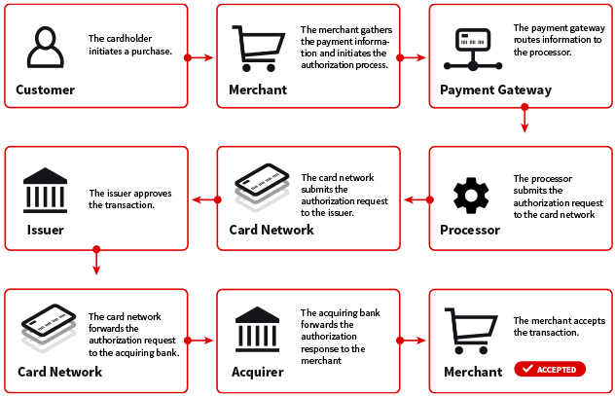
Stages of Payment Processing - authorization
* https://homebusinessmag.com/money/how-to-guides-money/step-step-guide-processing-online-payments/

Slide 10
Stages of Payment Processing - batching
Rather than using real-time data transmission to submit individual transactions to be paid one at a time, it’s generally considered more efficient for merchants to store transaction data and submit it in a batch.*
Not only is this process more efficient, it also provides time to manually review each order and check for indicators of fraud.*
If fraud is detected, the transaction can be terminated.*
But if transactions are processed immediately without the manual review process, there is a strong likelihood that unauthorized transactions will be overlooked and the resulting chargebacks will cause significant revenue loss.*
* https://homebusinessmag.com/money/how-to-guides-money/step-step-guide-processing-online-payments/

Slide 11
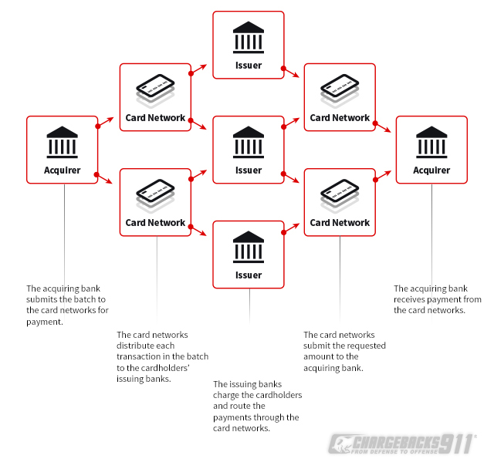
Stages of Payment Processing - clearing
At the next step in the cycle, the acquirer accepts the batched transactions from the processor and forwards them to the card networks.*
The card networks then distribute the payments to the corresponding issuer.*
The issuer debits the cost of the transaction from the cardholder’s account, then routes those funds back to the acquirer via the card network.*
* https://homebusinessmag.com/money/how-to-guides-money/step-step-guide-processing-online-payments/

Slide 12
Stages of Payment Processing - funding
Funding is the last step in the process, at which point the acquirer deposits the money from the transaction into the merchant’s account.*
Of course, the services provided by each party in the chain of events do not come free—the final total the merchant receives will be minus fees assessed by each party in the transaction.*
The interchange fee is paid to the issuer.
The assessment fee is charged by the card networks.
The processor’s fee is collected by the processor.
* https://homebusinessmag.com/money/how-to-guides-money/step-step-guide-processing-online-payments/

Slide 13
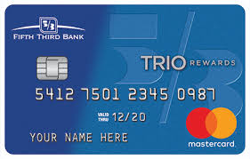
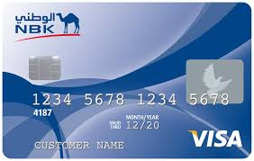
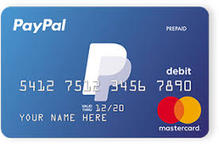
Types of e-commerce payments
Credit Card*
The most popular form of payment for e-commerce transactions.
It is simple to use; the customer has to just enter their credit card number and date of expiry in the appropriate area on the seller’s web page.
To improve the security system, increased security measures, such as the use of a card verification number (CVN), have been introduced to on-line credit card payments.
The CVN system helps detect fraud by comparing the CVN number with the cardholder's information.
*https://services.amazon.in/resources/seller-blog/different-types-of-e-commerce-payment-systems.html

Slide 14
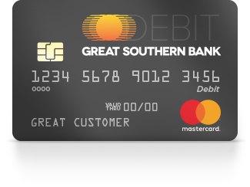
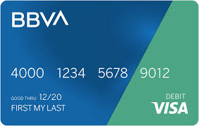
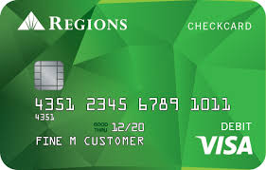
Types of e-commerce payments
Debit Card*
Debit cards are the second largest e-commerce payment medium in India.
Customers who want to spend online within their financial limits prefer to pay with their Debit cards.
With the debit card, the customer can only pay for purchased goods with the money that is already there in his/her bank account as opposed to the credit card where the amounts that the buyer spends are billed to him/her and payments are made at the end of the billing period.
*https://services.amazon.in/resources/seller-blog/different-types-of-e-commerce-payment-systems.html

Slide 15
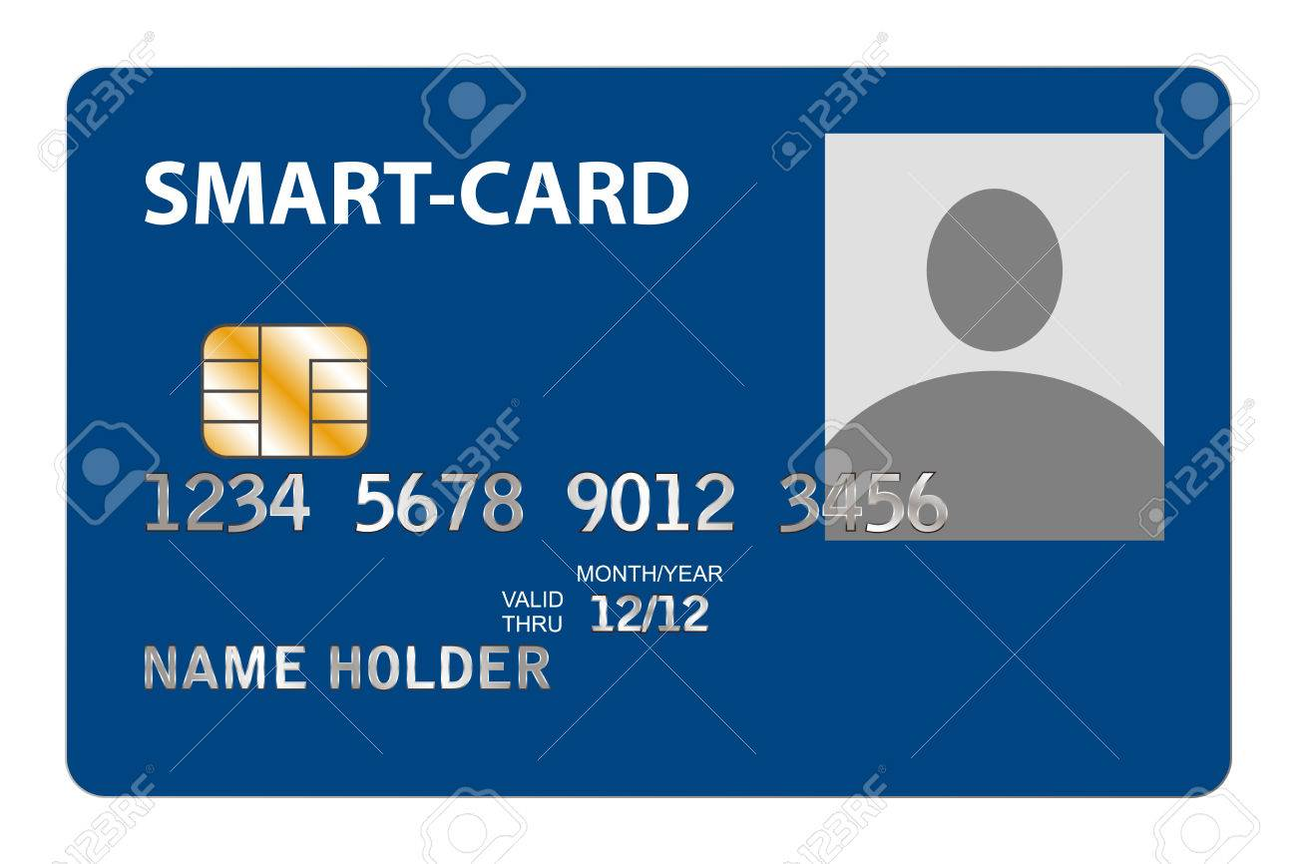
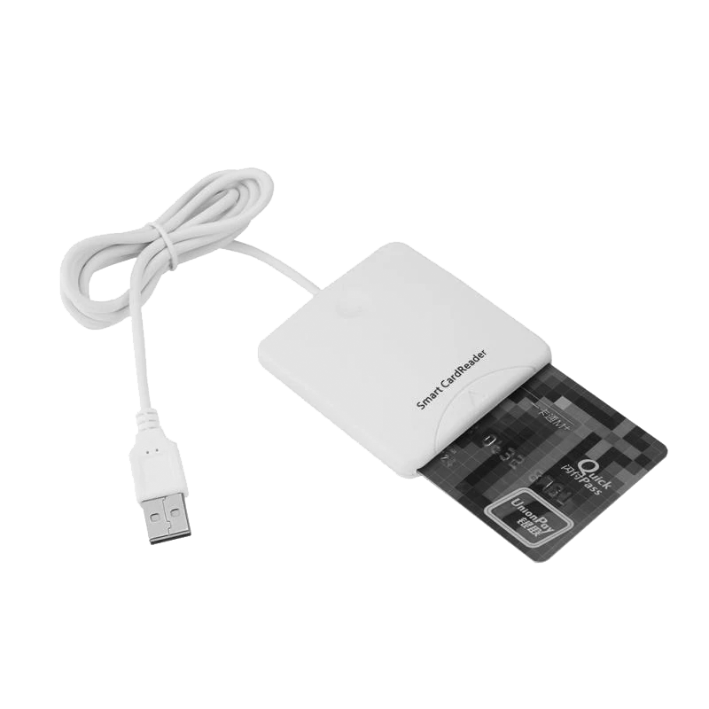
Types of e-commerce payments
Smart Card*
It is a plastic card embedded with a microprocessor that has the customer’s personal information stored in it and can be loaded with funds to make online transactions and instant payment of bills.
The money that is loaded in the smart card reduces as per the usage by the customer and has to be reloaded from his/her bank account.
*https://services.amazon.in/resources/seller-blog/different-types-of-e-commerce-payment-systems.html

Slide 16
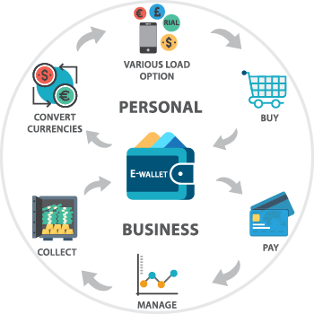
Types of e-commerce payments
E-Wallet*
E-Wallet is a prepaid account that allows the customer to store multiple credit cards, debit card and bank account numbers in a secure environment.
This eliminates the need to key in account information every time while making payments.
Once the customer has registered and created E-Wallet profile, he/she can make payments faster.
*https://services.amazon.in/resources/seller-blog/different-types-of-e-commerce-payment-systems.html
** https://eniac-tech.com/en/Ewallet.php

Slide 17
Types of e-commerce payments
Netbanking
This is another popular way of making e-commerce payments.
It is a simple way of paying for online purchases directly from the customer’s bank.
It uses a similar method to the debit card of paying money that is already there in the customer’s bank.
Net banking does not require the user to have a card for payment purposes but the user needs to register with his/her bank for the net banking facility.
While completing the purchase the customer just needs to put in their net banking id and pin.
*https://services.amazon.in/resources/seller-blog/different-types-of-e-commerce-payment-systems.html

Slide 18
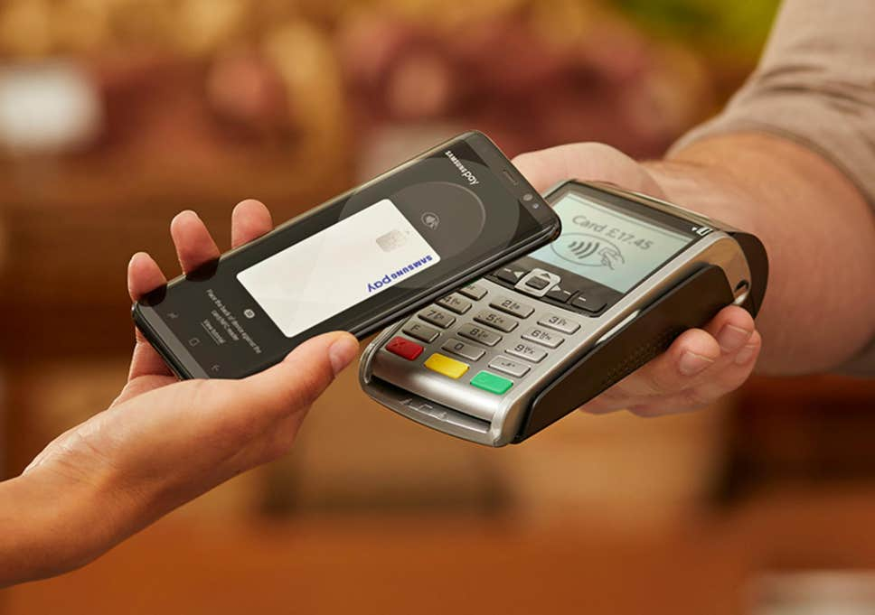
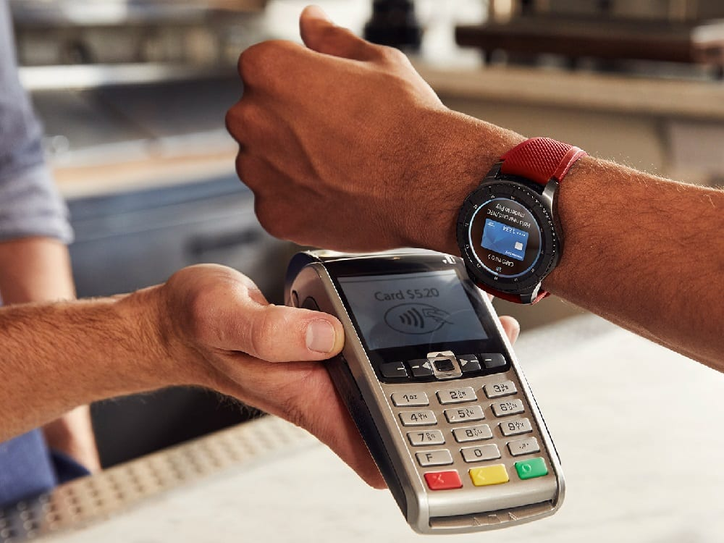
Types of e-commerce payments
Mobile Payment*
One of the latest ways of making online payments are through mobile phones.
Instead of using a credit card or cash, all the customer has to do is send a payment request to his/her service provider via text message; the customer’s mobile account or credit card is charged for the purchase.
To set up the mobile payment system, the customer just has to download a software from his/her service provider’s website and then link the credit card or mobile billing information to the software.
*https://services.amazon.in/resources/seller-blog/different-types-of-e-commerce-payment-systems.html

Slide 19
Address verification system for all transaction
It is extremely important for store owners to predict and analyze that the person making the purchase is truly a cardholder.*
Various techniques can be utilized to prevent this fraud.*
Implementing the address verification system in the e-Commerce store is the best way to analyze and verify the fraud.*
The system will check if the billing address is correct by verifying it with cardholder’s data from the issuing bank.*
As a result person with a stolen card or card number doesn’t have the access to the wrong billing address.*
Incorrect billing address may not necessarily mean that the transaction is fraudulent hence it is advisable to take additional security measures to identify the customer.*
*https://magnetoitsolutions.com/blog/ecommerce-payment-security

Slide 20
Secure Socket Layer (SSL)
Secure socket layer is the most consistent security model used and developed for eCommerce business, secured through its payment channel.*
Through the SSL, transmission of data is encrypted, client and server information is authenticated and message integrity for TCP/IP connections.*
The protocol is design to prevent tampering of information and forgery while transmitting data over the internet between interacting applications.*
*https://magnetoitsolutions.com/blog/ecommerce-payment-security

Slide 21
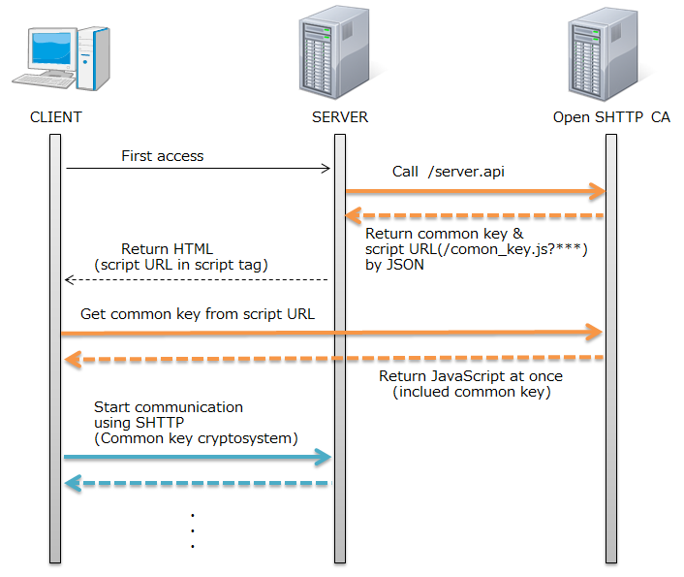
Secure Hypertext Transfer Protocol (S-HTTP)
S-HTTP is an advanced version of normal HTTP internet protocol with enhanced security which ensures secure authentication, public key encryption and digital signatures.
Secure HTTP enabled website makes the transaction more secure by negotiating encryptions schemes used between a server and the clients.
It can seamlessly integrate with the HTTP and ensure an optimal end-user security with different defence mechanisms.
*https://magnetoitsolutions.com/blog/ecommerce-payment-security
** https://networkencyclopedia.com/secure-hypertext-transfer-protocol-s-http/

Slide 22
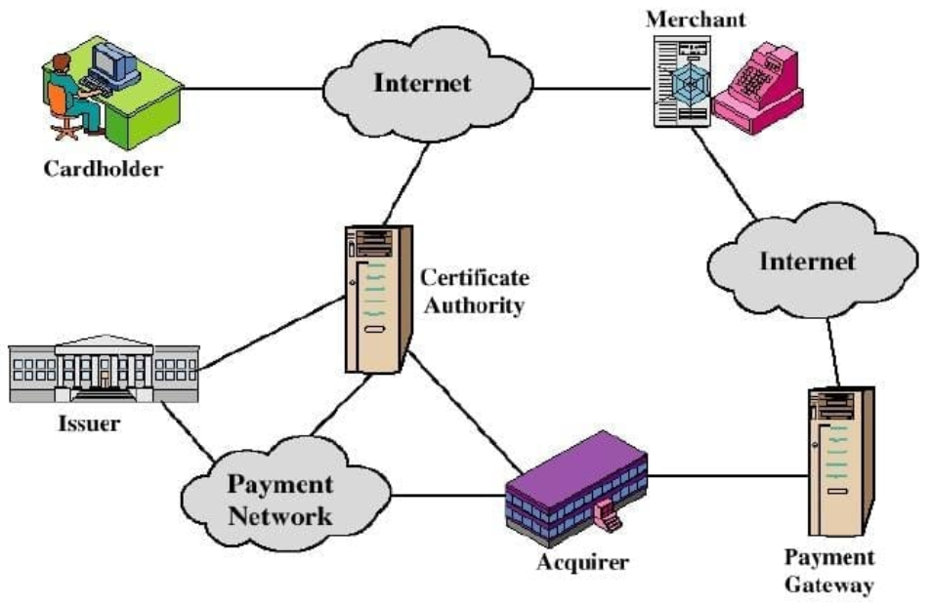
Secure Electronic Transaction (SET)
SET is a joint collaboration by MasterCard and VISA which ensures that safety of all parties involved in electronic payments of an e-Commerce transaction.
It is designed to handle complex and critical functions like:
Authenticating the cardholders and merchants;
Confidentiality of information and payment data;
Define protocols & electronic security service, providers.
*https://magnetoitsolutions.com/blog/ecommerce-payment-security

Slide 23
Electronic payment system
https://securionpay.com/blog/e-payment-system/
https://www.business2community.com/ecommerce/e-payment-system-01641721
https://squareup.com/us/en/townsquare/electronic-payment-systems
https://www.worldpay.com/en-us/insights-hub/article/choosing-the-right-electronic-payment-system-for-your-business
https://www.slideshare.net/inam12/e-payment-methods-28602565
https://www.techwalla.com/articles/types-of-ecommerce-payment-systems

Slide 24
The end
Thank you for your attention!
Any questions?

