Slide 1
E-business
Trends of e-business development
Petr Suchánek
E-business

Slide 2
Outline of the lecture
Business Intelligence (BI)
Competitive Intelligence (CI)
E-business trends

Slide 3
Business Intelligence
The term Business Intelligence (BI) refers to technologies, applications and practices for the collection, integration, analysis, and presentation of business information.*
The purpose of Business Intelligence is to support better business decision making.*
Essentially, Business Intelligence systems are data-driven Decision Support Systems (DSS).*
Business Intelligence is sometimes used interchangeably with briefing books, report and query tools and executive information systems.*
*https://olap.com/learn-bi-olap/olap-bi-definitions/business-intelligence/

Slide 4
Business Intelligence
Overall, the role of business intelligence is to improve all parts of a company by improving access to the firm's data and then using that data to increase profitability.*
Companies that employ BI practices can translate their collected data into insights of their business processes.*
The insights can then be used to create strategic business decisions that improve productivity, increase revenue and accelerate growth.*
*https://olap.com/learn-bi-olap/olap-bi-definitions/business-intelligence/

Slide 5
Business Intelligence
Other potential benefits of business intelligence tools include:
accelerating and improving decision-making;
optimizing internal business processes;
increasing operational efficiency;
driving new revenues;
gaining competitive advantage over business rivals;
assisting companies in the identification of market trends; and
spotting business problems that need to be addressed.
*https://searchbusinessanalytics.techtarget.com/definition/business-intelligence-BI

Slide 6
Business Intelligence – analysis*
Spreadsheet Analysis
Analyzing data contained in spreadsheets with the goal of evaluating or anticipating company wide, or specific unit performance. E.g., using Excel to track hours your employees work.
Ad-Hoc Query
Software that allows users to develop their own specific data queries. E.g., creating a query that displays how many of one item has been sold in a specific time period.
Visualization Tools
Software that takes raw data and creates a visualization that users can read and understand. E.g., a pie chart that compares the method by which customers contacted you in a one-month period.
*https://www.apex.com/four-main-types-bi/

Slide 7
Business Intelligence – monitoring*
Dashboard
A central location where all useful and actionable metrics and data are contained. They are usually represented graphically to make it easier for users to read. E.g., the new Google+ dashboards which can be accessed by logging into your business Google+ page and selecting Dashboard from the drop-down menu on the left.
Key Performance Indicators (KPIs)
KPIs measure the performance of a specific action or project. E.g., Return on Investment (ROI).
Business Performance Management
A system that is designed to ensure that performance goals for your organization or projects are being met and results are being delivered. E.g., number of new customers acquired. Some businesses and BI providers will call this the Balanced Scorecard.
*https://www.apex.com/four-main-types-bi/

Slide 8
Business Intelligence – prediction*
The reason many businesses employ BI methodologies is to try and predict what will happen based on the data currently available and other trends. There are two main types of prediction:
Data Mining
Is the act of finding patterns and relations in and between large sets of data. The main goal of data mining is to extract or transform data into something we can understand and further use.
Predictive Modelling
Any modeling that sets out to predict the outcome of an action, or the probability of an outcome.
*https://www.apex.com/four-main-types-bi/

Slide 9
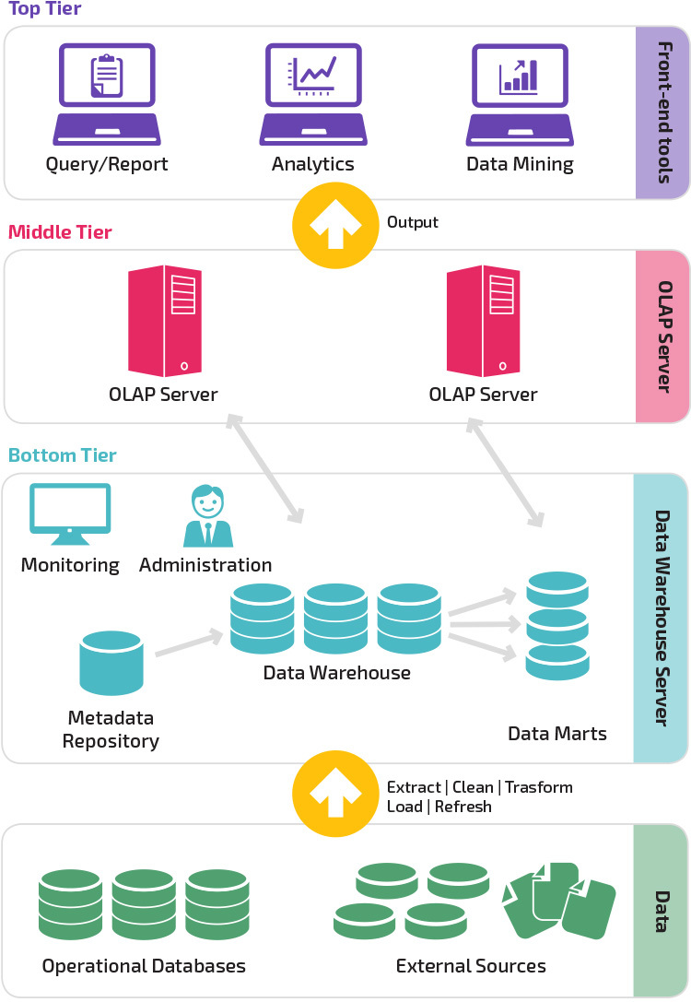
Business Intelligence – data warehouse
A data warehouse is a relational database that aggregates structured data from across an entire organization.*
It pulls together data from multiple sources - much of it is typically online transaction processing (OLTP) data.*
The data warehouse selects, organizes and aggregates data for efficient comparison and analysis.*
*https://panoply.io/data-warehouse-guide/bi-and-data-warehousing/

Slide 10
Business Intelligence
Business intelligence combines a broad set of data analysis applications, including:
Ad hoc analytics;
Online analytical processing (OLAP);
Mobile BI;
Real time BI;
Operational BI;
Software-as-a-service BI (SaaS BI);
Open source BI (OSBI);
Collaborative BI;
Location intelligence (LI).
*https://searchbusinessanalytics.techtarget.com/definition/business-intelligence-BI

Slide 11
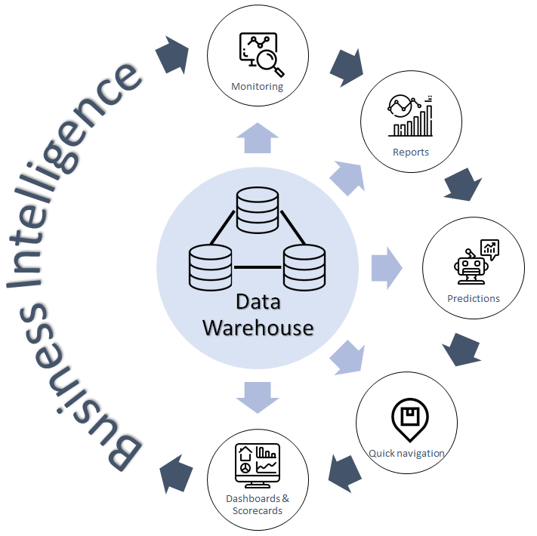
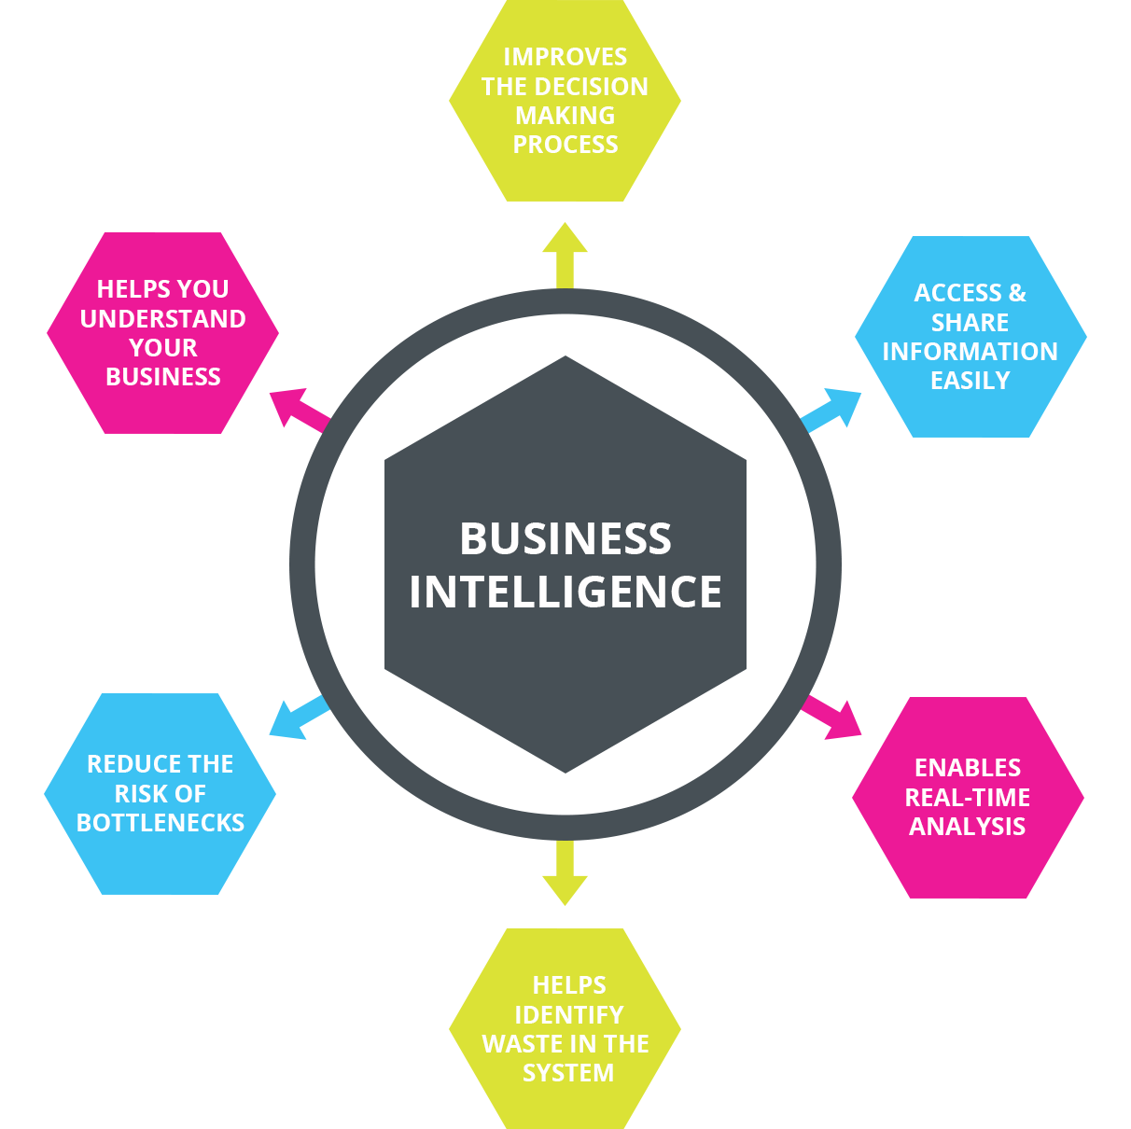
Business Intelligence
*https://bluesoft.com/en/competence-centers/business-intelligence-data-warehouse/
**http://www.matricis.com/en/iot-advanced-analytics/business-intelligence/

Slide 12
Business Intelligence
https://www.jinfonet.com/resources/bi-defined/bi-reporting/
https://www.sisense.com/blog/real-difference-reporting-business-intelligence/
https://searchbusinessanalytics.techtarget.com/definition/business-intelligence-BI
https://mopinion.com/business-intelligence-bi-tools-overview/
https://brainstation-23.com/business-intelligence-for-e-commerce/
https://data-flair.training/blogs/business-intelligence-and-data-warehousing/
https://selecthub.com/business-intelligence/business-intelligence-and-data-warehousing/

Slide 13
Competitive Intelligence
Competitive intelligence refers to information collected by a company about rival businesses and markets, which may then be analyzed to create more effective business strategies moving forward.*
By definition, competitive intelligence assembles actionable information from diverse published and unpublished sources, collected efficiently and ethically.*
Ideally, a business successfully employs competitive intelligence by cultivating a detailed enough portrait of the marketplace, that it may anticipate and respond to challenges and problems before they arise.*
*https://www.investopedia.com/terms/c/competitive-intelligence.asp

Slide 14
Competitive Intelligence – tactical intelligence
This approach is on a smaller scale and usually operational, not focusing much on being predictive.*
Some examples of tactical issues are competitors’ plans for modifying the manner by which they distinguish one, two or multiple products from yours, their price policies and terms of sale.*
Some of the key users of this approach are middle-level sales and marketing managers because they have a desire to know how to be a winner each day.*
*https://www.cleverism.com/competitor-analysis-competitive-intelligence/

Slide 15
Competitive Intelligence – strategic intelligence
This approach mainly has to do with acquiring comprehension of a competitor’s current strategy, future goals, capabilities – diagnostic components and conjectures with respect to itself and the industry.*
Intelligence pertaining to the firm’s partners (in research and development or marketing alliances), suppliers and chief customers is frequently also of strategic value.*
*https://www.cleverism.com/competitor-analysis-competitive-intelligence/

Slide 16
Competitive Intelligence – counter intelligence
Counter intelligence involves protecting company secrets.*
Just as you are interested in knowing your competitors’ plans, they may be interested in knowing your plans, possibly even more interested than you in theirs.*
Frequently, this area of effort would incorporate information technology and security.*
Others such as firing and hiring strategies are frequently overlooked so that competitor opportunities can be contained within the firm.*
*https://www.cleverism.com/competitor-analysis-competitive-intelligence/

Slide 17
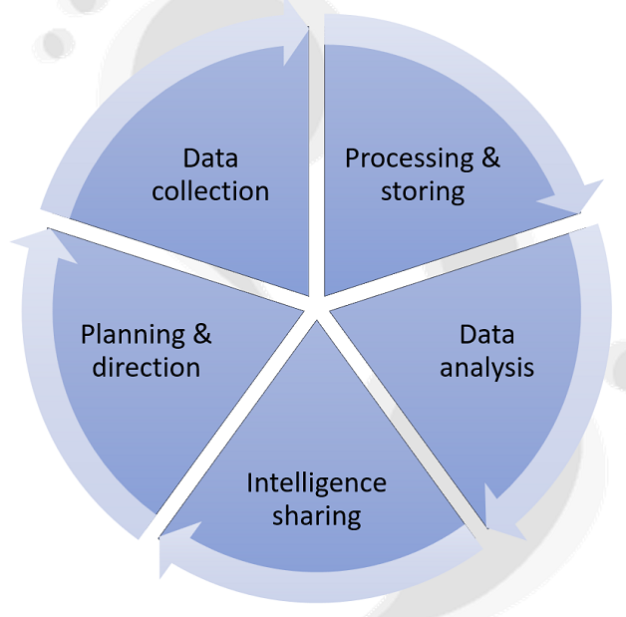
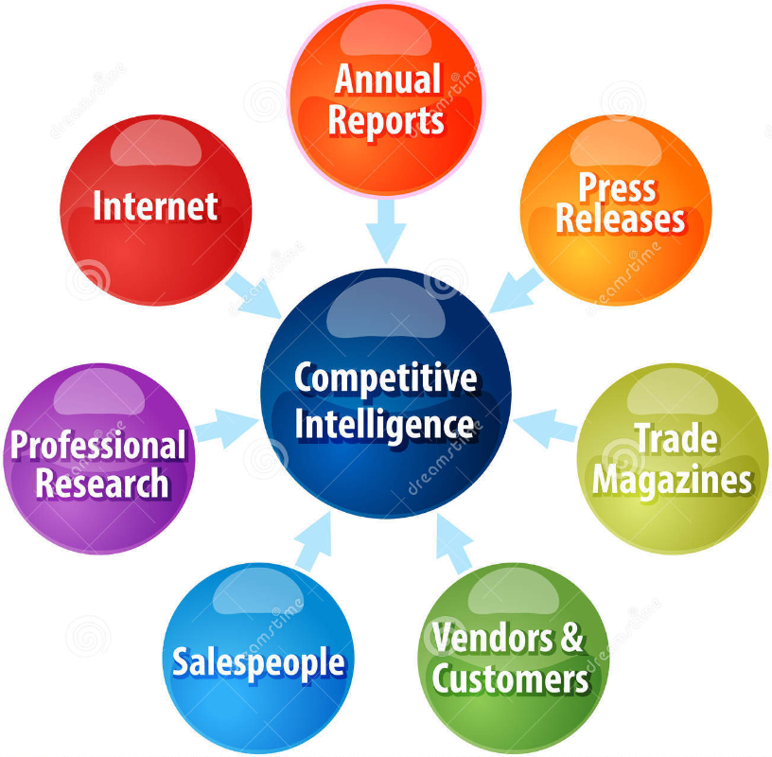
Competitive Intelligence – cycle
*https://www.talkwalker.com/blog/marketers-guide-to-competitive-intelligence
**https://www.dreamstime.com/stock-illustration-competitive-intelligence-business-diagram-illustration-strategy-concept-infographic-sources-image53015208

Slide 18
Competitive Intelligence
http://competia.com/50-competitive-intelligence-analysis-techniques
https://www.marketingsherpa.com/article/how-to/5-tactics-to-research-your
https://www.cleverism.com/competitor-analysis-competitive-intelligence/
https://www.crayon.co/blog/6-steps-to-design-a-successful-competitive-intelligence-process
https://isngs.com/market-intelligence-techniques/
https://www.segmentify.com/blog/5-essential-steps-for-a-detailed-competitor-analysis-in-ecommerce/

Slide 19
E-business trends
https://www.businessnewsdaily.com/10557-ecommerce-trends-to-watch.html
https://ecommerce-platforms.com/articles/5-future-ecommerce-trends-of-2019
https://www.business.com/articles/ecommerce-trends-2019/
https://www.cloudways.com/blog/latest-ecommerce-trends/
https://www.forbes.com/sites/jiawertz/2019/07/26/3-e-commerce-trends-leading-the-way-in-2019/#6b210a2e5560
https://www.etondigital.com/11-e-commerce-trends-to-watch-out-for-in-2019/

Slide 20
The end
Thank you for your attention!
Any questions?

