Slide 1

Informatics
Text editors - 1
Petr Suchánek
Informatics

Slide 2

Outline of the lecture
Text editors
Microsoft Office Word
Microsoft Word Options
Character & Text formatting
Paragraphs
Styles
Numbering

Slide 3
Text editors
A text editor is a computer program that lets a user enter, change, store, and usually print text (characters and numbers, each encoded by the computer and its input and output devices, arranged to have meaning to users or to other programs).*
Typically, a text editor provides an "empty" display screen (or "scrollable page") with a fixed-line length and visible line numbers. You can then fill the lines in with text, line by line.*
The word processor has replaced the typewriter as a way to generate print writing, and features items like margins, spell check and fonts which accommodate different types of presentation for letters, documents, etc.**
*https://whatis.techtarget.com/definition/text-editor
**https://www.techopedia.com/definition/5478/text-editor

Slide 4
Microsoft Office Word*
With Word on your PC, Mac, or mobile device, you can:
Create documents from scratch, or a template.
Add text, images, art, and videos.
Research a topic and find credible sources.
Access your documents from a computer, tablet, or phone with OneDrive.
Share your documents, and work with others.
Track and review changes.
*https://support.office.com/en-gb/article/create-a-document-in-word-aafc163a-3a06-45a9-b451-cb7250dcbaa1?wt.mc_id=otc_word

Slide 5
Microsoft Word – some features*
Edit Document
  Word offer many time saving features to help you edit text in a document. You can add, delete & rearrange text. You can also quickly count the number of words in a document. Check your document for spelling & grammar errors & use words the thesaurus to find more suitable words.
Format Document
  You can format a document to enhance the appearance of the document you can use various font, styles and colours to important text. You can also adjust the spacing between lines of text, changes the margins and create newspaper columns.
*https://sciencetutorz.blogspot.com/2017/11/microsoft-word-2016.html

Slide 6
Microsoft Word – some features*
Edit Images
  Ms Word 2010, 13 & 16 includes a palette of artistic tool & filters you can apply to images in your documents.
Tables & Graphics
  You can format a document to enhance the appearance of the document you can use various font, styles and colours to important text. You can also adjust the spacing between lines of text, changes the margins and create newspaper columns.
Business Talks
  Ms Word 2016 offers you to business talk with your Microsoft account using the skype. Using this feature, you can create skype chat groups and work with your group members online on a single project.
*https://sciencetutorz.blogspot.com/2017/11/microsoft-word-2016.html

Slide 7
Microsoft Word – text formatting*
Formatting text in Microsoft Word involves tasks like:
  bolding the text;
  italicising it,
  changing the font;
  changing the size.
The commands to perform all of these formatting tasks are found on the Home tab in the Font group.
Select your text and then click on the required formatting button to see the effects.
*http://www.electricteacher.com/wformat.htm

Slide 8
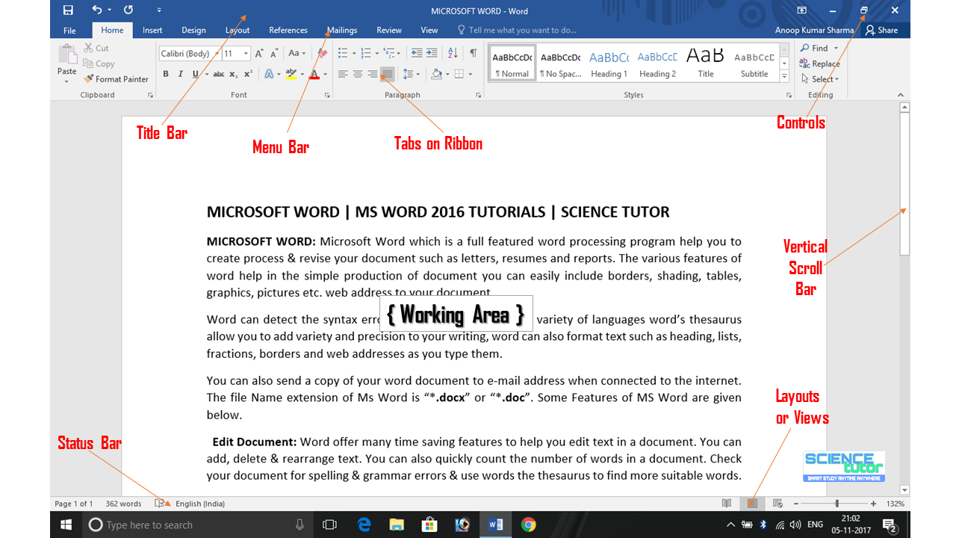
Microsoft Office Word*
*https://sciencetutorz.blogspot.com/2017/11/microsoft-word-2016.html

Slide 9
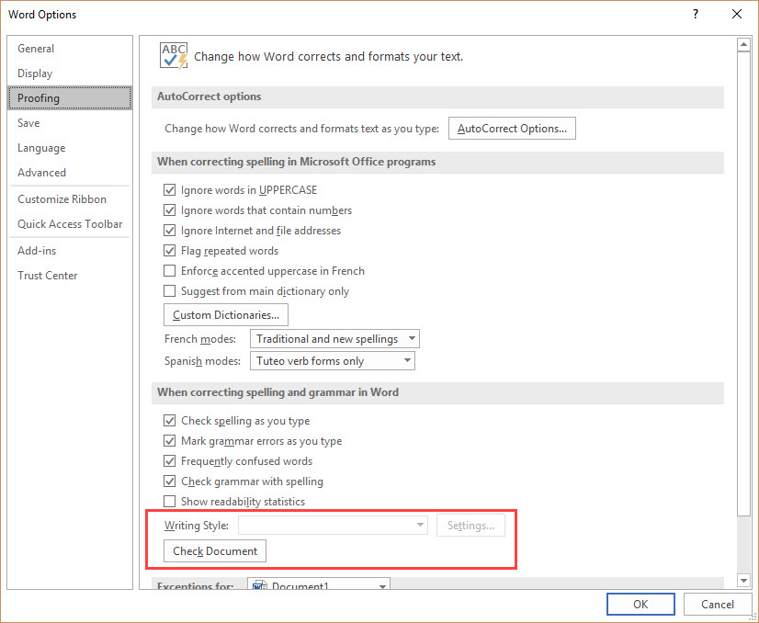
Microsoft Word - Options
File/Options
*https://answers.microsoft.com/en-us/msoffice/forum/all/writing-style-option-is-grayed-out-disabled-in-ms/f8492425-1e2b-4c65-8ea1-11781eb0c52f

Slide 10
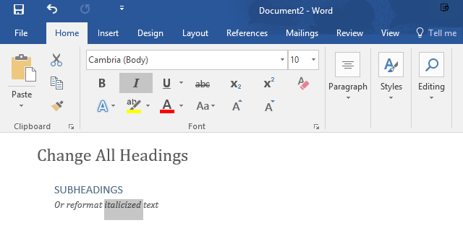
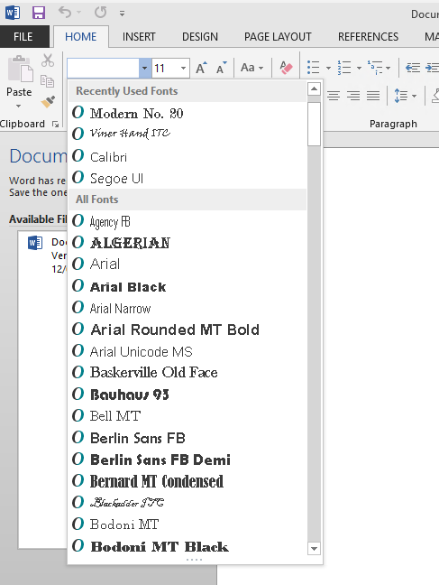
Microsoft Word – text formatting
Select some text in your document that represents the formatting you want to change. It could be just one word.*
*https://www.laptopmag.com/articles/select-text-similar-formatting-word

Slide 11
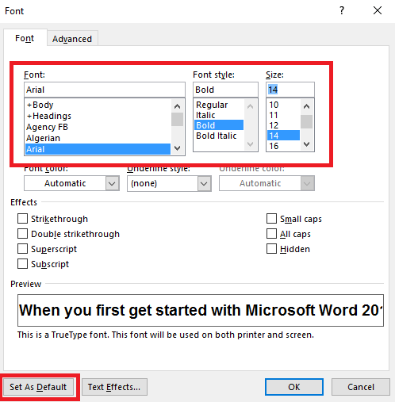
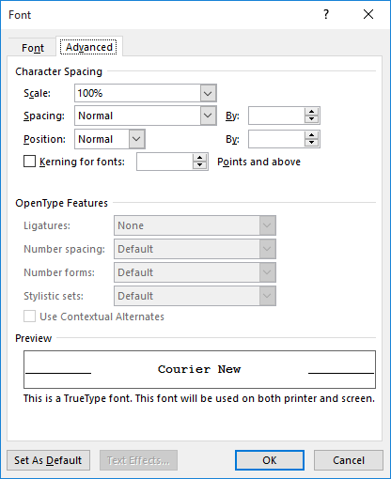
Microsoft Word – text formatting
Formatting text – Home/Font
*https://www.windowscentral.com/how-change-font-defaults-microsoft-word-2016-windows
**https://wordribbon.tips.net/T006009_Adjusting_the_Width_of_Characters.html

Slide 12
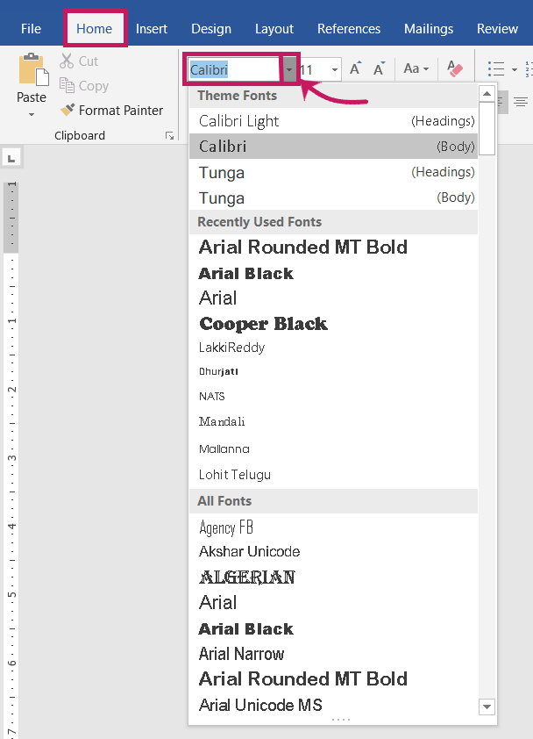
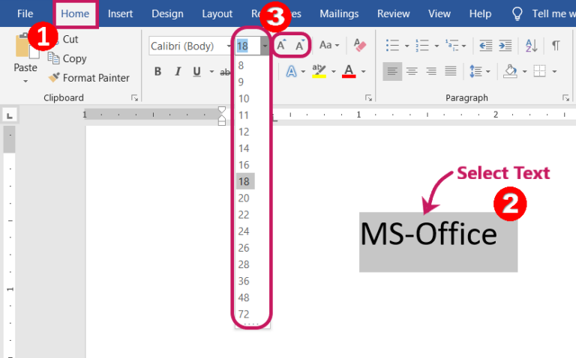
Microsoft Word – text formatting
https://www.digiruns.com/font-text-formatting-in-microsoft-word/
*https://www.digiruns.com/font-text-formatting-in-microsoft-word/

Slide 13
Microsoft Word – paragraphs
A paragraph in Word is any text that ends with a hard return. You insert a hard return anytime you press the Enter key.*
Paragraph formatting lets you control the appearance if individual paragraphs.*
For example, you can change the alignment of text from left to center or the spacing between lines form single to double.*
You can indent paragraphs, number them, or add borders and shading to them.*
Paragraph formatting is applied to an entire paragraph.*
All formatting for a paragraph is stored in the paragraph mark and carried to the next paragraph when you press the Enter key.*
*https://www.mediacollege.com/microsoft/word/paragraph.html

Slide 14
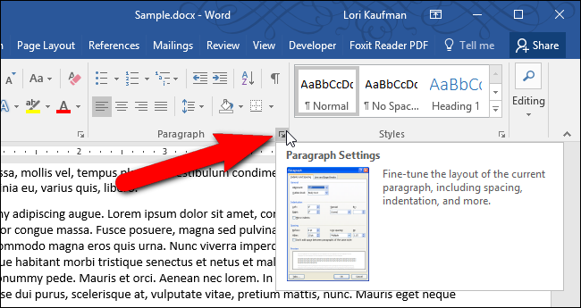
Microsoft Word – paragraphs*
*https://www.howtogeek.com/256909/how-to-stop-a-paragraph-from-splitting-between-pages-in-microsoft-word/

Slide 15
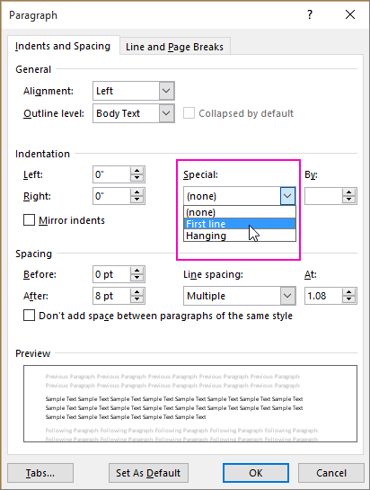
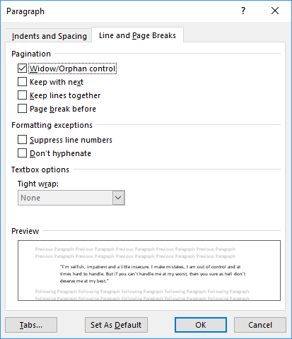
Microsoft Word – paragraphs*/**
*https://support.office.com/en-us/article/indent-the-first-line-of-a-paragraph-b3721167-e1c8-40c3-8a97-3f046fc72d6d
**https://www.officetooltips.com/word_2016/tips/how_to_keep_lines_and_paragraphs_together_in_a_word_document.html

Slide 16
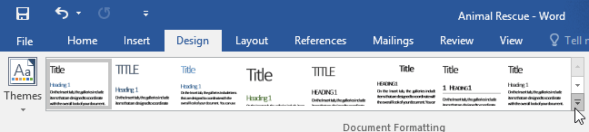
Microsoft Word – styles*
A style is a predefined combination of font style, color, and size that can be applied to any text in your document.
Styles can help your documents achieve a more professional look and feel.
You can also use styles to quickly change several things in your document at the same time.
*https://edu.gcfglobal.org/en/word2016/applying-and-modifying-styles/1/

Slide 17
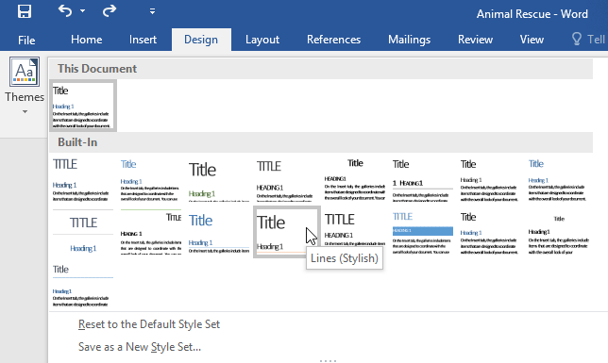
Microsoft Word – styles*
From the Design tab, click the More drop-down arrow in the Document Formatting group.
Choose the desired style set from the drop-down menu.
The selected style set will be applied to your entire document.
*https://edu.gcfglobal.org/en/word2016/applying-and-modifying-styles/1/

Slide 18
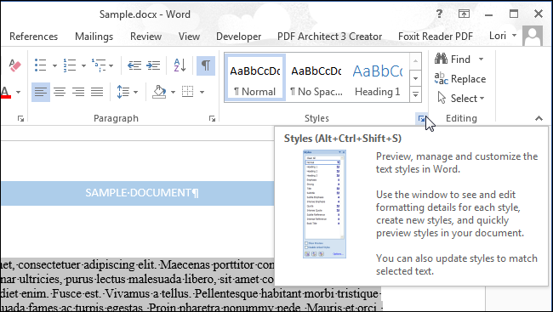
Microsoft Word – styles*
You can also quickly change the formatting for all paragraphs with the same style in an existing document.*
Open the document and click the “Styles” button in the “Styles” section of the “Home” tab.*
*https://www.howtogeek.com/220776/how-to-set-paragraph-formatting-in-word/

Slide 19
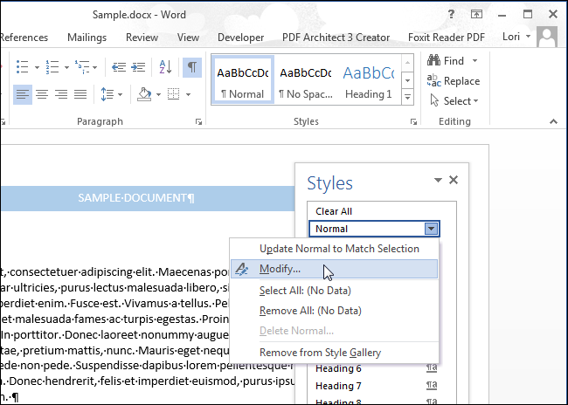
Microsoft Word – styles*
Find the style you want to change in the list and move your mouse over it.*
Click down arrow and select “Modify” from the drop-down list.*
*https://www.howtogeek.com/220776/how-to-set-paragraph-formatting-in-word/

Slide 20
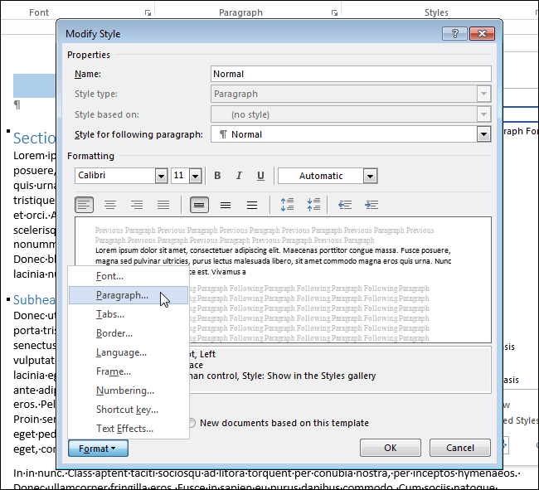
Microsoft Word – styles*
Select options on the “Modify Style” dialog box to change the formatting to what you want.
Click the “Format” button for access to additional formatting options.*
*https://www.howtogeek.com/220776/how-to-set-paragraph-formatting-in-word/

Slide 21
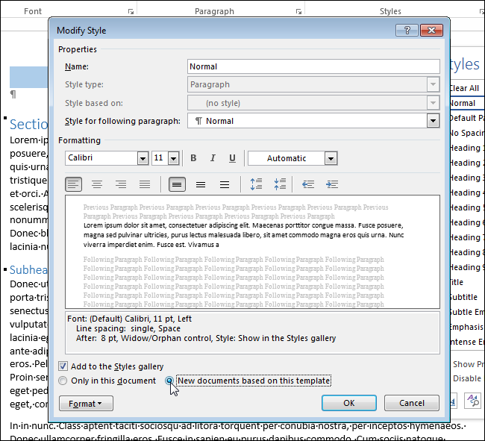
Microsoft Word – styles*
To apply the formatting changes to all new documents based on the current template, select the “New documents based on this template” radio button.
This saves the formatting changes to the current template so that the next time you create a document based on this template, the new formatting will be used.
*https://www.howtogeek.com/220776/how-to-set-paragraph-formatting-in-word/

Slide 22
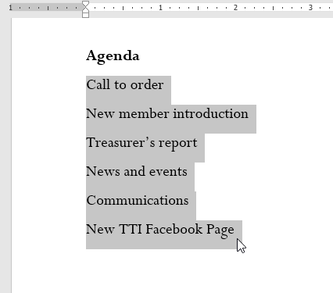
Microsoft Word – bulleted lists*
Bulleted and numbered lists can be used in your documents to outline, arrange, and emphasize text.
Select the text you want to format as a list.
*https://edu.gcfglobal.org/en/word2016/lists/1/

Slide 23
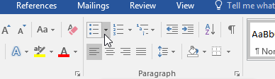
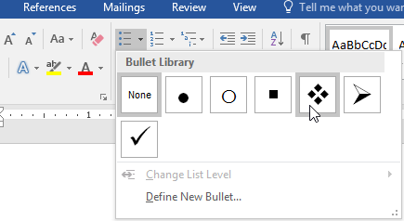
Microsoft Word – bulleted lists*
On the Home tab, click the drop-down arrow next to the Bullets command. A menu of bullet styles will appear.
Move the mouse over the various bullet styles. A live preview of the bullet style will appear in the document. Select the bullet style you want to use.
*https://edu.gcfglobal.org/en/word2016/lists/1/

Slide 24
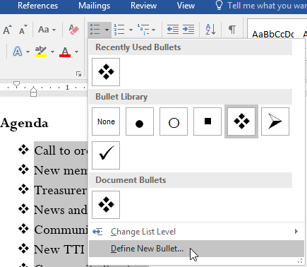
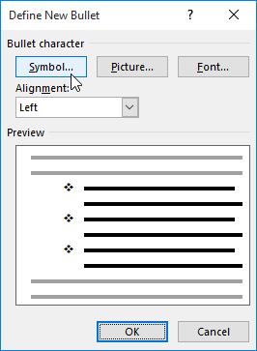
Microsoft Word – bulleted lists*
On the Home tab, click the drop-down arrow next to the Bullets command. Select Define New Bullet from the drop-down menu.
The Define New Bullet dialog box will appear. Click the Symbol button.
*https://edu.gcfglobal.org/en/word2016/lists/1/

Slide 25
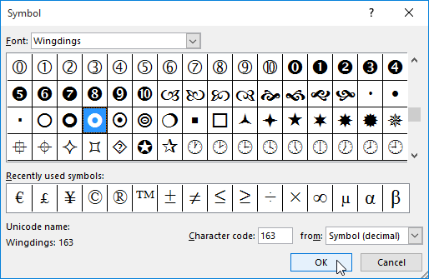
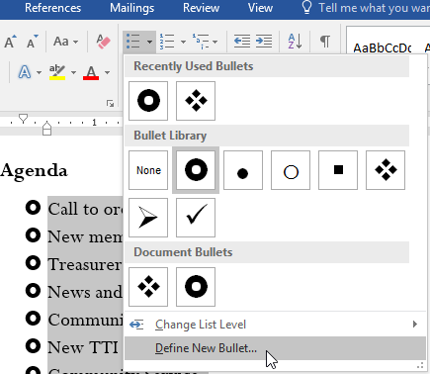
Microsoft Word – bulleted lists*
*https://edu.gcfglobal.org/en/word2016/lists/1/

Slide 26
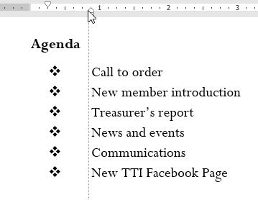
Microsoft Word – bulleted lists*
To remove numbers or bullets from a list, select the list and click the Bulleted or Numbered list command.
When you're editing a list you can press Enter to start a new line, and the new line will automatically have a bullet or number. When you've reached the end of your list, press Enter twice to return to normal formatting.
By dragging the indent markers on the Ruler, you can customize the indenting of your list and the distance between the text and the bullet or number.
*https://edu.gcfglobal.org/en/word2016/lists/1/

Slide 27

Microsoft Word – numbered lists*
Numbered lists are created in a manner similar to bulleted lists, except that instead of bullets Word places sequential numbers.
This is a very useful feature, because if you add a paragraph in the middle of a numbered list or rearrange the order of the paragraphs in a list, Word automatically renumbers the paragraphs so that they retain their sequence.
On the Home tab, in the Paragraph group, click Bullets or Numbering.
*https://www.officetooltips.com/word_2016/tips/creating_numbered_lists.html

Slide 28
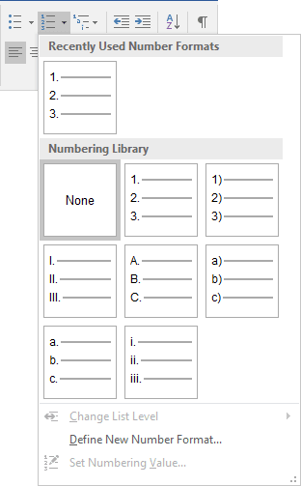
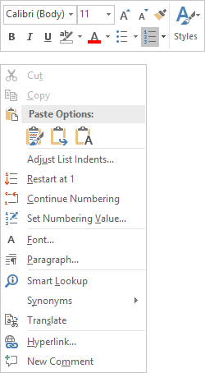
Microsoft Word – numbered lists*
You can find different bullet styles and numbering formats by clicking the arrow next to Bullets or Numbering on the Home tab, in the Paragraph group.
You can move an entire list to the left or the right. Click a bullet or number in the list, and drag it to a new location. The entire list moves as you drag. The numbering levels do not change.
*https://www.officetooltips.com/word_2016/tips/creating_numbered_lists.html

Slide 29
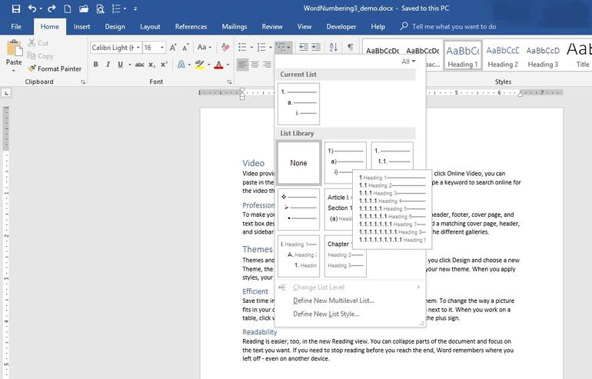
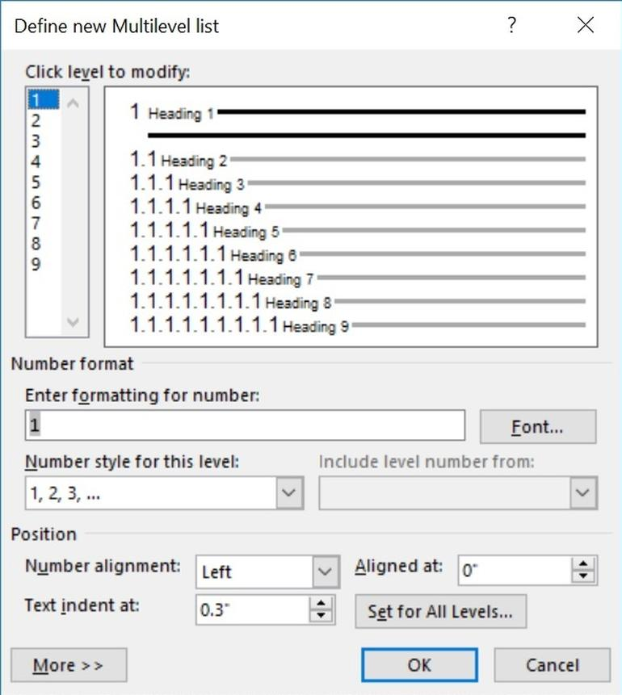
Microsoft Word – heading multilevel numbering*
*https://www.techrepublic.com/article/how-to-create-multilevel-numbered-headings-in-word-2016/

Slide 30
The end
Thank you for your attention!
Any questions?

