Slide 1

Informatics
Spreadsheet calculator - I
Petr Suchánek
Informatics

Slide 2

Outline of the lecture
Data file
Data sources – external data
Cells
Sheets
Table and list
Formulas and functions
Charts

Slide 3
Spreadsheet calculator
A spreadsheet is a computer application or program that enables the user to tabulate and collate data.*
This data can then be used to make calculations, show graphical representations or analysis.*
A spreadsheet comprises of a grid of ‘cells’ arranged in rows and columns and information can be inserted into each cell.*
Each cell can contain text, numbers and formulas.*
A formula is a calculation based from the contents of cells or a total of a combination of cells. The total in that formula can change if the content of the combination cells used is also amended.*
* https://www.digitalunite.com/technology-guides/creating-documents/microsoft-excel/what-spreadsheet

Slide 4
Spreadsheet calculator
Spreadsheets can be useful for home budgeting or accounting and they make it easy to display information.*
Spreadsheets can consist of a number of different worksheets that can include different data as well as enabling cells on one worksheet to be used and referenced on other different worksheets.*
Information can also be sorted and filtered by a spreadsheet.*
The Microsoft Office spreadsheet is called Excel but there are open office spreadsheets available, including internet based web apps such as Google spreadsheets.*
Spreadsheets have a number of tools included to support many different types of calculations and can include graphical presentations such as graphs, pie charts etc.*
* https://www.digitalunite.com/technology-guides/creating-documents/microsoft-excel/what-spreadsheet

Slide 5
Microsoft Office Excel
Microsoft Excel is a spreadsheet program included in the Microsoft Office suite of applications.*
Microsoft Excel usually comes bundled with Microsoft Office and is compatible with other applications offered in the suite of products.*
In addition to its standard spreadsheet features, Excel also offers programming support via Microsoft's Visual Basic for Applications (VBA), the ability to access data from external sources via Microsoft’s Dynamic Data Exchange (DDE), and extensive graphing and charting capabilities.*
* https://www.webopedia.com/TERM/M/microsoft_excel.html

Slide 6
Data file
You can save an Excel file in another file format by clicking the File / Save As.*
The file formats that are available in the Save As dialog box vary, depending on what type of sheet is active (a worksheet, chart sheet, or other type of sheet).*
https://support.office.com/en-us/article/file-formats-that-are-supported-in-excel-0943ff2c-6014-4e8d-aaea-b83d51d46247
If you have on your computer an xls file and you save it in xlsx, you will see that the size has been significantly reduced.**
The XML code compress your file. Have a look at this tip.**
*https://support.office.com/en-us/article/file-formats-that-are-supported-in-excel-0943ff2c-6014-4e8d-aaea-b83d51d46247
**https://www.excel-exercise.com/xls-xlsx-file/

Slide 7
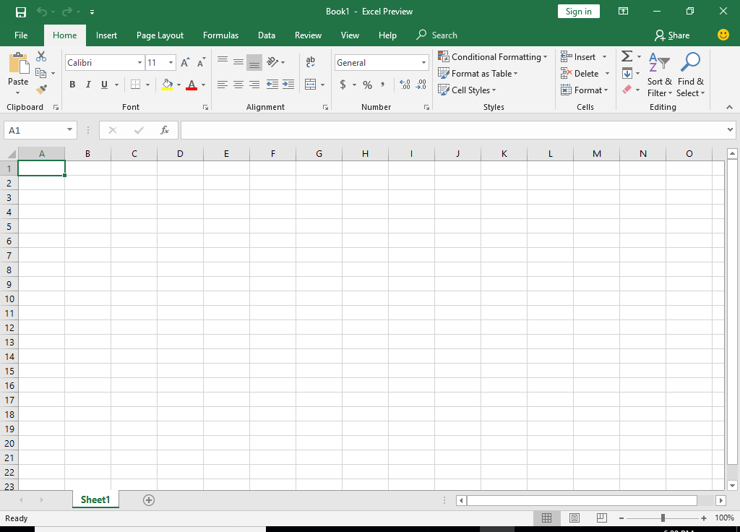
Microsoft Excel 2016
*https://techhelpday.com/microsoft-office-2019/
**

Slide 8
Data file
You can save an Excel file in another file format by clicking the File / Save As.*
The file formats that are available in the Save As dialog box vary, depending on what type of sheet is active (a worksheet, chart sheet, or other type of sheet).*
https://support.office.com/en-us/article/file-formats-that-are-supported-in-excel-0943ff2c-6014-4e8d-aaea-b83d51d46247
If you have on your computer an xls file and you save it in xlsx, you will see that the size has been significantly reduced.**
The XML code compress your file. Have a look at this tip.**
*https://support.office.com/en-us/article/file-formats-that-are-supported-in-excel-0943ff2c-6014-4e8d-aaea-b83d51d46247
**https://www.excel-exercise.com/xls-xlsx-file/

Slide 9
Data sources – external data
The main benefit of connecting to external data is that you can periodically analyze this data in Microsoft Office Excel without repeatedly copying the data, which is an operation that can be time-consuming and error-prone.*
After connecting to external data, you can also automatically refresh (or update) your Excel workbooks from the original data source whenever the data source is updated with new information.*
https://support.office.com/en-us/article/tutorial-import-data-into-excel-and-create-a-data-model-4b4e5ab4-60ee-465e-8195-09ebba060bf0
*https://support.office.com/en-us/article/connect-to-import-external-data-9967afd8-85ee-4df3-aa06-753bcc1a2724

Slide 10
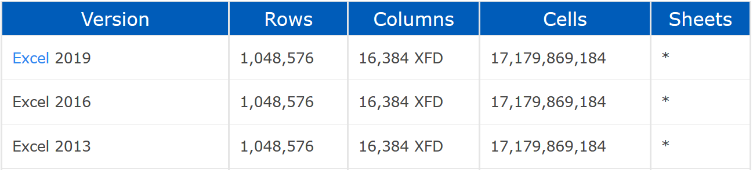
Cells
The number of cells, columns, rows, and sheets supported by a spreadsheet depend on the software being used, and the data contained in the spreadsheet.*
* https://www.computerhope.com/issues/ch000357.htm

Slide 11
Cells
There are two types of cell references: relative and absolute. Relative and absolute references behave differently when copied and filled to other cells.*
Relative references change when a formula is copied to another cell.*
Absolute references, on the other hand, remain constant no matter where they are copied.*
By default, all cell references are relative references.*
* https://edu.gcfglobal.org/en/excel2016/relative-and-absolute-cell-references/1/

Slide 12
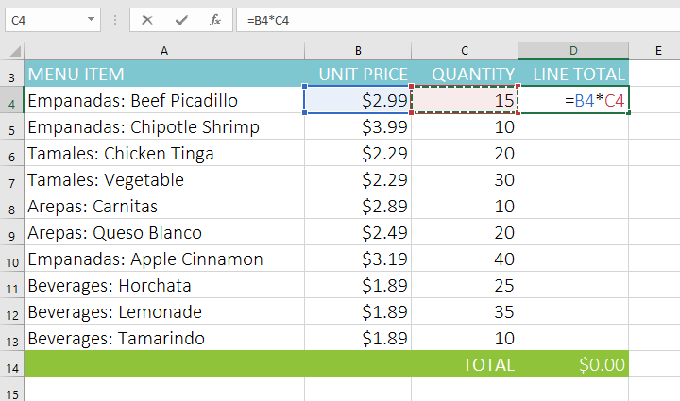
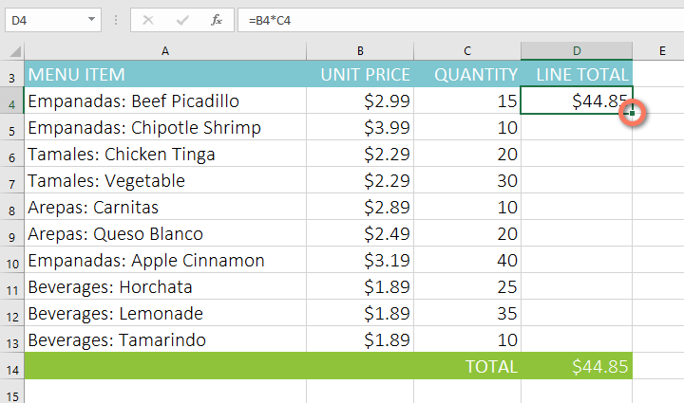
Cells
When copied across multiple cells, they change based on the relative position of rows and columns.*
For example, if you copy the formula =A1+B1 from row 1 to row 2, the formula will become =A2+B2.*
Relative references are especially convenient whenever you need to repeat the same calculation across multiple rows or columns.*
*https://edu.gcfglobal.org/en/excel2016/relative-and-absolute-cell-references/1/

Slide 13
Cells
There may be a time when you don't want a cell reference to change when copied to other cells.*
Unlike relative references, absolute references do not change when copied or filled.*
You can use an absolute reference to keep a row and/or column constant.*
An absolute reference is designated in a formula by the addition of a dollar sign ($).*
It can precede the column reference, the row reference, or both.*
*https://edu.gcfglobal.org/en/excel2016/relative-and-absolute-cell-references/1/

Slide 14
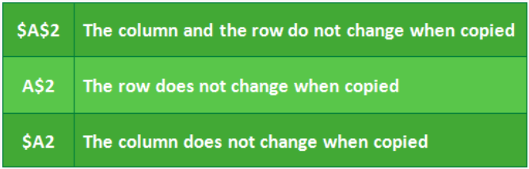
Cells
When writing a formula, you can press the F4 key on your keyboard to switch between relative and absolute cell references, as shown in the video below.*
This is an easy way to quickly insert an absolute reference.*
https://edu.gcfglobal.org/en/excel2016/relative-and-absolute-cell-references/1/
*https://edu.gcfglobal.org/en/excel2016/relative-and-absolute-cell-references/1/

Slide 15
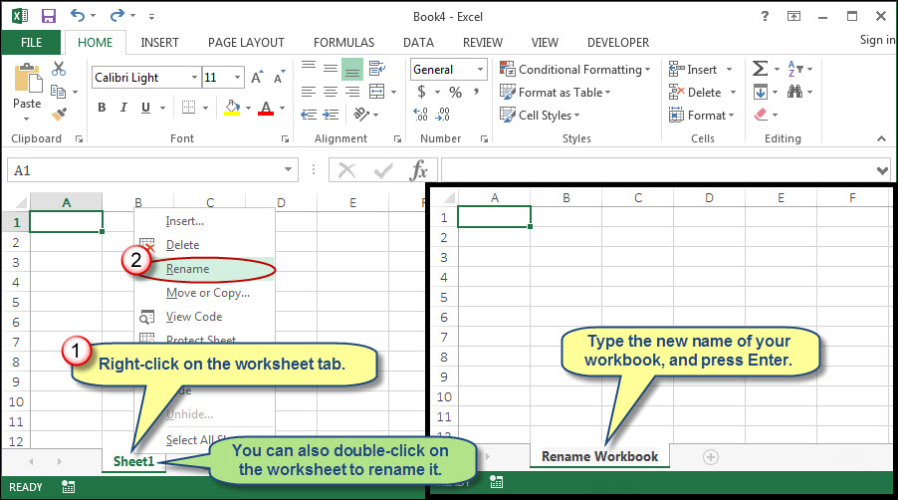
Sheets
*https://edu.gcfglobal.org/en/excel2016/relative-and-absolute-cell-references/1/

Slide 16
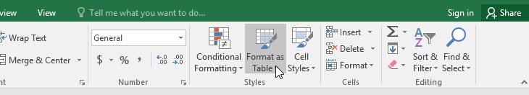
Table and list
Once you've entered information into your worksheet, you may want to format your data as a table.*
Just like regular formatting, tables can improve the look and feel of your workbook, and they'll also help you organize your content and make your data easier to use.*
Excel includes several tools and predefined table styles, allowing you to create tables quickly and easily.*
https://edu.gcfglobal.org/en/excel2016/tables/1/
*https://edu.gcfglobal.org/en/excel2016/tables/1/

Slide 17
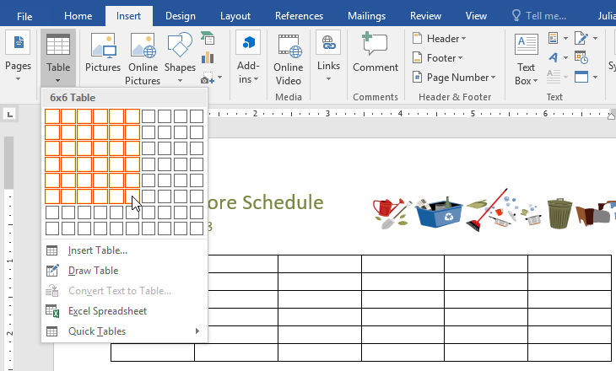
Table and list
*https://edu.gcfglobal.org/en/excel2016/tables/1/

Slide 18
Table and list
https://edu.gcfglobal.org/en/excel2016/tables/1/
https://support.office.com/en-us/article/create-and-format-tables-e81aa349-b006-4f8a-9806-5af9df0ac664
https://support.office.com/en-us/article/overview-of-excel-tables-7ab0bb7d-3a9e-4b56-a3c9-6c94334e492c
https://www.contextures.com/xlExcelTable01.html

Slide 19
Formulas and functions
One of the most powerful features in Excel is the ability to calculate numerical information using formulas.*
Just like a calculator, Excel can add, subtract, multiply, and divide.*
Excel uses standard operators for formulas, such as:
  a plus sign for addition (+);
  a minus sign for subtraction (-);
  an asterisk for multiplication (*);
  a forward slash for division (/);
  a caret (^) for exponents.
All formulas in Excel must begin with an equals sign (=).
*https://edu.gcfglobal.org/en/excel2016/intro-to-formulas/1/

Slide 20
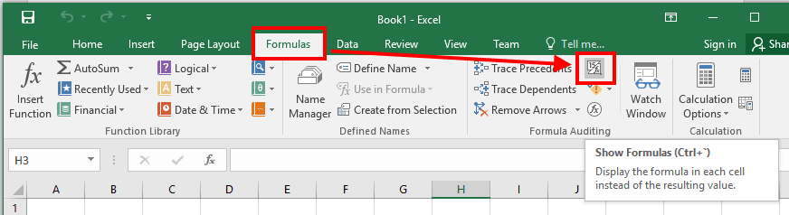
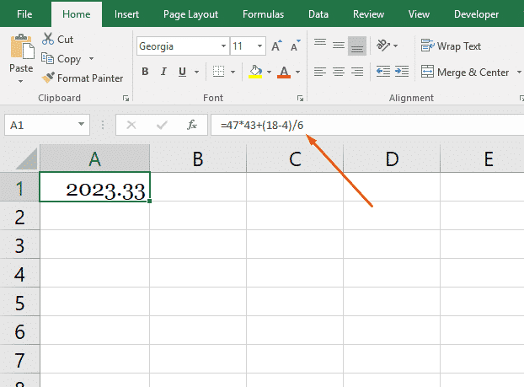
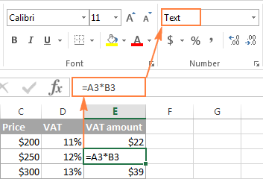
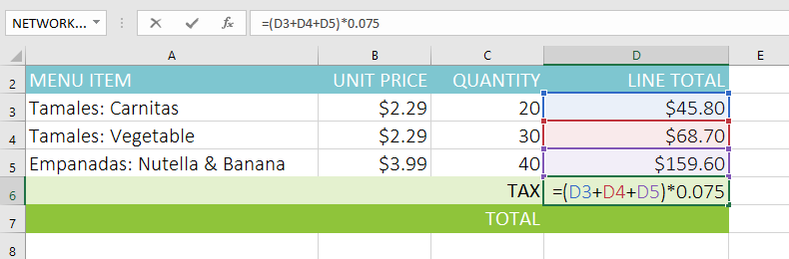
Formulas and functions
*https://edu.gcfglobal.org/en/excel2016/intro-to-formulas/1/

Slide 21
Formulas and functions
Functions, just like formulas, always begin with an equal sign (=). After the equal sign, you enter in the name of the function.*
It doesn't matter if you enter it in uppercase or lowercase. Following the name of the function, you provide the arguments of the function.*
Arguments are always enclosed parentheses.*
There are just a few things you need to remember before starting to insert functions into your spreadsheets:
  When typing a function into a cell, don't insert spaces between the equal sign, function name, and arguments.*
  If you're adding more than one value, separate each function with a comma.*
*https://www.universalclass.com/articles/computers/excel/excel-2016-how-to-use-formulas-and-functions.htm

Slide 22
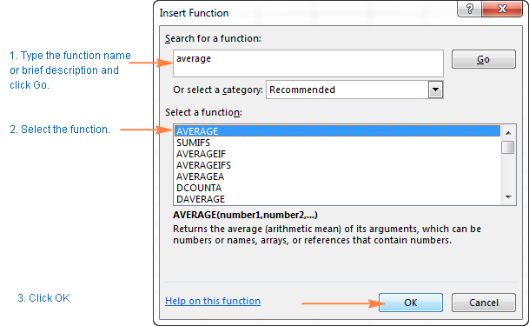
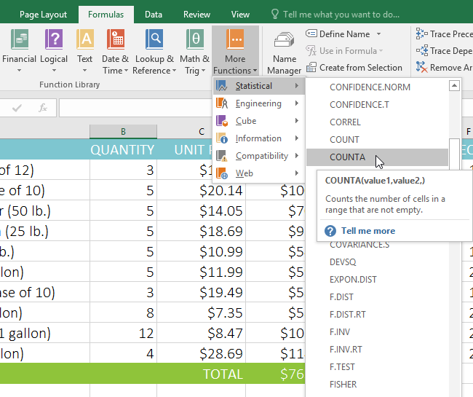
Formulas and functions
To insert a function directly into a cell, click the cell where you want to insert the function. Next, go to the Formulas tab, then click Insert Function.*
When you click Insert Function, you'll see this dialogue box:
*https://www.universalclass.com/articles/computers/excel/excel-2016-how-to-use-formulas-and-functions.htm

Slide 23
Formulas and functions
https://support.office.com/en-us/article/overview-of-formulas-in-excel-ecfdc708-9162-49e8-b993-c311f47ca173
https://www.universalclass.com/articles/computers/excel/excel-2016-how-to-use-formulas-and-functions.htm
https://www.managementboek.nl/code/inkijkexemplaar/9780789755643/excel-2016-formulas-and-functions-engels-paul-mcfedries.pdf
https://www.excel-easy.com/introduction/formulas-functions.html
https://edu.gcfglobal.org/en/excel2016/intro-to-formulas/1/

Slide 24
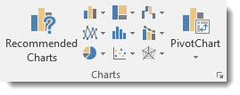
Charts
In Excel 2016, charts and diagrams can show trends, averages, high and low points, and more.*
Not only do they make your worksheets more visually appealing, they also serve a definite function.*
They make it easier for your intended audience to sort out and understand the information you are presenting to them.*
This is especially true when dealing with data.*
*https://www.universalclass.com/articles/computers/excel/excel-2016-creating-charts-and-diagrams.htm

Slide 25
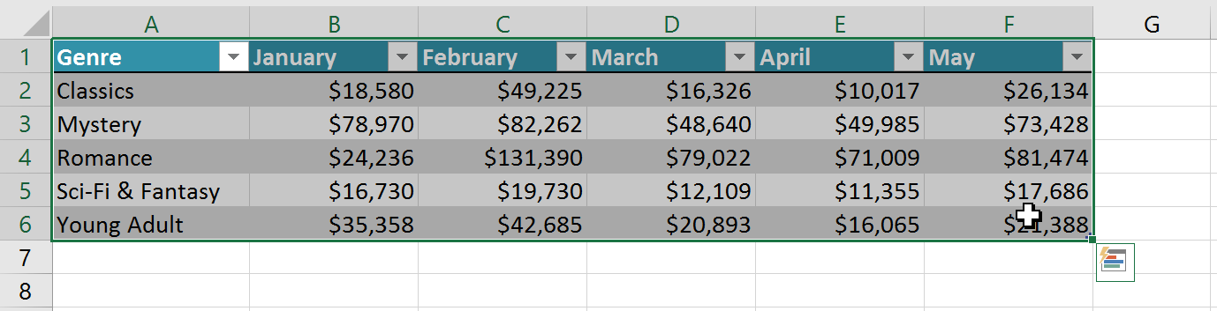
Charts
Excel has several different types of charts, allowing you to choose the one that best fits your data.*
In order to use charts effectively, you'll need to understand how different charts are used.*
Select the cells you want to chart, including the column titles and row labels. These cells will be the source data for the chart.*
*https://edu.gcfglobal.org/en/excel2016/charts/1/

Slide 26
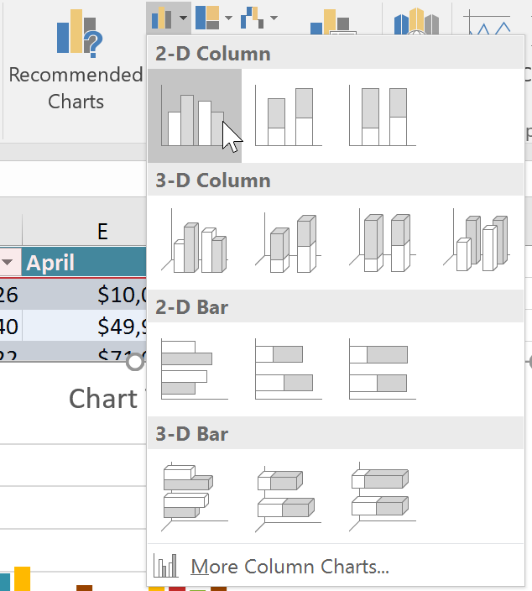
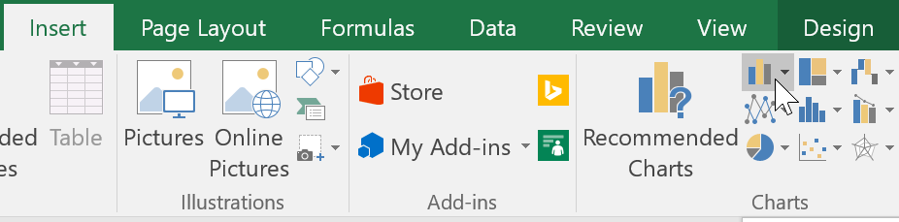
Charts
From the Insert tab, click the desired Chart command. In our example, we'll select Column.*
Choose the desired chart type from the drop-down menu.*
*https://edu.gcfglobal.org/en/excel2016/charts/1/

Slide 27
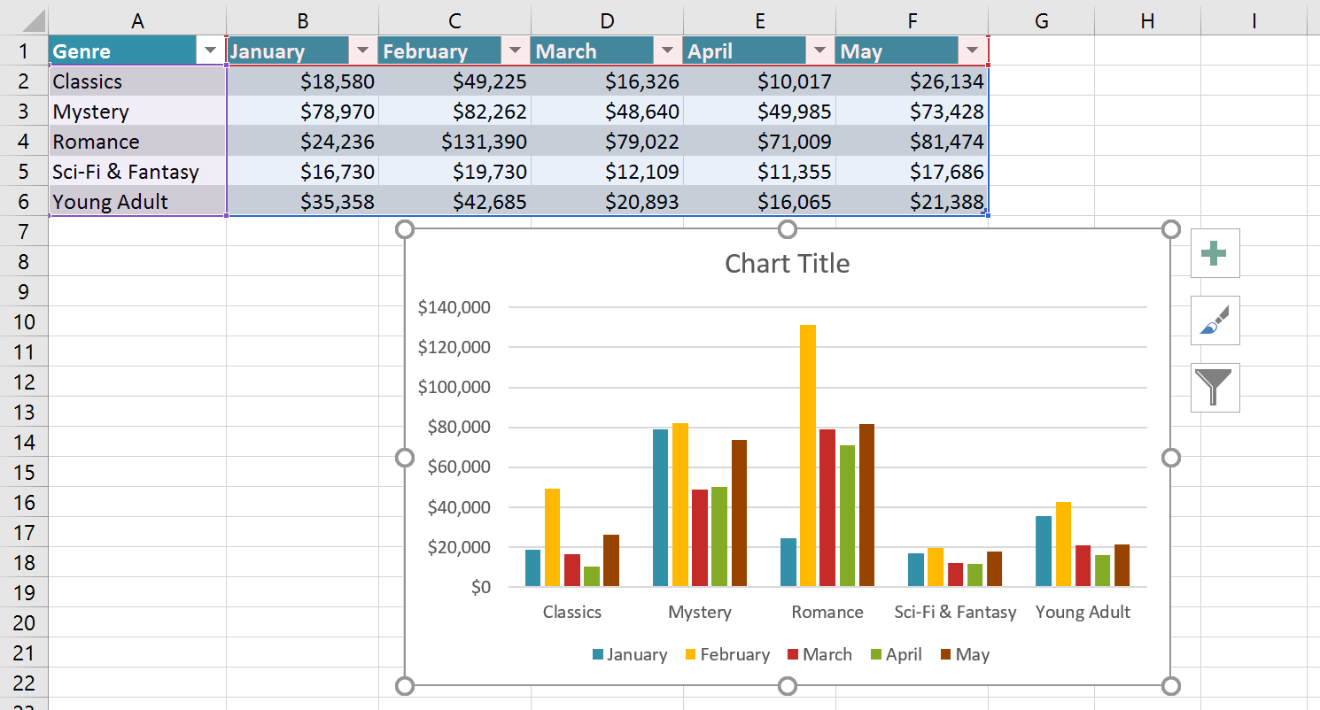
Charts
The Selected chart will be inserted into the worksheet.*
*https://edu.gcfglobal.org/en/excel2016/charts/1/

Slide 28
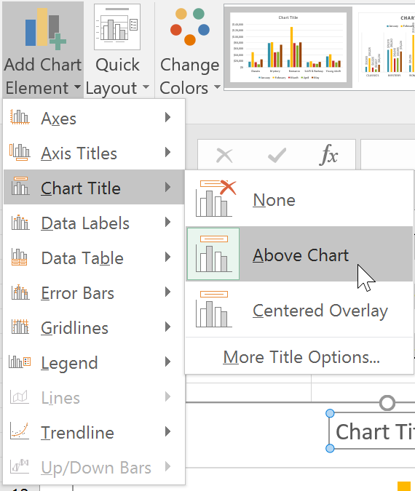
Charts
Excel allows you to add chart elements—such as chart titles, legends, and data labels - to make your chart easier to read.*
To add a chart element, click the Add Chart Element command on the Design tab, then choose the desired element from the drop-down menu.*
*https://edu.gcfglobal.org/en/excel2016/charts/1/

Slide 29
Charts
https://edu.gcfglobal.org/en/excel2016/charts/1/
https://www.techonthenet.com/excel/charts/line_chart2016.php
https://support.office.com/en-us/article/create-a-chart-with-recommended-charts-cd131b77-79c7-4537-a438-8db20cea84c0
https://trumpexcel.com/advanced-charts/
https://www.smartsheet.com/how-to-make-charts-in-excel
https://www.microsoft.com/en-us/microsoft-365/blog/2015/07/02/introducing-new-and-modern-chart-types-now-available-in-office-2016-preview/

Slide 30
The end
Thank you for your attention!
Any questions?

