Slide 1
Quantitative Methods
Lecture 1
Introduction,
sets and mathematical language
INM/BAKVM

Slide 3
Syllabus (short version)
1. Motivational introduction, history of mathematics
2. Algebraic Expressions
3. Equations and Inequalities
4. Matrix calculus
5. Determinants
6. Systems of linear algebraic equations
7. Sequences, limits of sequences
8. Basic functions of one real variable
9. Limits of functions of one real variable
10. Differential calculus of functions of one real variable
11. Using differential calculus of functions of one real variable
12. Integral calculus of functions of one variable and its applications
13. Application of differential and integral calculus in economics and management

Slide 4
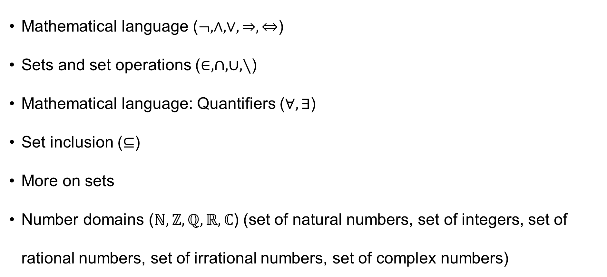
Mathematical language ($¬,∧,∨,⇒,⇔$)
Sets and set operations ($∈,∩,∪,∖$)
Mathematical language: Quantifiers ($∀,∃$)
Set inclusion ($⊆$)
More on sets
Number domains ($ℕ,ℤ,ℚ,ℝ,ℂ$) (set of natural numbers, set of integers, set of rational numbers, set of irrational numbers, set of complex numbers)

Slide 5
Mathematical language
Simple propositions
Logical conjunctions
Some useful equivalences
Sylogism

Slide 6
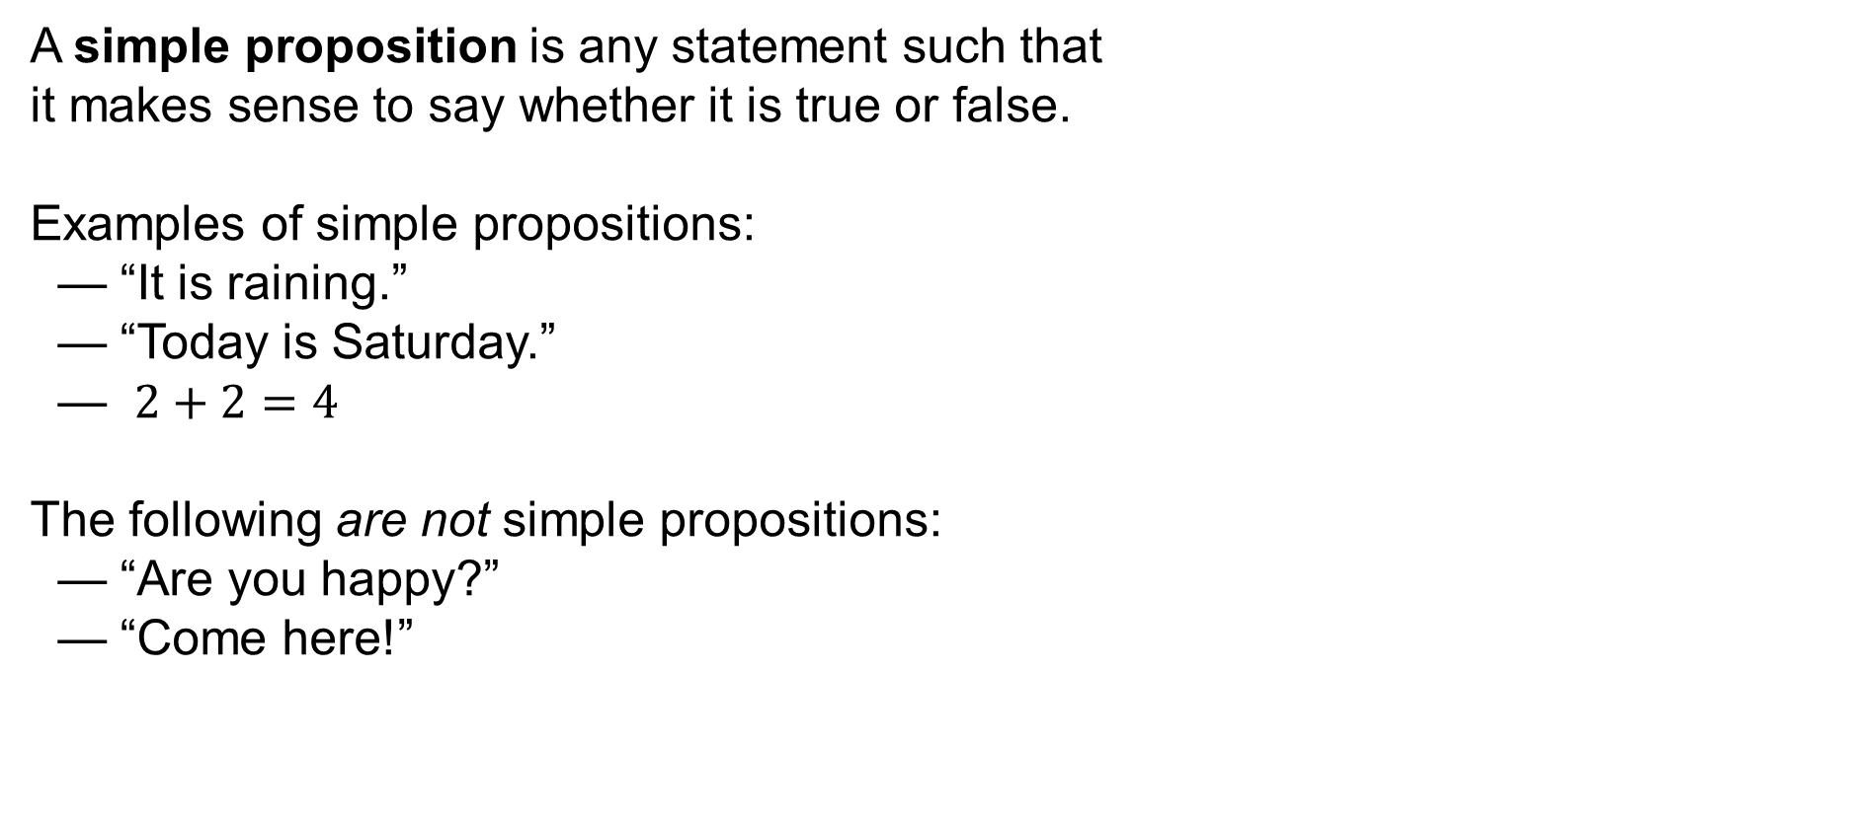
Mathematical language
A simple proposition is any statement such that
it makes sense to say whether it is true or false.
Examples of simple propositions:
— “It is raining.”
— “Today is Saturday.”
— $2+2=4$
The following are not simple propositions:
— “Are you happy?”
— “Come here!”

Slide 7
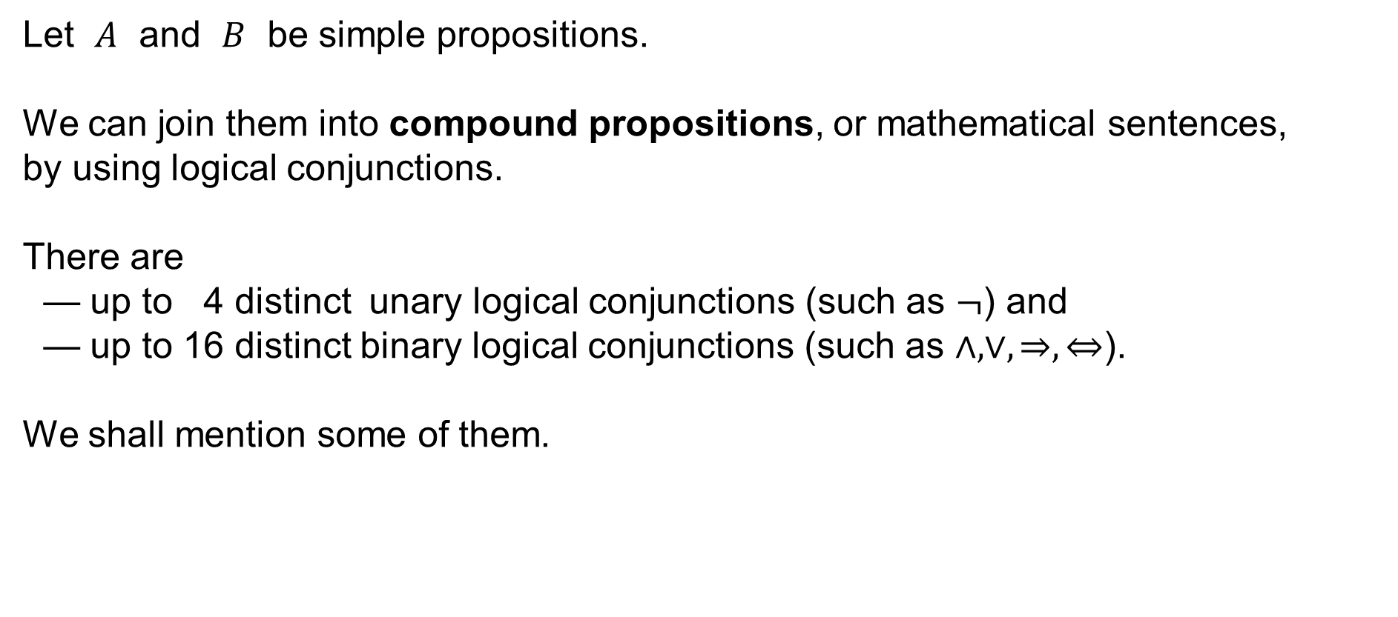
Mathematical language
Let $A$ and $B$ be simple propositions.
We can join them into compound propositions, or mathematical sentences,
by using logical conjunctions.
There are
— up to 4 distinct unary logical conjunctions (such as $¬$) and
— up to 16 distinct binary logical conjunctions (such as $∧,∨,⇒,⇔$).
We shall mention some of them.

Slide 8

Mathematical language
Logical negation: read “$¬A$” as “not $A$”
Table of truth values:
truth value of given simple proposition result
$A$ $¬A$
false true
true false

Slide 9
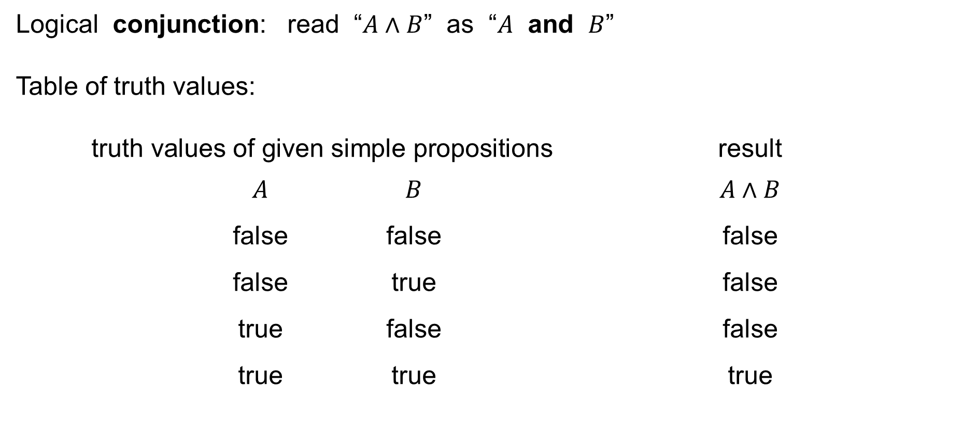
Mathematical language
Logical conjunction: read “$A∧B$” as “$A$ and $B$”
Table of truth values:
truth values of given simple propositions result
$A$ $B$ $A∧B$
false false false
false true false
true false false
true true true

Slide 10
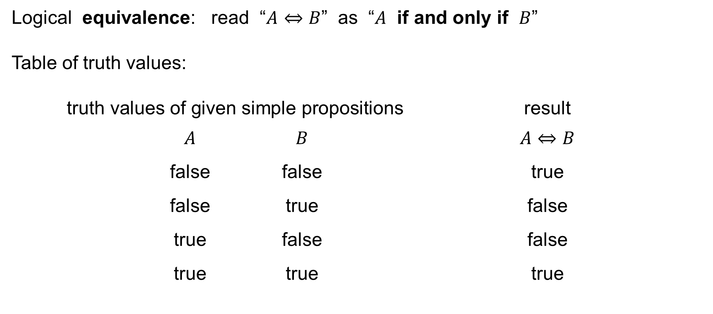
Mathematical language
Logical equivalence: read “$A⇔B$” as “$A$ if and only if $B$”
Table of truth values:
truth values of given simple propositions result
$A$ $B$ $A⇔B$
false false true
false true false
true false false
true true true

Slide 11
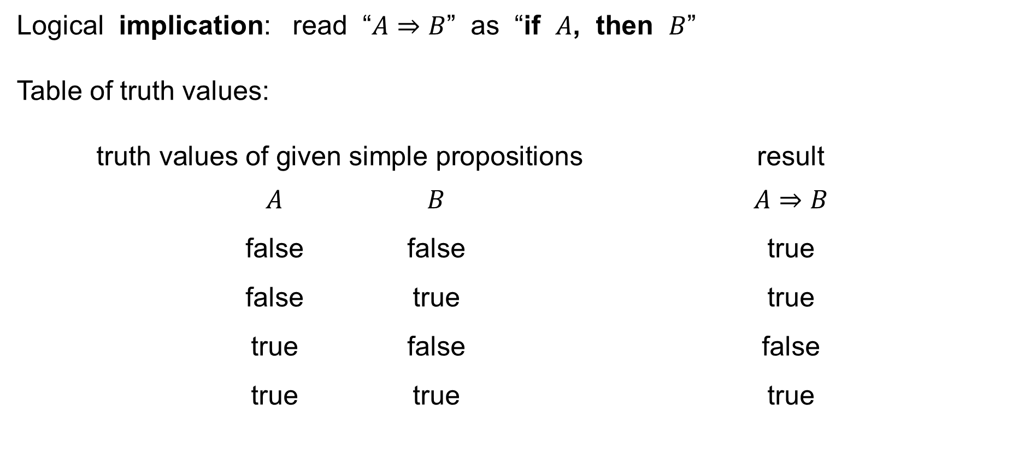
Mathematical language
Logical implication: read “$A⇒B$” as “if $A$, then $B$”
Table of truth values:
truth values of given simple propositions result
$A$ $B$ $A⇒B$
false false true
false true true
true false false
true true true

Slide 12

Some equivalences I
Let $A$ and $B$ be simple propositions.
Notice and observe that the following equivalences are easy to see:
Identity:
$$A⟺A$$
Idempotency:
$$\left(A∧A\right)⟺A \\ \left(A∨A\right)⟺A$$

Slide 13

Some equivalences II
Let $A$ and $B$ be simple propositions.
Notice and observe that the following equivalences are easy to see:
Double negation:
$$A⟺¬¬A$$
Tertium non datur :
$$A∨¬A$$

Slide 14

Some equivalences III
Let $A$ and $B$ be simple propositions.
Notice and observe that the following equivalences are easy to see:
De Morgan’s Laws:
$$¬\left(A∧B\right)⟺\left(¬A∨¬B\right) \\ ¬\left(A∨B\right)⟺\left(¬A∧¬B\right)$$

Slide 15
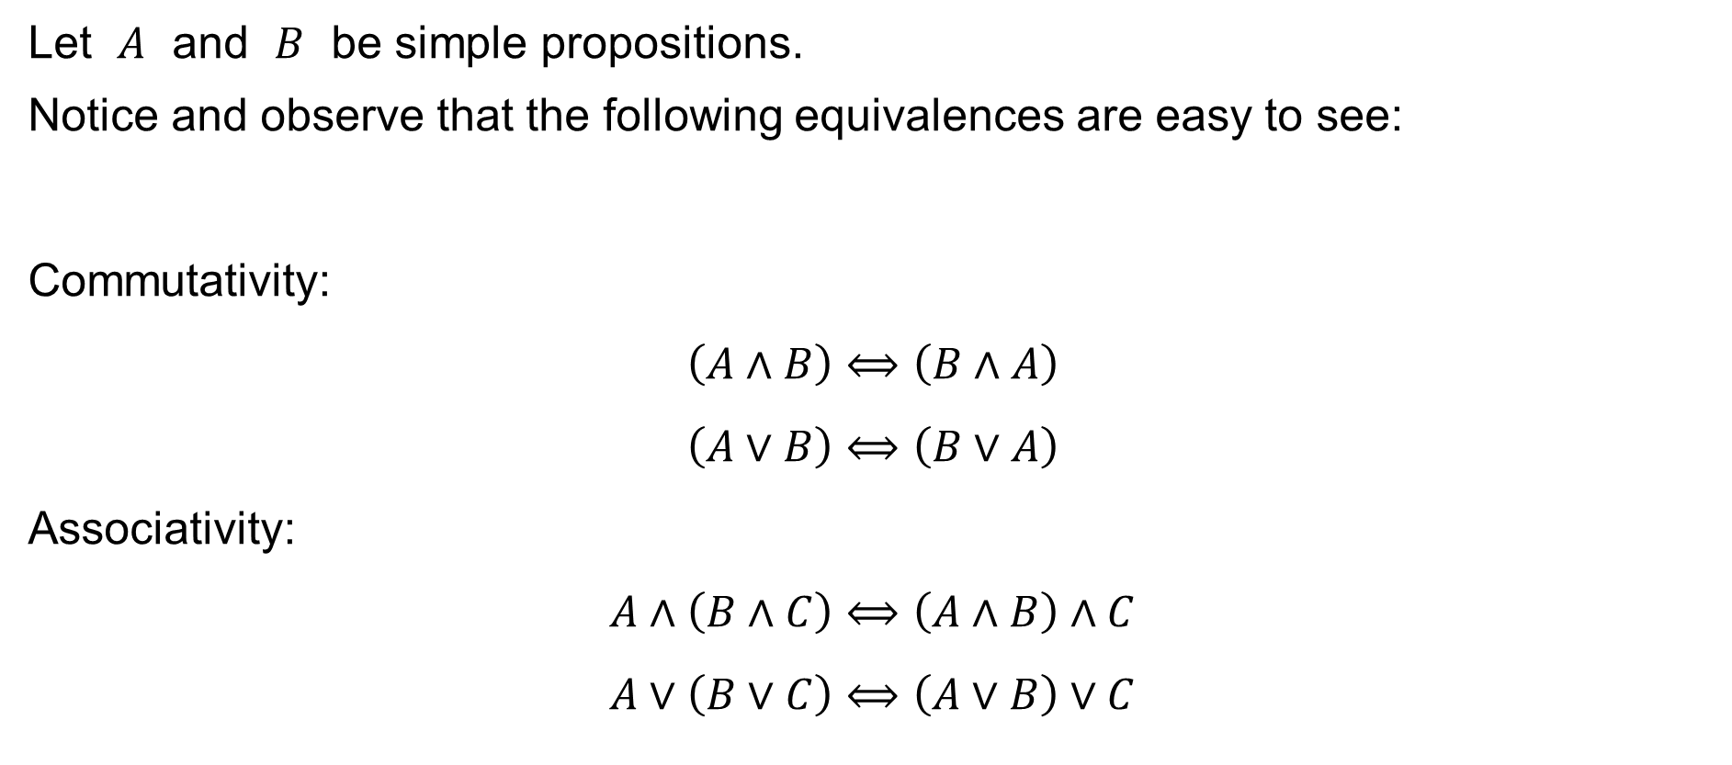
Some equivalences IV
Let $A$ and $B$ be simple propositions.
Notice and observe that the following equivalences are easy to see:
Commutativity:
$$\left(A∧B\right)⟺\left(B∧A\right) \\ \left(A∨B\right)⟺\left(B∨A\right)$$
Associativity:
$$A∧\left(B∧C\right)⟺\left(A∧B\right)∧C \\ A∨\left(B∨C\right)⟺\left(A∨B\right)∨C$$

Slide 16
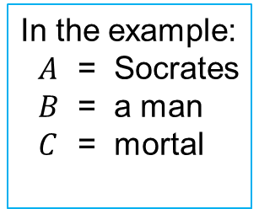


Sylogism
Let $A,B,C$ be simple propositions.
Notice and observe that the following proposition is easy to see:
Sylogism:
$$\left(A⇒B\right)⟹\left(\left(B⇒C\right)⇒\left(A⇒C\right)\right)$$
Example:
— Socrates is a man.
— A man is mortal.
Conclude that:
— Socrates is mortal.
By using the “import” rule:
$$\left(\left(A⇒B\right)∧\left(B⇒C\right)\right)⟹\left(A⇒C\right)$$
In the example:
$A$ = Socrates
$B$ = a man
$C$ = mortal

Slide 17
Sets and set operations
Sets
The empty set
Set operations
Some useful equalities

Slide 18
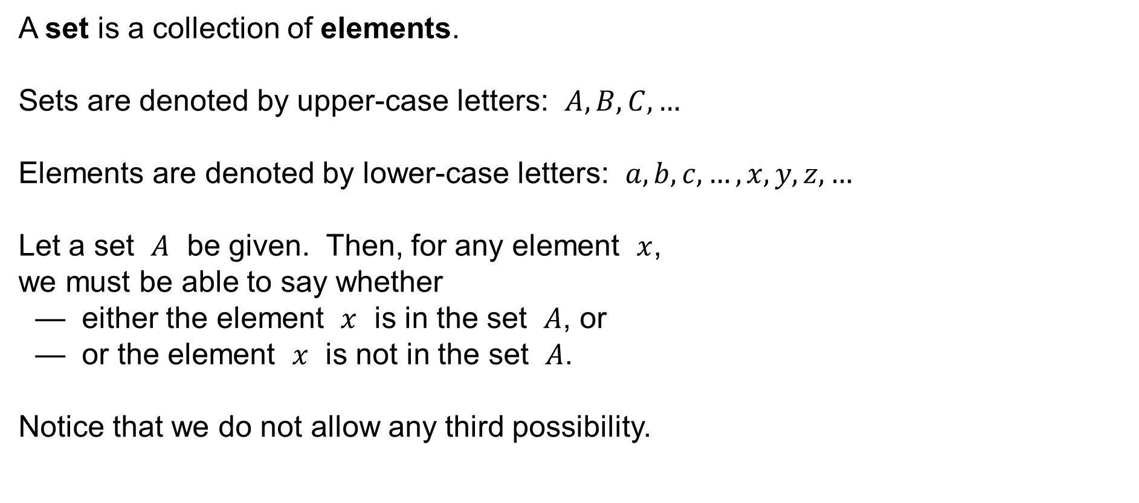
Sets
A set is a collection of elements.
Sets are denoted by upper-case letters: $A,B,C,…$
Elements are denoted by lower-case letters: $a,b,c,…,x,y,z,…$
Let a set $A$ be given. Then, for any element $x$,
we must be able to say whether
— either the element $x$ is in the set $A$, or
— or the element $x$ is not in the set $A$.
Notice that we do not allow any third possibility.

Slide 19

Sets
Let a set $A$ and an element $x$ be given.
We write the fact that the element $x$ is in the set $A$ as
$$x∈A$$
We write the fact that the element $x$ is not in the set $A$ as
$$x∉A$$

Slide 20

Sets
A set is often given by the list of its elements. For example:
$$A=\left\{1, 3, 5, 7, 9\right\} \\ B=\{2, 4, 6, 8\}$$
Then, for example, it holds
$$1∈A, 2∈B, 1∉B, 2∉A$$

Slide 21

The empty set
The empty set is a set that contains no elements:
$$∅=\{ \}$$
Notice that the set $\{∅\}$ is not empty, we have
$$∅∈\left\{∅\right\}$$
and
$$\left\{∅\right\}≠∅$$

Slide 22



Set operations
Let $A$ and $B$ be sets.
The union of the sets is:
$$A∪B=\left\{ x :x∈A∨x∈B \right\}$$
$$A$$
$$B$$

Slide 23

Set operations
Let $A$ and $B$ be sets.
The intersection of the sets is:
$$A∩B=\left\{ x :x∈A∧x∈B \right\}$$
$$A$$
$$B$$

Slide 24

Set operations
Let $A$ and $B$ be sets.
The difference of the sets is:
$$A∖B=\left\{ x :x∈A∧x∉B \right\}$$
$$A$$
$$B$$

Slide 25



Set inclusion
Let $A$ and $B$ be sets.
We say that $A$ is a subset of $B$ (or $A$ is included in $B$) and write
$$A⊆B$$
if and only if
$$∀x:x∈A⟹x∈B$$
$$A$$
$$B$$

Slide 26

Set operations
Let $A$ and $B$ be sets.
Union:
$$A∪B=\left\{ x :x∈A∨x∈B \right\}$$
Intersection:
$$A∩B=\left\{ x :x∈A∧x∈B \right\}$$
Difference:
$$A∖B=\left\{ x :x∈A∧x∉B \right\}$$

Slide 27
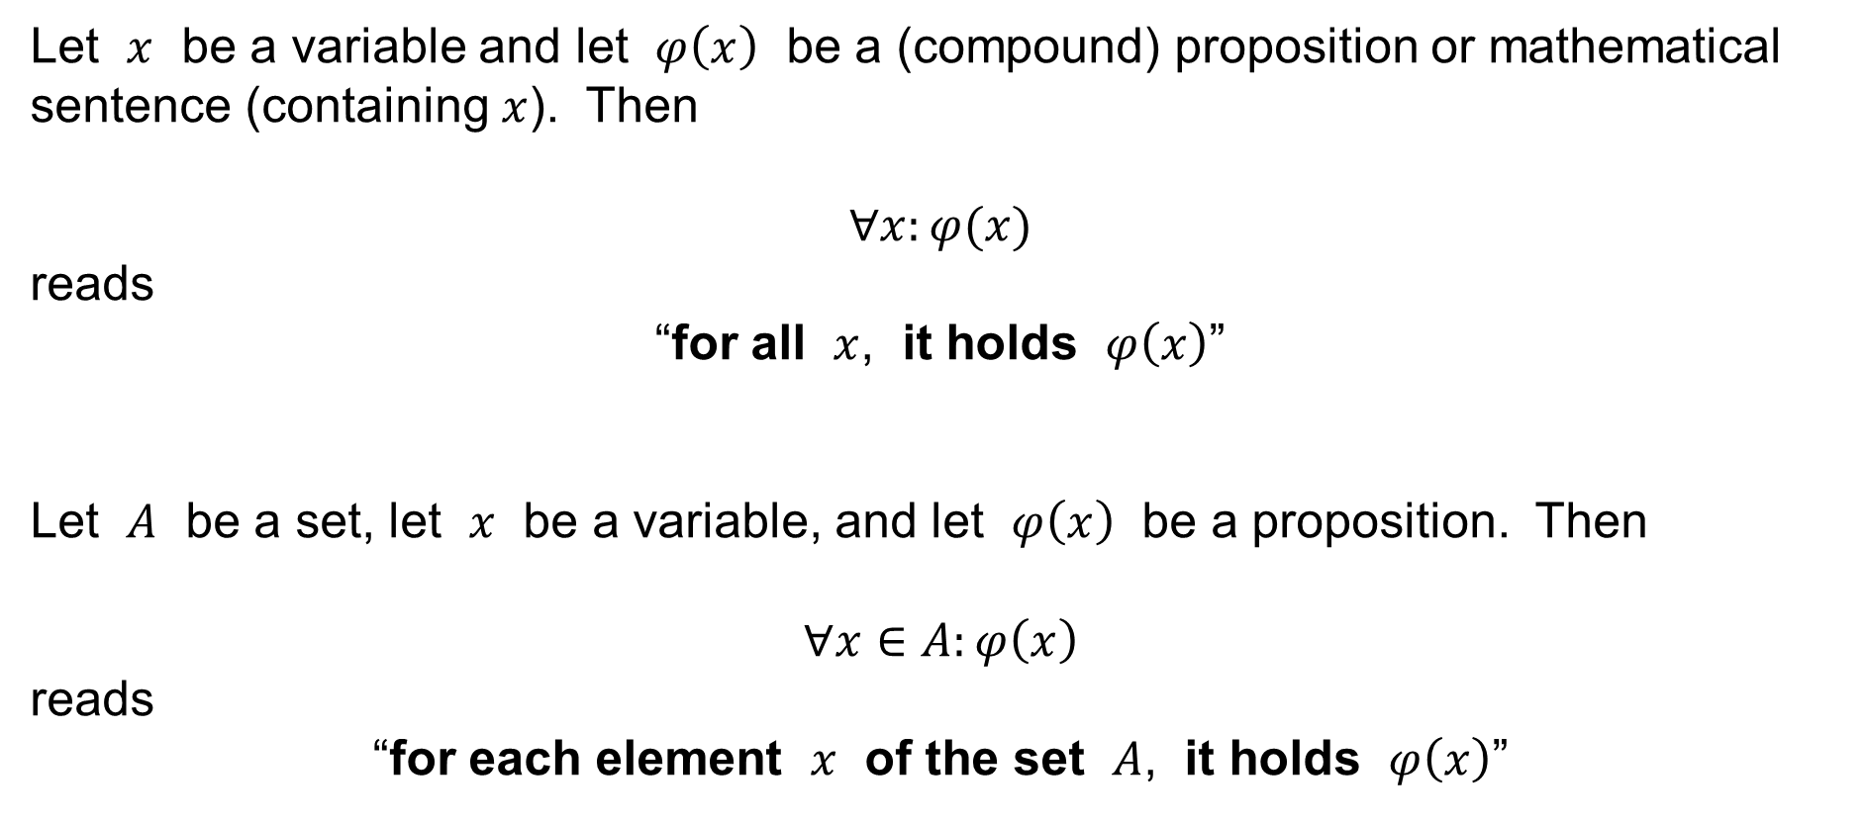
Mathematical language: Quantifiers
Let $x$ be a variable and let $φ\left(x\right)$ be a (compound) proposition or mathematical sentence (containing $x$). Then
$$∀x:φ(x)$$
reads
“for all $x$, it holds $φ\left(x\right)$”
Let $A$ be a set, let $x$ be a variable, and let $φ\left(x\right)$ be a proposition. Then
$$∀x∈A:φ\left(x\right)$$
reads
“for each element $x$ of the set $A$, it holds $φ\left(x\right)$”

Slide 28
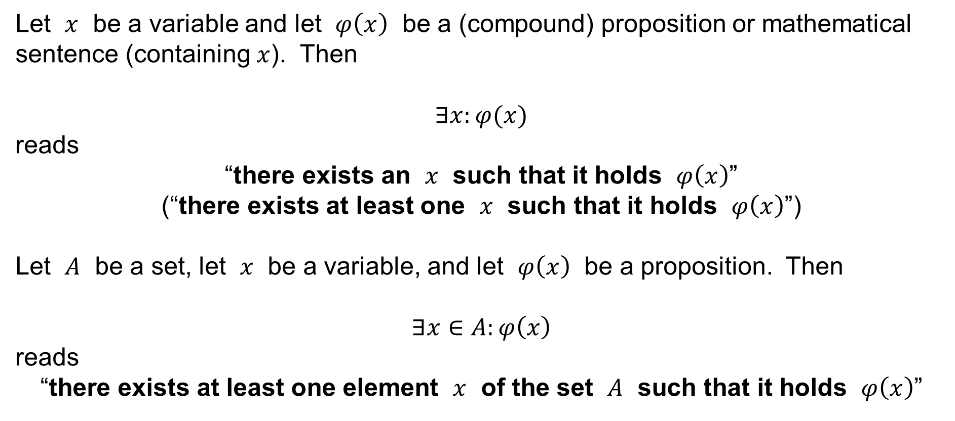
Mathematical language: Quantifiers
Let $x$ be a variable and let $φ\left(x\right)$ be a (compound) proposition or mathematical sentence (containing $x$). Then
$$∃x:φ(x)$$
reads
“there exists an $x$ such that it holds $φ\left(x\right)$”
(“there exists at least one $x$ such that it holds $φ\left(x\right)$”)
Let $A$ be a set, let $x$ be a variable, and let $φ\left(x\right)$ be a proposition. Then
$$∃x∈A:φ\left(x\right)$$
reads
“there exists at least one element $x$ of the set $A$ such that it holds $φ\left(x\right)$”

Slide 29
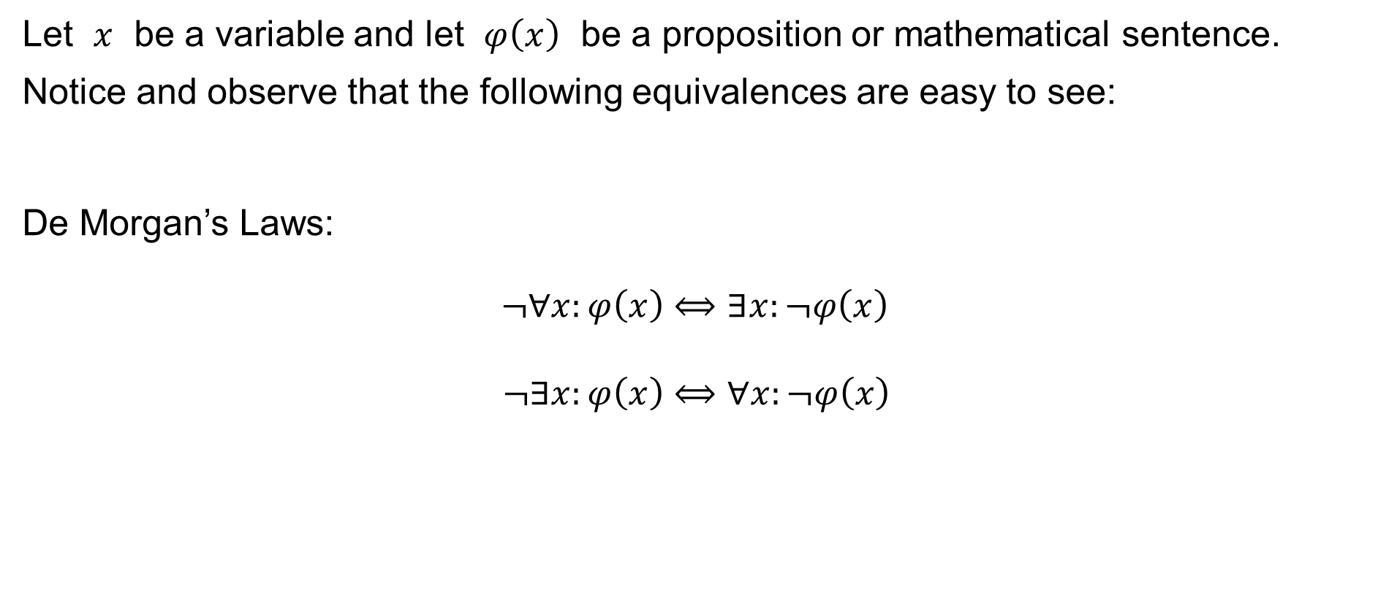
De Morgan’s Laws I
Let $x$ be a variable and let $φ\left(x\right)$ be a proposition or mathematical sentence.
Notice and observe that the following equivalences are easy to see:
De Morgan’s Laws:
$$¬∀x:φ\left(x\right)⟺∃x:¬φ\left(x\right) \\ ¬∃x:φ\left(x\right)⟺∀x:¬φ\left(x\right)$$

Slide 30
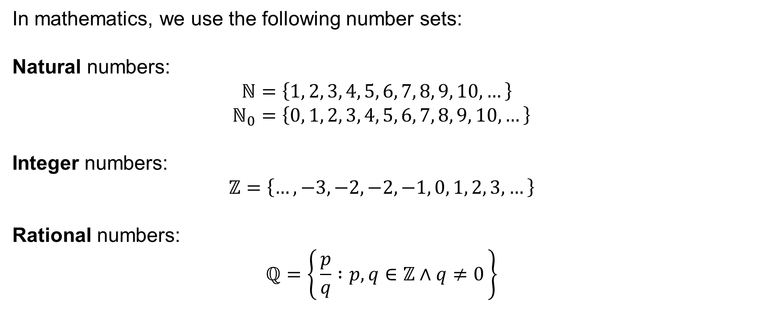
Number domains
In mathematics, we use the following number sets:
Natural numbers:
$$ℕ=\left\{1, 2, 3, 4, 5, 6, 7, 8, 9, 10,…\right\} \\ ℕ_{0}=\left\{0, 1, 2, 3, 4, 5, 6, 7, 8, 9, 10,…\right\}$$
Integer numbers:
$$ℤ=\left\{…,−3,−2,−2,−1, 0, 1, 2, 3,…\right\}$$
Rational numbers:
$$ℚ=\left\{ \frac{p}{q} :p,q∈ℤ∧q≠0 \right\}$$

Slide 31











Number domains
Real numbers:
$$ℝ=…$$
the definition is rather difficult, but the real numbers can be depicted as the points of a line:
$$⋯$$
$$−3$$
$$−2$$
$$−1$$
$$\text{0}$$
$$\text{1}$$
$$\text{2}$$
$$\text{3}$$
$$⋯$$
$$ℝ$$

Slide 32







Number domains
Complex numbers:
$$ℂ=\left\{ a+bi :a,b∈ℝ \right\}$$
where “$i$” is the
imaginary unit
($i^{2}=−1$).
$$\text{Im}$$
$$a+bi$$
$$bi$$
$$\text{0}$$
$$a$$
$$\text{Re}$$

