Slide 1

Quantitative methods
Lecture 2
Mgr. Radmila Krkošková, Ph.D.
BAKVM

Slide 2
A real function of one real variable
A function is a relation f between two sets X and Y such that each x from X is related to exactly one y from Y.
We write y = f(x).
Examples:
The set X is called a domain, the set Y is called a range or a co-domain.
In economics the domain usually consists of non-negative real numbers.

Slide 3
A graph of a function
Lecture 2
A graph of a function is the collection of all ordered pairs (x,y) displayed in a two-dimensial plane.
In a two dimensional plane it as a curve.
Examples:
Linear function: a line,
Quadratic function: a parabola,
Reciprocal function: a hyperbola.
Other functions are represented by more complex curves.

Slide 4
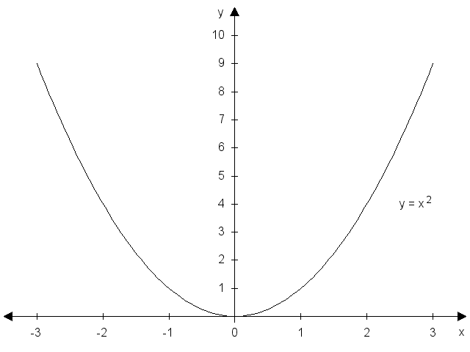
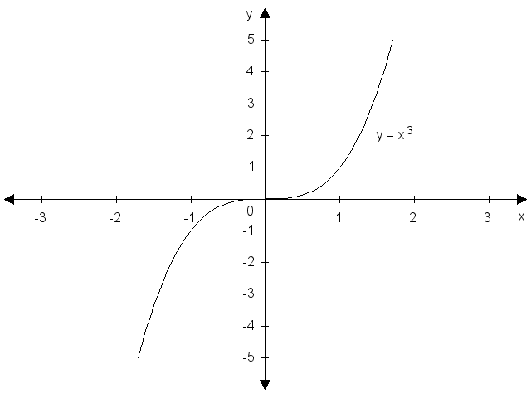
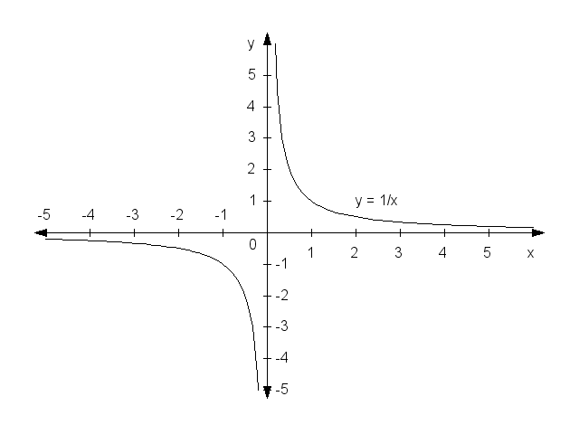
A graph of a function: examples
Lecture 2

Slide 5
Elementary function properties
Lecture 2
Domain and range,
Monotonicity (increasing, decreasing, non-increasing, non-decreasing, constant)
Extremes (local or global maximum or minimum),
Concavity and convexity,
Inflection points,
Bounded vs unbounded function,
Even functions and odd functions,
Peridiocity.

Slide 6
Elementary functions
Lecture 2
Linear function: y = ax + b,
Quadratic function:
Polynomial function:
Linear reciprocal function:
Logarithmic function:
In the logarithmic function, a is the so called a base. The decadic logarithm: a = 10, the natural logarithm: a = e = 2.718… For a larger than 1, the function is increasing, and for a smaller than 1 it is decreasing.

Slide 7
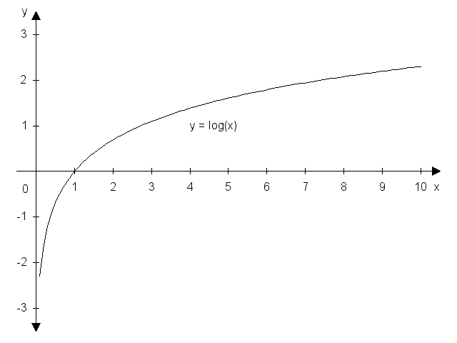
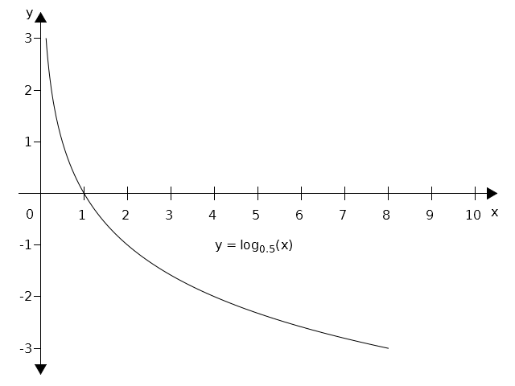
Graphs of logarithmic functions
Lecture 2

Slide 8
Elementary functions - continued
Lecture 2
Exponential function:
Goniometric functions: y = sinx, y = cosx, y = tgx,
y = cotgx.
Cyclometric functions: y = arcsinx, y = arccosx,
y = arctgx, y = arccotgx.
Notes: exponential and logarithmic functions are inverse to each other. The same applies to goniometric and cyclometric functions.

Slide 9
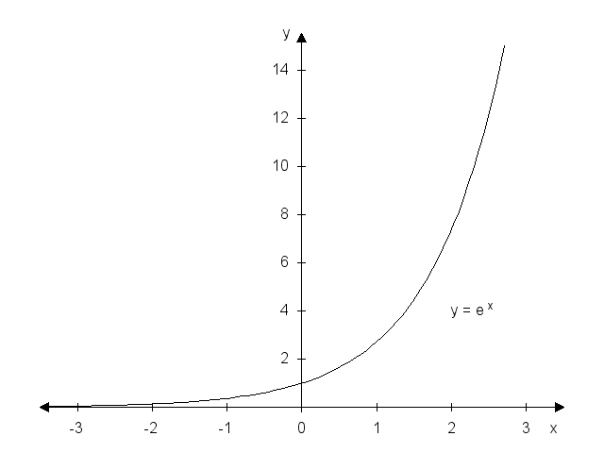
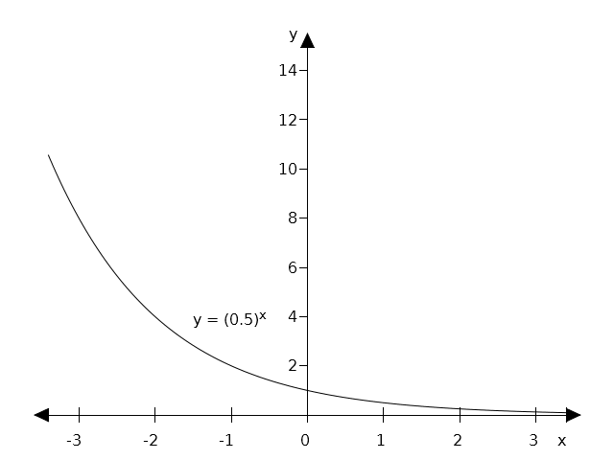
Graphs of exponential functions
Lecture 2
For a >1, the exponential function is increasing, for a < 1 is
decreasing.

Slide 10
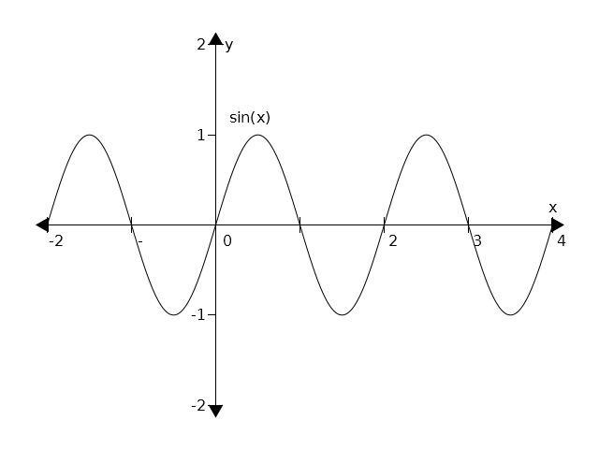
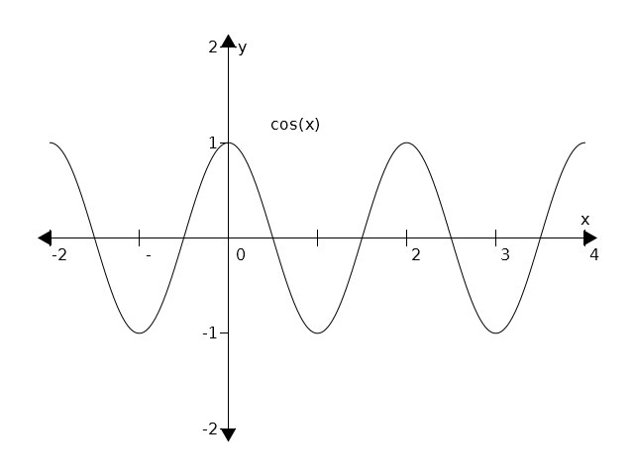
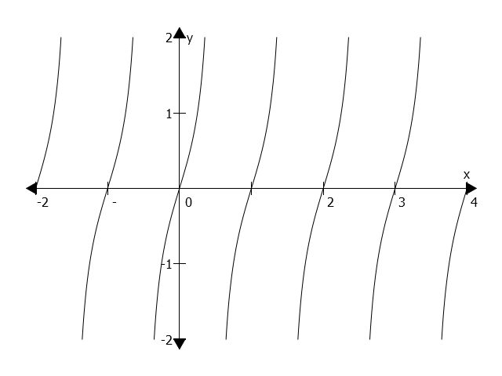
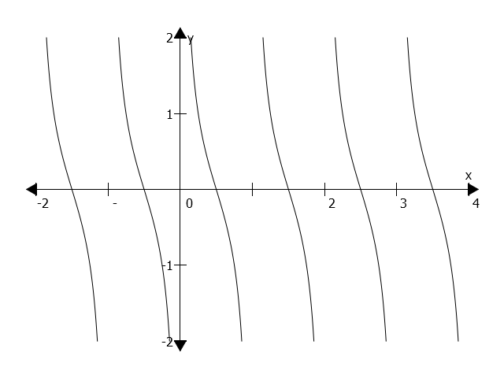
Graphs of goniometric functions
Lecture 2

Slide 11
Polynomials
Lecture 2
In economics, various functions, such as demand or supply, are expressed by polynomials. Two main tasks when dealing with polynomials are transformation of a polyonomial into a product, and to find roots of a polynomial.
Let denote a polynomial of a degree n.
Polynomial roots are such values of x that .
The equation above can be solved via known formulas or identities such as .

Slide 12
Demand and supply function, equilibrium
Lecture 2
The demand function expresses relationship between a price of a good (P) and a demanded quantity (Q) by customers. Usually, the demand function is denoted as Q= D(P) or QD , and it is assumed this function is decreasing.
The supply function expresses relationship between a price of a good (P) and a supplied quantity (Q) by sellers. Usually, the supply function is denoted as Q= S(P) or Qs , and it is assumed this function is increasing.
A point where demand is equal to supply, ant a market is cleared, is called an equilibrium.

Slide 13
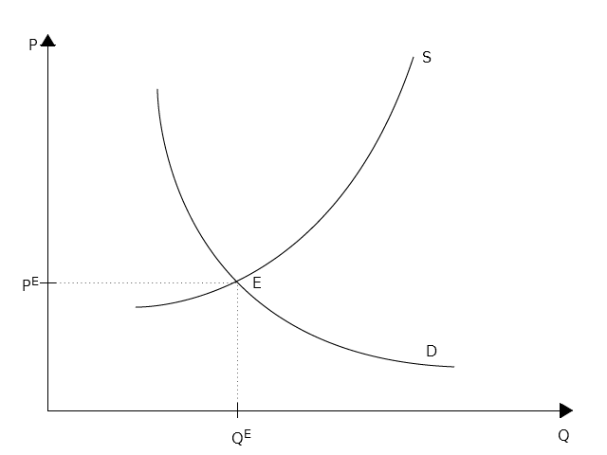
Demand and supply function, equilibrium – cont.
Lecture 2

Slide 14
Solved problem 1
Lecture 2
Find the domain of the function f: .
Solution: the expression under the square root sign must be non-negative, therefore we obtain:
Hence, the domain is .

Slide 15
Solved problem 2
Lecture 2
Find the domain of the function f: .
Solution: the expression in the logarithm must be positive, therefore we obtain:
We expand the term on the left hand side:
From the last inequality it follows that -5 and 5 are the roots that divide the x line into three intervals. By checking the sign in each interval we obtain the final solution:

Slide 16
Solved problem 3
Lecture 2
Find the domain of the function f: .
Solution: the expression in the arcsin is bounded by -1 from below and by 1 from above. Therefore, we obtain:
By dividing this inequality into two simple linear inequalities we obtain:
and
Hence, we obtain the solution:

Slide 17
Solved problem 4
Lecture 2
Let us asssume that the demand and the supply functions are given as follows: , .
Find the equilibrium.
Solution: in the equilibrium both functions are equal:
Therefore, we obtain: PE = 6, and QE = 4. Draw both function!
How will the situation change if there is a price floor P = 8?

Slide 18
Solved problem 5
Lecture 2
Let us asssume that the demand and the supply functions are given as follows: , .
Find the equilibrium.
Solution: in the equilibrium both functions are equal:
Therefore, we obtain: PE = 3, and QE = 18. Draw both function!

Slide 19
Problems to solve
Lecture 2
1. Find the domain of the following functions:

Slide 20
Problems to solve – cont.
Lecture 2
2. Draw a graph of the following functions:

Slide 21
Problems to solve – cont.
Lecture 2
3. For the given functions of demand and supply find the equilibrium both geometrically and algebraically:

Slide 22
Lecture 2
Thank you for your attention!

