Slide 1
Quantitative Methods
Lecture 3
Matrix calculus
BAKVM

Slide 2
Matrix calculus
Vector space of matrices
(addition and scalar multiplication)
Rank of a matrix
Multiplication of matrices
Square matrices
Singular and non-singular matrices

Slide 3
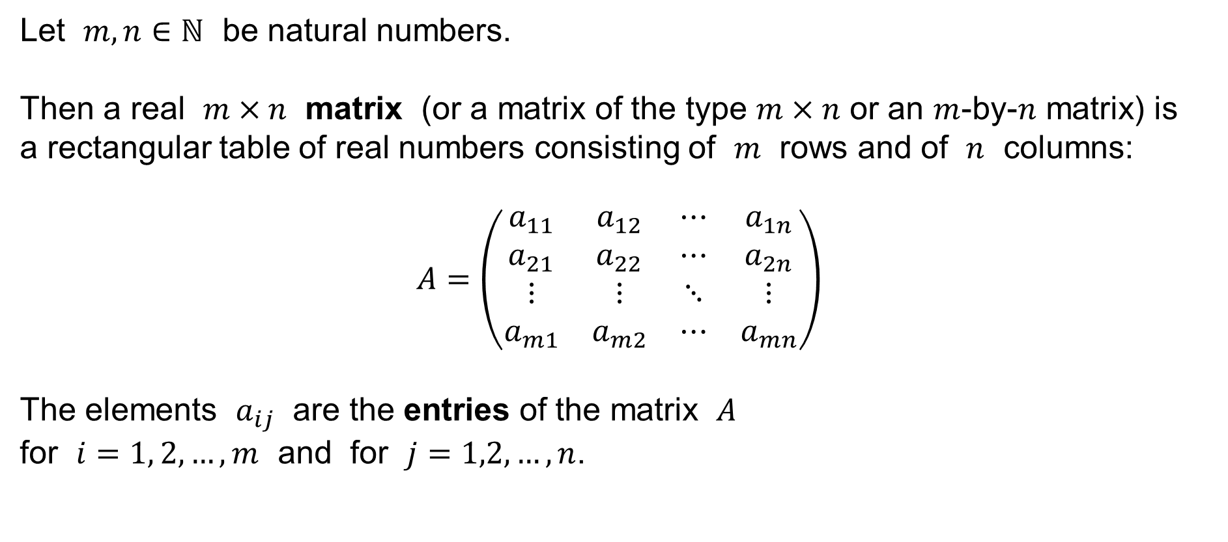
Matrix
Let $m,n∈ℕ$ be natural numbers.
Then a real $m×n$ matrix (or a matrix of the type $m×n$ or an $m$-by-$n$ matrix) is
a rectangular table of real numbers consisting of $m$ rows and of $n$ columns:
$$A=\left(\begin{matrix}a_{11} & a_{12} & ⋯ & a_{1n} \\ a_{21} & a_{22} & ⋯ & a_{2n} \\ ⋮ & ⋮ & ⋱ & ⋮ \\ a_{m1} & a_{m2} & ⋯ & a_{mn}\end{matrix}\right)$$
The elements $a_{ij}$ are the entries of the matrix $A$
for $i=1, 2,…,m$ and for $j=1,2,…,n$.

Slide 4
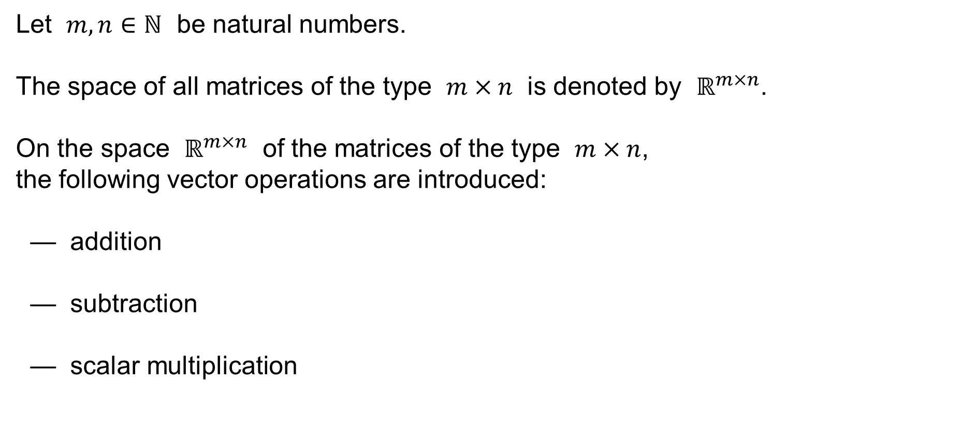
The vector space of matrices
Let $m,n∈ℕ$ be natural numbers.
The space of all matrices of the type $m×n$ is denoted by $ℝ^{m×n}$.
On the space $ℝ^{m×n}$ of the matrices of the type $m×n$,
the following vector operations are introduced:
— addition
— subtraction
— scalar multiplication

Slide 5
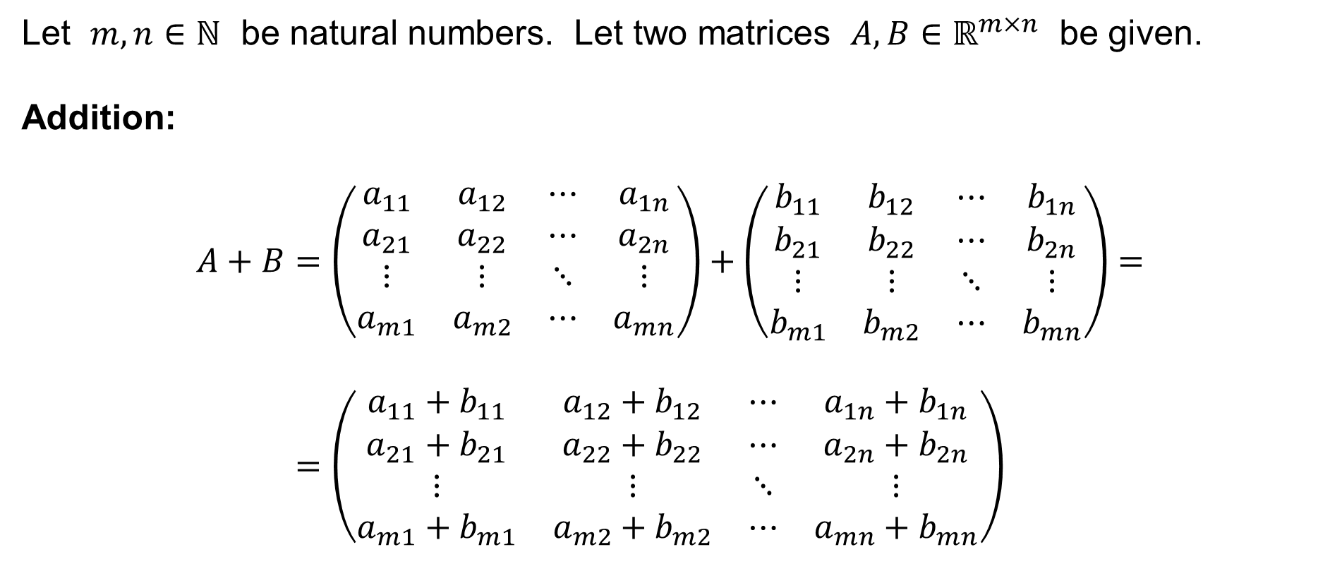
Addition of matrices
Let $m,n∈ℕ$ be natural numbers. Let two matrices $A,B∈ℝ^{m×n}$ be given.
Addition:
$$A+B=\left(\begin{matrix}a_{11} & a_{12} & ⋯ & a_{1n} \\ a_{21} & a_{22} & ⋯ & a_{2n} \\ ⋮ & ⋮ & ⋱ & ⋮ \\ a_{m1} & a_{m2} & ⋯ & a_{mn}\end{matrix}\right)+\left(\begin{matrix}b_{11} & b_{12} & ⋯ & b_{1n} \\ b_{21} & b_{22} & ⋯ & b_{2n} \\ ⋮ & ⋮ & ⋱ & ⋮ \\ b_{m1} & b_{m2} & ⋯ & b_{mn}\end{matrix}\right)= \\ =\left(\begin{matrix}a_{11}+b_{11} & a_{12}+b_{12} & ⋯ & a_{1n}+b_{1n} \\ a_{21}+b_{21} & a_{22}+b_{22} & ⋯ & a_{2n}+b_{2n} \\ ⋮ & ⋮ & ⋱ & ⋮ \\ a_{m1}+b_{m1} & a_{m2}+b_{m2} & ⋯ & a_{mn}+b_{mn}\end{matrix}\right)$$

Slide 6
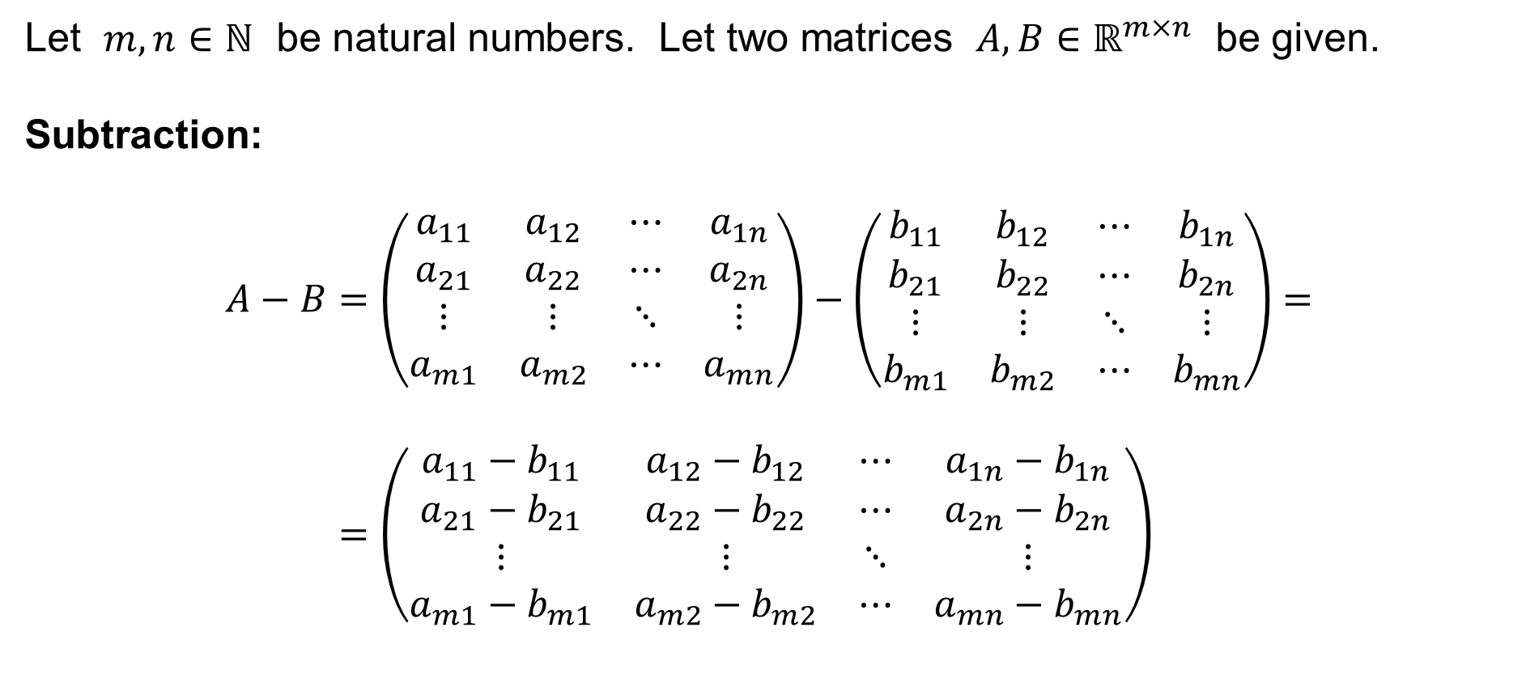
Subtraction of matrices
Let $m,n∈ℕ$ be natural numbers. Let two matrices $A,B∈ℝ^{m×n}$ be given.
Subtraction:
$$A−B=\left(\begin{matrix}a_{11} & a_{12} & ⋯ & a_{1n} \\ a_{21} & a_{22} & ⋯ & a_{2n} \\ ⋮ & ⋮ & ⋱ & ⋮ \\ a_{m1} & a_{m2} & ⋯ & a_{mn}\end{matrix}\right)−\left(\begin{matrix}b_{11} & b_{12} & ⋯ & b_{1n} \\ b_{21} & b_{22} & ⋯ & b_{2n} \\ ⋮ & ⋮ & ⋱ & ⋮ \\ b_{m1} & b_{m2} & ⋯ & b_{mn}\end{matrix}\right)= \\ =\left(\begin{matrix}a_{11}−b_{11} & a_{12}−b_{12} & ⋯ & a_{1n}−b_{1n} \\ a_{21}−b_{21} & a_{22}−b_{22} & ⋯ & a_{2n}−b_{2n} \\ ⋮ & ⋮ & ⋱ & ⋮ \\ a_{m1}−b_{m1} & a_{m2}−b_{m2} & ⋯ & a_{mn}−b_{mn}\end{matrix}\right)$$

Slide 7
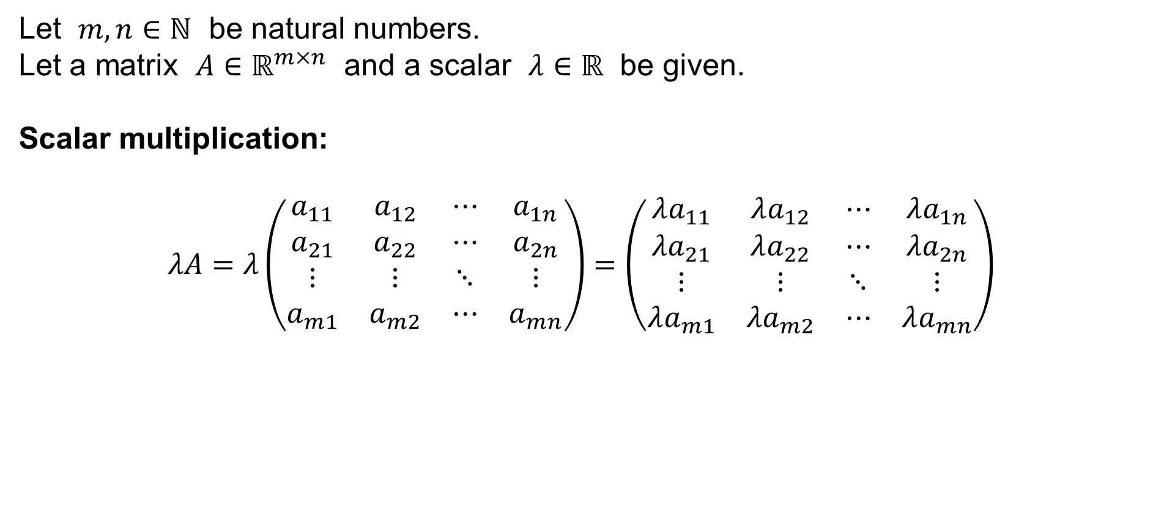
Multiplication of a matrix by a scalar
Let $m,n∈ℕ$ be natural numbers.
Let a matrix $A∈ℝ^{m×n}$ and a scalar $λ∈ℝ$ be given.
Scalar multiplication:
$$λA=λ\left(\begin{matrix}a_{11} & a_{12} & ⋯ & a_{1n} \\ a_{21} & a_{22} & ⋯ & a_{2n} \\ ⋮ & ⋮ & ⋱ & ⋮ \\ a_{m1} & a_{m2} & ⋯ & a_{mn}\end{matrix}\right)=\left(\begin{matrix}λa_{11} & λa_{12} & ⋯ & λa_{1n} \\ λa_{21} & λa_{22} & ⋯ & λa_{2n} \\ ⋮ & ⋮ & ⋱ & ⋮ \\ λa_{m1} & λa_{m2} & ⋯ & λa_{mn}\end{matrix}\right)$$

Slide 8

The zero matrix
Let $m,n∈ℕ$ be natural numbers.
The zero matrix of the type $m×n$ is
$$O=\left(\begin{matrix}0 & 0 & ⋯ & 0 \\ 0 & 0 & ⋯ & 0 \\ ⋮ & 0 & ⋱ & ⋮ \\ 0 & 0 & ⋯ & 0\end{matrix}\right)$$
The zero matrix consists of the zeros ($0$) only.

Slide 9



The vector space of matrices
Let $m,n∈ℕ$ be natural numbers.
For any matrices $A,B,C∈ℝ^{m×n}$ and for any scalars $λ,μ∈ℝ$, it holds:
We can see now that the space $ℝ^{m×n}$ of the matrices
of the type $m×n$ is a real vector space of dimension $m×n$.
$$A+B=B+A$$
$$\left(A+B\right)+C=A+\left(B+C\right)$$
$$A+O=A=O+A$$
$$A−A=O$$
$$\left(λ+μ\right)A=λA+μA$$
$$λ\left(A+B\right)=λA+λB$$
$$\left(λμ\right)A=λ\left(μA\right)$$
$$1A=A$$

Slide 10
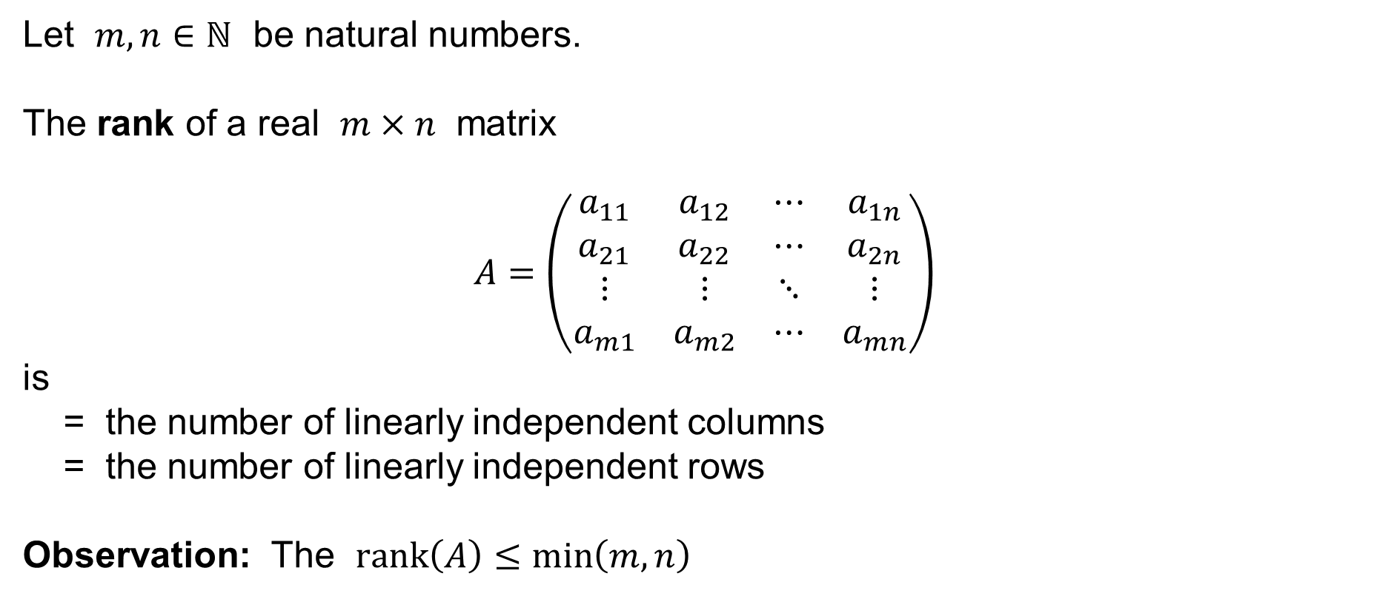
The rank of a matrix
Let $m,n∈ℕ$ be natural numbers.
The rank of a real $m×n$ matrix
$$A=\left(\begin{matrix}a_{11} & a_{12} & ⋯ & a_{1n} \\ a_{21} & a_{22} & ⋯ & a_{2n} \\ ⋮ & ⋮ & ⋱ & ⋮ \\ a_{m1} & a_{m2} & ⋯ & a_{mn}\end{matrix}\right)$$
is
= the number of linearly independent columns
= the number of linearly independent rows
Observation: The $rank\left(A\right)≤\min\left(m,n\right)$

Slide 11
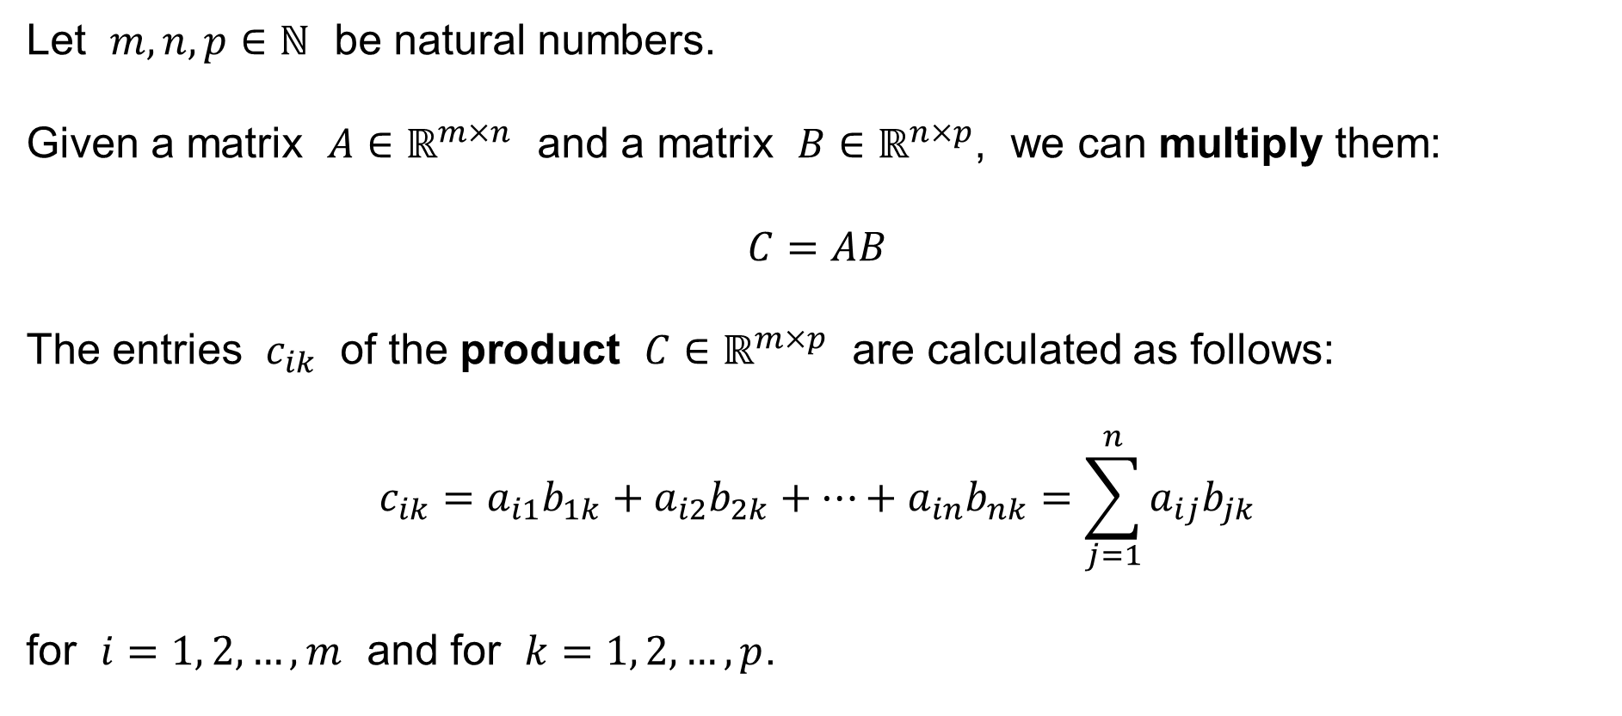
Multiplication of matrices
Let $m,n,p∈ℕ$ be natural numbers.
Given a matrix $A∈ℝ^{m×n}$ and a matrix $B∈ℝ^{n×p}$, we can multiply them:
$$C=AB$$
The entries $c_{ik}$ of the product $C∈ℝ^{m×p}$ are calculated as follows:
$$c_{ik}=a_{i1}b_{1k}+a_{i2}b_{2k}+⋯+a_{in}b_{nk}=\sum_{j=1}^{n}{a_{ij}b_{jk}}$$
for $i=1, 2,…,m$ and for $k=1, 2,…,p$.

Slide 12
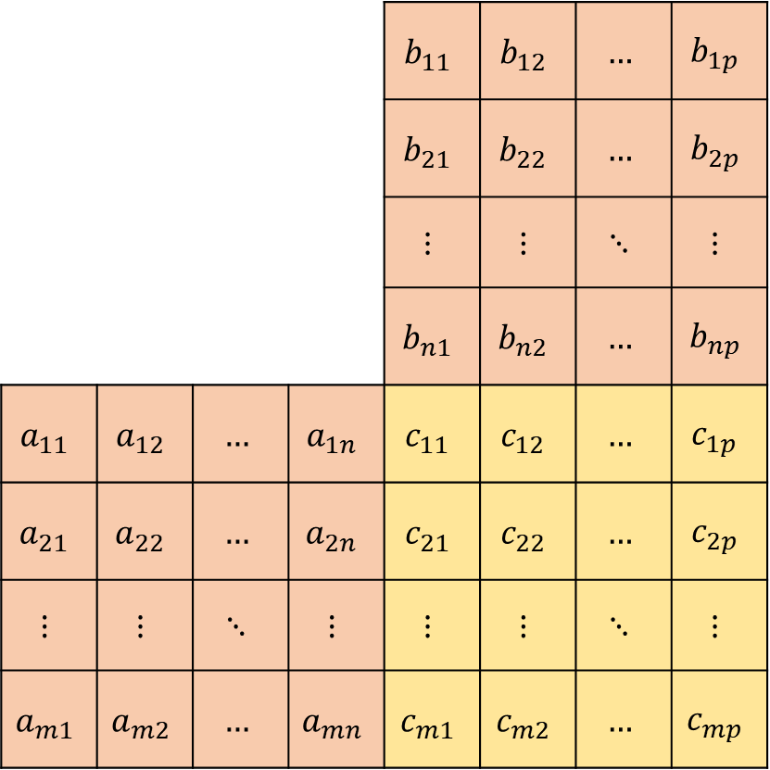
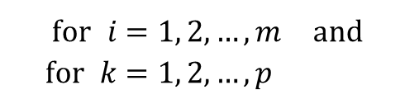
Multiplication of matrices
 |  |  |  | $$b_{11}$$ | $$b_{12}$$ | $$…$$ | $$b_{1p}$$
 |  |  |  | $$b_{21}$$ | $$b_{22}$$ | $$…$$ | $$b_{2p}$$
 |  |  |  | $$⋮$$ | $$⋮$$ | $$⋱$$ | $$⋮$$
 |  |  |  | $$b_{n1}$$ | $$b_{n2}$$ | $$…$$ | $$b_{np}$$
$$a_{11}$$ | $$a_{12}$$ | $$…$$ | $$a_{1n}$$ | $$c_{11}$$ | $$c_{12}$$ | $$…$$ | $$c_{1p}$$
$$a_{21}$$ | $$a_{22}$$ | $$…$$ | $$a_{2n}$$ | $$c_{21}$$ | $$c_{22}$$ | $$…$$ | $$c_{2p}$$
$$⋮$$ | $$⋮$$ | $$⋱$$ | $$⋮$$ | $$⋮$$ | $$⋮$$ | $$⋱$$ | $$⋮$$
$$a_{m1}$$ | $$a_{m2}$$ | $$…$$ | $$a_{mn}$$ | $$c_{m1}$$ | $$c_{m2}$$ | $$…$$ | $$c_{mp}$$
$$c_{ik}=a_{i1}b_{1k}+a_{i2}b_{2k}+⋯+a_{in}b_{nk}$$
$$\text{for} i=1, 2,…,m \text{and} \\ \text{for} k=1, 2,…,p$$

Slide 13

Square matrices
Let $n∈ℕ$ be a natural number.
A square matrix is any matrix of type $n×n$
$$A=\left(\begin{matrix}a_{11} & a_{12} & ⋯ & a_{1n} \\ a_{21} & a_{22} & ⋯ & a_{2n} \\ ⋮ & ⋮ & ⋱ & ⋮ \\ a_{n1} & a_{n2} & ⋯ & a_{nn}\end{matrix}\right)$$

Slide 14
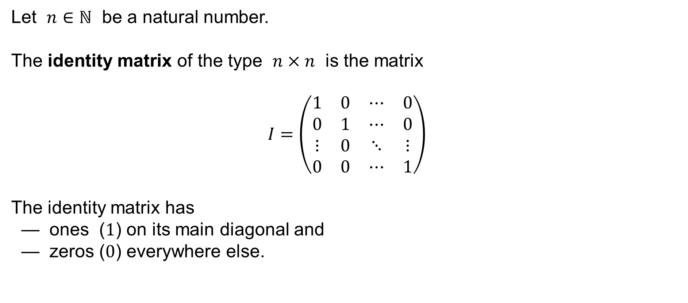
The identity matrix
Let $n∈ℕ$ be a natural number.
The identity matrix of the type $n×n$ is the matrix
$$I=\left(\begin{matrix}1 & 0 & ⋯ & 0 \\ 0 & 1 & ⋯ & 0 \\ ⋮ & 0 & ⋱ & ⋮ \\ 0 & 0 & ⋯ & 1\end{matrix}\right)$$
The identity matrix has
— ones ($1$) on its main diagonal and
— zeros ($0$) everywhere else.

Slide 15
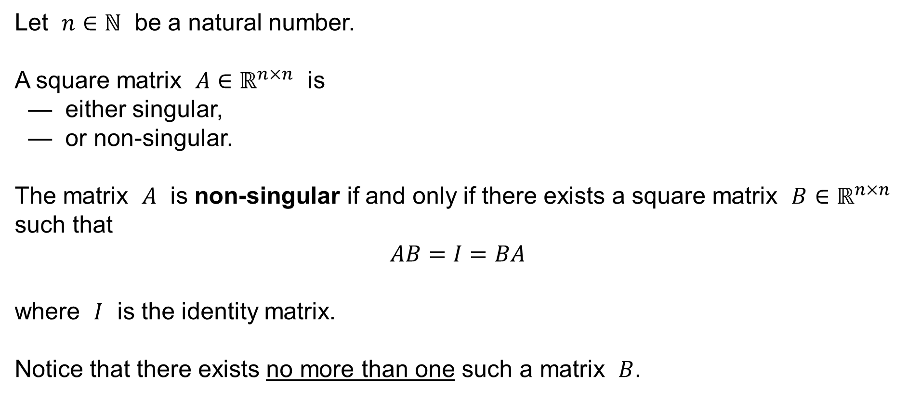
Non-singular square matrices
Let $n∈ℕ$ be a natural number.
A square matrix $A∈ℝ^{n×n}$ is
— either singular,
— or non-singular.
The matrix $A$ is non-singular if and only if there exists a square matrix $B∈ℝ^{n×n}$ such that
$$AB=I=BA$$
where $I$ is the identity matrix.
Notice that there exists no more than one such a matrix $B$.

Slide 16
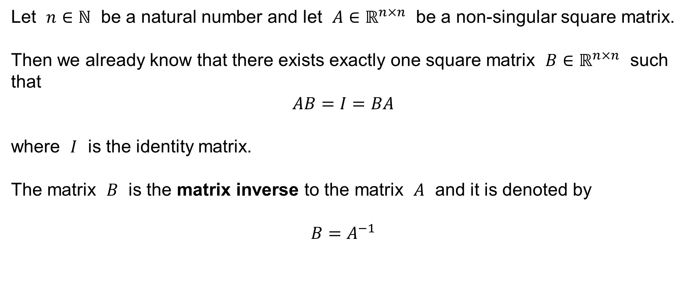
The inverse matrix
Let $n∈ℕ$ be a natural number and let $A∈ℝ^{n×n}$ be a non-singular square matrix.
Then we already know that there exists exactly one square matrix $B∈ℝ^{n×n}$ such that
$$AB=I=BA$$
where $I$ is the identity matrix.
The matrix $B$ is the matrix inverse to the matrix $A$ and it is denoted by
$$B=A^{−1}$$

Slide 17
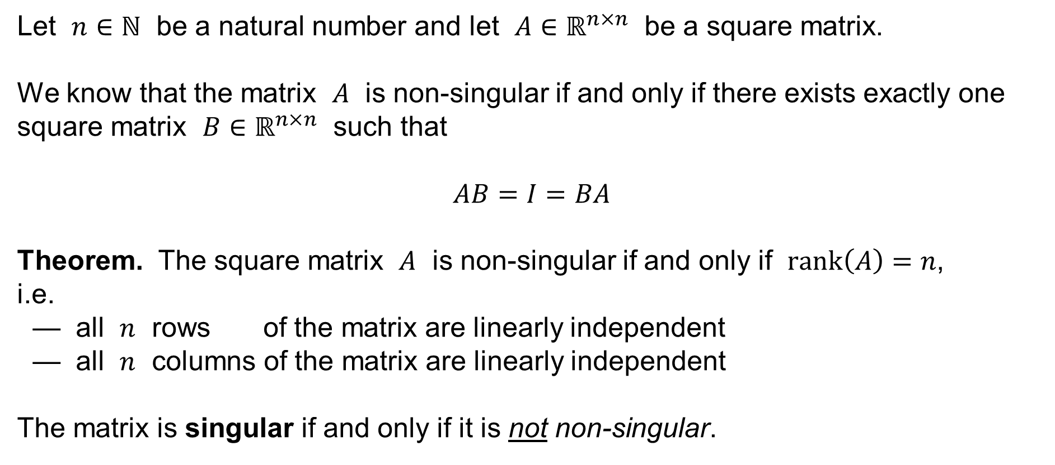
Singular and non-singular matrices
Let $n∈ℕ$ be a natural number and let $A∈ℝ^{n×n}$ be a square matrix.
We know that the matrix $A$ is non-singular if and only if there exists exactly one square matrix $B∈ℝ^{n×n}$ such that
$$AB=I=BA$$
Theorem. The square matrix $A$ is non-singular if and only if $rank\left(A\right)=n$,
i.e.
— all $n$ rows of the matrix are linearly independent
— all $n$ columns of the matrix are linearly independent
The matrix is singular if and only if it is not non-singular.

Slide 18




Summary I
Let $n∈ℕ$ be a natural number, let $A,B,C∈ℝ^{n×n}$ be square matrices, and
let $λ,μ∈ℝ$ be scalars. It holds:
$$A+B=B+A$$
$$\left(A+B\right)+C=A+\left(B+C\right)$$
$$A+O=A=O+A$$
$$A−A=O$$
$$\left(λ+μ\right)A=λA+μA$$
$$λ\left(A+B\right)=λA+λB$$
$$\left(λμ\right)A=λ\left(μA\right)$$
$$1A=A$$
$$\left(AB\right)C=A\left(BC\right)$$
$$AI=A=IA$$
$$A\left(B+C\right)=AB+AC$$
$$\left(A+B\right)C=AC+BC$$

Slide 19

Summary II
Let $n∈ℕ$ be a natural number and let $A∈ℝ^{n×n}$ be a square matrix.
If, moreover, the matrix $A$ is non-singular, then it also holds
$$AA^{−1}=I=A^{−1}A$$

