Slide 1
Quantitative Methods
Lecture 5
Sequences, series
and infinite sums
BAKVM

Slide 2
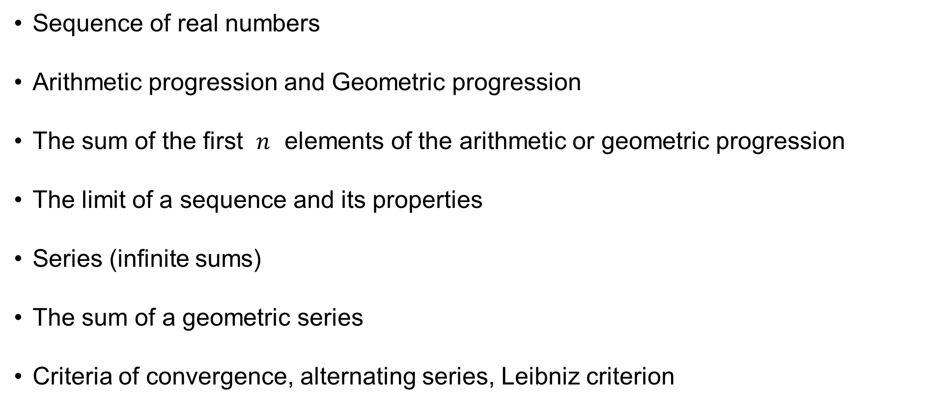
Sequence of real numbers
Arithmetic progression and Geometric progression
The sum of the first $n$ elements of the arithmetic or geometric progression
The limit of a sequence and its properties
Series (infinite sums)
The sum of a geometric series
Criteria of convergence, alternating series, Leibniz criterion

Slide 3











A sequence of real numbers
Recall the set of the natural numbers
$$ℕ=\left\{1, 2, 3, 4, 5, 6, 7, 8, 9, 10,…\right\}$$
and the set of the real numbers:
We shall now deal with sequences of real numbers:
$$a_{1},a_{2},a_{3},a_{4},a_{5},a_{6},a_{7},a_{8},a_{9},a_{10},…∈ℝ$$
$$⋯$$
$$−3$$
$$−2$$
$$−1$$
$$\text{0}$$
$$\text{1}$$
$$\text{2}$$
$$\text{3}$$
$$⋯$$
$$ℝ$$

Slide 4
























A sequence of real numbers
Recall that $ℕ=\left\{1, 2, 3, 4, 5, 6, 7, 8, 9, 10,…\right\}$.
A sequence of real numbers ($a_{1},a_{2},a_{3},a_{4},a_{5},a_{6},a_{7},a_{8},a_{9},a_{10},…∈ℝ$)
is a mapping, or function,
$$a:ℕ⟶ℝ \\ a:n⟼a_{n} \text{for} n∈ℕ$$
$$a_{10}$$
$$a_{8}$$
$$a_{3}$$
$$a_{9}$$
$$a_{7}$$
$$⋯$$
$$a_{1}$$
$$a_{4}$$
$$a_{6}$$
$$a_{2}$$
$$a_{5}$$
$$\text{0}$$
$$\text{1}$$
$$\text{2}$$
$$\text{3}$$
$$\text{4}$$
$$\text{5}$$
$$\text{6}$$
$$\text{7}$$
$$\text{8}$$
$$\text{9}$$
$$\text{10}$$
$$⋯$$

Slide 5

A sequence of real numbers
The sequence of real numbers ($a_{1},a_{2},a_{3},a_{4},a_{5},a_{6},a_{7},a_{8},a_{9},a_{10},…∈ℝ$),
i.e. the mapping $a:ℕ⟶ℝ$, is denoted by
$${\left\{a_{n}\right\}}_{n=1}^{∞}$$
$$a_{10}$$
$$a_{8}$$
$$a_{3}$$
$$a_{9}$$
$$a_{7}$$
$$⋯$$
$$a_{1}$$
$$a_{4}$$
$$a_{6}$$
$$a_{2}$$
$$a_{5}$$
$$\text{0}$$
$$\text{1}$$
$$\text{2}$$
$$\text{3}$$
$$\text{4}$$
$$\text{5}$$
$$\text{6}$$
$$\text{7}$$
$$\text{8}$$
$$\text{9}$$
$$\text{10}$$
$$⋯$$

Slide 6
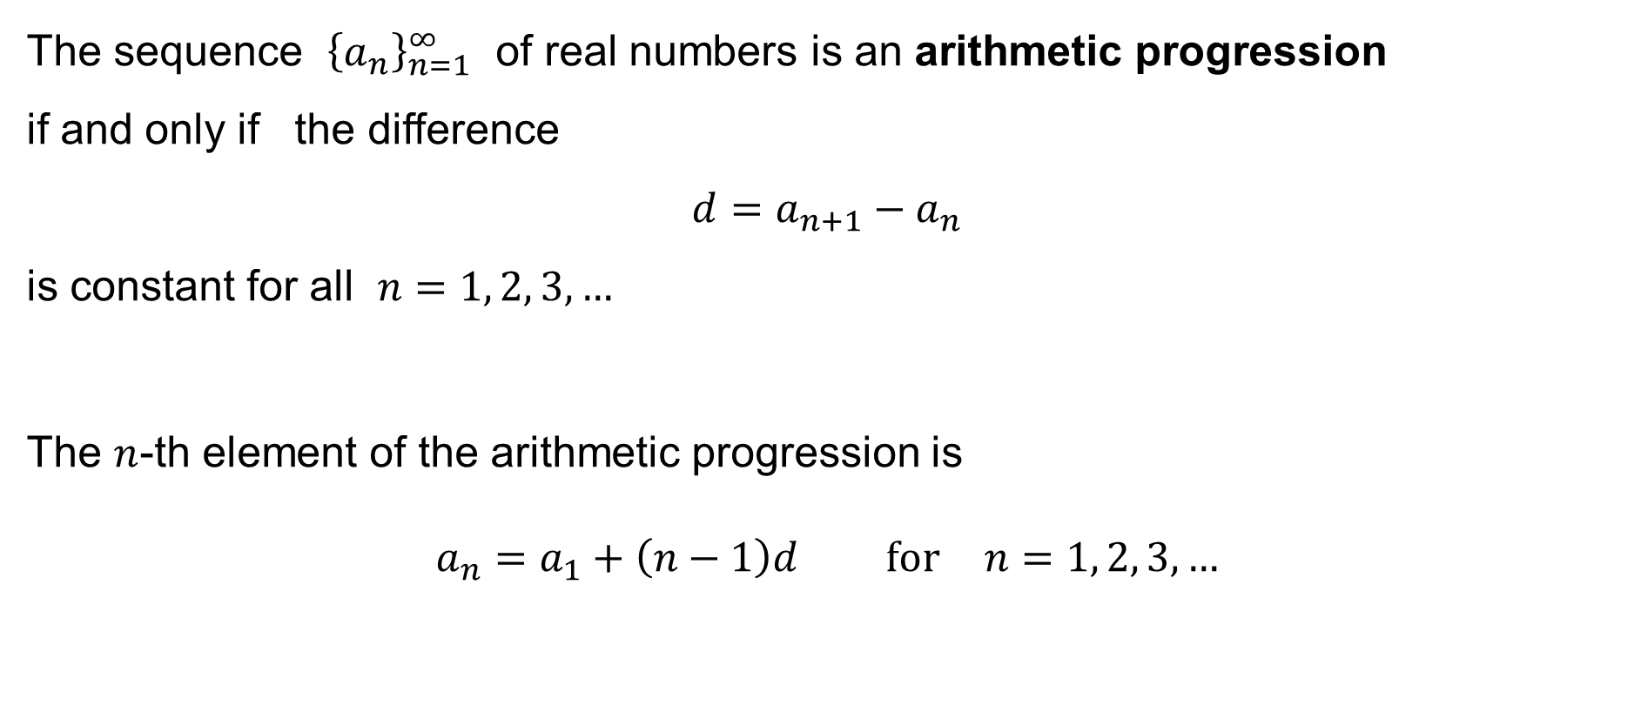
Arithmetic progression
The sequence ${\left\{a_{n}\right\}}_{n=1}^{∞}$ of real numbers is an arithmetic progression
if and only if the difference
$$d=a_{n+1}−a_{n}$$
is constant for all $n=1, 2, 3,…$
The $n$-th element of the arithmetic progression is
$$a_{n}=a_{1}+\left(n−1\right)d \text{for} n=1, 2, 3,…$$

Slide 7

Arithmetic progression: the sum of the first n elements
Let the sequence ${\left\{a_{n}\right\}}_{n=1}^{∞}$ of real numbers be an arithmetic progression.
The sum of the first $n$ elements is
$$\sum_{k=1}^{n}{a_{k}}=a_{1}+a_{2}+⋯+a_{n}$$
and it holds
$$\sum_{k=1}^{n}{a_{k}}=\frac{a_{1}+a_{n}}{2}$$

Slide 8
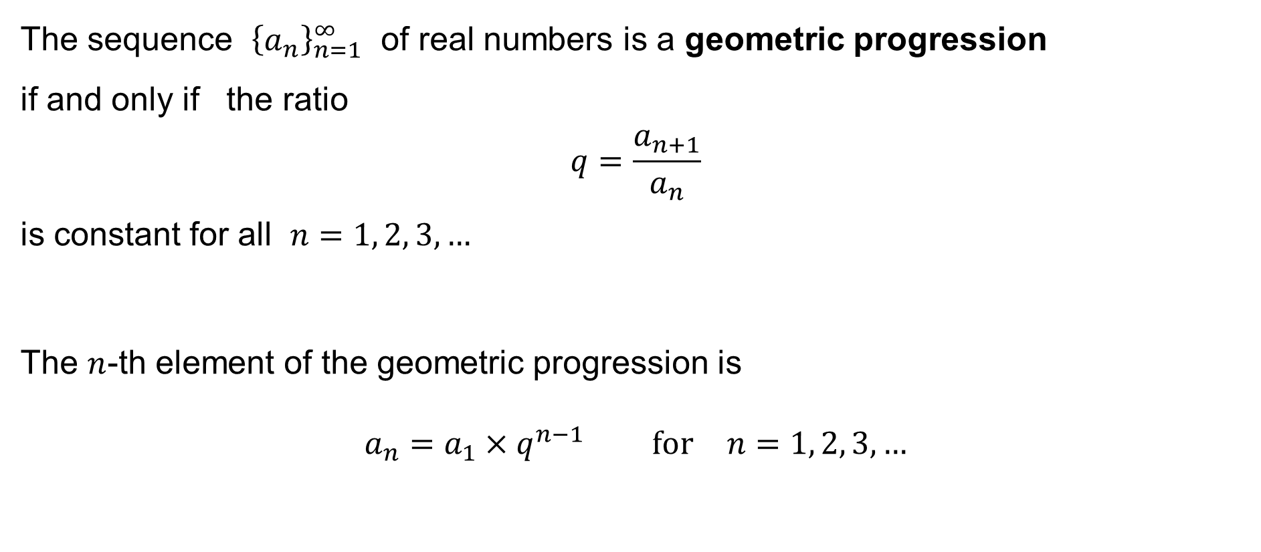
Geometric progression
The sequence ${\left\{a_{n}\right\}}_{n=1}^{∞}$ of real numbers is a geometric progression
if and only if the ratio
$$q=\frac{a_{n+1}}{a_{n}}$$
is constant for all $n=1, 2, 3,…$
The $n$-th element of the geometric progression is
$$a_{n}=a_{1}×q^{n−1} \text{for} n=1, 2, 3,…$$

Slide 9
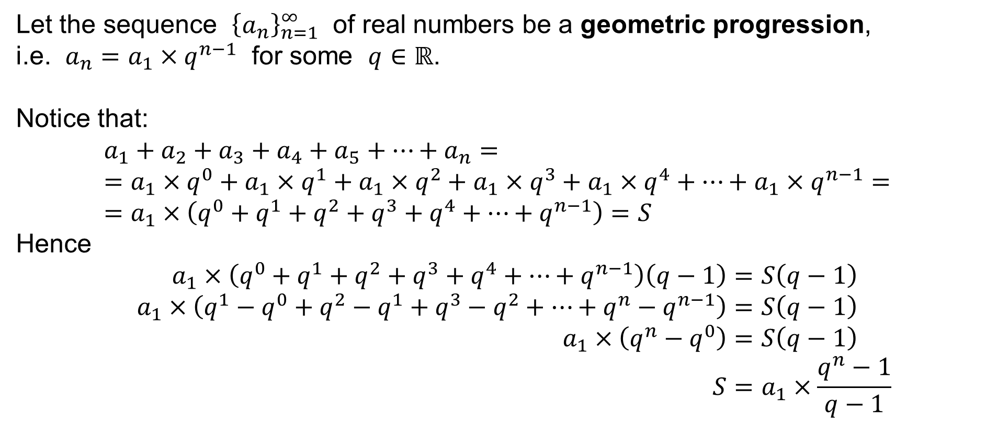
Geometric progression: the sum of the first n elements
Let the sequence ${\left\{a_{n}\right\}}_{n=1}^{∞}$ of real numbers be a geometric progression,
i.e. $a_{n}=a_{1}×q^{n−1}$ for some $q∈ℝ$.
Notice that:
$$a_{1}+a_{2}+a_{3}+a_{4}+a_{5}+⋯+a_{n}= \\ =a_{1}×q^{0}+a_{1}×q^{1}+a_{1}×q^{2}+a_{1}×q^{3}+a_{1}×q^{4}+⋯+a_{1}×q^{n−1}= \\ =a_{1}×\left(q^{0}+q^{1}+q^{2}+q^{3}+q^{4}+⋯+q^{n−1}\right)=S$$
Hence
$$a_{1}×\left(q^{0}+q^{1}+q^{2}+q^{3}+q^{4}+⋯+q^{n−1}\right)\left(q−1\right)=S\left(q−1\right) \\ a_{1}×\left(q^{1}−q^{0}+q^{2}−q^{1}+q^{3}−q^{2}+⋯+q^{n}−q^{n−1}\right)=S\left(q−1\right) \\ a_{1}×\left(q^{n}−q^{0}\right)=S\left(q−1\right) \\ S=a_{1}×\frac{q^{n}−1}{q−1}$$

Slide 10

Geometric progression: the sum of the first n elements
Let the sequence ${\left\{a_{n}\right\}}_{n=1}^{∞}$ of real numbers be a geometric progression.
The sum of the first $n$ elements is
$$\sum_{k=1}^{n}{a_{k}}=a_{1}+a_{2}+⋯+a_{n}$$
and it holds
$$\sum_{k=1}^{n}{a_{k}}=a_{1}×\frac{q^{n}−1}{q−1}$$

Slide 11


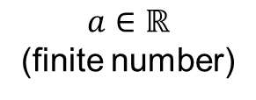




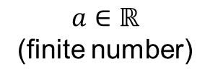


The limit of a sequence: the neighbourhood of a point
The neighbourhood of a point is the set of all “nearby” points:
A refined neighbourhood of the point is a smaller set of all “nearby” points:
And we are about to consider smaller and smaller neighbourhoods…
$$⋯$$
$$⋯$$
$$−∞$$
$$a∈ℝ$$
(finite number)
$$+∞$$
$$⋯$$
$$⋯$$
$$−∞$$
$$a∈ℝ$$
(finite number)
$$+∞$$

Slide 12
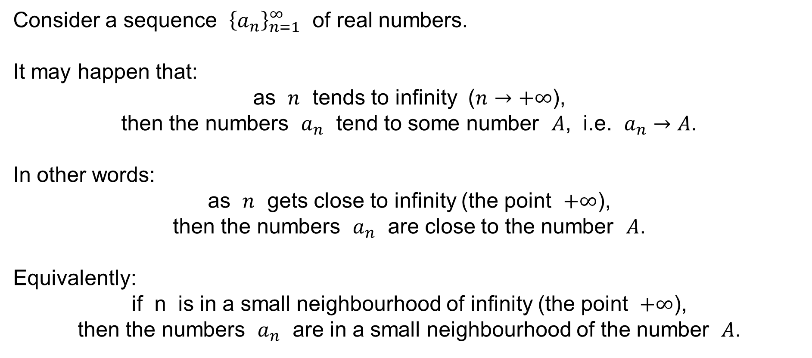
The limit of a sequence
Consider a sequence ${\left\{a_{n}\right\}}_{n=1}^{∞}$ of real numbers.
It may happen that:
as $n$ tends to infinity ($n→+∞$),
then the numbers $a_{n}$ tend to some number $A$, i.e. $a_{n}→A$.
In other words:
as $n$ gets close to infinity (the point $+∞$),
then the numbers $a_{n}$ are close to the number $A$.
Equivalently:
if n is in a small neighbourhood of infinity (the point $+∞$),
then the numbers $a_{n}$ are in a small neighbourhood of the number $A$.

Slide 13
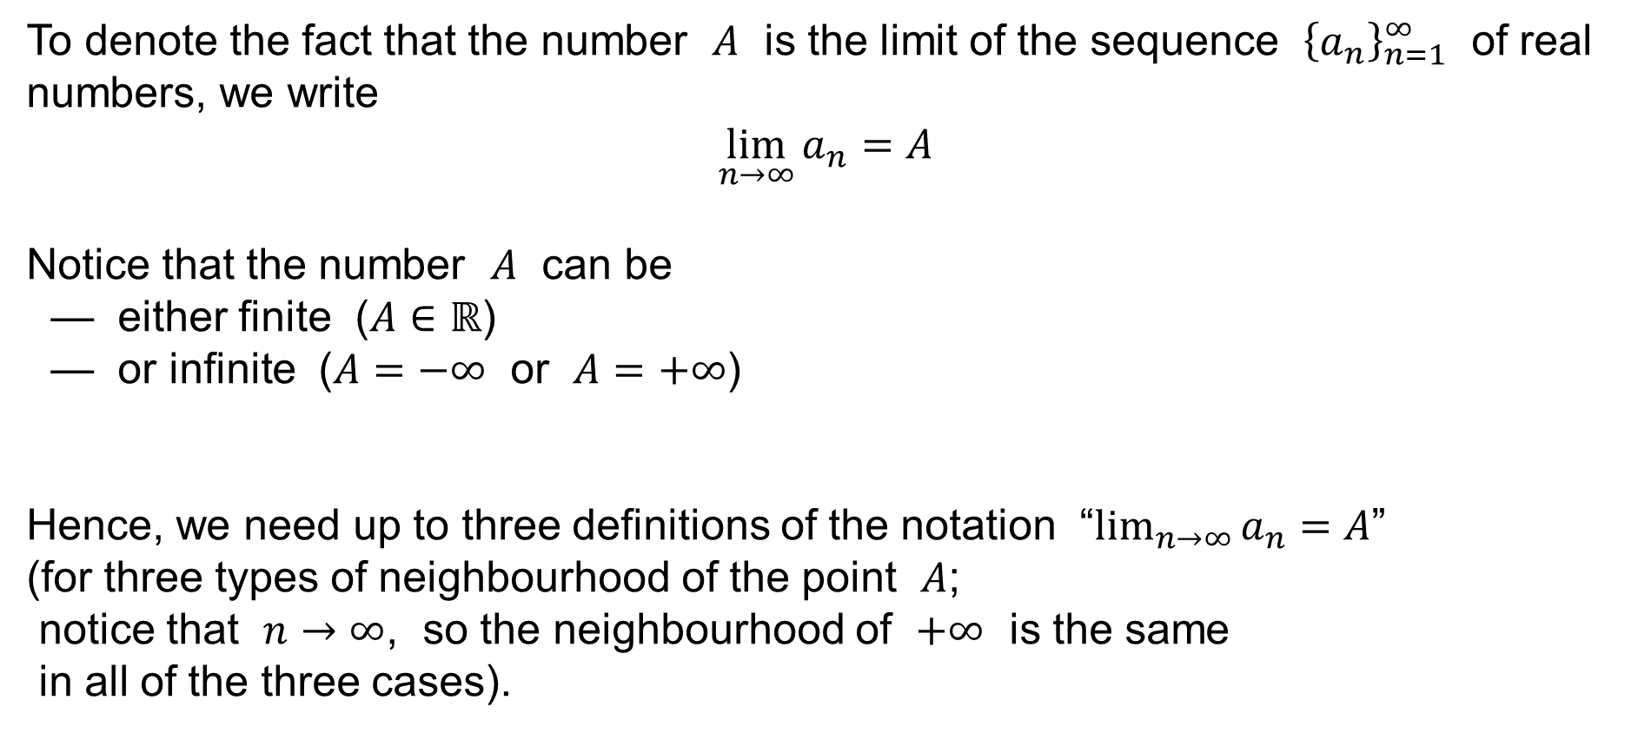
The limit of a sequence
To denote the fact that the number $A$ is the limit of the sequence ${\left\{a_{n}\right\}}_{n=1}^{∞}$ of real numbers, we write
$$\lim_{n→∞}{a_{n}}=A$$
Notice that the number $A$ can be
— either finite ($A∈ℝ$)
— or infinite ($A=−∞$ or $A=+∞$)
Hence, we need up to three definitions of the notation “$\lim_{n→∞}{a_{n}}=A$”
(for three types of neighbourhood of the point $A$;
notice that $n→∞$, so the neighbourhood of $+∞$ is the same
in all of the three cases).

Slide 14
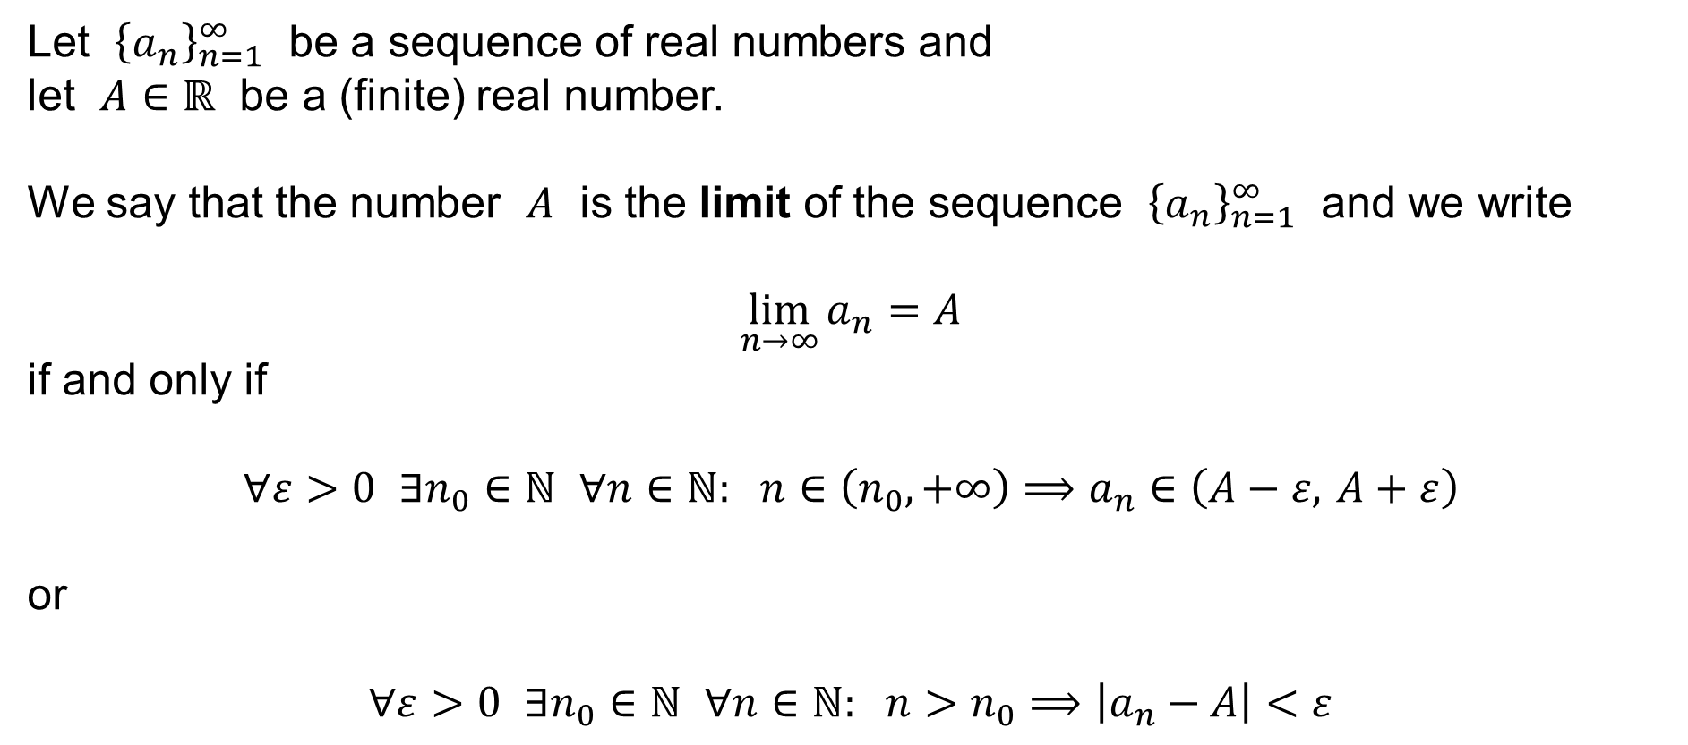
The limit of a sequence
Let ${\left\{a_{n}\right\}}_{n=1}^{∞}$ be a sequence of real numbers and
let $A∈ℝ$ be a (finite) real number.
We say that the number $A$ is the limit of the sequence ${\left\{a_{n}\right\}}_{n=1}^{∞}$ and we write
$$\lim_{n→∞}{a_{n}}=A$$
if and only if
$$∀ε>0 ∃n_{0}∈ℕ ∀n∈ℕ: n∈\left(n_{0},+∞\right)⟹a_{n}∈\left(A−ε, A+ε\right)$$
or
$$∀ε>0 ∃n_{0}∈ℕ ∀n∈ℕ: n>n_{0}⟹\left|a_{n}−A\right|<ε$$

Slide 15
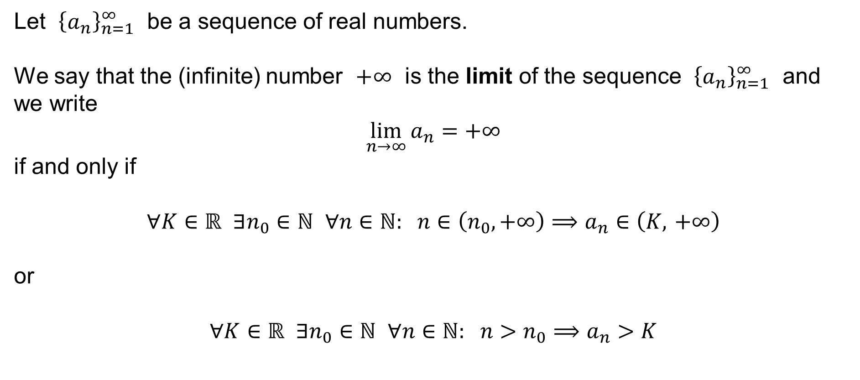
The limit of a sequence
Let ${\left\{a_{n}\right\}}_{n=1}^{∞}$ be a sequence of real numbers.
We say that the (infinite) number $+∞$ is the limit of the sequence ${\left\{a_{n}\right\}}_{n=1}^{∞}$ and we write
$$\lim_{n→∞}{a_{n}}=+∞$$
if and only if
$$∀K∈ℝ ∃n_{0}∈ℕ ∀n∈ℕ: n∈\left(n_{0},+∞\right)⟹a_{n}∈\left(K, +∞\right)$$
or
$$∀K∈ℝ ∃n_{0}∈ℕ ∀n∈ℕ: n>n_{0}⟹a_{n}>K$$

Slide 16
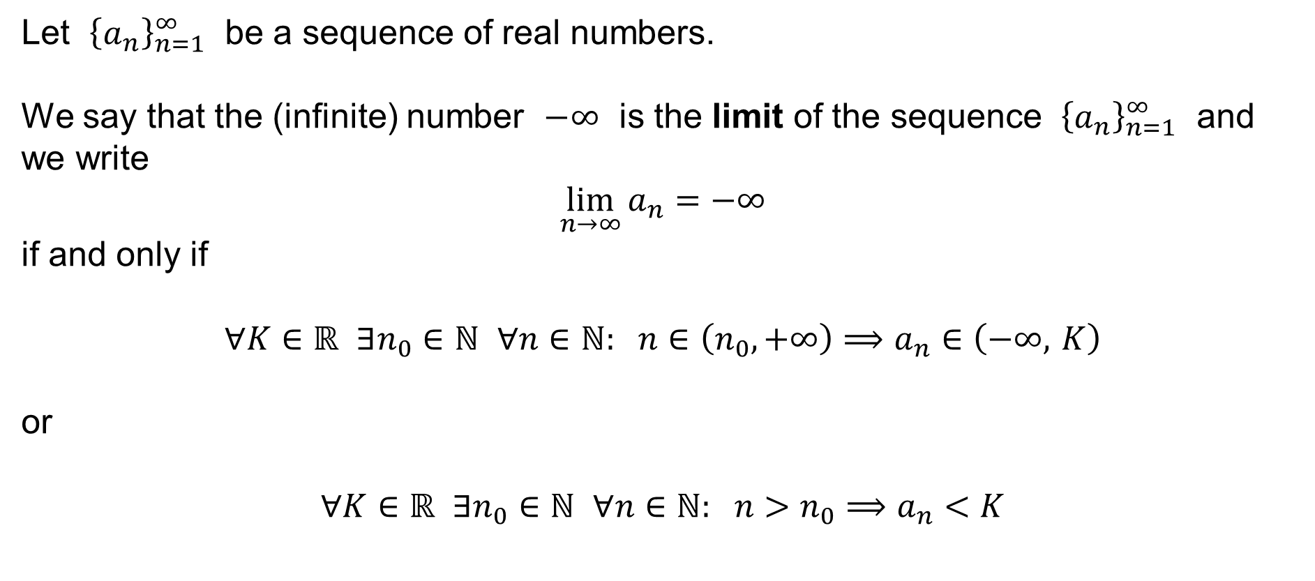
The limit of a sequence
Let ${\left\{a_{n}\right\}}_{n=1}^{∞}$ be a sequence of real numbers.
We say that the (infinite) number $−∞$ is the limit of the sequence ${\left\{a_{n}\right\}}_{n=1}^{∞}$ and we write
$$\lim_{n→∞}{a_{n}}=−∞$$
if and only if
$$∀K∈ℝ ∃n_{0}∈ℕ ∀n∈ℕ: n∈\left(n_{0},+∞\right)⟹a_{n}∈\left(−∞, K\right)$$
or
$$∀K∈ℝ ∃n_{0}∈ℕ ∀n∈ℕ: n>n_{0}⟹a_{n}<K$$

Slide 17
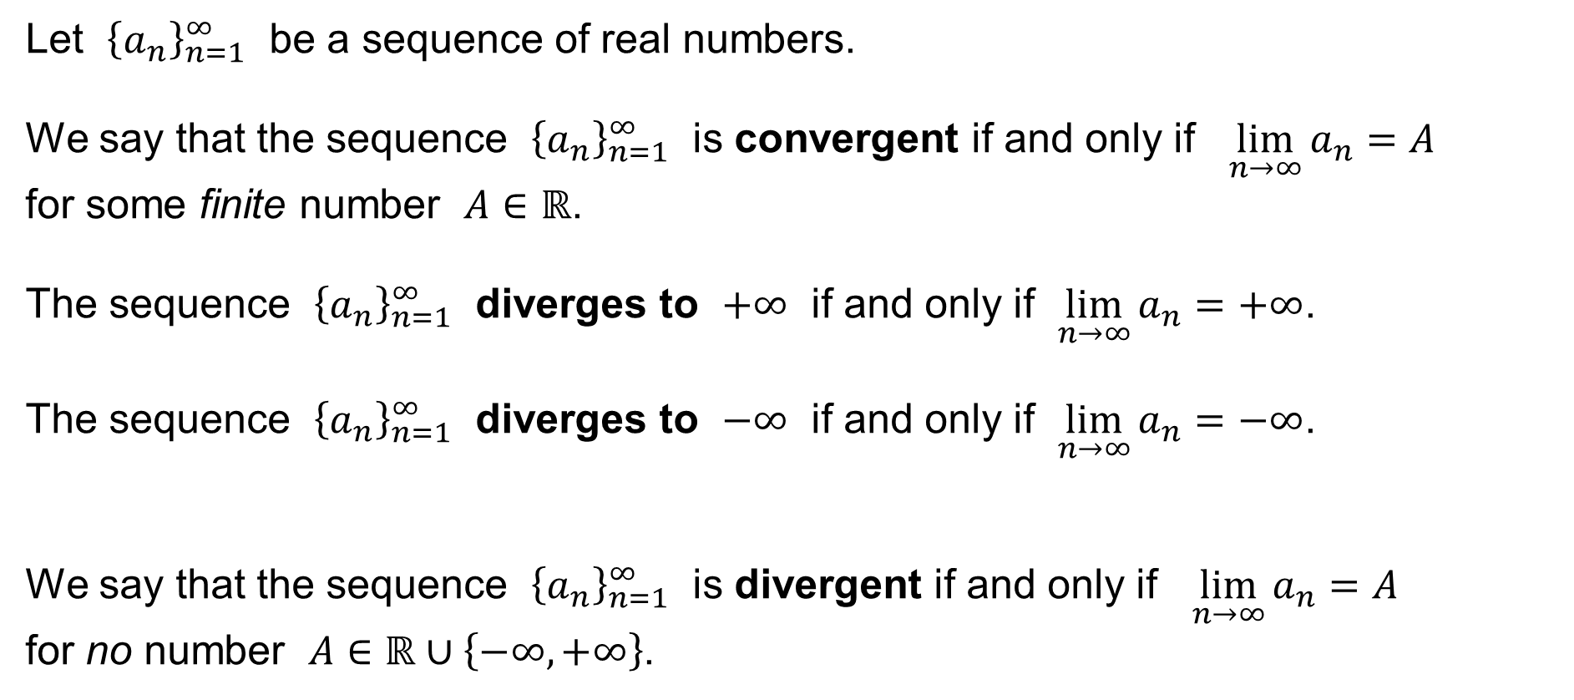
The limit of a sequence
Let ${\left\{a_{n}\right\}}_{n=1}^{∞}$ be a sequence of real numbers.
We say that the sequence ${\left\{a_{n}\right\}}_{n=1}^{∞}$ is convergent if and only if $\lim_{n→∞}{a_{n}}=A$
for some finite number $A∈ℝ$.
The sequence ${\left\{a_{n}\right\}}_{n=1}^{∞}$ diverges to $+∞$ if and only if $\lim_{n→∞}{a_{n}}=+∞$.
The sequence ${\left\{a_{n}\right\}}_{n=1}^{∞}$ diverges to $−∞$ if and only if $\lim_{n→∞}{a_{n}}=−∞$.
We say that the sequence ${\left\{a_{n}\right\}}_{n=1}^{∞}$ is divergent if and only if $\lim_{n→∞}{a_{n}}=A$
for no number $A∈ℝ∪\left\{−∞,+∞\right\}$.

Slide 18

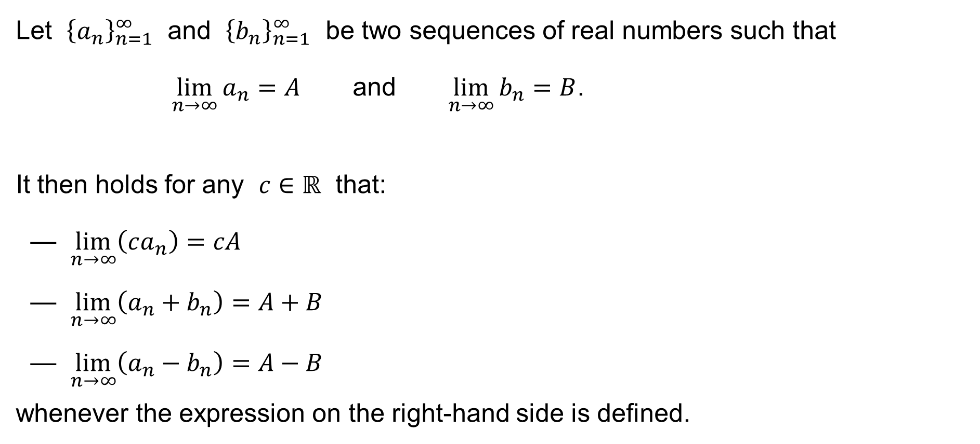
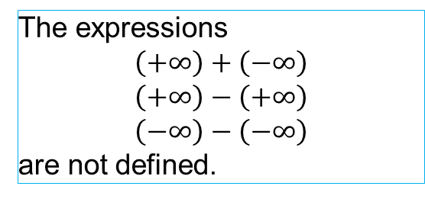
Properties of the limit
Let ${\left\{a_{n}\right\}}_{n=1}^{∞}$ and ${\left\{b_{n}\right\}}_{n=1}^{∞}$ be two sequences of real numbers such that
$\lim_{n→∞}{a_{n}}=A$ and $\lim_{n→∞}{b_{n}}=B$.
It then holds for any $c∈ℝ$ that:
— $\lim_{n→∞}\left(ca_{n}\right)=cA$
— $\lim_{n→∞}\left(a_{n}+b_{n}\right)=A+B$
— $\lim_{n→∞}\left(a_{n}−b_{n}\right)=A−B$
whenever the expression on the right-hand side is defined.
We define for any $a∈ℝ$:
$$a+\left(+∞\right)=+∞+a=+∞$$
$$a+\left(−∞\right)=−∞+a=−∞$$
$$\left(+∞\right)+\left(+∞\right)=+∞$$
$$\left(−∞\right)+\left(−∞\right)=−∞$$
The expressions
$$\left(+∞\right)+\left(−∞\right)$$
$$\left(+∞\right)−\left(+∞\right)$$
$$\left(−∞\right)−\left(−∞\right)$$
are not defined.

Slide 19

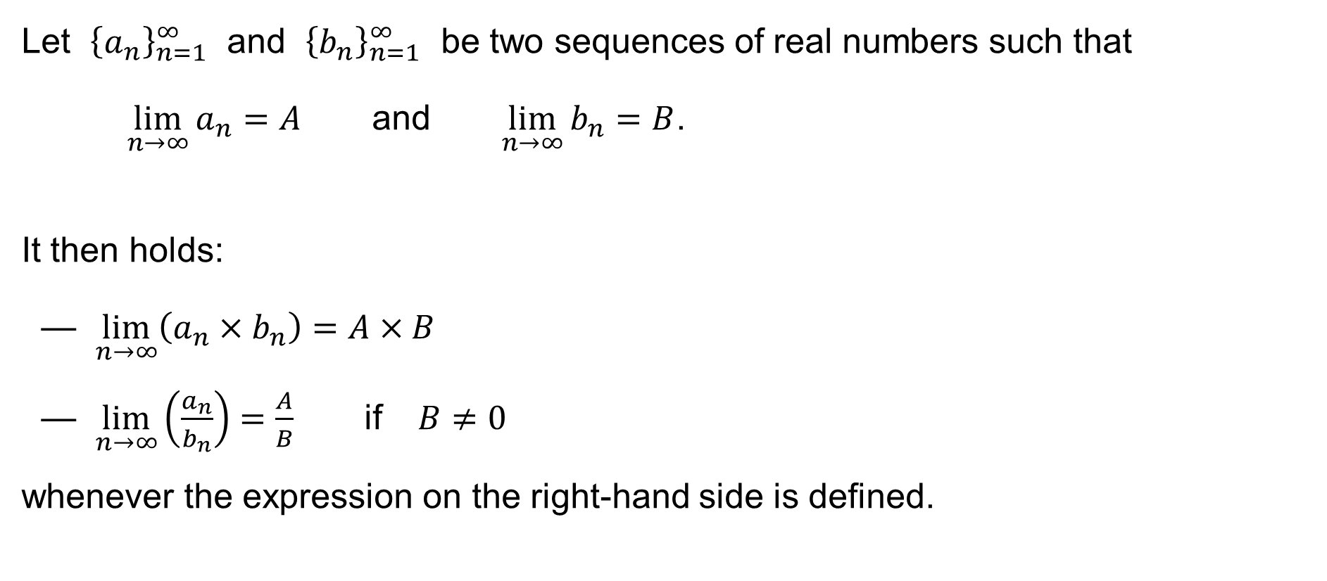
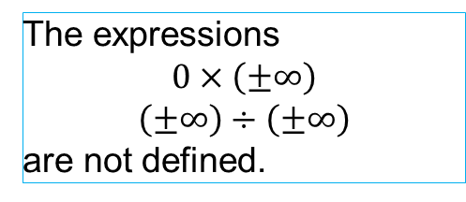
Properties of the limit
Let ${\left\{a_{n}\right\}}_{n=1}^{∞}$ and ${\left\{b_{n}\right\}}_{n=1}^{∞}$ be two sequences of real numbers such that
$\lim_{n→∞}{a_{n}}=A$ and $\lim_{n→∞}{b_{n}}=B$.
It then holds:
— $\lim_{n→∞}\left(a_{n}×b_{n}\right)=A×B$
— $\lim_{n→∞}\left(\frac{a_{n}}{b_{n}}\right)=\frac{A}{B}$ if $B≠0$
whenever the expression on the right-hand side is defined.
We define for any $a∈ℝ^{+}$:
$$a×\left(+∞\right)=+∞×a=+∞$$
$$a×\left(−∞\right)=−∞×a=−∞$$
We define for any $a∈ℝ^{−}$:
$$a×\left(+∞\right)=+∞×a=−∞$$
$$a×\left(−∞\right)=−∞×a=+∞$$
Moreover:
$$\left(+∞\right)×\left(+∞\right)=\left(−∞\right)×\left(−∞\right)=+∞$$
$$\left(+∞\right)×\left(−∞\right)=\left(−∞\right)×\left(+∞\right)=−∞$$
The expressions
$$0×\left(±∞\right)$$
$$\left(±∞\right)÷\left(±∞\right)$$
are not defined.

Slide 20
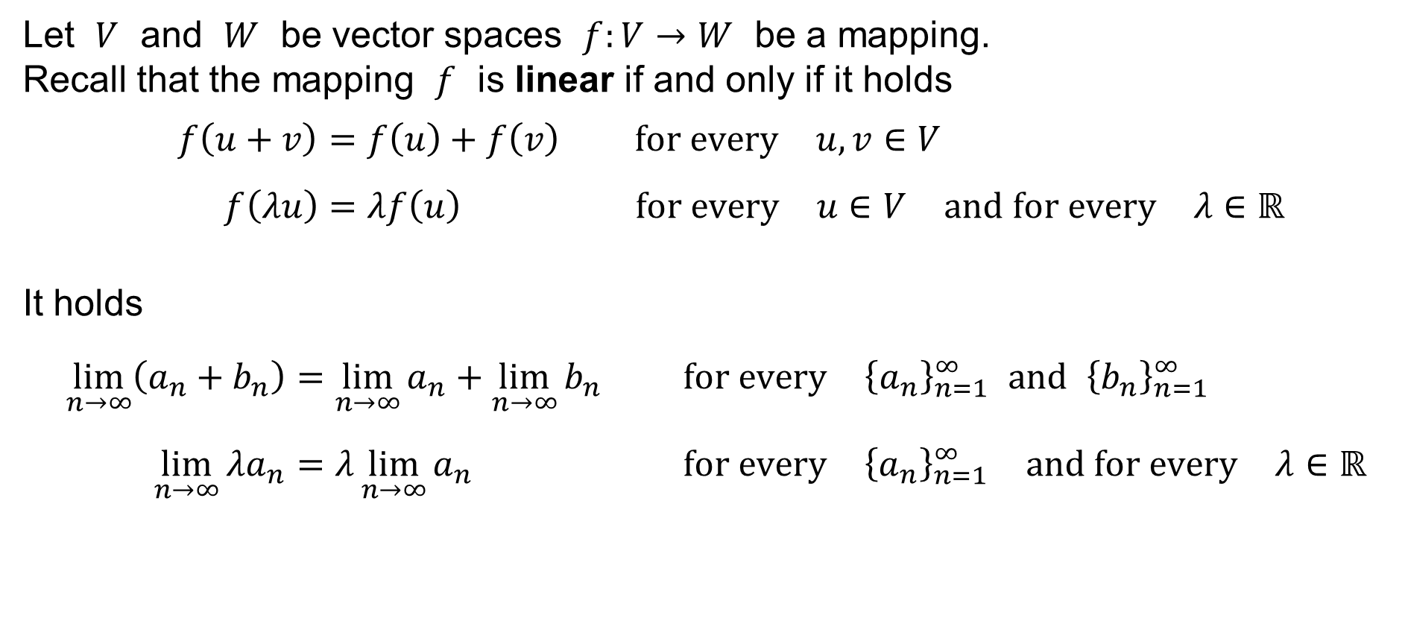
The limit as a linear mapping
Let $V$ and $W$ be vector spaces $f:V→W$ be a mapping.
Recall that the mapping $f$ is linear if and only if it holds
$$f\left(u+v\right)=f\left(u\right)+f\left(v\right) \text{for} \text{every} u,v∈V \\ f\left(λu\right)=λf\left(u\right) \text{for} \text{every} u∈V \text{and} \text{for} \text{every} λ∈ℝ$$
It holds
$$\lim_{n→∞}\left(a_{n}+b_{n}\right)=\lim_{n→∞}{a_{n}}+\lim_{n→∞}{b_{n}} \text{for} \text{every} {\left\{a_{n}\right\}}_{n=1}^{∞} \text{and} {\left\{b_{n}\right\}}_{n=1}^{∞} \\ \lim_{n→∞}{λa_{n}}=λ\lim_{n→∞}{a_{n}} \text{for} \text{every} {\left\{a_{n}\right\}}_{n=1}^{∞} \text{an}\text{d} \text{for} \text{every} λ∈ℝ∈ℝ$$

Slide 21

Theorem
Let ${\left\{a_{n}\right\}}_{n=1}^{∞}$, ${\left\{b_{n}\right\}}_{n=1}^{∞}$, ${\left\{c_{n}\right\}}_{n=1}^{∞}$ be sequences of real numbers such that
$$a_{n}≤b_{n}≤c_{n} \text{for} \text{all} n∈ℕ$$
If
$$\lim_{n→∞}{a_{n}}=B=\lim_{n→∞}{c_{n}} \text{for} \text{some} B∈ℝ∪\left\{+∞,−∞\right\}$$
then
$$\lim_{n→∞}{b_{n}}=B$$

Slide 22

Infinite series
Let ${\left\{a_{n}\right\}}_{n=1}^{∞}$ be a sequence of real numbers.
The infinite series or the infinite sum is
$$\sum_{n=1}^{∞}{a_{n}}=a_{1}+a_{2}+a_{3}+a_{4}+a_{5}+a_{6}+a_{7}+⋯$$

Slide 23
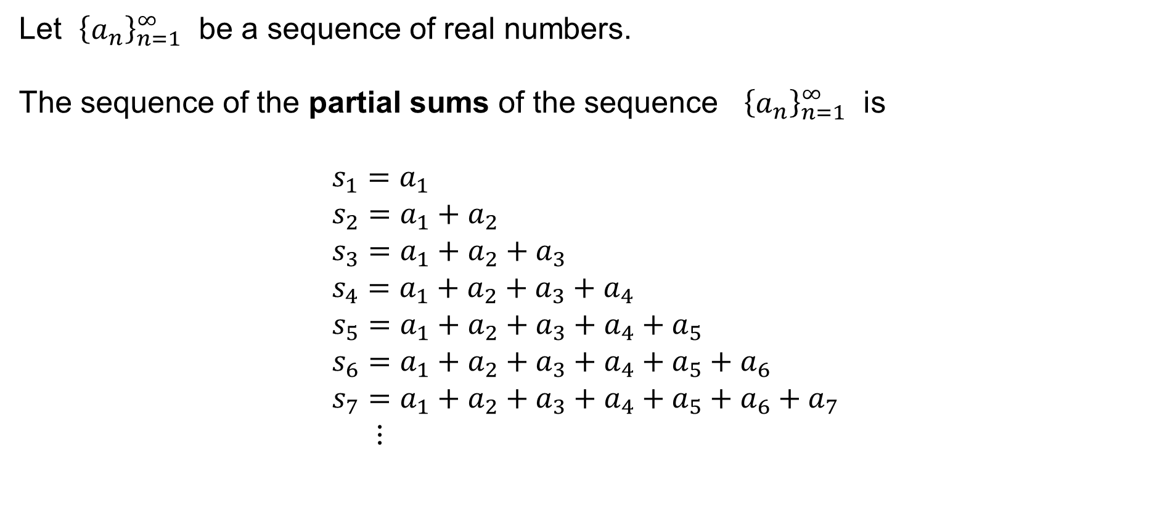
Sequence of partial sums
Let ${\left\{a_{n}\right\}}_{n=1}^{∞}$ be a sequence of real numbers.
The sequence of the partial sums of the sequence ${\left\{a_{n}\right\}}_{n=1}^{∞}$ is
$$s_{1}=a_{1} \\ s_{2}=a_{1}+a_{2} \\ s_{3}=a_{1}+a_{2}+a_{3} \\ s_{4}=a_{1}+a_{2}+a_{3}+a_{4} \\ s_{5}=a_{1}+a_{2}+a_{3}+a_{4}+a_{5} \\ s_{6}=a_{1}+a_{2}+a_{3}+a_{4}+a_{5}+a_{6} \\ s_{7}=a_{1}+a_{2}+a_{3}+a_{4}+a_{5}+a_{6}+a_{7} \\ ⋮$$

Slide 24
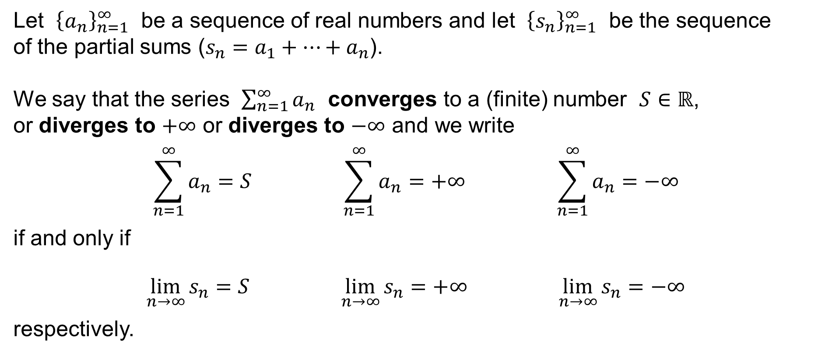
The sum of a series
Let ${\left\{a_{n}\right\}}_{n=1}^{∞}$ be a sequence of real numbers and let ${\left\{s_{n}\right\}}_{n=1}^{∞}$ be the sequence
of the partial sums ($s_{n}=a_{1}+⋯+a_{n}$).
We say that the series $\sum_{n=1}^{∞}{a_{n}}$ converges to a (finite) number $S∈ℝ$,
or diverges to $+∞$ or diverges to $−∞$ and we write
$$\sum_{n=1}^{∞}{a_{n}}=S \sum_{n=1}^{∞}{a_{n}}=+∞ \sum_{n=1}^{∞}{a_{n}}=−∞$$
if and only if
$$\lim_{n→∞}{s_{n}}=S \lim_{n→∞}{s_{n}}=+∞ \lim_{n→∞}{s_{n}}=−∞$$
respectively.

Slide 25
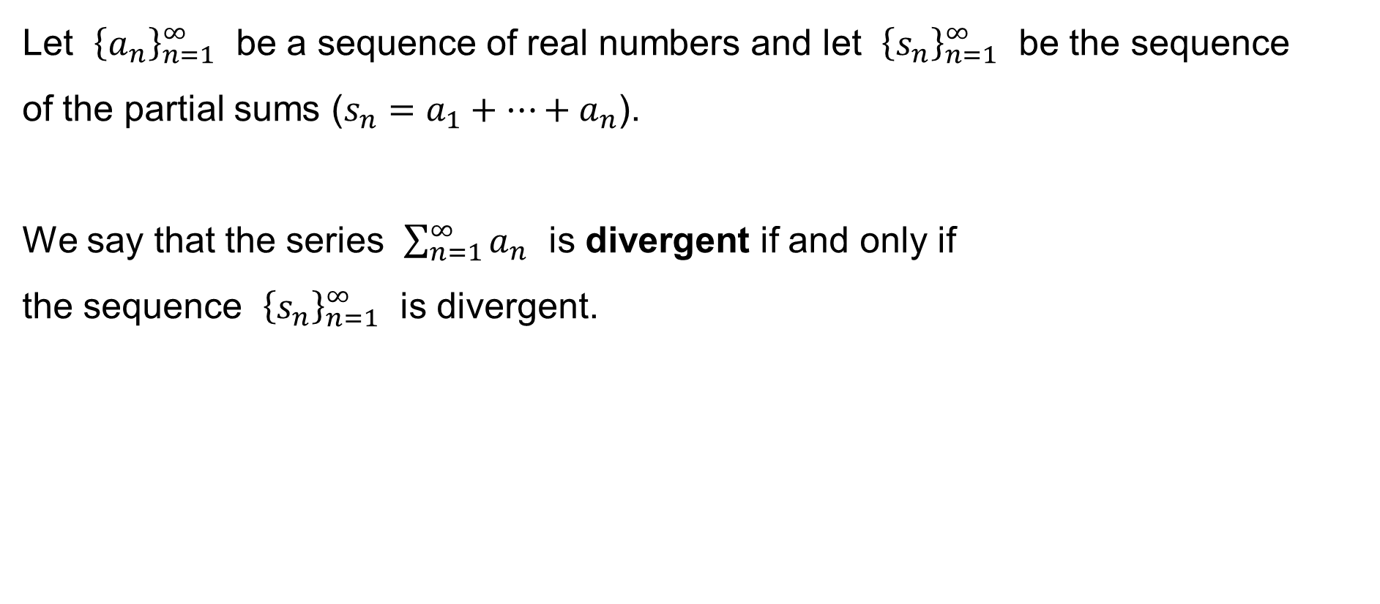
Divergent series
Let ${\left\{a_{n}\right\}}_{n=1}^{∞}$ be a sequence of real numbers and let ${\left\{s_{n}\right\}}_{n=1}^{∞}$ be the sequence
of the partial sums ($s_{n}=a_{1}+⋯+a_{n}$).
We say that the series $\sum_{n=1}^{∞}{a_{n}}$ is divergent if and only if
the sequence ${\left\{s_{n}\right\}}_{n=1}^{∞}$ is divergent.

Slide 26
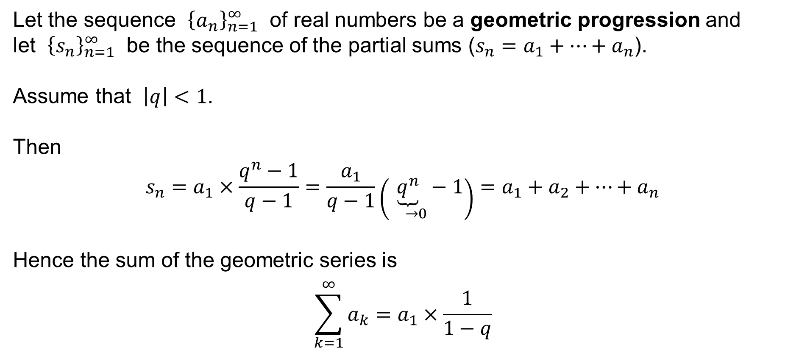
The sum of a geometric series
Let the sequence ${\left\{a_{n}\right\}}_{n=1}^{∞}$ of real numbers be a geometric progression and
let ${\left\{s_{n}\right\}}_{n=1}^{∞}$ be the sequence of the partial sums ($s_{n}=a_{1}+⋯+a_{n}$).
Assume that $\left|q\right|<1$.
Then
$$s_{n}=a_{1}×\frac{q^{n}−1}{q−1}=\frac{a_{1}}{q−1}\left(\underset{ →0}{\underbrace{q^{n}}}−1\right)=a_{1}+a_{2}+⋯+a_{n}$$
Hence the sum of the geometric series is
$$\sum_{k=1}^{∞}{a_{k}}=a_{1}×\frac{1}{1−q}$$

