Slide 1
Quantitative Methods
Lecture 8
Sketching the graph of a function
BAKVM

Slide 2
Sketching the graph of a function
(functions increasing and decreasing, convex and concave,
local minima and maxima, inflection points)

Slide 3
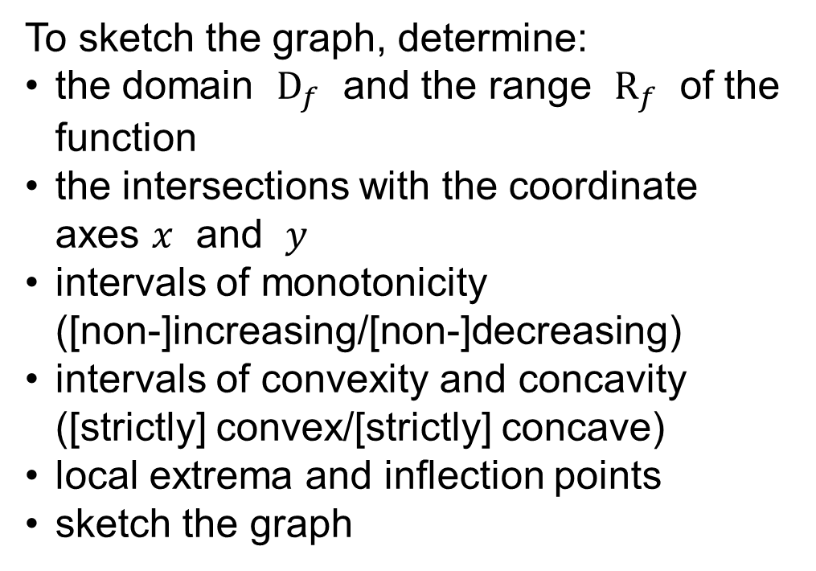
Sketching the graph of a function
To sketch the graph, determine:
the domain $D_{f}$ and the range $R_{f}$ of the function
the intersections with the coordinate axes $x$ and $y$
intervals of monotonicity
([non-]increasing/[non-]decreasing)
intervals of convexity and concavity ([strictly] convex/[strictly] concave)
local extrema and inflection points
sketch the graph

Slide 4
Intervals of monotonicity and of convexity and concavity
Function increasing, non-decreasing, non-increasing, and decreasing
Convex combination of points
Function strictly convex, convex, concave, and strictly concave
Characterization by the derivatives of the first, second and higher order

Slide 5
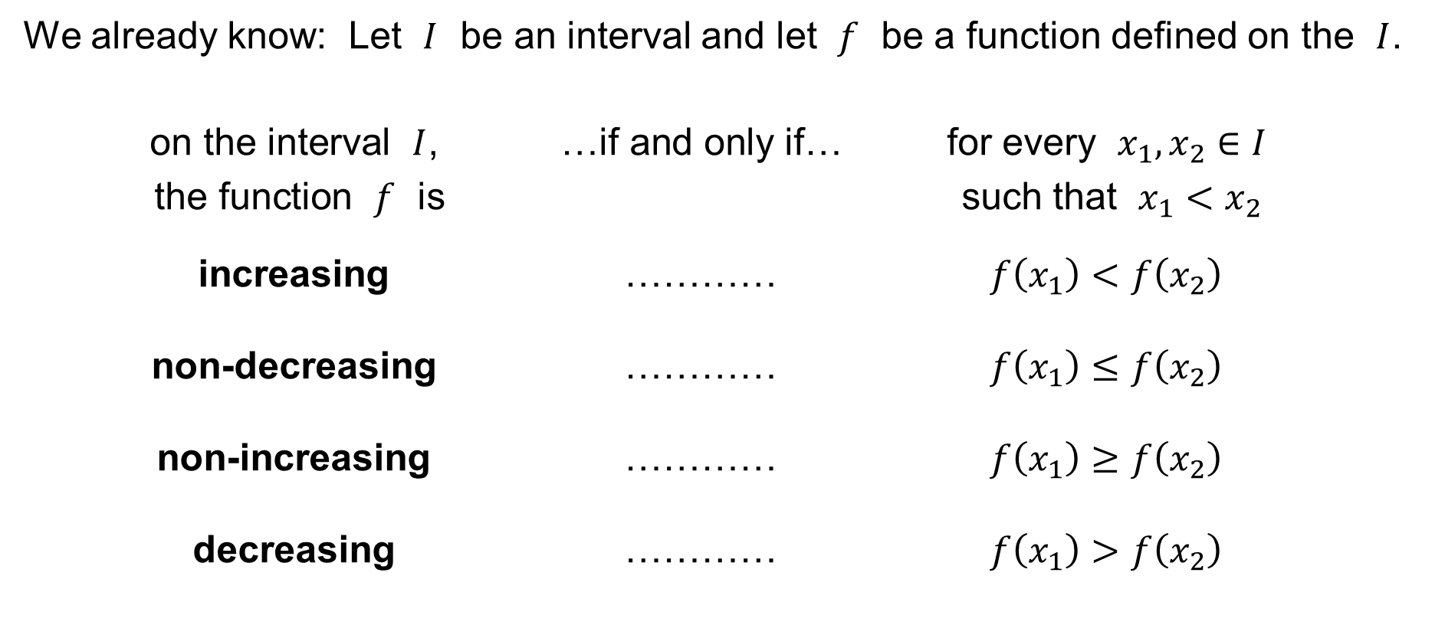
Sketching the graph of a function
We already know: Let $I$ be an interval and let $f$ be a function defined on the $I$.
on the interval $I$, …if and only if… for every $x_{1},x_{2}∈I$
the function $f$ is such that $x_{1}<x_{2}$
increasing ………… $f\left(x_{1}\right)<f\left(x_{2}\right)$
non-decreasing ………… $f\left(x_{1}\right)≤f\left(x_{2}\right)$
non-increasing ………… $f\left(x_{1}\right)≥f\left(x_{2}\right)$
decreasing ………… $f\left(x_{1}\right)>f\left(x_{2}\right)$

Slide 6
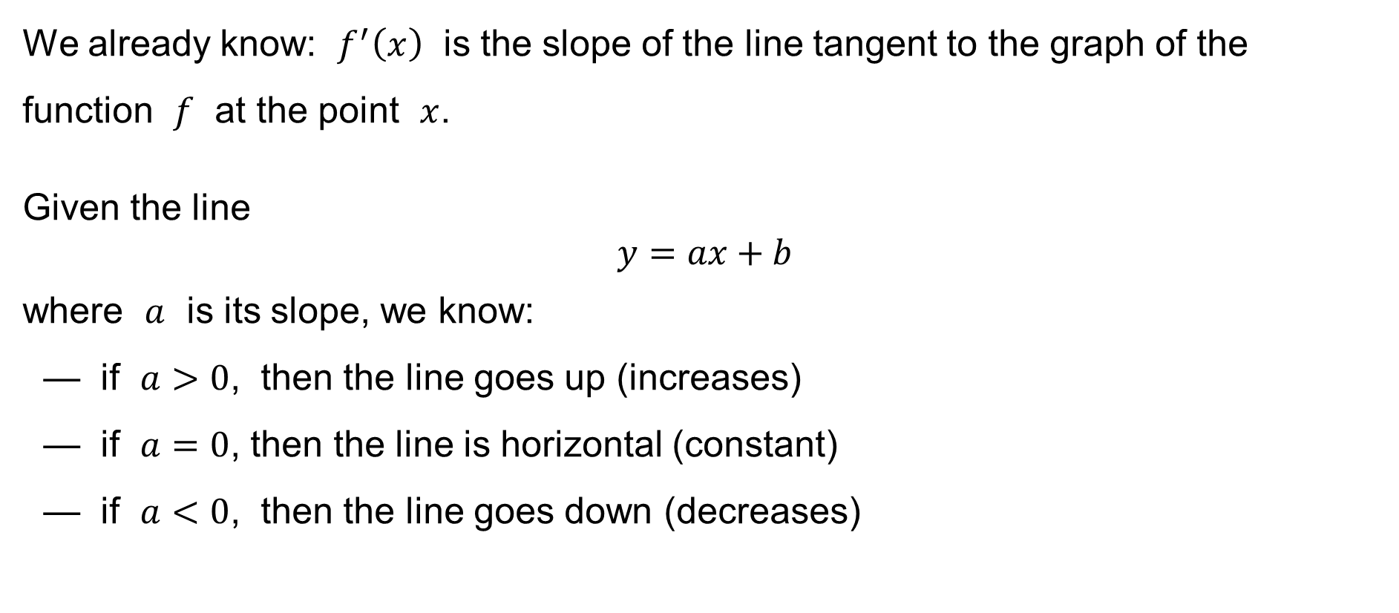
Sketching the graph of a function
We already know: $f^{′}\left(x\right)$ is the slope of the line tangent to the graph of the function $f$ at the point $x$.
Given the line
$$y=ax+b$$
where $a$ is its slope, we know:
— if $a>0$, then the line goes up (increases)
— if $a=0$, then the line is horizontal (constant)
— if $a<0$, then the line goes down (decreases)

Slide 7

Sketching the graph of a function
Hence:
If $f^{′}\left(x\right)>0$ at every point $x$ of an interval $I$,
then the function $f\left(x\right)$ is increasing on $I$.
Example (however): The function
$$y=x^{3}$$
is increasing, but
$$y^{′}=3x^{2}$$
is zero at $x=0$.

Slide 8
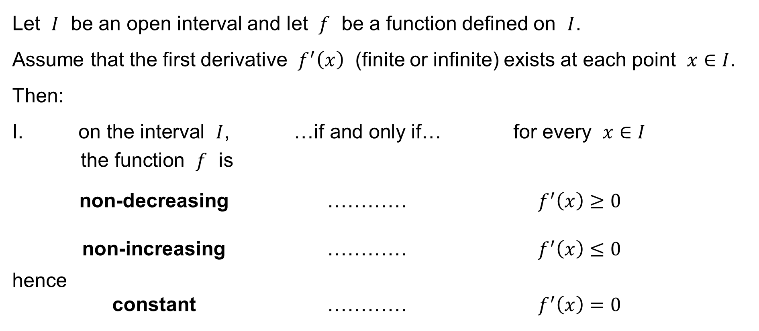
Theorem
Let $I$ be an open interval and let $f$ be a function defined on $I$.
Assume that the first derivative $f^{′}\left(x\right)$ (finite or infinite) exists at each point $x∈I$.
Then:
I. on the interval $I$, …if and only if… for every $x∈I$
the function $f$ is
non-decreasing ………… $f^{′}\left(x\right)≥0$
non-increasing ………… $f^{′}\left(x\right)≤0$
hence
constant ………… $f^{′}\left(x\right)=0$

Slide 9
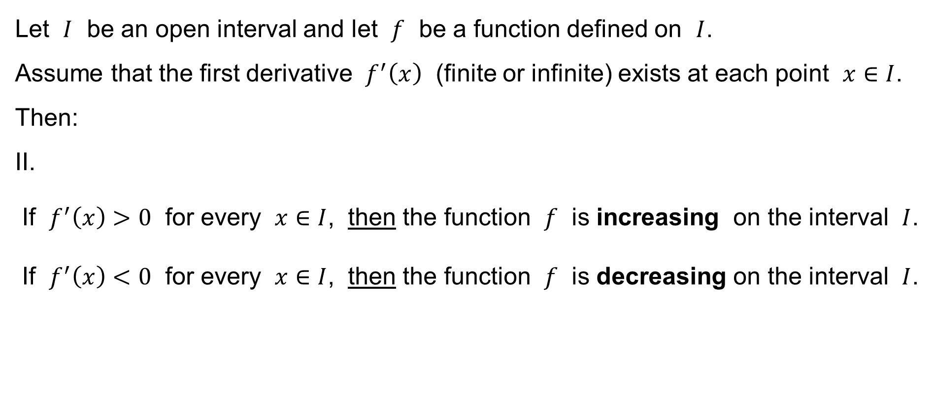
Theorem
Let $I$ be an open interval and let $f$ be a function defined on $I$.
Assume that the first derivative $f^{′}\left(x\right)$ (finite or infinite) exists at each point $x∈I$.
Then:
II.
If $f^{′}\left(x\right)>0$ for every $x∈I$, then the function $f$ is increasing on the interval $I$.
If $f^{′}\left(x\right)<0$ for every $x∈I$, then the function $f$ is decreasing on the interval $I$.

Slide 10
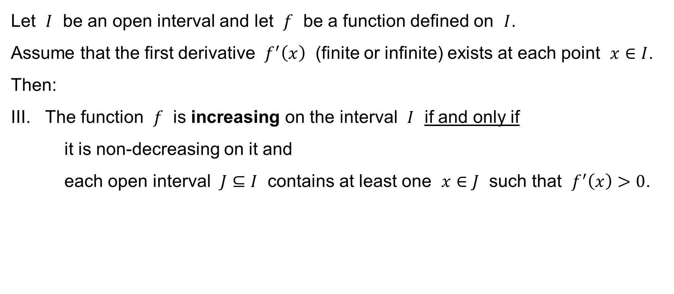
Theorem
Let $I$ be an open interval and let $f$ be a function defined on $I$.
Assume that the first derivative $f^{′}\left(x\right)$ (finite or infinite) exists at each point $x∈I$.
Then:
III. The function $f$ is increasing on the interval $I$ if and only if
it is non-decreasing on it and
each open interval $J⊆I$ contains at least one $x∈J$ such that $f^{′}\left(x\right)>0$.

Slide 11
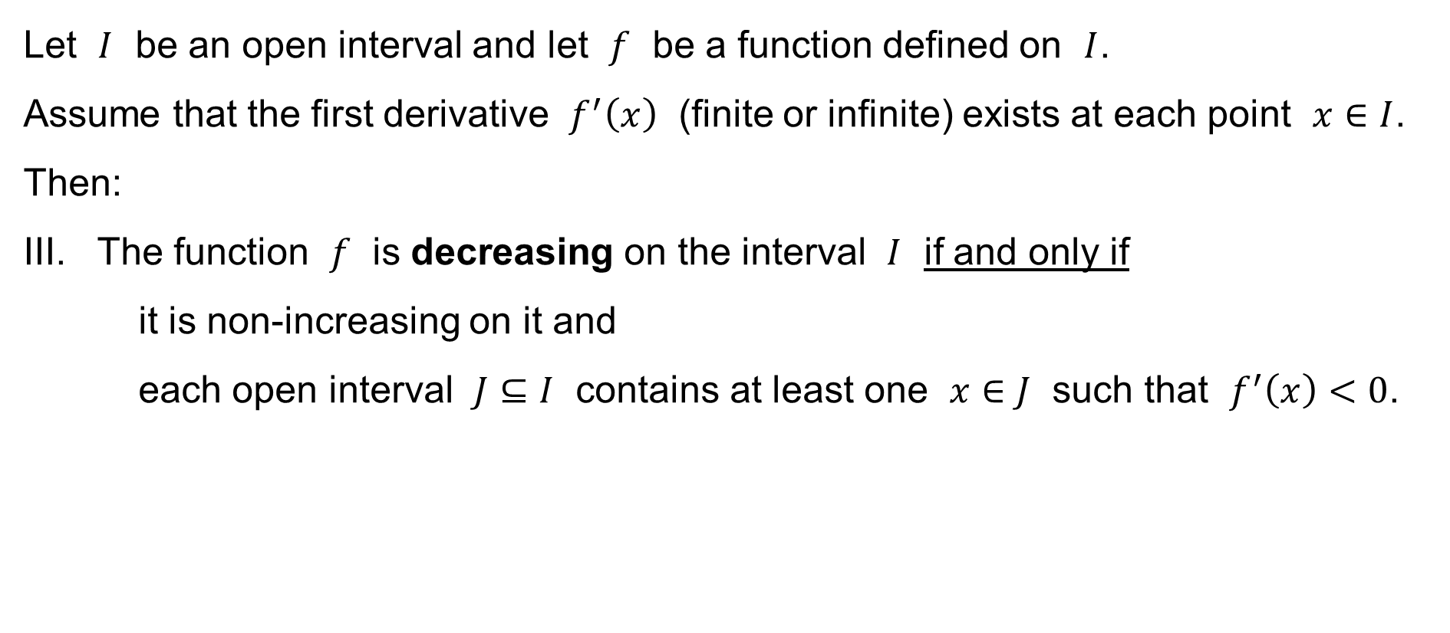
Theorem
Let $I$ be an open interval and let $f$ be a function defined on $I$.
Assume that the first derivative $f^{′}\left(x\right)$ (finite or infinite) exists at each point $x∈I$.
Then:
III. The function $f$ is decreasing on the interval $I$ if and only if
it is non-increasing on it and
each open interval $J⊆I$ contains at least one $x∈J$ such that $f^{′}\left(x\right)<0$.

Slide 12

Sketching the graph of a function
Analogously:
If $f^{′′}\left(x\right)>0$ at every point $x$ of an interval $I$,
then the first derivative $f^{′}\left(x\right)$ is increasing on $I$.
What does that mean?
→ The function $f\left(x\right)$ is strictly convex on $I$.

Slide 13

Sketching the graph of a function
Analogously:
If $f^{′′}\left(x\right)>0$ at every point $x$ of an interval $I$,
then the function $f\left(x\right)$ is strictly convex on $I$.
Example (however): The function
$$y=x^{4}$$
is strictly convex, but
$$y^{′′}=4×3x^{2}$$
is zero at $x=0$.

Slide 14
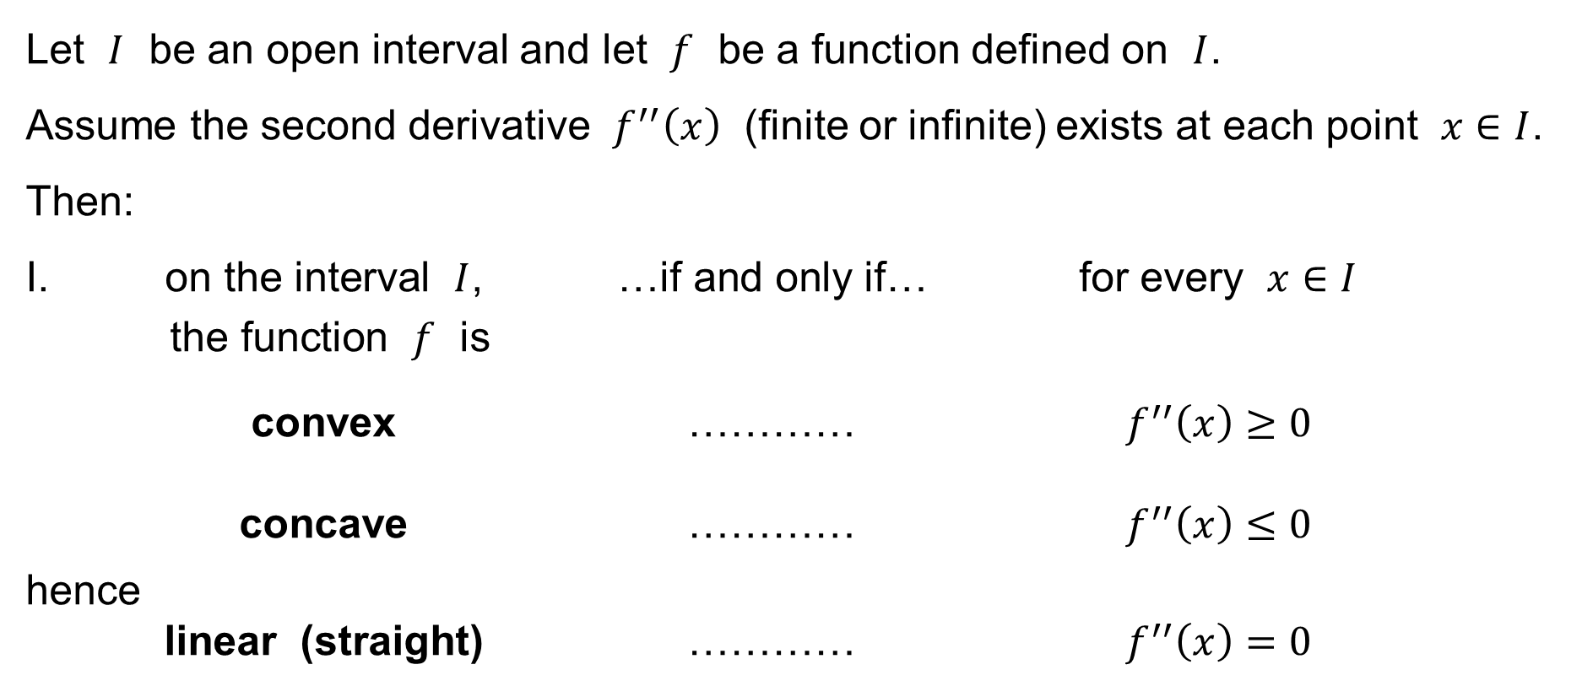
Theorem
Let $I$ be an open interval and let $f$ be a function defined on $I$.
Assume the second derivative $f^{′′}\left(x\right)$ (finite or infinite) exists at each point $x∈I$.
Then:
I. on the interval $I$, …if and only if… for every $x∈I$
the function $f$ is
convex ………… $f^{′′}\left(x\right)≥0$
concave ………… $f^{′′}\left(x\right)≤0$
hence
linear (straight) ………… $f^{′′}\left(x\right)=0$

Slide 15
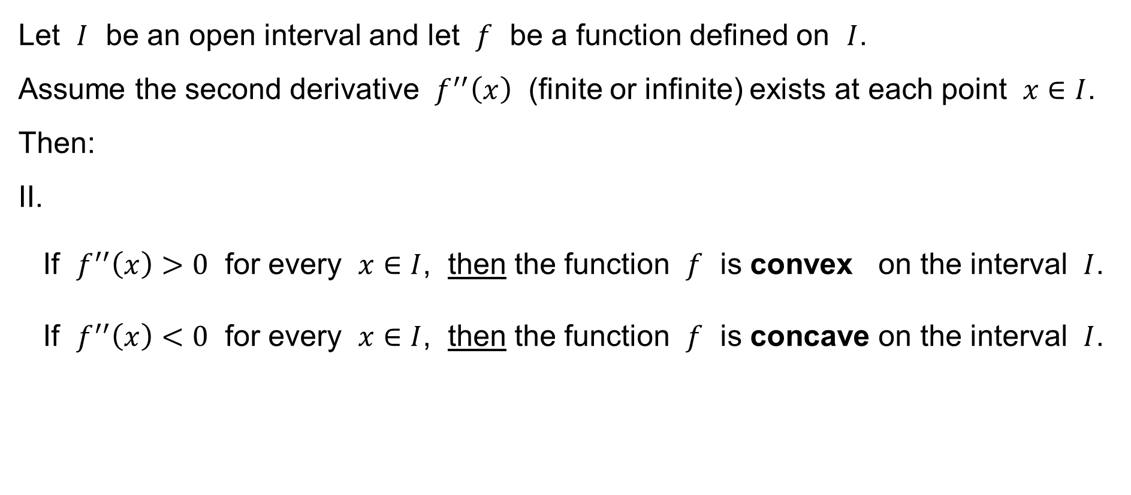
Theorem
Let $I$ be an open interval and let $f$ be a function defined on $I$.
Assume the second derivative $f^{′′}\left(x\right)$ (finite or infinite) exists at each point $x∈I$.
Then:
II.
If $f^{′′}\left(x\right)>0$ for every $x∈I$, then the function $f$ is convex on the interval $I$.
If $f^{′′}\left(x\right)<0$ for every $x∈I$, then the function $f$ is concave on the interval $I$.

Slide 16
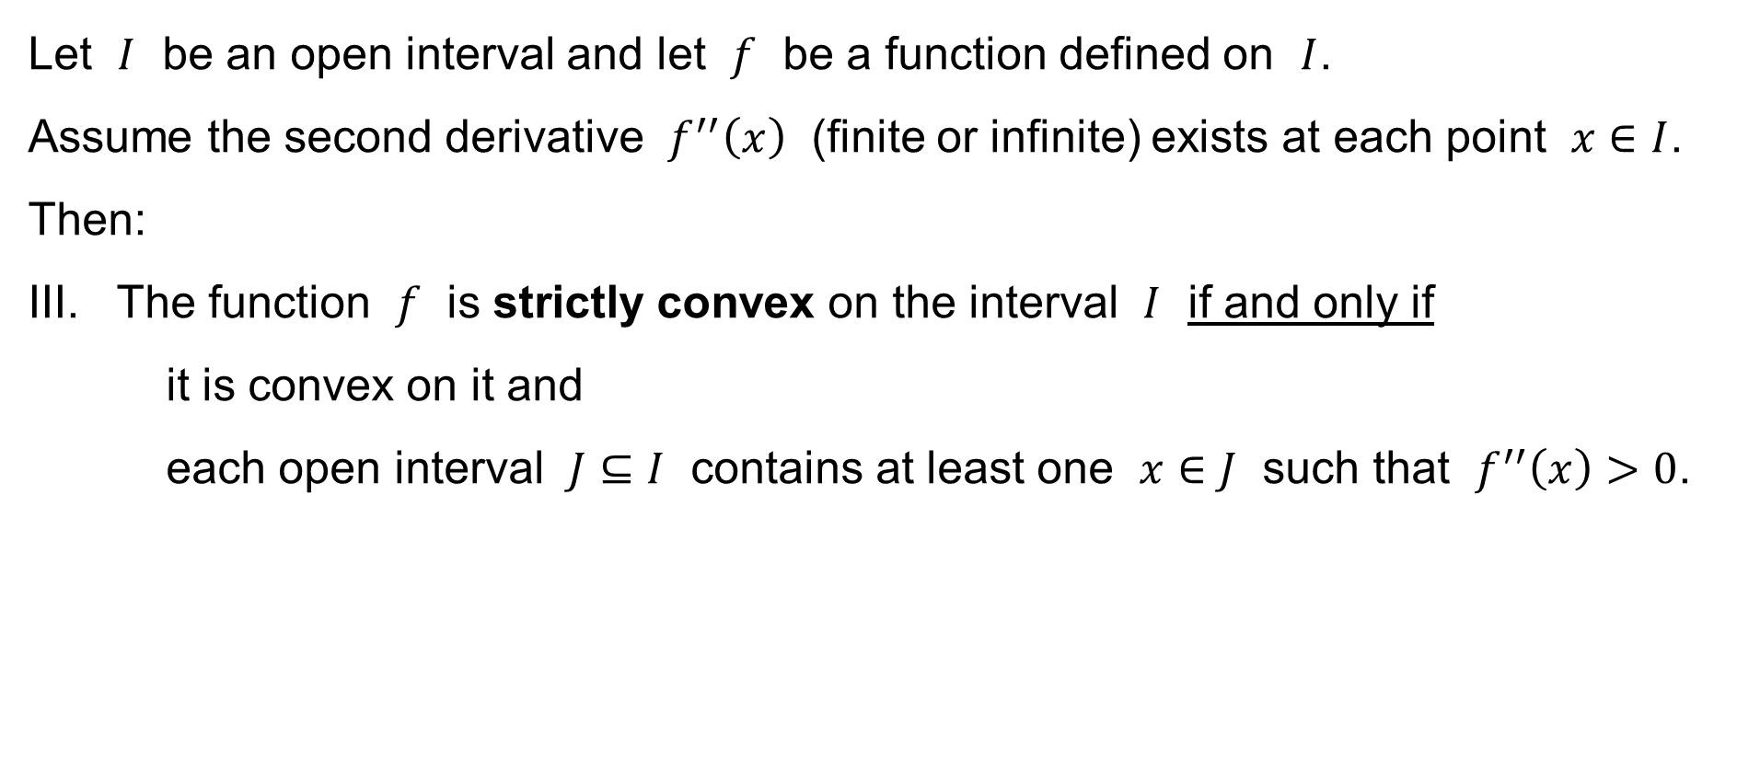
Theorem
Let $I$ be an open interval and let $f$ be a function defined on $I$.
Assume the second derivative $f^{′′}\left(x\right)$ (finite or infinite) exists at each point $x∈I$.
Then:
III. The function $f$ is strictly convex on the interval $I$ if and only if
it is convex on it and
each open interval $J⊆I$ contains at least one $x∈J$ such that $f^{′′}\left(x\right)>0$.

Slide 17
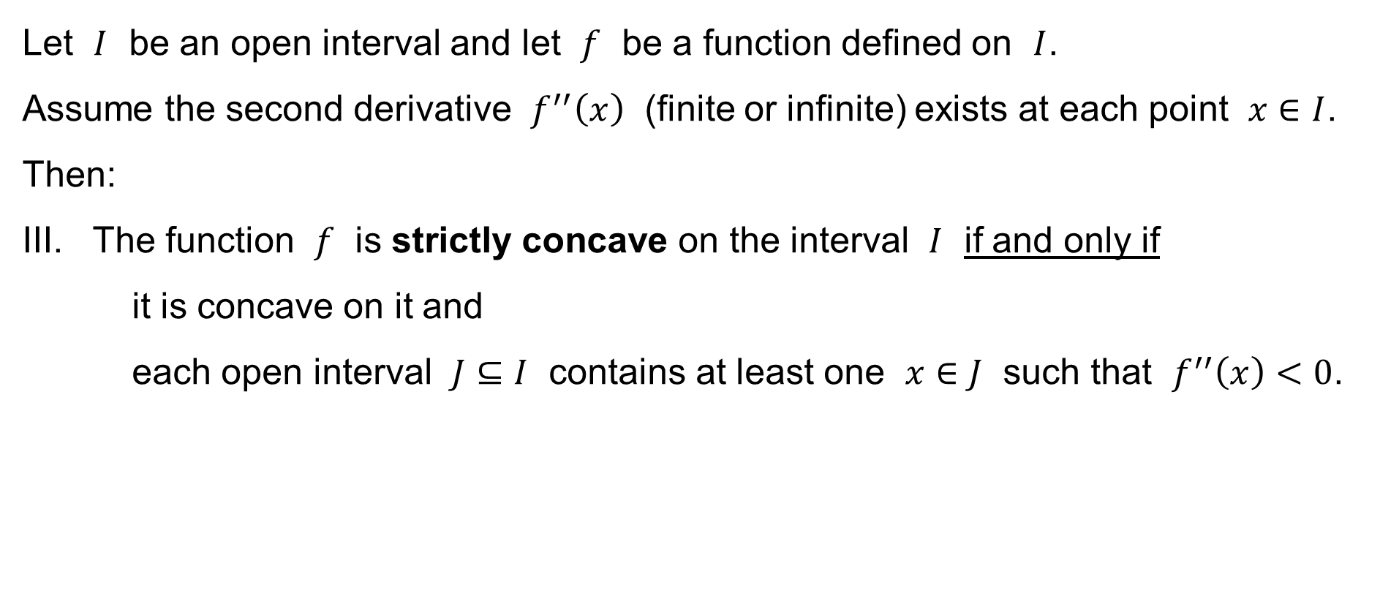
Theorem
Let $I$ be an open interval and let $f$ be a function defined on $I$.
Assume the second derivative $f^{′′}\left(x\right)$ (finite or infinite) exists at each point $x∈I$.
Then:
III. The function $f$ is strictly concave on the interval $I$ if and only if
it is concave on it and
each open interval $J⊆I$ contains at least one $x∈J$ such that $f^{′′}\left(x\right)<0$.

Slide 18
Local extrema and inflection points
Function increasing / decreasing
at a point
The point of a
(strict) local maximum / minimum
The line tangent to the graph
of a function at a point
Function strictly convex / concave
at a point
The point of inflection

Slide 19
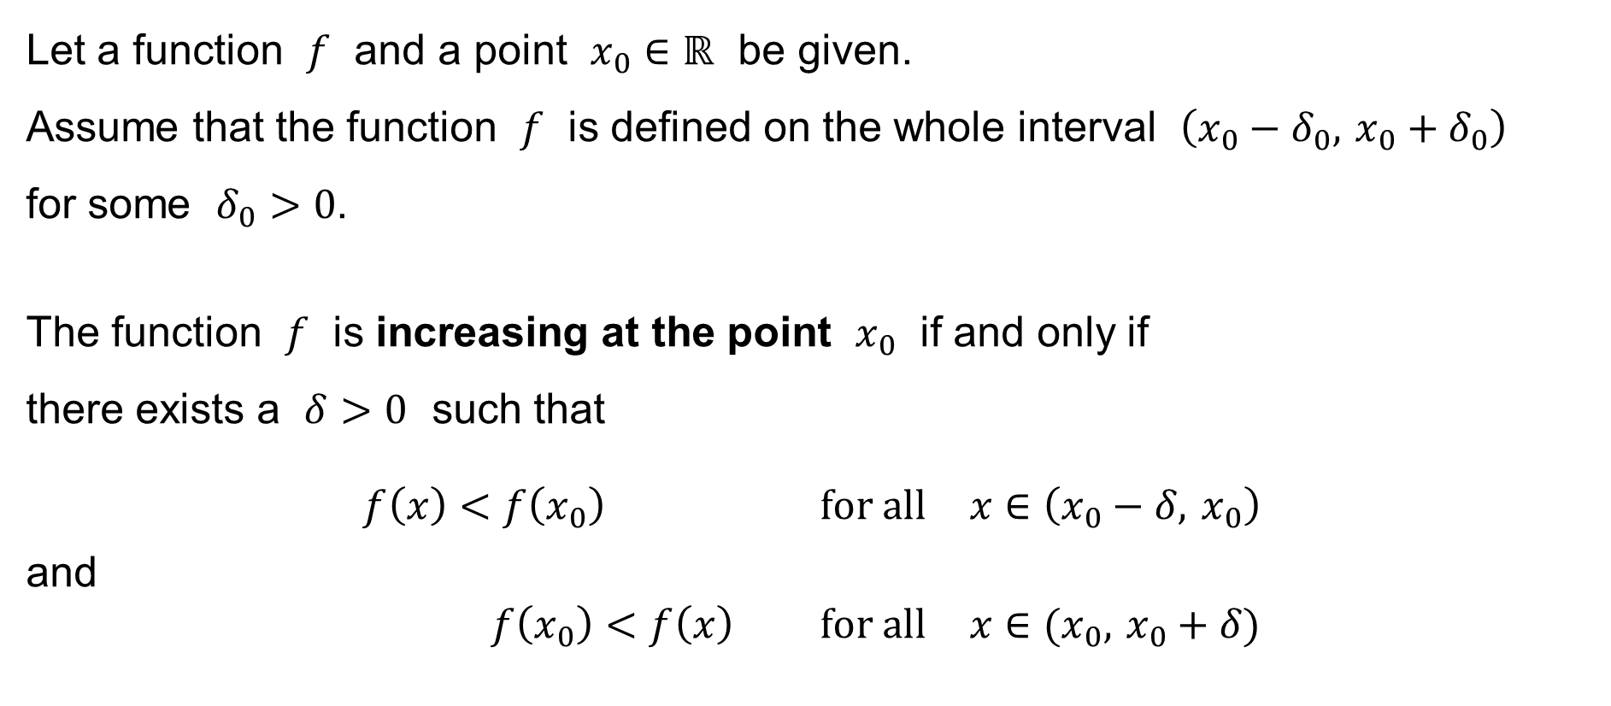
Function increasing and decreasing at a point
Let a function $f$ and a point $x_{0}∈ℝ$ be given.
Assume that the function $f$ is defined on the whole interval $\left(x_{0}−δ_{0}, x_{0}+δ_{0}\right)$
for some $δ_{0}>0$.
The function $f$ is increasing at the point $x_{0}$ if and only if
there exists a $δ>0$ such that
$$f\left(x\right)<f\left(x_{0}\right) \text{for} \text{all} x∈\left(x_{0}−δ, x_{0}\right)$$
and
$$f\left(x_{0}\right)<f\left(x\right) \text{for} \text{all} x∈(x_{0}, x_{0}+δ)$$

Slide 20
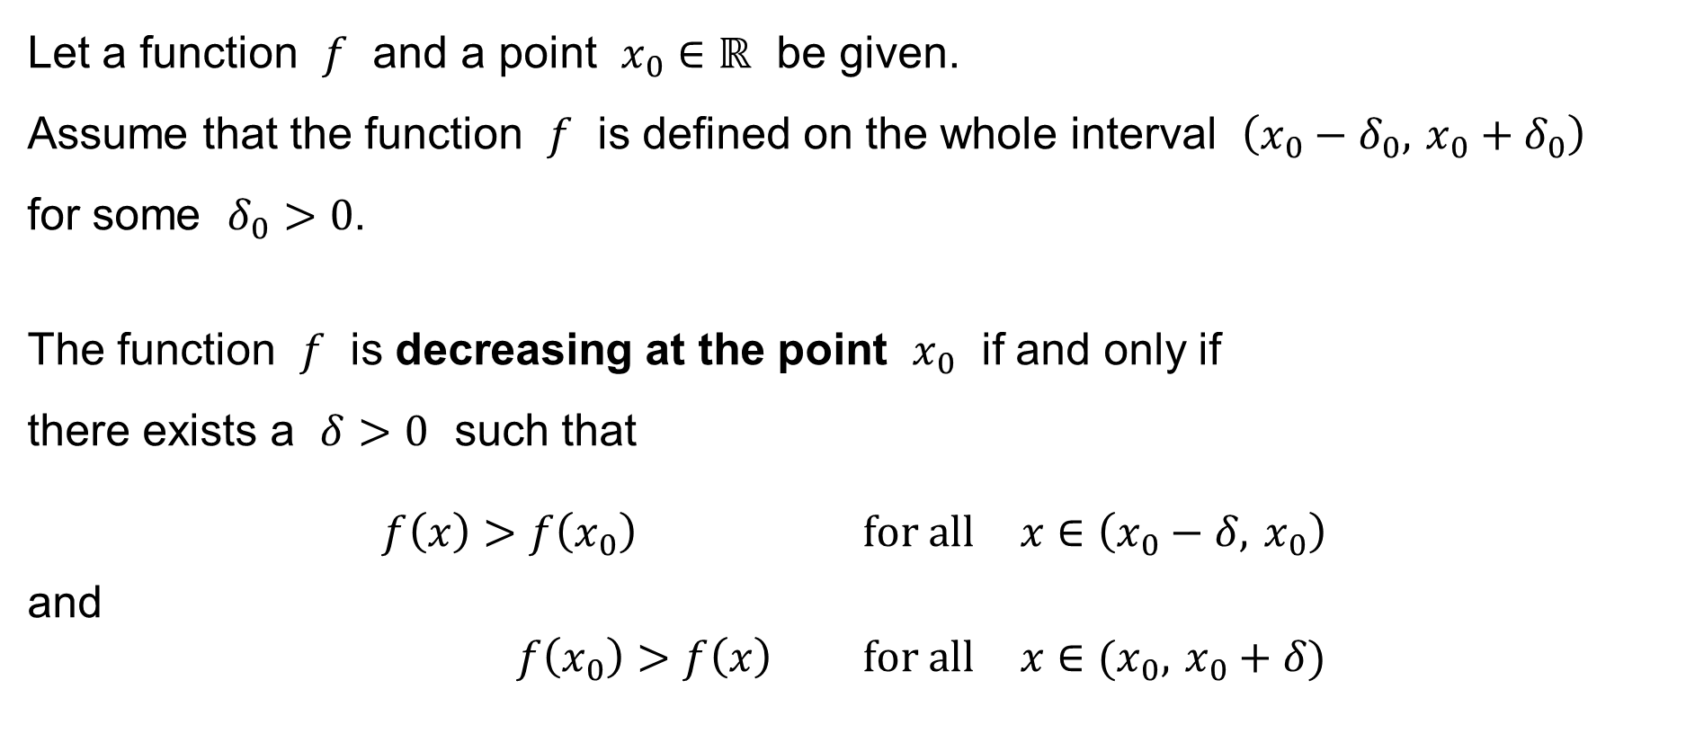
Function increasing and decreasing at a point
Let a function $f$ and a point $x_{0}∈ℝ$ be given.
Assume that the function $f$ is defined on the whole interval $\left(x_{0}−δ_{0}, x_{0}+δ_{0}\right)$
for some $δ_{0}>0$.
The function $f$ is decreasing at the point $x_{0}$ if and only if
there exists a $δ>0$ such that
$$f\left(x\right)>f\left(x_{0}\right) \text{for} \text{all} x∈\left(x_{0}−δ, x_{0}\right)$$
and
$$f\left(x_{0}\right)>f\left(x\right) \text{for} \text{all} x∈(x_{0}, x_{0}+δ)$$

Slide 21
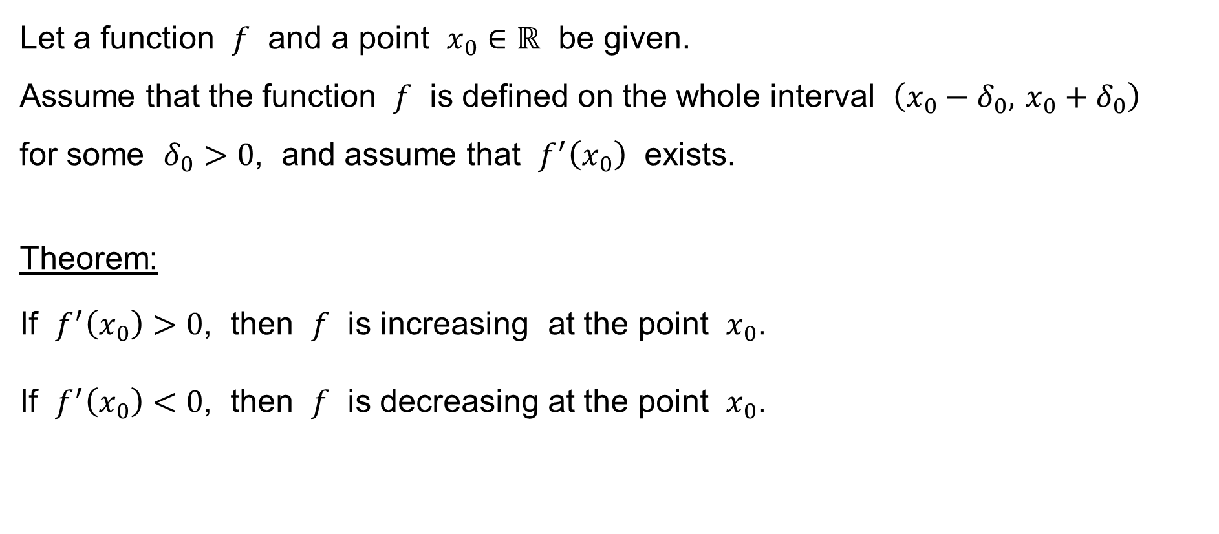
Function increasing and decreasing at a point
Let a function $f$ and a point $x_{0}∈ℝ$ be given.
Assume that the function $f$ is defined on the whole interval $\left(x_{0}−δ_{0}, x_{0}+δ_{0}\right)$
for some $δ_{0}>0$, and assume that $f^{′}\left(x_{0}\right)$ exists.
Theorem:
If $f^{′}\left(x_{0}\right)>0$, then $f$ is increasing at the point $x_{0}$.
If $f^{′}\left(x_{0}\right)<0$, then $f$ is decreasing at the point $x_{0}$.

Slide 22
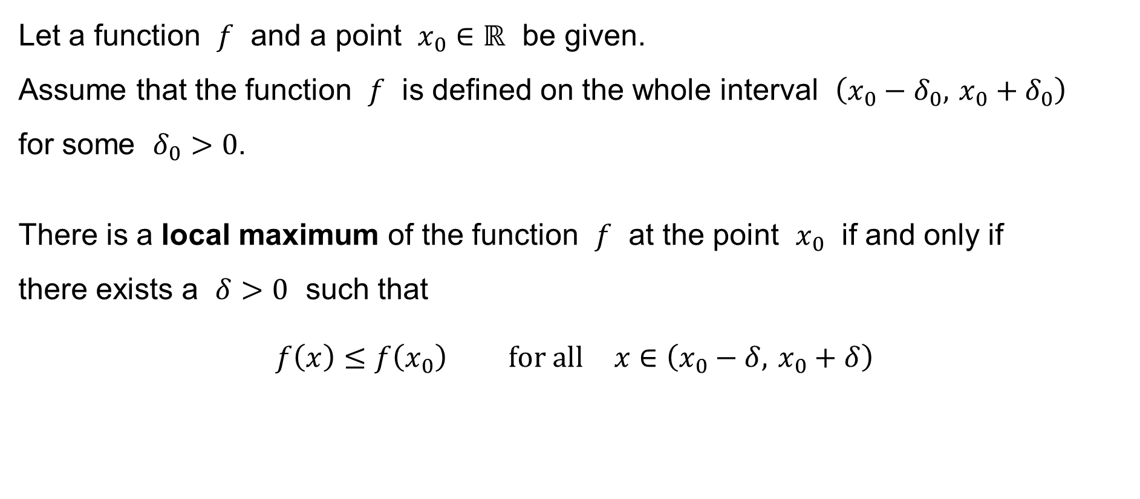
Local extrema of a function
Let a function $f$ and a point $x_{0}∈ℝ$ be given.
Assume that the function $f$ is defined on the whole interval $\left(x_{0}−δ_{0}, x_{0}+δ_{0}\right)$
for some $δ_{0}>0$.
There is a local maximum of the function $f$ at the point $x_{0}$ if and only if
there exists a $δ>0$ such that
$$f\left(x\right)≤f\left(x_{0}\right) \text{for} \text{all} x∈\left(x_{0}−δ, x_{0}+δ\right)$$

Slide 23
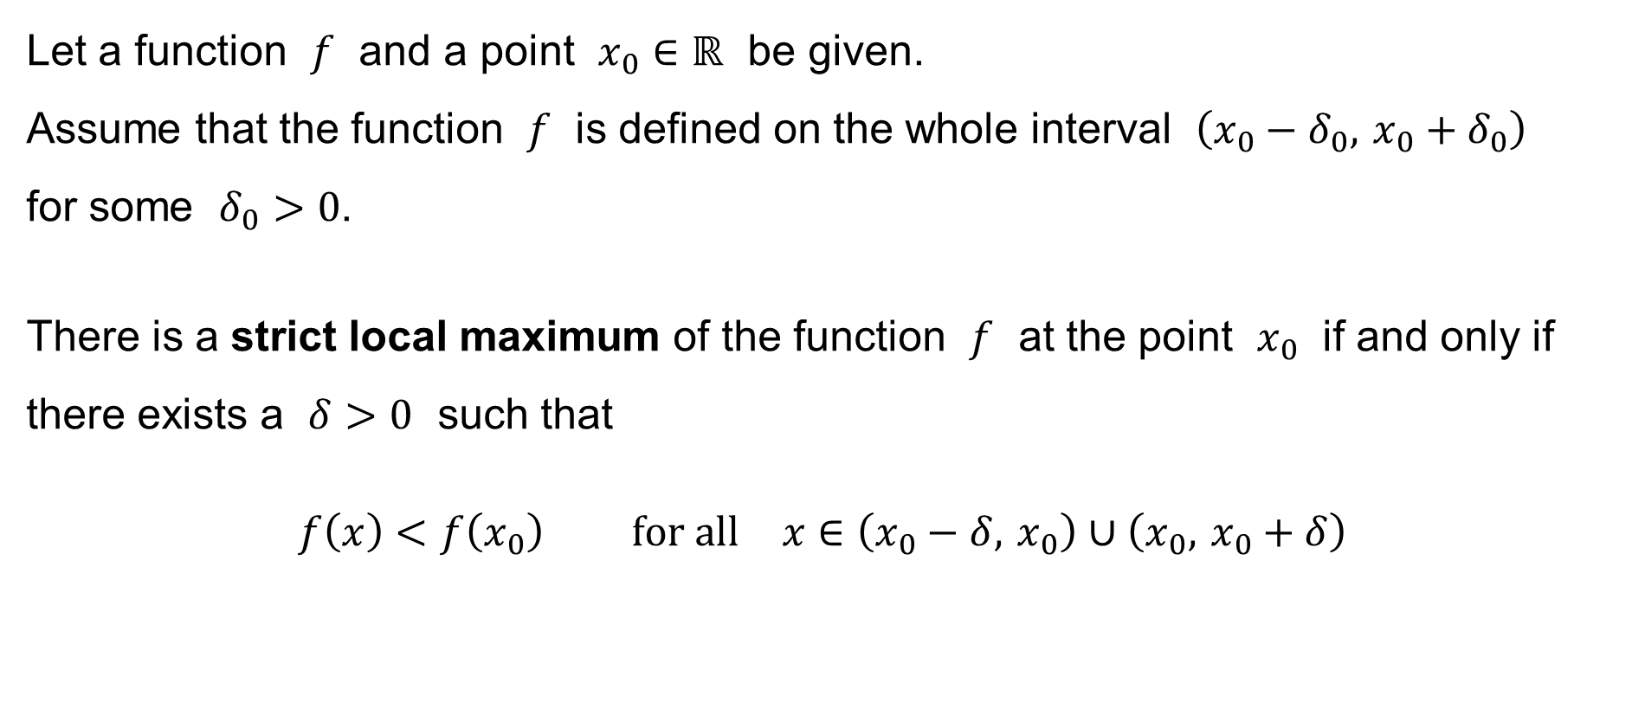
Local extrema of a function
Let a function $f$ and a point $x_{0}∈ℝ$ be given.
Assume that the function $f$ is defined on the whole interval $\left(x_{0}−δ_{0}, x_{0}+δ_{0}\right)$
for some $δ_{0}>0$.
There is a strict local maximum of the function $f$ at the point $x_{0}$ if and only if
there exists a $δ>0$ such that
$$f\left(x\right)<f\left(x_{0}\right) \text{for} \text{all} x∈\left(x_{0}−δ, x_{0}\right)∪\left(x_{0}, x_{0}+δ\right)$$
increasing
↓
decreasing

Slide 24
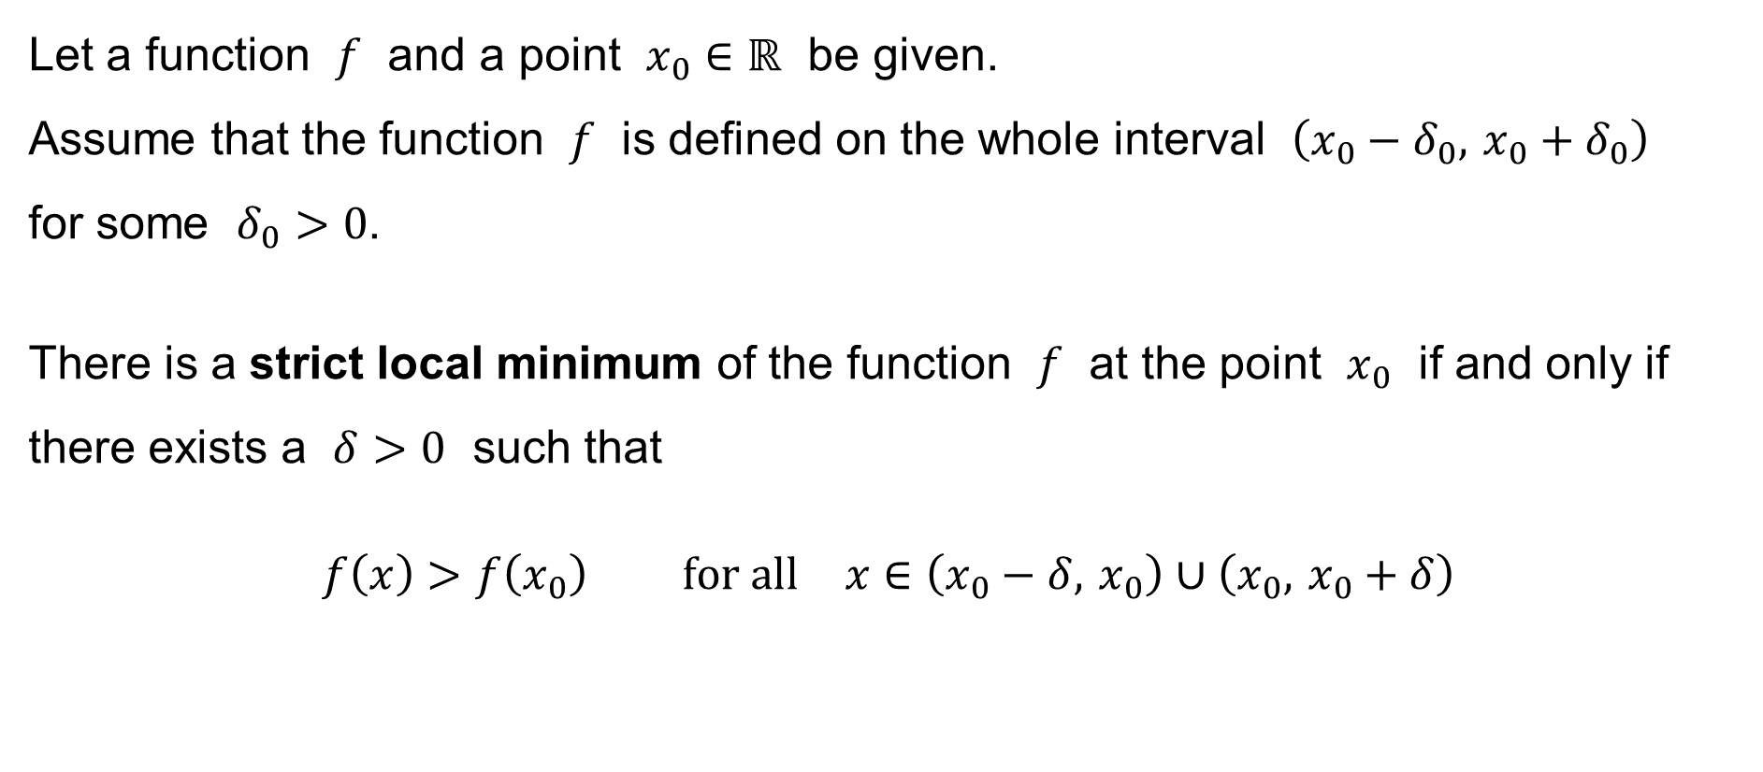
Local extrema of a function
Let a function $f$ and a point $x_{0}∈ℝ$ be given.
Assume that the function $f$ is defined on the whole interval $\left(x_{0}−δ_{0}, x_{0}+δ_{0}\right)$
for some $δ_{0}>0$.
There is a strict local minimum of the function $f$ at the point $x_{0}$ if and only if
there exists a $δ>0$ such that
$$f\left(x\right)>f\left(x_{0}\right) \text{for} \text{all} x∈\left(x_{0}−δ, x_{0}\right)∪\left(x_{0}, x_{0}+δ\right)$$
decreasing
↓
increasing

Slide 25
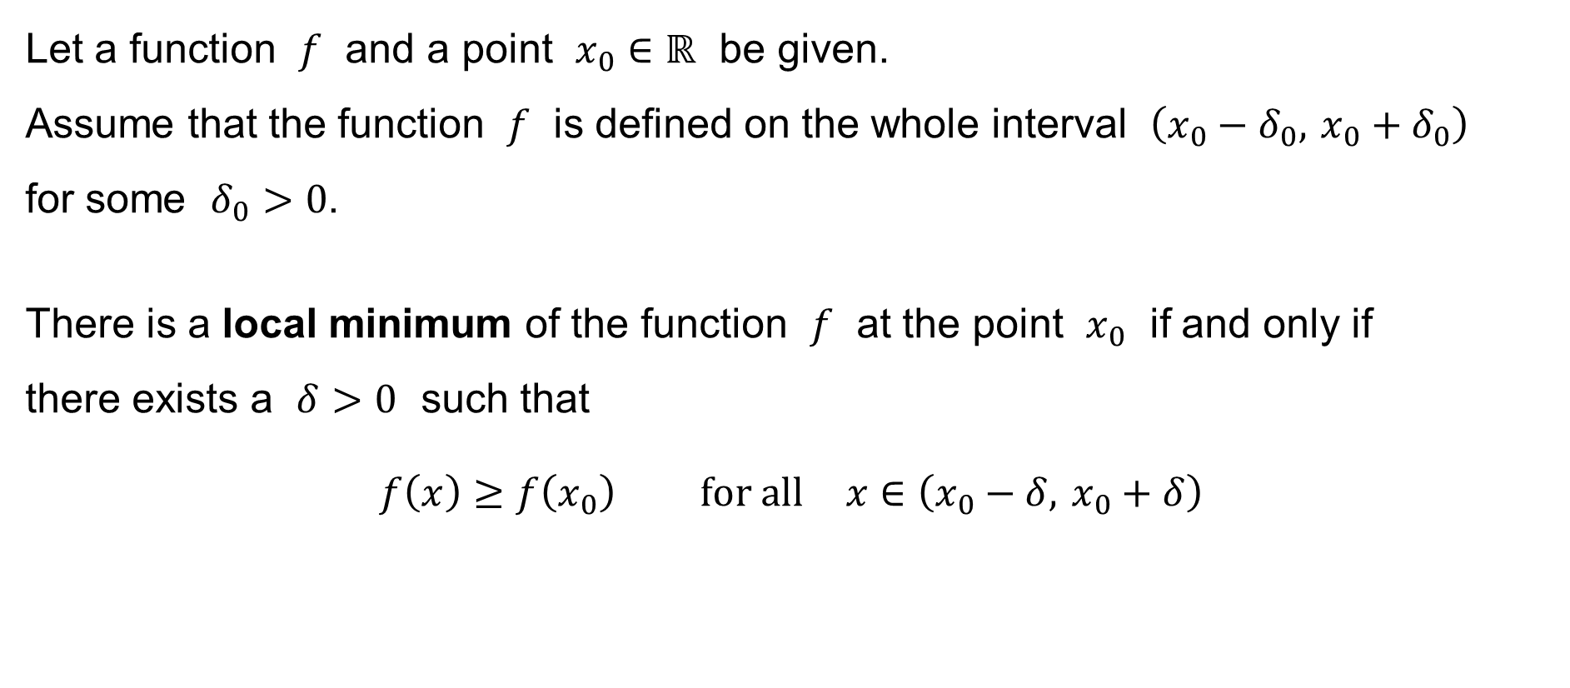
Local extrema of a function
Let a function $f$ and a point $x_{0}∈ℝ$ be given.
Assume that the function $f$ is defined on the whole interval $\left(x_{0}−δ_{0}, x_{0}+δ_{0}\right)$
for some $δ_{0}>0$.
There is a local minimum of the function $f$ at the point $x_{0}$ if and only if
there exists a $δ>0$ such that
$$f\left(x\right)≥f\left(x_{0}\right) \text{for} \text{all} x∈\left(x_{0}−δ, x_{0}+δ\right)$$

Slide 26
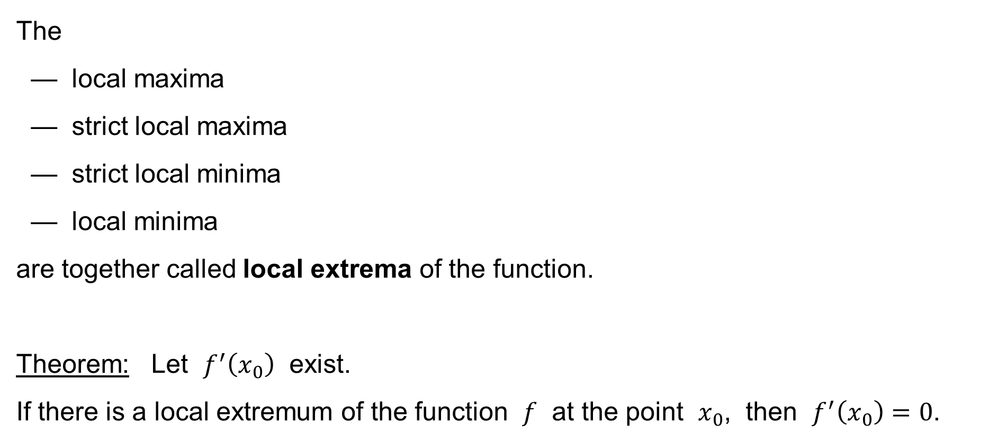
Local extrema of a function
The
— local maxima
— strict local maxima
— strict local minima
— local minima
are together called local extrema of the function.
Theorem: Let $f^{′}\left(x_{0}\right)$ exist.
If there is a local extremum of the function $f$ at the point $x_{0}$, then $f^{′}\left(x_{0}\right)=0$.

Slide 27
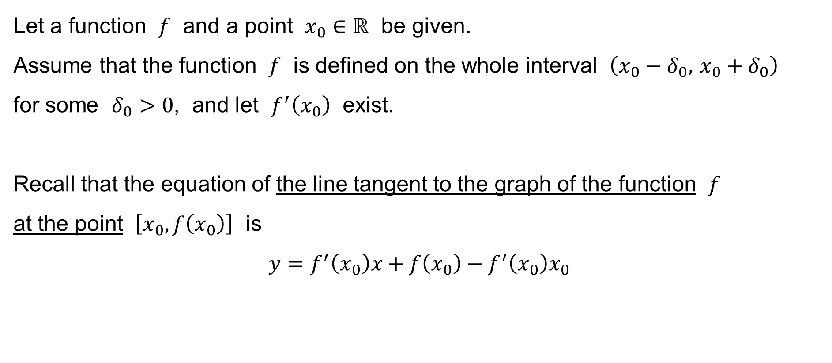
The line tangent to the graph of a function
Let a function $f$ and a point $x_{0}∈ℝ$ be given.
Assume that the function $f$ is defined on the whole interval $\left(x_{0}−δ_{0}, x_{0}+δ_{0}\right)$
for some $δ_{0}>0$, and let $f^{′}\left(x_{0}\right)$ exist.
Recall that the equation of the line tangent to the graph of the function $f$
at the point $\left[x_{0},f\left(x_{0}\right)\right]$ is
$$y=f^{′}\left(x_{0}\right)x+f\left(x_{0}\right)−f^{′}\left(x_{0}\right)x_{0}$$

Slide 28
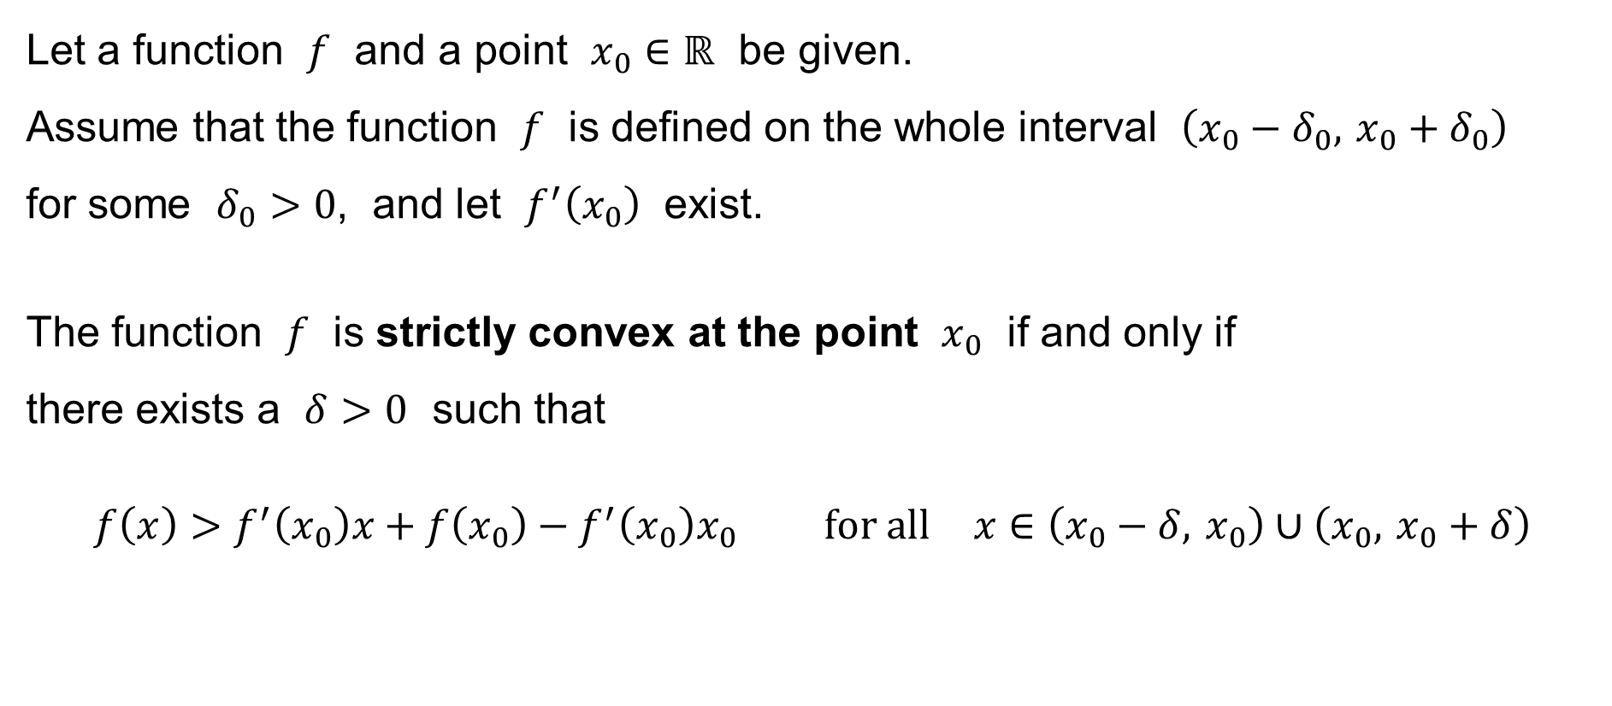
Function strictly convex / concave at a point
Let a function $f$ and a point $x_{0}∈ℝ$ be given.
Assume that the function $f$ is defined on the whole interval $\left(x_{0}−δ_{0}, x_{0}+δ_{0}\right)$
for some $δ_{0}>0$, and let $f^{′}\left(x_{0}\right)$ exist.
The function $f$ is strictly convex at the point $x_{0}$ if and only if
there exists a $δ>0$ such that
$$f\left(x\right)>f^{′}\left(x_{0}\right)x+f\left(x_{0}\right)−f^{′}\left(x_{0}\right)x_{0} \text{for} \text{all} x∈\left(x_{0}−δ, x_{0}\right)∪\left(x_{0}, x_{0}+δ\right)$$

Slide 29
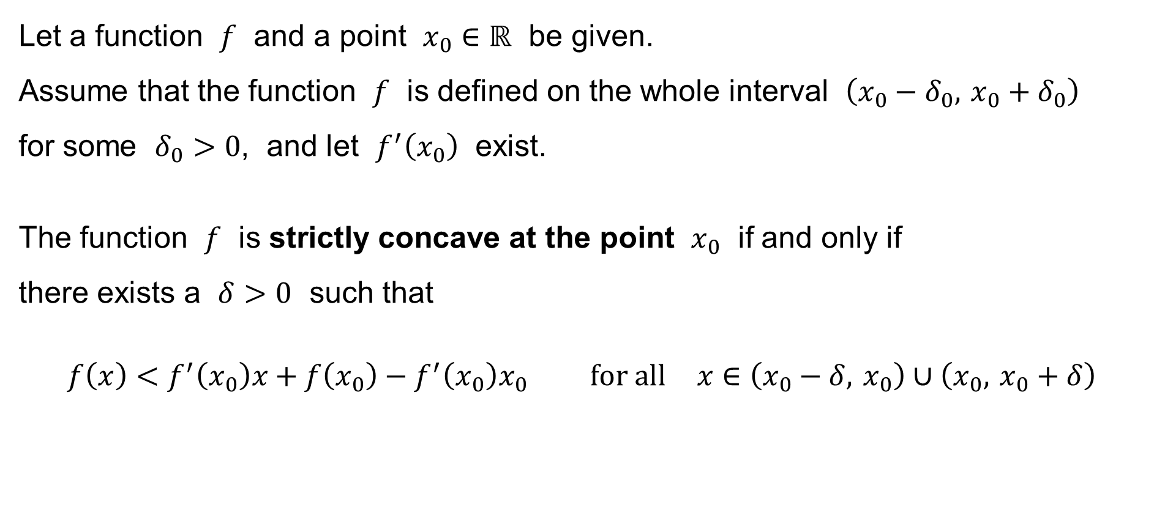
Function strictly convex / concave at a point
Let a function $f$ and a point $x_{0}∈ℝ$ be given.
Assume that the function $f$ is defined on the whole interval $\left(x_{0}−δ_{0}, x_{0}+δ_{0}\right)$
for some $δ_{0}>0$, and let $f^{′}\left(x_{0}\right)$ exist.
The function $f$ is strictly concave at the point $x_{0}$ if and only if
there exists a $δ>0$ such that
$$f\left(x\right)<f^{′}\left(x_{0}\right)x+f\left(x_{0}\right)−f^{′}\left(x_{0}\right)x_{0} \text{for} \text{all} x∈\left(x_{0}−δ, x_{0}\right)∪\left(x_{0}, x_{0}+δ\right)$$

Slide 30
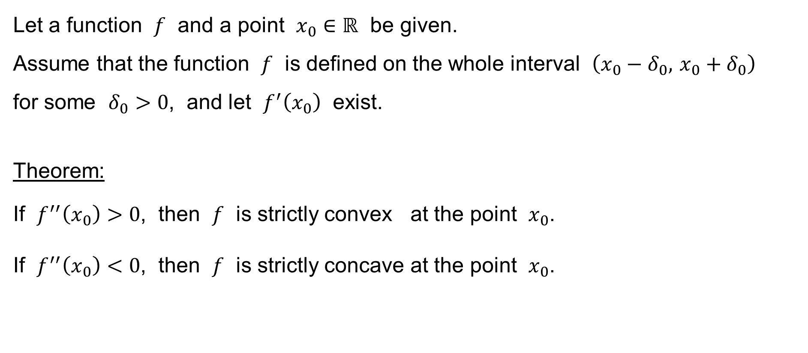
Function strictly convex / concave at a point
Let a function $f$ and a point $x_{0}∈ℝ$ be given.
Assume that the function $f$ is defined on the whole interval $\left(x_{0}−δ_{0}, x_{0}+δ_{0}\right)$
for some $δ_{0}>0$, and let $f^{′}\left(x_{0}\right)$ exist.
Theorem:
If $f^{′′}\left(x_{0}\right)>0$, then $f$ is strictly convex at the point $x_{0}$.
If $f^{′′}\left(x_{0}\right)<0$, then $f$ is strictly concave at the point $x_{0}$.

Slide 31
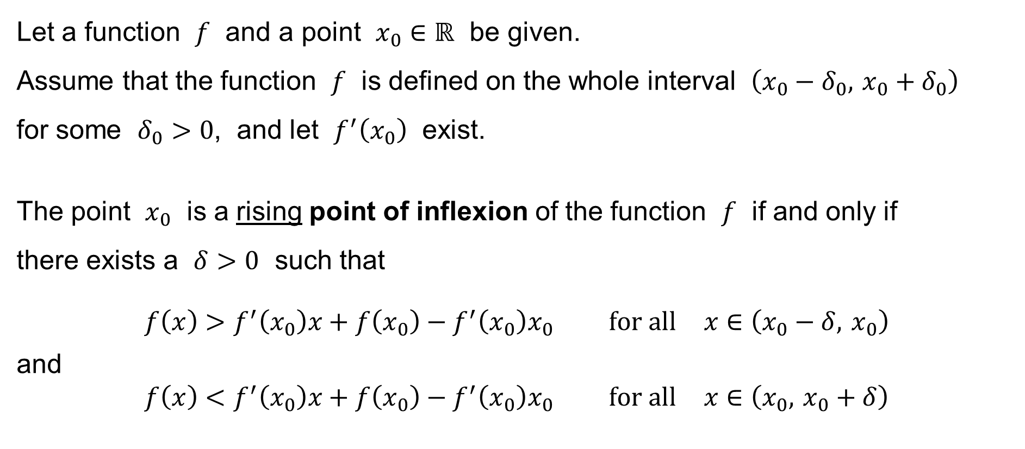
Points of inflexion
Let a function $f$ and a point $x_{0}∈ℝ$ be given.
Assume that the function $f$ is defined on the whole interval $\left(x_{0}−δ_{0}, x_{0}+δ_{0}\right)$
for some $δ_{0}>0$, and let $f^{′}\left(x_{0}\right)$ exist.
The point $x_{0}$ is a rising point of inflexion of the function $f$ if and only if
there exists a $δ>0$ such that
$$f\left(x\right)>f^{′}\left(x_{0}\right)x+f\left(x_{0}\right)−f^{′}\left(x_{0}\right)x_{0} \text{for} \text{all} x∈\left(x_{0}−δ, x_{0}\right)$$
and
$$f\left(x\right)<f^{′}\left(x_{0}\right)x+f\left(x_{0}\right)−f^{′}\left(x_{0}\right)x_{0} \text{for} \text{all} x∈\left(x_{0}, x_{0}+δ\right)$$
convex
↓
concave

Slide 32
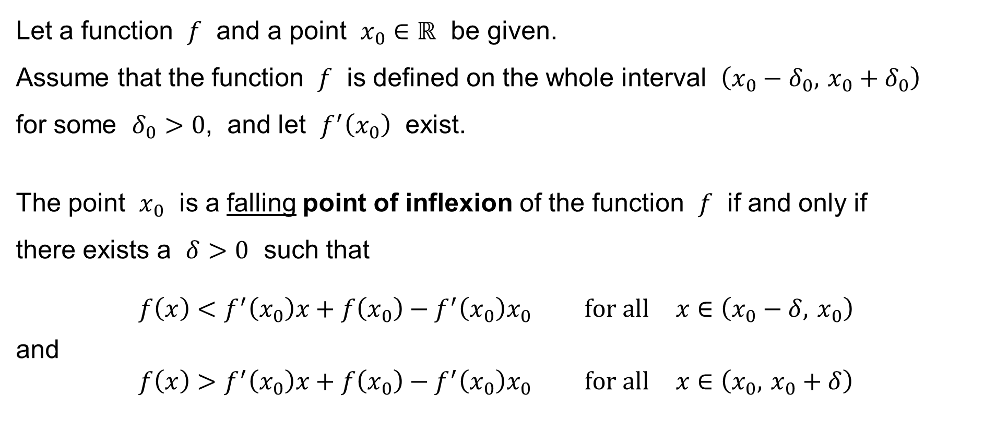
Points of inflexion
Let a function $f$ and a point $x_{0}∈ℝ$ be given.
Assume that the function $f$ is defined on the whole interval $\left(x_{0}−δ_{0}, x_{0}+δ_{0}\right)$
for some $δ_{0}>0$, and let $f^{′}\left(x_{0}\right)$ exist.
The point $x_{0}$ is a falling point of inflexion of the function $f$ if and only if
there exists a $δ>0$ such that
$$f\left(x\right)<f^{′}\left(x_{0}\right)x+f\left(x_{0}\right)−f^{′}\left(x_{0}\right)x_{0} \text{for} \text{all} x∈\left(x_{0}−δ, x_{0}\right)$$
and
$$f\left(x\right)>f^{′}\left(x_{0}\right)x+f\left(x_{0}\right)−f^{′}\left(x_{0}\right)x_{0} \text{for} \text{all} x∈\left(x_{0}, x_{0}+δ\right)$$
concave
↓
convex

Slide 33
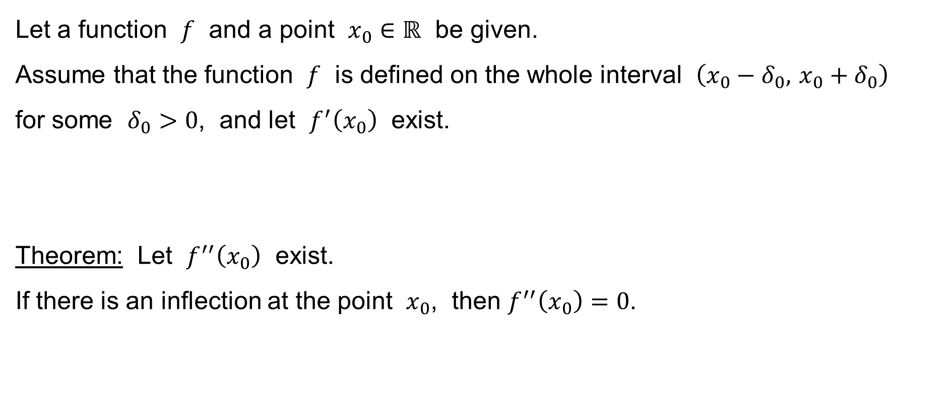
Points of inflexion
Let a function $f$ and a point $x_{0}∈ℝ$ be given.
Assume that the function $f$ is defined on the whole interval $\left(x_{0}−δ_{0}, x_{0}+δ_{0}\right)$
for some $δ_{0}>0$, and let $f^{′}\left(x_{0}\right)$ exist.
Theorem: Let $f^{′′}\left(x_{0}\right)$ exist.
If there is an inflection at the point $x_{0}$, then $f^{′′}\left(x_{0}\right)=0$.

Slide 34

Examples
Example 1:
$$y=x^{3}$$
and consider the point
$$x_{0}=0$$
We have
$$y^{′}=3x^{2}$$
hence
$$y^{′}\left(x_{0}\right)=0$$
but there is no local extremum at $x_{0}$ – the function is strictly increasing there!

Slide 35

Examples
Example 2:
$$y=x^{4}$$
and consider the point
$$x_{0}=0$$
We have
$$y^{′}=4x^{3}$$
hence
$$y^{′}\left(x_{0}\right)=0$$
and yes, there is a strict local minimum at $x_{0}$.

Slide 36

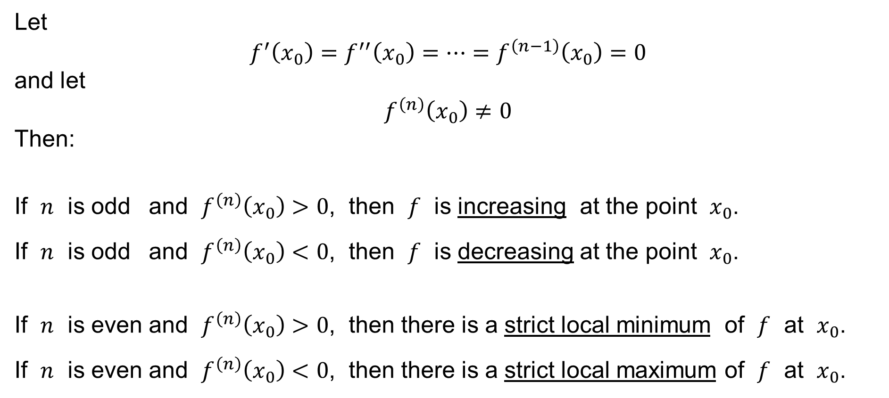
Theorem
Let
$$f^{′}\left(x_{0}\right)=f^{′′}\left(x_{0}\right)=⋯=f^{\left(n−1\right)}\left(x_{0}\right)=0$$
and let
$$f^{\left(n\right)}\left(x_{0}\right)≠0$$
Then:
If $n$ is odd and $f^{\left(n\right)}\left(x_{0}\right)>0$, then $f$ is increasing at the point $x_{0}$.
If $n$ is odd and $f^{\left(n\right)}\left(x_{0}\right)<0$, then $f$ is decreasing at the point $x_{0}$.
If $n$ is even and $f^{\left(n\right)}\left(x_{0}\right)>0$, then there is a strict local minimum of $f$ at $x_{0}$.
If $n$ is even and $f^{\left(n\right)}\left(x_{0}\right)<0$, then there is a strict local maximum of $f$ at $x_{0}$.
e.g. $n=2$

Slide 37
Examples
Example 1:
$$y=x^{3}$$
and consider the point
$$x_{0}=0$$
We have
$$y^{′}=3x^{2}$$
hence
$$y^{′}\left(x_{0}\right)=0$$
but there is no local extremum at $x_{0}$ – the function is strictly increasing there!

Slide 38
Examples
Example 2:
$$y=x^{4}$$
and consider the point
$$x_{0}=0$$
We have
$$y^{′}=4x^{3}$$
hence
$$y^{′}\left(x_{0}\right)=0$$
and yes, there is a strict local minimum at $x_{0}$.

