Slide 1
Economic applications

Slide 2


Economic applications of derivatives
The elasticity of a function y = f(x):
The price elasticity of demand:
The price elasticity of supply:

Slide 3



Marginal product of labour:
Marginal revenue:
Marginal cost:

Slide 4
Solved problems
Find marginal revenue MR (x) of the total revenue
and marginal costs of the total costs
.
Solution:

Slide 5
Solved problem
Find extremes of the production function . Draw its graph.
Solution:
The first derivative is , we find roots of the first derivative: L = 0 and L = 1. By the use of the second derivative, or by checking signs of the first derivative, we obtain that L = 0 is a local minimum and L = 1 is a local maximum. Therefore, the highest (optimal) production is achieved when L = 1.
The graph is provided on the next slide.

Slide 6
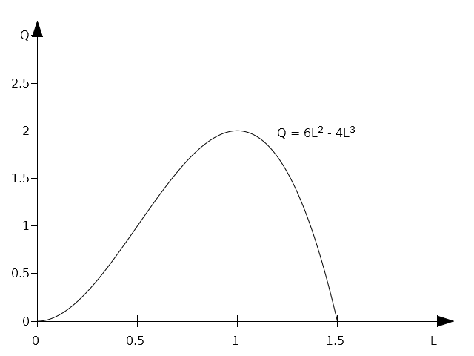

Slide 7
Assignment
Find the maximum of total revenue function .
Find the minimum of total cost function: .
Find the maximum of the profit function: .
Find the maximum of total revenue function: .

Slide 8
Differential calculus of two real variables
Many economic functions contain more then one variable.
For example, Cobb-Douglas function includes labour L and
capital K as well as the technological parameter A:
We will limit ourselved to functions of two variables. A graph
of a function of two real variables is a plane in 3D space,
See the next slide.

Slide 9
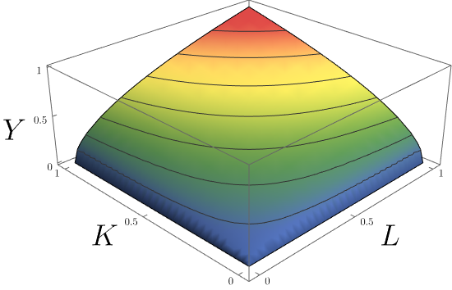
A graph of Cobb-Douglas function

Slide 10
Cobb – Douglas function
C-D function: .
Usually, we assume that .
Then, C-D:
Marginal product of labour:
Marginal product of capital:

Slide 11
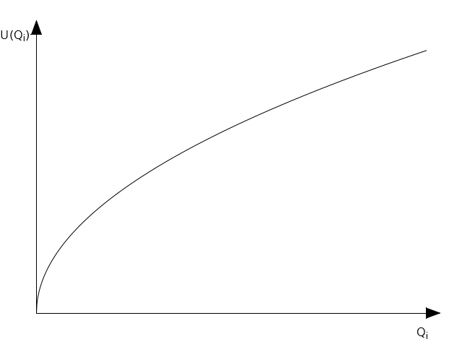
A utility function
Let n be the number of different types of good. Let Q1, Q2, …. Be the amount of the good 1, 2, etc.
Then a function is called the utility function. Typically, a utility function is concave:

Slide 12
Marginal utility
Marginal utility is defined as follows:
etc.
Example:
Find marginal utilities of the utility function .
Solution:

