Slide 1

Management information systems
Basic concepts
Petr Suchánek
Management information systems
DAMIA

Slide 2

Outline of the lecture
Current business environment
Systems
Information and Communication technology
Information systems
Data
Big Data
Information
Knowledge
Wisdom

Slide 3
Current business environment
A continuing stream of information technology innovations is transforming the traditional business world.
All innovations are enabling entrepreneurs and innovative traditional firms to create new products and services, develop new business models, and transform the day-to-day conduct of business.
The rapid growth of online content stores has forever changed the older business models.
Cloud-based content delivered on the Internet is beginning to challenge the dominance of cable television networks for the delivery of television shows.
The management of business firms has changed: With new mobile smartphones, high-speed wireless Wi-Fi networks, and wireless laptop and tablet computers, remote salespeople on the road.

Slide 4
New topics in current business environment
Social Business
  Businesses use social networking platforms, including Facebook, Twitter, and internal corporate social tools, to deepen interactions with employees, customers, and suppliers. Employees use blogs, wikis, e-mail texting, and messaging to interact in online communities.
Big Data
  Businesses look for insights from huge volumes of data from Web traffic, e-mail messages, social media content, and machines (sensors) that require new data management tools to capture, store, and analyze.
Cloud Computing
  A flexible collection of computers on the Internet begins to perform tasks traditionally performed on corporate computers. Major business applications are delivered online as an Internet service (Software as a Service, or SaaS).
Ethical and Social issues

Slide 5
New topics in current business environment
Social graph
Social marketing
Social search
Social CRM
Consumerization of IT and BYOD
Mobile device management
Mobile application development
Responsive Web design
Cyberlockers
Expanded coverage of business analytics
Machine learning
Windows 8, Android, iOS, and Chrome operating systems
Apps
HTML5
IPv6
Microblogging
Multitouch interface
Siri
Software-defined networking
Tablet computers
3-D printing

Slide 6
The 10 Characteristics of a Future Facing Company*
Exploit – Explore
  This characteristic speaks to the company's orientation. To what extent are they caught up in their previous success. Traditional management thinking views strategy as a process via which companies find their competitive advantage and then work as hard as possible to protect it. A future facing company does not rest on its laurels. The leaders in such a company understand that there is no longer such a thing as long term competitive advantage. The only competitive advantage they have is their ability to move from advantage to advantage. And so while such a company will maintain its excellence at executing on its current business model, it will work just as hard to develop excellent management tools and practices to search for new business models.
Balanced Portfolio
  This shift in orientation means a future facing company does not view itself as a monolithic organization with one business model. Instead, a future facing company takes a portfolio approach to its business. The goal is to have a balanced portfolio of products, services and business models. A future facing portfolio has core products serving current customers, adjacent innovations that create new products for current customers or take our current products to new markets, and transformational innovations where new products are created for new markets.
*https://www.forbes.com/sites/tendayiviki/2017/08/08/the-10-characteristics-of-a-future-facing-company/#4c1c9f9918b5

Slide 7
The 10 Characteristics of a Future Facing Company*
Innovation Thesis
  A key factor in becoming a future facing company with a balanced portfolio, is having a point of view about what that future might potentially look like. This is not science fiction daydreaming, but an innovation thesis based on social, technological and economic trends. An innovation thesis is a merely a statement of what we believe is happening is specific sectors of the economy and how that will impact our future. It is also a clear statement about how we are going use innovation to respond. This innovation thesis becomes the basis upon which we make sure our investments in innovation are an expression of our strategic intentions.
Innovation Framework
  A future facing company understands that they cannot manage innovation using the same tools and processes they use to manage their core products. As such, these companies develop clear innovation frameworks that provide guidance for innovators by setting the right expectations. For example, a good innovation management framework encourages innovators to test their ideas before launching them at scale. Innovation frameworks are great for providing a shared language that helps innovators know where they are on their journey and make decisions of what to do next. Innovation frameworks also helps leaders to manage innovators by asking the right questions at the right time.
*https://www.forbes.com/sites/tendayiviki/2017/08/08/the-10-characteristics-of-a-future-facing-company/#4c1c9f9918b5

Slide 8
The 10 Characteristics of a Future Facing Company*
Innovation Accounting
  In a traditional company, all investment decisions are based on business plans with five year revenue projections. This often results in large investments that are made on a few big projects. A future facing company understands that the future is unknowable, especially for transformational innovation. As such, they make a lot of little bets using incremental investing. This process allows the company to make small bets on many ideas and only double-down investment on those ideas that demonstrate traction. Innovation accounting, along with a good innovation framework, provide innovation teams with sufficient resources to do the right things at the right time. Managers can then ask the right questions to track progress and make incremental investment decisions when they are needed.
Lean Startup
  A future facing company uses iterative customer-centric product development processes. Innovation accounting can only be effective if innovation teams are able to provide the evidence that informs investment decision making. Using lean startup methods helps teams identify and test their riskiest assumptions, by getting outside the building and meeting with real customers. This build-measure-learn loop helps teams make products people want.
*https://www.forbes.com/sites/tendayiviki/2017/08/08/the-10-characteristics-of-a-future-facing-company/#4c1c9f9918b5

Slide 9
The 10 Characteristics of a Future Facing Company*
Cross-Functional Teams
  Most traditional companies are organized in siloed departments. Marketing, HR, Finance, Technology and other departments all work separately using handoffs and memos to collaborate. A future facing company understands that innovation requires cross-functional collaboration. As such, they create innovation teams that are made up of people from various departments working together. No handoffs and no memos; knowledge and learnings are shared in real time.
Less Hierarchy
  A future facing organization is less hierarchical than a traditional company. While there may be managers, employees are empowered to make decisions because they are closest to the customers. There is also less distance between the executives and the customer facing parts of the organization. This allows leaders to be able to get a sense of customers needs without the filtered layers of middle managers.
*https://www.forbes.com/sites/tendayiviki/2017/08/08/the-10-characteristics-of-a-future-facing-company/#4c1c9f9918b5

Slide 10
The 10 Characteristics of a Future Facing Company*
Open – Collaborative
  A future facing company is open to ideas from outside its walls. The company has a process for working collaboratively with startups, academia and customers. There is an understanding that good ideas can come from anywhere. This open approach to innovation allows a future facing company to sense and respond to emerging trends that may impact the business.
Ambidextrous Leadership
  Finally, a future facing company is led by an ambidextrous leadership team. The ability to exploit current advantages while searching for new ones is now Management 101. As such, future facing leaders need to have these dual skills as individuals, or be part of a leadership team that has a mix of leaders who are great at executing the current business and searching for new business models.
*https://www.forbes.com/sites/tendayiviki/2017/08/08/the-10-characteristics-of-a-future-facing-company/#4c1c9f9918b5

Slide 11
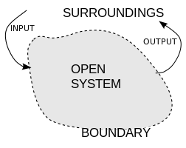
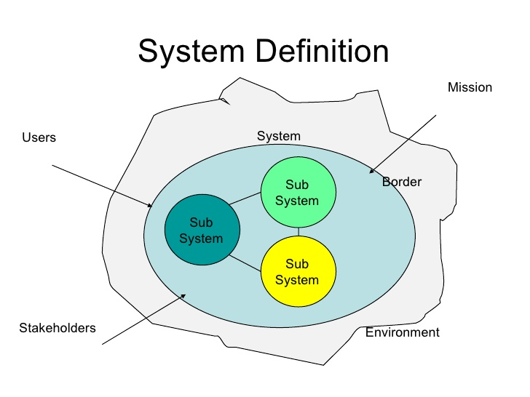
System
Open systems have input and output flows, representing exchanges of matter, energy or information with their surroundings.*
A system is any set (group) of interdependetnt or temporally interacting parts.
Parts are generally systems themselves and are composed of other parts, just as systems are generally parts of other systems.**
*https://en.wikipedia.org/wiki/System
**https://www.slideshare.net/elfuchs/csse

Slide 12
System
System
  A system is a regularly interacting or interdependent group of items forming a unified whole.*
  A set of detailed methods, procedures and routines created to carry out a specific activity, perform a duty, or solve a problem.**
  An organized, purposeful structure that consists of interrelated and interdependent elements (components, entities, factors, members, parts etc.). These elements continually influence one another (directly or indirectly) to maintain their activity and the existence of the system, in order to achieve the goal of the system.**
All systems have**
  inputs, outputs and feedback mechanisms;
  maintain an internal steady-state (called homeostasis) despite a changing external environment;
  display properties that are different than the whole (called emergent properties) but are not possessed by any of the individual elements;
  have boundaries that are usually defined by the system observer.
*https://www.merriam-webster.com/dictionary/system
**http://www.businessdictionary.com/definition/system.html

Slide 13
Information and communication technology (ICT)*
ICT
  ICT is the infrastructure and components that enable modern computing.
  ICT is generally accepted to mean all devices, networking components, applications and systems that combined allow people and organizations (i.e., businesses, nonprofit agencies, governments and criminal enterprises) to interact in the digital world.
  The list of ICT components is exhaustive, and it continues to grow. Some components, such as computers and telephones, have existed for decades. Others, such as smartphones, digital TVs and robots, are more recent entries.
  ICT commonly means more than its list of components, though. It also encompasses the application of all those various components. It's here that the real potential, power and danger of ICT can be found.
Components of an ICT system
  ICT encompasses both the internet-enabled sphere as well as the mobile one powered by wireless networks. It also includes antiquated technologies, such as landline telephones, radio and television broadcast -- all of which are still widely used today alongside cutting-edge ICT pieces such as artificial intelligence and robotics.
*http://searchcio.techtarget.com/definition/ICT-information-and-communications-technology-or-technologies

Slide 14
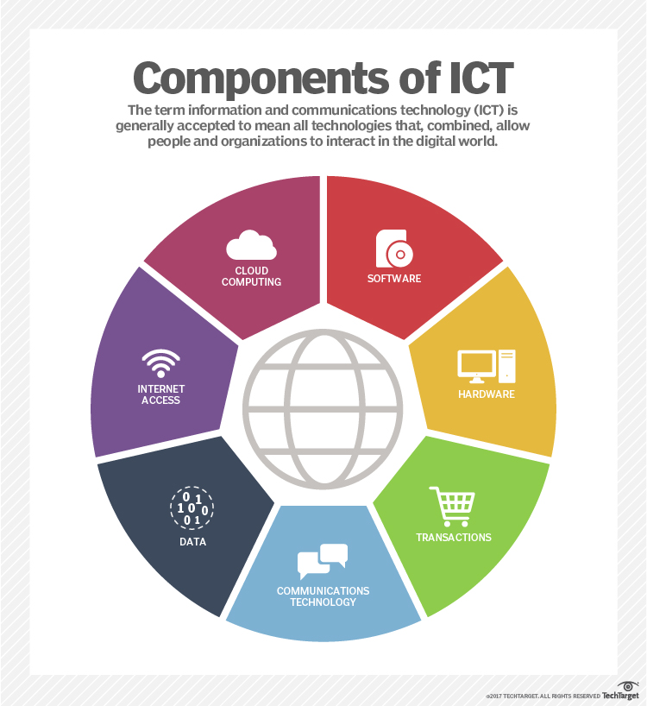
Information and communication technology (ICT)*
The significance of ICT in enterprises
  For businesses, advances within ICT have brought a slew of cost savings, opportunities and conveniences. They range from highly automated businesses processes that have cut costs, to the big data revolution where organizations are turning the vast trove of data generated by ICT into insights that drive new products and services, to ICT-enabled transactions such as internet shopping and telemedicine and social media that give customers more choices in how they shop, communicate and interact.
*http://searchcio.techtarget.com/definition/ICT-information-and-communications-technology-or-technologies

Slide 15
Information systems
Information system
  Information systems (IS) is the study of complementary networks of hardware and software that people and organizations use to collect, filter, process, create, and distribute data.*
  Information systems are combinations of hardware, software, and telecommunications networks that people build and use to collect, create, and distribute useful data, typically in organizational settings.**
  Information systems are interrelated components working together to collect, process, store, and disseminate information to support decision making, coordination, control, analysis, and visualization in an organization.***
As we can see, these definitions focus on two different ways of describing information systems: the components that make up an information system and the role that those components play in an organization.
*Wikipedia entry on "Information Systems," as displayed on August 19, 2012. Wikipedia: The Free Encyclopedia. San Francisco: Wikimedia Foundation..
**Excerpted from Information Systems Today - Managing in the Digital World, fourth edition. Prentice-Hall, 2010.
***Excerpted from Management Information Systems, twelfth edition, Prentice-Hall, 2012.

Slide 16
Information systems
Information system architecture*
  An information system architecture is a formal definition of the business processes and rules, systems structure, technical framework, and product technologies for a business or organizational information system.
  An information system architecture usually consists of four layers:
    Business process architecture - is a blue print of enterprise, that provides a common understanding of the organization and is used to align objectives and demands.
    Systems architecture - is the conceptual model that defines the structure, behavior and more views of the systems. here we set the conventions, rules and standards employed in a system.
    Technical architecture - defines all the Technical requirements like operational, performance, etc.
    Product delivery architecture - as the information regarding the delivery of the product, maintenance, etc.
*http://misformba.blogspot.cz/2015/03/information-system-architecture.html

Slide 17
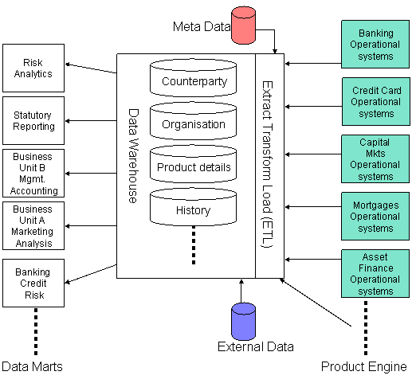
Information systems
Information system architecture – example*
*http://misformba.blogspot.cz/2015/03/information-system-architecture.html

Slide 18
Components of Information systems
Technology*
  Technology can be thought of as the application of scientific knowledge for practical purposes. From the invention of the wheel to the harnessing of electricity for artificial lighting, technology is a part of our lives in so many ways that we tend to take it for granted. As discussed before, the first three components of information systems – hardware, software, and data – all fall under the category of technology. Each of these will get its own chapter and a much lengthier discussion, but we will take a moment here to introduce them so we can get a full understanding of what an information system is.
Hardware**
  The components of the system we can physically touch - computers, keyboards, disk drives, iPads, and flash drives are all examples of information systems hardware.
  desktop computers;
  laptop computers;
  mobile phones;
  tablet computers;
  e-readers;
  storage devices, such as flash drives;
  input devices, such as keyboards, mice, and scanners;
  output devices such as printers and speakers.
*https://bus206.pressbooks.com/chapter/chapter-1/
**https://bus206.pressbooks.com/chapter/chapter-2-information-systems-hardware/

Slide 19
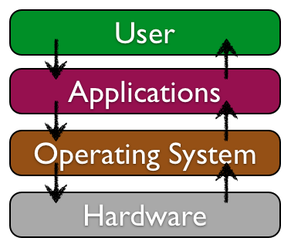
Components of Information systems
Software
  Software is the set of instructions that tell the hardware what to do. Software is created through the process of programming. Software can be broadly divided into two categories:
  operating systems - Operating systems manage the hardware and create the interface between the hardware and the user.
  application software - Application software is the category of programs that do something useful for the user.
*https://bus206.pressbooks.com/chapter/chapter-3-information-systems-software/

Slide 20
Components of Information systems
Data*
  Data are the raw bits and pieces of information with no context. Data can be:
    Quantitative - quantitative data is numeric, the result of a measurement, count, or some other mathematical calculation.
    Qualitative - qualitative data is descriptive. (“Ruby Red,” the color of a 2013 Ford Focus, is an example of qualitative data. A number can be qualitative too: if I tell you my favorite number is 5, that is qualitative data because it is descriptive, not the result of a measurement or mathematical calculation.)
    Data are often in the form of facts or figures obtained from experiments or surveys, used as a basis for making calculations or drawing Conclusions.
  For example, numbers, text, images, and sounds, in a form that is suitable for storage in or processing by a computer.
*https://bus206.pressbooks.com/chapter/chapter-4-data-and-databases/

Slide 21
Components of Information systems
Big Data*
  Big data is a term for data sets that are so large or complex that traditional data processing application software is inadequate to deal with them. Big data challenges include capturing data, data storage, data analysis, search, sharing, transfer, visualization, querying, updating and information privacy.
*https://en.wikipedia.org/wiki/Big_data

Slide 22
Components of Information systems
Information*
  Data that is:
    accurate and timely;
    specific and organized for a purpose;
    presented within a context that gives it meaning and relevance;
    can lead to an increase in understanding and decrease in uncertainty.
  Information is valuable because it can affect behavior, a decision, or an outcome. For example, if a manager is told his/her company's net profit decreased in the past month, he/she may use this information as a reason to cut financial spending for the next month. A piece of information is considered valueless if, after receiving it, things remain unchanged. For a technical definition of information see information theory.
*http://www.businessdictionary.com/definition/information.html

Slide 23
Components of Information systems
Information*
definite knowledge acquired or supplied about something or somebody;
the collected facts and data about a particular subject;
a telephone service that supplies telephone numbers to the public on request;
the communication of facts and knowledge;
computer data that has been organized and presented in a systematic fashion to clarify the underlying meaning;
a formal accusation of a crime brought by a prosecutor, as opposed to an indictment brought by a grand jury.
*http://otec.uoregon.edu/data-wisdom.htm

Slide 24
Components of Information systems
Knowledge*
  general awareness or possession of information, facts, ideas, truths, or principles;
  clear awareness or explicit information, for example, of a situation or fact;
  all the information, facts, truths, and principles learned throughout time;
  familiarity or understanding gained through experience or study.
Wisdom*
  the knowledge and experience needed to make sensible decisions and judgments, or the good sense shown by the decisions and judgments made;
  accumulated knowledge of life or in a particular sphere of activity that has been gained through experience;
  an opinion that almost everyone seems to share or express;
  ancient teachings or sayings.
*http://otec.uoregon.edu/data-wisdom.htm

Slide 25
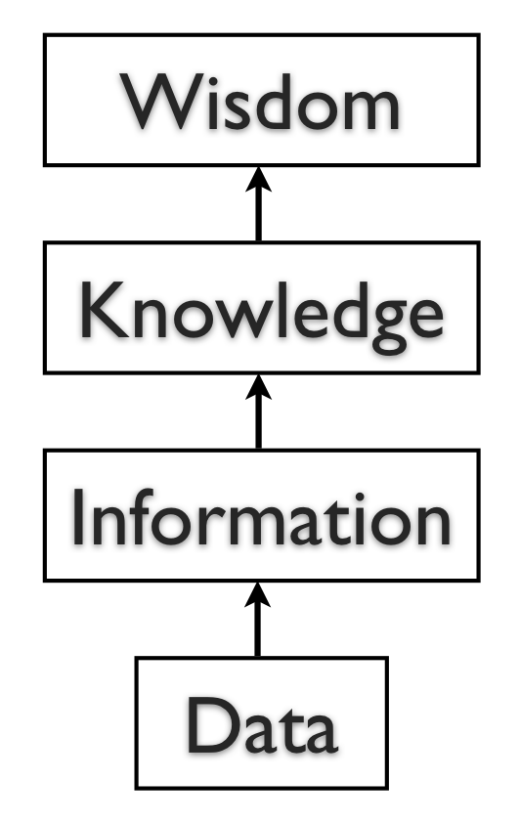
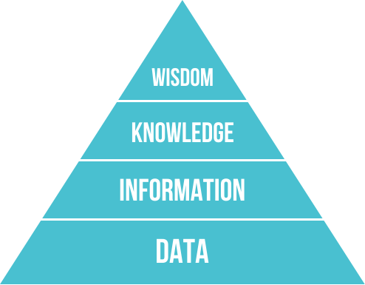
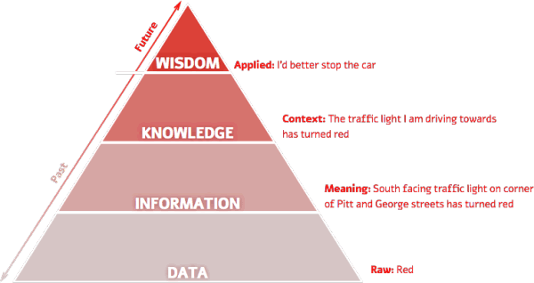
Components of Information systems
The DIKW pyramid
  The DIKW model or DIKW pyramid is an often used method, with roots in knowledge management, to explain the ways we move from data (the D) to information (I), knowledge (K) and wisdom (W) with a component of actions and decisions.*
*https://www.i-scoop.eu/big-data-action-value-context/dikw-model/

Slide 26
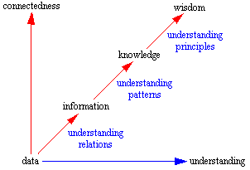
Components of Information systems
The DIKW model
* http://www.systems-thinking.org/dikw/dikw.htm

Slide 27
Components of Information systems
Information - Classification by Characteristic*
    Strategic Information
      Strategic information is concerned with long term policy decisions that defines the objectives of a business and checks how well these objectives are met. For example, acquiring a new plant, a new product, diversification of business etc, comes under strategic information.
    Tactical Information
      Tactical information is concerned with the information needed for exercising control over business resources, like budgeting, quality control, service level, inventory level, productivity level etc.
    Operational Information
      Operational information is concerned with plant/business level information and is used to ensure proper conduction of specific operational tasks as planned/intended. Various operator specific, machine specific and shift specific jobs for quality control checks comes under this category.
*https://www.tutorialspoint.com/management_information_system/classification_of_information.htm

Slide 28
Components of Information systems
Information - Classification by Application*
  Planning Information
    These are the information needed for establishing standard norms and specifications in an organization. This information is used in strategic, tactical, and operation planning of any activity. Examples of such information are time standards, design standards.
  Control Information
    This information is needed for establishing control over all business activities through feedback mechanism. This information is used for controlling attainment, nature and utilization of important processes in a system. When such information reflects a deviation from the established standards, the system should induce a decision or an action leading to control.
  Knowledge Information
    Knowledge is defined as "information about information". Knowledge information is acquired through experience and learning, and collected from archival data and research studies.
*https://www.tutorialspoint.com/management_information_system/classification_of_information.htm

Slide 29
Components of Information systems
Information - Classification by Application*
  Organizational Information
    Organizational information deals with an organization's environment, culture in the light of its objectives. Karl Weick's Organizational Information Theory emphasizes that an organization reduces its equivocality or uncertainty by collecting, managing and using these information prudently. This information is used by everybody in the organization; examples of such information are employee and payroll information.
  Functional/Operational Information
    This is operation specific information. For example, daily schedules in a manufacturing plant that refers to the detailed assignment of jobs to machines or machines to operators. In a service oriented business, it would be the duty roster of various personnel. This information is mostly internal to the organization.
  Database Information
    Database information construes large quantities of information that has multiple usage and application. Such information is stored, retrieved and managed to create databases. For example, material specification or supplier information is stored for multiple users.
*https://www.tutorialspoint.com/management_information_system/classification_of_information.htm

Slide 30
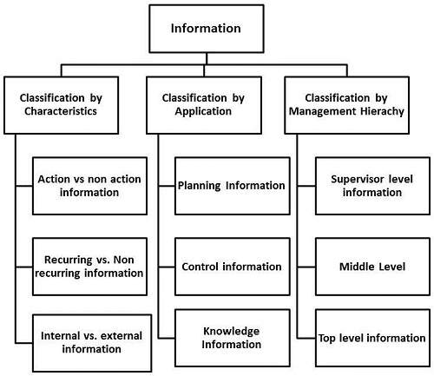
Components of Information systems
Information*
*https://www.tutorialspoint.com/management_information_system/classification_of_information.htm

Slide 31
Components of Information systems
Information*
  Following are the dimensions or elements of Information Quality:
    Intrinsic
      Accuracy, Objectivity, Believability, Reputation;
    Contextual
      Relevancy, Value-Added, Timeliness, Completeness, Amount of information;
    Representational
      Interpretability, Format, Coherence, Compatibility;
    Accessibility
      Accessibility, Access security.
*https://www.tutorialspoint.com/management_information_system/classification_of_information.htm

Slide 32
Components of Information systems
Information*
  Various authors propose various lists of metrics for assessing the quality of information. Let me generate a list of the most essential characteristic features for information quality:
    Reliability - It should be verifiable and dependable.
    Timely - It must be current and it must reach the users well in time, so that important decisions can be made in time.
    Relevant - It should be current and valid information and it should reduce uncertainties.
    Accurate - It should be free of errors and mistakes, true, and not deceptive.
    Sufficient - It should be adequate in quantity, so that decisions can be made on its basis.
    Unambiguous - It should be expressed in clear terms. In other words, in should be comprehensive.
    Complete - It should meet all the needs in the current context.
    Unbiased - It should be impartial, free from any bias. In other words, it should have integrity.
    Explicit - It should not need any further explanation.
    Comparable - It should be of uniform collection, analysis, content, and format.
    Reproducible - It could be used by documented methods on the same data set to achieve a consistent result.
*https://www.tutorialspoint.com/management_information_system/classification_of_information.htm

Slide 33
Components of Information systems
Information*
  The following list summarizes the five main uses of information by businesses and other organizations:
  Planning - At the planning stage, information is the most important ingredient in decision making. Information at planning stage includes that of business resources, assets, liabilities, plants and machineries, properties, suppliers, customers, competitors, market and market dynamics, fiscal policy changes of the Government, emerging technologies, etc.
  Recording - Business processing these days involves recording information about each transaction or event. This information is collected, stored, and updated regularly at the operational level.
  Controlling - A business need to set up an information filter, so that only filtered data is presented to the middle and top management. This ensures efficiency at the operational level and effectiveness at the tactical and strategic level.
  Measuring - A business measures its performance metrics by collecting and analyzing sales data, cost of manufacturing, and profit earned.
  Decision-making - MIS is primarily concerned with managerial decision-making, theory of organizational behavior, and underlying human behavior in organizational context. Decision-making information includes the socio-economic impact of competition, globalization, democratization, and the effects of all these factors on an organizational structure.
*https://www.tutorialspoint.com/management_information_system/classification_of_information.htm

Slide 34
Information systems in practice
Advantages*
  Communication
    with help of information technologies the instant messaging, emails, voice and video calls becomes quicker, cheaper and much efficient.
  Globalization and cultural gap
    by implementing information systems we can bring down the linguistic, geographical and some cultural boundaries. Sharing the information, knowledge, communication and relationships between different countries, languages and cultures becomes much easier.
  Availability
    information systems has made it possible for businesses to be open 24×7 all over the globe. This means that a business can be open anytime anywhere, making purchases from different countries easier and more convenient. It also means that you can have your goods delivered right to your doorstep with having to move a single muscle.
*https://blogs.deusto.es/master-informatica/advantages-and-disadvantages-of-information-systems/

Slide 35
Information systems in practice
Advantages*
  Creation of new types of jobs
    one of the best advantages of information systems is the creation of new and interesting jobs. Computer programmers, Systems analyzers, Hardware and Software developers and Web designers are just some of the many new employment opportunities created with the help of IT.
  Cost effectiveness and productivity
    the IS application promotes more efficient operation of the company and also improves the supply of information to decision-makers; applying such systems can also play an important role in helping companies to put greater emphasis on information technology in order to gain a competitive advantage. IS has a positive impact on productivity, however there are some frustrations can be faced by systems users which are directly linked to lack of training and poor systems performance because of system spread.
*https://blogs.deusto.es/master-informatica/advantages-and-disadvantages-of-information-systems/

Slide 36
Compulsory and recommended references
LAUDON, K.C. and J.P LAUDON, 2015. Management Information Systems: Managing the Digital Firm (14th Edition). New York: Pearson Publishing. ISBN 978-0133898163.
http://www.thefreedictionary.com/system
https://www.britannica.com/topic/information-system/Information-system-infrastructure-and-architecture
http://otec.uoregon.edu/data-wisdom.htm
http://www.informationisbeautiful.net/2010/data-information-knowledge-wisdom/
https://www.i-scoop.eu/big-data-action-value-context/dikw-model/
https://kvaes.wordpress.com/2013/05/31/data-knowledge-information-wisdom/

